Slide 1
FIGU-Landesgruppe Canada
http://ca.figu.org

Slide 2
Reincarnation and the Evolution of Consciousness

Slide 3
alleviate fear surrounding death
consider what is presented

Slide 4
Primarily based on excerpts from the book
“Wiedergeburt, Leben, Sterben, Tod und Trauer”
by
‘Billy’ Eduard Albert Meier

Slide 5
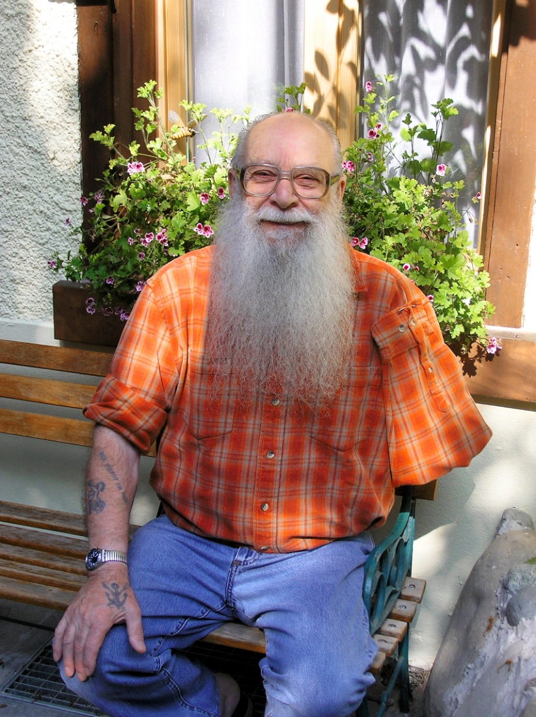

Slide 6
Ongoing contacts with extraterrestrials for over 75 years
Billy took 1,476 photos and 34 films – mostly taken in 1975 -76, metal samples, sound recordings of their spaceships
Billy has written over 63 books (German) including 1000’s of pages of contact notes

Slide 7
Introduction to Meditation
The Psyche
Might of Thoughts
Goblet of the Truth
Prophecies and Forecasts
The Law of Love
Life and Death
The Way to Live, etc.
ca.figu.org

Slide 8
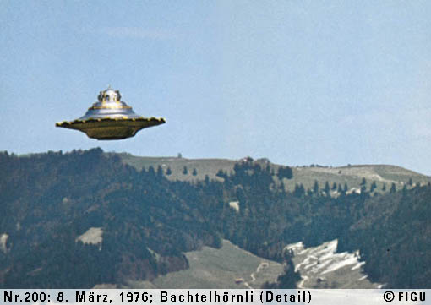

Slide 9
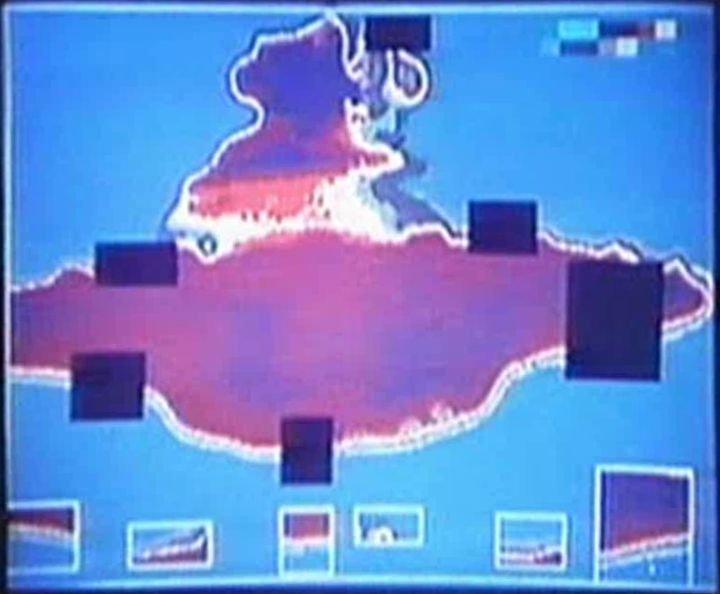

Slide 10
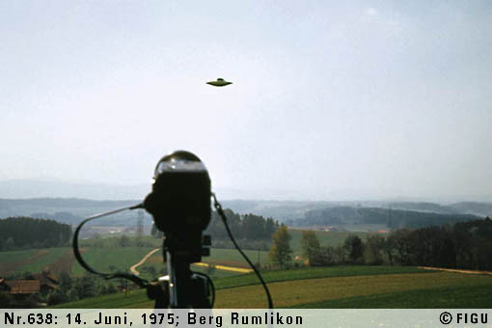

Slide 11
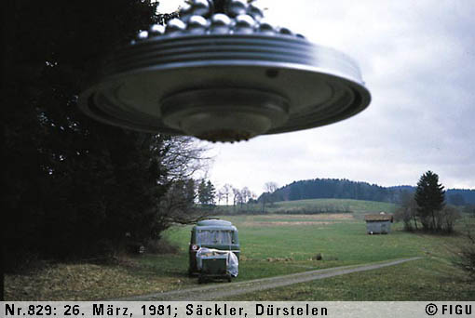

Slide 12
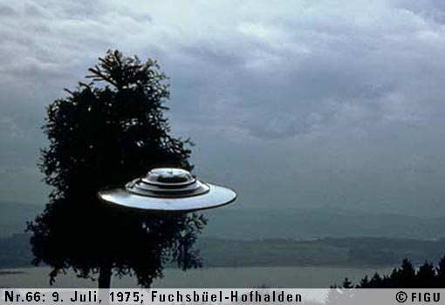

Slide 13
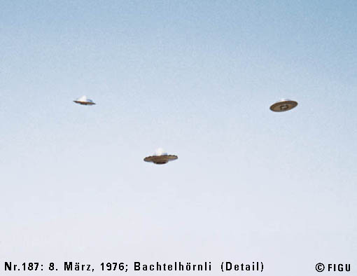

Slide 14
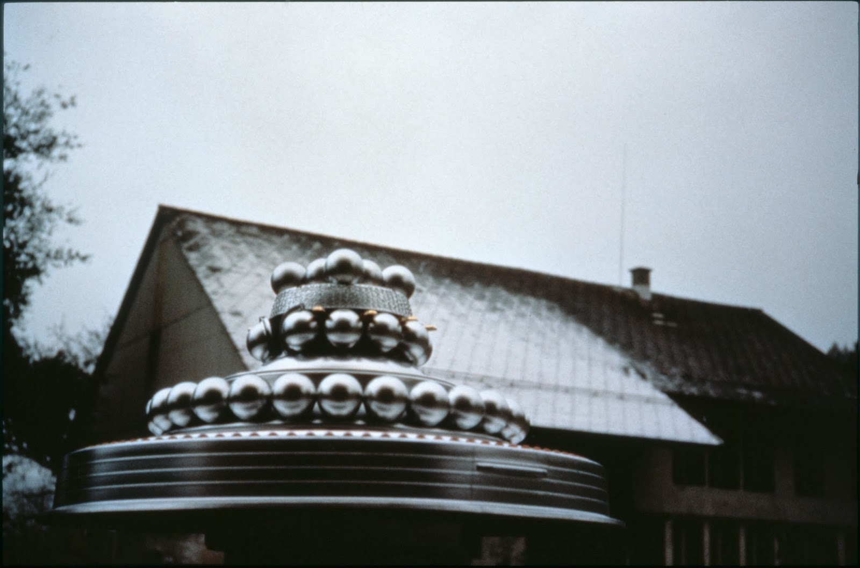

Slide 17
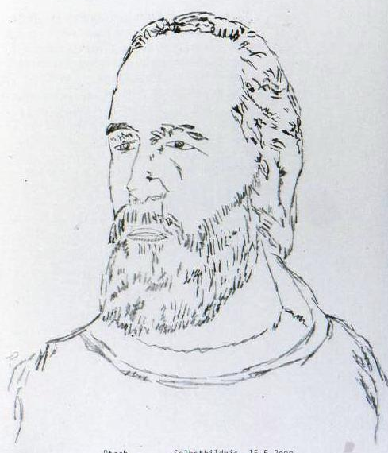
Ptaah
(self portrait)

Slide 18
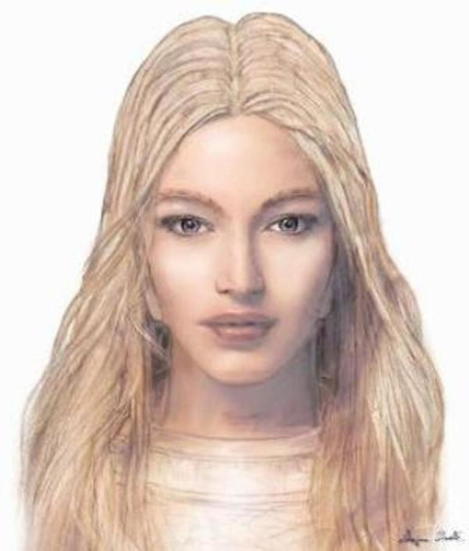
Semjase

Slide 19
The Spirit-form What is it?

Slide 20
The Creation
Spirit-form
Spirit-form
Material Consciousness
Notes:
Prior to entering the human being for the first time, the spirit-form is an absolutely neutral energy-agglomeration in timeless existence and is totally unknowing. (a product of the creational-idea) (evolves independently)

Slide 21
The Creation
Notes:
Its power and wisdom are the mightiest and most immense in its own Space-Time-Structure
is the power and might of all life in the entire universe, which at the same time, is the Creation itself.

Slide 22
not God

Slide 23
not male figure

Slide 24
= Universal Consciousness

Slide 25
= all-spirit

Slide 26
= all-spirit
= all-consciousness

Slide 27
= all-spirit
= all-consciousness
= life-consciousness

Slide 28
= all-spirit
= all-consciousness
= life-consciousness
= universal-power

Slide 29
= all-spirit
= all-consciousness
= life-consciousness
= universal-power
= universal-might

Slide 30
= all-spirit
= all-consciousness
= life-consciousness
= universal-power
= universal-might
= BEING-energy, etc.

Slide 31
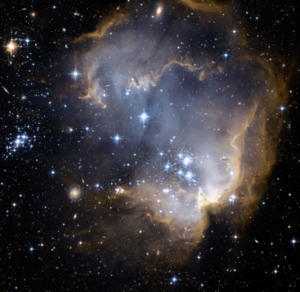
155.52 trillion years
46 trillion years

Slide 32
155.52 trillion years
46 trillion years

Slide 33
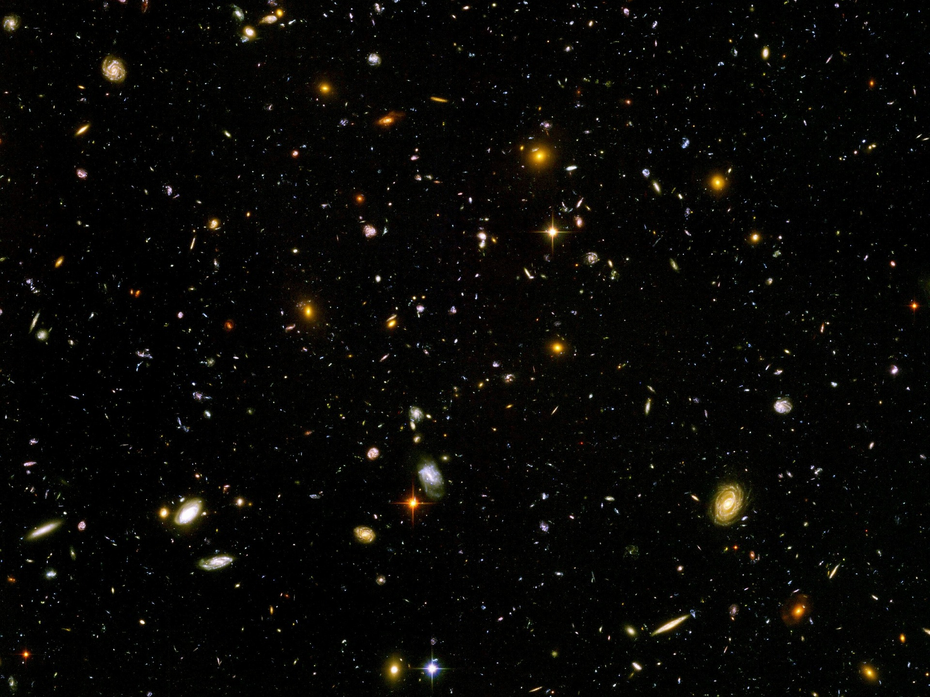
The Creation
Stars
Spiritual Energies
Galaxies
planets
Matter
atoms

Slide 34
The Creation
Fine-material energies
Stars
Spiritual Energies
Galaxies
planets
gas formations
nebulas
Matter
electrons, neutrons, neutrinos, protons, photons, nucleons,
atoms

Slide 35
The Creation
Fine-material energies
Stars
Spiritual Energies
fauna and flora
Galaxies
radiations
planets
gas formations
nebulas
subatomic particles
Matter
electrons, neutrons, neutrinos, protons, photons, nucleons,
atoms

Slide 36
Needs to evolve...

Slide 37
The Creation
Symbol of the Spiritual Teaching
Notes:
'The Decalogue' by Billy Meier.
"The Creation is the BEING and the NON-BElNG of the life. It is the most immense mass of spiritual energy in the universe. It is spirit in purest form and unmeasurable in its wisdom, in its knowledge, in its love and in its harmony and truth. The Creation is something spiritually dynamic, a pure-spirit-intelligence-energy, ungraspable for human beings, prevailing over all, an at all times active, creative, standing in unstoppable evolution, all gathered into itself, wisdom and love."
The Creation is the universe, the stars and the life of all flora and fauna and all life, the becoming and the passing away
The Creation is existing and pulsing in all life and even in the death, which only represents another dimension-form of life.

Slide 38
the spirit-form: How does it evolve?
Notes:
The ego, the ‘I’, represents the personality, respectively, the material consciousness. It independently makes perceptions, researches and explores things and facts, consciously learns and processes results.
Evolutive values, those which correspond to truth and reality, are transferred over in an impulse-based form from the thoughts and feelings to the spiritual consciousness.
The SF further processes and stores these within itself for all time. In this manner, the SF grows in its power and energy as it becomes wiser and more knowing.

Slide 39
Fine Material Realm
Spirit-form

Slide 40
Fine Material Realm
Spirit-form
Overall Consciousness-block

Slide 41
Fine Material Realm
Spirit-form
Overall Consciousness-block

Slide 42
Overall Consciousness-block

Slide 43
Overall Consciousness-block
Consciousness-block

Slide 44
Consciousness-block
Ego, Personality, Material Consciousness

Slide 45
Evolution in the Material Realm

Slide 46
Day 21

Slide 47
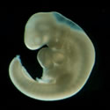
Fine Material Realm
Spirit-form
Overall Consciousness-block

Slide 48
Fine Material Realm
Spirit-form
Overall Consciousness-block
Spirit-form
Consciousness-block

Slide 49
Superior Colliculus

Slide 50
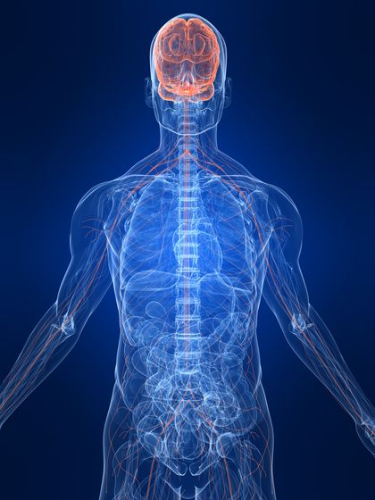

Slide 51
unaffected by the material realm

Slide 52
Consciousness-block
Ego, Personality, Material Consciousness

Slide 53
Spirit-form
Evolutive
Values
Consciousness-block

Slide 54
Functions of the Overall Consciousness-block

Slide 55
Fine Material Realm
Spirit-form
Overall Consciousness-block
Brain Ceases

Slide 56
Fine Material Realm
Spirit-form
Overall Consciousness-block
Spirit-form
Consciousness-block

Slide 57
Overall Consciousness-block
Dissolves “I” or Ego
ConsciousnessPersonality

Slide 58
Overall Consciousness-block
Processes
ConsciousnessPersonality

Slide 59
Spirit-form
Evolutive
Values
Overall Consciousness-block

Slide 60
Overall Consciousness-block
Stored
ConsciousnessPersonality

Slide 61
Overall Consciousness-block
ConsciousnessPersonality

Slide 62
Overall Consciousness-block
Dissolved

Slide 63
Overall Consciousness-block
changed into Neutral Form

Slide 64
Overall Consciousness-block
creates
New Consciousness-block
Notes:
Creating a new personality takes seconds or perhaps minutes but it is the programming/building up of the information from all previous lifetimes which takes time.

Slide 65
Overall Consciousness-block
New Consciousness-block

Slide 66
The Consciousness-block
Only Incarnates
(guarantees progress)

Slide 67
The Spirit-form
Reincarnates

Slide 68
Programming the new Personality

Slide 69
Fine Material Realm
Spirit-form
Overall Consciousness-block

Slide 70
Fine Material Realm
Spirit-form
Overall Consciousness-block
Spirit-form
Consciousness-block

Slide 71
new starting point
previous

Slide 72
Overall Consciousness-block
essences of
consciousness forms
Consciousness-block
Notes:
The OCB programs or inputs into the memory of the subsconsciousness, which is a factor of the CB, the essence of all evolutive values that were gathered throughout all previous incarnations.
These evolutive values are comprised of consciousness forms, which are all at various levels of development. Examples of consciousness forms can be love, respect, patience, honesty, etc.
The highest level of each of these consciousness forms is considered to be its essence. These essences, which are inputted into the subconsciousness, are representative of the overall level of consciousness evolution.

Slide 73
Material Consciousness
Thoughts
Feelings
Psyche
Its own body and the environment
Censor
Material Subconsciousness
Material Central Consciousness

Slide 74
Material Consciousness
Thoughts
Feelings
Psyche
Its own body and the environment
Censor
Essences
Material Subconsciousness
Material Central Consciousness

Slide 75
consciousness forms

Slide 76
love

Slide 77
honesty

Slide 78
respect

Slide 79
patience

Slide 80
diligence

Slide 81
artistic-consciousness-form

Slide 82
Mathematical-consciousness-form

Slide 83
highest level = essence

Slide 89
Material Consciousness
Thoughts
Feelings
Psyche
Its own body and the environment
Censor
Essences
Material Subconsciousness
Material Central Consciousness

Slide 90
The Overall evolutionary process to the Creation

Slide 91
physical realm the beyond (death-life)
100 years 152 years
overpopulation 10, 30...

Slide 92
129 billion spirit forms
fine-material realm
https://pixabay.com

Slide 93
40 – 60 million years
material

Slide 94
18 million years

Slide 95
18 million years

Slide 96
18 million years

Slide 97
56 million years
half material / half spiritual
40 – 60 million years
material

Slide 98
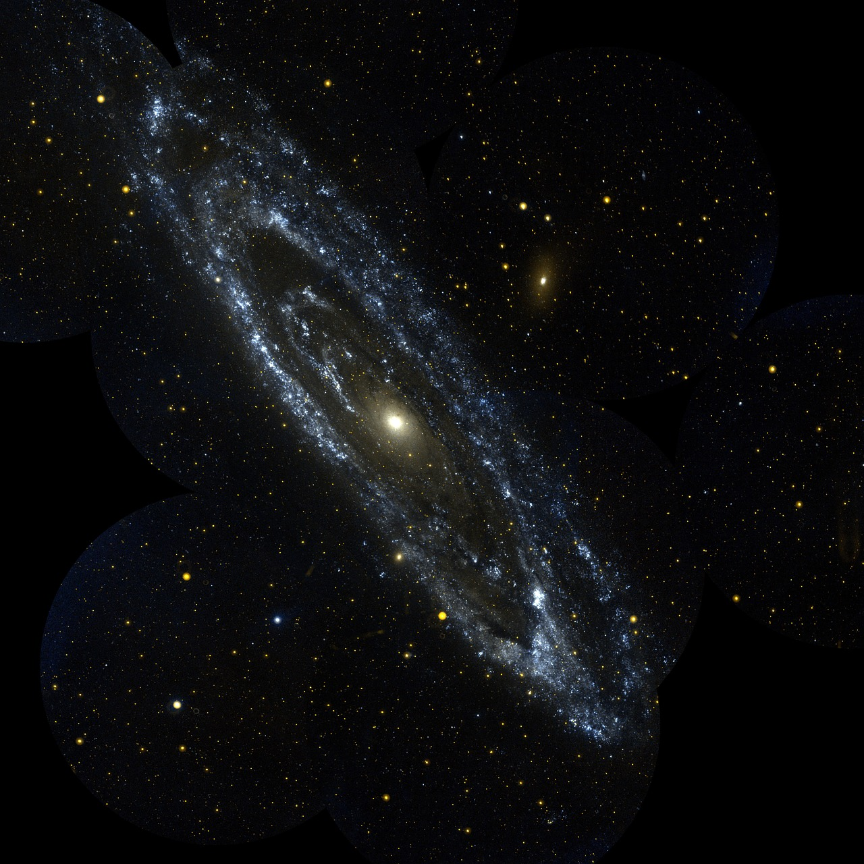
Andromeda Galaxy 2.537 million light years
https://pixabay.com
56 million years
half material / half spiritual
40 – 60 million years
material

Slide 99
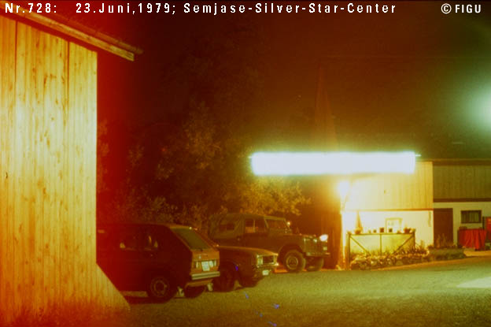

Slide 100
2,902,200,000 years
pure spirit levels
56 million years
half material / half spiritual
40 – 60 million years
material

Slide 101
The Seven Pure Spirit Levels
Petale level
“The blooming level of the Creation, crown of the Creation”
( plus 5 more levels )
Arahat Athersata level
“The valueful one who contemplates the times”

Slide 102
Age of Spirit-forms for
Human Beings on Earth:
4.8 - 8 million years old

Slide 103
The Creation
Symbol of the Spiritual Teaching

Slide 104
Spiritual Consciousness

Slide 105
The spirit-form is a
Creation-based
learning-consciousness or evolution-consciousness

Slide 106
not able to think creatively

Slide 107
not conscious and has no ego

Slide 108
neutral recipient and processor of evolutive impulses

Slide 109
needs to evolve through the consciousness of the human being

Slide 110
The human consciousness has a conscious consciousness evolution

Slide 111
Creation-evolution
Conscious consciousness-evolution
Instinct-evolution
Impulse-evolution
Energy-evolution
Micro-evolution
Intelligence-evolution

Slide 112
Creation-evolution
Conscious consciousness-evolution
Instinct-evolution
Impulse-evolution
Energy-evolution
Micro-evolution
Intelligence-evolution

Slide 113
Creation-evolution
Conscious consciousness-evolution
Instinct-evolution
Impulse-evolution
Energy-evolution
Micro-evolution
Intelligence-evolution

Slide 114
Creation-evolution
Conscious consciousness-evolution
Instinct-evolution
Impulse-evolution
Energy-evolution
Micro-evolution
Intelligence-evolution

Slide 115
Creation-evolution
Conscious consciousness-evolution
Instinct-evolution
Impulse-evolution
Energy-evolution
Micro-evolution
Intelligence-evolution

Slide 116
Creation-evolution
Conscious consciousness-evolution
Instinct-evolution
Impulse-evolution
Energy-evolution
Micro-evolution
Intelligence-evolution

Slide 117
Common Misunderstandings

Slide 118
The spirit-form is not the soul.
The soul is an incorrect term for the psyche.

Slide 119
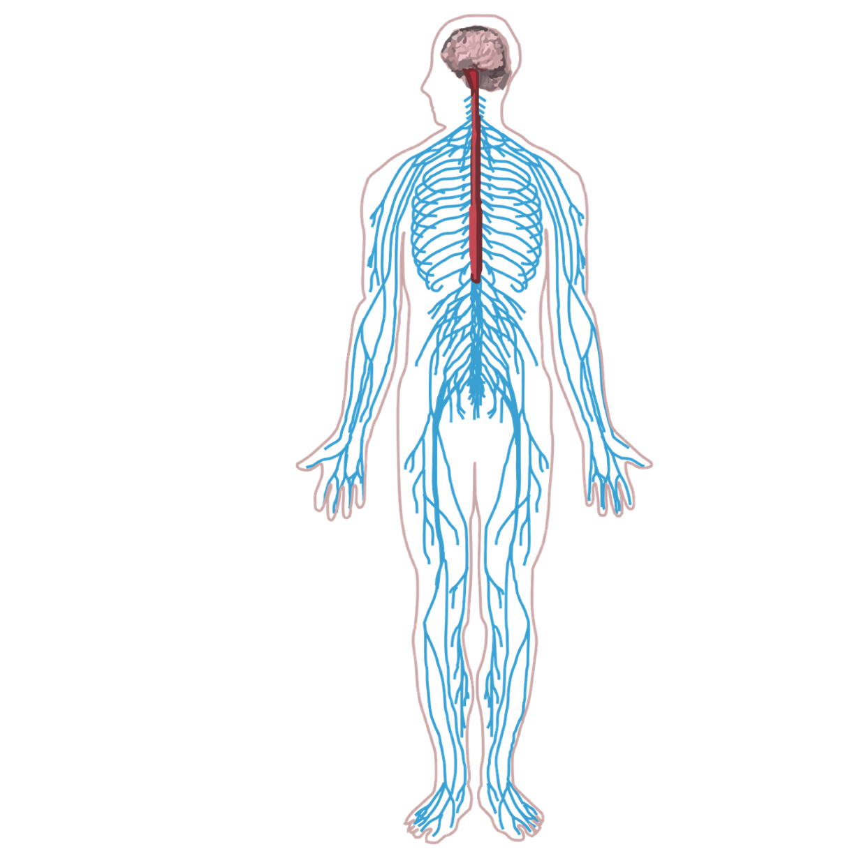

Slide 121
A human being cannot take their personality with them
into subsequent incarnations
as has been falsely taught by
the Buddhist or Hindu religions.

Slide 122
A human being’s spirit-form cannot enter into an animal or into a plant
in another reincarnation, nor is the reverse possible.

Slide 123
Upon the deceasing of the human body, life does not continue in Nirvana, Paradise or Heaven nor in a hell or Hades, etc.

Slide 124
There is no possibility of a resurrection or sentencing on Judgement Day nor any karma burdened future life.

Slide 125
Inner Influence of the Fluidal Energies

Slide 126
What are fluidal energies?

Slide 128
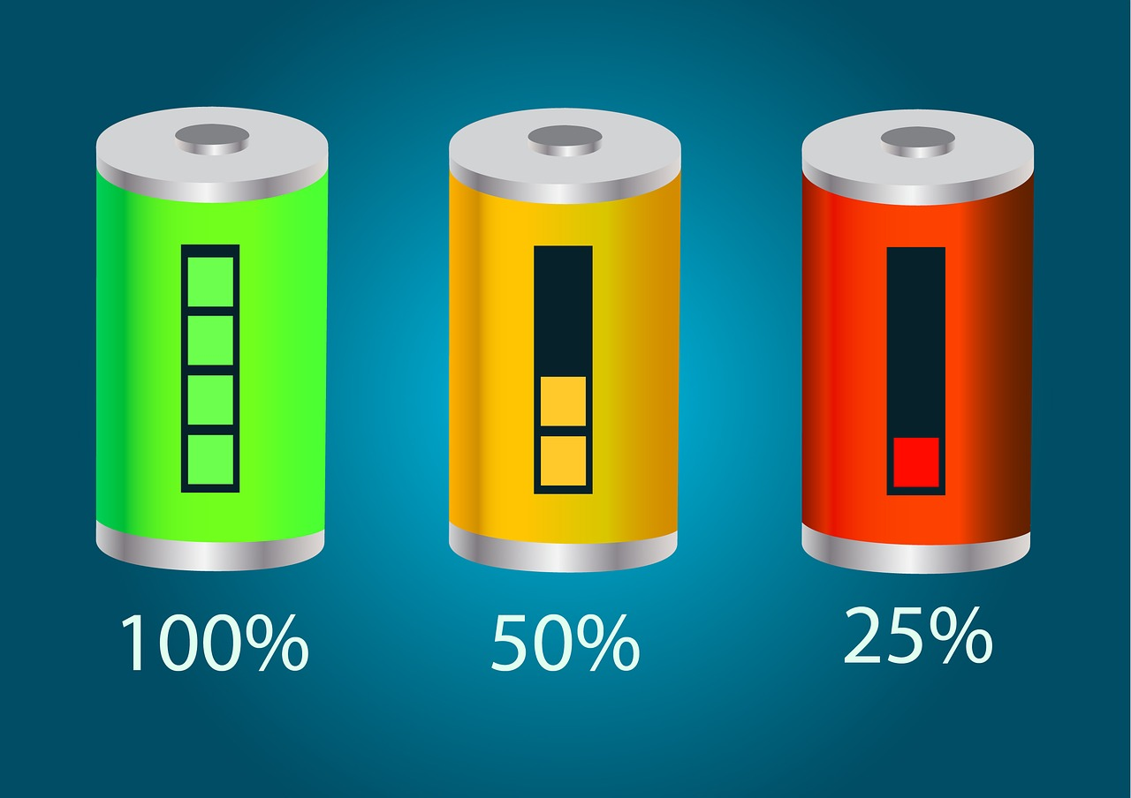

Slide 129
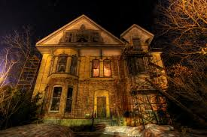
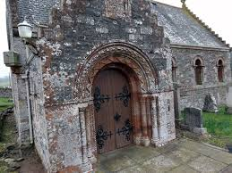

Slide 130
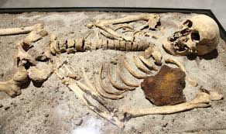

Slide 131
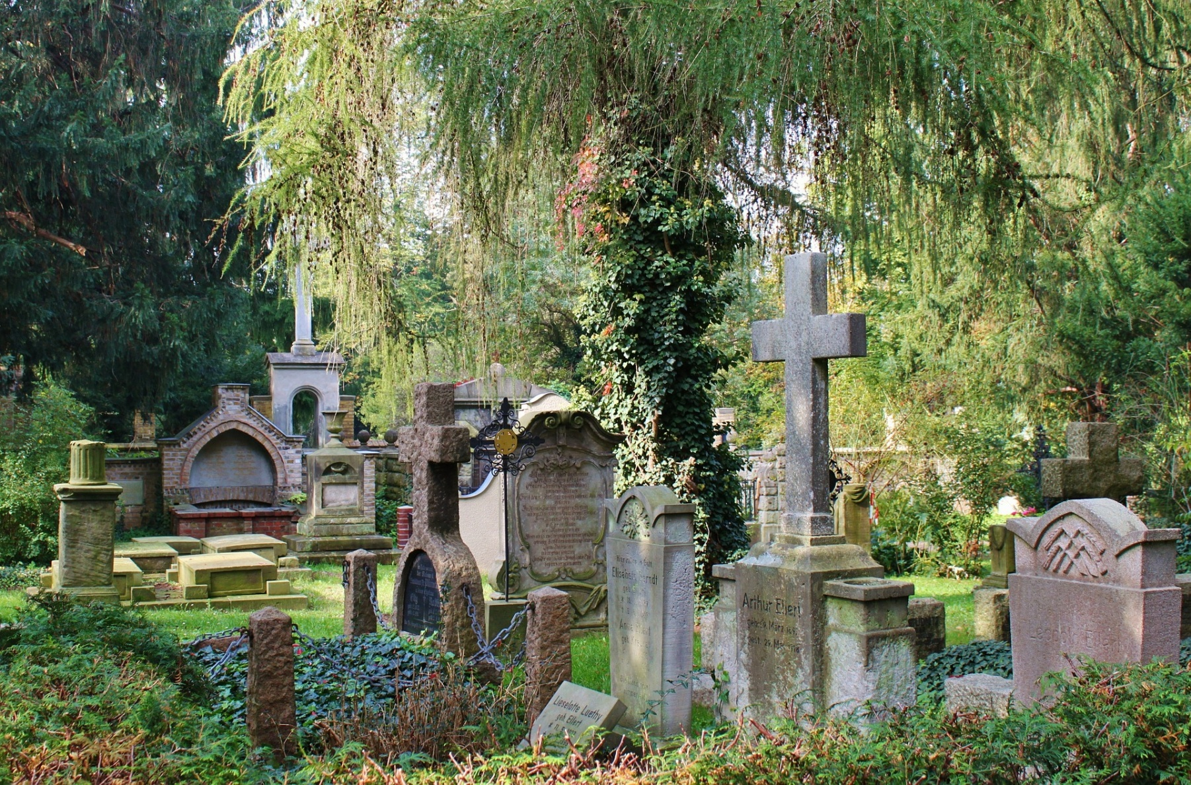
Cremation vs. Burial
Notes:
If the body and the skeleton are destroyed through fire, then the human being shuts themselves from the possibility of back-connecting to that former life and this can considerably hamper the evolution of the mental-block.
Back-connecting is necessary. Also in the actual life it is of great importance, when in the later years of one's life, connections to the fluidal power from childhood can be lived out, unfolded and bring about mental evolution-success.

Slide 132
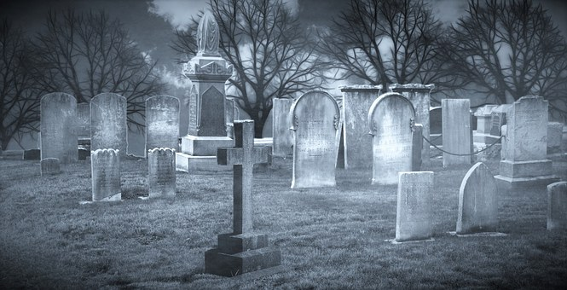
Subconsciously Connected to
Multiple Past Lives

Slide 134
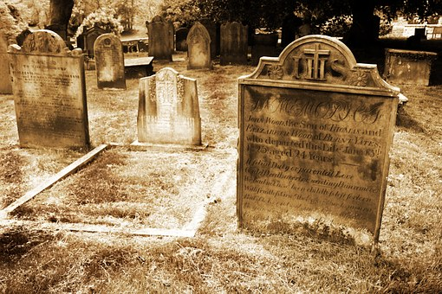

Slide 135
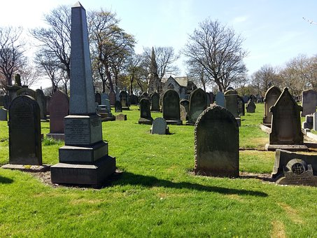

Slide 136
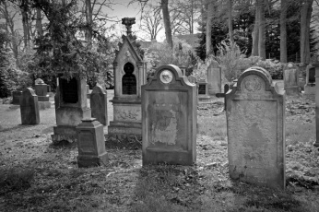

Slide 137
Organ Transplants
Notes:
Unfortunately the Earth human being at the present time and simply at the end of the 20th century is still not so far advanced that he is able to grasp, to measure and to explain the mental fluidal power of the physical and consequently in this regard, complete unknowledge prevails. This is also the case in regard to the transfer of the mental fluidal power of another human being, if they become implanted with a transplant of another deceased or living person. Thereby also those elements bring about confusion, which seek to explain the entire thing, from a religious or spiritualist or esoteric view with senselessness, which not to mention, contributes to all misunderstandings and is viewed from a standpoint of delusional belief.

Slide 138
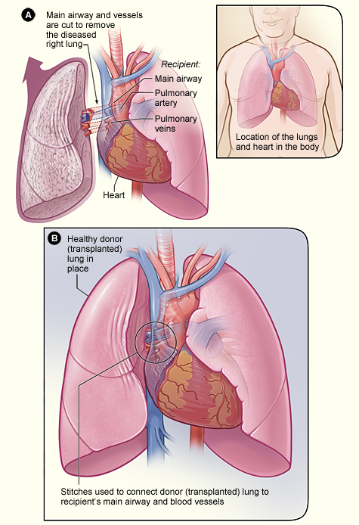
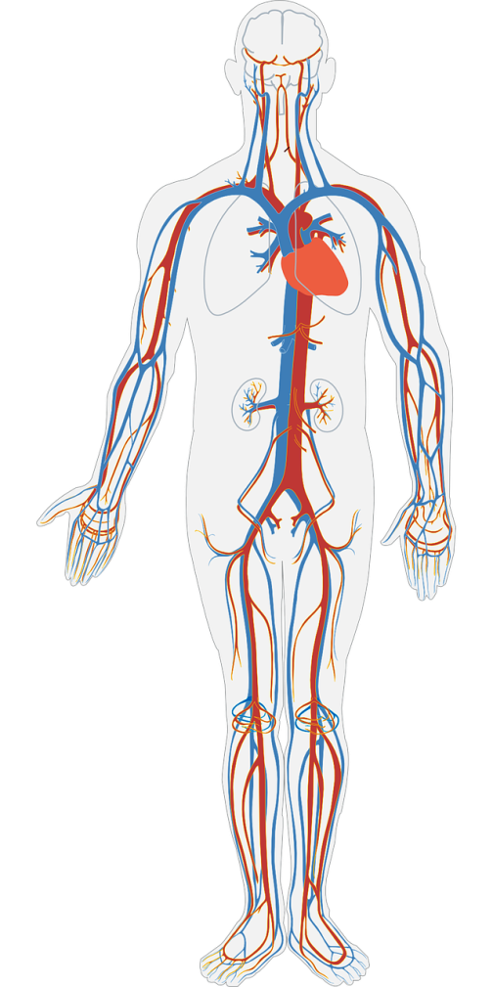
hopes, wishes, habits and quirks, etc.
Notes:
Therefore, in that respect, not only are the energies and powers of the thoughts and feelings as well as the psyche and consciousness contained, but rather also the hopes, wishes, habits and quirks, etc. of the human being, which deposit themselves overall in the body and in all its organs. At the same time, that appears however also in neutral wise, if the mental fluidal powers are deposited into a room, a place or in a thing, which then, by the next personality after their birth can again be utilised. For that reason, there ensues that new personalities then take on idiosyncrasies and behaviours, etc. of their old personalities and can bring them into expression. However, this is not compulsory, because it lies solely and exclusively with each individual personality, whether they, through back-connections, take on or not, that which is neutral in the deposited mental swinging-waves and their energies and powers of old idiosyncrasies and behaviours.

Slide 139
Organic Memory / Cellular Memory
Notes:
Organ transplants are never harmless, no matter whether it is an organ or bone, because even an eye or a finger will bring about its effects in regard to the mental fluidal power. Implanted organs and bones, call forth in each case, and actually in each case any smaller or greater changes in the organ receiver, whereby in the worst case, crass personality changes emerge in the form that the organ receiver, takes on the personality-wise of the organ donating person. Therefore it is possible, for example, that a human being, which received the heart of a murderer, under circumstances becomes a murderer themselves. These are facts which today, by the medical doctors, etc. still become contested, nevertheless the time will prove that it is really so and that this is no abnormal or esoteric theory and no nonsense. (This information arises from a private talk with the Plejaren Ptaah and Quetzal)

Slide 140
Life

Slide 141
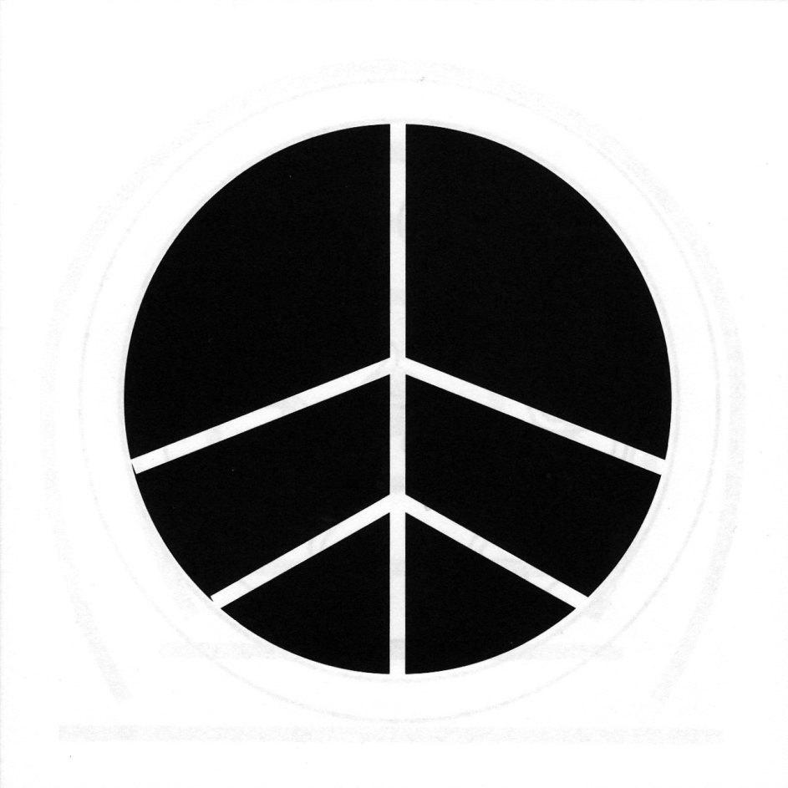
Dying

Slide 142
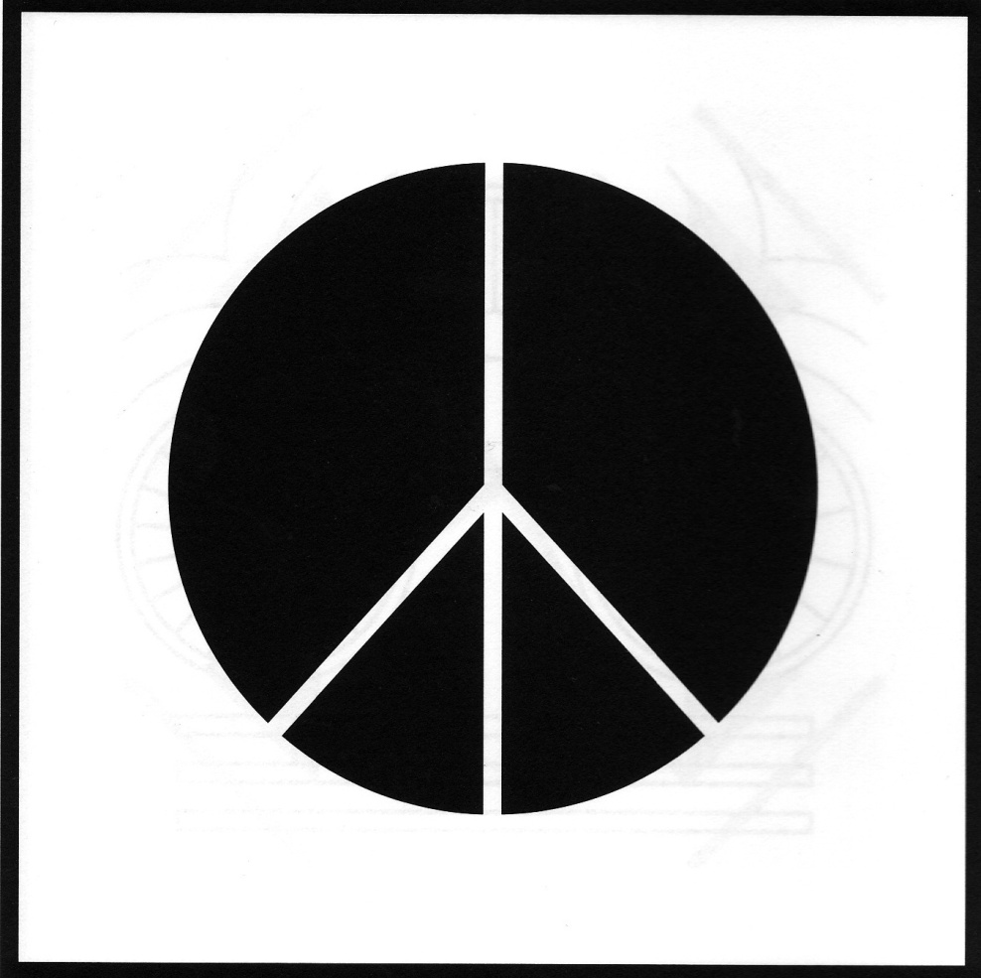
Death / Death-Existence / Death-Life

Slide 143
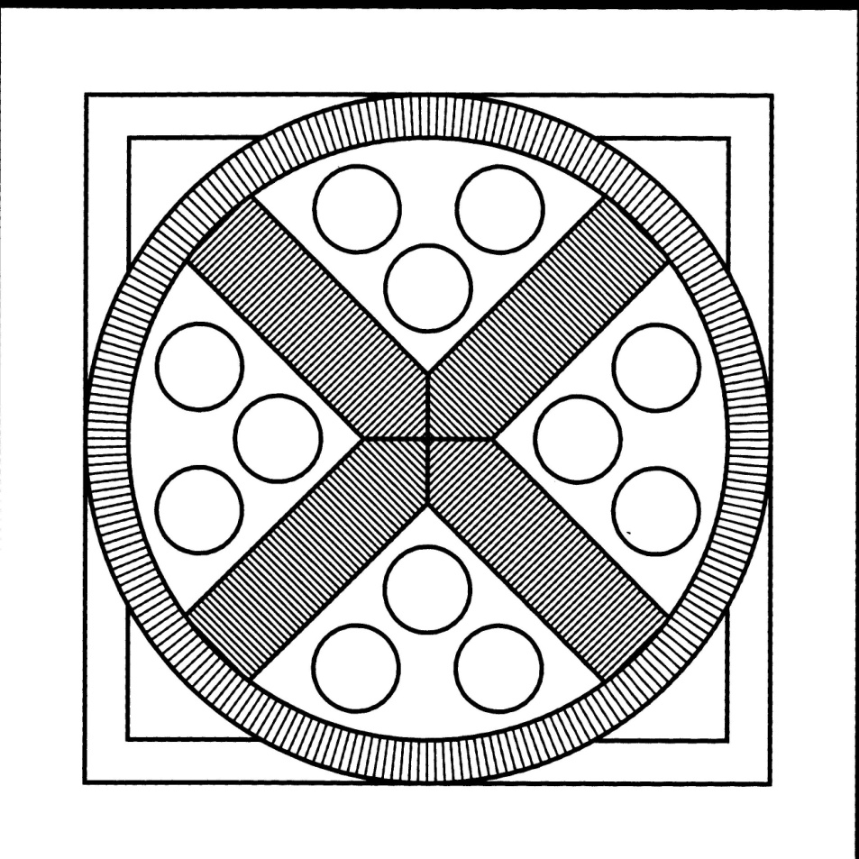
Wiedergeburt / Reincarnation

Slide 144
FIGU-Landesgruppe Canada
http://ca.figu.org

