Slide 1

RSAI Update ZOOM Meeting
SW Region
July 22, 2020

Slide 2
Introductions
Name ____________________________________
District(s) Role ____________________________________

Slide 3

RSAI Team
Paul Croghan, SW Region Rep
Dennis McClain, At-large Rep
Tim Mitchell, Legislative Rep
VACANCY, At-Large Rep to be elected at Annual Meeting in October
Jen Albers, Administrator
Larry Sigel, ISFIS Partner
Margaret Buckton, Professional Advocate
Dave Daughton, Legislative Advocate

Slide 4
Agenda:
RSAI Membership
SF 2310 Online Learning and COVID-19 Flexibility
Governor’s Proclamation and DE Guidance
RSAI Corporate Sponsor: BoardWorks support for virtual learning

Slide 5
Member Benefits
Advocacy presence at the Iowa Capitol focused on RSAI priority issues
Weekly legislative update reports and weekly recap videos to share the latest news from the statehouse and calls to action when needed
A voice to advocate with the executive branch and represent rural schools on various task forces and stakeholder committees convened by DE.
Advocacy resources for local leaders to use, including position papers, advocacy tool kits, talking points, maps, and school finance estimates
Assistance with communications, letters to the editor or sample letters to legislators
Easy to share information, such as RSAI Legislative Priorities Video, to inform school boards, staff, and stakeholders.
RSAI is the state affiliate of the National Rural Education Association, which brings access to NREA research, updates about happenings in Washington, networking
Free Summer regional meetings and RSAI annual conference in October.
Authentic grassroots development of legislative priorities in a one district one vote democratic process.
Free access to NASDTEC teacher licensure checks with your RSAI membership. Learn more about the program here.
Discount on ISFIS Policy services
Collective purchasing power as a group, attracting needed supports at discounted prices
Networking, Sharing, Best Practice Connections with other like districts

Slide 6
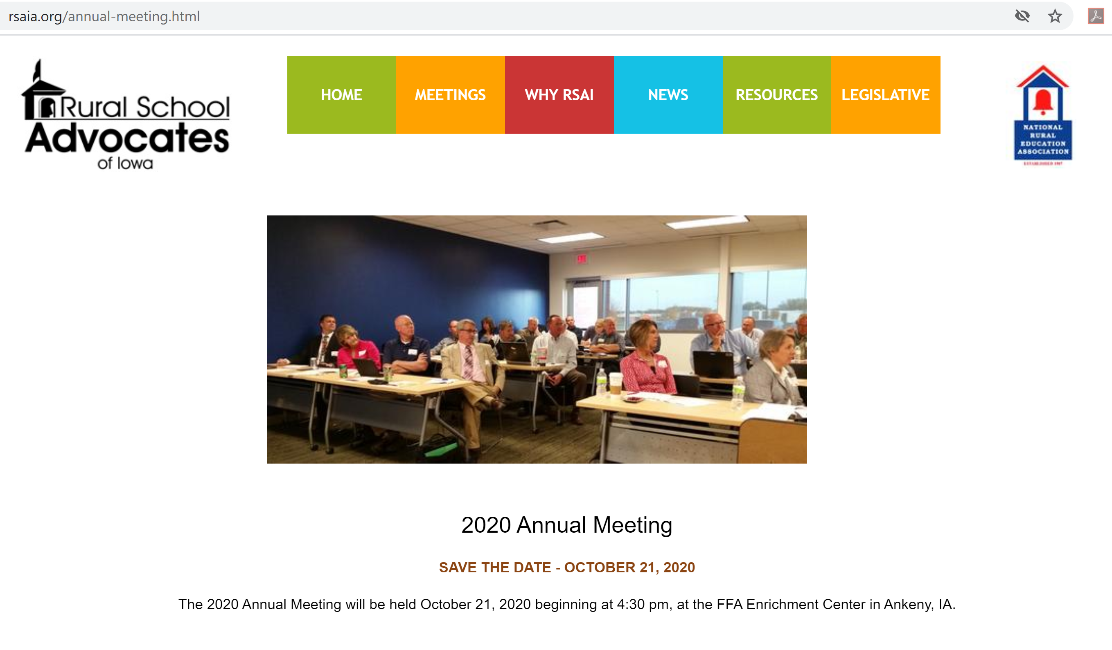

Slide 7
SF 2310 Online Learning
and
COVID-19 Flexibility

Slide 8
Please answer in the chat pane: Is your district ready to open school in August including a virtual option for students with health concerns?
____________________________________
____________________________________

Slide 9
SF 2310 Details:
Requires state BOE rules regarding offer and teach (256.11 subsection 17) and online learning provider approval (256.17) and new district online learning options (new section 256.7 subsection 32)
Requires online learning coursework to be rigorous, high-quality, aligned with Iowa core standards/content and meet the national standards of quality for online courses, and taught by an Iowa licensed teacher with specialized training or experience in online learning (including but not limited to AEA’s PD project for online learning, teacher preservice or comparable coursework.)
Allows DE and the AEAs to also develop and offer online learning meeting those same standards and requires DE to approve private providers (there is no requirement for DE to approve local online courses outside of the accreditation process.)

Slide 10
SF 2310 Details:
Offer and Teach Section:
Removes world language, financial literacy and computer science from physical offer and teach (in school buildings) and allows those to be taught online.
Retains the ability for districts to offer up to two of the other O&T requirements online if a good faith effort is made but you can’t hire a teacher or fewer than 10 students typically register for the course.
Allows the DE to waive provision of two additional courses annually if a good faith effort is made but you can’t hire a teacher. Requires that the waived course be provided by an online alternative.

Slide 11
SF 2310 Details:
Allows districts to offer their own online learning, work with other districts or AEAs. These locally developed courses must be aligned and taught by an Iowa licensed teacher. Also allows districts to engage a private provider, who’s courses must also align and be approved by DE. Requires districts to report via the CSIP a list and description of on-line coursework for enrolled students.
Allows DE/AEAs to establish an online coursework and platform with GF or available federal funds – doesn’t require schools to use it, but allows both public and private schools to access courses. Does not state that public school students can access the courses without the district offering them. DE is working to provide CANVAS at no cost to districts and to nonpublic schools and Home School students this year, paid with federal funds. The legislation otherwise requires districts to pay for courses accessed from the platform.

Slide 12
SF 2310 Details:
Allows districts to provide instruction primarily over the internet if provided in accordance with an approved RTL plan, in response to a proclamation of a public health disaster emergency (Governor’s Proclamation) which satisfies the instructional time requirements (either days or hours) regardless of the nature, location or medium of instruction if the RTL plan includes the minimum number of days/hours, as long as the remote learning is compulsory.
Requires that district RTL plans must contain provisions for in-person instruction and provide that in-person instruction is the presumed method of instruction.

Slide 13
SF 2310 Details:
Allows funding flexibility for additional instructional time above the minimum days/hours, approved by board resolution for PD funds used for 36 hours of PD outside of the instructional day. Requires hour for hour exchange (one hour of instruction replaces one hour of PD collaboration.
All PD requirements of chapter 284 are waived for the funds used for instruction.
Governor’s July 17 proclamation allows virtual instruction in place of making up snow days. May create an opportunity to use PD funds for some of your instructional time.

Slide 14
SF 2310 Details:
Allows a parent to notify the district by July 15, 2020 of an open enrollment request to a public online academy, based on health condition of student/family/caretaker and doctor’s note.
Requires districts to provide to students whose parent requests CPI, HSAP and Dual Enrollment, textbooks and supplementary materials, on the same basis as provided to enrolled students. (Note – does not say that the district provides the online learning platform to the home school students.)

Slide 15
SF 2310 Details:
If the Governor proclaims a public health emergency, the bill allows local board to authorize closure of the school district or any school attendance center due to outbreak of COVID-19.
  Encourages school districts to follow CDC guidelines, consult with IDPH and states that local leaders may consult with local board of health with determining social distancing measure or authorizing a school closure. Linn County Return to School Guidance. https://www.linncounty.org/DocumentCenter/View/14019/Return-to-School-Guidance-PDF
  Prohibits waiver of instructional time requirements for school closure unless the district provides compulsory remote learning.
  States that, unless explicitly authorized in a proclamation of the governor related to COVID-19, the district shall not take action to provide instruction primarily through remote-learning opportunities.
If the board of directors determines at any time during the 2020-21 school year that a remote learning period is necessary, requires the board to ensure that teachers/staff are available to support students, engage in PD, perform other job-related functions during the regular required contract hours.

Slide 16
SF 2310 Details:
Defines a student that does not participate in compulsory remote learning as truant, unless enrolled in CPI or IPI per parent notification prior to July 1, 2019. Allows a student with significant health concern to report to the district and requires the district to provide accommodation via remote learning.
Teacher endorsement waiver: if every reasonable and good faith effort is made to employ a licensed teacher with specific grade level or subject endorsement, and you can’t employ such a person, and you can’t develop or provide online program for that area, allow district to request and DE to waive the teacher endorsement requirements.

Slide 17
SF 2310 Details:
Social Distancing: in implementing social distancing policies included in the RTL plan, the board shall, to the extent possible, provide in-person instruction for core academic subjects.
Requires schools to make reasonable accommodations for remote learning for a student or family’s significant health condition that increases the risk of COVID-19, including written confirmation from the doctor. (Think back to the beginning of the bill – locally developed content, content provided through a consortium with another district(s) or AEA, or engaging a private provider)

Slide 18
SF 2310 Details:
Notwithstanding any other provision to the contrary, a district may provide instruction primarily over the internet
  in accordance with a RTL plan submitted by the district to the DE
  in response to a proclamation of public health disaster emergency explicitly addressing school closures, issued by the Governor related to COVID-19,
without regard to whether the district is approved to provide instruction primarily through continuous remote-learning opportunities.
Must use Iowa licensed teacher and maintain evidence of alignment with core

Slide 19
Governor’s Proclamation and DE Guidance
DE Guidance on SF 2310 https://educateiowa.gov/documents/pk-12/2020/07/senate-file-2310-guidance-schools
DE FAQ on SF 2310 https://educateiowa.gov/documents/pk-12/2020/07/senate-file-2310-and-governor-s-proclamation-frequently-asked-questions
SF 2310 https://www.legis.iowa.gov/legislation/BillBook?ga=88&ba=SF2310

Slide 20
Governor’s Proclamation and DE Guidance: Q/A from DE:
How did the Department and governor determine that schools cannot provide more than half of instruction through remote learning? Where did the 50% come from?
Section 15 of Senate File 2310 states: Unless explicitly authorized in a proclamation of a public health disaster emergency issued by the governor pursuant to section 29C.6 and related to COVID-19, a brick-and-mortar school district or accredited nonpublic school shall not take action to provide instruction primarily through remote learning opportunities. This is in addition to and separate from the “presumed method” language in section 9 of Senate File 2310.
Based on a plain language reading of the statute, the Department interprets “primarily” to mean more than half of a school’s instruction.

Slide 21

“Primarily”
Who decides the meaning of Primarily?
Is it mostly, mainly, chiefly, or predominately?
Compared to what?
Most RTL plans have 3 types of learning: in person, synchronous online, and working at home. If in person is 40% and synchronous and at home are each 30%, is in person the main kind of learning or the predominate kind of learning?

Slide 22
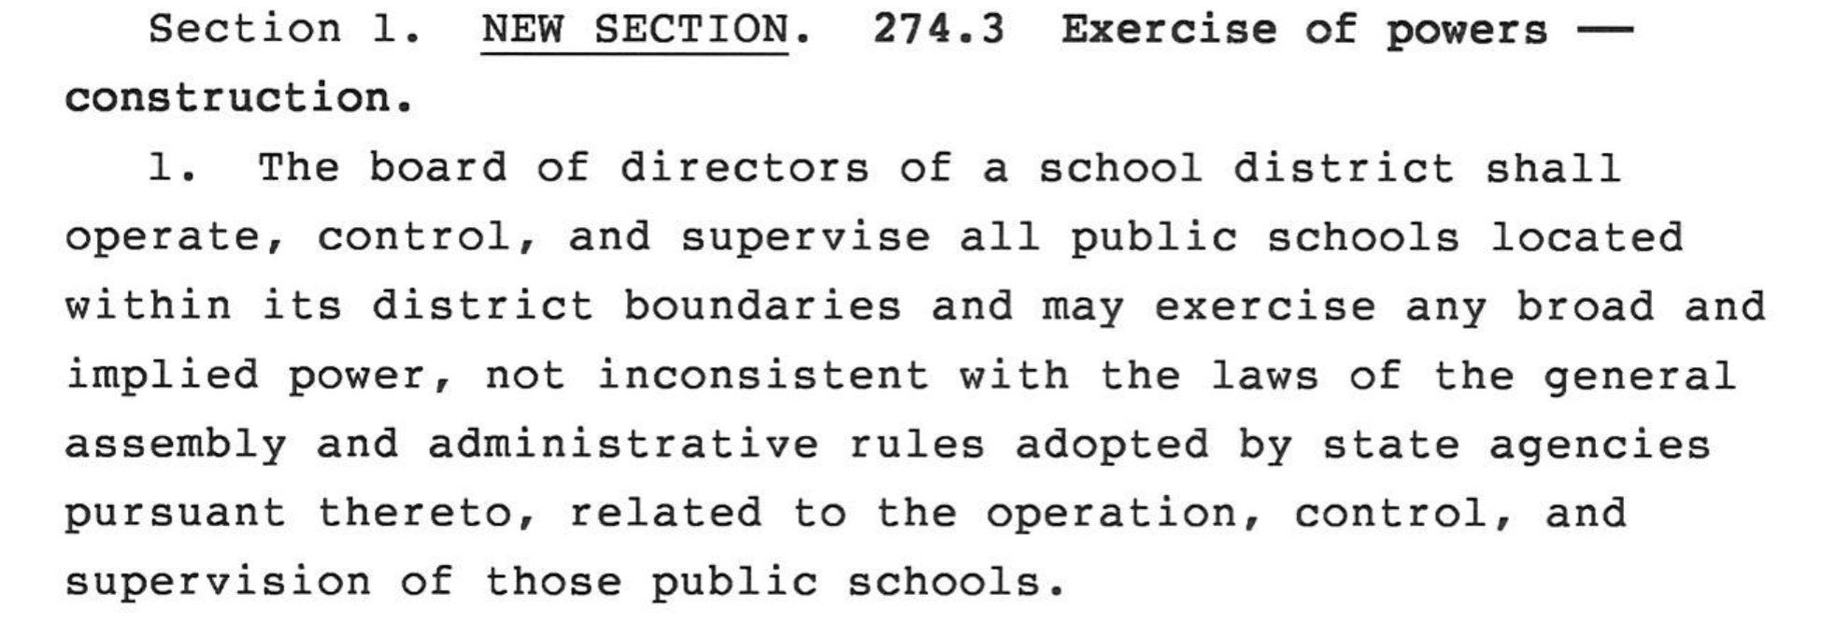
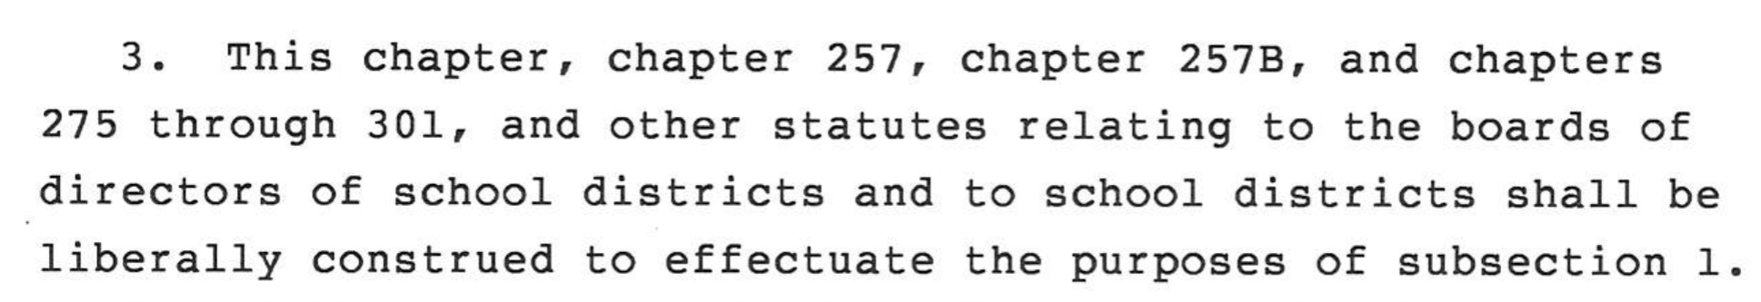
Home Rule
Legislature gave school districts “Statutory Home Rule” in HF 573 in 2017 Legislative Session
Exceptions: can’t levy a tax or charge a fee not authorized or adopt/enforce a policy hindering law enforcement agency
Do you think that the DE and Governor liberally construed SF 2310 to effectuate the purposes of local control?

Slide 23
Governor’s Proclamation and DE Guidance: Other things
Requires temporary approval from DE before a board can decide to close a school or district. DE hinted that approvals will be in 2 week increments, no longer.
Weather days can be virtual and count toward hours/days--IF you implement your virtual learning plan. Stated during the DE webinar that not more than 5 inclement weather days can be held virtually without DE approval.
DE and BOEE are working on multiple changes to rules regarding substitute teachers and licenses that will potentially assist you in having substitute teachers, including allowing substitutes to be in the classroom longer than 30 days, and allowing paras or AA degrees to also be substitute teachers.
Additional Return to School guidance will be provided by Aug. 1.

Slide 24

Set all of this aside for a few minutes:
How do we support our staff to provide engaging learning to students in these many environments, moving in and out of virtual learning as necessary for individual students or classrooms or entire schools?
How do we best serve students with different internet connections and capabilities?

Slide 25


Slide 26
THANK YOU FOR YOUR VOICE on behalf of rural students!
Watch for RSAI Legislative Priority Survey
Stay connected through the Interim and into the Legislative Session
Let us know what you need to beef up your advocacy efforts.
See you at the Oct. 21 Annual Meeting!
Professional Advocate
Margaret Buckton, margaret@iowaschoolfinance.com
1201 63rd Street, Des Moines, IA 50311 (515) 201-3755 cell

