Slide 1
Nursing Essentials in Castration-Resistant Prostate Cancer
Frank dela Rama, RN, MS, AOCNS®, AGN-BC
Clinical Nurse Specialist
Palo Alto Medical Foundation

Slide 2
Accreditation: i3 Health is accredited with distinction as a provider of continuing nursing education by the American Nurses Credentialing Center's Commission on Accreditation. A maximum of 1.0 contact hour may be earned by learners who successfully complete this continuing nursing education activity. Provider approved by the California Board of Registered Nursing, Provider Number 15824, for 1.0 contact hour.
How to Claim CNE Credit: An activity evaluation form is in your conference bag. To claim credit, you must turn in a completed and signed evaluation form at the conclusion of the program or complete the evaluation online at: www.i3Health.com/GLAONS. Your certificate of attendance will be emailed to you within 7 days.
Commercial Support: This activity is supported by an independent educational grant from Sanofi Genzyme. Aggregate participant data will be shared with commercial supporters of this activity.
Unapproved Use Disclosure: i3 Health requires CNE faculty (speakers) to disclose to attendees when products or procedures being discussed are off-label, unlabeled, experimental, and/or investigational (not FDA approved), as well as any limitations on the information that is presented, such as data that are preliminary or that represent ongoing research, interim analyses, and/or unsupported opinion. Faculty may discuss information about pharmaceutical agents that is outside of U.S. Food and Drug Administration approved labeling.
This information is intended solely for continuing medical education and is not intended to promote off-label use of these medications. If you have questions, contact the medical affairs department of the manufacturer for the most recent prescribing information.
Disclaimer: The information provided at this CNE activity is for continuing education purposes only and is not meant to substitute for the independent medical/clinical judgment of a healthcare provider relative to diagnostic and treatment options of a specific patient’s medical condition.

Slide 3
Disclosures
Mr. dela Rama has no relevant financial relationships to disclose

Slide 4
Learning Objectives
Differentiate the safety and efficacy profiles of novel therapies for nonmetastatic and metastatic CRPC
Outline findings from recent clinical studies on novel combination and sequential treatment strategies for nonmetastatic and metastatic CRPC
Assess strategies to manage adverse events associated with novel therapies for nonmetastatic and metastatic CRPC
CRPC = castration-resistant prostate cancer.

Slide 5
CRPC: Scope of the Problem

Slide 6
Prostate Cancer in the United States
Most commonly diagnosed cancer in men in the United States
  Approximately 174,650 new cases are projected for 2019
Second leading cause of cancer-related death in men in the United States
  Approximately 31,620 deaths projected to occur in 2019
Approximately 50% of patients who die from prostate cancer have metastases at initial diagnosis
Mortality rates based upon ethnicity
  African Americans > Caucasians > Hispanics > Asian/Pacific Islanders > Southeast Asians
ACS, 2019; Rebbeck, 2017; Siegel et al, 2019.

Slide 7
Prostate Cancer in the United States (cont.)
Five-year survival for distant-stage prostate cancer is <30%, compared with nearly 100% for local and regional disease
Overall, prostate cancer incidence since 2007 has shown a steady decline of 6.5% per year
  However, incidence of distant-stage disease increased between 2010 and 2014
Siegel et al, 2019; Negoita et al, 2018.

Slide 8

Castration-Resistant Prostate Cancer
Categorizing advanced prostate cancers
  Castration resistant versus castration naive
  Hormone refractory versus hormone sensitive
  Metastatic (M1) versus nonmetastatic (M0)
NCCN treatment guidelines
  Systemic therapy for M0 CRPC
  Systemic therapy for M1 CRPC
NCCN = National Comprehensive Cancer Network.
NCCN, 2019.
Notes:
Categorizing advanced prostate cancer:
Castration-naive often arises first, so androgen deprivation therapy (ADT) is given as initial therapy
If disease progress in the face of ADT, the cancer is considered castration resistant
National Comprehensive Cancer Network (NCCN) treatment guidelines can help direct care among multiple clinical pathways.
Our focus today is mainly on castration-resistant prostate cancer (CRPC).

Slide 9
Audience Poll

Slide 10
Question 1 for the Audience
In my current practice, I work with patients who have metastatic prostate cancer:
  Multiple times in one day
  Daily to weekly
  One to three times per month
  Rarely to never over the course of a year

Slide 11
Question 2 for the Audience
My primary work setting is in:
  Academic/teaching hospital
  Community hospital
  Community-based outpatient cancer center
  Private practice
  Not in a clinical setting

Slide 12
Question 3 for the Audience
For men with CRPC who have bone metastasis but no visceral metastasis, abiraterone is always given concurrently with:
  Cabazitaxel
  Prednisone
  Enzalutamide
  Pembrolizumab

Slide 13
Question 4 for the Audience
Patient education regarding abiraterone treatment should stress all of the following EXCEPT:
  Avoid or minimize drinking alcohol
  Complete blood tests for liver function
  Maintain adequate fluid intake
  Take each dose with food

Slide 14
Question 5 for the Audience
Which of the following biomarkers will help in treatment decision making between enzalutamide or abiraterone versus taxane chemotherapy?
  MSI
  dMMR
  AR-V7
  PMS2
MSI = microsatellite instability; dMMR = deficient mismatch repair; AR-V7 = androgen receptor splice variant 7.

Slide 15
Criteria for Diagnosis, Staging, and Risk Stratification

Slide 16
Discovering CRPC
Diagnosis
Localized versus advanced
Monitoring after surgery or radiation
  PSADT
  Bone imaging
  CT: chest or abdominal/pelvic
  MRI: prostate/pelvic
  PET/CT
  Biopsy: prostate or prostate bed
PSADT = prostate-specific antigen doubling time; CT = computed tomography; MRI = magnetic resonance imaging; PET = positron emission tomography.
NCCN, 2019.
Notes:
Initial prostate cancer diagnosis is often established with microscopic analysis of tissue obtained upon needle biopsy. For advanced prostate cancer patients, a substantial amount of time may have passed since initial diagnosis with biopsy, as patients may have been classified previously with only localized low- to intermediate-risk disease. Others may first present with advanced stage disease, only revealed by symptoms or captured by imaging. Once identified, risk stratification based upon clinical findings can help to determine potential clinical pathways.

Slide 17
Discovering CRPC
Risk Stratification
Has primary androgen deprivation therapy (ADT) been used? Is it effective?
  Never used: castration naive
  Effective: castration sensitive (hormone sensitive)
  Not effective: castration resistant (hormone refractory)
Today’s focus
  Nonmetastatic CRPC
  Metastatic CRPC
NCCN, 2019.
Notes:
Initial prostate cancer diagnosis is often established with microscopic analysis of tissue obtained upon needle biopsy. For advanced prostate cancer patients, a substantial amount of time may have passed since initial diagnosis with biopsy, as patients may have been classified previously with only localized low- to intermediate-risk disease. Others may first present with advanced stage disease, only revealed by symptoms or captured by imaging. Once identified, risk stratification based upon clinical findings can help to determine potential clinical pathways.

Slide 18
Current Standards and New Data in the Management of CRPC

Slide 19
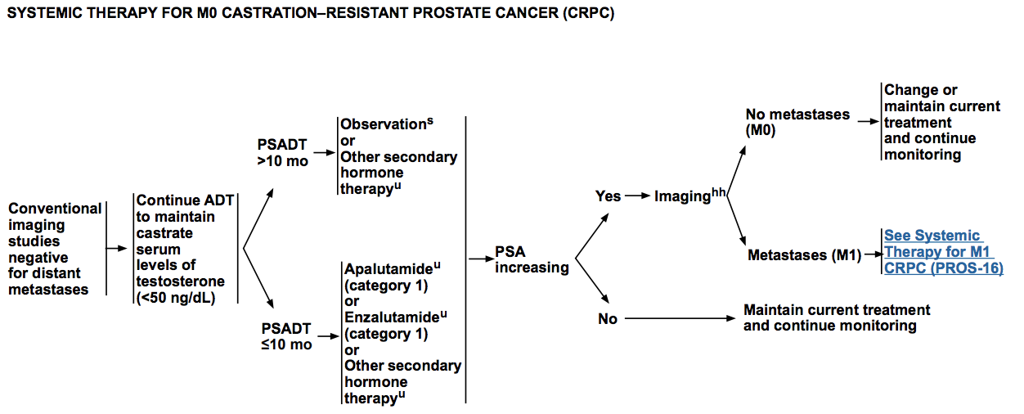
NCCN Treatment Guidelines: M0 CRPC
NCCN, 2019.

Slide 20
Systemic Treatments Approved for M0 CRPC
Treatment | Key Trial | MFS (vs Placebo) | FDA Approval
Apalutamide | SPARTAN | 40.5 vs 16.2 months | 2018
Enzalutamide | PROSPER | 36.6 vs 14.7 months | 2018
Darolutamide | ARAMIS | 40.4 vs 18.4 months | 2019
MFS = metastasis-free survival.
Smith et al, 2018; Hussain et al, 2018; Fizazi et al, 2019.
Notes:
Memory Jogger: AZ, CJ, EX, RX
For 80 years, ADT alone was standard. Compare that to now, examining what was approved between 2010 and 2014.

Slide 21
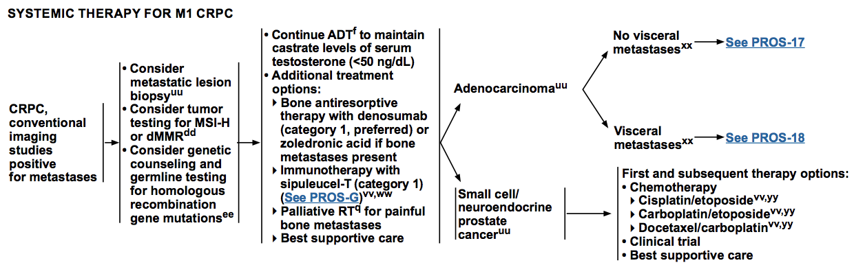
NCCN Treatment Guidelines: M1 CRPC
MSI-H = MSI-high; RT = radiation therapy.
NCCN, 2019.

Slide 22
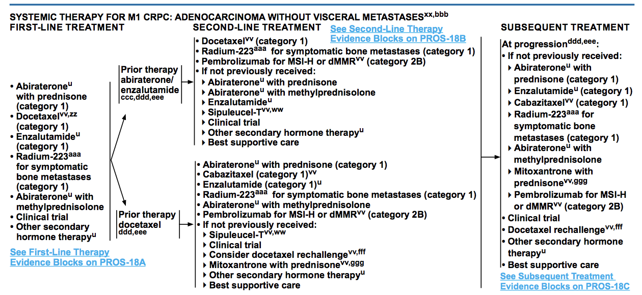
NCCN Treatment Guidelines: M1 CRPC (cont.)
NCCN, 2019.

Slide 23
Systemic Treatments Approved Since 2010 for mCRPC
Treatment | Key Trial(s) | Efficacy | FDA Approval | Sequencing
Abiraterone | COU-AA-301 COU-AA-302 | OS: 14.8 vs 10.9 monthsª OS: NR vs 27.2 monthsª | 2011 2012 | Post-doce First line
Cabazitaxel | TROPIC | OS: 15.1 vs 12.7 months^{b} | 2010 | Post-doce
Enzalutamide | AFFIRM PREVAIL | OS: 18.4 vs 13.6 monthsª 1-yr rPFS: 65% vs 12%ª | 2012 2014 | Post-doce First line
Radium-223 | ALSYMPCA | OS: 14.0 vs 11.2 monthsª | 2013 | Bone-met disease only
Sipuleucel-T | IMPACT | OS: 25.8 vs 21.7 monthsª | 2010 | First line
ªcompared with placebo.
^{b}compared with mitoxantrone.
mCRPC = metastatic castration-resistant prostate cancer; doce = docetaxel; rPFS = radiographic progression-free survival; bone-met = bone metastatic.
de Bono et al, 2010; de Bono et al, 2011; Ryan et al, 2013; Scher et al, 2012; Beer et al, 2014; Parker et al, 2013; Kantoff et al, 2010; dela Rama & Pratz, 2015.
Notes:
Memory Jogger: AZ, CJ, EX, RX
For 80 years, ADT alone was standard. Compare that to now, examining what was approved between 2010 and 2014.

Slide 24
Systemic Treatments Approved Since 2010 for mCRPC (cont.)
Agent | MOA and Indications | Possible Side Effects
Abiraterone | Inhibits CYP17 Approved for mCRPC in combination with low-dose prednisone | Fatigue, edema, arthralgia, constipation Liver toxicity may also be seen. Liver function should be measured at baseline and throughout treatment; dose reductions may be necessary depending on transaminase levels
Cabazitaxel | Novel taxane Approved for mCRPC previously treated with docetaxel | Increased risk of abnormal blood counts (eg, anemia, neutropenia), diarrhea, fatigue, and nausea/vomiting Patients receiving cabazitaxel should be educated on infection monitoring and prevention measures. They should also undergo regular blood monitoring
MOA = mechanism of action.
de Bono et al, 2010; de Bono et al, 2011; Ryan et al, 2013; Zytiga® prescribing information, 2019; Jevtana® prescribing information, 2018.
Notes:
ABIRATERONE ACETATE is converted in vivo to abiraterone, an androgen biosynthesis inhibitor, which inhibits 17 α-hydroxylase/C17, 20-lyase (CYP17). This enzyme is expressed in testicular, adrenal, and prostatic tumor tissues and is required for androgen biosynthesis. CYP17 catalyzes two sequential reactions: the conversion of pregnenolone and progesterone to their 17 α-hydroxy derivatives by 17 α-hydroxylase activity and the subsequent formation of dehydroepiandrosterone (DHEA) and androstenedione, respectively, by C17, 20-lyase activity. DHEA and androstenedione are androgens and precursors of testosterone. Inhibition of CYP17 by abiraterone can also result in increased mineralocorticoid production by the adrenals. Androgen-sensitive prostatic carcinoma responds to treatment that decreases androgen levels. Androgen-deprivation therapies, such as treatment with GnRH agonists or orchiectomy, decrease androgen production in the testes but do not affect androgen production by the adrenals or in the tumor. Abiraterone decreases serum testosterone and other androgens.
However, when prednisone is given with abiraterone, it’s given for a different reason. One of the purposes is to actually LESSEN side effects from the abiraterone treatment. Simply put, abiraterone can actually lower blood levels of cortisol in many patients, so the prednisone is considered cortisol “replacement”, which can help reduce side effects from abiraterone treatment. This is a much different situation than giving prednisone alone for other reasons such as gout or arthritis.
An article in December 2014 of The Oncologist says it this way, “…glucocorticoid compensates for abiraterone-induced reductions in serum cortisol and blocks the compensatory increase in adrenocorticotropic hormone seen with abiraterone. Consequently, 5 mg prednisone twice daily serves as a glucocorticoid replacement therapy when coadministered with abiraterone acetate…”
Cabazitaxel “is a microtubular inhibitor [that] binds to tubulin and promotes its assembly into microtubules while simultaneously inhibiting disassembly. This leads to stabilization of microtubules and results in inhibition of mitotic and interphase cellular functions” (Jevtana® prescribing information, 2019).

Slide 25
Systemic Treatments Approved Since 2010 for mCRPC (cont.)
Agent | MOA and Indications | Possible Side Effects
Enzalutamide | Androgen receptor inhibitor | Fatigue, back pain, arthralgia, gastrointestinal side effects, hypertension, and seizure
Radium-223 | Radiopharmaceutical that selectively targets bone metastases Approved for mCRPC with symptomatic bone metastases without visceral metastases | Anemia, gastrointestinal effects, fatigue, bone pain, fatigue, myelosuppression, and peripheral edema
Sipuleucel-T | Therapeutic cancer vaccine Approved for asymptomatic or minimally symptomatic mCRPC | Chills, fever, headache, influenza-like illness, cerebrovascular events
Beer et al, 2014; Scher et al, 2012; Parker et al, 2013; Kantoff et al, 2010; Xofigo® prescribing information, 2018.
Notes:
Prostate cancer cells may adapt in response to luteinizing hormone-releasing hormone (LHRH) therapy so that androgen receptor signaling continues to drive cell growth through the following mechanisms:
Androgen receptor overexpression, which increases the chance of androgen binding despite castrate levels of androgen
Androgen receptor promiscuity, in which androgen receptors can be activated by non-androgen ligands such as estrogen, progesterone, and prednisone
Androgen-independent activation, in which androgen receptors continue their activity without need of androgens (Xtandi® prescribing information, 2019)
Radium targets osteoblastic bone metastasis by acting as a calcium (periodic table).
Sipuleucel-T
Mild infusion-related toxicities: fever, chills
Slightly higher risk of spinal cord compression. Consider spinal magnetic resonance imaging (MRI) in men at risk of higher volume spinal disease
No impact on prostate-specific antigen (PSA) or radiographic response, progression-free survival (PFS) (IMPACT trial): earlier use preferred versus abiraterone/enzalutamide, given lack of short-term benefits on PSA, disease control, and possible improved survival impact earlier in the disease course (Kantoff et al, 2010)

Slide 26
Treatment Sequencing
What We Know…
Sipuleucel-T and androgen-targeted agents (abiraterone, enzalutamide)
  Asymptomatic/mildly symptomatic patients
Chemotherapies (cabazitaxel, docetaxel)
  Symptomatic patients
Radium-223
  Symptomatic bone metastases and no known visceral metastatic disease
dela Rama & Pratz, 2015.
Notes:
Based on trial findings, sipuleucel-T and androgen-targeted agents (abiraterone, enzalutamide) are indicated for asymptomatic/mildly symptomatic patients, whereas chemotherapies (cabazitaxel, docetaxel) and androgen-targeted agents are indicated for symptomatic patients. Radium-223 is indicated for patients with symptomatic bone metastases and no known visceral metastatic disease. However, the number of available agents that should be sequenced to optimize clinical benefit is unknown. Most preliminary studies evaluating treatment sequencing are retrospective and address the post-docetaxel setting only (Sartor & Gillessen, 2014).

Slide 27
Treatment Sequencing (cont.)
What We Know…
Previous treatment with docetaxel
  Reduces activity of the second agent (abiraterone followed by enzalutamide or vice versa)
  Responses to enzalutamide are still observed even after docetaxel and abiraterone failure
  Responses to cabazitaxel appear to be unaffected by prior abiraterone or enzalutamide treatment
dela Rama & Pratz, 2015.
Notes:
Available data suggest that in patients previously treated with docetaxel, subsequent treatment with abiraterone followed by enzalutamide, or vice versa, reduces activity of the second agent (Bianchini et al, 2014; de Bono et al, 2011; Loriot et al, 2013; Noonan et al, 2013; Scher et al, 2012; Schrader et al, 2014). However, responses to enzalutamide are observed even after docetaxel and abiraterone failure, with more pronounced responses seen in patients who had previously responded to abiraterone (Cheng et al, 2014; Thomson et al, 2014). Following docetaxel, response to cabazitaxel appears to be unaffected by prior abiraterone or enzalutamide treatment (de Bono et al, 2010; Pezaro et al, 2014). One study suggests that third-line abiraterone has activity after docetaxel and cabazitaxel (Wissing et al, 2015). However, whether prior abiraterone therapy decreases responses to docetaxel is unclear (Aggarwal et al, 2014; Mezynski et al, 2012). A paucity of data evaluating responses after first-line enzalutamide or post–radium-223 exists (Sartor & Gillessen, 2014).

Slide 28
Treatment Sequencing
Decision-Making Strategies
Cross-trial comparisons
Clinical considerations
  Patient preference
  Prior treatment
  Visceral disease
Toxicity profiles
dela Rama & Pratz, 2015.
Notes:
Despite this lack of clinical evidence, sequential use of available agents is a rational approach in suitable patients. Without randomized studies that directly compare newer agents or validated factors to predict patient benefit from specific agents, treatment decisions are based on cross-trial comparisons, clinical considerations (patient preference, prior treatment, presence or absence of visceral disease) and toxicity profiles (NCCN, 2019; Sartor & Gillessen, 2014). A European expert panel published a report on contemporary metastatic CRPC (mCRPC) management, which included conclusions regarding treatment sequencing (Fitzpatrick et al, 2014). In particular, patients with a short response to first-line ADT (less than one year) are considered to have a higher risk of resistance to androgen-targeted agents. Several other characteristics were also linked to resistance to androgen-targeted agents, including high Gleason score, visceral metastases, rapid PSA doubling time, high testosterone level, anemia, high lactate dehydrogenase, high alkaline phosphatase, degree of bone pain, and decreased patient performance. However, no factor alone was enough to indicate that chemotherapy should be selected over androgen-targeted therapy. In addition, although a poor response to abiraterone or enzalutamide was associated with decreased probability of response to the other drug, some patients did benefit. Overall, taxanes were considered to be the therapy of choice in patients with a well-defined risk of primary resistance to androgen-targeted agents (ie, based on multiple factors). Mechanisms of resistance are likely multifactorial and may involve constitutively active androgen receptor splice variants (AR-Vs). A prospective biomarker study (N=62) found that the AR-V7 in circulating tumor cells was associated with poor PSA response and decreased PFS in patients receiving abiraterone or enzalutamide. Some AR-V7–negative patients became positive during treatment, suggesting a mechanism for acquired resistance. This highlights the potential for biomarkers to predict resistance to androgen-targeted agents and guide treatment decisions (Antonarakis et al, 2014).

Slide 29
Implications of Drug Resistance

Slide 30
Drug Resistance in CRPC
Up to 1/3 of patients receiving abiraterone and 1/4 of patients receiving enzalutamide fail to respond to initial treatment with these drugs
Even patients who initially benefit from treatment develop drug resistance within 24 months of initial exposure
Armstrong & Gao, 2015.
Notes:
“Chemotherapeutics currently available for the treatment of CRPC include systemic therapies, such as docetaxel and cabazitaxel, as well as drugs like enzalutamide and abiraterone which target [androgen receptor (AR)] activation either directly or indirectly. Sadly, primary resistance to these treatments is not uncommon. Up to one third of patients receiving abiraterone and one fourth of patients receiving enzalutamide fail to respond to initial treatment with these drugs. Even patients who initially benefit from treatment develop drug resistance within 24 months of initial exposure” (Armstrong & Gao, 2015).

Slide 31
Drug Resistance in CRPC (cont.)
Cross-resistance: recent findings
  Prior exposure to abiraterone or docetaxel reduced response to subsequent enzalutamide treatment
  Cabazitaxel appears to have less cross-resistance with AR-targeted therapies than docetaxel
    Cross-resistance with docetaxel occurs regardless of the order in which docetaxel and AR-targeted therapies are administered
AR = androgen receptor.
Armstrong & Gao, 2015.
Notes:
“With the increase in available chemotherapeutics, cross-resistance has become evident and limits the effective agents in patients who have failed prior therapy. Cross-resistance does not seem to be limited to one class of therapeutics but rather involves all approved CRPC treatments. In a study observing 310 patients with metastatic CRPC, Cheng et al observed that prior exposure to abiraterone or docetaxel had reduced response to subsequent enzalutamide treatment. Additionally, PSA decline and PSA progression-free survival were diminished in patients previously treated with abiraterone or, to a lesser degree, docetaxel. Other groups have observed similar trends in patients treated with docetaxel following abiraterone treatment and in those receiving enzalutamide post-docetaxel. Interestingly, cabazitaxel appears to have less cross-resistance with [androgen receptor (AR)]-targeted therapies than docetaxel. This may be due to the innate differences in mechanisms of action between these two taxanes, including the higher affinity of docetaxel for MDRP and the increased impact of cabazitaxel on cell cycle pathways and chromatin organization. The reduction in docetaxel efficiency observed following AR-targeted therapies suggests that taxane therapy may have a role in AR axis modulation. It is important to note, however, that this cross-resistance occurs regardless of the order in which docetaxel and AR-targeted therapies are administered. The emergence of cross-resistance in prostate cancer highlights the necessity for identifying molecules that inhibit resistance pathways that can be used as cotreatments with existing therapies to improve clinical outcome” (Armstrong & Gao, 2015).

Slide 32
Role of Molecular Biomarkers in CRPC

Slide 33
Circulating Tumor Cells
AR-V7 Status and Treatment Decision Making
Enzalutamide or abiraterone versus taxane chemotherapy
  AR-V7 positive = poor response to AR inhibitors; taxane preferred
  AR-V7 negative = continue AR inhibitor-based therapy
AR-V7 should be retested prior to subsequent rounds of treatment
Scher et al, 2016.
Notes:
The decision to use these newer therapies, enzalutamide and abiraterone, may have been made based upon clinical stage and grade, as well as what previous therapies had been completed, including chemotherapy. Adding another dimension to this decision, analyzing circulating tumor cells (CTCs) for nuclear AR-V7 through a simple blood test can determine if the patient would benefit from AR inhibitors like enzalutamide and abiraterone versus taxane chemotherapy. Tumors with AR-V7–positive status do not respond well to AR inhibitors, so taxane chemotherapy would be preferred (Scher, et al., 2016). With AR-V7–negative status, we can more confidently proceed with AR inhibitors, but AR-V7 can be retested prior to subsequent rounds of treatment, since CTC status can change in response to treatments over time.

Slide 34
Tissue Genetic Testing
Tumor Testing for MSI/dMMR
Tissue-based genetic testing may reveal MSI or dMMR (dMMR detected by immunochemistry)
  Associated with germline mutations in Lynch Syndrome (MLH1, MSH2, MSH6 and PMS2)
Haraldsdottir et al, 2013.
Notes:
Tumor testing for microsatellite instability / mismatch repair deficiency
Tissue-based genetic testing may reveal microsatellite instability MSI or deficient mismatch repair (dMMR detected by immunochemistry), as associated with germline mutations in Lynch Syndrome (MLH1, MSH2, MSH6 and PMS2). If confirmed, patients may be eligible for treatment with pembrolizumab, a monoclonal antibody that can inhibit the PD-1/PD-L1 pathways, allowing our own immune system work more effectively against cancer. Pembrolizumab is given intravenously only in men with mCRPC that has already progressed after at least one line of systemic therapy. The most common side effects are anemia, fatigue, high blood sugar, itching, cough, nausea, low sodium levels and albumin levels. Patients should be monitored for immune-mediated reactions, primarily those affecting the bowel, liver, skin, nerves and endocrine system.

Slide 35
Tissue Genetic Testing (cont.)
Tumor Testing for MSI/dMMR
With MSI or dMMR, patients may be eligible for treatment with pembrolizumab
  Monoclonal antibody inhibiting the PD-1/PD-L1 pathways
  Allows our own immune system to work more effectively against cancer
Pembrolizumab and other anti–PD-1/PD-L1 monoclonal antibodies are FDA approved for use in selected cancers but not yet in prostate cancer
  The only way for men with advanced prostate cancer to access this class of drug is through tumor testing
PD-1 = programmed cell death protein 1; PD-L1 = programmed death-ligand 1.
Velho & Antonarakis, 2018.
Notes:
Immune checkpoint inhibitors which work on the programmed cell death protein 1 (PD-1)/programmed death-ligand 1 (PD-L1) pathway make up emerging therapies that may be useful in using the patient’s immune system to fight advanced and metastatic cancers. By blocking immune checkpoint proteins, including PD-1 and PD-L1, with monoclonal antibodies, the immune system can overcome cancer’s ability to resist the immune responses and stimulate the body's own mechanisms to remain effective in its defenses against cancer. In this arena, a number of new drugs have recently been FDA approved for use in selected cancers but not yet in prostate cancer (Velho & Antonarakis, 2018).

Slide 36
Pembrolizumab
Immune Checkpoint Inhibitor for mCRPC
Given intravenously in men with mCRPC and progression after at least one line of systemic therapy
Common side effects
  Anemia, fatigue, high blood sugar, itching, cough, nausea, low sodium and albumin levels
  Patients should be monitored for immune-mediated reactions, primarily affecting the bowel, liver, skin, nerves, and endocrine system
NCCN, 2019; Keytruda® prescribing information, 2019.

Slide 37
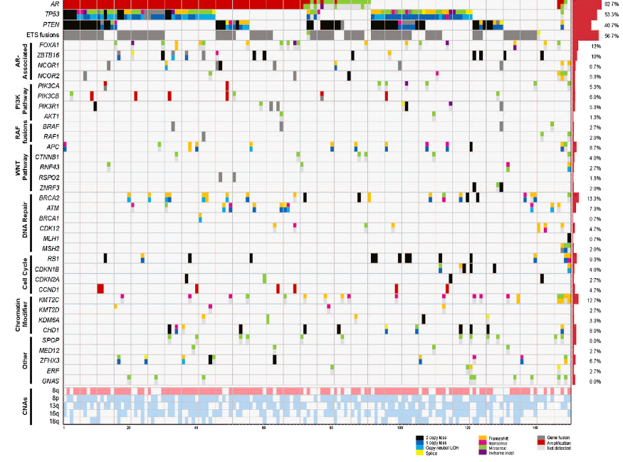
Genomic Landscape of Advanced Prostate Cancer
Robinson D et al, Cell, 2015
23% of mCRPCs harbor DNA repair alterations
The frequency of DNA repair alterations increases with disease progression
DNA = deoxyribonucleic acid.
Robinson et al, 2015.

Slide 38
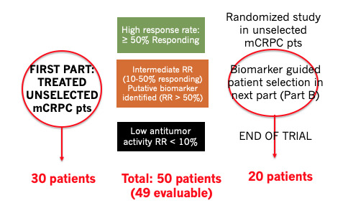
TOPARP-A: Trial of Olaparib in mCRPC
Eligibility: Histologically confirmed mCRPC, ECOG 0-2, no previous PARPi or platinum
ECOG = Eastern Cooperative Oncology Group; PARPi = poly (adenosine diphosphate [ADP]) ribose polymerase inhibitors; pts = patients; RR = response rate.
Mateo et al, 2015.

Slide 39
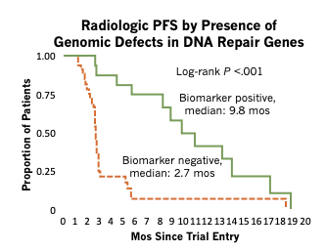
TOPARP-A: PFS by Presence of DNA Repair Defects
All patients (N=50) treated with olaparib 400 mg PO BID
PFS = progression-free survival; PO = orally; BID = twice a day; mos = months.
Mateo et al, 2015.

Slide 40
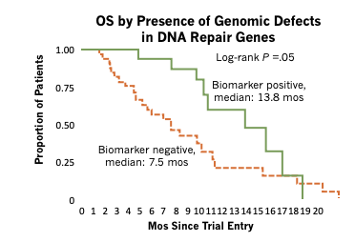




TOPARP-A: OS by Presence of DNA Repair Defects
All patients (N=50) treated with olaparib 400 mg PO BID
OS = overall survival.
Mateo et al, 2015.
Notes:
Olaparib adverse events: anemia, fatigue, leukopenia, thrombocytopenia, and neutropenia.

Slide 41
Disease Monitoring in CRPC

Slide 42
Disease Monitoring
CRPC M0 or M1
Imaging studies are encouraged early and often as appropriate, including pre-treatment baseline scans
  Frequency depends upon multiple factors:
    Individual risks
    Age
    PSADT
    Gleason grade
    Overall patient health
  Scans should be performed more frequently when PSADT <8 months
NCCN, 2019.
Notes:
“Current guidelines dictate that the patient should be screened early and often using the best available tools to identify potential metastasis and optimize treatment outcomes for patients with metastatic disease. For optimal effectiveness, the following factors should be taken into consideration when deciding on the frequency of imaging: individual risks, age, PSA doubling time (PSADT), Gleason grade, and overall patient health. Scans should be performed more frequently when the PSADT is less than 8 months. For patients with non-metastatic CRPC, the RADAR Guidelines recommend obtaining the first scan when the PSA level reaches 2 ng/mL. Imaging modalities recommended for the initial testing include 99 mTc-MDP scintigraphy and abdomen/pelvis/chest CT. If the imaging is negative, this should be followed by another scan when the PSA level reaches 5 ng/mL, and for every doubling of PSA level thereafter. Delays in ordering bone scans are common in clinical practice, resulting in delayed diagnosis of metastasis and delayed therapy, which can negatively impact patient outcomes” (Albala, 2017).

Slide 43
Disease Monitoring (cont.)
CRPC M0 or M1
Newer options have been developed that may offer increased diagnostic accuracy versus traditional bone scans
  18F-sodium fluoride PET-CT, MRI, and CT scans
  Emerging scanning options: PET with choline tracers, targeted PSMA, and whole-body MRI
PSMA = prostate-specific membrane antigen.
NCCN, 2019.

Slide 44
Disease Monitoring
M0 CRPC
If M0 status confirmed on imaging and PSADT >10 months: consider observation alone
If PSADT is 10 months or less, secondary hormone therapy may be considered
  Apalutamide or enzalutamide
NCCN, 2019.

Slide 45
Disease Monitoring
M1 CRPC
Castrate levels of testosterone (<50 ng/dL, <1.7 nmol/L) should be maintained with LHRH agonists or antagonists
Bone metastases
  Monitor for skeletal-related events
  Continue denosumab or zoledronic acid therapy
Visceral metastases
  PSA increase alone does not define progression on docetaxel
LHRH = luteinizing hormone-releasing hormone.
NCCN, 2019.

Slide 46
Managing Side Effects
Toxicity (Drug) | Key Considerations | Management Recommendations
Administration effects (sipuleucel-T) | Perioral and digital tingling, chills, nausea, and fainting | Discuss the procedure in advance, including the long duration and resulting need to be well hydrated, to avoid caffeine, and to consume a calcium-rich breakfast on the day of the procedure Procedure can cause fatigue; advise patients to bring a caregiver
Diarrhea (cabazitaxel, enzalutamide) | Grade ≥3 diarrhea can lead to dose delay or reduction Diarrhea and electrolyte imbalance following treatment can lead to death; patients should be monitored | Educate patients about rehydration or antidiarrheal medication; administer when required Instruct patients to maintain adequate fluid intake Advise dietary modifications Obtain patient information on bowel habits prior to treatment to help assess the severity of on-treatment diarrhea
Fatigue (cabazitaxel, enzalutamide) | Causes of fatigue are multifactorial Dose modification may reduce impact on patient functioning Possible contributing causes: sleep deprivation, depression, pain, and anemia | Inform patients that fatigue is a common side effect, that severity will fluctuate between treatment cycles, and that ongoing treatment can have a cumulative effect on fatigue Investigate exercise regimens, food supplements, stress relief, counseling, cognitive behavioral therapy, and sleep medication
dela Rama & Pratz, 2015.
Notes:
3. Your patient is a 62-year old man newly diagnosed with mCRPC. His treatment plan consists of external beam radiation therapy in conjunction with neoadjuvant, concurrent, and adjuvant ADT. Which of the following would you suggest to reduce the risk of fatigue in advance of his starting therapy?
a. Get plenty of rest
b. Begin an exercise regimen
c. Limit alcohol consumption and eat a healthy diet
d. All of the above
e. A and C only

Slide 47
Managing Side Effects (cont.)
Toxicity (Drug) | Key Considerations | Management Recommendations
Food effect (abiraterone) | Abiraterone exposure increases by as much as 10-fold when taken with meals, increasing the likelihood of toxicity | Educate patients about the risks of taking abiraterone with food Abiraterone should be taken on an empty stomach (at least 1 hour before or 2 hours after a meal)
Hematologic AEs or infection (cabazitaxel) | Neutropenic deaths have been reported with cabazitaxel, so frequent blood monitoring is recommended to determine if growth factor support and/or dose modification is needed Consider primary prophylaxis in high-risk patients (age >65 years, poor performance status, previous febrile neutropenia, extensive radiation ports, poor nutritional status, other serious comorbidities) | Colony-stimulating factor is recommended for all patients with cancer undergoing chemotherapy with ≥20% risk of febrile neutropenia Discuss measures to reduce infection risk Educate patients about the high risk of infection at neutrophil nadir and how to recognize the signs of neutropenic complications (eg, dysuria, cough, dyspnea, diarrhea, fever, chills) Advise patients to monitor their temperature and seek immediate advice should it exceed 100.4°F for any duration or 99.5°F for more than 1 hour Advise patients that acetaminophen and NSAIDs can mask symptoms like fever
Hypersensitivity (cabazitaxel) | All patients should receive premedication with IV antihistamine, corticosteroid, and an H2 antagonist | Should severe hypersensitivity occur, treatment should be stopped immediately
AEs = adverse events; NSAIDs = nonsteroidal anti-inflammatory drugs; IV = intravenous; H2 = histamine 2.
dela Rama & Pratz, 2015.
Notes:
5. Your patient is a 76-year old man with progressive mCRPC, previously treated with docetaxel. His treatment plan now consists of abiraterone + prednisone along with continued androgen deprivation therapy. He complains today about his swollen ankles. You might address this patient’s concern in all of the following ways EXCEPT what?
a. Confirming that the patient is continuing to take his prescribed prednisone daily
b. Suggesting that the patient put up his feet several times per day
c. Recommending that the patient take abiraterone with food
d. Ensuring that the patient is adequately hydrated

Slide 48
Managing Side Effects (cont.)
Toxicity (Drug) | Key Considerations | Management Recommendations
Liver function abnormalities (abiraterone) | Patients with moderate hepatic impairment should receive a reduced abiraterone dose (250 mg) and more frequent monitoring Liver function tests should be performed before treatment | Patients with normal transaminase levels at baseline should be monitored every 2 weeks for the first 3 months and then monthly thereafter Marked increases in liver enzymes may require treatment discontinuation or a dose reduction
Nausea and vomiting (cabazitaxel) | Prolonged periods of uncontrolled vomiting may require hospital admission for fluid replacement and parenteral antiemetics | Inform patients that antiemetics will be included in their medications for cabazitaxel Instruct patients to maintain adequate fluid intake Discuss the incidence of nausea and vomiting at each visit, potentially assisted by a patient diary
Peripheral neuropathy (cabazitaxel) | Chemotherapy-induced peripheral neuropathy can be extremely painful and lead to significant loss of functional abilities and decreased quality of life The clinical course commonly begins with paresthesia (tingling) and dysesthesia (eg, pain, itching, “pins and needles”) in fingers and toes, then spreads to arms and legs | No treatments are known Provide educational support and monitor symptoms over time Interruption of chemotherapy can alleviate symptoms, but recovery tends to be slow
dela Rama & Pratz, 2015.

Slide 49
Managing Side Effects (cont.)
Toxicity (Drug) | Key Considerations | Management Recommendations
Renal failure (cabazitaxel) | Most cases occurred in association with sepsis, dehydration, or obstructive uropathy Identify causes of renal failure and treat aggressively | Refer patients for specialist management as needed
Seizures (enzalutamide) | Patients with predisposing factors for seizure were excluded from phase 3 trials of enzalutamide | Inform patients receiving enzalutamide about the risks of seizure and sudden loss of consciousness Advise patients not to participate in activities that could lead to serious harm should a seizure occur
Toxicity associated with elevated steroid synthesis (abiraterone) | Monitor for fluid retention, hypertension, and hypokalemia at least once per month Abiraterone should be used with caution in patients with a history of CVD, particularly where underlying medical conditions may be compromised by fluid retention, hypertension, or hypokalemia Consider concurrent administration of abiraterone with low-dose glucocorticoids | Obtain an accurate patient history related to cardiovascular conditions Hypertension and hypokalemia should be controlled before and during therapy with abiraterone Mineralocorticoid-related side effects can be treated using the mineralocorticoid receptor antagonist eplerenone in combination with a salt-restricted diet
CVD = cardiovascular disease.
dela Rama & Pratz, 2015.

Slide 50
Case Studies

Slide 51
Case Study #1
Nonmetastatic CRPC
Mr. JM is a 68-year-old man who has been on leuprolide q3mo for 2 years, since his PSA started rising post-RRP. Most recent CT and bone scan were negative
Which of these below is the most appropriate next step to consider based upon PSA?
Observation
Apalutamide
Denosumab
Docetaxel
DATE | PSA
6/2019 | 1.8
3/2019 | 1.0
12/2018 | 0.8
9/2018 | 0.7
6/2018 | 0.7
q3mo = once every 3 months; RRP = radical retropubic prostatectomy.

Slide 52
Case Study #1 (cont.)
Nonmetastatic CRPC
(b) Apalutamide
With a PSADT <10 months, observation alone is not recommended
Docetaxel would be appropriate for metastatic disease
Denosumab is not directly related to PSA, but rather to bone health and prevention of skeletal-related events

Slide 53
Case Study #2
Metastatic CRPC
Mr. SK is a 70-year-old man with a negative CT abd/pel, but a bone scan showed persistent metastatic disease in the hip and lumbar spine, despite completing a course of docetaxel. His pain is minimal
In considering next steps, his doctor ordered AR-V7 analysis of his blood, which shows, “Nuclear AR-V7: POSITIVE”
Which of the following would be a recommended treatment option based upon this result?
    Cabazitaxel
    Abiraterone
    Apalutamide
    Radium-223
Abd/pel = abdominal/pelvic.

Slide 54
Case Study #2 (cont.)
Metastatic CRPC
Cabazitaxel
AR-V7–positive status: not likely to benefit from abiraterone, apalutamide, or enzalutamide
Radium-223 is only given to symptomatic patients
Apalutamide is appropriate in M0 CRPC patients only, not M1

Slide 55
Case Study #2 (cont.)
Metastatic CRPC
Mr. SK decided to pursue cabazitaxel therapy. In the education visit, the nurse emphasizes that which of the following side effects are basically irreversible?
    Fatigue
    Neutropenia
    Peripheral neuropathy
    Diarrhea

Slide 56
Case Study #2 (cont.)
Metastatic CRPC
(c) Peripheral neuropathy
There are no treatments for peripheral neuropathy that fix the nerve damage. Instead, treatment is given to relieve and manage symptoms
  Unfortunately, many of the treatments are not proven to help and have side effects of their own
Nurses should assess for peripheral neuropathy early and frequently in order to identify it promptly
The other symptoms listed are associated with cabazitaxel but are routinely reversible after completion of treatment along with supportive care

Slide 57
Future Directions in CRPC Management

Slide 58
Development Pipeline in CRPC
Emerging Technologies
New AR antagonist: darolutamide (FDA approved July 2019)
Signaling pathway inhibitors
DNA damage repair pathway inhibitors
Targeted radiopharmaceuticals
Prostate-specific membrane antigen targeting
Continuing work on validating combination therapies and sequencing
Implications of tumor testing/genomics
Nevedomskaya et al, 2018; Fizazi et al, 2019.
Notes:
“Darolutamide is a second-generation competitive oral AR antagonist with a novel chemical structure. A strong binding to the AR [ligand-binding domain] translating into potent anti-tumor efficacy in preclinical models and unique antagonistic activity against AR mutants identified in treatment-resistant prostate cancer patients have been reported. Unlike other AR antagonists, darolutamide has low blood-brain barrier penetration, which may result in a better side-effect profile. Phase 3 studies are presently ongoing for darolutamide in nmCRPC with [metastasis-free survival] as the primary endpoint and for darolutamide in addition to standard ADT plus docetaxel in [metastatic hormone-sensitive prostate cancer]” (Nevedomskaya et al, 2018).

Slide 59
Key Takeaways

Slide 60
Key Takeaways
Treatment for advanced prostate cancer was very limited for over 70 years (1941-2004), but over recent years, a wide variety of options that improve quality of life and overall survival are available
Much is still unknown about sequencing for these novel agents, so treatment decision making can be a complex process
Analysis of tissue-based genetics and circulating tumor cells can help determine if patients will respond to specific treatments
The pipeline of emerging technologies continues to grow rapidly in an era of precision medicine

Slide 61
Key Takeaways (cont.)
Nurses play a key role in patient education, assessment, and advocacy
With a working knowledge of CRPC therapies, nurses can best guide patients through the cancer care continuum
Through shared experience, nurses can provide pertinent advice and relevant support to the patients and families they are helping through CRPC

Slide 62
References
Aggarwal RR, Harris A, Formaker C, et al (2014). Response to subsequent docetaxel in a patient cohort with metastatic castration-resistant prostate cancer after abiraterone acetate treatment. Clin Genitourin Cancer, 12(5):e167-e172. DOI:10.1016/j.clgc.2014.03.010
Albala DM (2017). Imaging and treatment recommendations in patients with castration-resistant prostate cancer. Rev Urol, 19(3):200-202. DOI:10.3909/riu193PracticeProfile
American Cancer Society (2019). Cancer facts & figures 2019. Available at: https://www.cancer.org/latest-news/facts-and-figures-2019.html
Antonarakis ES, Lu C, Wang H, et al (2014). AR-V7 and resistance to enzalutamide and abiraterone in prostate cancer. N Engl J Med, 371(11):1028-1038. DOI:10.1056/NEJMoa1315815
Armstrong CM & Gao AC (2015). Drug resistance in castration-resistant prostate cancer: resistance mechanisms and emerging treatment strategies. Am J Clin Exp Urol, 3(2):64-76.
Beer TM, Armstrong AJ, Rathkopf DE, et al (2014). Enzalutamide in metastatic prostate cancer before chemotherapy. N Engl J Med, 371(5):424-433. DOI:10.1056/NEJMoa1405095
Bianchini D, Lorente D, Rodriguez-Vida A, et al (2014). Antitumour activity of enzalutamide (MDV3100) in patients with metastatic castration-resistant prostate cancer (CRPC) pre-treated with docetaxel and abiraterone. Eur J Cancer, 50(1):78-84. DOI:10.1016/j.ejca.2013.08.020
Cheng HH, Nadal R, Gulati R, et al (2014). The effect of prior abiraterone (abi) use on the activity of enzalutamide (enza) in men with mCRPC. J Clin Oncol, 32(4):18. DOI:10.1200/jco.2014.32.4_suppl.18
de Bono JS, Logothetis CJ, Molina A, et al (2011). Abiraterone and increased survival in metastatic prostate cancer. N Engl J Med, 364(21):1995-2005. DOI:10.1056/NEJMoa1014618
de Bono JS, Oudard S, Ozguroglu M, et al (2010). Prednisone plus cabazitaxel or mitoxantrone for metastatic castration-resistant prostate cancer progressing after docetaxel treatment: a randomized open-label trial. Lancet, 376(9747):1147-1154. DOI:10.1016/S0140-6736(10)61389-X
dela Rama F & Pratz C (2015). Navigating treatment of metastatic castration-resistant prostate cancer: nursing perspectives. Clin J Oncol Nurs, 19(6):723-732. DOI:10.1188/15.CJON.723-732
Fizazi K, Shore N, Tammela TL, et al (2019). Darolutamide in nonmetastatic, castration-resistant prostate cancer. N Engl J Med, 380(12):1235-1246. DOI:10.1056/NEJMOA1815671
Fitzpatrick JM, Bellmunt J, Fizazi K, et al (2014). Optimal management of metastatic castration-resistant prostate cancer: highlights from a European Expert Consensus Panel. Eur J Cancer, 50(9):1617-1627. DOI:10.1016/j.ejca.2014.03.010
Haraldsdottir S, Hampel H, Wei L, et al (2013). Prostate cancer incidence in males with Lynch syndrome. Genet Med, 553-557. DOI:10.1038/gim.2013.193
Hussain M, Fizazi K, Saad F, et al (2018). Enzalutamide in men with nonmetastatic, castration-resistant prostate cancer. N Engl J Med, 378:2465. DOI:10.1056/NEJMoa1800536
Jevtana® (cabazitaxel) prescribing information (2019). Sanofi Genzyme. Available at: https://www.jevtanapro.com/moa
Kantoff PW, Higano CS, Shore ND, et al (2010). Sipuleucel-T immunotherapy for castration-resistant prostate cancer. N Engl J Med, 363(5):411-422. DOI:10.1056/NEJMoa1001294
Keytruda® (pembrolizumab) prescribing information (2019). Merck. Available at: https://www.merck.com/product/usa/pi_circulars/k/keytruda/keytruda_pi.pdf
Loriot Y, Bianchini D, Ileana E, et al (2013). Antitumour activity of abiraterone acetate against metastatic castration-resistant prostate cancer progressing after docetaxel and enzalutamide (MDV3100). Ann Oncol, 24(7):1807-1812. DOI:10.1093/annonc/mdt136

Slide 63
References
Mateo J, Carreira S, Sandhu S, et al (2015). DNA-repair defects and olaparib in metastatic prostate cancer. N Engl J Med, 373(18):1697-1708. DOI:10.1056/NEJMoa1506859
Mezynski J, Pezaro C, Bianchini D, et al (2012). Antitumour activity of docetaxel following treatment with the CYP17A1 inhibitor abiraterone: clinical evidence for cross-resistance? Ann Oncol, 23(11):2943-2947. DOI:10.1093/annonc/mds119
National Comprehensive Cancer Network (2019). Clinical Practice Guidelines in Oncology: prostate cancer. Version 2.2019. Available at: http://www.nccn.org
Negoita S, Feuer EJ, Mariotto A, et al (2018). Annual report to the nation on the status of cancer, part II: recent changes in prostate cancer trends and disease characteristics. Cancer, 124(13):2801-2814. DOI:10.1002/cncr.31549
Nevedomskaya E, Baumgart SJ & Haendler B (2018). Recent advances in prostate cancer treatment and drug discovery. Int J Mol Sci, 19(5):E1359. DOI:10.3390/ijms19051359
Noonan KL, North S, Bitting RL, et al (2013). Clinical activity of abiraterone acetate in patients with metastatic castration-resistant prostate cancer progressing after enzalutamide. Ann Oncol, 24(7):1802-1807. DOI:10.1093/annonc/mdt138
Parker C, Nilsson S, Heinrich D, et al (2013). Alpha emitter radium-223 and survival in metastatic prostate cancer. N Engl J Med, 369(3):213-223. DOI:10.1056/NEJMoa1213755
Pezaro CJ, Omlin AG, Altavilla A, et al (2014). Activity of cabazitaxel in castration-resistant prostate cancer progressing after docetaxel and next-generation endocrine agents. Eur Urol, 66(3):459-465. DOI:10.1016/j.eururo.2013.11.044
Rebbeck TR (2017). Prostate cancer genetics: variation by race, ethnicity, and geography. Semin Radiat Oncol, 27(1):3-10. DOI:10.1016/j.semradonc.2016.08.002
Robinson D, Van Allen EM, Wu YM, et al (2015). Integrative clinical genomics of advanced prostate cancer. Cell, 161(5):1215-1228. DOI:10.1016/j.cell.2015.05.001
Ryan CJ, Smith MR, de Bono JS, et al (2013). Abiraterone in metastatic prostate cancer without previous chemotherapy. N Engl J Med, 368(2):138-148. DOI:10.1056/NEJMoa1209096
Sartor O & Gillessen S (2014). Treatment sequencing in metastatic castrate-resistant prostate cancer. Asian J Androl, 16(3):426-431. DOI:10.4103/1008-682X.126378
Scher HI, Fizazi K, Saad F, et al (2012). Increased survival with enzalutamide in prostate cancer after chemotherapy. N Engl J Med, 367(13):1187-1197. DOI:10.1056/NEJMoa1207506
Scher HI, Lu D, Schreiber NA, et al (2016). Association of AR-V7 on circulating tumor cells as a treatment-specific biomarker with outcomes and survival in castration-resistant prostate cancer. JAMA Oncol, 2(11):1441-1449. DOI:10.1001/jamaoncol.2016.1828
Schrader AJ, Boegemann M, Ohimann CH, et al (2014). Enzalutamide in castration-resistant prostate cancer patients progressing after docetaxel and abiraterone. Eur Urol, 65(1):30-36. DOI:10.1016/j.eururo.2013.06.042
Siegel RL, Miller KD & Jemal A (2019). Cancer statistics, 2019. CA Cancer J Clin, 69(1):7-34. DOI:10.332/caac.21551
Smith M, Saad F, Chowdhury S, et al (2018). Apalutamide treatment and metastasis-free survival in prostate cancer. N Engl J Med, 378:1408. DOI:10.1056/NEJMoa1715546
Thomson D, Charnley N & Parikh O (2014). Enzalutamide after failure of docetaxel and abiraterone in metastatic castrate-resistant prostate cancer. Eur J Cancer, 50(5):1040-1041. DOI:10.1016/j.ejca.2013.12.017

Slide 64
References
Velho PI & Antonarakis ES (2018). PD-1/PD-L1 pathway inhibitors in advanced prostate cancer. Expert Rev Clin Pharmacol, 11(5):475-486. DOI:10.1080/17512433.2018.1464388
Xofigo® (radium-223) prescribing information (2018). Bayer. Available at: http://labeling.bayerhealthcare.com/html/products/pi/Xofigo_PI.pdf
Xtandi® (enzalutamide) prescribing information (2019). Astellas, Pfizer Oncology. Available at: https://www.xtandihcp.com/about-mcrpc/pathogenesis
Wissing MD, Coenen JL, van den Berg P, et al (2015). CAST: a retrospective analysis of cabazitaxel and abiraterone acetate sequential treatment in patients with metastatic castrate-resistant prostate cancer previously treated with docetaxel. Int J Cancer, 136(6):E760-E772. DOI:10.1002/ijc.29231
Zytiga® (abiraterone acetate) prescribing information (2019). Janssen. Available at: http://www.janssenlabels.com/package-insert/product-monograph/prescribing-information/ZYTIGA-pi.pdf

