Slide 1
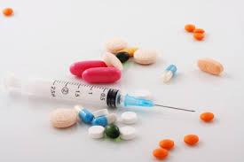
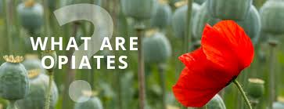
-OPIATES-
How do people under the influence of opiates behave
What kind of opiates are affecting our communities
How to recognize opiate abuse in a Emergency Shelter
What to do if you witness an overdose
How to care for someone going through withdrawal
Presented by: Liisa Jackson MRC Coordinator

Slide 2
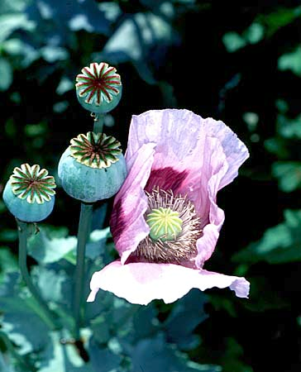
Definition
Opium
  Fluid obtained from the poppy plant
Opiate
  a substance derived from opium
Opioid
  substance with morphine-like actions, but not derived directly from the poppy plant
Papaver Somniferum
“Poppy Plant”

Slide 3
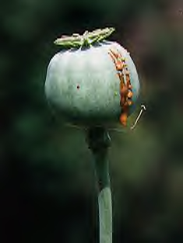
OPIATES ARE DERIVED FROM THE POPPY PLANT
CONTENTS OF THE POPPY
POD FLUID:
Morphine 4 - 21 %
Codeine 1 - 25%

Slide 4
OPIUM HISTORY
4000 – 2000 BC: Opium believed to be discovered in the Mediterranean area.
1500 BC: Egyptian papyri list opium as one of 7000 remedies.
1st century AD: Opium poisoning described.
1655: Portuguese physician, Acosta, wrote of withdrawal sickness.
1701: British physician, John Jones, advocated moderation in the use of the drug in order to avoid the discomforts with its continued use.
1805: Morphine isolated as the main active ingredient in opium.

Slide 5
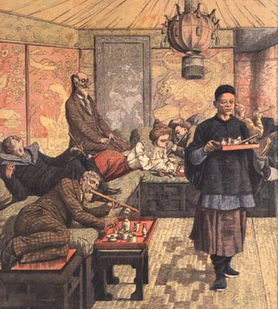
Continued OPIUM HISTORY
1850 – 1865 thousands of Chinese laborers immigrated to the US and brought the habit of opium smoking with them (Opium Den shown on right)
Civil war soldiers became opioid dependent through medical treatment – referred to as “army disease” or “soldier’s disease”
It was estimated that the total number of opium users in the U.S. in 1868 was 100,000
Heroin was first synthesized in 1874 by the chemist, C.R. Alder Wright
First commercial production in 1898 by the Bayer Pharmaceutical Company
1898: Heinrich Dreser announced that tests confirmed heroin was ideal for treating bronchitis, emphysema, asthma, tuberculosis, and was a cure for opium and morphine dependence

Slide 6
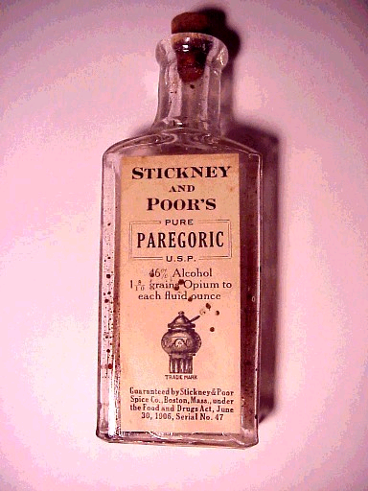
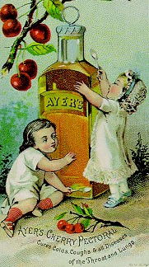
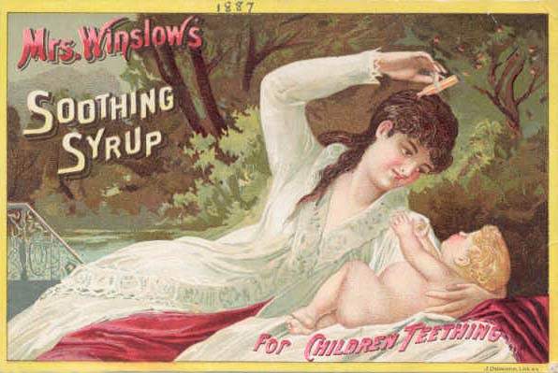
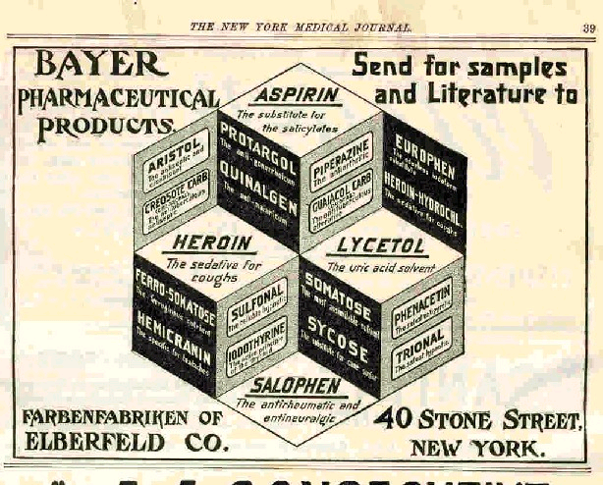
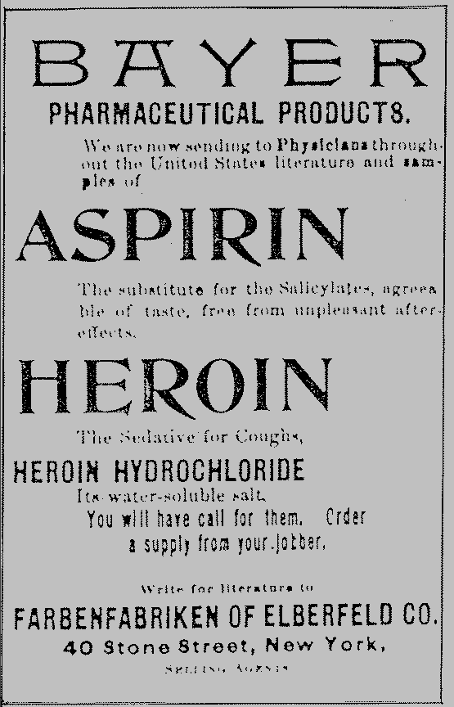
HISTORICAL OPIATE PRODUCTS sold to the public
This bottle of Stickney and Poor's paregoric was distributed much like the spices for which the company is better known. McCormick also manufactured and sold paregoric, which is a mixture of opium and alcohol. Doses for infants, children, and adults are given on the bottle. At 46% alcohol, this product is 92 proof which is pretty potent in itself.
There were ads in papers and journals for Bayer’s many products, including aspirin and heroin.

Slide 7
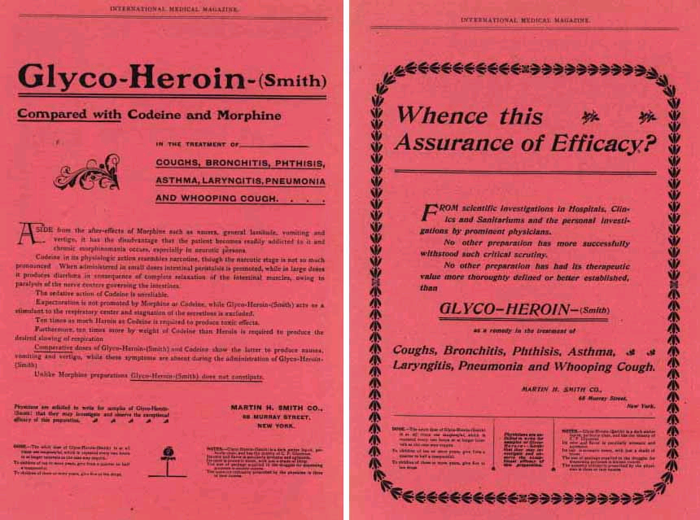
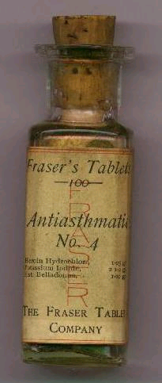
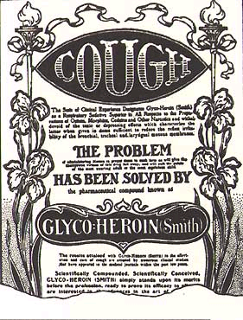
Heroin PRODUCTS sold to the public
These heroin tablets, manufactured by the Fraser Tablet Company, were marketed for the relief of asthma.
These magazine advertisements are for Glyco-Heroin manufactured by Martin H. Smith Company (New York). Heroin was widely used not only as an analgesic, but also as a remedy for asthma, coughs, and pneumonia. Mixing heroin with glycerin (and often adding sugar or spices) made the bitter-tasting opiate more palatable for oral consumption. (From International Medical Magazine, January, 1902.)

Slide 8
FEDERAL LAWS ASSOCIATED WITH THE CONTROL OF NARCOTICS
1914 – HARRISON ACT
  First federal legislation to regulate and control the production, importation, sale, purchase and free distribution of opium and drugs derived from opium
1922 – NARCOTIC DRUG IMPORT AND EXPORT ACT
  Intended to eliminate the use of narcotics, except for medical and other legitimate purposes
1924 – HEROIN ACT
  Made it illegal to manufacture heroin
1942 – OPIUM POPPY CONTROL ACT
Prohibited growing opium poppies in the US, except under license1956 – NARCOTIC CONTROL ACT
  Intended to impose very severe penalties for those convicted of narcotics or marijuana charges
1966 – NARCOTIC ADDICT REHABILITATION ACT
  Enhanced federal efforts to treat and rehabilitate narcotic addicts through three programs
    These programs provided voluntary and pretrial civil commitment and sentencing to treatment of convicted addicts
1956 – NARCOTIC CONTROL ACT
  Intended to impose very severe penalties for those convicted of narcotics or marijuana charges
1966 – NARCOTIC ADDICT REHABILITATION ACT
  Enhanced federal efforts to treat and rehabilitate narcotic addicts through three programs
    These programs provided voluntary and pretrial
1966 – NARCOTIC ADDICT REHABILITATION ACT
  Enhanced federal efforts to treat and rehabilitate narcotic addicts through three programs
    These programs provided voluntary and pretrial civil commitment and sentencing to treatment of convicted addicts
    1972 – DRUG ABUSE OFFICE AND TREATMENT ACT
  Established NIDA
  Established NIMH
1973 – METHADONE CONTROL ACT
  Placed controls on methadone licensing
1973 – DRUG ENFORCEMENT ADMINISTRATION
BUREAU OF NARCOTICS AND DANGEROUS DRUGS was remodeled to become the DEA1974 – NARCOTIC ADDICT TREATMENT ACT
  Required separate DEA registrations for physicians who want to use approved narcotics
1986 – EXECUTIVE ORDER 12564
  Mandated a drug-free workplace program
1988 – ANTI DRUG ABUSE ACT
  Established the OFFICE OF NATIONAL DRUG CONTROL POLICY (ONDCP) in the executive office of the President of the United States to oversee all federal policies regarding research about control of drug abuse
2000 – CHILDREN’S HEALTH ACT
  A section of this act dealt with drug addiction treatment (DATA)
    Allowed qualified physicians to prescribe medications classified as schedule III, IV and V narcotics for treatment of addiction. This is the law that allows and regulates buprenorphine use in addiction treatment.

Slide 9
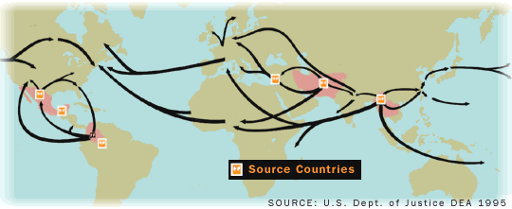
MARKETING AND DISTRIBUTION – THE PROCESS
Growers
  Southeast Asia
  Middle East
  Latin and South America
Shippers
Manufacturers
Large wholesale buyers
  Prices per kilo depend on the purchase amount
Mid-range buyers
  Dilute or “step on” the heroin using white substances that are not easily detected
    These substances or “Cut” can be – lactose, mannitol, talc
Continuous dilution can occur all the way down to the point of sale
  Bag = 1/10 to 1/15 gram
  10 bags = bundle

Slide 10
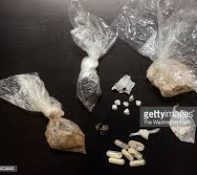
What is on the streets?
Street retail
  Bags may be a “cap” or “1/4 spoon” in other parts of US
  Slang terms for heroin are: junk, dope, smack, shot, shit, h, etc.
  The onset of a heroin "rush" from a needle is about 3-7 seconds, and lasts about 3 seconds.

Slide 11
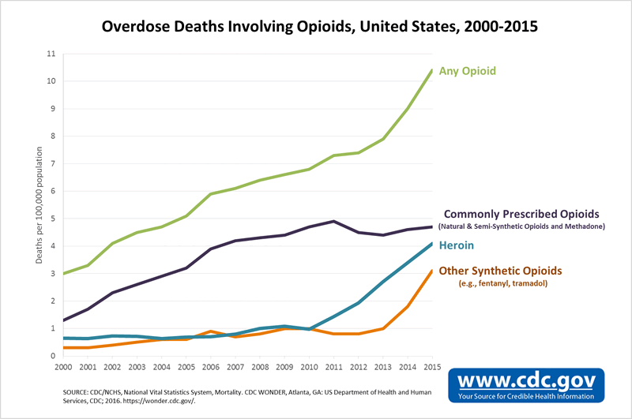
How many deaths from opiates in the last 15 years?

Slide 12
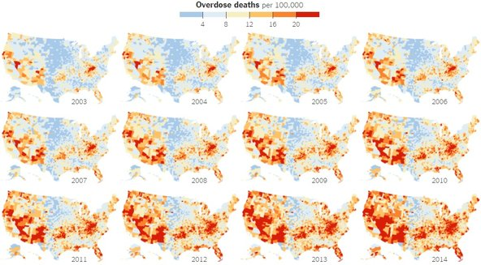
Overdose deaths 2003-2014

Slide 13
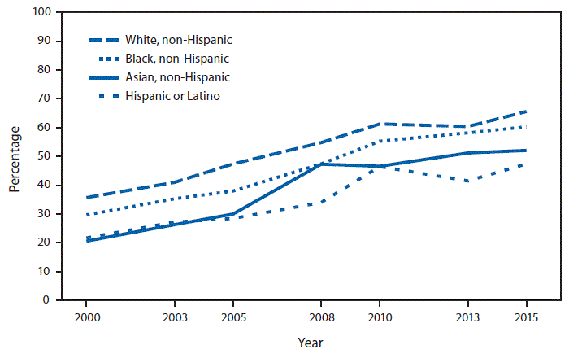
Who is affected

Slide 14
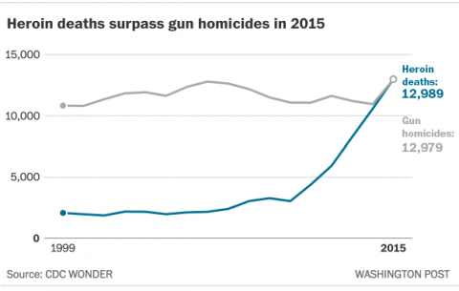
Heroin surpasses homicides in causes of death in US

Slide 15

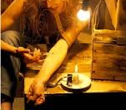
Why do people use opiates?

Slide 16
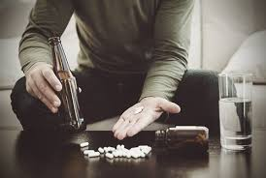


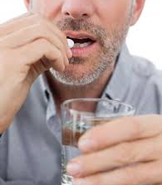
Who uses opiates?

Slide 17
How do people start to using opiates
Started taking because of surgery and now need to take opiates to feel good
Tried opiates at a party or with friends and now their body is dependent on opiates
Many people suffering from unresolved trauma or PTSD causing depression and a desire to self medicate with opiates

Slide 18
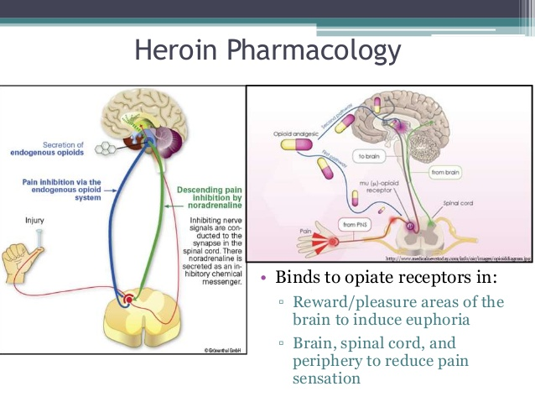
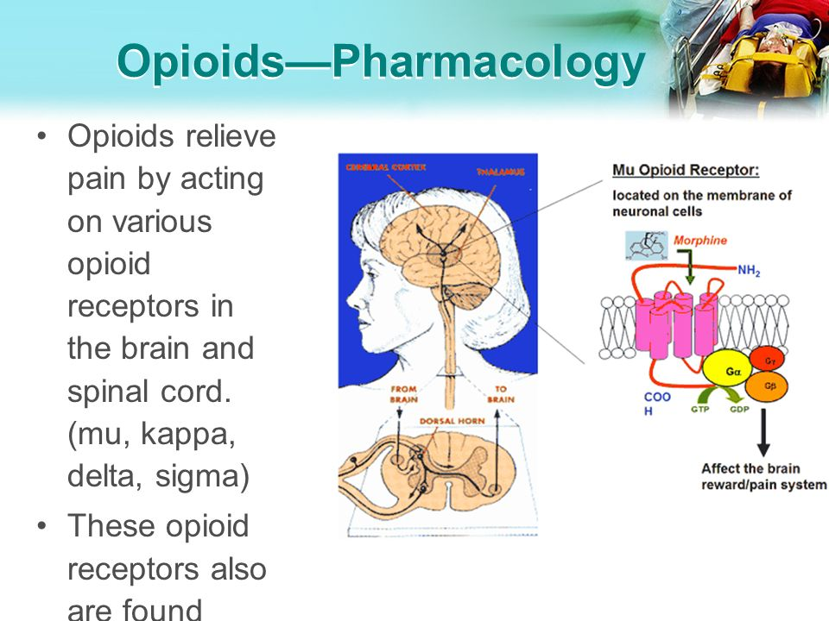
Opiate-Heroin PHARMACOLOGY
Notes:
Comparison of the amino acid sequences of the cloned mouse deta and kapa and rat mu receptor. The blue indicated common amino acid sequences. G protein couple receptors.

Slide 19
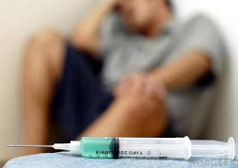
While taking opiates the person feels:
Euphoric
Sedated
Desensitize

Slide 20
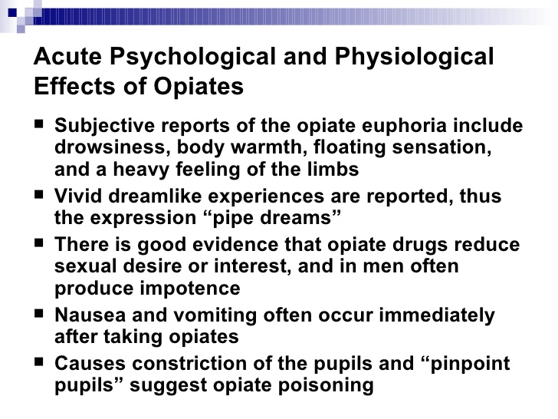
Acute effects of opiates

Slide 21
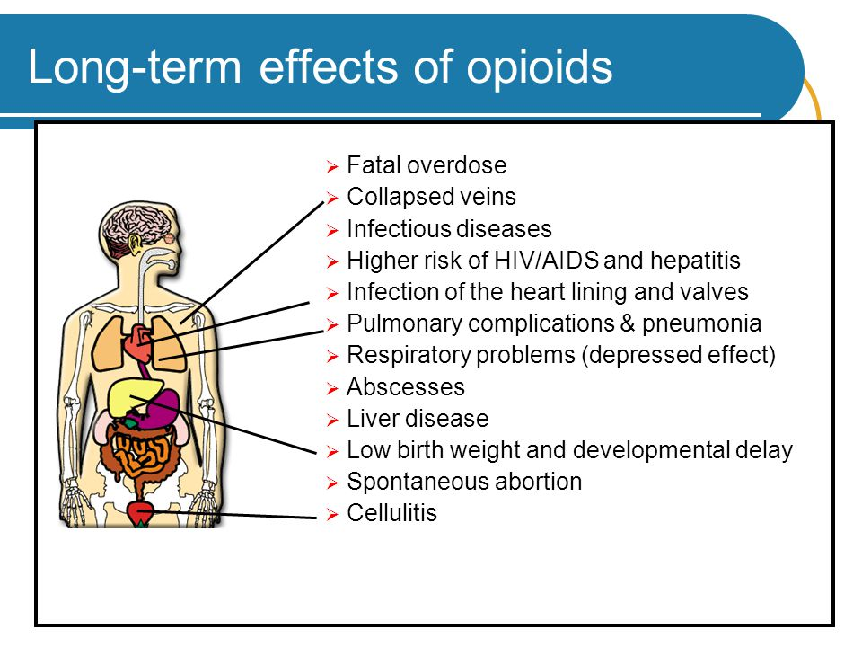
Long-term effects

Slide 22
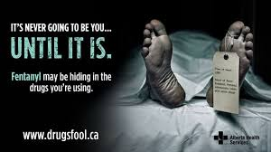
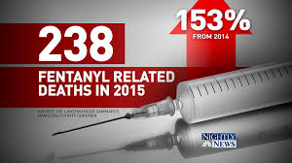
Fentanyl is in our communities

Slide 23
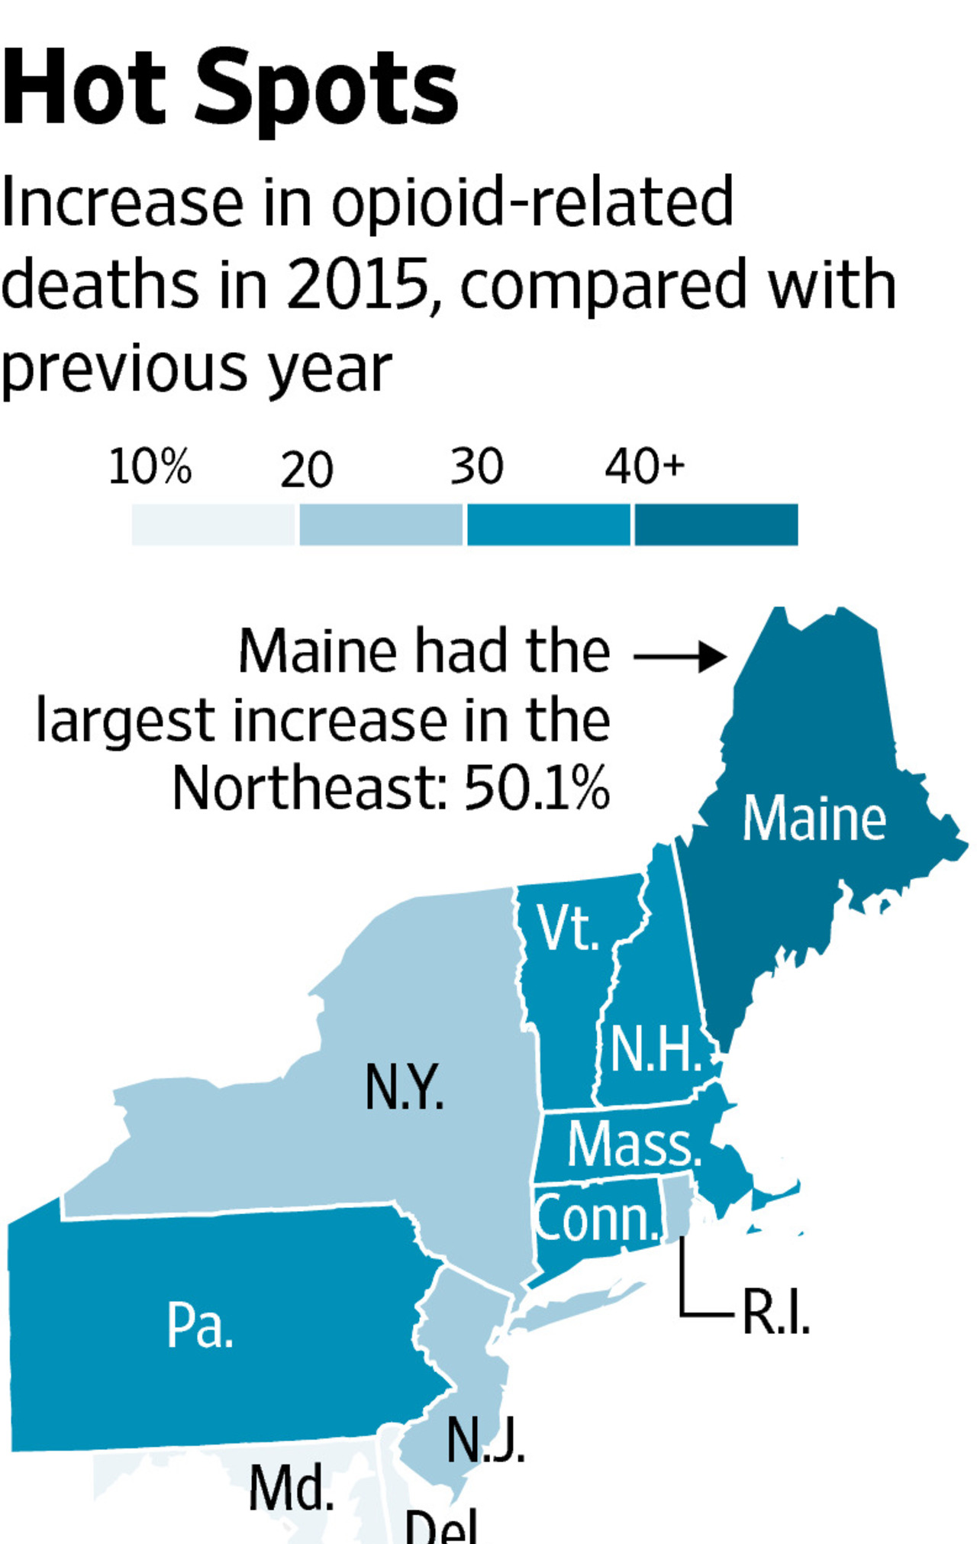
What is Fentanyl?
Used in Veterinary Medicine to immobilize large animals
A synthetic opioid, which is 30 to 50 times more powerful than heroin. When prescribed by a physician it is typically used to treat patients with severe pain, or to manage pain after surgery. However it is increasingly being mixed with street-sold heroin or cocaine, amplifying both the drug's potency—and the dangers.

Slide 24
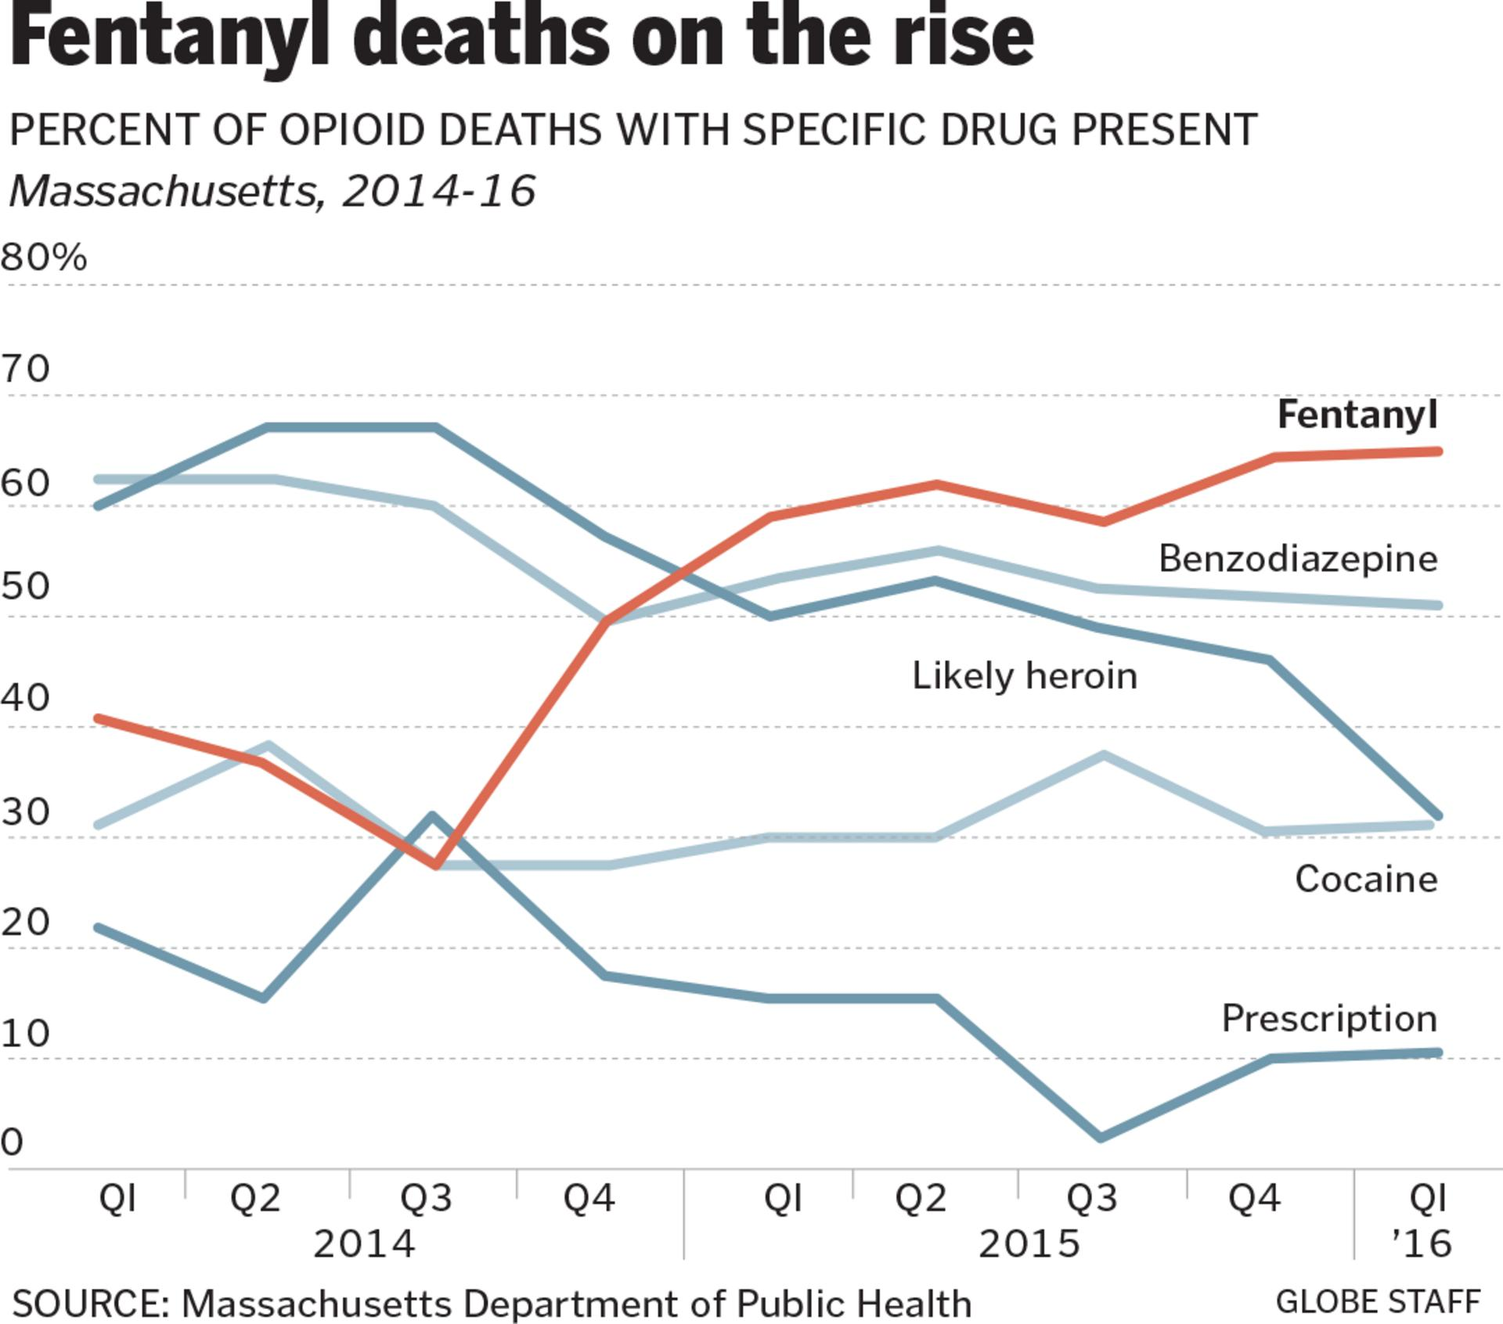
Fentanyl Deaths

Slide 25
How to recognize
OPIATE INTOXICATION-OVERDOSE-WITHDRAWAL in a Disaster Shelter

Slide 26

Which EYE is INTOXICATION
Which EYE is WITHDRAWAL
Always look at the pupils; the pupil size can give
very good clinical information.

Slide 27
INTOXICATION OR WITHDRAWAL?
Withdrawal
Intoxication

Slide 28
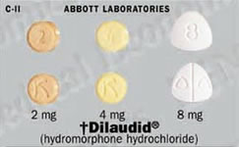
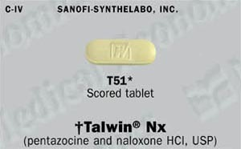
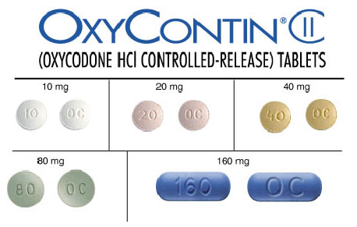
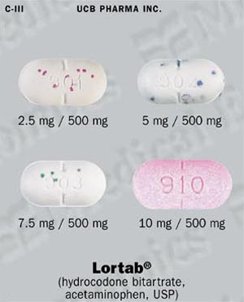
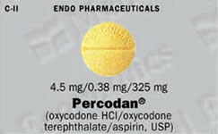
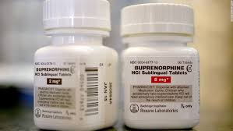

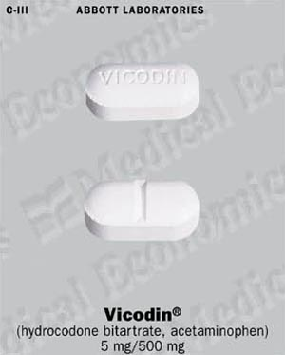
Recognizing Prescribed OPIATE MEDICATIONS

Slide 29
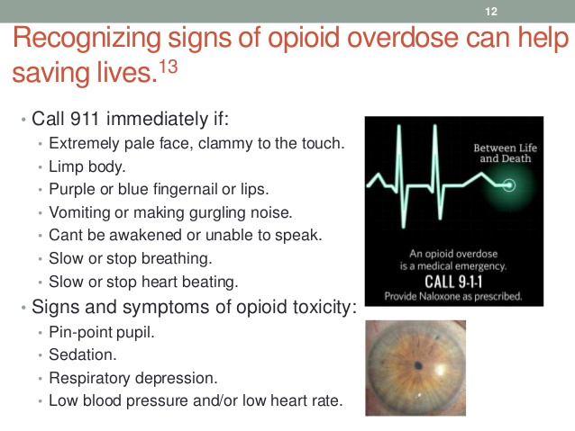
OPIATE OVERDOSE

Slide 30
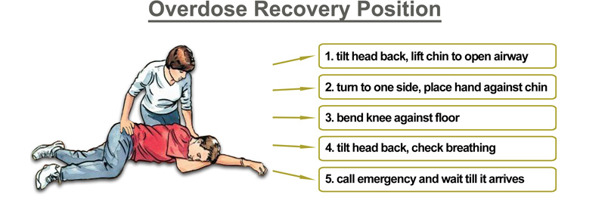
OVERDOSE Recovery Position

Slide 31
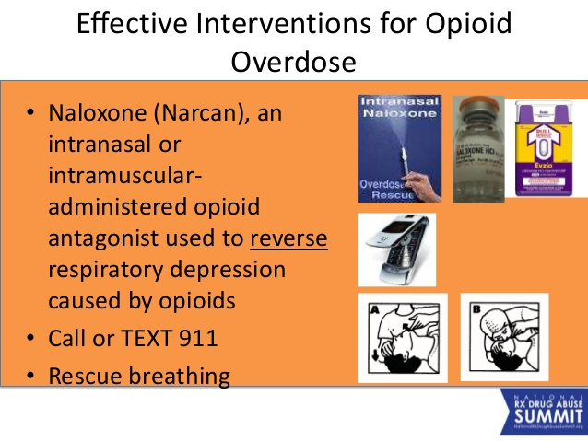
Intervention for opioid overdose

Slide 32
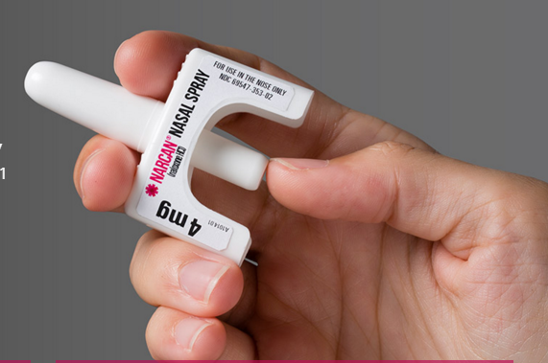

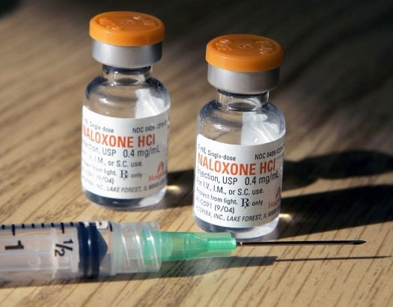
NARCAN-OPIATE OVERDOSE TREATMENT

Slide 33
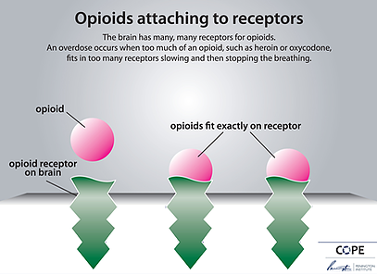
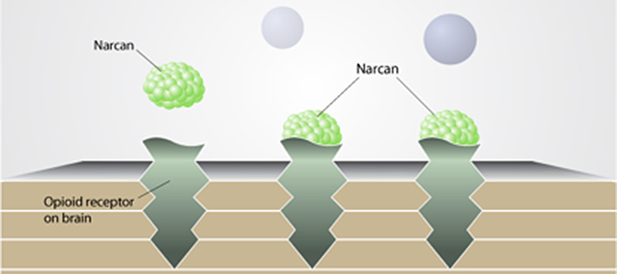
Opiates attaching to receptors-Narcan blocking receptors

Slide 34
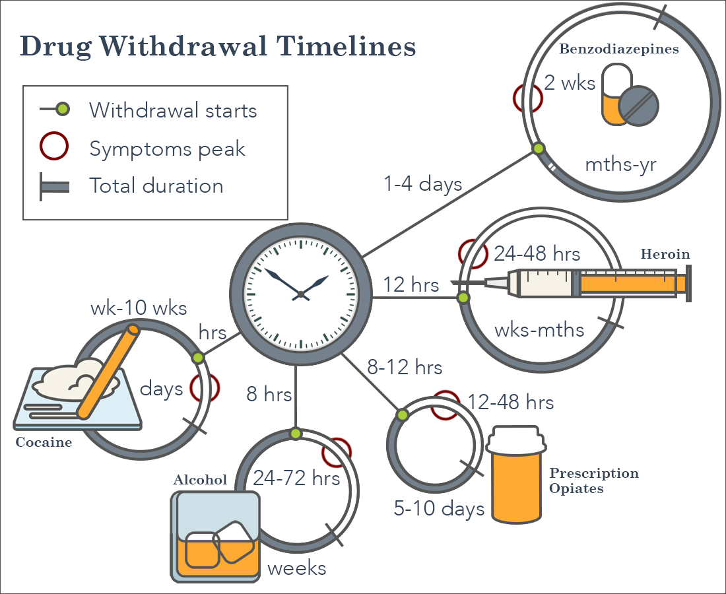
OPIATE WITHDRAWAL

Slide 35
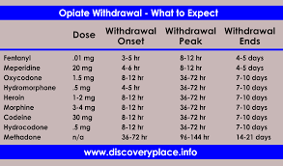
OPIATE MEDICATIONS

Slide 36
Other COMPLICATIONS from Opiate use
MANY OF THE COMPLICATIONS OF OPIATE USE ARE DUE TO THE ROUTE OF USE AND THE
LIFESTYLE OF THE USER, NOT THE DRUG
  NEUROLOGIC
    Toxic amblyopia (optic nerve pathology)
    Mononeurpathy (dysfunction of a single nerve)
    Polyneuropathy (dysfunction of several nerves)
    Meningitis
    Brain abscess
  DERMATOLOGIC
    Abscess
    Tracks
    Lymphangitis (swelling and dysfunction of the lymph system)
  PULMONARY
    Aspiration
    Pneumonia
    Lung abscess
    Pulmonary emboli (clots going to the lung)
    Pulmonary fibrosis (scarring of the lung)
    Noncardiogenic pulmonary edema (lung fills with fluid not as a result of heart dysfunction)
  HEPATIC
    Hepatitis B,C,D,G
  INFECTIONS
    Endocarditis
    Tetanus in immigrants in California

Slide 37
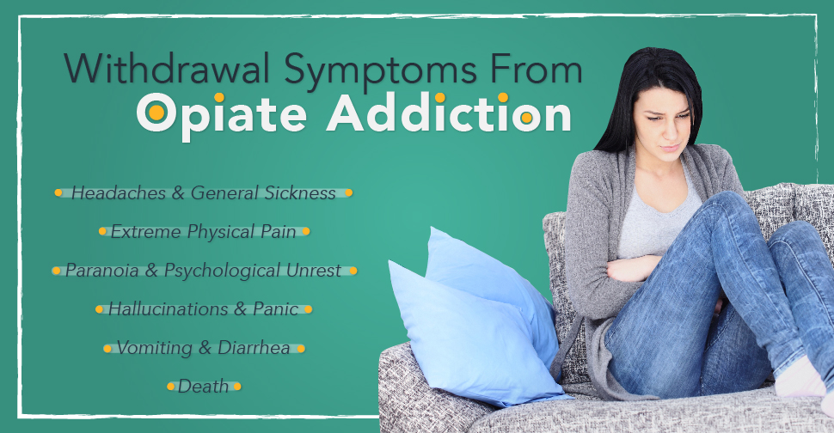
How to care for someone going through opiate withdrawal
Fluids that contain electrolytes
Over the counter pain relief
Dramamine or Bonine for nausea
Keep comfortable and safe
Emotional support from family and friends
Call doctor or send to the hospital

Slide 38
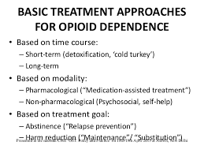
Referrals for OPIATE WITHDRAWAL TREATMENT
CAN BE INPATIENT OR AMBULATORY DETOX
PROGRAMS*
  METHADONE TREATMENT
  PART 816 CRISIS SERVICES
  OUTPATIENT TREATMENT
  INPATIENT/RESIDENTIAL TREATMENT

Slide 39
-OPIATES-
Do you understand the effect people under the influence of opiates?
How are opiates affecting our communities
Can you recognize opiate abuse in a emergency shelter
What to do when someone is suffering from withdrawals in a emergency shelter
Presented by: Liisa Jackson MRC Coordinator

