Slide 1

2023 CRCA Trade Show & Seminars Details
In Case of Emergency
  Contact Shirted Staff; ON SITE & LOCAL Police
  Call 911 – 100 Drury Lane Oakbrook Terrace
Emergency Exits
  Crystal Room Left and Right
  Exhibit Hall - Entry, by Bars, North Walls
Mobile Phones…Vibrate/Silent/Off
  CRCA Trade Show Exhibit Hall Opens 11am Thursday and 9 am Friday
  EXIT ALL SEMINARS ONTO TRADE SHOW FLOOR VIA REAR DOORS
Notes:
Emergency Exits, Emergency Procedure, See Program for Full Bios, Presentations available after the trade show

Slide 2
2023 CRCA Trade Show & Seminars Details
Antitrust Policy – Do Not Discuss
  Prices (current, past or future)
  Terms of sale, warranties
  Territories, not competing in certain markets
  Agreement to bid or not to bid
  Refusal to deal with a company due to practices

Slide 3
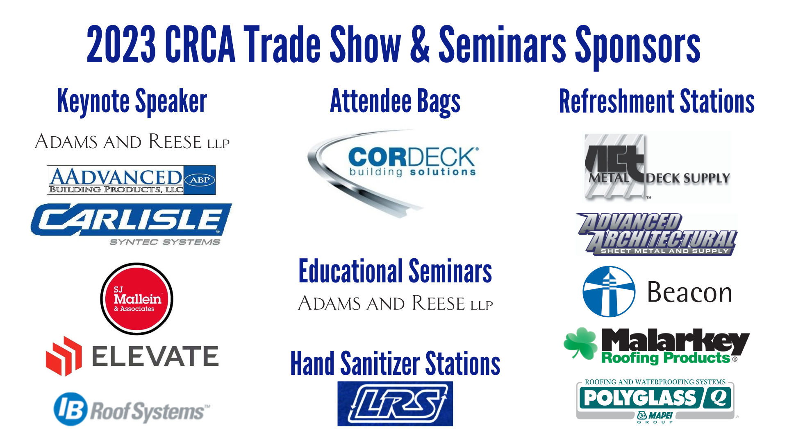

Slide 4
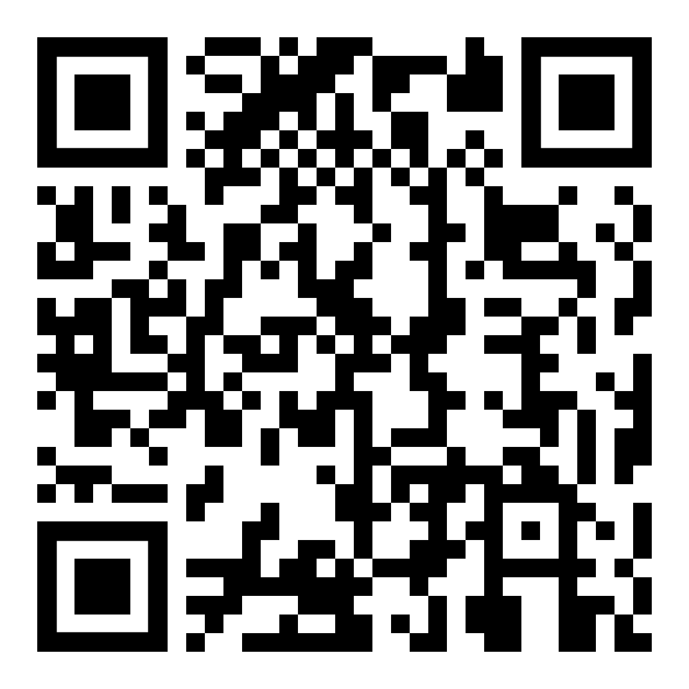
2023 CRCA Trade Show & Seminars
Scan QR Code for Program Guide & Speaker Bios
Notes:
QR Code for Program & Schedule

Slide 5
2023 CRCA Trade Show & Seminars AGENDA
Friday Seminars
  11:15 am - 12:15 pm – Roofing Technical Issues
  Mark Graham (NRCA)
Exhibit Hall Floor 9 am – 1 pm
Notes:
Friday Seminar Schedule

Slide 6

Mark Graham, NRCA

Slide 7

Illinois STRETCH Code
Commercial – 2024 IECC DRAFT
Residential – 2021 IECC Unamended – EXTRA
Confused yet???
Notes:
Emergency Exits, Emergency Procedure, See Program for Full Bios, Presentations available after the trade show

Slide 8
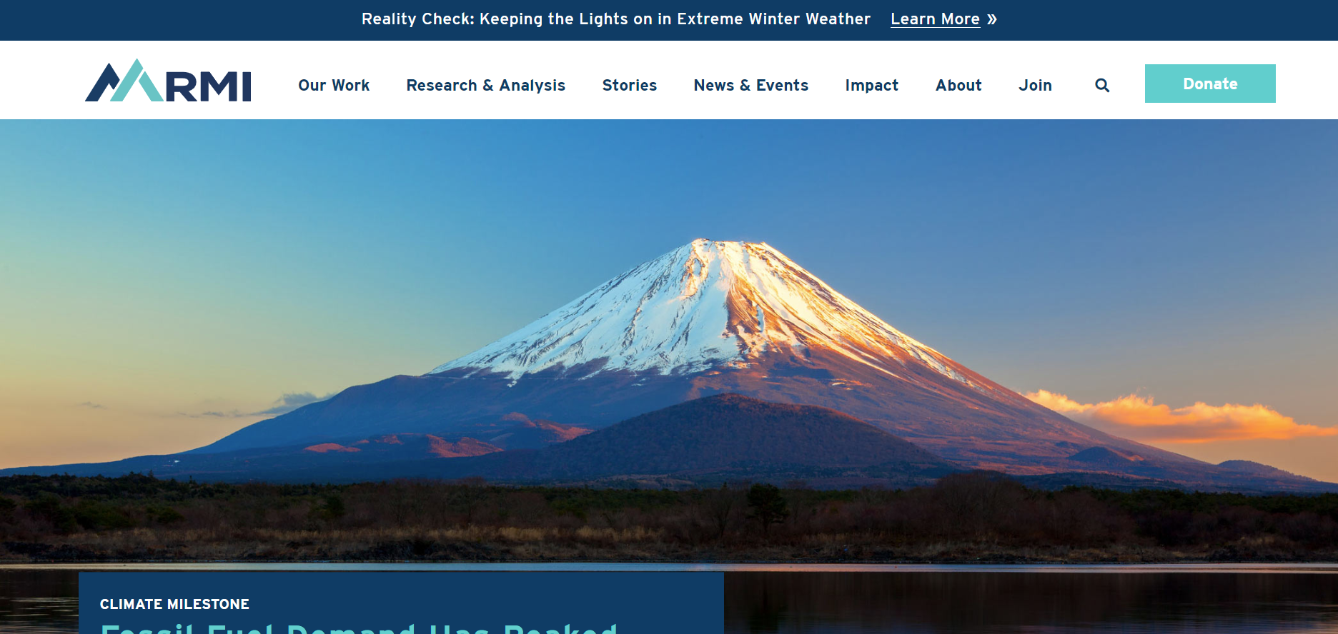
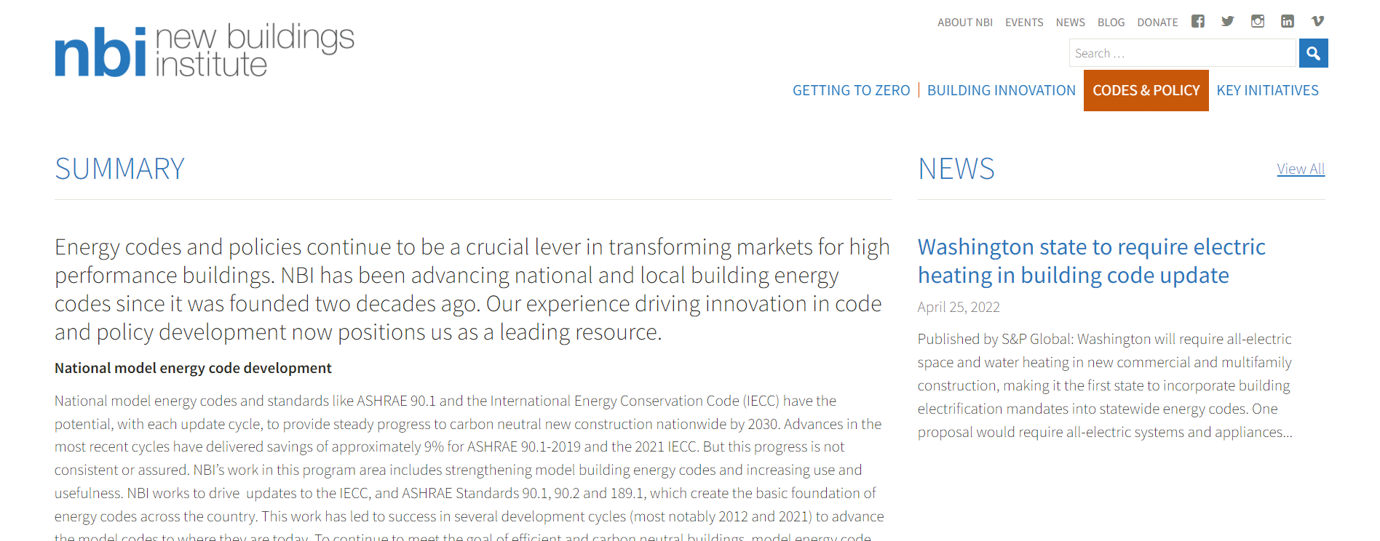
Illinois STRETCH Code
2021 & 2024 “Concepts”
Notes:
Emergency Exits, Emergency Procedure, See Program for Full Bios, Presentations available after the trade show

Slide 9
Illinois STRETCH Code
Commercial – 2024 IECC DRAFT
  Electrification
  De-Carbononization
  No exceptions – existing buildings
Notes:
Emergency Exits, Emergency Procedure, See Program for Full Bios, Presentations available after the trade show

Slide 10
Illinois STRETCH Code
Residential – 2021 IECC Unamended w/EXTRAS
  2x4’s to 2x8’s??
  Added Insulation @ Walls & Ceilings?
  Electrification
    EV Ready?
    ESS?
    ALL ELECTRIC APPLIANCES?
    Eventually, Heat Pumps @ replacement?
  Permit for new AC?
Notes:
Emergency Exits, Emergency Procedure, See Program for Full Bios, Presentations available after the trade show

Slide 11
Illinois STRETCH Code
Residential – 2021 IECC Unamended w/EXTRAS
  2x4’s to 2x8’s??
  Added Insulation @ Walls & Ceilings?
  Electrification
    EV Ready?
    ESS?
    ALL ELECTRIC APPLIANCES?
    Eventually, Heat Pumps @ replacement?
  Permit for new AC?
Notes:
Emergency Exits, Emergency Procedure, See Program for Full Bios, Presentations available after the trade show

Slide 12
Illinois STRETCH Code
How to comment: There are two ways to comment. There will also be opportunities to comment on a later draft of the stretch code in Spring 2023.
At the public comment meeting:
  For the commercial stretch code: 10:30 a.m. - 12:30 p.m. CT on January 18. Click here to join the WebEx meeting.
  For the residential stretch code: 9:00 - 11:00 a.m. CT on January 23. Click here to join the WebEx meeting.
In writing: Please complete the form linked below for the stretch code you wish to comment on. Both forms will close on February 3, 2023. If you wish to submit a proposal to be considered in either stretch code, complete the attached form and return it to CDB.BuildingCodes@illinois.gov no later than February 3, 2023.
  For the commercial stretch code, comment with this form
  For the residential stretch code, comment with this form
  From CDB
Notes:
Emergency Exits, Emergency Procedure, See Program for Full Bios, Presentations available after the trade show

Slide 13
Illinois STRETCH Code
What is being considered to include in the stretch codes? To review the draft concepts for both stretch codes, please see these resources.
For the commercial stretch code:
Concepts under consideration are summarized in this presentation for the commercial stretch code.
For further detail on the draft concepts, please see this spreadsheet of proposed commercial code provisions.
For the residential stretch code:
Concepts under consideration are summarized in this presentation for the residential stretch code.
For further detail on the draft concepts, please see this spreadsheet of proposed residential code provisions.
How can I receive future updates on energy code development? Email me, Lisa Hennigh, at lisa.hennigh@illinois.gov and ask to be added to the energy code update list. You may also check this webpage for updates.
From CDB
Notes:
Emergency Exits, Emergency Procedure, See Program for Full Bios, Presentations available after the trade show

Slide 14
Chicago ?
Chicago Energy Transformation Code
Chicago Building Code
Chicago Building Rehabilitation Code
  Technical Infeasibility
  Roof Membrane Peel & Replacement.
Notes:
Emergency Exits, Emergency Procedure, See Program for Full Bios, Presentations available after the trade show

Slide 15
Illinois 2021 IECC Adoption
Residential/Commercial
  2018 IL ECC – Until Further Notice
2021 IL Energy Conservation Code
  IL Energy Conservation Advisory Council
  6 months – recommendations
    Technical Infeasibility
    Roof Membrane Peel & Replacement
  IL ECAC Chair, CDB Employee, withdrew APPROVED ‘21 IL ECC @ JCAR, based on answers from PNNL
  IL ECAC Chair SUBMITTING UNAMENDED IECC ‘21 to CDB
  Rules to JCAR, then Gov.
Notes:
Emergency Exits, Emergency Procedure, See Program for Full Bios, Presentations available after the trade show

Slide 16
Chicago ?
Chicago Energy Transformation Code
Chicago Building Code
Chicago Building Rehabilitation Code
  Technical Infeasibility
  Roof Membrane Peel & Replacement.
Notes:
Emergency Exits, Emergency Procedure, See Program for Full Bios, Presentations available after the trade show

Slide 17
Chicago ?
Chicago Building Rehabilitation Code
  2. Roof replacement or roof recover of existing lows loped
  roofs shall comply with the roof insulation
  requirements for new construction unless the installation
  of additional insulation above the structural
  roof deck is infeasible due to the height of existing
  parapets, equipment curbs, skylight curbs, window
  sills, door thresholds, and similar elements with
  flashing into the roof system. In no case shall a roof
  replacement or roof recover reduce the insulating
  value of the roof.
Notes:
Emergency Exits, Emergency Procedure, See Program for Full Bios, Presentations available after the trade show

Slide 18
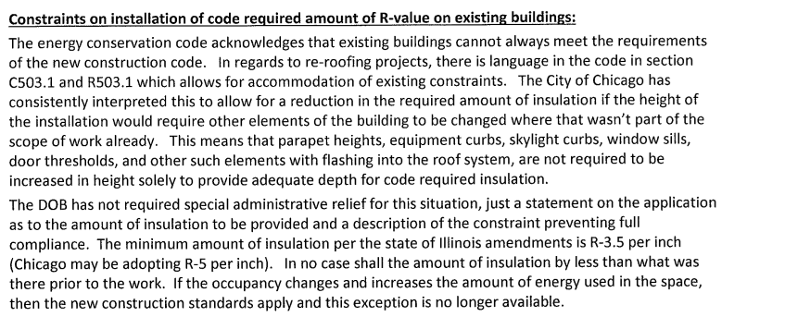
Chicago ?
  2016 Chicago Memorandum
Notes:
Emergency Exits, Emergency Procedure, See Program for Full Bios, Presentations available after the trade show

Slide 19




At Seminar Conclusion, exit through the Crystal Room’s rear doors onto Trade Show Floor
Attendance / CE Certificates will be sent via email to attendees’ email approximately January 27, 2023.
Notes:
Ce’s…onsite.

Slide 20


Slide 21


Low-slope technical update
Roofing Week in Chicago
January 18-20, 2023
Mark S. Graham
Vice President, Technical Services
National Roofing Contractors Association

Slide 22
Topics
Market condition update
Ignition temperature testing
Moisture in concrete roof decks
  Vapor retarder adhesion testing
Code development and adoptions
Contractor-reported problems
Questions… and other topics

Slide 23
Market condition update

Slide 24
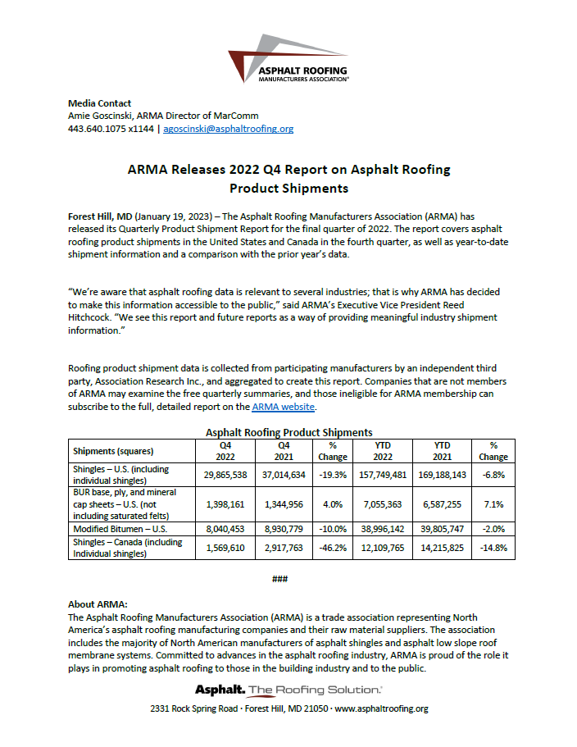
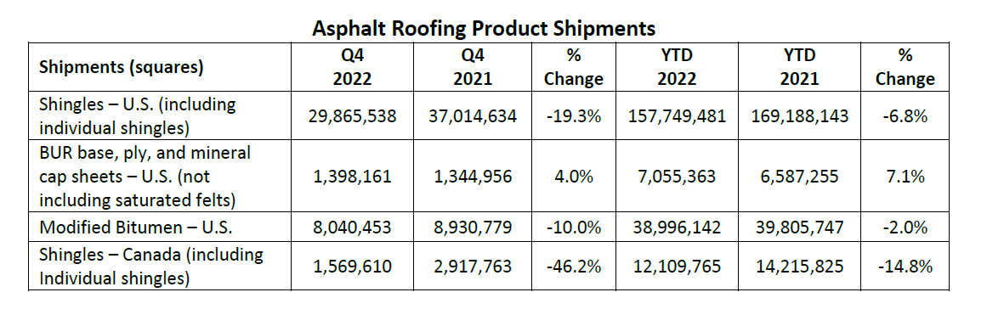

Slide 26
What to expect in 2023…

Slide 27
Ignition temperature testing

Slide 28


Published in 1953

Slide 29
Some known roof application temperatures
Mopping bitumen:
EVT: 375 F to 455 F (typ.)
Flash point: 525 F (min.)
Hot-air welding:
Equipment settings up to 600 C (1,112 F)
Torch application:
Blue flame: 3,596 F
Yellow/orange flame: 1,800 F

Slide 30
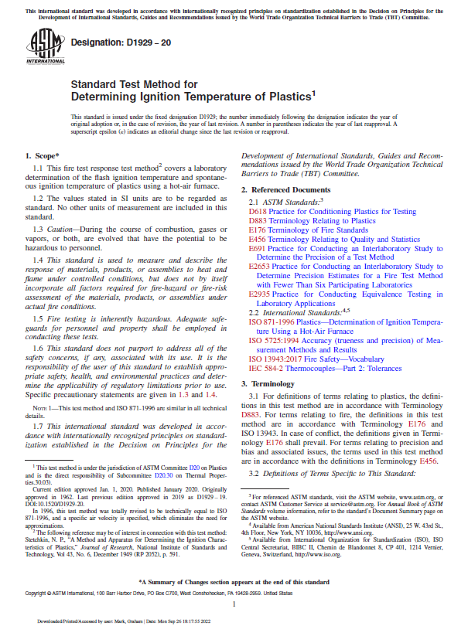
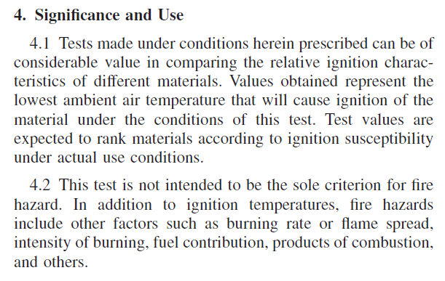
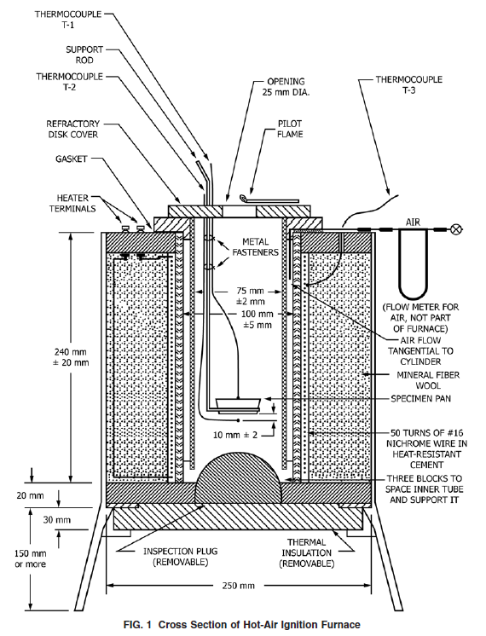
ASTM D1929, “Standard Test Method for Determining Ignition Temperature of Plastics”

Slide 31
ASTM D1929 results
Sample | Test result
Extruded polystyrene | 865 F
HD polyiso with glass facer | 865 F
Wood fiberboard | 875 F
Polyiso with coated glass facer | 895 F
Perlite board | 905 F
Expanded polystyrene | 910 F
Polyiso with cellulose/glass facer | 920 F
Cellular glass with facer | 965 F
Mineral fiber board | 1,040 F
Gypsum-fiber board | Greater than 1,740 F
Gypsum board with coated fiberglass facer | Greater than 1,740 F
Cellular glass (no facer) | Greater than 1,740 F

Slide 32
Recommendations
When hot-air welding or torching roofing products, realize the relative differences in ignition temperatures of various insulation substrates
Share this information/concept with field workers

Slide 33
Moisture-related issues with concrete roof decks

Slide 34
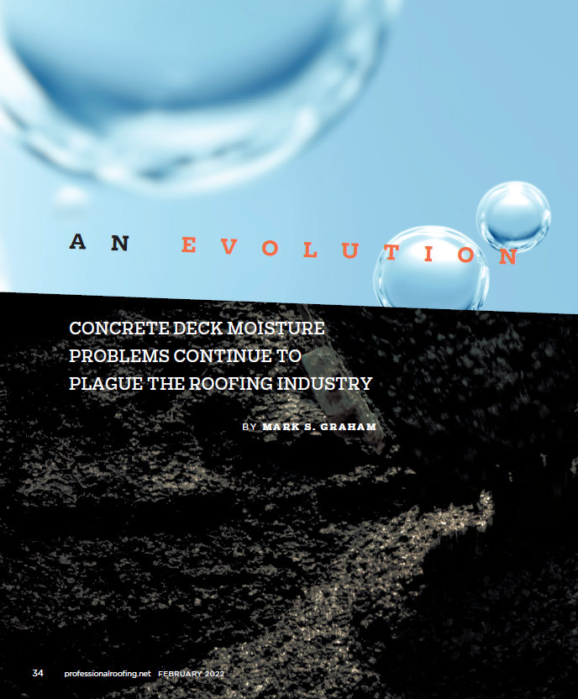
Professional Roofing
February 2022
Link

Slide 35
NRCA recommends designers specify an adhered vapor retarder…
but isn’t adhesion of the vapor retarder a concern?

Slide 36
Vapor retarder adhesion testing
Moisture-related issues with concrete roof decks

Slide 37
What we tested
Vapor retarder adhesion testing
2-ply asphalt BUR membrane
Manufacturer A-SA vapor retarder
Manufacturer B-SA vapor retarder
Manufacturer C-SA vapor retarder
Manufacturer D-SA vapor retarder

Slide 38
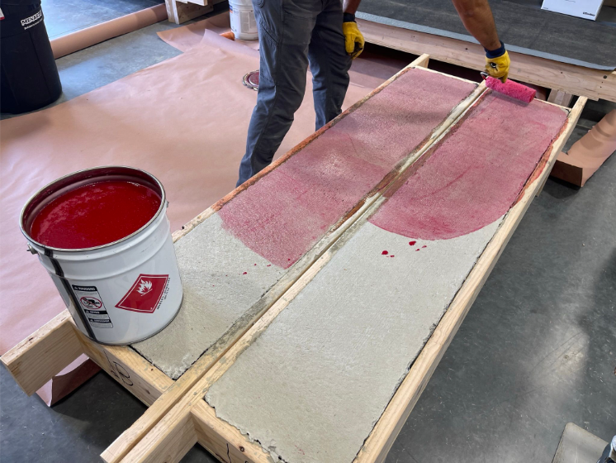
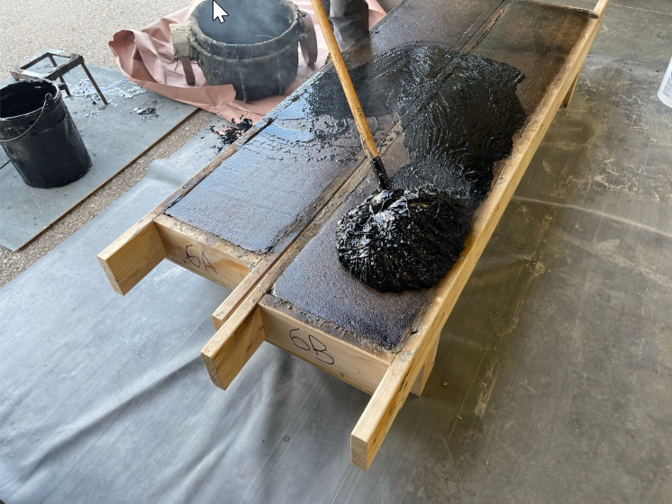
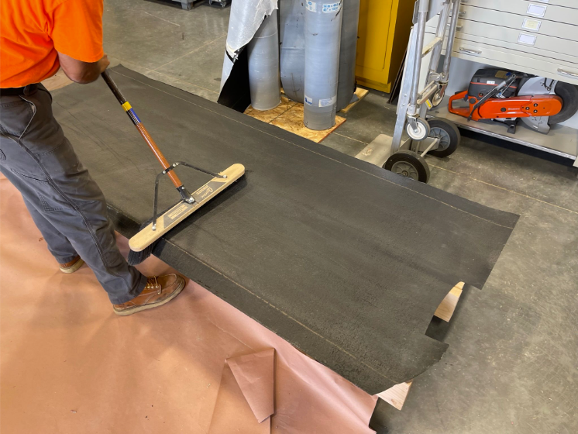
28-day cure

Slide 39
Sample conditioning
After vapor retarder application
Conditioned for 60-days
One set of each at standard laboratory conditions
Other set of each at a 30 F temperature differential
  The temperature differential creates an upward vapor pressure drive

Slide 40
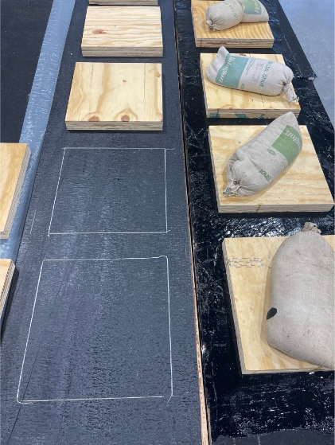
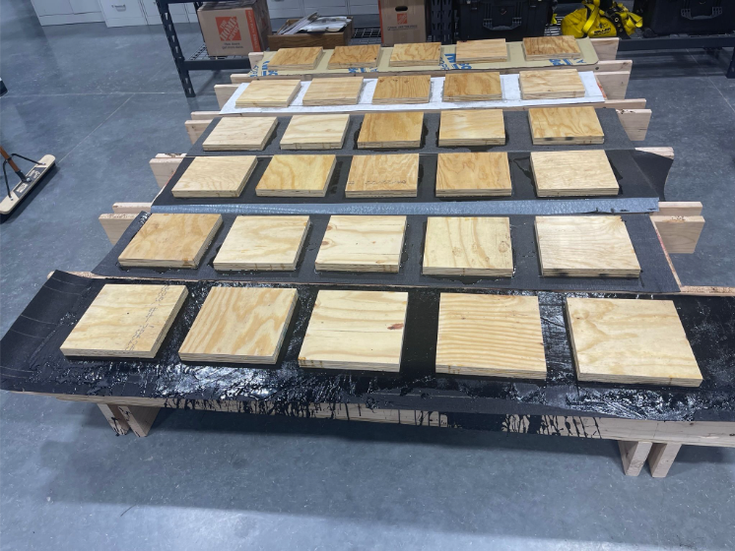
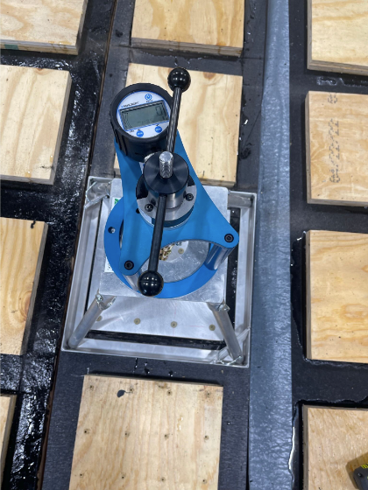

Slide 41
Test results
Vapor retarder adhesion
Sample | Tested pull resistance |  | Difference
 | Lab. conditions 60-day conditioning (Average of 5 specimens) | Vapor drive 60-day conditioning (Average of 5 specimens) | Differential | Percent differential
2-ply built-up membrane | 1,421 psf | 833 psf | -588 psf | -41%
Manufacturer 1-SA VR | 768 psf | 645 psf | -123 psf | -16%
Manufacturer 2-SA VR | 331 psf | 318 psf | -13 psf | -4%
Manufacturer 3-SA VR | 1,139 psf | 1,311 psf | +172 psf | +15%
Manufacturer 4-SA VR | 1,415 psf | 707 psf | -708 psf | -50%

Slide 42
Conclusions
Vapor retarder adhesion
Results vary
For 4 of 5 samples, vapor drive conditioning resulted in lower values, but Manufacture 3-SA VR is higher
All results greater than 90 psf (i.e., FM 1-90)

Slide 43
“Preliminary” recommendations
Vapor retarder adhesion
Designers should specify vapor retarders after considering vapor retarder adhesion both at the time of application and in-service.
Manufacturers should incorporate some form of vapor drive conditioning assessment in their product development and assessment and make that information available to specifiers.
The vapor drive conditioning used in this testing is one possible assessment method.

Slide 44
Code development and adoptions
2021 I-codes published
  Adoptions beginning
Development of 2024 I-codes complete, except 2024 IECC
  Q3 2023 publication planned, except 2024 IECC
New Chicago Energy Code
Development of updated IL energy code and “stretch code”

Slide 45
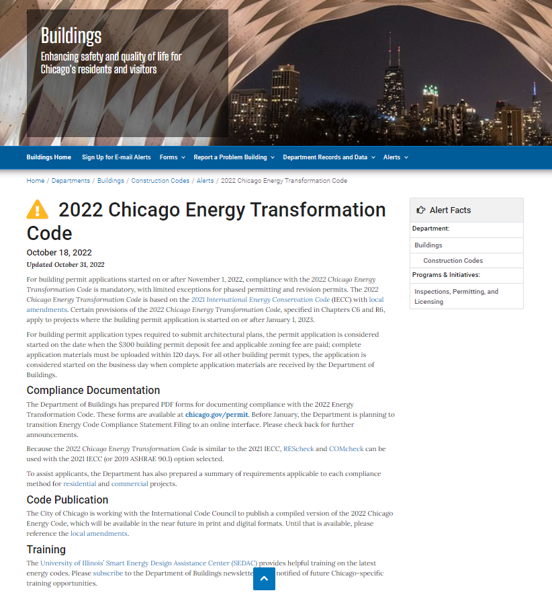
Link

Slide 46
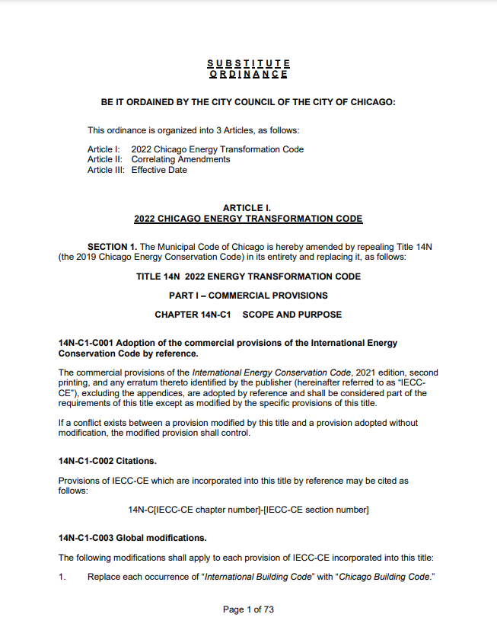
Link

Slide 47
State of Illinois-new Energy Code development
Triggered by the publication of the current edition of IECC
  IECC 2021 was published in January 2021 (Jan. 29, 2021 first printing)
CDB established an Energy Code Advisory Council, which sought public input and developed draft Commercial and Residential provisions
Provision approved by CDB Board on June 14, 2022; filed with the Secretary of State on June 29, 2022.
First notice to the Joint Committee on Admirative Rules on July 15, 2022 (Link). 45-day review period

Slide 48
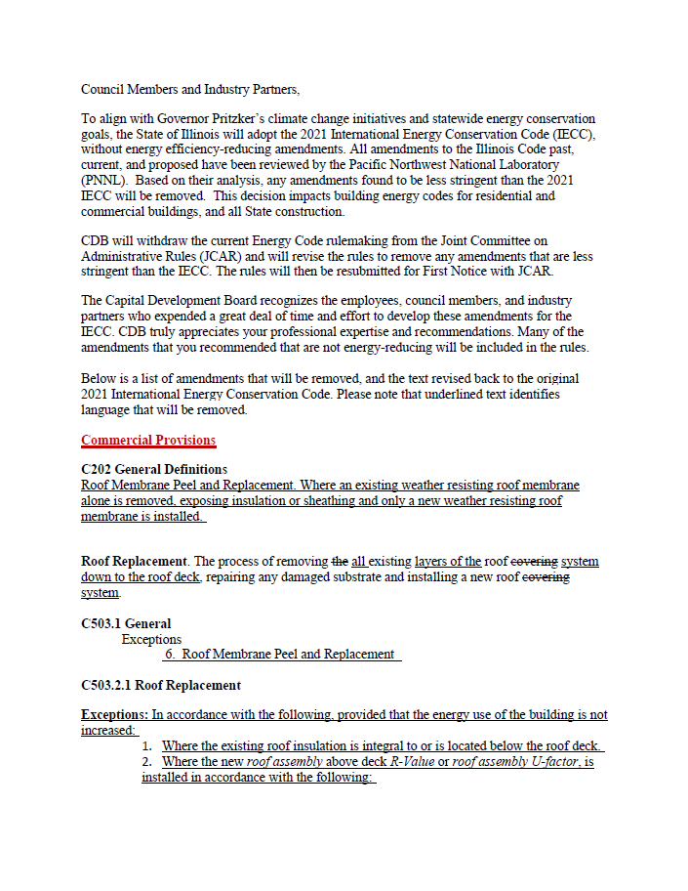
Email attachment forwarded by CDB’s Public Information Officer on December 5, 2022

Slide 49
Next steps…
CDB making revisions
CDB Board meeting in February
Conclusions…
The process has been “…a bit irregular…”
Expect Illinois’ new Energy Code to be finalized and adopted statewide (except Chicago) in 2023

Slide 50
Development of Illinois’ stretch energy code
Stretch/reach code concept

Slide 51
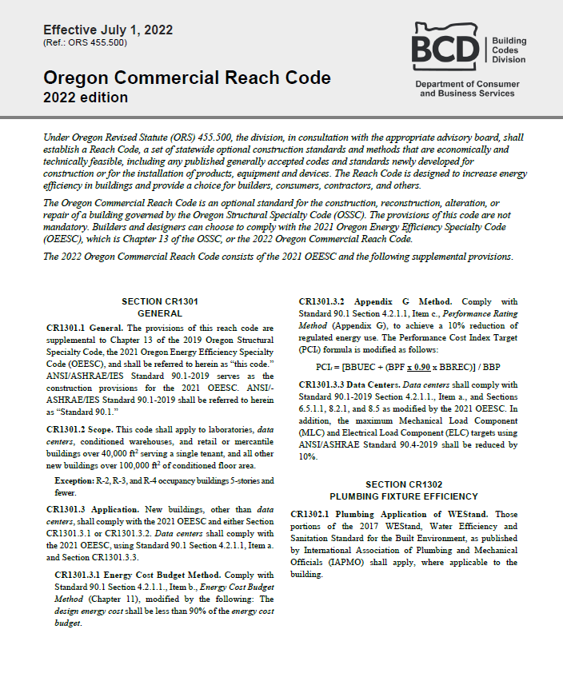
Oregon Commercial Reach Code, 2022 Edition
Link

Slide 52
Development of Illinois’ stretch energy code
Stretch/reach code concept
Illinois’ Climate and Equitable Jobs Act (CEJA) (Link):
  CDB to develop a stretch code using the Energy Code Advisory Council, add voting members to the Advisory Council and be complete by July 31, 2023
CDB has acknowledged they are not technically knowledgeable and have accepted an offer for “free” technical assistance in stretch code development
An initial draft is currently being developed

Slide 53
Development of Illinois’ stretch energy code—cont.
Initial public comments:
  Commercial: January 18 (two days ago)
  Residential: January 23 (next Monday)
  Written public comments by Feb. 3
A first draft should be available in February
Process beyond that is still somewhat unclear
After the July 31 “due date”, the legislative approval process still needs to take place

Slide 54
CRCA and NRCA are advocating for the Illinois roofing industry…

Slide 55
Contractors’ recently-reported problems

Slide 56
Questions… and other topics

Slide 57
Mark S. Graham
Vice President, Technical Services
National Roofing Contractors Association
10255 West Higgins Road, 600
Rosemont, Illinois 60018-5607
(847) 299-9070 mgraham@nrca.net www.nrca.net
Personal website: www.MarkGrahamNRCA.com

