Slide 1
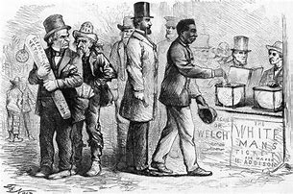
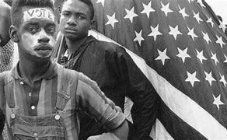
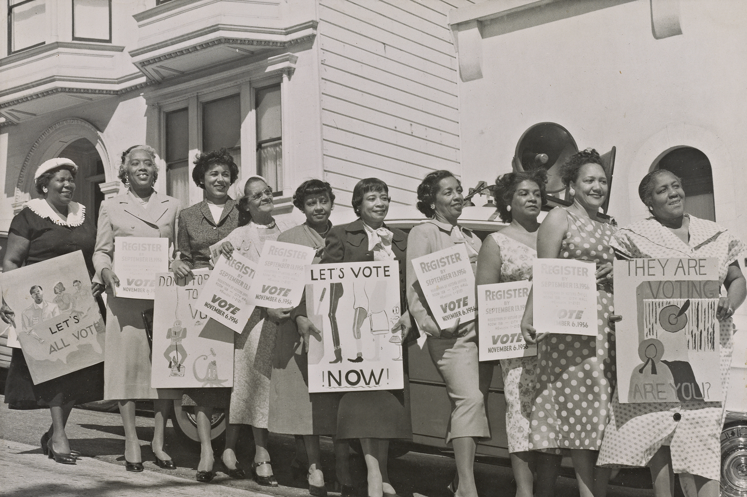
Voting 101

Slide 2
2024 General Election:
Important Dates to Remember
Voter Registration Deadline: October 11, 2024
Early Voting: October 17, 2024 – November 2, 2024
Election Day: November 5, 2024

Slide 3

STEP 1:
Voter Registration
Check Registration Status:
  https://vt.ncsbe.gov/RegLkup/
How to Register
  On-site registration is available TONIGHT!
  Mail
  Online
Locked Up? Not Locked Out.
  If you have a misdemeanor conviction or are awaiting trial on a felony charge, you DO NOT lose your right to vote.
  Upon conviction of a felony, voting rights are restored upon competition of your sentence (incl. probation, post-release supervision, and parole).
Deadline: October 11, 2024
  NOTE: you can register in-person during Early Voting Cycle (Oct. 17 through Nov. 2)
  If you are using an out-of-state license as your form of ID, you must be registered to vote in North Carolina 90 days before the election = August 7, 2024

Slide 4
STEP 2:
Voter ID
NC driver’s license or other “acceptable photo ID” required to vote.
  Other Acceptable ID’s –
    Non-Driver’s ID from NCDMV
    Out-of-State driver’s license or Non-Driver ID
    US passport/passport card
    Military/veteran ID card
    Public assistance program ID card
    College/University student ID
    State/local government/charter school employee ID
    Tribal Enrollment Card
      NOTE: there are very specific requirements for ALL forms of ID.
    NC Voter Photo ID
      FREE the Forsyth County Board of Elections located at 201 N. Chestnut St., W-S, NC 27101; 336-703-2800
  Please SEE https://www.ncvoter.org/voter-id/ for additional information

Slide 5
STEP 3:
WHO & WHAT
- Your Ballot -
Obtain a Sample Ballot – https://www.ncsbe.gov/voting.sample-ballot
Local
  Local Judges
  District Attorneys
  Board of Education
State
  Governor
  Lt. Governor
  Attorney General
  Secretary of State
  State Treasurer
  Superintendent of Public Instruction
  Commissioners of: Agriculture, Insurance, and Labor
  State Judges and Justices
    NC Court of Appeals & NC Supreme Court
  State Legislature – NC House & NC Senate
Federal
  President
  U.S. Congress – House of Representatives

Slide 6
STEP 4:
Where to Vote?
REMEMBER
  Early Voting: Thursday, October 17 – Saturday, November 2
  Election Day: Tuesday, November 5th
Find Your Polling Place
  Early Voting – https://vt.ncsbe.gov/EVSite/
  Election Day – https://vt.ncsbe.gov/PPLkup
Vote By Mail: “Absentee” Voting
  https://ncvoter.org/absentee
Preservation of Historically Black Polling Sites

Slide 7
TAKEAWAY’S
Reflect On Your “Why”
Prepare Yourself & Others
Educate Yourself & Others – “EACH one, REACH one”
Vote, VOTE, VOTE!!!
Online Resources
  NC State Board of Elections – https://www.ncsbe.gov
  Forsyth County Board of Elections – https://www.co.forsyth.nc.us/elections/
  Democracy NC – https://democracync.org

