Slide 1
New IHSS Overtime Rules

Slide 2
Why Are There New Rules
New state law – IHSS providers must receive overtime and travel time between recipients
  Providers must read, sign, and submit the new SOC 846 form by April 15, 2016
  Providers who are eligible for travel time must complete the SOC 2255 and return before Travel Claim Forms are issued
Takes effect February 1, 2016
Dedicated phone line for assistance
(209) 468-1600

Slide 3
What Stays the Same
Does not affect the hours you receive as a recipient
Pay periods are still the same
Benefits are still available
*Providers and recipients will get a notice telling you how many hours he/she gets each month and each week.

Slide 4
What is Different
More than 40 hours worked in a week is overtime (Sun-Sat)
If you have only 1 recipient; the max number of hours you can work is 70 hours and 45 min per week. Recipient needs to be approved for 283 hours.
If you work for multiple recipients, the max number of hours is 66 hours per week

Slide 5
What is Different
Time spent traveling between recipients during the same day will be paid
  7 hour weekly cap
  You will get travel time when using public transportation or personal vehicle to travel between recipients
  Must submit SOC 2255/ Travel Claim Form

Slide 6
How Does it Work
Workweeks begin 12:00am (Midnight) on Sunday and end on 11:59pm the following Saturday
Overtime is paid at 1 ½ times the regular wage
  Ex: 43 hours worked in week 1
    40 hours are paid at $10.50 per hour
    3 hours are paid at $15.75 per hour

Slide 7
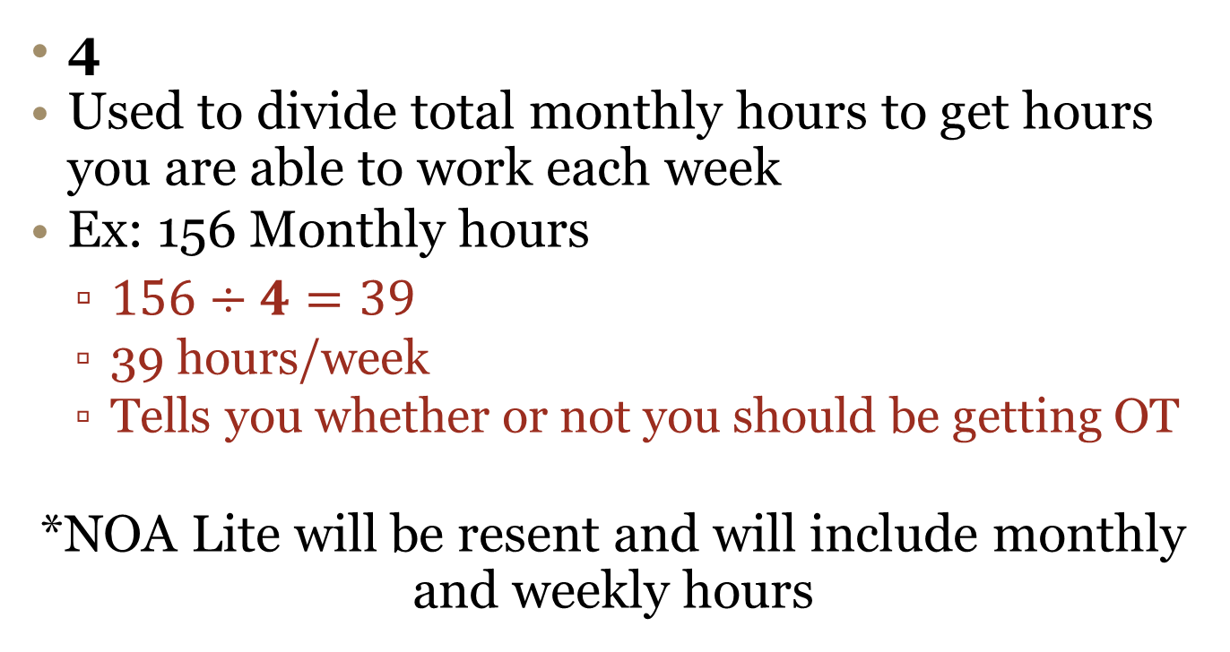
The Golden Number
4
Used to divide total monthly hours to get hours you are able to work each week
Ex: 156 Monthly hours
  $156÷4=39$
  39 hours/week
  Tells you whether or not you should be getting OT
*NOA Lite will be resent and will include monthly and weekly hours

Slide 8
Review
What is staying the same?
When does the workweek begin and end?
If a provider has multiple recipients what is the maximum number of hours they can work in a workweek?
How do I calculate what my weekly hours are?

Slide 9
Limitations
If a provider’s weekly hours do not normally exceed 40, then overtime has to be approved by the IHSS SW
Provider must inform recipient how many hours he/she is able to work

Slide 10
Limitations
Prior approval is needed if:
  Total monthly hours is 160 (40 per week). Your Client wants you to work 50 hours one week and 30 hours the next.
    This scenario creates 10 hours of overtime that would not normally be allowed and, therefore, needs authorization.

Slide 11
What Will Happen
Recipients whose providers have multiple clients and work more than 66 hours/week will need to hire additional providers
  The provider is required to tell the recipient how many hours he/she is working each week
The provider will be terminated if repeatedly violates new regulations
  May 1, 2016
It is important to have your workweeks planned out in order to avoid getting a violation

Slide 12
Review
180 monthly hours for one recipient = 45 weekly hours
  60 hours for workweek 1
  30 hours for workweek 2
  Does this need approval from my SW?
264 monthly hours between my two recipients = 66 weekly hours
  70 hours for workweek 1
  63 hours for workweek 2
  Does this need approval from my SW?
130 monthly hours for one recipient – 32 hours and 30 minutes weekly
  40 hours for workweek 1
  25 hours for workweek 2
  Does this need approval from my SW?

Slide 13
Violations
Beginning May 1, 2016, every time you do any of the following you will get a violation:
  Work more than 40 hours in a workweek when you normally do not;
  Work more than 66 hours in a workweek;
  Claim more than 7 hours of travel time.

Slide 14
Violations
If you violate the workweek schedule, you will receive the following:
  1st Violation = Your recipient(s) and you will receive a written notice with appeal information.
  2nd Violation = Your recipient(s) and you will receive a second written warning notice, and you will have a choice to complete a one-time training about workweek and travel time limits. If you choose to complete the training, you will avoid the 2nd violation.
  If you choose not to complete the training within 14 calendar days of the date of notice, you will receive a 2nd violation.

Slide 15
Violations
  3rd Violation = Your recipient(s) and you will receive a third violation with appeal information. You will be suspended as an IHSS provider for 3 months.
  4th Violation = Your recipient(s) and you will receive a 4th violation notice with appeal information.
  You will be terminated for a period of one (1) year.
  Your violations will be reduced by one every year you are violation free
  After one year, if you wish to return as an IHSS provider, you must complete all of the provider enrollment requirements again, including the criminal background check, the provider orientation, and completion of all required forms.

Slide 16
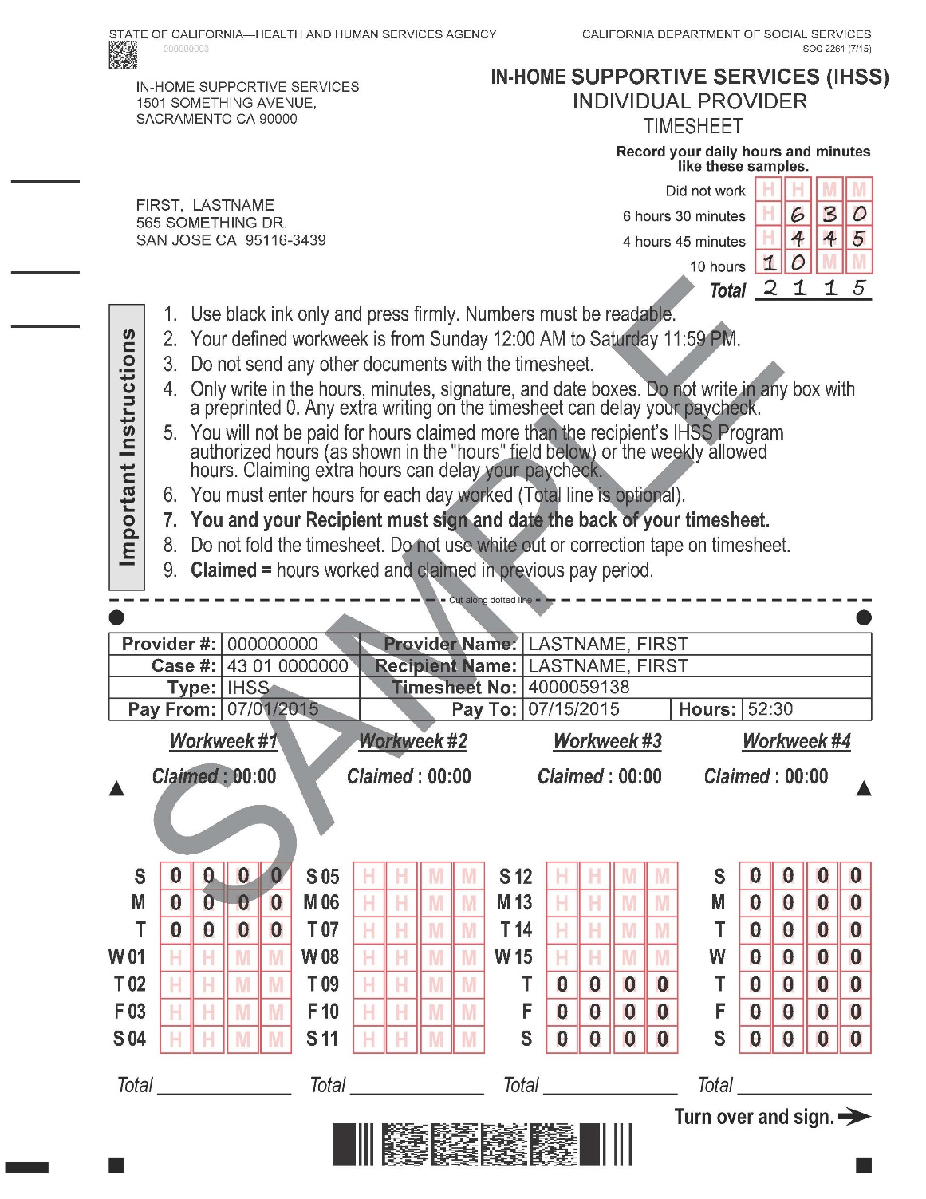
Sample Timesheet
Work week begins Sunday
Shows hours claimed in the previous pay period

Slide 17
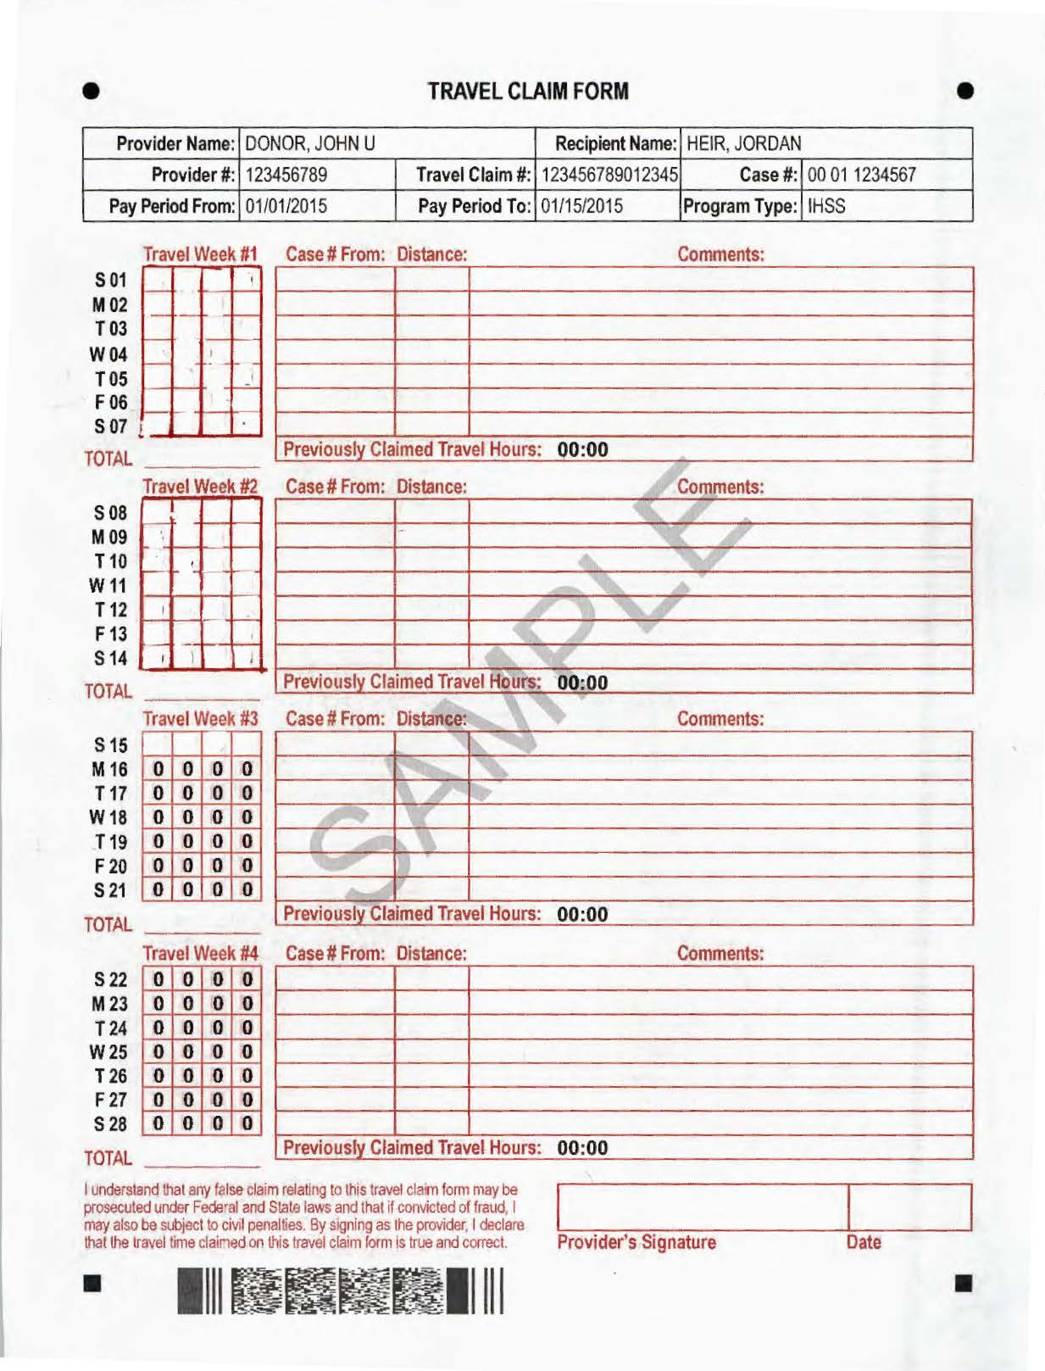
Travel Claim Form
SOC 2255 must be completed and submitted first.
Time travelled from one recipient to another on the same day must be claimed on the Travel Claim Form for the recipient you travelled to.
In special situations where you travelled to the same recipient twice in the same day, enter the total amount of time travelled for that day. A comment is required in this situation.
Travel Hours claimed cannot exceed the 7-hour weekly travel cap.
Use black ink only and press firmly. Numbers must be readable.

Slide 18
Travel Claim Form
In the “Case # From” column, please write the recipient’s case number you travelled from.
In the “Distance” column, write the distance you travelled from one recipient to another recipient on the same day.
Comments are required to explain the following:
If a special circumstance occurred to cause the travel time to be longer than expected than what you wrote on your SOC 2255, Provider Workweek and Travel Time agreement.
The provider must sign and date the back of Travel Claim Form.

Slide 19
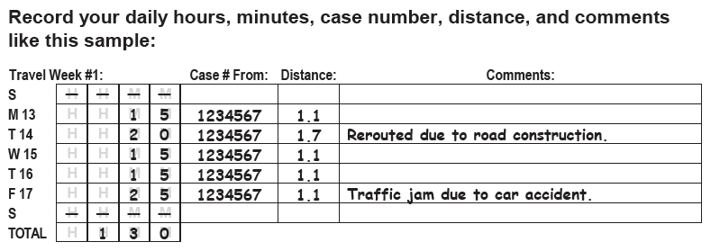
Travel Claim Form Example
Important Things to Remember:
The total number of hours and the distance claimed on the Travel Claim Form will be compared to the Work Week Agreement
Changes to your schedule may require a new Work Week Agreement
Total line is optional

Slide 20
Review
When can you claim travel time? Which recipient do you claim travel time for?
If I claim 8 hours of travel time in workweek one but only claim 6 hours of travel time in workweek two will this cause me to receive a violation?
If I receive two written notices in the same month stating that I worked over my weekly hours cap, how many violations will I have against me?

Slide 21
Exemption for Family Live-in Care Providers
IHSS providers who meet the following requirements may provide services to two or more live-in family member recipients and work up to 12 hours per day, not to exceed 360 hours per month or 90 hours in a workweek.
  On or before January 31, 2016, IHSS provider must be enrolled as a care provider and living with two or more recipients; and
  Must be a parent, grandparent, adoptive parent, step-parent or legal guardian, who is care for two or more disabled minor or adult children, or disabled minor or adult grandchildren
  CDSS is sending more information

