Slide 1
EMT Refresher
Module 1
Airway/Neuro Management
Airway/Neurological Management/EMS Research/Evidence Based Medicine

Slide 2
Module I-Section I-Ventilation & Oxygenation
Objectives
  Discuss and Describe the ventilatory process
  Identify adequate vs. inadequate breathing
    Tidal volume
    Minute volume
    Vital capacity
    Hypoxia
    Hypoxic Drive
    Dyspnea
  Describe ventilatory assist and measurement of adequacy-ETCO2
    When to oxygenate and when to ventilate
  Discuss cellular metabolism thru oxygenation
  Discuss Internal vs. External respiration
    Difference between respiratory arrest and failure
  Discuss use of CPAP* (optional per agency medical direction)

Slide 3
Anatomy Upper Airway
Nasopharynx
Oropharynx
Larynx
Thyroid cartilage
Cricoid cartilage
Glottis
Vocal cords
Notes:
Review the anatomy of the upper airway, discussing the function of each part and the significance and role in management of a patent airway.

Slide 4
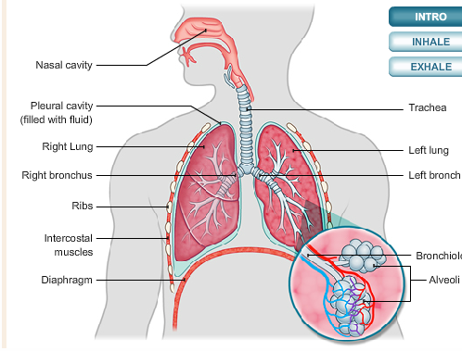
Anatomy Lower Airway
Trachea
Carina
Bronchi
Bronchioles
Alveoli
Mediastinum
Notes:
Discuss each part of the lower airway anatomy and the role in management of the respiratory system.

Slide 5
Ventilatory Process
Inhalation
  Active, muscular part of breathing. The diaphragm and intercostal muscles contract. The thoracic cavity enlarges. Lungs have no muscles and cannot move on their own. Accessory muscles are the secondary muscles of respiration.
Exhalation
  Passive process, relaxation, thorax decreases in size. Air pressure in chest cavity becomes higher than the outside pressure
Notes:
Discuss ventilation, oxygenation and respiration, the differences and processes.

Slide 6
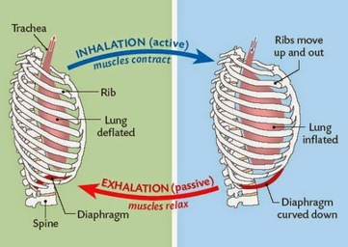
Ventilatory Process (cont.)
Tidal volume
Minute volume
Vital capacity
Hypoxia
Hypoxic Drive
Dyspnea
Notes:
Discuss and define each term

Slide 7
Oxygenation
Chemical process through cellular metabolism combining sugar and oxygen producing energy and exchanging waste products through respiration.
External Respiration
Surfactant-reduces surface tension
Internal Respiration
Exchange of oxygen and carbon dioxide between the systemic circulatory system and the cells
Aerobic metabolism-cells convert glucose into energy in the presence of oxygen
Anaerobic metabolism-lack of oxygen, fails to convert enough glucose, produces lactic acid and other toxins that accumulate in cells

Slide 8
Factors Affecting Respiration
Internal
External
Infections, pneumonia
Allergic reactions
COPD
Pulmonary edema, drowning victims
High altitudes
Carbon monoxide, toxic gases
Closed environments, mines, trenches

Slide 9
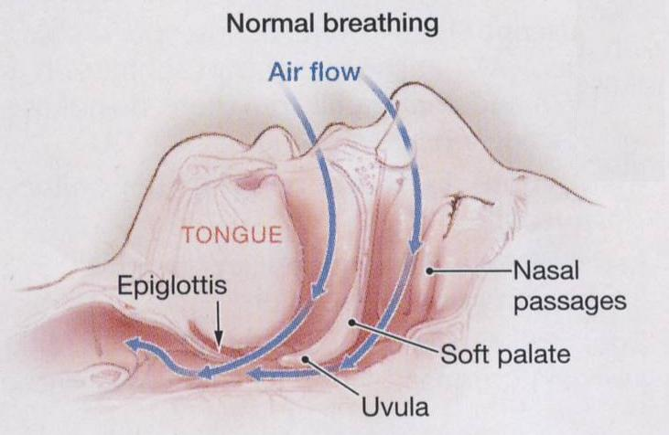
Adequate vs. Inadequate Breathing
Adequate
  Normal Rate (Between 12 & 20 breaths/min
  Regular Pattern
  Clear & Equal lung sounds
  Regular, equal chest expansion
  Adequate depth (tidal volume)

Slide 10
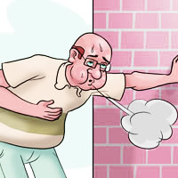
Adequate vs. Inadequate Breathing
Inadequate
  Labored
  Accessory muscle use (retractions)
  Agonal gasps
  Apnea
  Ataxic respirations

Slide 11
Assessment of Respiration
Level of Consciousness
Skin Color
Pulse oximetry (indications/Contraindications)
End title C02 (35-45mmHg)
Capnometry vs. Capnography
Notes:
Explain the difference between capnometry and capnography
Define end title and demonstrate it’s use
Define pulse oximetry and the “false positives”, indications/contraindications

Slide 12
Respiratory Distress vs. Respiratory Failure
Respiratory Distress
  Retractions
  Two word sentences
  Pursed lips
  Cyanosis
Respiratory Failure
  Decreased consciousness
  Poor chest rise
  Pale, cool, mottled
  Minimal air movement
Notes:
Explain how to recognize distress vs. failure

Slide 13
Assisted Ventilations/CPAP
BVM
  Most common method to assist ventilations
  Can deliver up to 100% oxygen
  Most effective two person technique
CPAP
  Indications:
    Pt must be alert
    Displaying signs of distress
    Resp Rate greater than 26
    Pulse ox reading less than 90%
  Contraindications:
    Pt is resp arrest
    S/S of pneumothorax or chest trauma
    Pt with tracheostomy
    Active GI bleed or vomiting
    Altered mental status
Notes:
Demonstrate BVM use
Demonstrate CPAP, review protocol

Slide 14
Summary
Oxygen is good, blue is bad
Oxygenation is vital but without ventilatory effort nothing is perfused
Ventilation is the act of breathing
Know how to use the CPAP, follow your agency guidelines, practice its use, indications, contraindications.

Slide 15
Module I-Section II-Neurological Management
Objectives
  Define altered mental status
  Define diverse types of seizures: generalized, partial, status epilepticus
  List possible causes of seizures
  Explain the importance to recognize seizure activity and identify other problems associated with seizures
  Describe the postictal state and the patient care interventions
  Identify the s/s of a pt. with a traumatic brain injury
  Discuss the current research and practices for the use of selective spinal immobilization
  Discuss differences between ischemic vs. hemorrhagic stroke and TIA
  Discuss s/s of stroke and some mimics
  Discuss causes of stroke
  Discuss identifying, assessing and treatment of the stroke patient
  Discuss importance of knowing the timeline of stroke events
  Discuss transport to appropriate stroke facilities

Slide 16
A & P of the Brain
Brain is the body’s computer
  Controls breathing, speech and all other body functions
  All thoughts, memories, needs and desires take up residence in the brain
Divided in three major parts:
  Brainstem
    Basic functions, breathing, BP, swallowing, pupil constriction
  Cerebellum
    Muscle and body coordination
  Cerebrum (largest part, right and left hemisphere-speech)
    Back part-sight
    Front part-emotion and thought
    Middle part-sensation and movement

Slide 17
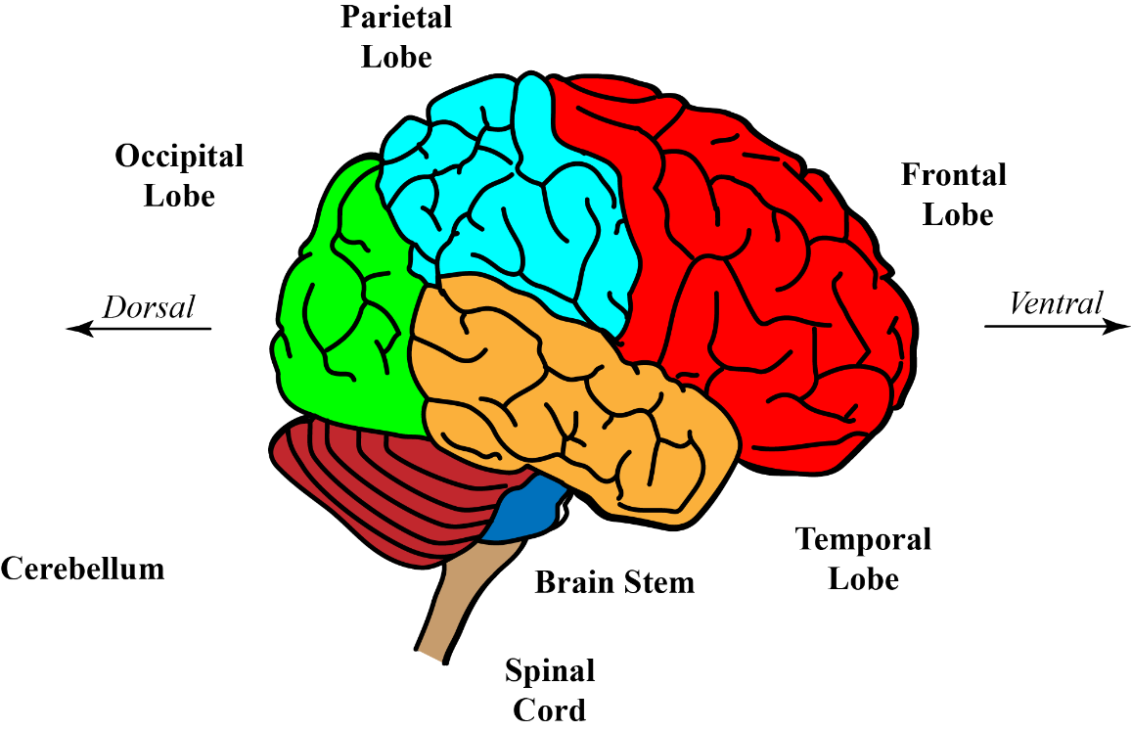
Pathophysiology
Altered consciousness can be affected by changes in oxygen, glucose and temperature levels.
Any one of these can cause a neurologic change in mental status.

Slide 18

Causes of Altered Mental Status
A-alcohol
E-epilepsy
I-infection
O-overdose
U-uremia
T-trauma
I-insulin
P-psychosis
S-stroke
Notes:
Discuss each cause of altered mental status and what s/s you may expect to see with each and how they differ.

Slide 19
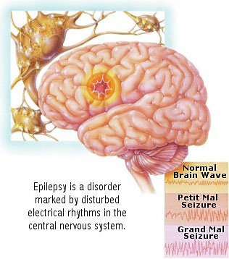
Types of Seizures
Generalized (tonic-clonic)
  May be associated with body movement and usually with a brief period of unconsciousness
Partial
  Simple or complex, single part of anatomy twitching, aura, lip smacking, usually no loss of consciousness
Status Epilepticus
  Generalized full tonic-clonic seizure, unconsciousness, lasting longer than 5 minutes without the person regaining consciousness and having more than one episode, and may last as long as 30 minutes
Febrile
  Fever goes very high very fast, usually in children

Slide 20
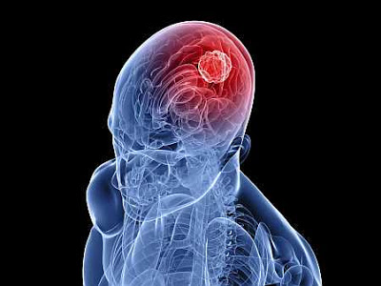
Causes of Seizures
Congenital
High Fever
  Meningitis
Structural problems of the brain
  Tumors
Metabolic or chemical problems of body
  Hypoglycemia
  Poisons
  Overdoses
Idiopathic

Slide 21
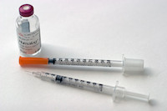
Recognizing seizure activity and identify other problems associated with seizures
Excessive oxygen consumption
Decrease in Blood sugar use in diabetics
Trauma from the fall
Loss of bowel and bladder control

Slide 22
Postictal state
Muscles relax become flaccid
Breathing labored (fast and deep) trying to compensate for acid build up
Lethargy and confusion
Combativeness
*The longer the seizure the longer the postictal state.
*In some situations the postictal state may be characterized by hemiparesis or weakness on one side of the body mimicking a stroke.

Slide 23
Patient Care Interventions
Place in recovery position
Maintain patent airway
Apply oxygen
Provide suctioning
Check glucose
Maintain patient’s modesty
Provide reassurance
Assess for trauma
*Some patient’s may not wish to be transported after a seizure.

Slide 24
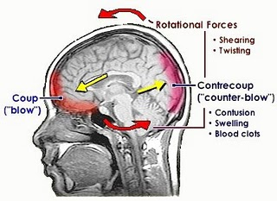
Traumatic Brain Injury
Primary Injury (Direct)
  Brain and associated structures
Secondary (indirect)
  Caused by
    Cerebral edema
    Intracranial hemorrhage
    Cerebral ischemia
    Infection
    *Two most common causes Hypotension and Hypoxia

Slide 25
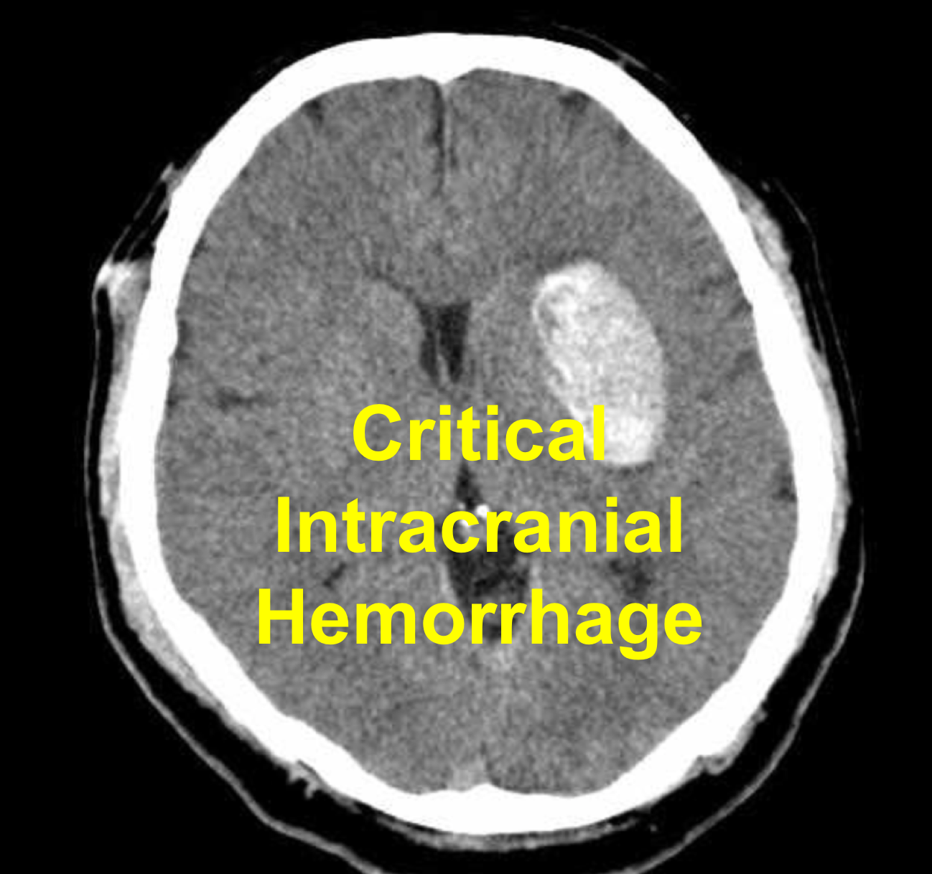
Signs Increased Intracranial Pressure
Cushing’s reflex
  Increased systolic blood pressure
  Decreased pulse rate
  Irregular respirations
Notes:
Discuss traumatic brain injury

Slide 26
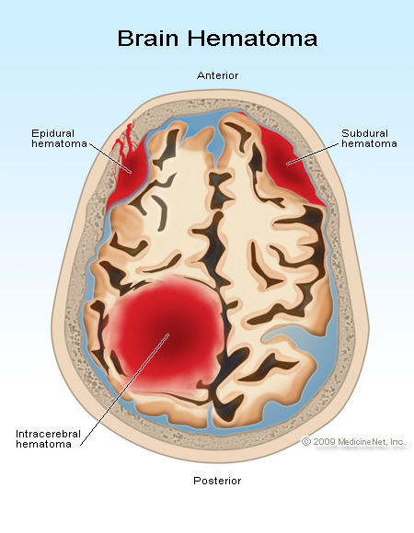
Forms of Traumatic Brain Injury
Epidural Hematoma
  Between skull and dura mater
  Temporal bone
  Middle meningeal artery
  Immediate LOC, lucid period
Subdural Hematoma
  Beneath dura but outside the brain
  Slow venous bleed
  Fluctuating LOC or slurred speech
  Hours, days or weeks
Intracerebral
  Within the brain-penetrating-rapid decelerating forces
  Frontal or temporal most common
  Once symptoms appear patient deteriorates quickly
Subarachnoid
  Subarachnoid space where CSF circulates
  Neck rigidity, headache

Slide 27
Forms of Traumatic Brain Injury
“Blow to the Head” with or without symptoms
LOC
Confusion
Brief loss of memory(retrograde right before, antegrade right after)
Dizziness, weakness, visual changes
Nausea, vomiting, ringing in the ears
Headache, lack of coordination

Slide 28
Assessment and Management Traumatic Head Injury
Hemorrhage control
Maintaining ABC’s
ETCO2 30-35 with assisted ventilations
Assess baseline LOC
Reduce on scene time is critical to survival after determining and correcting life threats
Determine whether cervical color needs to be applied or immobilization is necessary

Slide 29
Current Practices for Spinal Immobilization
Mechanism alone is not a reason to immobilize
Patient fully alert
No spinal complaints
No neuro deficits
No evidence of mind altering substances or other illnesses or injuries that could distract or mask symptoms
*If in doubt err on the side of caution and immobilize! Follow current protocol.

Slide 30
Stroke
Ischemic
  Blockage, clot (embolus)
  80% of all strokes
  Neuro deficits on opposite side (depending where the blockage is)
Hemorrhagic
  Bleed in the brain tissue itself, blood vessel rupture
  13%
  Often fatal
  Sudden, severe headache
  “worst headache I’ve ever had”

Slide 31
Transient Ischemic Attack
“mini stroke” (no actual death of tissue occurs)
Pre-warning that a stroke is imminent, should be followed up by a physician
Blood flow to the brain is obstructed with small clot resolves in less than 24 hours
Often times will resolve before EMS arrives or during transport
Important to note s/s, time of onset

Slide 32
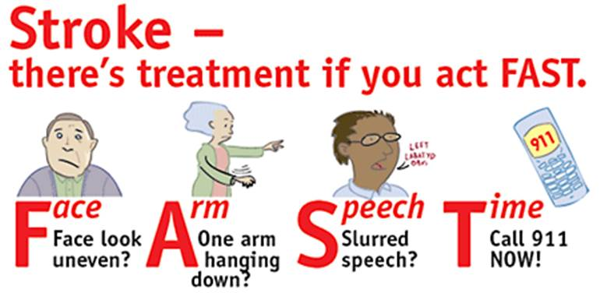
Signs and Symptoms of Stroke
Facial droop
Sudden weakness, numbness of face, arm, legs or one side of the body
Lack of muscle coordination
Blurred or double vision
Difficulty swallowing
Decreased level of respirations
Speech disorder, slurred speech
Notes:
Discuss atypical s/s of stroke that are not usually seen as well, and conditions that may mimic a stroke.

Slide 33
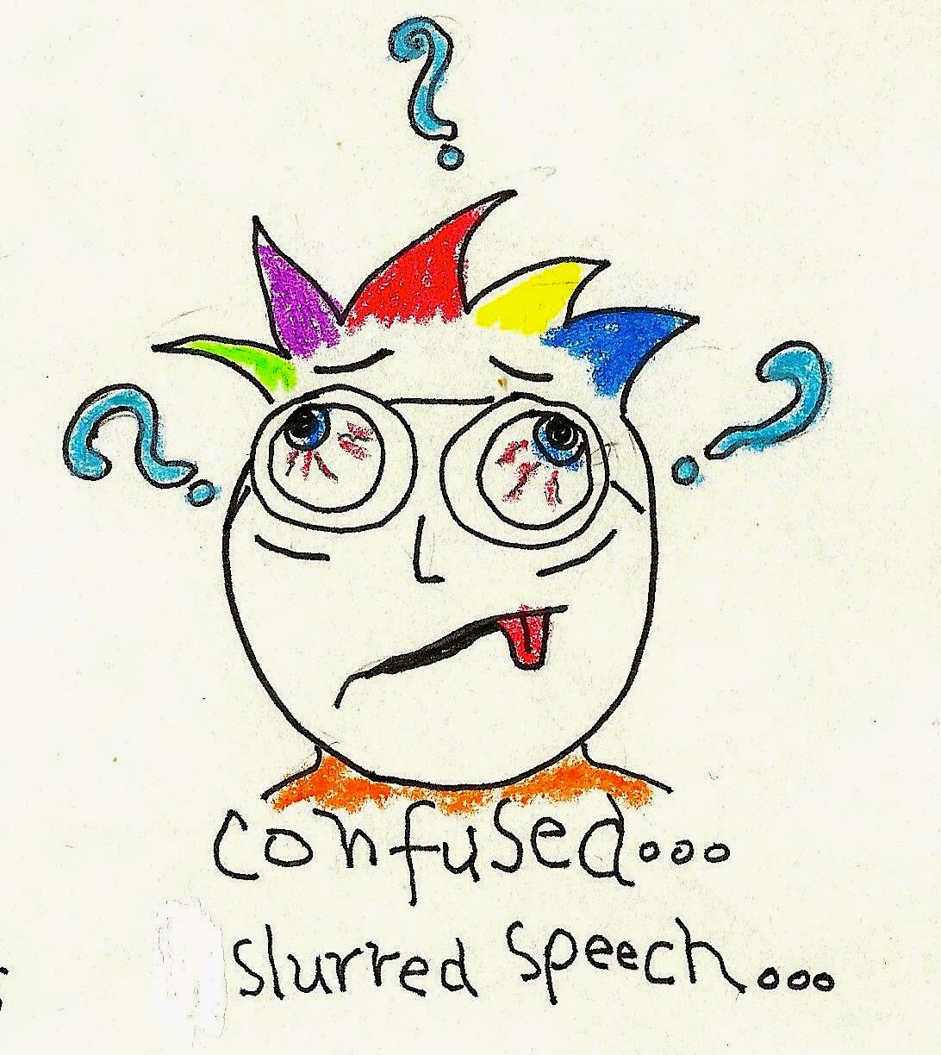
Signs and Symptoms of Stroke (cont.)
Aphasia (disordered thoughts either expressive (wrong words spoken) or receptive (not understanding)
Sudden severe headache
Confusion
Combativeness
Tongue deviation
Coma

Slide 34

Risk Factors for Stroke
Age (elderly)
Ethnicity (African-American at higher risk)
High blood pressure
High cholesterol
Diabetes
Heart disease
Stress
Obesity
Males
Cigarette smoking
Lack of exercise

Slide 35
Identifying, assessing and treating Stroke
Identifying s/s quickly and early is key!
“Time is brain”
Determining the exact time the patient was last seen “normal”
Manage ABC’s and life threats initially
Assess CPSS (Cincinnati Prehospital Stroke Scale)
Call for ALS assist (Don’t wait on scene, meet in route)
Position patient for transport
Transport to most appropriate facility
Notify receiving facility of “stroke” patient early

Slide 36
Summary
Remember the many reasons for altered mental status using your mnemonic:
  A
  E
  I
  O
  U
  T
  I
  P
  S
Be able to recognize quickly and transport appropriately the stroke victim

Slide 37
Module I – Section III – EMS Research/Evidence Based Medicine
Objectives
  Explain the practical use of research in EMS care
  Define different research methods in EMS research
  Explain the process of conducting a literature review for EMS research

Slide 38

Practical Use of Research
Identifies weaknesses and what is needed to improve quality of EMS care
Encourages accurate and complete documentation
Improves working conditions – safety research can be focused on EMS providers
Gathering supporting data to implement change
Notes:
Use resources such as: Federal Interagency Committee on EMS (FICEMS) which included “data-driven and evidence-based EMS systems that promote improved patient care quality” as a strategic goal, published in 2014, to help with examples when teaching the concept of the use of research for EMS to improve care.
Also NHTSA and another reference: CARES in Action

Slide 39
Different Research Methods in EMS
NHTSA supports development of evidence based guidelines through the use of standardization and improvement of EMS data collection (thus improving our documentation) using NEMSIS.
“CARES in ACTION”(Cardiac Arrest Registry to Enhance Survival) – programs across the U.S. used to improve prehospital cardiac arrest management. A registry designed to collect data to implement change.
Gathering supporting data to implement change for a specific protocol or guideline development, whether it be a skill change or medical treatment to enhance patient care.

Slide 40
Evidence Based Guideline Support
Resources available to aid State agencies in development of evidence based guidelines through research. (NASEMSO) National Association of EMS Officials
Patients benefit from evidence based guidelines also:
  Ensures high quality patient care
  Standardized consistent approach
  Proven successful practice and evidence
Notes:
Discuss the National Prehospital Evidence-based Guideline Model Process which will explain how evidence-based medicine is placed into practice.

Slide 41
EMT Refresher
Module II
Cardiac Management & Considerations
Cardiac arrest, rosc, vad, pain management, toxicological-opioids

Slide 42
Module II – Section I – Cardiac Arrest
Objectives
  Describe the A & P, pathophysiology, assessment and management of a myocardial infarction
  Describe the purpose and demonstrate the application and transmission of the 12-lead ECG
  Discuss pathophysiology, assessment and management of a cardiac arrest
  Discuss and demonstrate the application of an AED
  List the indications and contraindications of using the AED

Slide 43
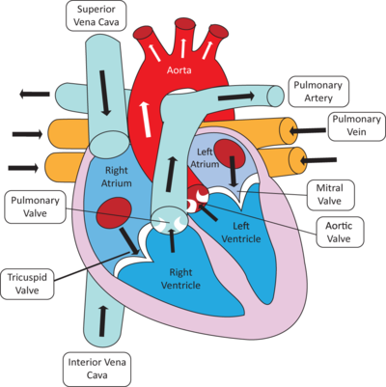
Anatomy Review of the Cardiovascular System
Heart – Four chambered muscle, two atria, two ventricles
Right atria receives blood from the body through the inferior and superior vena cava
Flows through the tricuspid valve to the right ventricle
Moves through the pulmonic valve through the pulmonary artery to the lungs to be oxygenated
Then travels back through the pulmonary vein to the left atria
Through the left atria and the mitral valve to the left ventricle and out of the body with oxygenated blood through the aortic valve through the aorta into the circulatory system

Slide 44
Anatomy/Physiology of the Heart
Heart also contains it’s own electrical system
  Controls rate
  Enables atria and ventricles to work together
Starts at the SA node (natural pacemaker) moves through both atria causing them to contract simultaneously
AV node is the bridge between the atria and ventricles.
Bundle of HIS, Purkinje fibers
Both ventricles are stimulated to contract simultaneously
*Continuous blood and oxygen supply is imperative for the myocardium or heart muscle to function normally

Slide 45
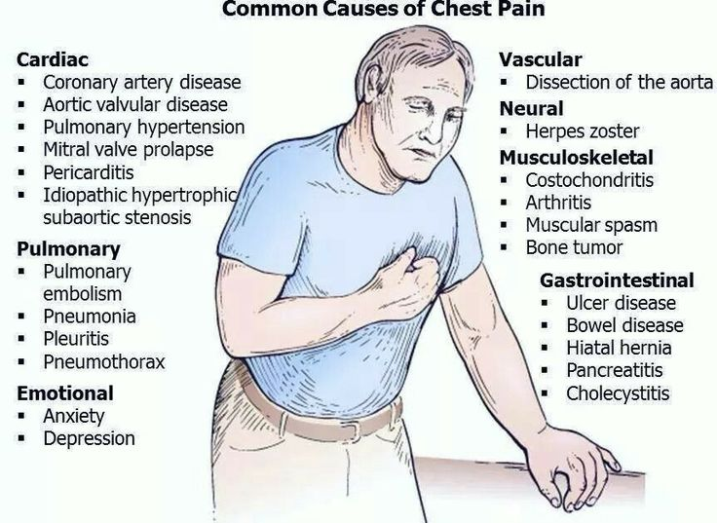
Chest pain
Decrease in blood flow, decrease in oxygen consumption, which in turn results in myocardial tissue ischemia
Partially occluded or completely occluded vessels
Cardiac vessel spasms
Pain can be described differently by different patients with different history:
    Squeezing
    Heaviness
    Stabbing
    “Life an elephant sitting on my chest”
    “Can’t get my breath”

Slide 46
Angina vs. Myocardia Infarction
Angina
  Heart tissue not getting enough oxygen for a brief period of time
    Could be a spasm of an artery
    Most often due to Atherosclerotic CAD
  Occurs more often due to physical or emotional stress, large meal or sudden fear
  Rarely lasts longer than 15 minutes
  When a person rests, pain subsides
  Pain is often midsternal, in arms, jaw, feels like
  Can have some SOB, nausea, diaphoresis
  Stable vs. Non-Stable
    Non-Stable is often not relieved by rest and is often difficult to distinguish from a myocardial infarction
Myocardial Infarction
S/S similar to that of angina but including sudden death
Some differences:
  May or may not be associated with exertion
  It can last from 30 minutes to several hours
  May or may not be relieved by rest or nitroglycerin
  “Time is muscle”
  With an MI heart muscle is dying or dead and may not be salvageable if not treated in a timely fashion
  Patients that may present differently:
    Elderly
    Women
    Diabetics

Slide 47
Care of patients with an Myocardial Infarction
Recognizing s/s
Assess ABC’s
Administer oxygen via NC if O2 saturation less than 95% 4 lpm/nc
If no improvement change to NRB and maintain saturation 95-99%
Obtain 12-lead ECG and transmit
If pulmonary edema is present may consider PPV with BVM or if no contraindications CPAP
Place in position of comfort
Transport to appropriate facility
Call for ALS assist
Administer Baby Aspirin per protocol if not contraindicated and patient has not already taken this
Consider Nitroglycerine if not contraindicated per protocol and MCP order

Slide 48
12-Lead ECG Purpose/Application
Early detection of STEMI for receiving facility
Used for comparison between pre-transport time and time of arrival to facility for changes
Steps to perform cardiac monitoring:
  BSI
  Prep the skin
  Put electrodes on leads before placing on patient
  Put limb leads on the LIMBS!
  Place V leads on the chest in these areas:
    V1-4th intercostal space to the right of the sternum
    V2-4th intercostal space to the left of the sternum
    V4-5th intercostal space midclavicular line
    V3-between V2 and V4
    V6-middle of the armpit straight across from V4
    V5-between V4 and V6
    (Transmission of the ECG will vary depending upon the monitor. Your instructor will demonstrate.)

Slide 49
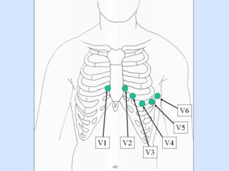
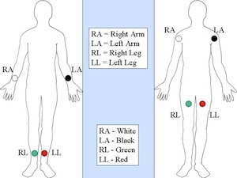
12-Lead ECG
Notes:
Practical exercise 12-lead placement and transmission

Slide 50
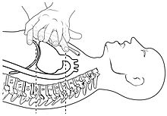
Cardiac Arrest – Assessment and Management
Chain of Survival
5 Links in the adult Chain of Survival
    Immediate recognition and activation of the emergency response system
    Early CPR, emphasis on chest compression
    Rapid defibrillation
    Effective advance life support
    Integrated post-cardiac arrest care
  Optimal chest compressions
    Compress at rate of 100 - 120 per minute
    At least 2 inches
    Allow complete recoil
    Minimize interruption
    High performance CPR (Pit Crew CPR)
    Mechanical CPR devices

Slide 51
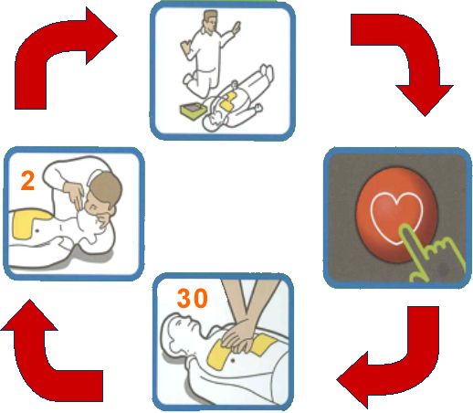
Automated External Defibrillator
Early Defibrillation offers the best opportunity to achieve a successful patient outcome
AED’s have become readily available in many schools, fitness clubs, sports venues, public facilities, mass gathering places.
Relatively self-guiding making it very easy to use
High quality compressions can be started and should be done by the EMS provider while the AED is being prepared for use
Notes:
Discuss and demonstrate

Slide 52
Automated External Defibrillator
Assure defibrillation safety for crew members, yourself and bystanders
Proper placement of pads – Don’t place over medication patches or implanted devices
Assure patient is in dry area not lying in a puddle of water prior to defibrillation and patient’s chest should be dried.
Make sure you have good pad contact – hairy chests must be dealt with
Consider spinal immobilization where trauma is concerned

Slide 53
Summary
Recognizing and managing the acute myocardial infarction
Applying and transmitting the 12-lead ECG
Being able to manage the adult cardiac arrest patient
Knowing when to correctly apply the AED

Slide 54
Module II – Section II - Return of Spontaneous Circulation
Objectives
  Describe ROSC and effectively manage hemodynamic instability
  Determine causes of cardiac arrest
    Make treatment choices based on the cause
    Determine appropriate treatment destination
  Describe the process of induced hypothermia

Slide 55
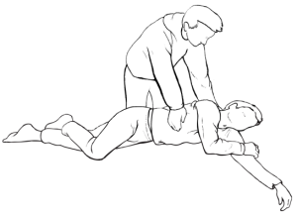
Signs of ROSC
Presence of Pulse
Monitor for signs of return of spontaneous breathing (this may or may not happen right away depending upon the cause of the arrest)
Can patient follow commands? Watch for patient movement.
Return of blood pressure (may be low initially, give it time)

Slide 56
ROSC and Management of Hemodynamic Instability
Ventilate and/or oxygenate to maintain saturation between 95 – 99%
Avoid excessive over-bagging, use ETCO2 (35-40)
  Reduces cardiac output
  Decreases cerebral blood flow
Monitor vital signs
  Treat for shock, try to maintain BP higher than 90 systolic
Transport to the most appropriate facility
  Most deaths following ROSC occur within the first 24 hours
ALS should have been called for if not already present

Slide 57
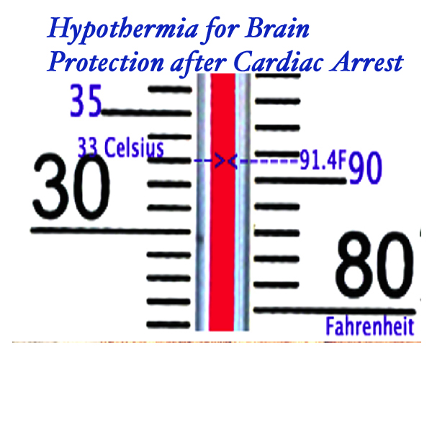

ROSC and Induced Hypothermia
Notes:
Review ROSC protocol

Slide 58
Summary
Being able to identify the causes of a cardiac arrest and managing what can be managed post arrest
Knowing how to effectively manage the patient who has return of spontaneous circulation (ROSC)
Knowing the options for induced hypothermia

Slide 59
Module II – Section III - VAD
Objectives
  Understand the function of VAD’s
  Discuss patient care issues/differences in assessment involved in patients with a VAD

Slide 60
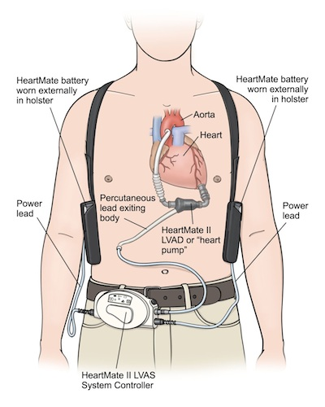
Function of VAD
Mechanical device placed in the patients chest to replace the function of the ventricles to circulate blood
Basically works as the patients mechanical heart while awaiting a heart transplant
Implanted in heart failure patients
Sometimes a temporary treatment, sometimes used as a permanent solution to very low cardiac output

Slide 61
Assessment of the VAD Patient
Initial assessment is the same as with patients without a VAD
Most VADs have continuous flow therefore they may not have palpable pulses or even an obtainable blood pressure
Listen over the left chest for a “whirling” sound or a “humming” sound to assure the VAD is working
Pulse oximetry may not be accurate
Mental status and skin temperature, color and condition may be the most reliable findings for adequate perfusion
Check the sight of insertion of the device for signs of infection
Check the external device for proper function, the family may be able to assist and there is probably a contact source available to trouble shoot and advise you
Notes:
Review VAD protocol

Slide 62
Management of the VAD patient
Let the family or caregiver assist you
Use the contact information for the patients medical caregivers (which is usually a 24/7 contact) to assist you to troubleshoot
Keep batteries and the external device secured to patient
Take extra batteries with you to the hospital, charger if necessary if the possibility of a prolonged stay (consider) flying patient to facility where device was implanted
Use caution when removing clothing not to inadvertently displace internal component
Verify with family or contact VAD consultant before chest compressions are initiated. Most patients with VADs, not breathing and appear to be in arrest with a VAD CPR is not recommended.
Follow local protocol

Slide 63
Summary
Understanding the function of the VAD
Knowing there are points of contact for troubleshooting the VAD improves patient care and assists the EMT
Understanding differences in assessment for the VAD patients

Slide 64
Module II – Section IV – Pain Management
Objectives
  Determine difference between acute and chronic pain management
  Discuss conducting pain assessment appropriate by patients age
  Discuss non-pharmacologic pain management options

Slide 65

Acute vs. Chronic Pain
Acute Pain
  Usually sudden, or new pain not something the patient has experienced before. Not typical.
Chronic Pain
  Pain that a patient has been experiencing for a prolonged period of time, months, years, etc.

Slide 66
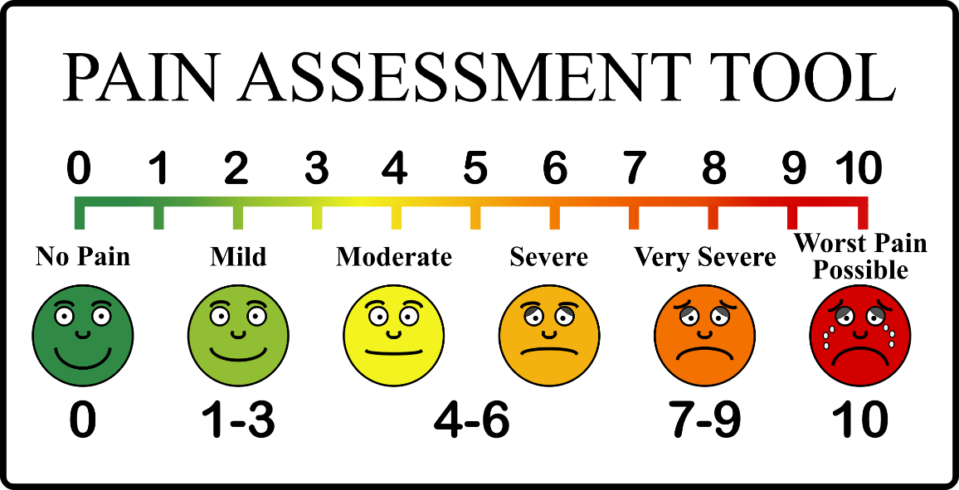
Pain Assessment (“5th Vital Sign”)
Adequate pain control is not routinely recognized or provided for a lot of reasons
  Frequent flyer
  Seeker
  EMS personnel may base their judgment on past or similar patients
Tools to assess
  Use the same scale to assess and reassess
  Patients Emotional State
  Patients Behavior
  Signs/Symptoms
Types of scales
  Numeric rating scales
  FACES (Pediatrics)

Slide 67
Non-Pharmacologic Pain Management
Position of comfort
Distraction away from painful stimuli through conversation
Parents presence typically reduces the level of distress in infants and children
Immobilization of fractures
Elevation
Ice
Padding when immobilizing
Warm blankets

Slide 68
Module II – Section V – Toxicological - Opioids
Objectives
  Identify common synthetic stimulants and natural or synthetic THC
    Recognize the effects
    Synthetic stimulants
    Natural and synthetic THC
  Identify common opioids
    Recognize the effects
  Discuss management and treatment of the opioid overdose patient

Slide 69
Common Synthetic and Natural and Synthetic THC (Tetrahydrocannabinol)
Common Synthetic Stimulants
  Bath Salts (sold as white powder usually) inhaled nasally but can be oral, IV or smoked
    Bliss, Blue Silk, Ivory Wave, White Dove, White Knight, White Lightning
  Methamphetamine (usually sold as crystals, white or can be yellow/red) smoked, snorted or injected IV
    Crank, Crystal Meth, Glass, Ice, Tweak, Yaba
  MDMA (liquid drops, sold in tablets or capsules) snorted or smoked
    Ecstasy, E, X, XTC, Smarties, Scooby-Snacks, Skittles
Natural and Synthetic THC
  Natural
    Weed, bud, doobie, Mary Jane, pot, blunt, herb, hemp, grass
  Synthetic
    Mimics natural THC
    Can cause psychosis
    K2, spice, black mamba, Bombay blue, genie, Zohaib
    Similar appearance to natural THC

Slide 70
Effects of THC
Impaired short term memory
Decreased concentration and attention
Impaired balance and coordination
Increased heart rate and blood pressure
Increased appetite

Slide 71
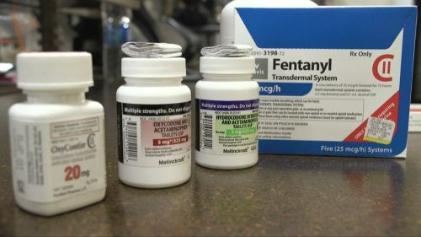
Common Opioids
Heroin
Morphine
Oxycodone (Percocet)
Codeine
Fentanyl
Hydrocodone (Vicodin)
Hydromorphone (Dilaudid)
Meperidine (Demerol)
Methadone
Notes:
Review also some sympathomimetics, stimulants that may be drugs of abuse such as cocaine.

Slide 72

Common Effects of Opioid Use
Respiratory depression
Drowsiness
Constipation
Constricted pupils
Dry mouth
Itching
Nausea and Vomiting
Prolonged use may lead to tolerance and/or addiction

Slide 73
Management and Treatment of the Opioid Overdose Patient
Management of ABC’s is vital
Narcan, opioid antagonist
  Follow Protocol
  Reverses CNS and respiratory depression caused by opioid overdose
  NOT effective against non-opioid drugs
  Can be given intranasally
  Patient should be transported follow medical direction

Slide 74
Summary
Differentiating between acute and chronic pain
Knowing different non-pharmacologic techniques to assist patients in alleviate their pain
Being able to recognize the effects of different stimulants, natural and synthetic THC and opioids
Managing and treating the overdose patient

Slide 75
EMT Refresher
Module III
Medical Emergencies I/Ops I Management & Considerations
Diabetic, Psychiatric/Behavioral, Ems Culture of Safety, Immunological, Infectious Disease, EMS Provider Hygiene-Safety and Vaccinations, At Risk Populations

Slide 76
Module III – Section I – Diabetic Emergencies
Objectives
  Explain the role glucose plays on the cells
  Explain the role of insulin
  Define and explain diabetes and the two types
    Hyperglycemia
    Hypoglycemia
  Discuss assessing the patient with a history of diabetes and an altered mental status
  Describe the interventions for care and treatment of both the conscious and unconscious patient with a history of diabetes who is having a hypoglycemic episode
  Explain the management of hyperglycemia

Slide 77
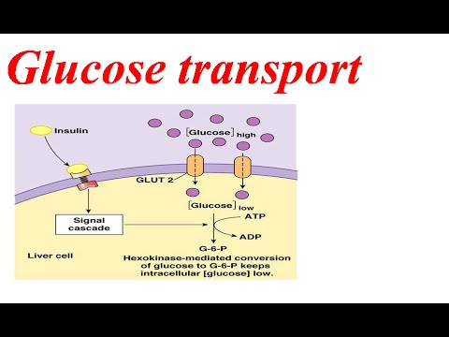
Roles Glucose Play on the cells
Glucose
  Fuel for cells
  Ensures proper brain and cellular functioning
  Changes in level of consciousness

Slide 78
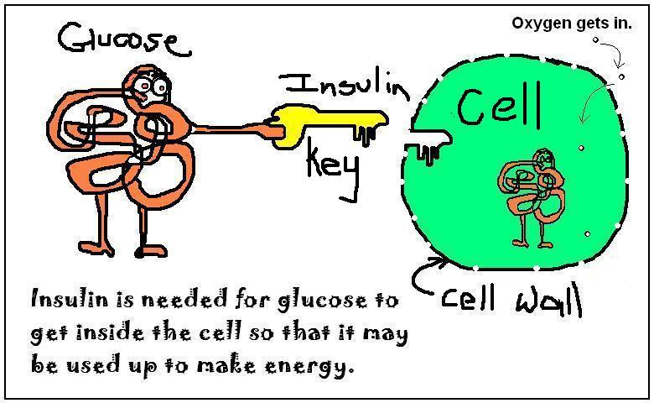
Roles Insulin Plays on the Cells
Insulin
  Acts as a “carrier” for glucose to enter the cells and be used
  Released into the bloodstream to regulate level of glucose
  Acts as the “key” to the “lock” on the cell

Slide 79
Hypoglycemia
*Normal blood glucose level is between 80 and 120 mg/dL
Blood glucose levels drop to insufficient amounts to support brain function.
Signs/Symptoms
  Rapid onset change in mental status
  Sweating
  Rapid pulse
  Rapid, shallow respirations
  Seizures, coma (late)
  Bizarre behavior
  Combativeness

Slide 80
Hyperglycemia
An abnormally high blood glucose level
  Slow onset and changes in mental status
  Rapid breathing , sweet breath odor
  Dehydration, pale, warm, dry
  Weakness, nausea, vomiting
  Weak, rapid pulse
  Polyuria, polydipsia, polyphagia

Slide 81
Diabetic Ketoacidosis (DKA) vs. Hyperosmolar Hyperglycemic Nonketotic Syndrome (HHNS)
Diabetic Ketoacidosis (DKA) – Body resorts to burning fats for energy.
Results are the development of “ketones” (acid wastes)
CO2 increases, respirations increase to blow this off which results in Kussmaul respirations
Abdominal pain, body aches, nausea, vomiting and altered mental status or unconsciousness (if severe)
Usually occurs in Type I Diabetics with blood sugars higher than 400
Hyperosmolar Hyperglycemic Nonketotic Syndrome (HHNS) – extremely high blood glucose levels, usually associated with profound infection or illness and most often with Type II diabetics.
Altered mental status, drowsiness, lethargy
Severe dehydration, thirst, dark urine
Visual or sensory deficits
Partial paralysis or muscle weakness
Seizures

Slide 82
Management of the Diabetic Patient
Scene Size-up
General Impression
AVPU
Initial Assessment (ABC’s), ? Trauma, hemorrhage
Altered consciousness and inability to swallow with hypoglycemia/hyperglycemia needs immediate transport, ALS intercept.
Patients who are awake with an intact ability to swallow with hypoglycemia follow protocol and treat
Patients who are conscious with hyperglycemia, maintain airway, breathing, ALS intercept, transport to nearest appropriate facility.
Notes:
Review protocol

Slide 83
Summary
Knowing the relationship between glucose and insulin with regard to cellular metabolism
Be able to differentiate between Hyper and Hypoglycemia
The EMT should know how to manage and care for the conscious and unconscious patient with a diabetic history

Slide 84
Module III – Section II – Psychiatric/Behavioral
Objectives
  Define a behavioral crisis
  Discuss special considerations for assessing and managing a behavioral crisis or psychiatric emergency
  Define agitated delirium and describe the care for a patient with agitated delirium
  State the risk factors for suicide

Slide 85
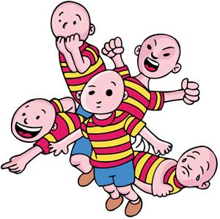
Behavioral Crisis
Behavior – a person’s reaction or actions to the environment around them
One who exhibits agitated, violent, or uncooperative behavior or who are in danger to themselves or others
Behaviors unacceptable to the patient, family or community
Behavior that interferes with the “activities of daily living”

Slide 86
Organic vs. Functional (Psychological) Causes
Organic (Physical)
  Sudden illness
  Traumatic brain injury
  Seizure disorders
  Drug and alcohol abuse
  Overdose or withdrawal
  Alzheimer dementia
  Meningitis
Functional (Psychological)
  Bipolar
  Schizophrenia
  Anxiety disorders
  Depression
  *Body seems structurally normal but physiologically impairs bodily function.

Slide 87
Agitated (Excited) Delirium
Delirium - A condition of impairment in cognitive function that can present with disorientation, hallucinations, or delusions.
Agitation – behavior characterized by restless and irregular physical activity.
Generally patients with delirium alone are not dangerous but when “agitated” can strike out irrationally.
Hyperactive behavior
Hypertension
Tachycardia
Diaphoresis
Dilated pupils

Slide 88
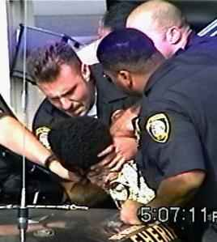
Agitated (Excited) Delirium Patient Care
Calm, supportive approach
Limit physical contact
Do not leave patient unattended unless situation becomes unsafe
Try to determine patient’s level of cognition
Consider ALS for chemical restraint
Uncontrolled or poorly controlled agitation can lead to cardiopulmonary arrest
Law enforcement for assist. TASERs can lead to sudden death. Be alert to positional asphyxia.
Restraints, follow protocol
*Remember the more agitated and the more aggressive we get the more dangerous it is for our patient

Slide 89
Suicide Risk Factors
Depression most significant factor.
Previous attempts
Family/child abuse
Recent diagnosis of serious illness
Recent loss of loved one, job, money or social status
PTSD
Alcohol or drug abuse
Loss or relationship
Gives away personal belongings/cherished possessions
Expresses a clear plan for committing suicide

Slide 90
Safe Approach to Behavioral Crisis
Scene Size-up, provider safety
Communication is Key!
AVPU
Initial Assessment (ABC’s), hemorrhage control
History – Very important in determining perhaps an underlying reason for the current behavior – SAMPLE
Involve family, friends, caregivers
Never let your guard down, behavior can change quickly!
Follow local protocol regarding restraint, this may only be done to prevent the patient from hurting himself or to protect yourself or others and always involve law enforcement.
Notes:
Discuss restraint and current protocol

Slide 91
Summary
The EMT should be able to differentiate between a behavioral crisis and a psychiatric emergency
Be able to identify agitated delirium and the management thereof
Knowing the risk factors for suicide and the management of the suicidal patient in the field setting

Slide 92
Module III – Section III – Immunological Emergencies
Objectives
  Understand and define the terms allergic reaction vs. anaphylaxis
  Discuss causes of an allergic reaction
  Discuss the assessment, management and treatment of a patient having an allergic vs. anaphylaxis reaction
  Describe some age-related contraindications to using epinephrine to treat an allergic reaction in a geriatric patient

Slide 93
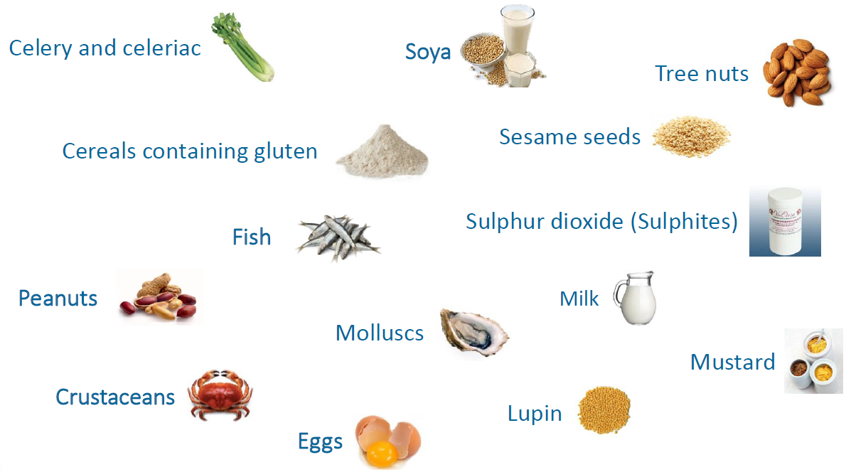
Common Allergens
Foods
  Shellfish
  peanuts
Medication
  Penicillin
  NSAIDs
Plants
  Ragweed
  Maple
  oak
Chemicals
  Makeup
  Soaps
  latex
Insect bites and stings
  Honeybee
  Wasps
  Yellow jacket
  Hornet
  ant

Slide 94
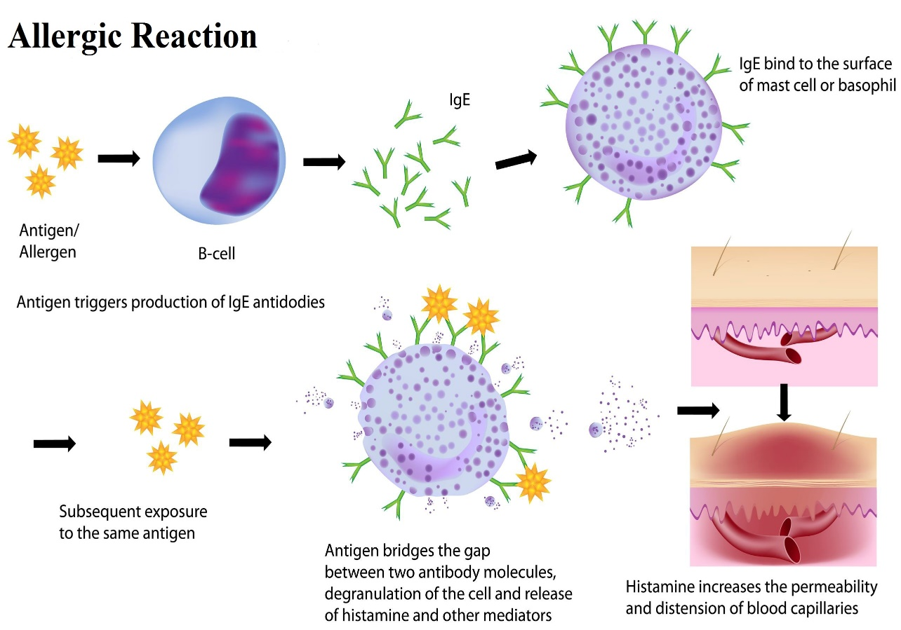
Allergic Reaction
Hyperactive, localized response to an allergen
Some histamine is released
Localized: redness, swelling, hives, itching
May cause nausea, vomiting and/or diarrhea
Usually requires minimal supportive therapies
Repeat exposures may lead to anaphylaxis (stings, foods, etc.)

Slide 95
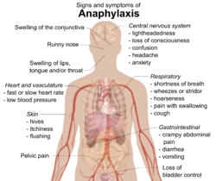
Anaphylaxis
Multiple body systems are affected
Life threatening reaction of the immune system to an allergen
Large quantities of histamine are released
Vasodilation and increased capillary permeability
May lead to shock
Bronchoconstriction and mucous production
Can lead to respiratory distress

Slide 96
Assessment and Management of the Patient with an Allergic Reaction
Scene Size-up, safe
General impression
Initial Assessment
ABCs, Identify and treat life threats, hemorrhage
High flow oxygen as needed
If allergic reaction becomes worse or anaphylaxis is suspected follow protocol for epinephrine treatment if patient does not have their own.
Transport to closest facility
Call for ALS if needed
Continually reassess

Slide 97
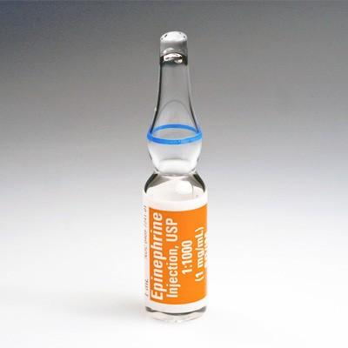
Epinephrine for Anaphylaxis
Sympathomimetic hormone the body normally produces. It mimics the sympathetic (fight or flight) response.
Causes blood vessel to constrict, which reverses vasodilation and hypotension, improves coronary blood flow.
Increases cardiac contractility and relieves bronchospasm in the lungs.
Acts immediately and rapidly reverses the effects of anaphylaxis
*Should only be given to those patients having signs of respiratory compromise or hypotension.
Notes:
Review protocol

Slide 98
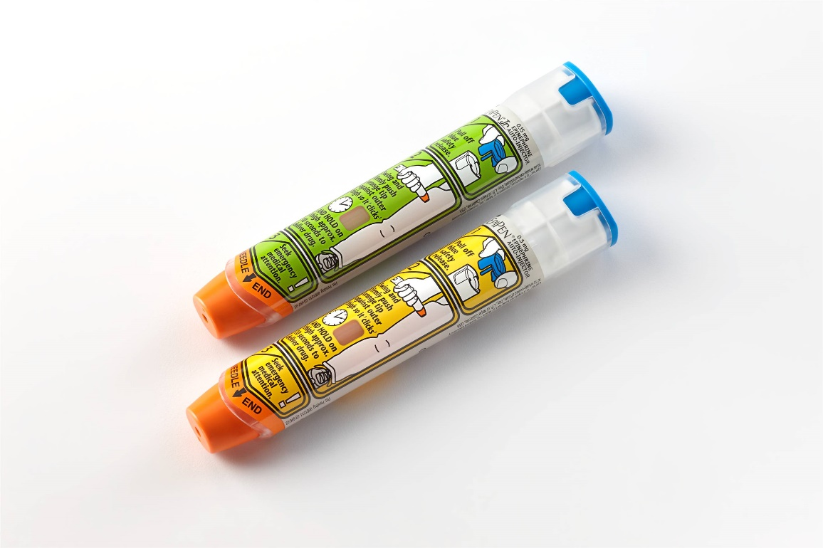
Epinephrine Precautions
Side effects:
  Increased pulse rate
  Increased myocardial oxygen demand
  Increased workload of the heart
Geriatric patients and those with cardiac and hypertensive history, the use of epinephrine can be very harmful.
*Follow local protocol

Slide 99
Summary
Be able to identify the difference between an allergic reaction and anaphylaxis
Recognize the most common allergens:
  Peanuts
  Bees
  Poison oak
  Poison ivy
  Shellfish
Understand epinephrine indications, contraindications and dosing

Slide 100
Module III – Section IV – Infectious Diseases
Objectives
  Define infectious disease and communicable disease
  Define bloodborne vs. airborne transmission
  Understand mode of transmission
  Explain post-exposure management

Slide 101
Infectious Disease vs. Communicable Disease
Infectious Disease
  Medical condition caused by growth and spread of small, harmful organisms within the body
  Not all infectious diseases are communicable
  Example: Salmonella
Communicable Disease
  Disease that can be spread from one person or species to another
  All communicable diseases are infectious
  Example: Hepatitis B

Slide 102
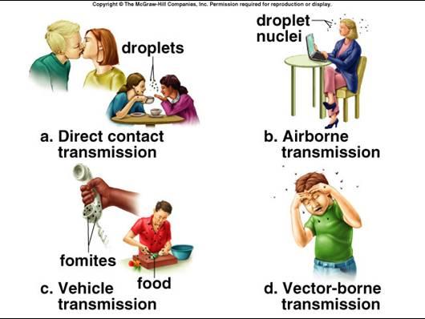
Modes of Transmission
Bloodborne Transmission
  Direct contact with blood
Airborne Transmission
  Cough, Sneeze
Foodborne Transmission
  Contamination of food or water
  Raw meat
Vector-borne Transmission
  Animals
  insects

Slide 103
Post Exposure Management
Immediately cleanse affected area
Follow agencies guidelines for medical care and treatment
Report incident to supervisor
Complete incident report
Notes:
Each agency should have an exposure control plan in place

Slide 104
Module III – Section V – EMS Provider Hygiene, Safety, and Vaccinations
Objectives
  Identify proper hand-washing technique
  Identify appropriate use of alcohol-based hand cleaner
  Discuss the CDC’s recommendations of vaccines for healthcare providers
  Assess eye safety indications and measures

Slide 105
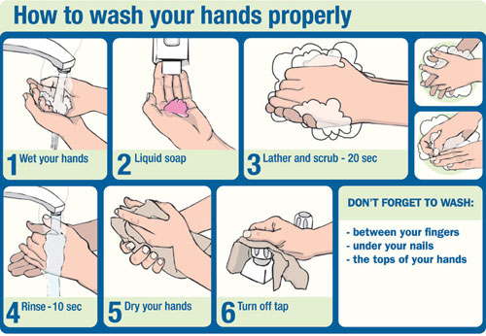
Proper Hand Hygiene
Simplest and most effective way to control disease transmission
Wash before and after contact with a patient
Warm water
Wash at least 20 seconds to work up a lather paying attention to nails and back of hand
Use paper towel to dry hands and use this to turn off the faucet

Slide 106

Alcohol-based hand cleaner/sanitizer
Should contain at least 60% alcohol
Reduces number of germs
Does not eliminate all types of germs
Does not kill viruses
Ineffective when hands are visibly dirty

Slide 107
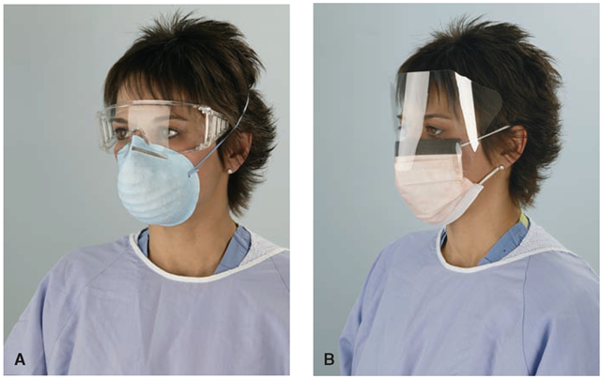
Eye and Face Protection
Blood splatters are a significant possibility in most trauma situations and some medical
Goggles
Face Shields
Safety glasses
Full face respirators

Slide 108
CDC’s Recommendations of Vaccines for Healthcare Providers
Prevention begins by maintaining your personal health
Recommendations:
  Hepatitis B
  Influenza (annually)
  Measles, mumps, and rubella (MMR) (typically a one-time vaccination)
  Varicella (chickenpox) vaccine or having had chickenpox
  Tetanus, diphtheria, pertussis (Tdap) (every 10 years)
  *Most of these vaccines are given as children, some may need boosters. Keep your vaccines up to date.
Notes:
Follow latest CDC vaccination recommendations.

Slide 109
Summary
Understanding the difference between an infectious and a communicable disease
As an EMT, the importance of understanding the many bloodborne and airborne diseases and how they are transmitted can assure that you are taking the necessary steps to protect yourself and others.
You need to be familiar with your own department post-exposure management plan
Proper hand-washing technique should be practiced routinely prior to and in between all patient contacts

Slide 110
Module III – Section VI – EMS Culture of Safety
Objectives
  Define Culture of Safety
  Identify and explain the six core elements necessary to advance EMS culture of safety
  Identify the role of the EMS provider in establishing a culture of safety within EMS organizations

Slide 111
EMS Culture of Safety
The value and priority placed on worker and public safety by everyone in every group at every level of the organization.
The extent to which individuals and groups will commit to personal responsibility for safety; act to preserve
Enhance and communicate safety concerns
Strive to actively learn, adapt and modify behavior based on lessons learned from mistakes
Notes:
Discuss roles of employer in management and the employee. Safety policy and procedures and how these are implemented and placed into practice, reviewed and inforced.

Slide 112
Six Core Elements Necessary to Advance an EMS Culture of Safety
Just Culture
  Development of environments in which EMS personnel are safe to report errors
  Assess risks in order to identify means of overcoming factors that contribute to errors
Coordinated support and resources
  Creation of a guidance and resource coordination body
EMS Safety Data System
  Data driven decisions and policies related to EMS safety can only be made if all data is accessible on a national level
EMS Education Initiatives
  Safety starts with EMS leaders and educators and involves everyone
EMS Safety Standards
  Safety standards for patient and responder safety must be developed using data and evidence
Requirements for reporting and investigation
  Mandates for reporting safety are necessary so a common language and data set can be created to improve responder and patient safety
Notes:
Reference: Strategy for a National EMS Culture of Safety

Slide 113
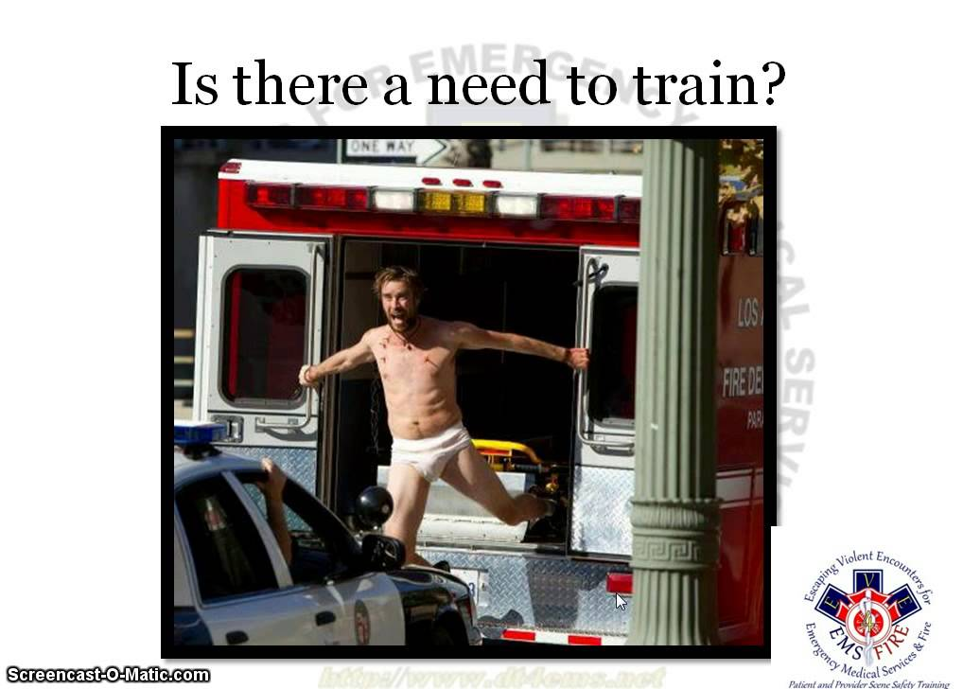
What is your role as an EMS Provider in establishing a Culture of Safety within your organization?
What changes are needed to encourage the development of a culture of safety?
How are mistakes handled if one is made during a patient care encounter?
How should it be handled if applying the concept of Just Culture?
*Blaming or punishing is not an option in Just Culture
Notes:
Reference: 2013 Strategy for a National EMS Culture of Safety

Slide 114
Summary
As an EMT it is your responsibility to promote safety in every aspect of your profession:
  Safe transportation of your crew members to and from a scene
  Safe transportation of your patient to the hospital
  Promote safe actions while on the scene
  Promote safety while training
  Assist leadership and following policies and guidelines for the promotion of a culture of safety

Slide 115
Module III – Section VI – At Risk Populations
Objectives
  Recognize the unique characteristics of at-risk populations
  Recognize circumstances that may indicate abuse
    Domestic abuse
    Human trafficking
    Non-accidental trauma
  State appropriate actions of EMS professionals in the presence of abused patients

Slide 116
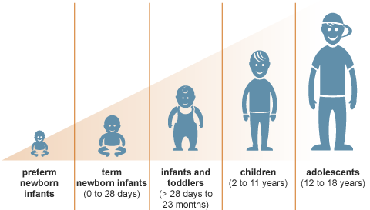
Unique Characteristics of the Pediatric Population
Wide range in development
  Neonatal to young adult
Non-verbal to highly communicative
Response to shock changes with organ development
Injury and illness patterns change with development
Depend on adults for protection and prevention
Notes:
Discuss the challenges in assessing and treating each age group as well as how each may respond to illness and injury.

Slide 117

Unique Characteristics of the Geriatric Population
Fragility is a better indicator of risk than age in years
Polypharmacy is common
  May have certain drug interactions including OTC herbal interactions
Medication overdoses
Age-related cognitive impairment
  Dementia
  Delirium
Loss of independence
May have reduced uptake of certain medications
Notes:
Discuss the challenges in assessment and treatment of this age group and the illnesses and injuries you may encounter of more prevalence

Slide 118
Indications of Abuse
Anatomical sites where domestic violence wounds are usually seen from most likely to least likely:
  Face and neck
  Arms
  Head
  Back and buttocks
  Breasts
  Abdomen (increases with pregnancy)
  Genitals
*Victims who are repeatedly abused may have wounds in different stages of healing

Slide 119
Indications of Human Trafficking
Bruises in various stages of healing
Scars, mutilations, or infections due to improper medical care
Urinary problems, rectal trauma, pregnancy
Chronic back problems, heart and lung problems from work environment
Poor eyesight or eye problems from poorly lit work areas
Malnourishment and/or serious dental problems
Disorientation, confusion, panic attacks, paranoia
Notes:
Department of Homeland Security – Blue Campaign: Human Trafficking

Slide 120
EMS Provider Assessment and Treatment of At-Risk Patients
Assessment Challenge
  Unreliable historians (afraid)
  Difficulty in relaying information
  Reliance on caregiver (are they the abuser?)
  Proper interpretation of the patient’s verbal and non-verbal communication
  Assess the environment the patient was found in
Treatment
  Provide supportive care
  Treat injuries and illnesses found as usual
  Documentation is key
  West Virginia law mandates that you report suspicions of abuse, follow protocol

Slide 121
Summary
Knowing which groups of patients are defined as “at risk”
As an EMT, you may find yourself in a position as first on scene to recognize the “at risk” patient which can become a very important factor in assisting this patient. Your documentation and transfer report is vital.
Remember, you don’t have to prove abuse to report your suspicions.

Slide 122
EMT Refresher
Module IV
Medical Emergencies II Management & Considerations
Pediatric Cardiac Arrest, OB Emergencies, Special Healthcare Needs

Slide 123
Module IV – Section I – Pediatric Cardiac Arrest
Objectives
  Discuss causes pediatric cardiac arrest
  Describe the current techniques of one and two rescuer CPR for pediatric cardiac arrest
  Demonstrate current techniques of one and two rescuer CPR for pediatric cardiac arrest
Notes:
National EMS Education Standards
Review Current AHA Guidelines

Slide 124
Common Causes of Pediatric Cardiac Arrest
Respiratory Arrest
  Asthma
Shock
  Bleeding (internally or externally
  Anaphylaxis
Submersion (drowning)
Infections
  Epiglottitis
Poisonings or drug overdose
Traumatic injuries
  Blunt and penetrating
  *Cardiac arrest is rare from a heart problem alone unless congenital

Slide 125
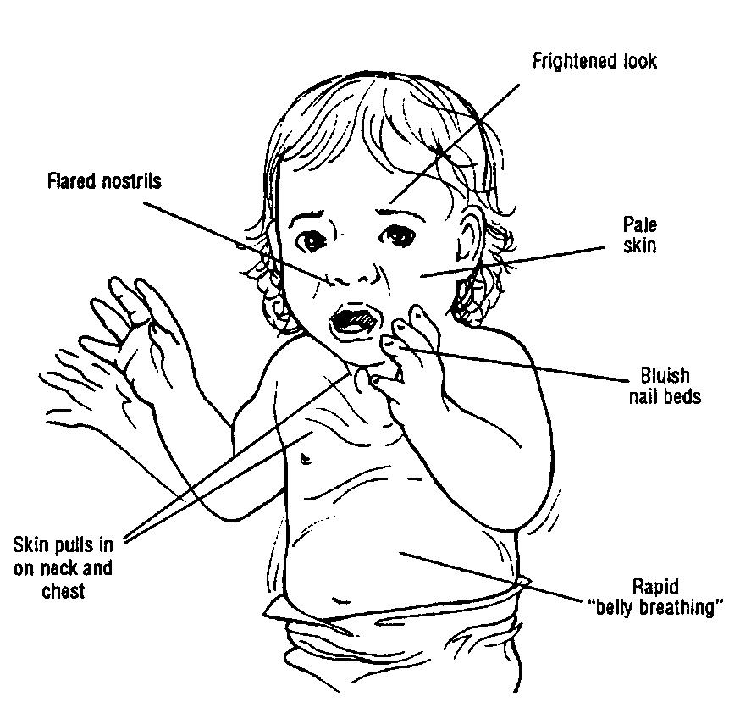
Respiratory Distress/Failure/Arrest
Respiratory Distress
  Increased work of breathing
  Nasal flaring
  Abnormal breath sounds
  Accessory muscle use
  Tripod position
Respiratory Failure
  Efforts to breathe decrease
  Chest rise is less
  Cyanosis will develop (late sign)
  Altered level of consciousness
  Bradycardia

Slide 126
Pediatric Asthma
True medical emergency if not identified and treated promptly.
Common triggers:
  Upper respiratory infection
  Smoke
  Exercise
  Exposure to cold air
  Emotional stress
Many asthmatic patients will have used their inhalers prior to EMS arrival and will have more than one.
How many admissions have there been over the past year?
What treatment was rendered the last time the patient was seen?
Albuterol nebulizer treatment may be needed, follow protocol
Be prepared for assisted ventilation

Slide 127
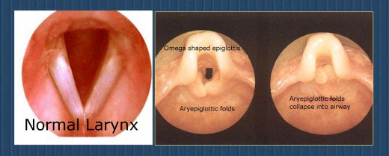
Epiglottitis
Infection of the soft tissue in the area above the vocal cords. Bacterial infection is the most common cause.
The epiglottis can swell two to three times its normal size.
Very sore throat
Fever
Difficulty swallowing
Drooling
Tripod positioning
True life-threatening emergency

Slide 128
Shock
Inadequate perfusion of blood and oxygen to the organs.
Common causes in pediatric patients:
  Traumatic injury with blood loss
  Severe infection
  Neurologic injury (head trauma)
  Severe allergic reaction (anaphylaxis)
  Diseases of the heart
  A collapsed lung (tension pneumothorax)
  Blood or fluid around the heart (cardiac tamponade)
Pediatric patients respond differently than adults to fluid loss.
  Tachycardia
  Poor capillary refill (<2 seconds)
  Mental status changes
  Blood pressure change is the most difficult sign to measure in children and is a very late sign of decompensated shock and is often too late.
Notes:
Discuss anaphylaxis

Slide 129
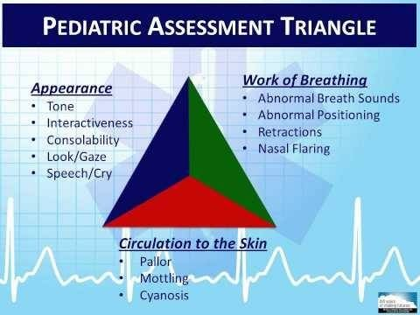
Pediatric Assessment Triangle
PAT
  Structured assessment tool used to rapidly form a general impression of the infant and child without touching him or her
  Appearance
  Work of breathing
  Circulation to skin
  This will identify those critically ill or injured pediatric patients hopefully before cardiopulmonary resuscitative efforts are needed.
Notes:
Explain the steps of the PAT, leading into the resuscitation of a critically ill or injured child.

Slide 130
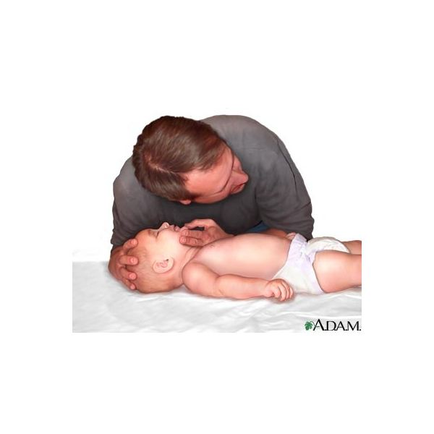
Single Rescuer Infant CPR
Infant (less than one year of age)
  2 fingers just below the nipple line
  100-120 compressions per minute (rate is extremely important determinant of ROSC and good neurological outcome)
  Depth is 1/3 of anterior-posterior diameter of the chest (about 1 ½ inches)
  Allow complete recoil between compressions
  Minimize interruptions
  Ventilation/Compression Ratio
    Two breaths after each 30 compressions just enough for chest to rise.

Slide 131
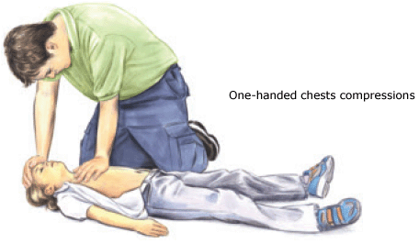
Single Rescuer Child CPR
Child (1 year of age until onset of puberty)
  Use one or two hands on the lower half of the sternum
  100-120 compressions per minute (rate is extremely important determinant of ROSC and good neurological outcome)
  Depth is 1/3 of anterior-posterior diameter of the chest (about 2 inches)
  Allow complete recoil between compressions
  Minimize interruptions
  Ventilation/Compression Ratio
    Two breaths after each 30 compressions just enough for chest to rise.

Slide 132
Two Rescuer Infant and Child CPR
Infant CPR Two Rescuer
  Use thumb encircling hand technique
  100-120 compressions per minute (rate is extremely important determinant of ROSC and good neurological outcome)
  Depth is 1/3 of anterior-posterior diameter of the chest (about 1 ½ inches)
  Allow complete recoil between compressions
  Minimize interruptions
  Ventilation/Compression Ratio
    Two breaths after each 15 compressions just enough for chest to rise.
Child CPR Two Rescuer
  Use one or two hands on the lower half of the sternum
  100-120 compressions per minute (rate is extremely important determinant of ROSC and good neurological outcome)
  Depth is 1/3 of anterior-posterior diameter of the chest (about 2 inches)
  Allow complete recoil between compressions
  Minimize interruptions
  Ventilation/Compression Ratio
    Two breaths after each 15 compressions just enough for chest to rise.

Slide 133
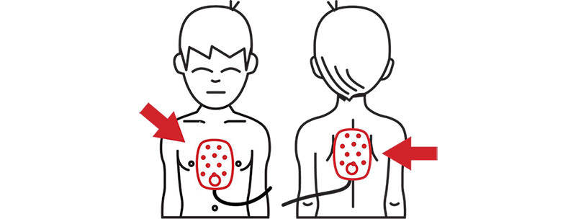
AED Use in Infants and Children
Apply AED to infants and children, pediatric-sized pads and a dose-attenuating system is preferable, however if these are not available use the adult pads and AED. Follow protocol.
If the adult pads are too big place in the anterior-posterior position.
Do not delay CPR while preparing the AED, remember the primary cause of cardiac arrest in infants and children may be respiratory in nature.
Notes:
Demonstrate CPR and AED techniques

Slide 134
Summary
Remember and use the PAT (Pediatric Assessment Triangle)
The EMT should be able to recognize a severely ill or injured child and begin life-saving measures immediately
Remember most cardiac arrests for pediatrics begin as respiratory issues in nature.
Follow your protocol for pediatric cardiac arrest management

Slide 135
Module IV – Section II – OB Emergencies
Objectives
  Identify abnormal presentations during childbirth and nuchal cord presentations
  Discuss management of abnormal presentation and nuchal cord presentation during delivery
  Recognize the need for neonatal resuscitation during delivery
  Describe steps for neonatal resuscitation
  Describe routine care of a newborn not requiring resuscitation

Slide 136
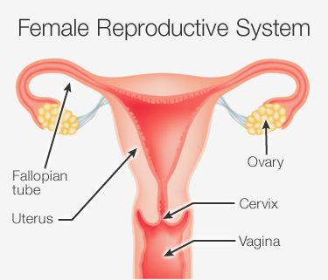
A & P of the Female Reproductive System
Ovaries
Fallopian tubes
Uterus
  Endometrium
Cervix
Vagina
Notes:
Discuss each and their function within the female reproductive system

Slide 137
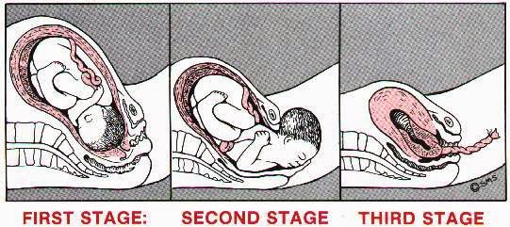
Pregnancy terms
Fertilization
Embryo
  0-10 weeks
Fetus
  10 weeks to delivery
Bloody show
  Mucous plug that seals the uterine opening preventing contamination from the outside
Perineum
  The area between the vagina and the anus
Placenta
  Disk-shaped structure attached to the uterine wall that provides nourishment to the fetus connected via the umbilical cord
Umbilical cord
  “lifeline” of the fetus to the placenta to mom
Amniotic sac
  Bag of waters, contains 500 to 1,000 cc of fluid, insulates and protects
Term gestation
  39 to 40 weeks of pregnancy
Notes:
Discuss each term and what their function or role is.

Slide 138
Abnormal Presentations in Childbirth
Breech
  Buttocks or both feet present first
  Management:
    Prompt transport
    Two patients to consider, mother and child
    Field delivery is not ideal
    When delivery is unavoidable
      Support buttock and legs
      If head does not deliver within 3 minutes insert a gloved hand into the vagina and use your fingers to form a “V” on either side of the infants nose. Push the vaginal wall away from the infant’s face. Immediately transport.

Slide 139
Abnormal Presentations in Childbirth cont.
Limb presentation
  One leg or arm protruding from vagina
  Management
    Do not touch the limb
    Do not attempt field delivery
    Provide supportive care and transport in the knee-chest position
Multiple births
  More than one baby
  Management
    Call for an additional ambulance and crew
    Manage as with a normal delivery, recognizing the need for additional equipment and personnel

Slide 140
Abnormal Presentations in Childbirth cont.
Prolapsed Cord
  Umbilical cord presents from the vaginal prior to the fetus
  Management
    Immediate transport in Trendelenburg or knee-chest position
    Insert two-fingers of a gloved hand into the vagina to remove pressure off the cord
    Keep the cord moist with sterile moist dressing
    Do not attempt to pull the cord or push the cord back into the vagina
Nuchal Cord
  Cephalic presentation but the umbilical cord is around the neck
  Common finding during delivery and rarely associated with adverse outcomes
  Management
    Attempt to slip the cord over the infant’s head
    If unable to slip the cord up and over the head, clamp and carefully cut the cord

Slide 141
Abnormal Presentations in Childbirth cont.
Shoulder Dystocia
  Shoulders unable to pass beyond pubic symphysis
  “Turtle sign” – head delivers but retracts back into the perineum because the shoulders are trapped.
  Management
    McRoberts maneuver – (buttocks off the end of the bed with thighs flexed upward) and apply firm pressure with your hand above the pubic symphysis
    Transport immediately (even if delivery attempt is unsuccessful)

Slide 142
Neonatal Resuscitation
Is there a need for resuscitation?
Three questions to ask:
  Full term gestation?
  Good muscle tone?
  Breathing or crying adequately?
  If “yes” to these questions then standard care and maintain newborn’s temperature. Infant can stay with mother.
  If “no” then resuscitative efforts should be started.
Resuscitation:
  Dry, warm, position airway, clear secretions, stimulate
  If heart rate below 100 or gasping/apnea: PPV with BVM or 100% oxygen via supplementary O2 for labored breathing or cyanosis
  Reassess in 30 seconds
  Heart rate is the most important measure in determining the need for further resuscitation.
  If heart rate continues to be below 100 after BVM begin chest compressions at a rate of 120 per minute, ratio of compression-to-ventilation 3:1
  Reassess in 30 seconds
  Consider ALS and continue BLS interventions as needed until resuscitation successful

Slide 143
Meconium Staining care of the Newborn
Meconium is simply fetal stool, dark green material in the amniotic fluid.
Meconium can be thick or thin
If the newborn is vigorous with good respiratory effort and muscle tone with meconium stained amniotic fluid present, suction as normal, mouth then nose with a bulb syringe, gently if needed.
If the newborn has signs of fetal distress, poor muscle tone, respiratory compromise, immediately begin resuscitative efforts.

Slide 144
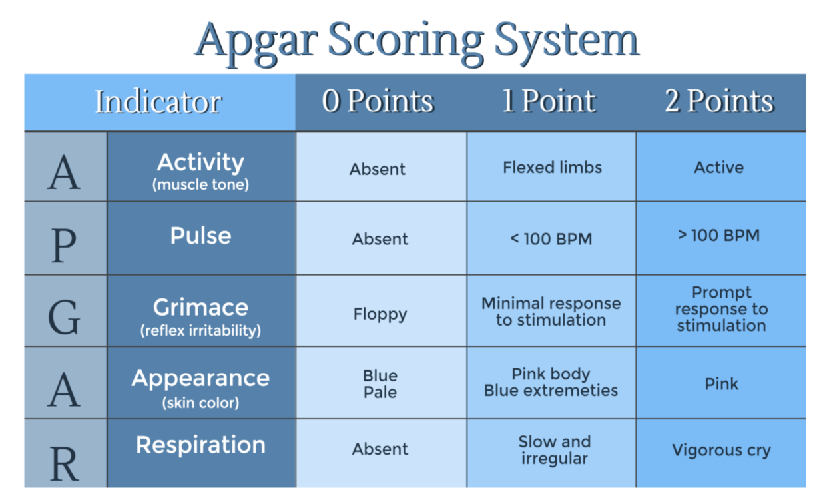
APGAR Scoring
Appearance
  Pink, blue
Pulse
  Equal to or above 100
Grimace or irritability
  Grimace, cry, or withdrawing
Activity
  Muscle tone, flexion and extension of knees and hips
Respirations
  Regular, rapid, good strong cry or slow, shallow and labored

Slide 145
Summary
Being able to recognized an abnormal presentation and when delivery is not an option for the EMT in the field
Recognize the distressed neonate
Know the steps to neonatal resuscitation for the distressed newborn
Know the steps for care of the newly born infant without distress

Slide 146
Module IV – Section III – Special Healthcare Needs
Objectives
  Identify common special needs patients seen in EMS
  Relate the role caregivers of the special needs patient to the EMS Professional’s patient care
  Describe patient assessment of a special needs patient

Slide 147
Define Special Healthcare Needs
Special Healthcare Need:
  A condition that requires medical management, healthcare intervention, and/or use of specialized services or programs. Health care for persons with special needs requires accommodation and adaptation above and beyond the normal routine EMS care usually given.
Can be any of the following:
  Physical limitations
  Mental limitations
  Heightened or decreased sensory attributes
  Behavioral, cognitive, or emotional impairment
Notes:
Discuss:
Physical limitations
Mental limitations
Heightened or decreased sensory attributes
Behavioral, cognitive, or emotional impairment
Examples.

Slide 148
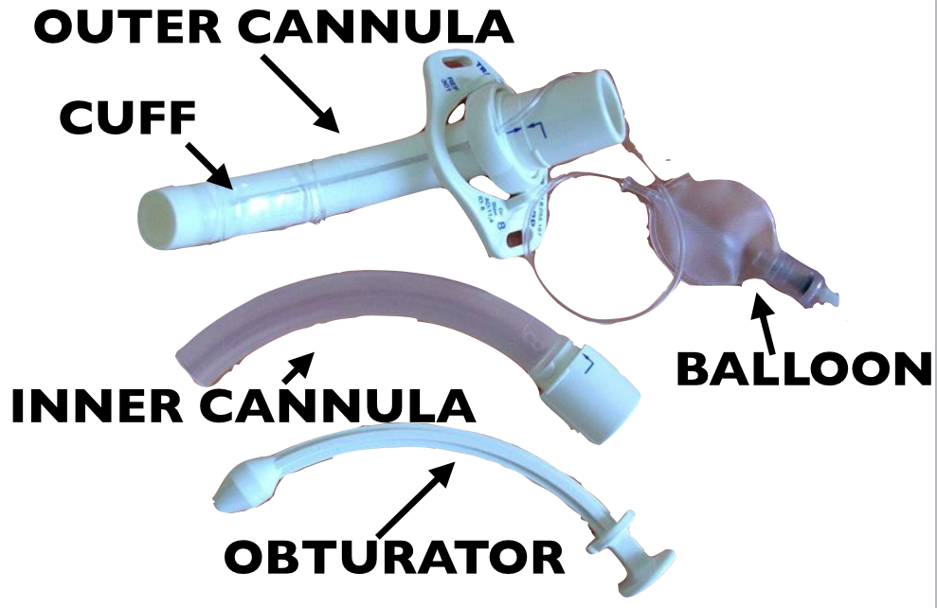
Common Equipment EMS Providers may Encounter
Tracheostomy Tube
  Surgical opening in the trachea (stoma)
  Can be temporary or permanent
  Keep clean and dry
  Suction as needed
  Useful mnemonic to remember in managing the trach tube is DOPE
    Displaced, dislodged or damaged tube
    Obstructed tube(secretions, blood, vomit)
    Pneumothorax
    Equipment failure (kinked tube, ventilator malfunction, empty oxygen supply)

Slide 149
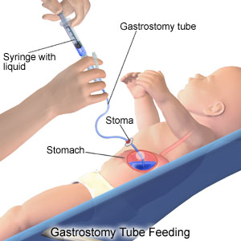
Common Equipment EMS Providers may Encounter
Feeding tubes
  Gastrostomy tubes or G-tubes can be inserted through the mouth or nose or into the stomach through the abdominal wall
  Tube can become dislodged with could cause nausea, abdominal pain, vomiting (either bright red blood or coffee-ground like emesis)
  Transport sitting up or on the right side to help prevent aspiration of stomach contents

Slide 150
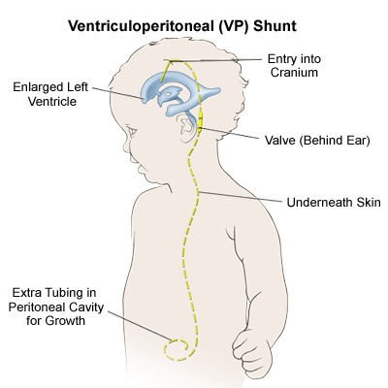
Common Equipment EMS Providers may Encounter
Cerebrospinal fluid shunts
  Device used to drain excess CSF from the brain
  The shunt drains fluid from the ventricles of the brain to the stomach
  The shunt can become blocked or infected
  s/s of an occluded shunt can be similar to a brain injured patient
  Fever, redness along the tract of the shunt for signs of infection

Slide 151

Common Equipment EMS Providers may Encounter
Urostomy
  Surgical opening from the urinary system creating a stoma to drain urine usually for someone who has had their bladder removed
Colostomy
  Surgical opening from the large intestine through the skin to drain waste products
Ileostomy
  Surgical opening from the small intestine through the skin to drain waste products

Slide 152


Colostomy and Ileostomy

Slide 153

Common Equipment EMS Providers may Encounter
Indwelling Central Venous Catheters (central line)
  Tip is placed in the Vena Cava for venous access long term for pain management, antibiotic long-term, chemotherapy, total parenteral nutrition (TPN) and hemodialysis
  Can be placed in the chest, upper arm or subclavian area
  Bleeding can occur at the site
  Potential for infection or occlusion

Slide 154
Cognitive Impairments
Developmental disability – insufficient development of the brain resulting in some level of dysfunction or impairment
Despite their age cognitively, impaired patients might still need a caregiver
Cognitively impaired or non-communicative patients may still be aware of your actions and words
Common difficulties EMS may encounter is obtaining an accurate and complete history
Time and patience are very much a factor for management
Role of the caregiver is vital

Slide 155
Cognitive Impairments
Autism Spectrum Disorder
  Describes a group of complex disorders of brain development that varies greatly in signs and symptoms.
  Impairment of social interaction may be apparent, severe behavioral problems, repetitive motor activities and verbal and nonverbal language impairment, hyper or hyposensitive to sensory stimuli.
  Rely on caregivers to guide your assessment actions.

Slide 156
Cognitive Impairments
Down Syndrome
  Genetic chromosomal defect resulting in mild to severe intellectual impairment
  Depending on their level of intellectual disability they may lead independent lives, they may be employed, vote, and get involved in their communities.
  They are at increased risk of medical complications such as:
    Cardiac, sensory, endocrine, musculoskeletal, dental, and GI system as well as neurological issues

Slide 157
Assessment of the Special Healthcare Needs Patient
Interaction with the caregiver for the special needs patient is going to be a very important part of your assessment. Parents, caregivers, home health staff are well versed in caring for and troubleshooting problems with these individuals.
Assess ABC’s and correct life-threatening issues
Assess the patient’s vital signs and note their normal “baseline” status and what is different today.
Do they have any specific allergies that you need to be made aware of, specifically latex or anything you may use that they may be highly sensitive to.
Do they have a specific facility that they need to be transported to?
Do they have a “go bag”? (this needs to go with them)
Follow your protocols for specific interventions

Slide 158
Summary
Should be able to identify patient with special needs and how to manage
Be able to address issues with the following: (follow protocol)
  Tracheostomy
  Feeding tubes
  Central Venous Catheters
  Cerebrospinal shunt
  Urostomy, colostomy, ileostomy
Handle patients with cognitive impairments

Slide 159
EMT Refresher
Module V
Trauma/Ops II Management & Considerations
Trauma and field triage, hemorrhage control, pediatric transport, ambulance safety, crew resource management, evidence based guidelines

Slide 160
Module V – Section I – Trauma and Field Triage
Objectives
  Identify triage criteria for the trauma patient in the Field Triage Decision Scheme
  State the four steps of the CDC’s Field Triage Decision Scheme
  Examine local protocols

Slide 161
Triage Criteria for the Trauma Patient
Physiologic Criteria
  Respiratory rate
  Peripheral pulses (indicating shock)
  Mental status
Anatomic Criteria (some patients may pass the physiologic criteria but have major injuries that require a higher priority)
  All penetrating injuries to the head, neck, torso, extremities proximal to elbow or knee
  Chest wall instability or deformity
  Two or more long-bone fractures
  Rushed, degloved, mangled, or pulseless extremity
  Amputation proximal to wrist or ankle
  Pelvic fractures
  Open or depressed fractures of the skull
  Paralysis
Notes:
Review triage tag

Slide 162
Triage Criteria for the Trauma Patient
Mechanism of Injury (transport to trauma center)
  Falls
    Adults >20 feet (one story = 10 feet)
    Children >10 feet or two to three times the height of the child
  High-risk auto crash
    Intrusion, including roof: >12 inches occupant site; > 18 inches any site
    Ejection
    Death in same compartment
  Automobile versus pedestrian/bicyclist thrown, run over, or with significant (> 20 mph) impact
  Motorcycle crash >20 mph
Special Considerations
  People who have not met any of the other factors but have comorbid factors or underlying health issues that may require them to be transported to a trauma center
  Anticoagulants and bleeding disorders
  Burns
  Pregnancy >20 weeks
  Older adults
    Risk for injury/death increases after age 55 years
    Low impact mechanisms might result in severe injury

Slide 163
Four Steps of the CDC’s Field Triage Decision Scheme
Step I
  Assess vital signs and level of consciousness
    GCS
    Resp Rate
    Systolic BP (peripheral pulses, perfusion)
Step II
  Assess anatomy of injury
Step III
  Assess mechanism of injury
Step IV
  Assess special patient or system considerations
    Considering priority transport to trauma center for older adults, pediatrics, burns, OB patients, anticoagulant and bleeding disorders
Notes:
CDC – Guidelines for Field Triage of Injured Patients, 2011

Slide 164
Summary
State the four criteria for triaging trauma patients:
  Physiologic
  Anatomic
  Mechanism of Injury
  Special Considerations

Slide 165
Module V – Section II – Hemorrhage Control
Objectives
  Identify and treat severe hemorrhage
  Define the indications, effects, and contraindications for use of
    Tourniquets
    Hemostatic agents

Slide 166

“C” ABC’s
Control Hemorrhage, after scene safety, this is the single most important factor of patient care in trauma management
Perfusion
  Circulation of blood within the organs and tissues in adequate amounts to meet the needs of the cells with oxygen, nutrients and waste removal
Shock
  Inadequate circulation of blood for every body part to perform its function

Slide 167
Signs and Symptoms of Hypoperfusion from blood loss
Change in mental status
Pale skin
Tachycardia
Weakness, dizziness at rest
Thirst
Nausea and vomiting
Cold, moist (clammy) skin
Shallow, rapid breathing
Dull eyes
Slightly dilated pupils that are slow to respond to light
Capillary refill time longer than 2 seconds in infant and children
Weak, rapid, (thread) pulse
Decreasing BP

Slide 168
Identifying Hemorrhage
External Bleeding
  Arterial bleeding
    Bright red and usually a large amount more difficult to control
  Venous bleeding
    Can flow slowly or rapidly depending upon the size of the wound, dark red in color
    *Note the amount of blood loss
Internal Bleeding
  Can be very serious.
  Difficult to determine the extent of the blood loss
  Suspect internal bleeding from mechanism of injury and reassess often for s/s of shock
Notes:
Note: Patients on blood thinners, their bleeding times are increased causing problems for both external and internal hemorrhage control to be exaggerated.

Slide 169

Tourniquet use in Hemorrhage Control
Tourniquets
  External bleeding from an extremity that cannot be controlled by direct pressure
  Should block arterial blood flow, tighten enough to stop bleeding or until no pulse is felt distal to the injury
  There is no contraindication to the use of a tourniquet in an emergency situation where bleeding cannot be controlled by direct pressure
  Treat for shock

Slide 170

Hemostatic Agents used to control External Hemorrhage
Chemical compound that slows or stops bleeding by assisting with clot formation. Primarily used in military medicine to stop profuse bleeding.
Used with massive hemorrhage in areas where tourniquet placement is impossible
Follow local protocol for type used (many brands are on the market)
Notes:
Discuss proper use and technique for use of the hemostatic agents

Slide 171
Summary
Rapid identification and control of hemorrhage if vital for optimum patient outcome
Recognize s/s of shock
Know when to use a tourniquet and how
Know when and how to use hemostatic agents

Slide 172
Module V – Section III – Pediatric Transport
Objectives
  Explain how to appropriately secure a child safety restraint to a stretcher
  Discuss the difference between the NHTSA recommendations for safe transport of children based on the condition of the child
  Discuss the on-going initiatives to increase the safety of children during ambulance transport and the limitations of those current recommendations

Slide 173
Safely Transporting Children General Guiding Principles
All ambulances should have seats and restraints appropriate for securing children from newborn up.
All child seats/restraints should only be attached to cots, cot mounts and restraints that have been tested and comply with standards. (NHTSA)
A child passenger, especially a newborn, must never be transported on an adult’s lap
It is NOT appropriate to transport children, even in a child restraint system, on the multi-occupant squad bench located in the patient compartment of ground ambulances.
All child seats/restraints used for transporting children in ambulances should be approved for such use

Slide 174
Transport of Children Based on Condition
Situation 1: Child is uninjured/not ill accompanying an injured or ill adult
  Transport the child in another vehicle other than the ambulance
  When another vehicle is not an option
    Transport in appropriate sized child restraint system in forward facing front seat passenger seat with airbags in the “off” position
    Transport in the forward-facing EMS provider seat/captain’s chair in size-appropriate restraint system
    Transport in a rear-facing EMS provider seat/captain’s chair in size-appropriate restraint system
    Leave the uninjured/not ill child under appropriate adult supervision on scene

Slide 175
Transport of Children Based on Condition, cont.
Situation 2: A child who is ill/injured and whose condition does not require continuous and/or intensive medical monitoring and/or interventions.
  Secure and transport the child on the cot in a size-appropriate child restraint system that complies with the injury criteria with the Federal Motor Vehicle Safety Standard
Situation 3: A child whose condition requires continuous and/or intensive medical monitoring and/or interventions.
  Secure and transport the child on the cot in a size-appropriate child restraint system that complies with the injury criteria of the Federal Motor Vehicle Safety Standard
Notes:
Refer to criteria FMVSS (Federal Motor Vehicle Safety Standard) No. 213, NHTSA
EMS.gov

Slide 176
Transport of Children Based on Condition, cont.
Situation 4: A child whose condition requires spinal immobilization or lying flat
  Secure the child to a size appropriate spine board (Pedi-board if available)
  Secure the spine board to the cot
    Head first, with a tether at the foot (if possible) to prevent forward movement
    Use three horizontal restraints across the torso (chest, waist, and knees)
    Use a vertical restraint across each shoulder

Slide 177
Transport of Children Based on Condition, cont.
Situation 5: A child or children who require transport as part of a multiple patient transport (newborn with mother, multiple children, etc.)
  When possible, transport each as a single patient according to one of the guidelines in the situations listed in 1-4.
  Transport in the forward-facing EMS provider’s seat in a size-appropriate child restraint system that complies with the Federal Motor Vehicle Safety Standard
  For mother and newborn, transport the newborn in an approved size-appropriate child restraint system that complies with the injury criteria of the Federal Motor Vehicle Safety Standard
    DO NOT USE the rear-facing only seat in the rear-facing EMS provider’s seat
    Transport the mother on the cot
Notes:
FMVSS No. 213, EMS.gov, NHTSA

Slide 178

Ongoing Initiatives to Increase Safety of Children During Transport
NASEMSO (National Association of State EMS Officials) leads the Safe Transport of Children Committee with these goals:
  Recommending criteria for proper restraint of children in ambulances, evidence-based, considering safety for both providers and patients
  Have recommended criteria adopted by one or more accredited standard setting organizations
  Developing a plan and resources for educating EMS providers on safely transporting in ground ambulances based on these standards or recommendations

Slide 179
Limitations of the Recommendations for the Safety of Children During Transport
Available research on child restraint systems only rates the safety in normal use, not in ambulances
Not enough evidence from research on simulated ambulance crashes involving child restraint systems to recommend evidence-based guidelines
All child restraint systems are only as effective as the manner in which they are secured to a cot and in an ambulance

Slide 180
Summary
Before you transport a the pediatric patient, make sure you have the appropriately sized child safety restraint system which meets the Federal Motor Vehicle Safety Standards
Each organization should probably take the time to prepare for every scenario when transporting pediatrics.
Follow protocol and more importantly be safe!

Slide 181
Module V – Section IV – Ambulance Safety
Objectives
  Discuss Federal initiatives developed to monitor and analyze ground ambulance crashes. Reference: NHTSA Advances Ground Ambulance Safety…..
  Identify the significance of ambulance crashes through the use of national data
  Evaluate policies and procedures at one’s own EMS service related to protecting patient and provider safety during ground ambulance transport

Slide 182
Ambulance Safety: NHTSA (National Highway Traffic Safety Administration) Initiatives
NHTSA collects, reports and analyzes data from ambulance crashes
NHTSA collaborates with national stakeholders, state and local officials to improve safety for EMS personnel, patients and the general public in relation to ground ambulance transport
The data that is collected, is disseminated and used to develop policies and procedures to protect EMS personnel and patients as well as the general public

Slide 183

Ambulance “Crash” Data
EMS providers did not use safety restraints in 80% of investigated crashes
In 71% of investigated crashes, patients were not restrained by both a shoulder and lap restraint during transport
Patients were ejected from cots in 44% of investigated crashes
Patients effected from the cot are at greater risk of sustaining severe or fatal injuries than those who remain restrained
Notes:
NHTSA Advances Ground Ambulance Safety by Tracking and Investigating Crashes
Ems.gov/newsletter/marapr2015/ground-ambulance

Slide 184
Significance of Ambulance Crashes
An average of 4,500 crashes annually (2014)
  1,500 of these are “injury crashes”
  59% while in emergency use
  Annual mean of 29 fatal crashes/year with 58% while in emergency use
  42% non-emergency use
    Of the fatalities
      4% ambulance driver
      21% ambulance passenger
      63% occupant of other vehicle
      12% non-occupant
    Of the injuries
      17% ambulance driver
      29% ambulance passenger
      54% occupant of other vehicle

Slide 185
Factors Contributing to Injuries/Fatalities Sustained During Ambulance Crashes
84% were unrestrained EMS providers
Unsecured patients (both shoulder and lap restraints)
  33% were secured by both restraints
44% of patients were ejected from the cot in serious crashes
61% of patients were restrained with lateral belts only
38% had shoulder harnesses available but were unused
Notes:
NHTSA Advances Ground Ambulance Safety by Tracking and Investigating Crashes
Infographic – When Ambulances Crash: EMS Provider and Patient Safety

Slide 186
Evaluating Your Own Departments EMS Service Policies and Procedures for Ambulance Safety
What are your own agencies policies/guidelines regarding patient restraint for transport? Do you have any?
What change would you make to reduce risk of patient injury in the event of an ambulance crash?
What are your agencies policies/guidelines regarding securing EMS providers in patient compartment during transport?
What changes would you make to reduce risk to your EMS provider in the event of an ambulance crash?
What are your agencies policies/guidelines regarding securing equipment and supplies in the patient compartment?
Are those adequate to prevent patient and/or EMS provider injury in the event of an ambulance crash (or during transport)?

Slide 187
Summary
Ambulance Safety requires due diligence on the part of all EMS providers.
Developing and enforcing policies/procedures regarding EMS provider and patient safety should be a priority for any organization

Slide 188
Module V – Section V – Crew Resource Management
Objectives
  Define Crew Resource Management
  Explain the benefits of CRM to EMS
  Explain the concept of communication in the team environment advocacy/inquiry or appreciative inquiry
  State characteristics of effective team leaders
  State characteristics of effective team members
  Explain how the use of CRM can reduce errors in patient care

Slide 189
Crew Resource Management
A way for team members to work together with the team leader to develop and maintain a shared understanding of the emergency situation.
Allows team members with different skill sets to join and communicate, meet their roles and responsibilities and achieve a shared goal for the best possible patient outcome.
Created to optimize human performance by reducing the effect of human error through the use of all resources, including:
  People
  Hardware
  Information

Slide 190
Benefits of Crew Resource Management
Aim is to reduce errors in patient care
Improve safety for patients and caregivers
Improve team performance
  Conflict resolution
  Improved communication
  Increased feedback
  Better workload management; task assignments
  Improved clinical decision making
All members of the organization participate in CRM and CRM training
Notes:
Briefly explain each segment of team performance*

Slide 191

Concept of Communication
Advocacy and Inquiry Communication; appreciative inquiry
  Four steps:
    Alert the other members of the team to a situation or action of concern
    State the problem as it is seen
    State a solution or alternative
    Obtain agreement among the team to alter plan or action

Slide 192

Characteristics of Effective Team Leaders
Team Leaders
  Creates, implements and revises and action plan
  Communicates accurately and concisely while listening and encouraging feedback
  Receives, processes, verifies, and prioritizes information
  Demonstrates confidence, compassion, maturity, and command presence
  Treats all team members as equals
  Uses closed-loop communication

Slide 193

Characteristics of Effective Team Members
Maintains situational awareness
Uses closed-loop communication
Performs tasks accurately and in a timely manner
Immediately suggests corrective action if a harmful intervention is ordered/performed by others
Communicates accurately and concisely while listening and encouraging feedback
Receives, processes, verifies, and prioritizes information
Demonstrates confidence, compassion, maturity, and command presence

Slide 194
Reducing Errors in Patient Care thru CRM
Increased communication among crew can reduce potential safety concerns for the crew
Team members experience a safe environment in which to identify human errors and suggest ways to mitigate or eliminate errors
Routine training and practice of CRM can increase self-awareness and self-efficacy for all personnel
Increasing patient safety, mitigation or elimination or errors, and increasing the overall effectiveness of a team
Improving communication during patient care

Slide 195
Summary
The concept of crew resource management states that each member is responsible for maintaining awareness of the current patient situation and providing critical information sharing with the team leader as is the team leader with the team members.
CRM recommends using a PACE mnemonic:
  P – Probe: look or ask to confirm the problem
  A – Alert: communicate the problem to the team leader
  C – Challenge: If the issue is not corrected, then “challenge” the team’s present course of action that is leading to the problem
  E – Emergency: if the problem is clear and critical (immediate safety issue), then immediately communicate the emergency to the entire team.
This concept is a “group” effort and there is no “i” in team!

Slide 196
Module V – Section VI – Evidence Based Guidelines
Objectives
  Define evidence based medicine and practice
  Identify resources available through NASEMSO (National Association of State EMS Officials) to aid states and agencies in developing evidence based guidelines
  Explain the benefits of evidence based guidelines for patients

Slide 197
Evidence-based Medicine and Practice
Statements developed through prolonged scientific inquiry that inform EMS systems, medical directors and EMS personnel on standards of care that have been vetted by research.
Patient care should be focused on procedures that have been proven useful in improving patient outcomes. This is why evidence-based practice is becoming an integral part of the EMS field.
As an EMT or any EMS provider at some point in your career you will be part of gathering or inputting data which will be part of a study to improve some segment of patient care – this is evidence-based medicine and practice.

Slide 198
Resources Assisting with Evidence-Based Guidelines
NASEMSO – Statewide Implementation of an Evidence-Based Guideline
NEMSAC (National EMS Advisory Council) and FICEMS (Federal Interagency Committee on EMS) both provided recommendations to support development and use of EBG’s
NAEMSP (National Association of EMS Providers) received funding from EMSC (Emergency Medical Services for Children) in cooperative agreement with NHTSA (National Highway Traffic Safety Association)
NEMSIS (National EMS Information System)
Notes:
National Prehospital Evidence-Based Guidelines Strategy

Slide 199
Examples of EMS Evidence-Based Guidelines
“Pediatric Prehospital Seizure Management”
“Prehospital Pain Management in Trauma”
“Air Medical Transport of Prehospital Trauma Patients”

Slide 200
Benefits of Evidence-Based Guidelines
Ensures high quality patient management
  Standardized, consistent approach
  Proven successful through expert practice and clinical evidence

Slide 201
Summary
As an EMT, you will primarily be involved in the research end of evidence-based guidelines through gathering data.
You may be part of a study to determine how much oxygen to give to a certain category of patients.
You may be part of a study to determine how long it takes to transport a trauma patient by ground vs. waiting for air transport and their arrival time to a trauma facility
You can even use your collected reports to gather data to assist in determining protocol development.
All is evidence-based and only helps to improve patient care.

