Slide 1
So Every BODY Can Move MN O&P Lobbying/Advocacy 101
Teri Kuffel, JD & Tom DeGree
February 2024

Slide 2
Presenters
Teri Kuffel, JD
Attorney, MN O&P Business Owner at Arise O&P
Wiggle Your Toes Board Member
MSOPP Board Member
AOPA Past President
Instructor Concordia MN (Master’s P&O)
15 Years Lobbying/Advocating in MN & DC
Tom DeGree
Teacher St. Paul Public Schools (SPPS)
Administrator SPPS
Associate Director Minnesota Association of Charter Schools (MACS)
Policy Director of MACS
2019 RBKA from car crash

Slide 3
Three Types of Advocacy
Self
Advocacy
Individual
Advocacy
System
Advocacy

Slide 4
Self Advocacy
Speak up for yourself!

Slide 5
Individual Advocacy
“Advocacy is having someone to stand beside you if you think something is unfair or that someone is treating you badly and you would like to do something to change it."

Slide 6
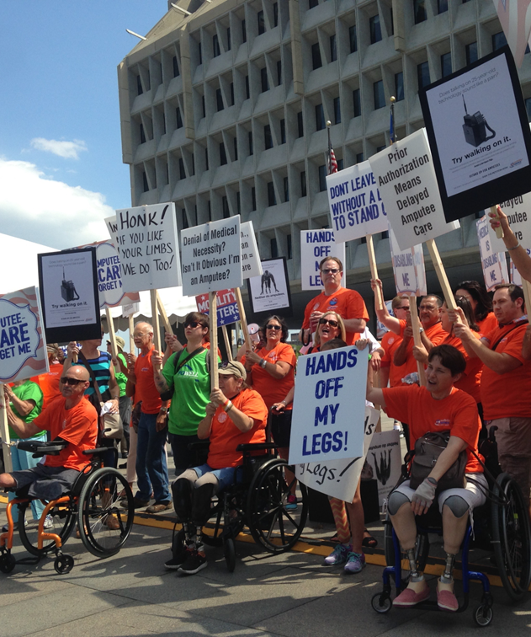
Systems Advocacy
Systems advocacy is about changing policies, laws or rules that impact how someone lives their life.

Slide 7
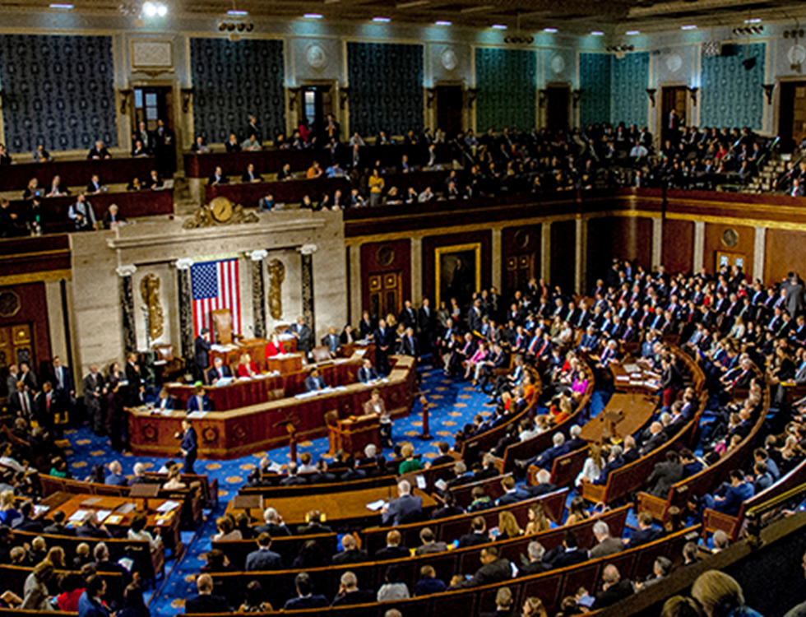
Who needs to hear our advocacy stories?

Slide 8
Let’s Talk Policy
Who is in harm?
How are they harmed?
How can the system prevent that harm?
What are the challenges that need to be addressed?
How are we forced to act in the face of those challenges?
MN Fact Sheet HF3339 & SF 3351 (handout)

Slide 9
MN HF3339 & SF3351: Public Health Problem
The public health problem affecting individuals with limb loss and limb difference (LLLD)…
There are over 28,000 individuals with LLLD in Minnesota.
Many of these Minnesotans are unable to afford and access life-changing orthotic and prosthetic (O&P) care that restores mobility due to:
lack of insurance coverage,
“not medically necessary” denials,
and high out of pocket costs.

Slide 10
MN HF3339 & SF3351: Public Health Problem
Without health plan coverage, adults, children, and families are forced to:
Incur prohibitive out-of-pocket costs (ranging from$5,000 -$50,000);
Risk harm/injury using an improper device;
Live socially isolated and sedentary lifestyles with costly health complications including obesity, diabetes and depression.
Minnesotans with disabilities need fair access to prostheses and orthoses for daily independence and physical activity.
Currently, 1.9 million people are living with limb loss in the US, with an average of 507 people continuing to lose a limb every day.

Slide 11
MN HF3339 & SF3351: GOAL
To amend MN law to improve access to O&P care for children and adults by requiring state insurance plans provide coverage for O&P:
1. At a level that is equivalent to the federal Medicare program;
2. In a manner that is not more restrictive than health plan’s other medical and surgical benefits including those for internal restorative devices;
3. For purposes of performing physical activities, including but not limited to running, biking, and swimming, and maximizing the enrollee's limb function;
4. For the purposes of showering or bathing; and
5. In a manner that shall not deny an O&P benefit for an individual with limb loss or absence that would otherwise be covered for a nondisabled person seeking medical or surgical intervention to restore or maintain the ability to perform the same activity.

Slide 12
MN HF3339 & SF 3351: Potential Social & Fiscal Impact
Ensuring appropriate O&P coverage has a minimal impact on insurance premiums while providing long term social and fiscal benefits by improving health access and equity for Minnesotans with disabilities.
***The estimated increase to MN premiums is conservatively calculated at $0.01-$0.39 Per Member Per Month (PMPM).
Legislation of this type is seeing widespread support across the country:
Arkansas (HB 1252), Colorado (HB 1136), Illinois (SB 2195), Maine (LD 1003), and New Mexico (HB 131) enacted similar legislation in 2022 and 2023.
Florida (SB 0828 / HB1003), Indiana (HB 1428), Maryland (SB 614), Massachusetts (HD 4491), Minnesota (HF 3339/ SF 3351), New Hampshire (SB 177), New Jersey (SB 1439), and Tennessee (HB 1992 / SB 2010) have all introduced similar legislation in 2024.

Slide 13
MN H3339 & SF3351: Coverage Benefits
Providing appropriate orthotic and prosthetic care lowers overall healthcare costs and reduces demands on government social support systems.
Without it, knee or hip problems resulting from lack of appropriate prosthetic care can result in increased healthcare costs ranging from $80,000 to $150,000 over the course of a single patient’s lifetime.
A Colorado state study showed that providing Medicaid prosthetic coverage decreased overall healthcare costs by $1,177.60 per patient.
People with disabilities who are physically active are more likely to be employed, advance in their careers, and have improved physical and mental health.

Slide 14
Creating the Advocacy Plan

Slide 15
Value of Your Legislative Visit
Thank you for being here!
You can make a difference!
In-person visits from constituents are the most influential way to communicate with a Member of Congress who is undecided on an issue.
These meetings provide a chance to build relationships, establish credibility, enable access and ultimately influence decisions.

Slide 16
Making Your Visit & Your Advocacy Effective
3 Words to Remember
10 Steps to Follow

Slide 17
3 Key Words to Remember – Why We Are All Here
EDUCATE
ADVOCATE
ACCESS

Slide 18
EDUCATE
We are all here to EDUCATE our legislators and their staff about the orthotic and prosthetic issues that are important to our patients, their friends/families and us.

Slide 19
ADVOCATE
We are all here to ADVOCATE for (and with) those who have limb loss and/or limb difference - our patients, friends, and family members.

Slide 20
ACCESS
We are all here to EDUCATE and ADVOCATE with purpose, to provide ACCESS for our patients to orthotic and prosthetic care and devices.

Slide 21
10 Steps to Your Effective Visit
1. Be Prepared
2. Do Your Homework
3. Select Your Spokesperson
4. Be Brief & Stay Focused
5. Personalize Your Issues
6. Be Positive & React Honestly
7. Be Friendly With Your Legislative Staff
8. Close the Deal & Remember the Ask
9. Leave-Behind Materials
10. Say Thank You & Write a Thank You

Slide 22
1. Be Prepared
Dress for success
Know where you are going
Building access may require security screening
Be prompt, 5-10 minutes early
Call/email the day before to confirm with office of legislator

Slide 23
2. Do Your Homework
Educate Yourself
Attend meetings, ask questions & talk to others
Review materials
Become the “Expert in the Room”
Be confident, but don’t make things up
Don’t use O&P acronyms

Slide 24
3. Select Your Spokesperson(s)
Trifecta = Patient + Practitioner +
Policy/Business Person/Student (1 person
or 3-10 people)
Decide ahead of time who will take the lead
Patients help EDUCATE & personalize the O&P issues
Practitioners explain how ACCESS to care & devices can be challenged
Policy/Business/Students ADVOCATE & explain how

Slide 25
4. Be Brief & Stay Focused
Have your short outline with you & stick to it
Start with an ice-breaker, “hometown small talk”
Know if your legislator is a Republican or Democrat
Know if your legislator is on a committee that is important to O&P and our agenda items
Know how your legislator has voted on recent healthcare bills
Know who the bill champions are

Slide 26
5. Personalize Your Issues
Tell your story
Talk about your patient/caring for your patient
Talk about your experience as student/resident
Talk about how your issue and how it will positively impact your patients
Talk about challenges in providing access to O&P care & devices

Slide 27
6. Be Positive & React Honestly
Focus on the positive aspects of the O&P world – our patients have remarkable stories and need our help
Don’t be afraid to address some of the negatives, but try to “sandwich them between” the positives
Be honest in your delivery and your responses
Be prepared to say, “I don’t know, but I can find out and get back to you!”
Don’t forget your legislator needs your vote and works for you!

Slide 28
7. Be Friendly with Your Legislative Staff
Find out with whom you are meeting, legislator or staff
Assigned staff usually has a healthcare focus
Establish a relationship with staff
DO NOT underestimate staffers
Phone/email staff to maintain your connection
Call/Email/Visit again, and again

Slide 29
8. Close the Deal & Remember the Ask
ASK them to author or co-sponsor our bill
ASK them to support our bill
ASK them to write a letter or sign onto a letter
ASK them for their support on any O&P related issues
ASK them to visit your facility or school
ASK them to take a photo

Slide 30
9. Leave- Behind Materials
Be sure to provide the “leave-behind” or fact sheet
Discuss the fact that you have materials for them so you can focus on the discussion during the meeting
Reference specific information during discussion
Provide your card/contact information so they can contact you with questions after the meeting

Slide 31
10. Say Thank You & Write a Thank You
Common courtesies go a long way!
Remember to say please and thank you!
Remember to write a thank you after your visit is finished!

Slide 32
O&P Day at the MN Capitol in Support of HF3339 & SF3351

Slide 33
Questions? Just Remember…
We are here to EDUCATE!
We are here to ADVOCATE!
We are here to help provide ACCESS to O&P care and devices for our patients/friends/family in need!
Enjoy this experience!

