Slide 1

Foot Care: Coding, Compliance, and Documentation: WPS
2019

Slide 2

Jeffrey D. Lehrman, DPM, FASPS, MAPWCA, CPC
Certified Professional Coder
Advisor, APMA Coding Committee
Expert Panelist, Codingline
Advisor, APMA MACRA Task Force
Board of Directors, American Society of Podiatric Surgeons
Board of Directors, American Professional Wound Care Association
Editorial Advisory Board, WOUNDS
Twitter: @DrLehrman

Slide 3
Learning Objectives
List the seven CPT codes for foot care
Differentiate between “routine foot care” and “nail debridement”
List the points of documentation necessary for thoroughness, continuity of care and risk management

Slide 4
Disclaimer
CPT codes and their descriptions and the policies discussed in this webinar do not reflect or guarantee coverage or payment. Just because a CPT code exists, payment for the service it describes is not guaranteed. Coverage and payment policies of governmental and private payers vary from time to time and for different areas of the country. Questions regarding coverage and payment by a payer should be directed to that payer. The coding advice provided in this webinar reflects only the opinions of the speaker. PICA and Jeffrey Lehrman and Lehrman Consulting, LLC do not claim responsibility for any consequences or liability attributable to the use of the information contained in this webinar.

Slide 5
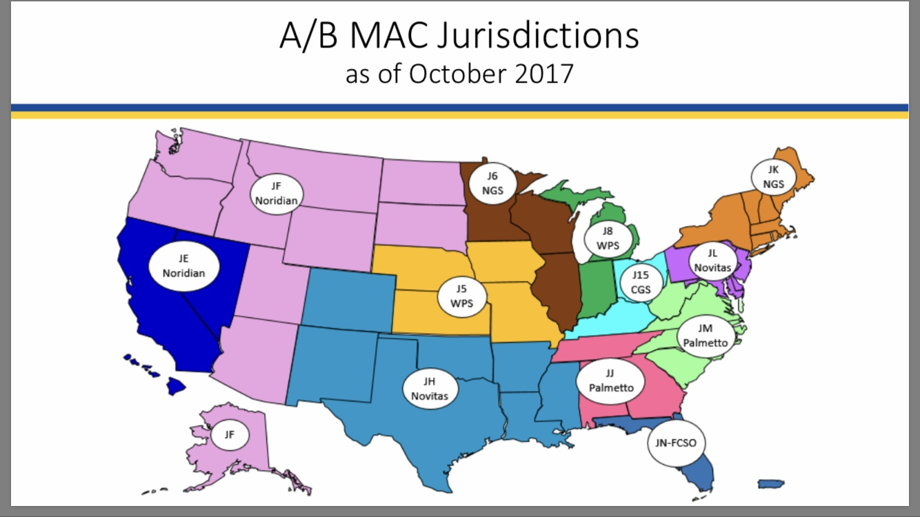
Medicare Contractors

Slide 6
WPS
Michigan
Indiana
Nebraska
Kansas
Iowa
Missouri

Slide 7
Medicare Contractors

Slide 8
WPS LCD L36404
“Foot Care”
https://www.cms.gov/medicare-coverage-database/details/lcd-details.aspx?LCDId=36404

Slide 9
WPS LCD L36404
“Foot Care”
https://www.cms.gov/medicare-coverage-database/details/lcd-details.aspx?LCDId=36404
February 15, 2019

Slide 10
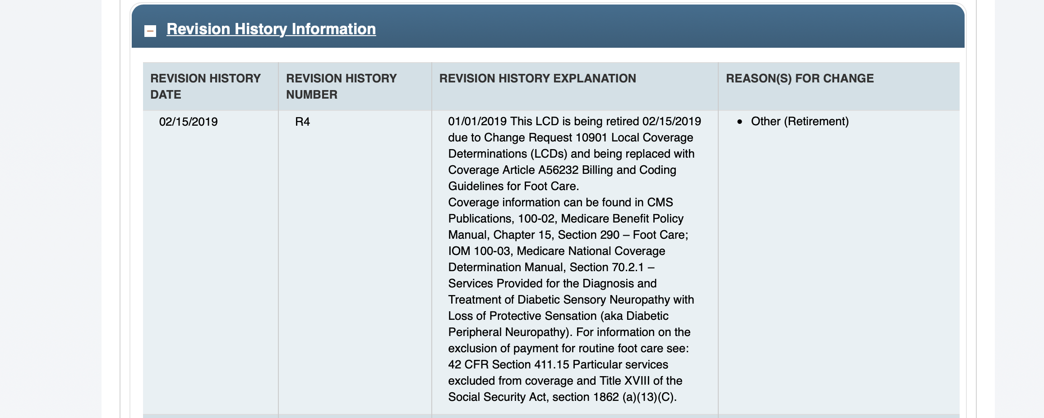

Slide 11
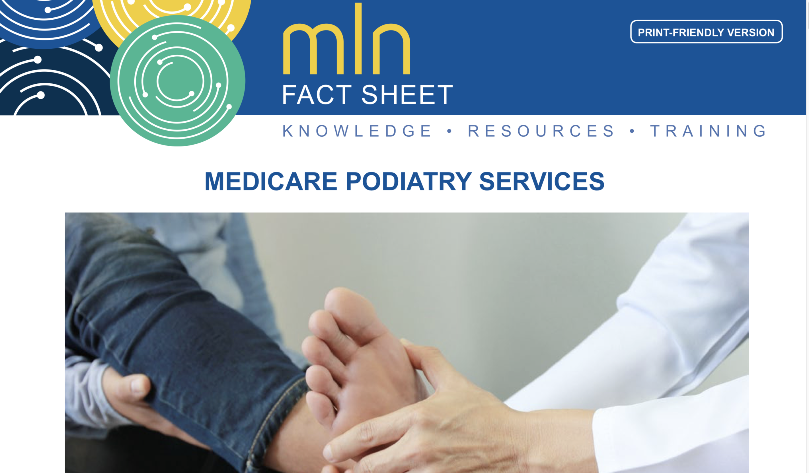
https://www.cms.gov/Outreach-and-Education/Medicare-Learning-Network-MLN/MLNProducts/Downloads/MedicarePodiatryServicesSE_FactSheet.pdf

Slide 12
Local Coverage Article:
Billing and Coding Guidelines for Foot Care (A56232)
https://www.cms.gov/medicare-coverage-database/details/article-details.aspx?articleId=56232

Slide 13
Two Different Things!
Routine Foot Care
Debridement of Mycotic Nails

Slide 14
Two Different Things!
Routine Foot Care

Slide 15
Five Qualifying Diagnoses
Diabetes mellitus *
Arteriosclerosis obliterans
Buerger’s disease
Chronic thrombophlebitis *
And……

Slide 16
Peripheral neuropathies involving the feet
  Associated with malnutrition and vitamin deficiency *
    Malnutrition
    Alcoholism
    Malabsorption
    Pernicious anemia
  Associated with carcinoma *
  Associated with diabetes mellitus *
  Associated with drugs or toxins *
  Associated with multiple sclerosis *
  Associated with uremia (chronic renal disease) *
  Associated with traumatic injury
  Associated with leprosy and neurosyphilis
  Associated with hereditary disorders
    Hereditary sensory radicular neuropathy
    Angiokeratoma corporis diffusum (Fabry’s)
    Amyloid neuropathy

Slide 17
Watch for the * !!!
MD or DO within the last 6 months

Slide 18
Class Findings
1 Class A finding (modifier Q7)
2 Class B findings (modifier Q8)
1 Class B and 2 Class C findings (modifier Q9)

Slide 19
Class A Finding:
  Nontraumatic amputation of foot
Class B Findings:
  Absent PT pulse
  Absent DP pulse
  Advanced trophic changes (at least three of the following):
    Decrease or absence of hair growth
    Nail changes
    Skin pigment changes
    Thin or shiny skin texture
    Rubor or redness of skin
Class C Findings:
  Claudication
  Temperature changes (cold feet)
  Edema
  Paresthesia (abnormal spontaneous sensations in feet)
  Burning

Slide 20
Qualifying Diagnoses Classes
1 Class A finding (modifier Q7)
2 Class B findings (modifier Q8)
1 Class B and 2 Class C findings (modifier Q9)

Slide 21
Routine Foot Care
CPT 11719: Trimming of nondystrophic nails, any number
G0127: Trimming of dystrophic nails, any number
CPT 11720: Debridement of nail(s) by any method(s); one to five
CPT 11721 : Debridement of nail(s) by any method(s); six or more
Debride = reduce bulk

Slide 22
Consider…….
CPT 11721
CPT 11720 + G0127

Slide 23
Where to put the modifier?
CPT 11720
G0127

Slide 24
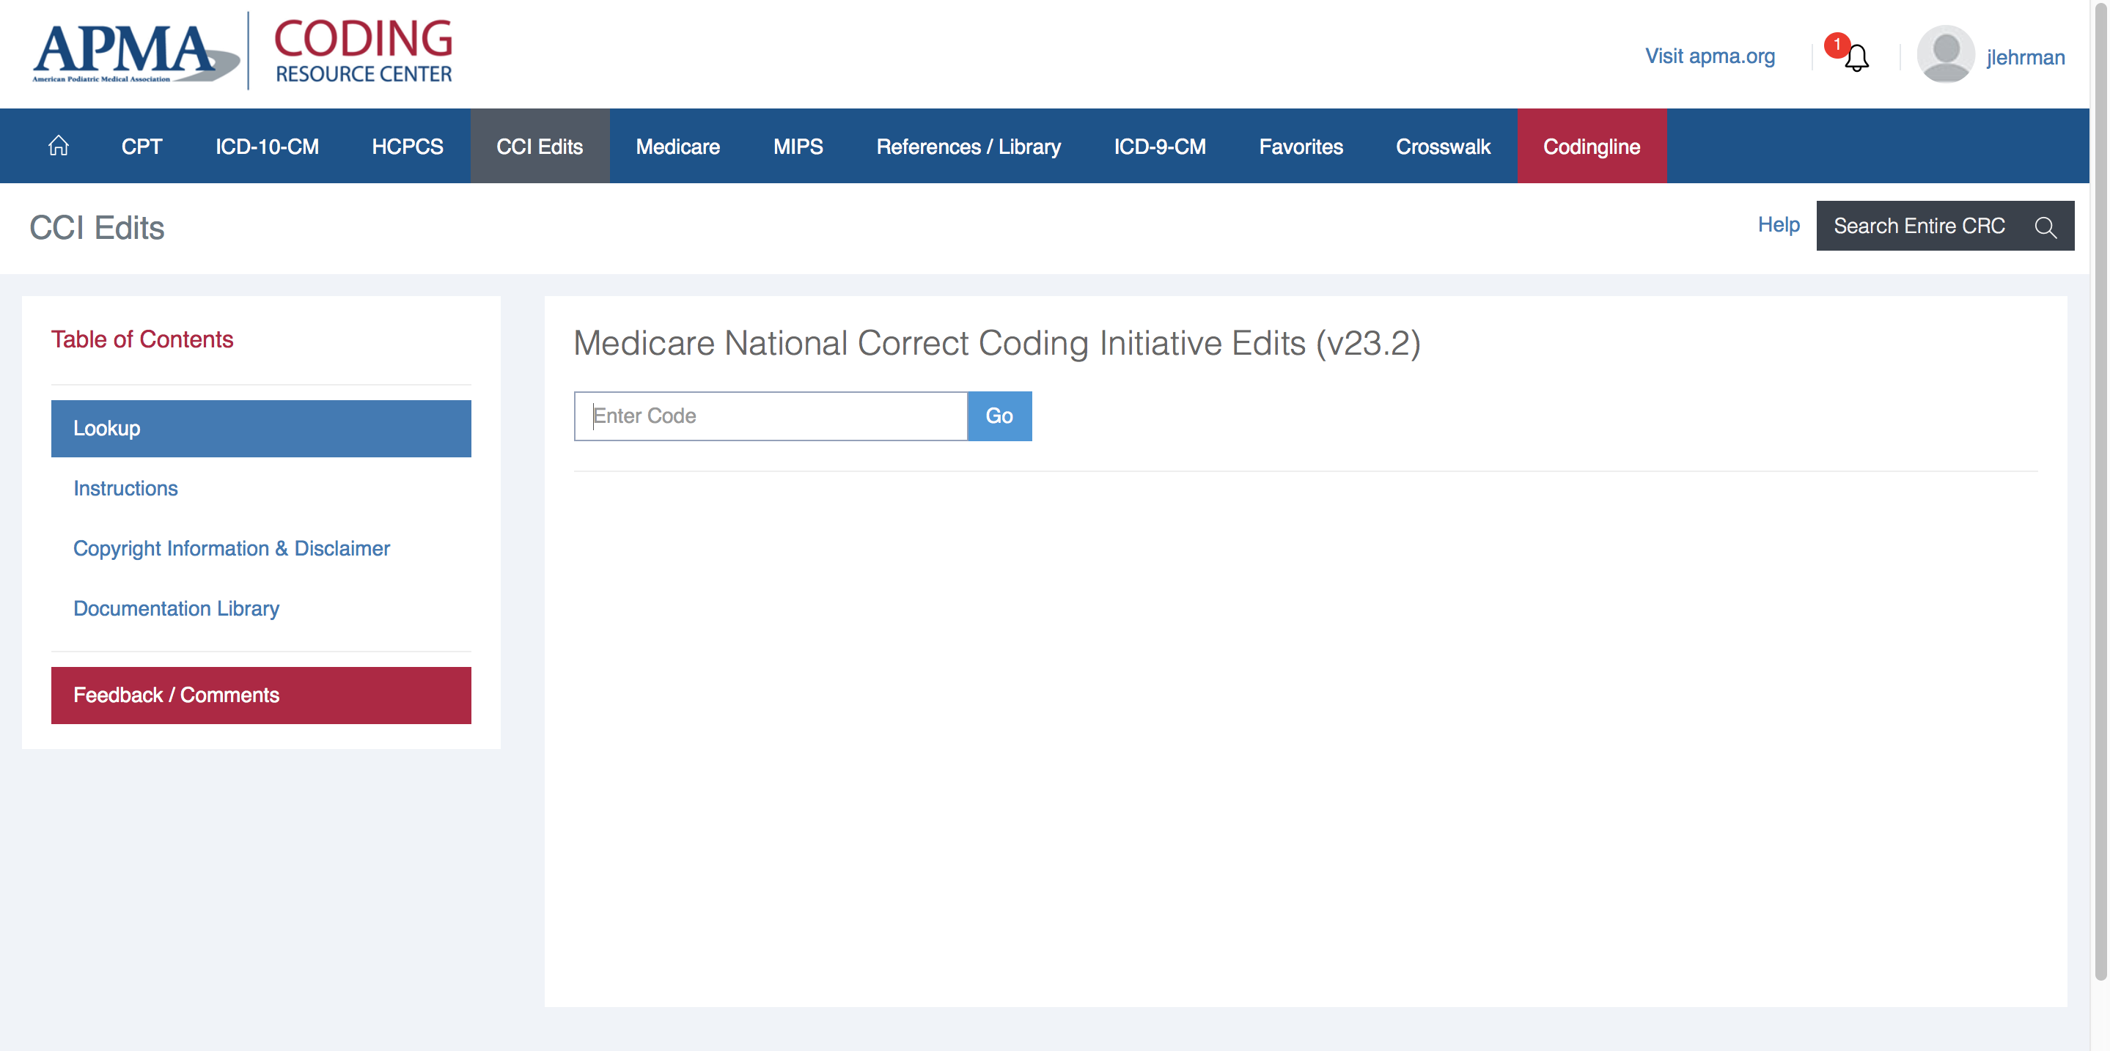

Slide 25
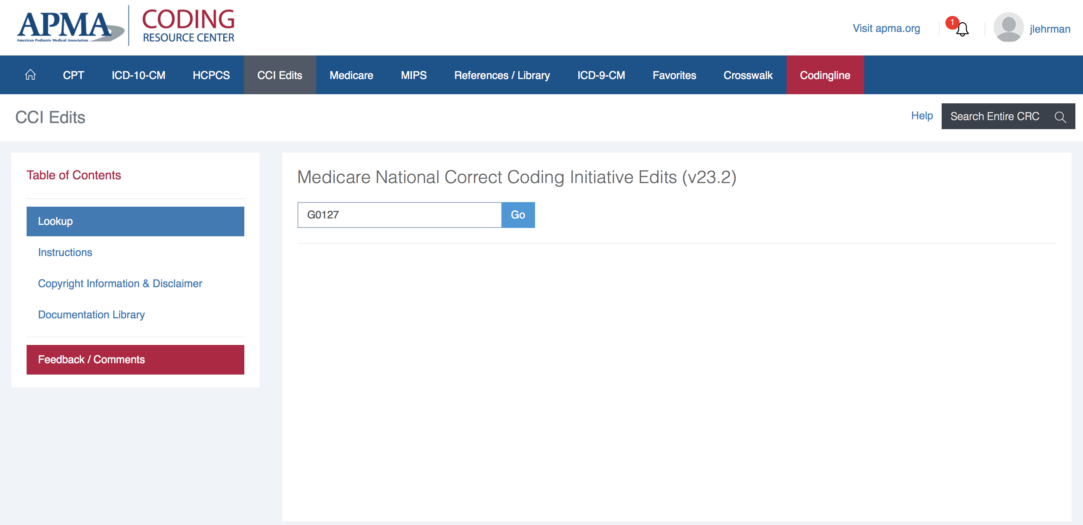

Slide 26
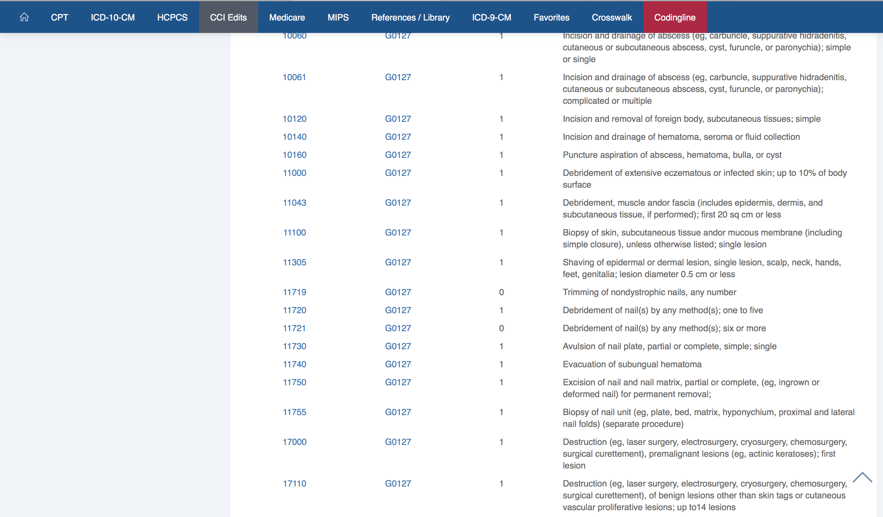

Slide 27
CPT 11720 – Q__
G0127 - 59 – Q__
Consider XS modifier instead!

Slide 28
X Modifiers
XE - Separate Encounter: A service that is distinct because it occurred during a separate encounter.
XP - Separate Practitioner: A service that is distinct because it was performed by a different practitioner.
XS - Separate Structure: A service that is distinct because it was performed on a separate organ/structure.
XU - Unusual Non-Overlapping Service: The use of a service that is distinct because it does not overlap usual components of the main service.

Slide 29
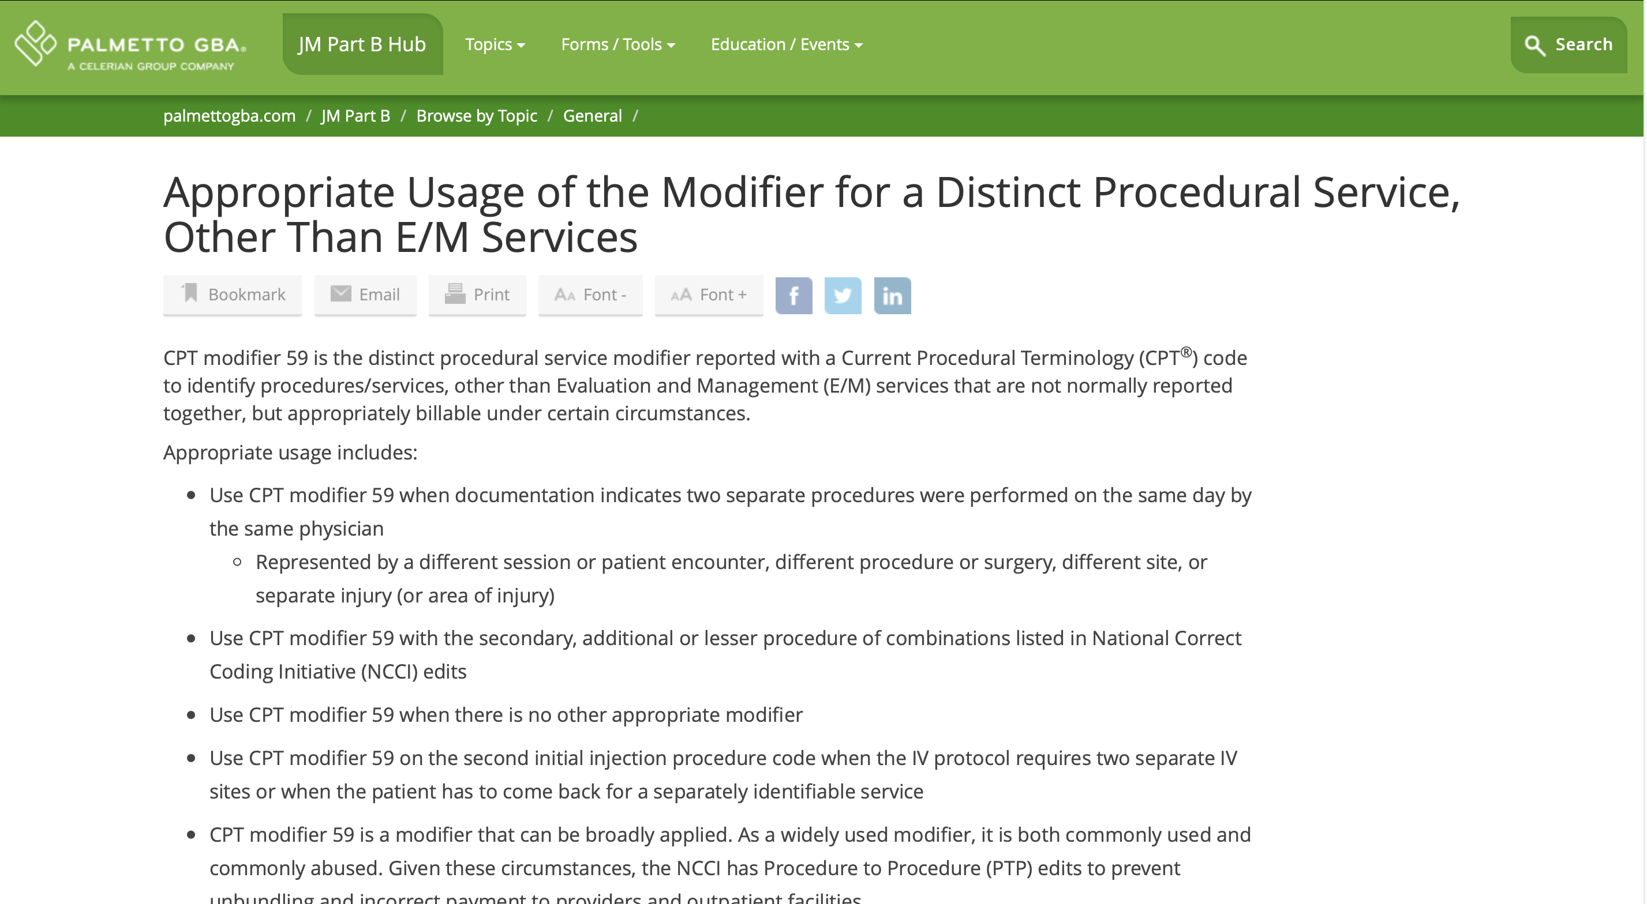
https://www.palmettogba.com/palmetto/providers.nsf/vMasterDID/B6JNBV8603?OpenDocument
November 15, 2018

Slide 30
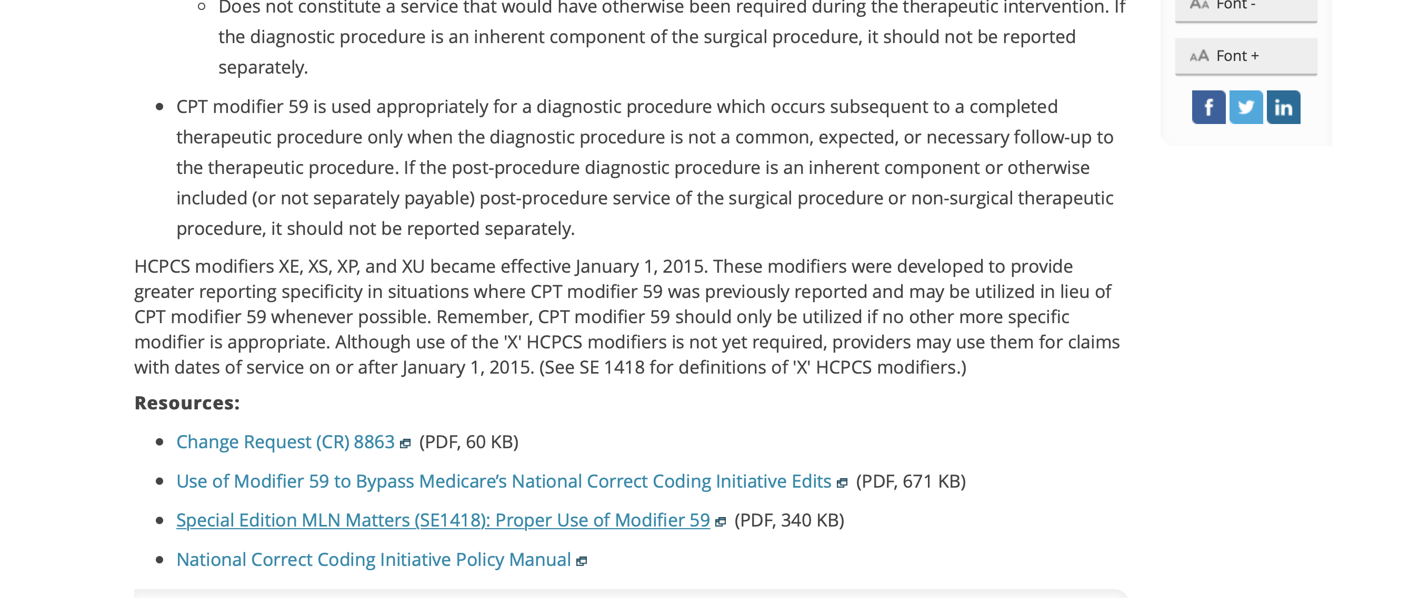
https://www.palmettogba.com/palmetto/providers.nsf/vMasterDID/B6JNBV8603?OpenDocument
November 15, 2018

Slide 31
X Modifiers
XE - Separate Encounter: A service that is distinct because it occurred during a separate encounter.
XP - Separate Practitioner: A service that is distinct because it was performed by a different practitioner.
XS - Separate Structure: A service that is distinct because it was performed on a separate organ/structure.
XU - Unusual Non-Overlapping Service: The use of a service that is distinct because it does not overlap usual components of the main service.

Slide 32
Routine Foot Care
CPT 11055 - Paring or cutting of benign hyperkeratotic lesion (eg, corn or callus); single lesion
CPT 11056 - Paring or cutting of benign hyperkeratotic lesion (eg, corn or callus); two to four lesions
CPT 11057 - Paring or cutting of benign hyperkeratotic lesion (eg, corn or callus); more than four lesions

Slide 33
Two Different Things!
Routine Foot Care
Debridement of Mycotic Nails

Slide 34
Two Different Things!
Debridement of Mycotic Nails

Slide 35
Ambulatory patients
Onychomycosis
AND
Marked limitation of ambulation, pain, or secondary infection resulting from the thickening and dystrophy of the infected toenail plate.

Slide 36
Non-ambulatory patients
Onychomycosis
AND
The patient suffers from pain or secondary infection or the condition compromises the patient's ADL or care resulting from the thickening and dystrophy of the infected toenail plate.

Slide 37
Debridement of Mycotic Nails
CPT 11719: Trimming of nondystrophic nails, any number
CPT G0127: Trimming of dystrophic nails, any number
CPT 11720: Debridement of nail(s) by any method(s); one to five
CPT 11721 : Debridement of nail(s) by any method(s); six or more
Debride = reduce bulk

Slide 38
Debridement of Mycotic Nails Diagnoses
Must Have:
L02.611-L02.612
L03.031-L03.032
L03.041-L03.042
M79.671- M79.672
M79.674-M79.675
R26.2
B35.1
And one of:

Slide 39
Debridement of Nails
Callus paring not covered under this qualification

Slide 40
Frequency
Every 60 days

Slide 41
“Professional”
M.D., D.O., D.P.M., Nurse Practitioner, Clinical Nurse Specialist, or Physician Assistant.

Slide 42
Obligation to Bill Non-covered Services
If the beneficiary believes that a service may be covered or desires a formal Medicare determination, must file a claim for that service.
Submit HCPCS modifier GY to denote that 'the item or service is statutorily excluded or does not meet the definition of any Medicare benefit.' Maintain documentation that the service is being submitted at the beneficiary's insistence. You may also submit HCPCS modifier GY when filing claims to obtain a Medicare denial for secondary payer purposes.

Slide 43
Case Studies

Slide 44
Case Study #1
Doctor saw 24 patients in nursing home one morning
All 24 claim forms exactly the same and all notes exactly the same

Slide 45
Case Study #1
Copying notes versus cloning notes

Slide 46
Case Study #2
Pt seen for at-risk foot exam. Patient has type 2 diabetes and states glucose is well controlled. She gets numbness in her feet, worse during the night. Class findings include non palpable PT pulses and complaints of paresthesias and burning.
All toenails long and dystrophic and thickened
Debrided all toenails in length and thickness and removed subungual debris

Slide 47
Case Study #2
Claim form
A – E11.43
B – B35.1
A,B – 11721 Q9
E11.43 Type 2 diabetes mellitus with diabetic autonomic (poly)neuropathy

Slide 48
Case Study #3
427 nail care services
427 CPT 11721
Zero CPT 11720
Zero CPT G0127
Zero CPT 11719

Slide 49
Case Study #4
Pt seen for at risk foot exam. Patient has type 2 diabetes and states glucose is well controlled. Class findings include non palpable DP and PT pulses.
All toenails long and dystrophic and thickened
Debrided all toenails in length and thickness and removed subungual debris
Sharply debrided calluses X 2

Slide 50
Jeffrey D. Lehrman, DPM, FASPS, MAPWCA, CPC
Advisor, APMA Coding Committee
Expert Panelist, Codingline
Advisor, APMA MACRA Task Force
Fellow, American Academy of Podiatric Practice Management
Board of Directors, American Society of Podiatric Surgeons
Board of Directors, American Professional Wound Care Association
Editorial Advisory Board, WOUNDS
Twitter: @DrLehrman

Slide 51
Foot Care: Coding, Compliance, and Documentation
Date Here

