Slide 1
Emergency Medical Responder
Chapin Area Rescue Squad

Slide 2
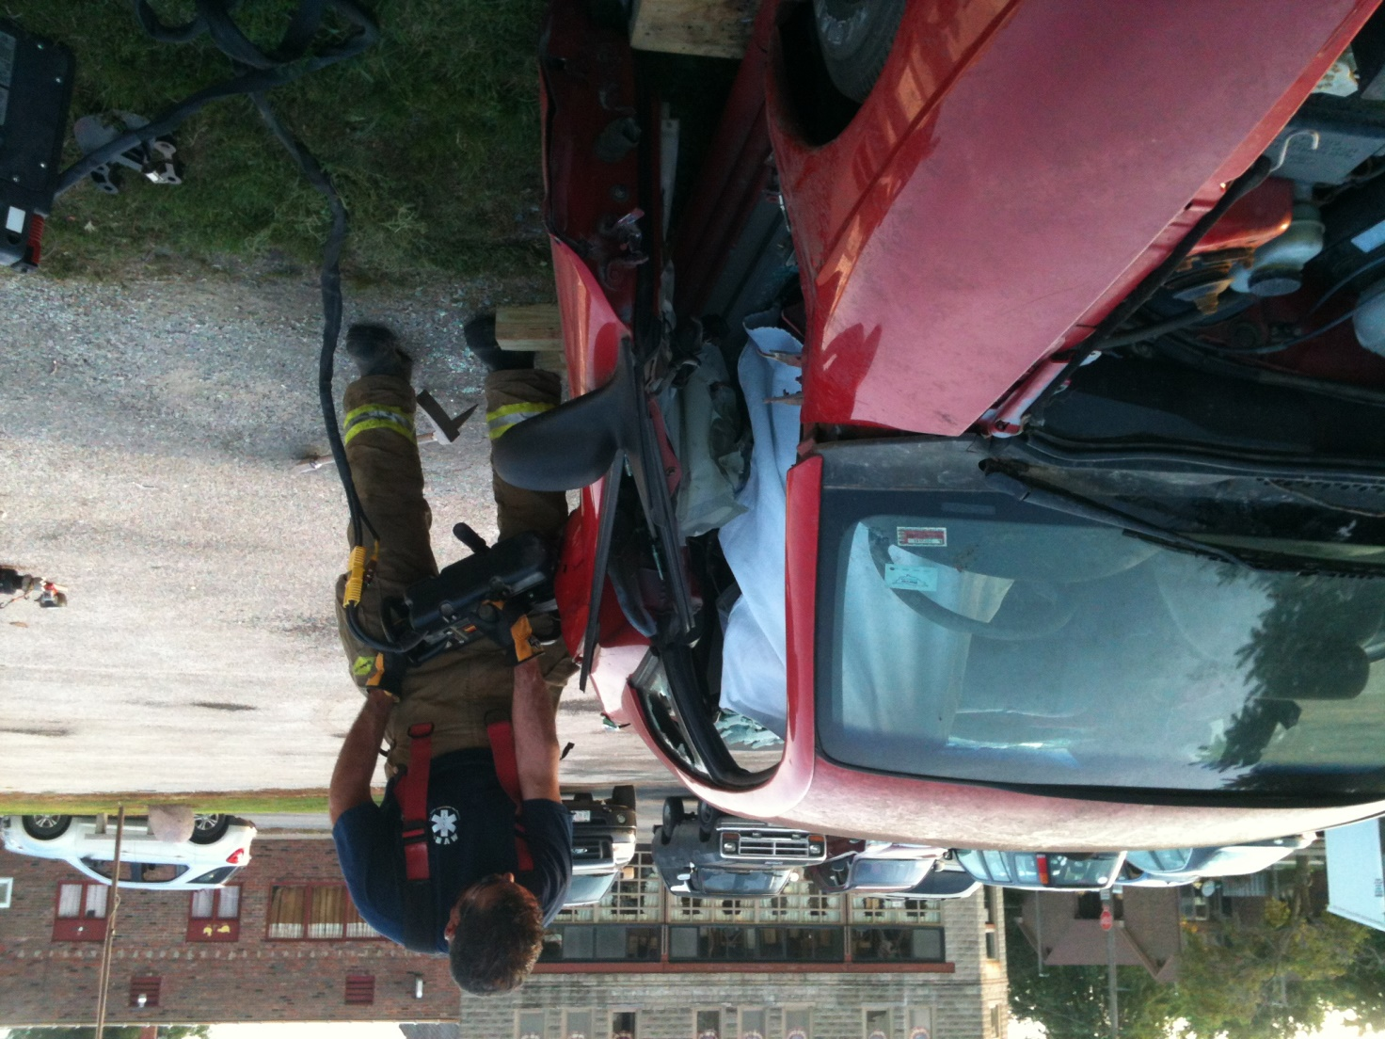
Chapter 3: Medical & Legal

Slide 3
Objectives
Understand the following concepts:
  Consent/refusal of care
  Confidentiality
  Advance directives
  Tort and criminal actions
  Evidence preservation
  Statutory responsibilities

Slide 4
Introduction
Above all else, do no harm.
Provide all your care in good faith.
Provide proper consistent care, be compassionate, and maintain your composure.
Scope of Care
  The US Department of Transportation, Emergency Medical Responder Educational Standards, Medical protocols or standing orders, and Online medical direction

Slide 5
Duty to Act
As a CARS EMR if you are dispatched to the scene of an accident or illness, you have a duty to act.
  You must proceed promptly to the scene and render emergency medical care within the limits of your training and available equipment.
  Can become confusing with volunteer agencies, so basically if you are in the rig, you legally must respond.

Slide 6
Standard of Care
The standard of care is the manner in which you must act or behave.
You must meet two criteria:
  You must treat the patient to the best of your ability.
  You must provide care that a reasonable, prudent person with similar training would provide under similar circumstances.

Slide 7
Consent
Consent simply means giving approval or permission
Expressed consent
  The patient actually lets you know—verbally or nonverbally—that he or she is willing to accept treatment.
  The patient must be of legal age and able to make a rational decision.
Implied consent
  The patient does not specifically refuse emergency care.
  Do not hesitate to treat an unconscious patient.
Consent for minors
  Under the law, minors are not considered capable of speaking for themselves.

Slide 8
Refusal of Care
Any person who is mentally in control has a legal right to refuse treatment.
Help the person understand the consequences of refusing care by explaining:
  The treatment
  The reason that the treatment is needed
  The potential risks if treatment is not provided
  Any alternative treatments that may help

Slide 9
DNRs and Advanced Directives
An advance directive is a document that specifies what a person would like to be done if he or she becomes unable to make his or her own medical decisions.
A durable power of attorney for health care
  Allows a patient to designate another person to make decisions about medical care
A do not resuscitate (DNR) order
  Written request giving permission to medical personnel not to attempt resuscitation in the event of cardiac arrest

Slide 10
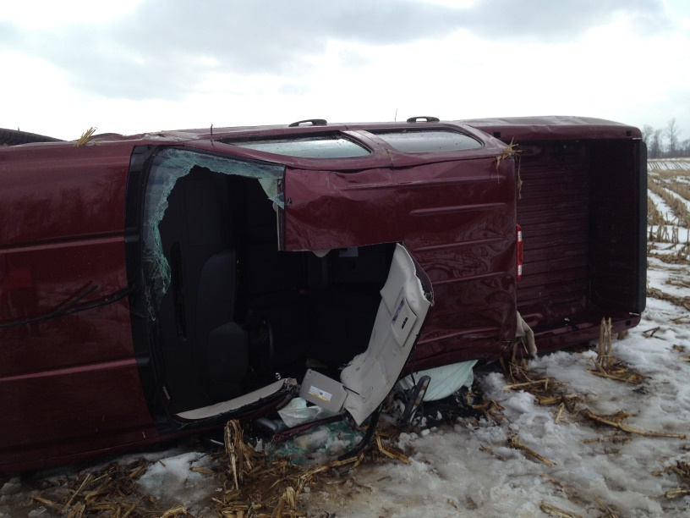
HIPPA
Health Insurance Portability and Accountability Act of 1996 (HIPAA)
  Strengthens laws for the protection of the privacy of health care information and safeguards patient confidentiality
Cannot talk about calls or any other information with others

Slide 11
Crime Scenes
Reportable crimes include:
  Knife wounds
  Gunshot wounds
  Motor vehicle collisions
  Suspected child or elder abuse
  Domestic violence
  Dog bites
  Rape

Slide 12
Review
As an EMR, you have a duty to act when you are dispatched on a medical call as a part of your official duties.
You should understand the differences between expressed consent, implied consent, consent for minors, consent of mentally ill persons, and the right to refuse care.

