Slide 1
30 Years of EM
DOE Communities

Slide 3
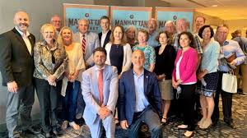

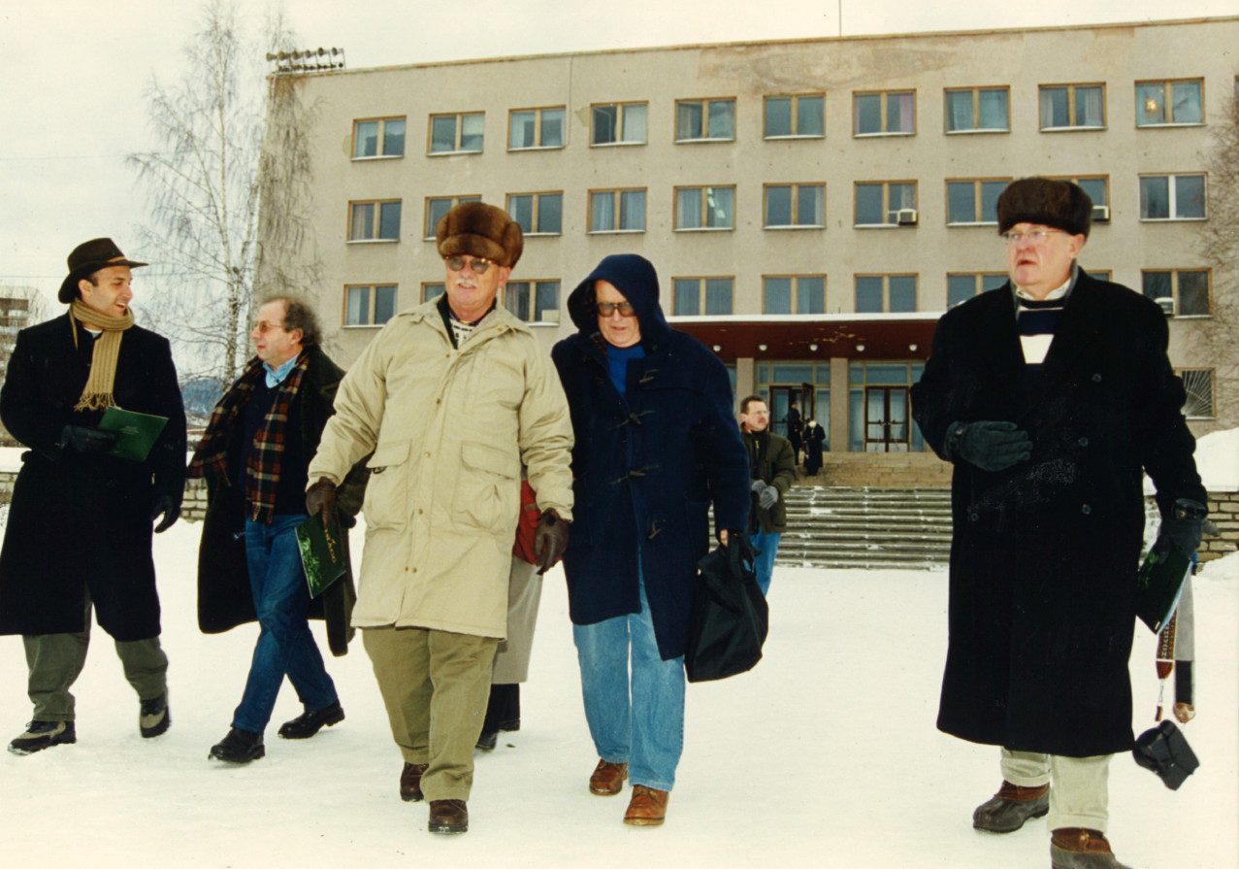
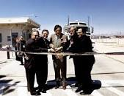
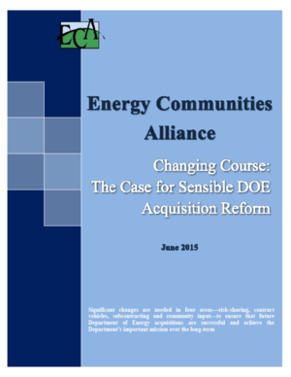
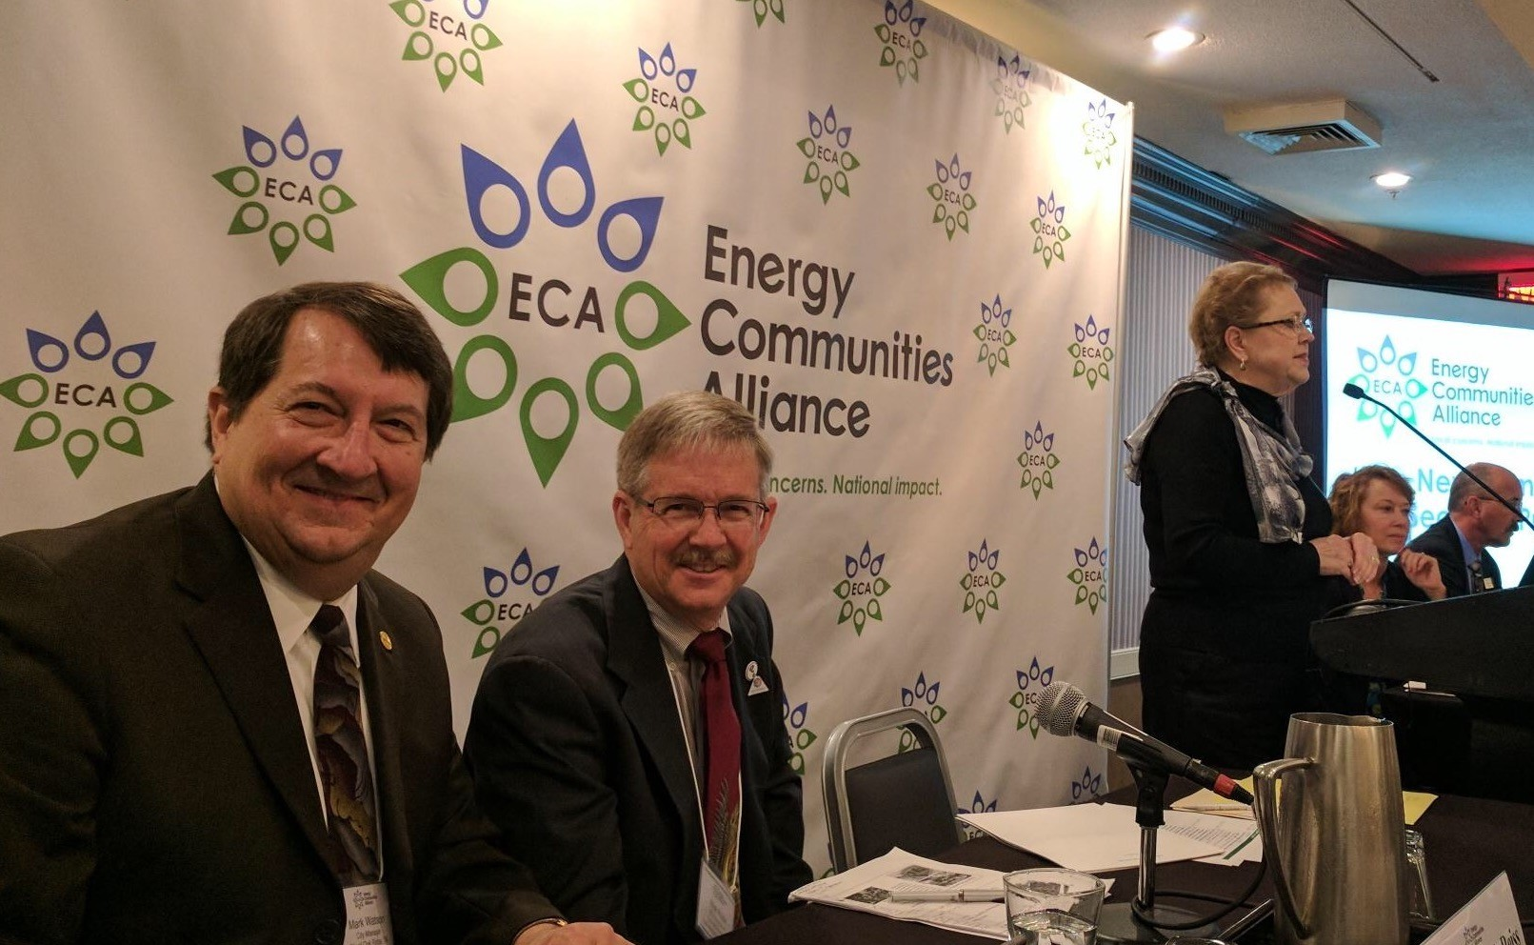
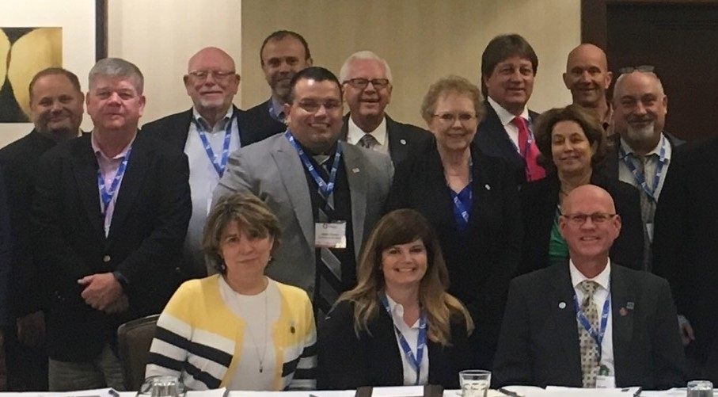
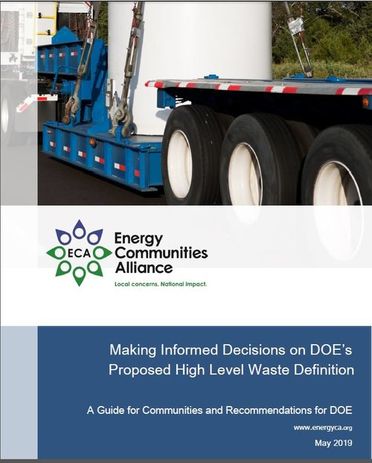
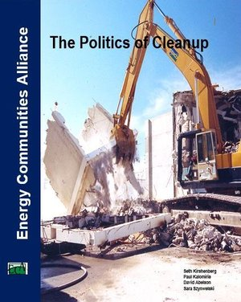

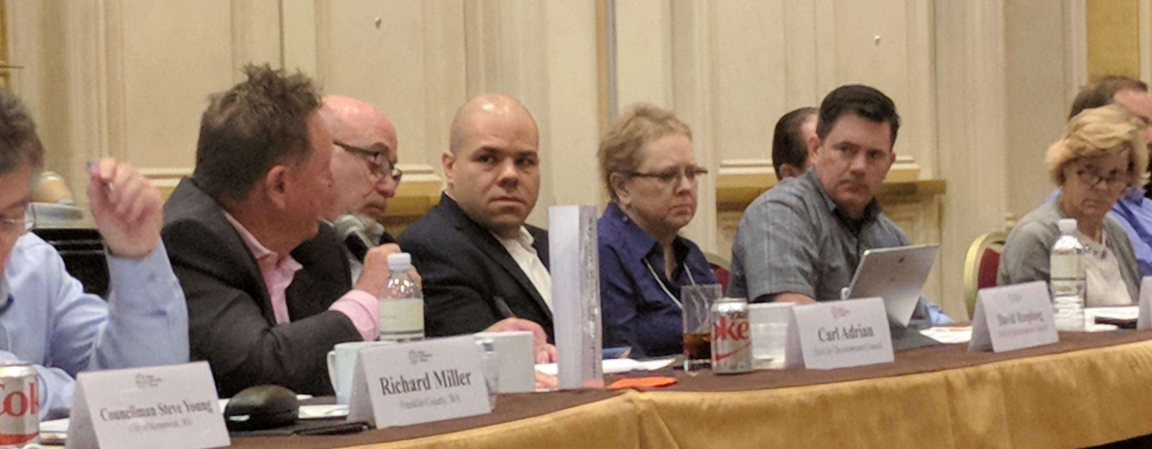

Slide 4
History
Opportunity
Politics
Regulations
Schedule
Cost
Risk
Restriction
No
Yes
Fees
Safety
Cleanup
Maybe
Agreements
Partnerships
Conflict
Contracting
Enforcement
Restrictions
How can we accomplish our goal?

Slide 5
EM History
  Beginning –
    Large Layoffs
    No – Don’t need to work with the communities – you have no oversight
    Goal prior to end of the cold war was not to release information
  EM History is one of conflict in the beginning

Slide 6
EM History
  ECA Created by Local Government leaders from across the sites
    First meeting at National League of Cities
    Formed 1994 (incorporated 1997)
    Originally Advocacy
    Moved towards Partnerships
    Partnered with EPA first and then DOE to educate communities

Slide 7
EM History
  Congressional Role in Shaping EM
    Economic Development Programs
    CRO creation and funding
    Land Conveyance
    Federal Facilities Compliance Act
      EPA Role
      State Role (RCRA litigation)
    CERCLA Section 120(f) provides a unique role for local governments to participate in remedy decision-making
    Special legilsation

Slide 8
EM History
A lot of conflict at closure sites led to successful policies
  Rocky Flats (use, cleanup levels,
  Mound
  Keystone Report I and II – Public Participation is important – SSABs created
  Land Use based cleanups
    Negotiations
    State Agreements on cleanup levels
    Reuse
    End State
    Contracting to meet goals

Slide 9
A Study in Organizational Dynamics
The Family of Participants:
    President
    Congress
    DOE
    Regulators
    Contractor(s)
    Community
    Cleanup family members have significantly different objectives and definitions of success

Slide 10
“Get your facts straight first, then you can distort them as you please.”
–Mark Twain

Slide 11
Community
  “Customer” setting cleanup standards.
  (Customer: By Whose Definition?)
    Elected leadership at several levels
    Stakeholders varied interests
  Real political interest
  Workforce Impact
  Economic Drivers
  Potential Reuse
  Cost not as important of a factor
  Concerned about risks

Slide 12
Cleanup Pressures
“Completion”
    President –Resource Availability $
    Congress – Mission Success and state and community pressures
    Contractor – Financial Reward
    Community – Remediated Site
    Workforce – Job Loss
    Regulators – Reassignment / Job Loss
    DOE – Resources/ Reassignment / Job Loss
  Who will have reached their objective?

Slide 13
Cleanup Pressures
“End State Contracting”
    Contractor – Scope of Work
    DOE – Contract Management Tool (really an IDIQ hybrid)
    Community – Expected Outcome
  Interpretation of the “End State” can vary significantly. Does your definition align with the others?

Slide 14
Cleanup Pressures
“Schedule”
  How long will the cleanup take?
  DOE commitment to Congress is based upon numerous cleanup assumptions.
  Are the assumptions consistent with your end state, and can they be accomplished within the timeframe and budget?

Slide 15
Lessons Learned
Communications
Definitions matter – everyone needs to be on the same page
Know and understand the other parties goals
DOE must engage the community (and vice a versa)
Build a working relationship and provide regular meetings
Following the minimum law is not enough
Communities need experts (sometimes DOE needs to provide the resources)
Define acceptable risk
Failure to make decisions leads to failures
Be Organized

