Slide 1
DOE High-Level Radioactive Waste (HLW) Interpretation
Mark Senderling
Deputy Assistant Secretary for Waste and Materials Management
Office of Environmental Management
September 12, 2019

Slide 2
Where Did This Waste Come From?
For national defense during the Cold War, the U.S. reprocessed used nuclear fuel rods to isolate key radioactive isotopes for our strategic weapons stockpile.
That reprocessing created varied radioactive waste byproducts like sludge, slurry, liquid, and debris that remain stored at DOE sites in South Carolina, Idaho, and Washington.
2
Notes:
This waste has been stored for decades where it was generated, and there is currently no near-term disposal path for certain reprocessing waste.
This “source-based” approach to managing HLW has constrained DOE from taking important actions to safely and permanently dispose of certain waste streams that would reduce risk to workers and the environment.

Slide 3
Overview
October 10, 2018: DOE issued a Federal Register Notice (FRN) inviting the public to comment on the HLW interpretation.
June 10, 2019: A Supplemental FRN was published providing the HLW interpretation and DOE’s response to public comments.
HLW, as defined in the Atomic Energy Act of 1954, as amended, and the Nuclear Waste Policy Act of 1982, as amended, is properly interpreted to mean that not all radioactive wastes from nuclear fuel reprocessing are HLW, and that some reprocessing wastes can be classified as non-HLW based on the radiological characteristics of the waste.
June 10, 2019: A second FRN was published to announce DOE’s intent to prepare National Environmental Policy Act (NEPA) documents to analyze treatment and commercial disposal of up to 10,000-gallons of Savannah River Site (SRS) Defense Waste Processing Facility recycle wastewater.
Notes:
Last Bullet on WVDP: due to distinct statutory language in the West Valley Demonstration Project Act that provides a separate definition of HLW from the Atomic Energy Act of 1954, as amended (AEA

Slide 4
Overview (cont’d)
The primary focus is to provide a safe and appropriate path forward to remove reprocessing waste for disposal from the states where it now resides.
DOE’s interpretation does not change or revise any current policies, legal requirements, or agreements.
Decisions about how this interpretation will apply to existing wastes will be the subject of subsequent actions (e.g., NEPA, regulatory).
DOE will work closely with local officials, regulators, and stakeholders where reprocessing waste is stored and where such waste might be disposed.
NRC will maintain their current role in commercial low-level radioactive waste (LLW) disposition:
Responsible for 10 CFR Part 61, Licensing Requirements for Land Disposal of Radioactive Waste
With Agreement States, regulate LLW disposal through a combination of regulatory requirements, licensing, and safety oversight.
The interpretation could apply to reprocessing waste at SRS, Hanford, and Idaho.
Notes:
Last Bullet on WVDP: due to distinct statutory language in the West Valley Demonstration Project Act that provides a separate definition of HLW from the Atomic Energy Act of 1954, as amended (AEA

Slide 5
AEA & Nuclear Waste Policy Act of 1982, As Amended
The AEA and NWPA define HLW as:
(A) the highly radioactive material resulting from the reprocessing of spent nuclear fuel, including liquid waste produced directly in reprocessing and any solid material derived from such liquid waste that contains fission products in sufficient concentrations; and
(B) other highly radioactive material that the Commission, consistent with existing law, determines by rule requires permanent isolation.
The terms “highly radioactive” and “sufficient concentrations” are not defined in the AEA or the NWPA. Congress left it to DOE to determine when the standards are met.

Slide 6
DOE HLW Interpretation
DOE may determine that waste is not HLW if the waste:
I. does not exceed concentration limits for Class C low-level radioactive waste as set out in Section 61.55 of Title 10, Code of Federal Regulations, and meets the performance objectives of a disposal facility;
or
II. does not require disposal in a deep geologic repository and meets the performance objectives of a disposal facility, as demonstrated through a performance assessment conducted in accordance with applicable requirements.
Waste meeting either of these criteria could be classified based on its radiological content and disposed of in accordance with disposal facility waste acceptance criteria, allowable radionuclide content, waste form and packaging requirements, and waste generator certifications and approvals.
Notes:
DOE would utilize historical records, and rigorous testing and characterization processes to assess the level of radioactivity in the reprocessing waste before any classification determination would be made to ensure the material shall be disposed of in an appropriate facility in accordance with its waste acceptance criteria, provided all applicable requirements of the disposal facility are met.
The Department and the commercial nuclear industry have decades of experience with the safe and effective disposal of low-level radioactive waste, which is already managed via its characteristics, not by how it was generated.

Slide 7
Key Facts
DOE’s HLW interpretation, if implemented, will:
Allow for safe disposal of reprocessing waste from the states where it now resides
Reduce risks to the public, workers and the environment
Accelerate waste removal
The HLW interpretation allows waste to be safely disposed of based on its physical characteristics and in compliance with performance objectives and other disposal facility requirements.
It’s sound science & judgment
The HLW interpretation is the product of a careful and considered process:
Comments were invited during an extended 90-day period
5,555 comments were received from public, lawmakers, tribes, state and local governments.
DOE will continue to ensure that waste is managed and disposed of safely, working with stakeholders including local officials, tribal governments, affected communities and regulators.
Non-HLW determinations will be made on a case-by-case basis and with appropriate NEPA analysis before any final designation or disposal decision, with a focus on:
Transparency
Established regulatory processes
Public participation
Reducing risk to human health and the environment

Slide 8
Key Facts (cont’d)
The HLW interpretation is in accordance with all technical and regulatory standards, and:
Does not change long-standing DOE or Nuclear Regulatory Commission (NRC) regulations.
Does require that all commercial and DOE disposal facilities continue meeting relevant safety rules.
The goal is to remove reprocessing waste from tanks.
Finding new disposition pathways out of state for lower-activity waste streams would reduce risk to the public, workers, and the environment
Support for the approach from independent organizations.
Experts and organizations, like the Massachusetts Institute of Technology and the Blue Ribbon Commission on America’s Nuclear Future, recommend that a risk-based interpretation of HLW is the best approach.
It’s time for the U.S. to align with International Atomic Energy Agency guidelines and best practices for radioactive waste management and disposal.
That means using a risk-based approach and defining waste primarily by its characteristics and radiological risks – not solely by its source. It’s time to join our peers.
DOE’s responsibilities will not change. Just as it has for decades, the Department will ensure that our nation’s radioactive waste is safely treated, stored and disposed.

Slide 9
General Steps
As described in the June 10 Federal Register Notice, the development of the path forward for the reprocessing waste determination of non-HLW, and decisions flowing from that path, will be dependent on executing a number of technical and regulatory steps:
Confirmation of potential disposal facilities.
Preliminary evaluation of disposal facility waste acceptance criteria.
NEPA analyses and documentation.
Preparation or revision of necessary permits and obtaining appropriate approvals from Federal, State and local regulators and authorities, if required.
Coordination with stakeholders.
As applicable, preparing Resource Conservation and Recovery Act or Comprehensive Environmental Response, Compensation, and Liability Act documentation, if needed, to retrieve, treat, package, characterize, and certify the wastes for disposal.
Modification of affected contracts, if necessary.
Funding.
As applicable, project management planning (DOE Order 413.3B, Program and Project Management for the Acquisition of Capital Assets).
Development of waste loading, packaging, and transportation cask systems as needed to remove the waste from the site and deliver it to the disposal facility.
9

Slide 10
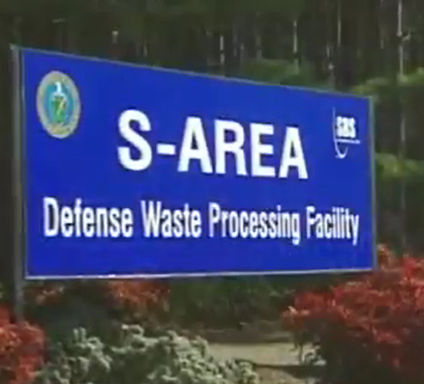
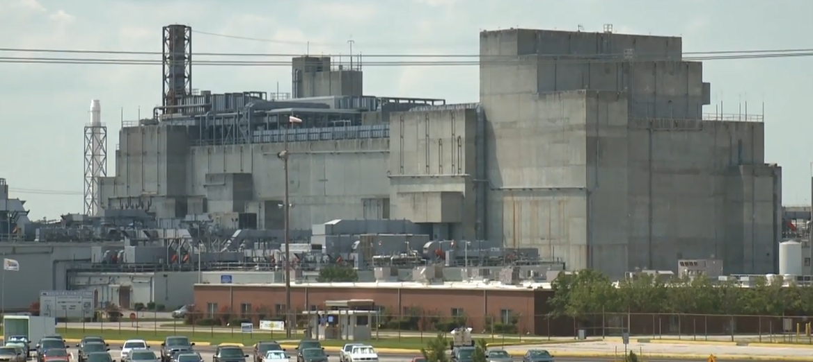
Next Steps
At the Savannah River Site, DOE manages certain reprocessing waste through the Defense Waste Processing Facility (DWPF).
DOE is preparing a NEPA analysis for the commercial disposal of up to 10,000 gallons of stabilized DWPF recycle wastewater.
If this material meets NRC standards for non-HLW disposal, DOE will safely treat and dispose of it in a licensed facility outside South Carolina.
NEPA allows state, local, and tribal officials and the public to comment on DOE’s environmental analyses.
At this time, DOE is only considering these 10,000 gallons for disposition under this interpretation.
Any future determinations would require NEPA and include engagement with all appropriate stakeholders.
10
Notes:
Implementation of the interpretation would be conducted on a site-by-site basis, and the Department will work closely with local officials, regulators and stakeholders where reprocessing waste is stored and where such waste might be disposed, to ensure compliance with applicable legal and programmatic requirements and regulatory agreements before any changes in how the waste is managed.
If DOE proposes an action to which NEPA would apply, DOE will analyze potential environmental impacts of such a proposal through the NEPA process.

Slide 11
Questions?
For Additional Information Visit:
https://www.energy.gov/em/high-level-radioactive-waste-hlw-interpretation

