Slide 1
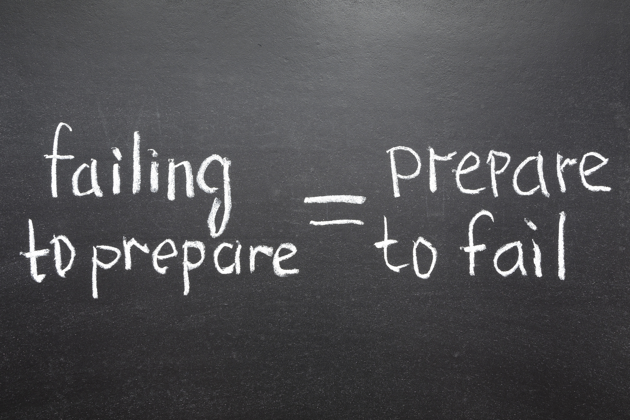
Preparation

Slide 2

What is Preparation?
The action or process of making ready or being made ready for use or consideration:

Slide 3
Preparation the foundation for understanding
To truly understand anything you have to prepare or ready yourself for it.
This means you need to ask the following:
What do I need to prepare for?
How do I need to prepare for it?
Why do I need to prepare for it?
When do I need to prepare for it – Now!!!

Slide 4
What Do I need to Prepare for?
This question has to be asked with foresight. It is the crystal ball in you that is called your dreams, goals and aspiration. The preparing or readying yourself should be in alignment with those things that support, improve, clears a path, connects the dots, develops the foundation, inspire you in your quest of your dreams, goals and aspirations.

Slide 5
How do I prepare for it?
The how is all about utilizing your critical thinking skills to dissect what it is you are going after. A key way of doing this is research. Research is an aspect of utilization of you critical thinking skills. You want to learn as much as you can prior to an opportunity or issue presenting itself. The is due diligence readies you for those thing that others may not see coming but because you were prepared you had the ability to understand and handle them.

Slide 6
Why do I need to prepare for it?
Why? Preparation is all about you. Although there is other factors that can benefit from your preparation but eventually it is about you.
It is about how you see yourself and how you want others to see you. It is a pride thing. It is a personal brand thing. It is about you.
If you don’t see the importance of those things above that relate to you then nothing else matters.

Slide 7
When do I need to prepare for it – Now!!!
Remember is the competition of life there is always someone out their that is doing the things that you know you should be doing.
Most of the time those individuals started on yesterday, compared to your today.
So let’s get it in motion and move forward.

Slide 8

bbv2m-brothersbrooksvision2missionllc.com

