Slide 1
Defense Waste Processing Facility
Recycle Wastewater Environmental Assessment A Waste Stream Proposed for Evaluation under DOE’s High-Level Waste (HLW) Interpretation
Michael Budney
Manager, Savannah River Operations Office
September 12, 2019
2019 National Cleanup Workshop

Slide 2
Where Did This Waste Come From?
Over the years, a primary Savannah River Site (SRS) mission has been the production of special radioactive isotopes to support national defense programs.
As a result, SRS generated large quantities of liquid radioactive waste.
  This waste was placed into underground storage tanks
  Waste is in three physical forms: sludge, salt, and liquid supernatant.
The sludge portion along with high activity constituents from the salt stream is being transferred to the on-site Defense Waste Processing Facility (DWPF) for vitrification into borosilicate glass to immobilize radioactive constituents.
2

Slide 3
Where Did This Waste Come From?
DWPF recycle wastewater is generated during vitrification of tank sludge.
  It is a combination of several dilute waste streams consisting primarily of condensates from high-temperature sludge pretreatment and vitrification processes.
  Other components include process samples, sample line flushes, sump flushes, and cleaning solutions.
DWTT: Decontamination Waste Treatment Tank
HEME: High Efficiency Mist Eliminator
OGCT: Off Gas Condensate Tank
RCT: Recycle Collection Tank
SME: Slurry Mix Evaporator
SMECT: Slurry Mix Evaporator Condensate Tank
SRAT: Sludge Receipt and Adjustment Tank
Notes:
The figure shows the multiple contributors for the DWPF recycle wastewater.
The first major contributor is condensate from the Chemical Process Cell, which is where pretreatment of the tank sludge and salt waste occurs prior to vitrification. Vapors from the Chemical Process Cell pretreatment operations are cooled, condensed, and collected in a storage tank referred to as the Slurry Mix Evaporator Condensate Tank (SMECT).
The second major contributor is condensate from the melter off-gas system. Off-gases from the melt pool in the melter are treated in an off-gas system composed of quenchers, steam atomized scrubbers, condensers, and filters, all of which remove radioactive particulate matter and volatile components before exhausting clean gases under an approved air permit. Condensate from the off-gas system is collected in the OffGas Condensate Tank (OGCT).
All of these aqueous streams are consolidated in the Recycle Collection Tank (RCT) and then Tank 22.

Slide 4
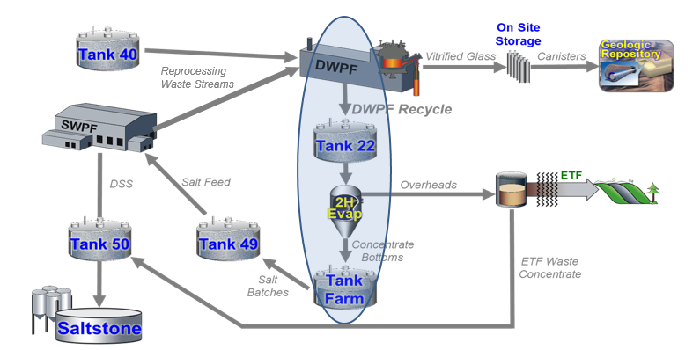
Current Practice
Currently, recycle wastewater is returned to the tank farm (Tank 22) for volume reduction by evaporation (evaporator 2H), or is beneficially reused in salt dissolution and pretreatment or sludge washing.
Notes:
As described in the Liquid Waste System Plan, Revision 21 (System Plan) beginning fiscal year 2024, SRS assumes that the practice of returning the recycle wastewater to the tank farm will be discontinued in order to support acceleration of tank closures.
In lieu of the current evaporation process performed in the tank farm, the System Plan assumes that DWPF recycle wastewater will be diverted outside of the tank farm, but a specific treatment path has not been selected.
As DOE completes tank closure activities in the future, DOE will not have the capability to beneficially reuse the DWPF recycle wastewater.

Slide 5
NEPA Analysis - Environmental Assessment
  Proposed Action:
    Dispose of up to 10,000 gallons of stabilized (grouted) DWPF recycle wastewater from SRS at a commercial LLW disposal facility located outside of South Carolina, licensed by either the NRC or an Agreement state under 10 CFR Part 61.
  Purpose and Need:
    Demonstrate capability to stabilize (grout) and dispose of this waste stream at licensed LLW commercial facilities.
    Demonstration would inform DOE’s planning efforts for later stages of tank closure (2031-2034) when facilities and systems currently used for reuse and management of DWPF recycle wastewater may no longer be operational to address residual volumes.
    DOE would conduct additional National Environmental Policy Act (NEPA) analysis if more than 10,000 gallons of DWPF recycle wastewater is proposed for disposal at an off-site commercial LLW disposal facility.

Slide 6
NEPA Analysis - Environmental Assessment
  DOE has developed three alternatives for accomplishing this Proposed Action:
    Alternative 1 would deploy a treatment capability at SRS to stabilize (grout) up to 10,000 gallons of DWPF recycle wastewater and then transport the grouted waste form to a licensed commercial disposal facility.
    Alternative 2 would transport up to 10,000 gallons of DWPF recycle wastewater to a licensed commercial disposal facility with the capability to stabilize (grout) and dispose of the final waste form.
    Alternative 3 would transport up to 10,000 gallons of DWPF recycle wastewater to a licensed commercial treatment facility with the capability to stabilize the liquid into a grouted waste form, and then transport the final waste form to a licensed commercial disposal facility.
    As required by 10 CFR 1021.321(c), a No-Action Alternative is also being evaluated.
Notes:
Alternative 1: It is assumed that the final, stabilized product would be packaged in a Type A package approved for transport under USDOT requirements to an offsite permitted disposal facility.
Alts. 2 and 3: It is assumed that containers used for transportation of the liquid waste would be Type B packages designed and certified under 10 CFR Part 71.
No Action: 10,000 gallons of recycle wastewater would remain in the SRS liquid waste system until disposition occurs; Would require another, as yet determined, process to handle recycle wastewater during the final years of the DWPF mission
LLW that meet requirements in 10 CFR 61.55 for Class A wastes could be accepted at both the WCS site and EnergySolutions site for disposal.
LLW that exceeds the criteria for Class A waste but is within the requirements for Class C waste could only be accepted at the WCS site for disposal.

Slide 7
Proposed Evaluation under DOE’s HLW Interpretation
  DWPF recycle wastewater is currently managed as HLW because it has radionuclides from reprocessing waste as a result of DWPF operations or storage in tanks that contain residual quantities of reprocessing waste.
  Under DOE’s Proposed Action, DOE will evaluate whether the stabilized wastewater could be disposed of at a commercial LLW facility as non-HLW under DOE’s HLW interpretation.
  DWPF recycle wastewater is the first NEPA evaluation using DOE’s HLW interpretation.
  The HLW interpretation, as published in its Supplemental Notice on June 10, 2019 (84 FR 26835), intends to facilitate the safe disposal of defense reprocessing waste if the waste meets either of the following two criteria:
  Does not exceed concentration limits for Class C LLW as set out in 10 CFR 61.55 and meets the performance objectives of a disposal facility, or
  Does not require disposal in a deep geologic repository and meets the performance objectives of a disposal facility as demonstrated through a performance assessment conducted in accordance with applicable requirements.
Notes:
This “source-based” approach to managing HLW has constrained DOE from taking important actions to safely and permanently dispose of certain waste streams that would reduce risk to workers and the environment.

Slide 8
Next Steps
  Issue Draft EA for public comment – anticipated Calendar Year (CY) 2019.
  Issue Final EA in consideration of public comments and issue either a Finding of No Significant Impact or a determination to prepare an Environmental Impact Statement.
  As stated in its Supplemental Notice, DOE will continue its current practice of managing reprocessing wastes as HLW unless and until specific wastes are determined to be non-HLW based on evaluations of waste characteristics and potential disposal options.
Notes:
The decision to issue a FONSI or to prepare a EIS will depend on the results of the Final EA.

Slide 9
Questions?

