Slide 1
Savannah River Nuclear Solutions
Stuart MacVean
President and CEO
National Cleanup Workshop
September 12, 2019

Slide 2
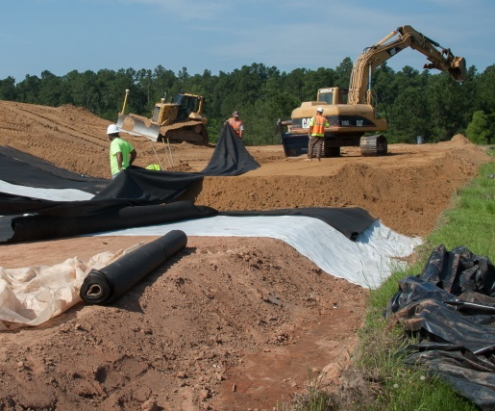
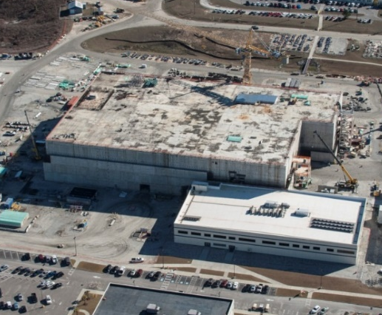
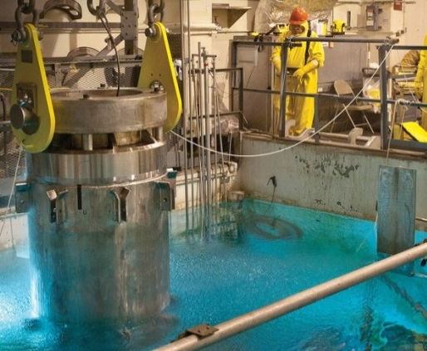
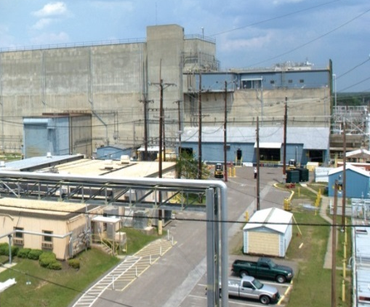
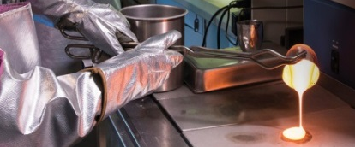
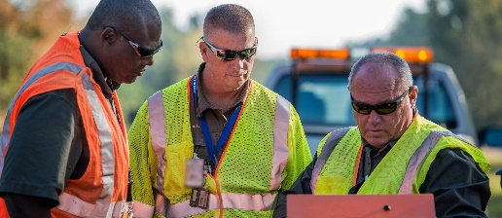
SRNS: Our four mission areas supply solutions around the world
Environmental
Stewardship
for soil, water and facilities
Nuclear Materials
for National Security
nuclear weapons deterrent
Securing
Nuclear Materials
to prevent unwanted proliferation
Transforming
Nuclear Materials
into assets and stable wasteforms
Savannah River
National Laboratory
putting science to work
6,600
Employees
“Making the
World Safer”
World-class
safety culture
Support Services
Emergency Services • Water • Electrical
Cyber/IT • Roads • Construction • Maintenance
Strong community support

Slide 3
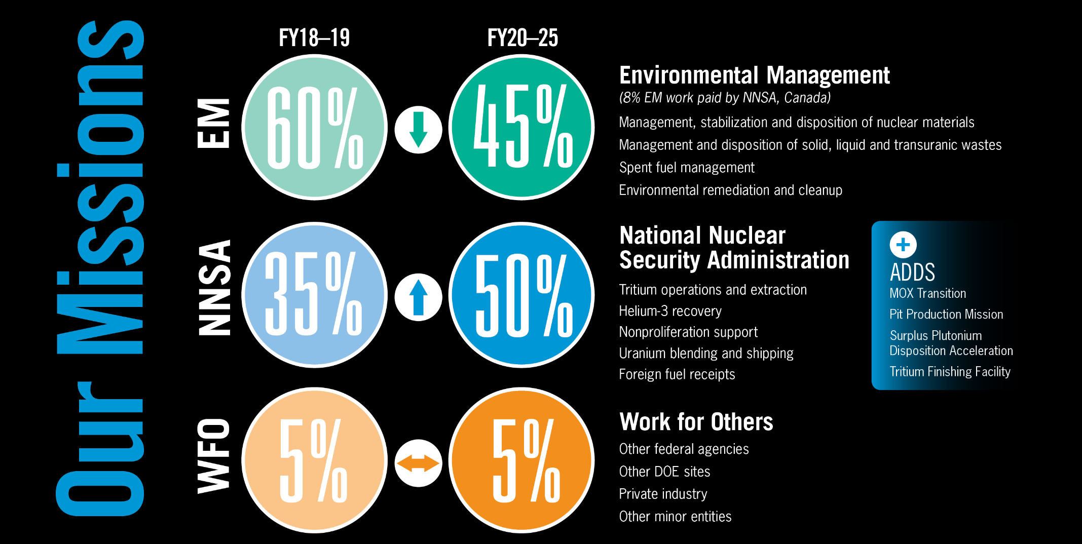
Changing Customer Landscape

Slide 4
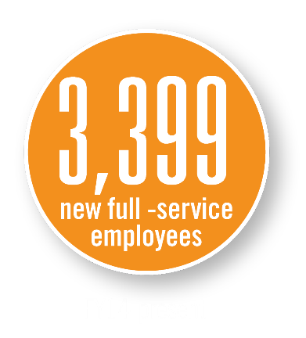
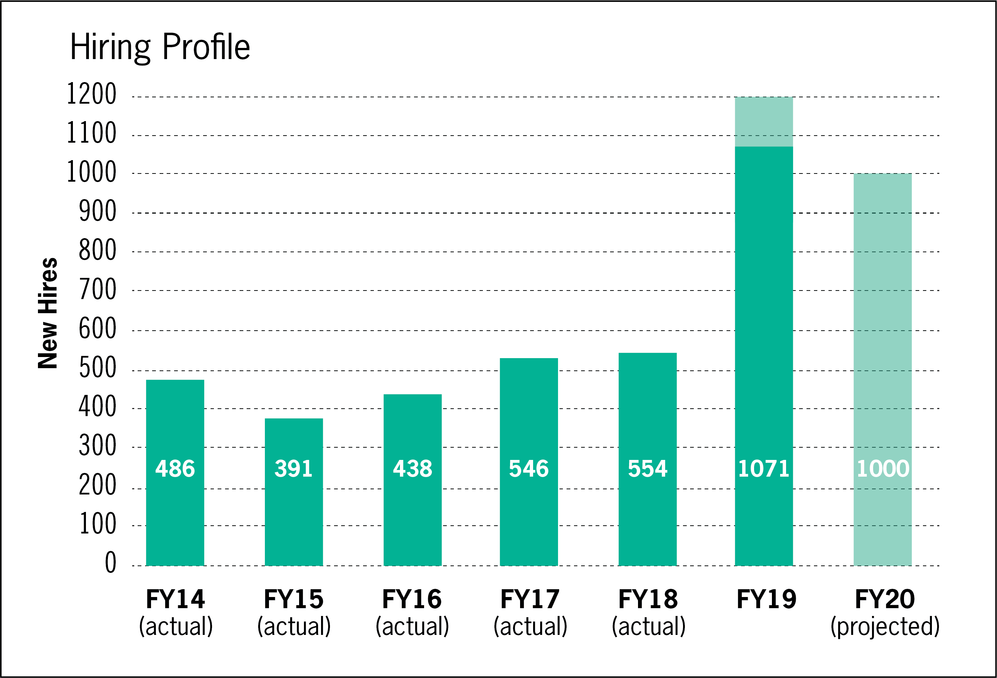


Changing Workforce Landscape
50% employees < 6 years experience
Hundreds of applications per opening

Slide 5
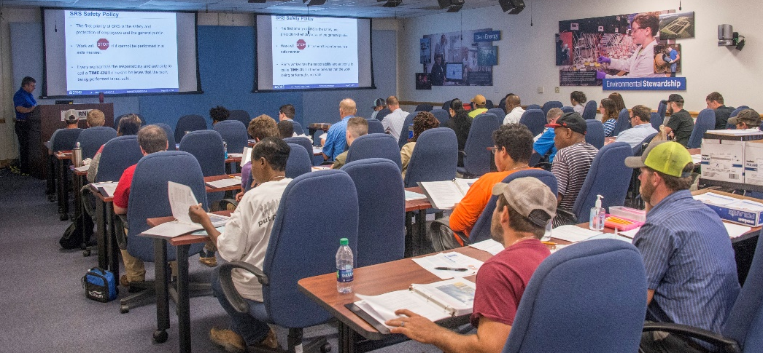
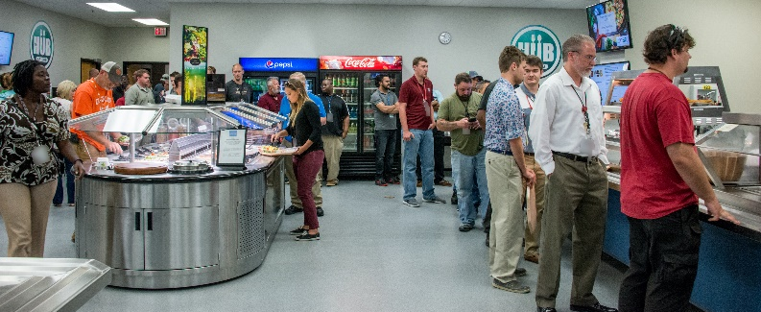
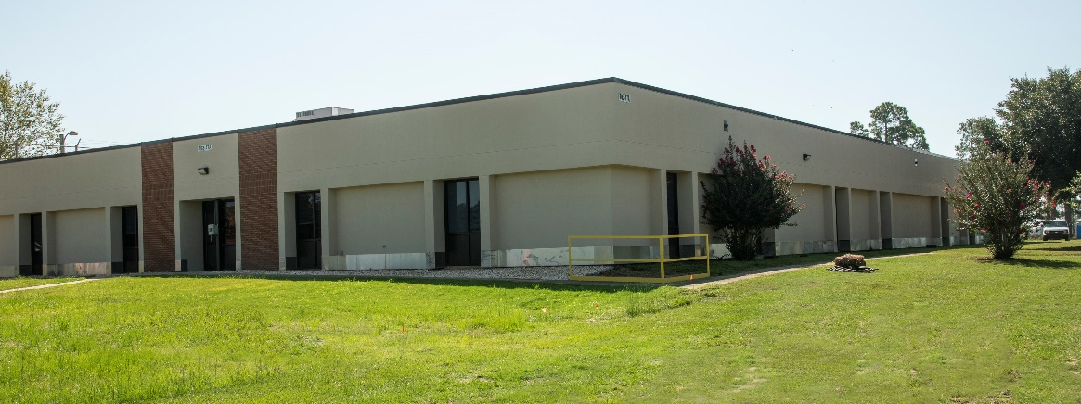
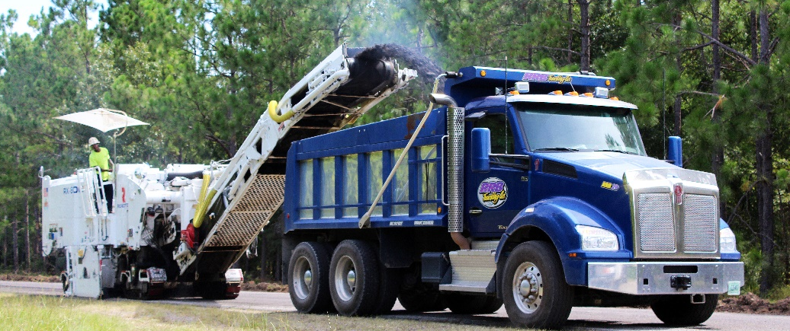
New Missions and Hiring Impacts
Agile and Responsive
Onboarding • Offices and Parking • Knowledge Transfer

Slide 6

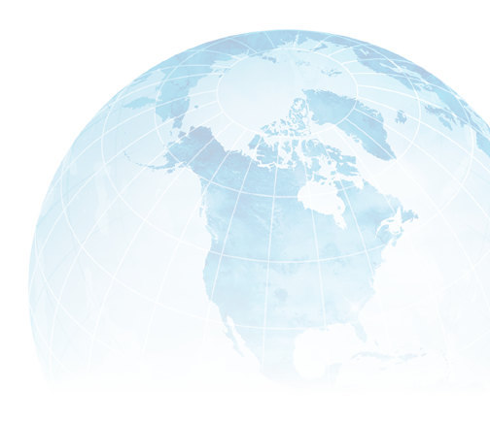
SRNS: We make the world safer.

