Slide 1
Fertility Control and the Management of the Wild Horses: Compared to What?
Jay F. Kirkpatrick
Kimberly M. Frank
Robin O. Lyda
The Science and Conservation Center, Billings MT

Slide 2
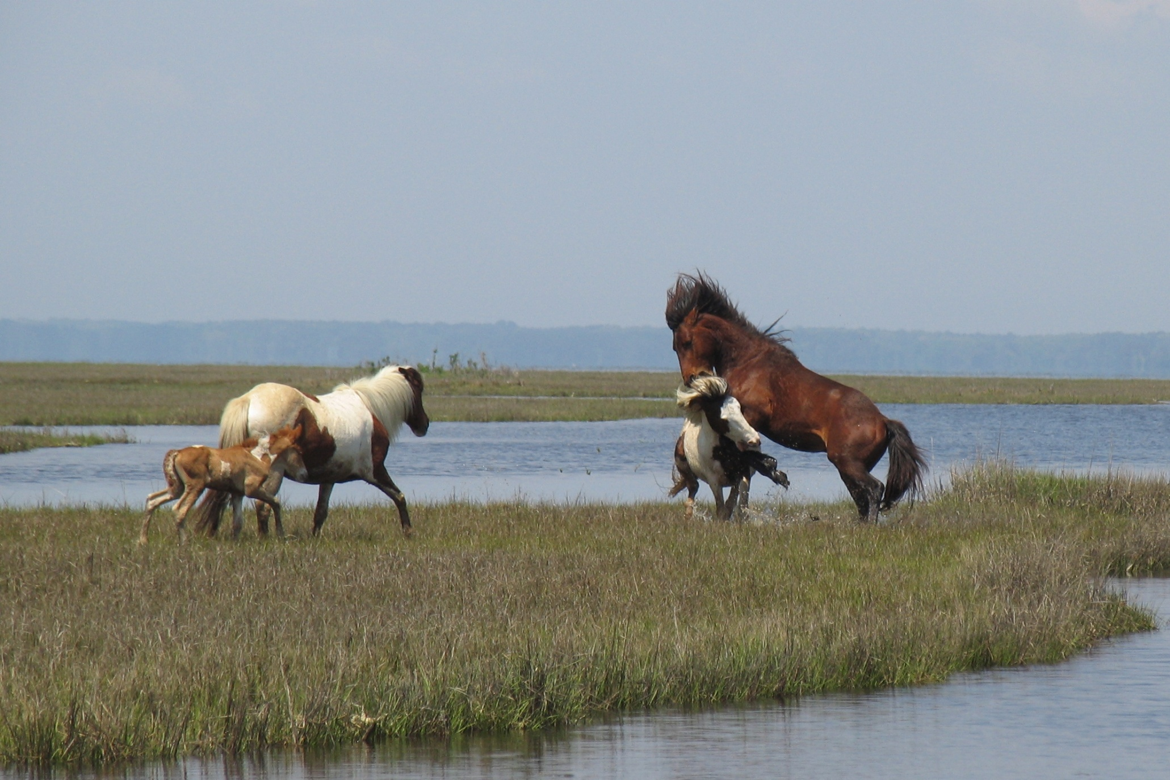

Slide 3
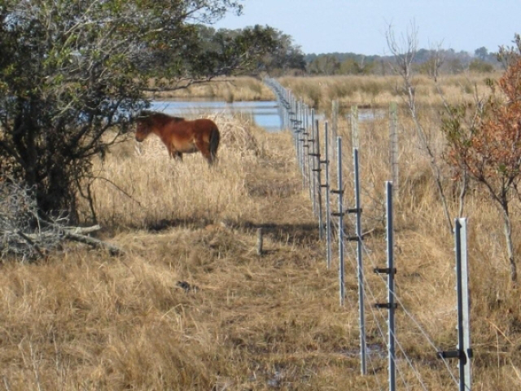

Slide 4
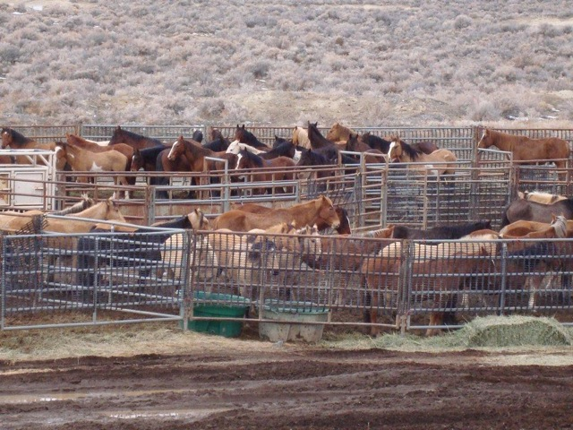

Slide 5

Gather/Removal
Fertility Control

Slide 6
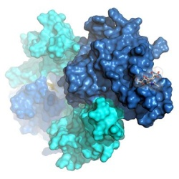

Slide 7
Successful Fertilization

Slide 8
I Do Not Think So!!

Slide 9

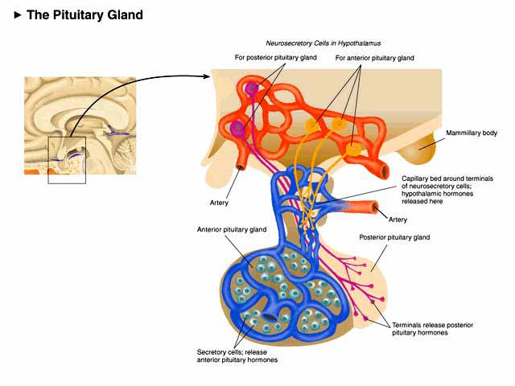


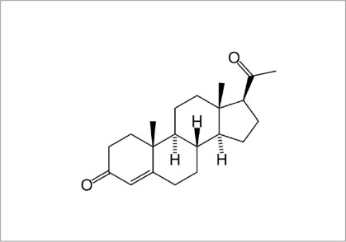
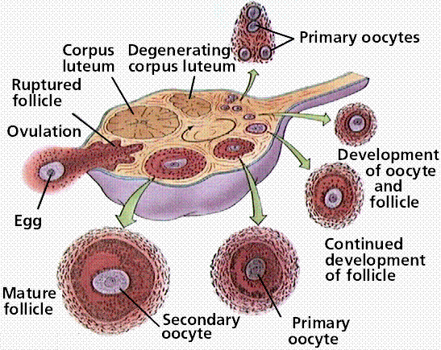
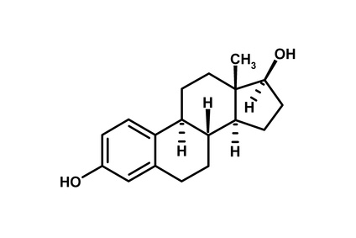
Reproductive “Stream”
GnRH
Neural signal
Hypothalamus
Ant. Pituitary
Estrous Behavior
LH
FSH
Progesterone
Maternal Behavior
Estradiol

Slide 10
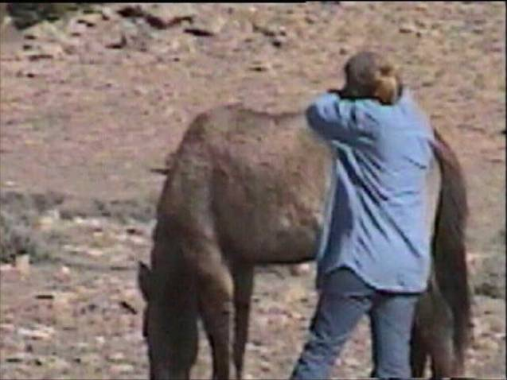
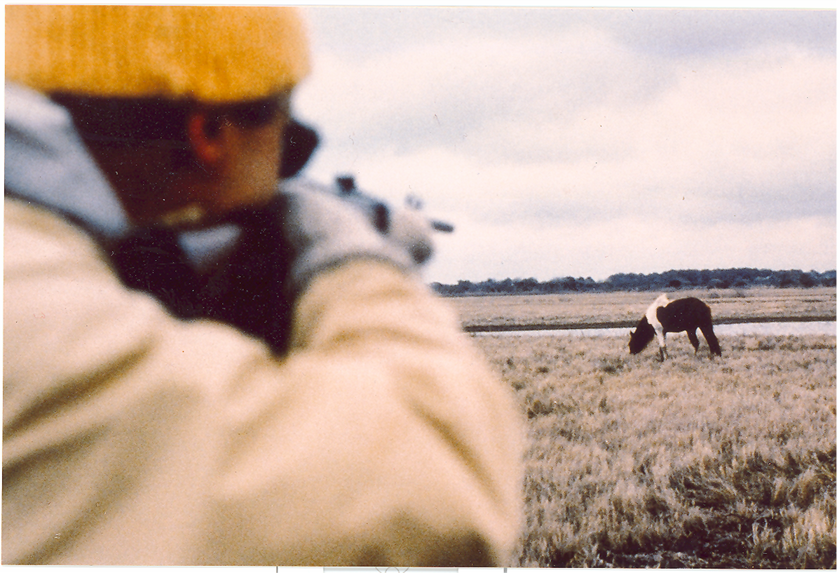

Slide 11
Gather/Removal Costs for Pryor Mountain Wild Horses
Removal Cost/horse | Preparation & Holding/horse | Adoption /horse | Compliance Check/horse | Total/horse
$800 | $40 | $1,100 | $225 | $2,165
CONTRACEPTIVE COSTS FOR PRYOR MOUNTAIN HORSESS
Application of a one-year PZP vaccine via remote darting/horse = $106
(Bartholow J. 2007. Economic benefits of fertility control in wild horse populations. J. Wildlife Management 71:2811-2819)

Slide 12
CONTRACEPTIVE EFFICACY ON ASSATEAGUE: 1994-2006
MARES FOALS BORN TO:
YEAR TREATED TREATED UNTREATED EFFICACY (%)
1994 76 0 22 100
1995 68 1 9 99
1996 72 2 3 97
1997 54 2 5 97
1998 49 1 2 98
1999 48 3 4 94
2000 64 1 10 98
2001 75 0 5 100
2002 66 5 2 93
2003 66 4 1 94
2004 74 3 2 95
2005 69 5 4 93
2006 65 3 1 96

Slide 13
Population Growth & Foal Production 1968 -2010

Slide 14
CBSG MODELING OF ASIS POPULATION
From Ballou et. Al. 2008. Wildl. Res. 35:502-512

Slide 15
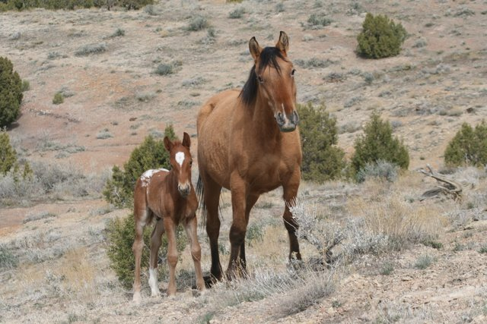

Slide 16
FOALING AND GATHER Data from the Little Book Cliff Wild Horse Range
Year | Foals | Horses Removed
1996 | 33 | 53
1997 | 32 | 10
1998 | 32
1999 | 39 | 57
2000 | 31
2001 | 38
2002 | 41 | 79
2003 | 41
2004 | 25 | 68
2005 | 17
2006 | 26
2007 | 24 | 55
2008 | 17
2009 | 16
2010 | 11
2011 | 12

Slide 17
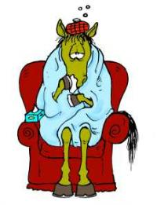

Slide 18
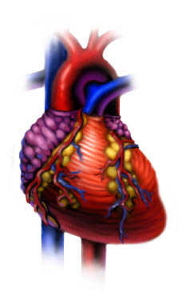
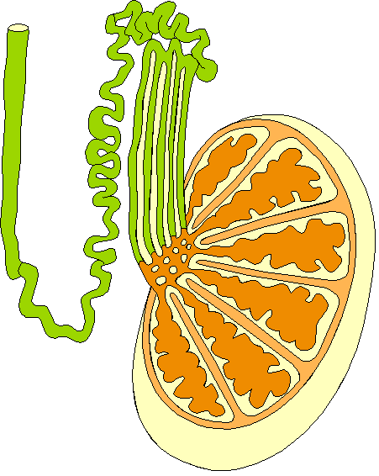
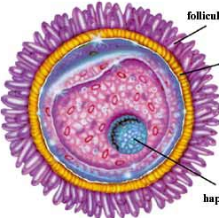
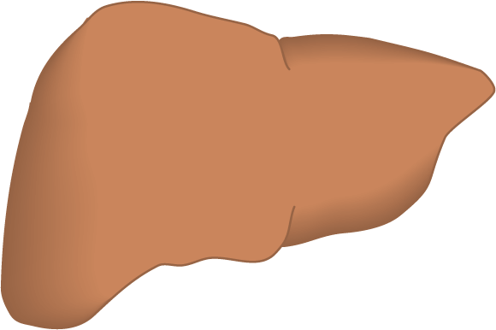
Antibodies Against Zona Proteins Are Tissue-specific
yuk
Y
Y
gag
Y
Yummy
Y
ugh

Slide 19
Reproductive “Stream”
GnRH
Neural signal
Hypothalamus
Ant. Pituitary
Estrous Behavior
LH
FSH
Progesterone
Maternal Behavior
Estradiol

Slide 20
Body Condition Scores for Assateague Horses, 1989 and 1999
Turner, A, and Kirkpatrick. 2002. Reproduction (Suppl. 60):187-195.

Slide 21
Mortality Among the Assateague Horses
From Turner, A & Kirkpatrick, J.F. 2002. Reprod. 60:187-195

Slide 22
MEAN AGE AT DEATH FOR ASIS HORSES AS A
FUNCTION OF LENGTH OF PZP TREATMENT
 | Stallions | Untreated Mares | Mares Treated < 3yrs | Mares Treated > 3yrs
Sample (N) | 56 | 42 | 11 | 19
Mean Age at Death | 10.33 | 6.47 | 10.27 | 19.94
SEM | 0.845 | 0.566 | 1.477 | 1.666
Kirkpatrick, J. F. and A. Turner. 2007. Zoo Biology. 26:237-244

Slide 23
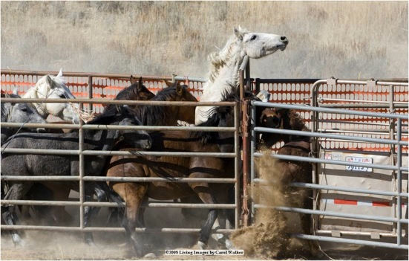
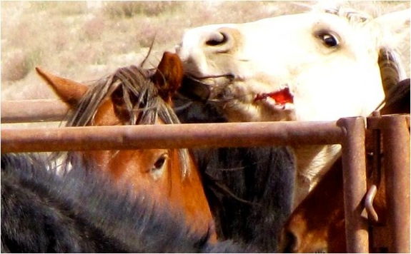
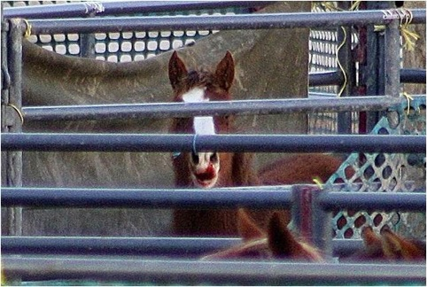

Slide 24
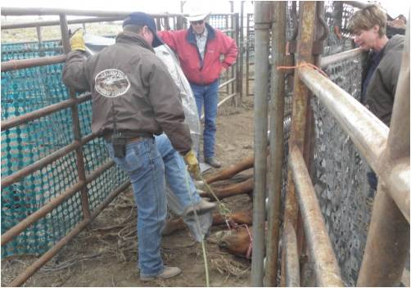
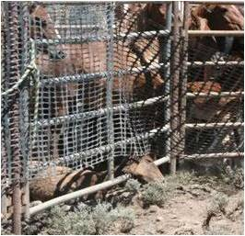

Slide 25
Mortality and wild horse gathers
(fiscal 2010)
Total Horses Gathered | Gather-related Mortality | “None-gather Related Mortality | Percent
1132 | 27 |  | 2.3
 |  | 71 | 6.2
Source: BLM report

Slide 26
Reversibility Data For Pryor Mountain PZP-Treated Wild Horses
Consecutive Years Treated | N | Reversal No/Reversal | % Reversed | Mean Yrs to Reversal
1 | 13 | 11/2 | 84.6 | 3.2
2 | 11 | 8/3 | 72.0 | 2.0
Total | 24 | 14/5 | 79.0 | 2.73
Reversibility Data For Horses in the 2009 Pryor Gather Removal
Horses Removed | Non-breeding Horses Removed | % of Horses Removed That Will Never Breed in the Pryors
58 | 38 | 68.5

Slide 27
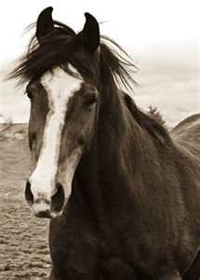
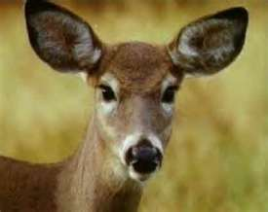
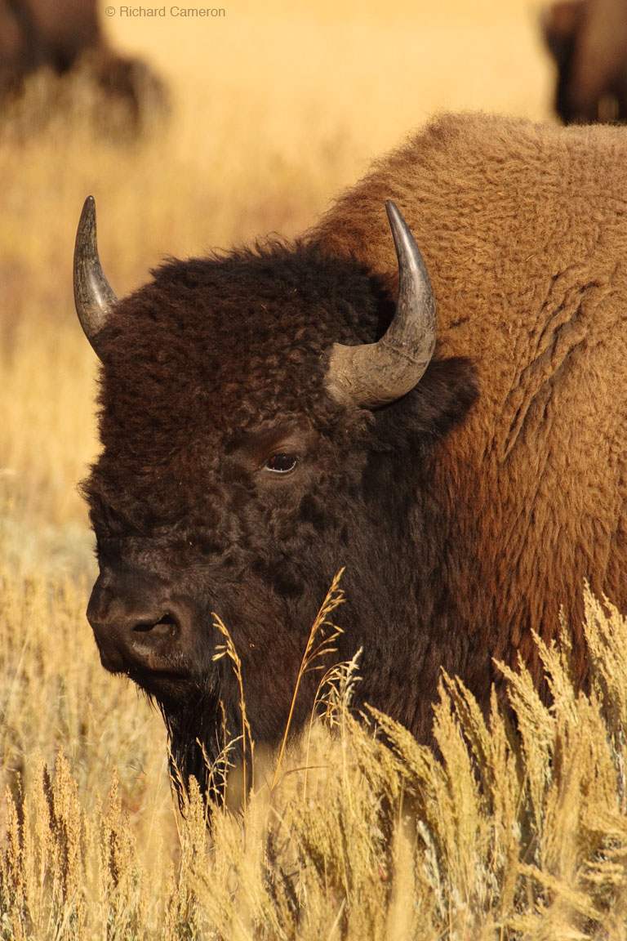
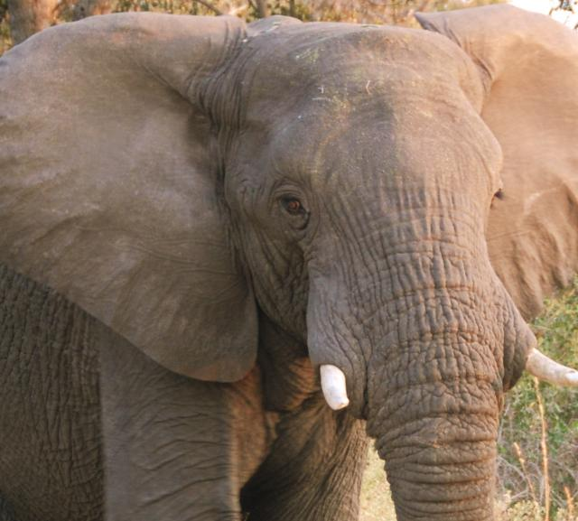
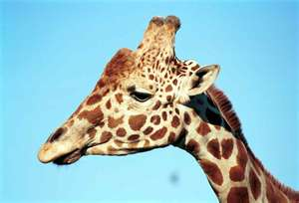

Slide 28
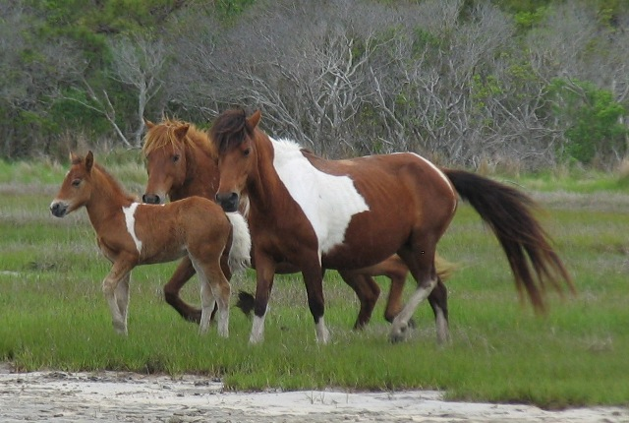

Slide 29
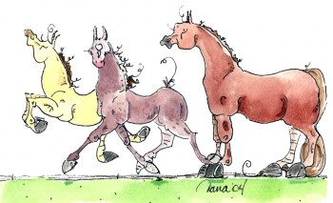
Adult mare exchanges on asis
March 1990-march 1994
Group | N | X Exchanges
PZP Treated | 29 | 4.4
No Treatment | 16 | 4.3
I am out of here!

Slide 30
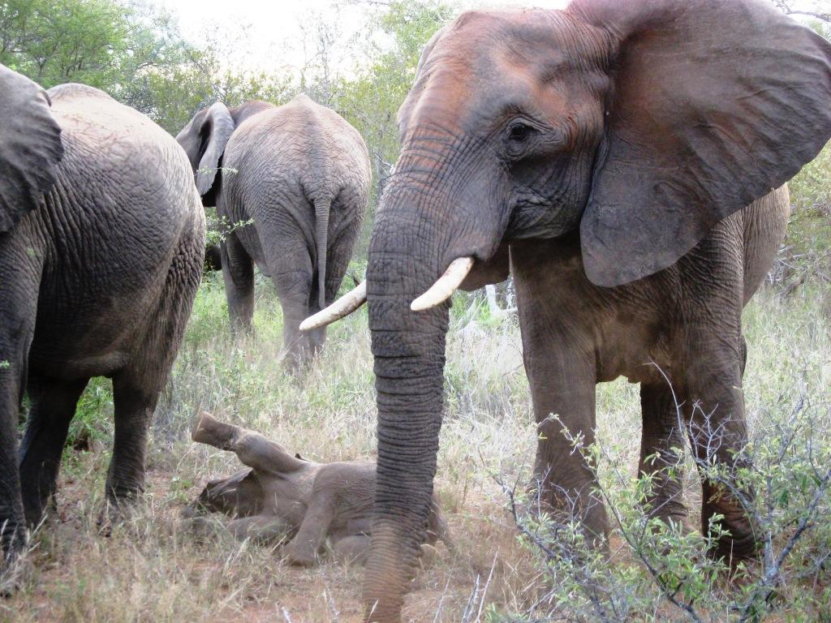

Slide 31
