Slide 1
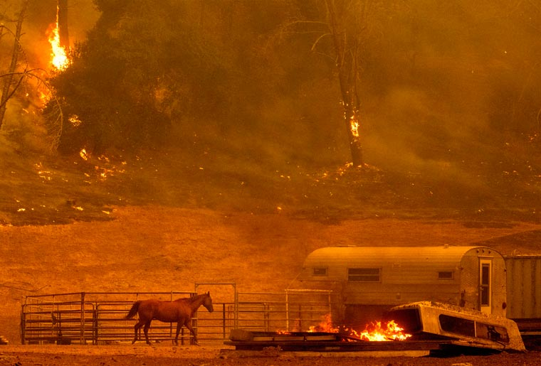
DECHC 2024

Slide 2
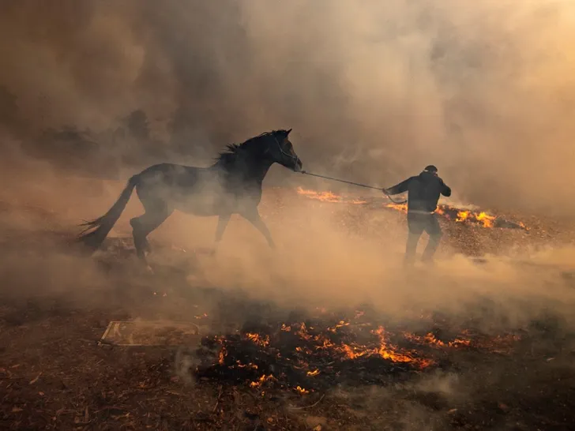
Prevention, Evacuation, Recovery
How You Can Succeed in a Disaster

Slide 3
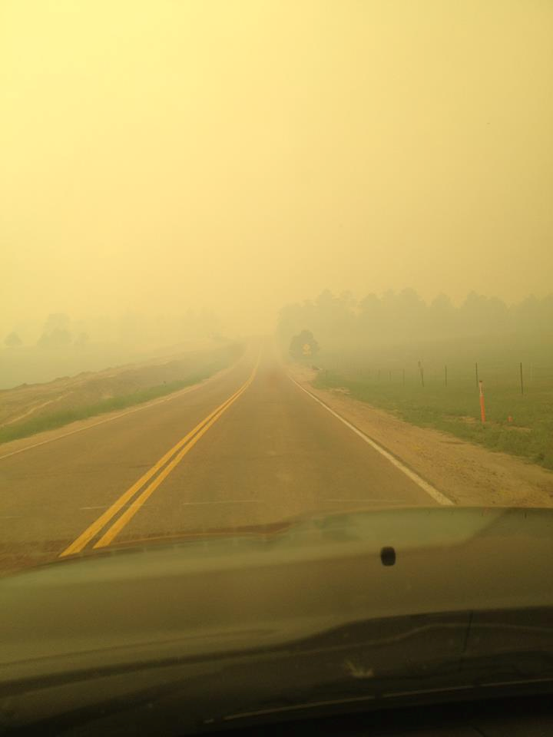
TODAY’S OBJECTIVES
Wind and the WUI, Our Newest Enemy
Building Defensible Spaces for the Worst Scenario
Get out!

Slide 4
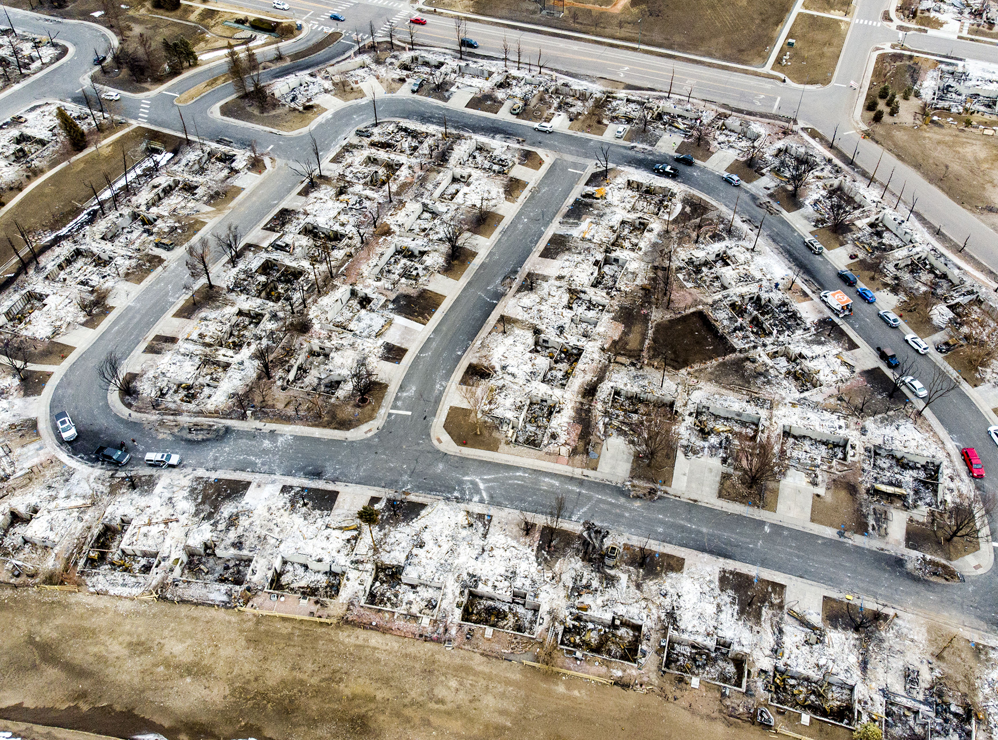
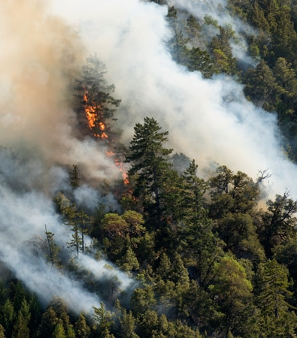
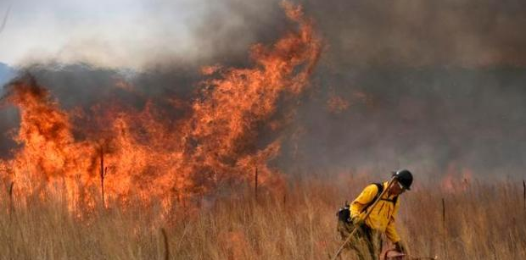
WHAT ARE WE FIGHTING?

Slide 5
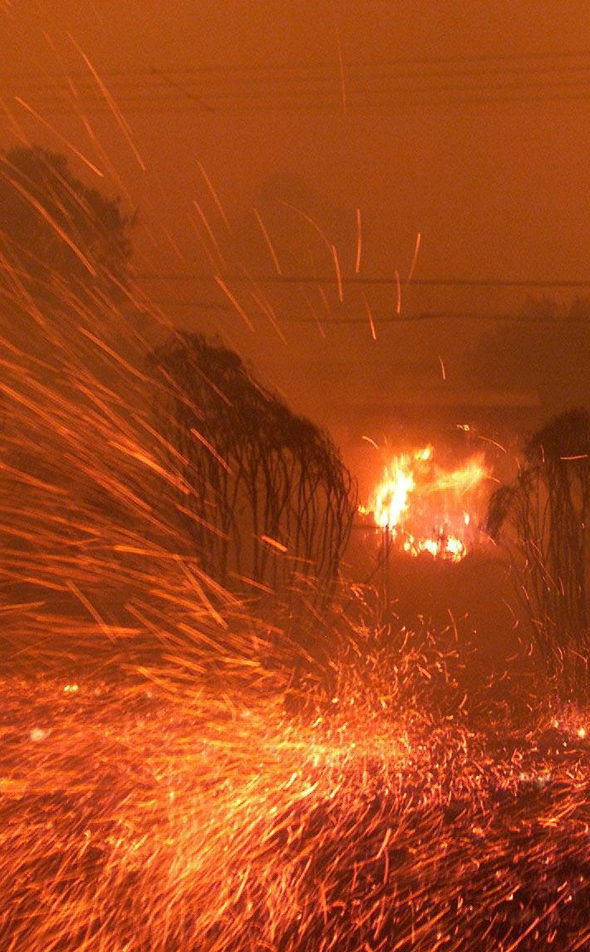
Wind Driven Fires:
Increased Fire Behavior Concerns
Decreased SA
Spot Fires and Embers
Infrastructure Damage
Blocked Exit Routes
Visibility

Slide 6
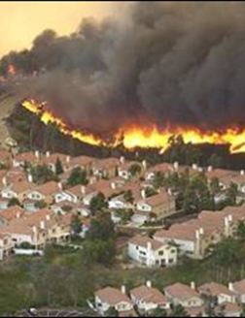
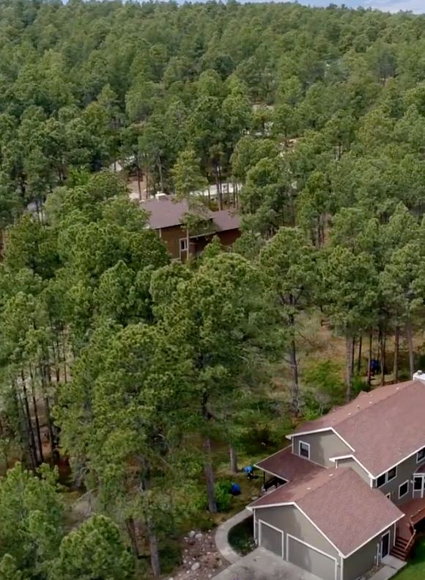
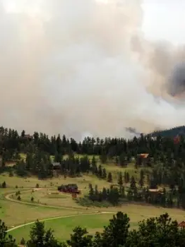

THE WUI:
Wildland Urban Interface
Transition between wilderness and Development
We are building homes in areas that weren’t considered accessible before.
Nature used to clean these areas for us.
We now have to stop nature from cleaning.

Slide 7
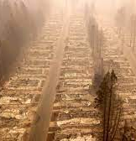
Camp Fire, Paradise California

Slide 8
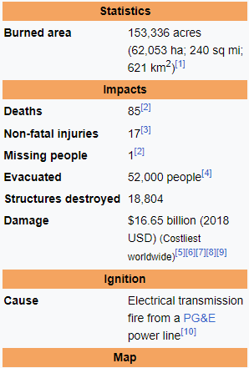
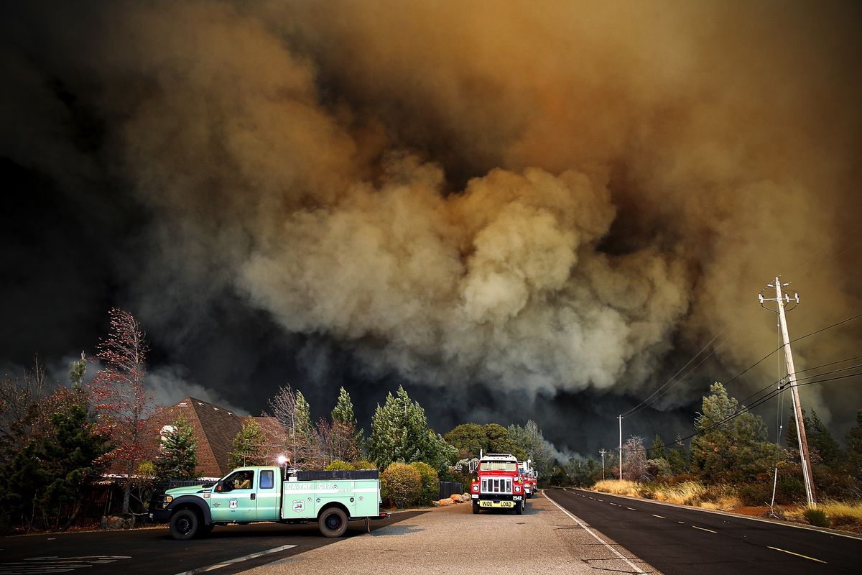
November 18th, 2018

Slide 9
“Battalion Chief Dan Rogers said recently that when evacuation orders are given, about half of residents heed advice and pack up. The other half stay in an effort to ride out the fire. As the flames get closer to those homes, the visibility and air quality decline quickly, and people panic and decide to evacuate. This is not a good time to begin evacuations.”

Slide 10
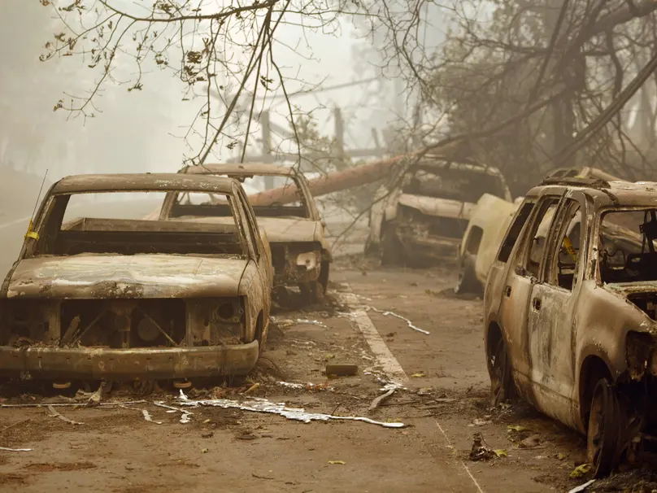
EVACUATION CONCERNS
Knowing When To Go
Notes:
THE PEOPLE WERE EVACUATED, THE OFFICIALS DIDN’T WANT UNTRAINED AND UNSAFE PEOPLE IN THE FIRE AREA, THE FIREFIGHTERS WERE TRYING TO MEET THEIR PRIORITIES.

Slide 11
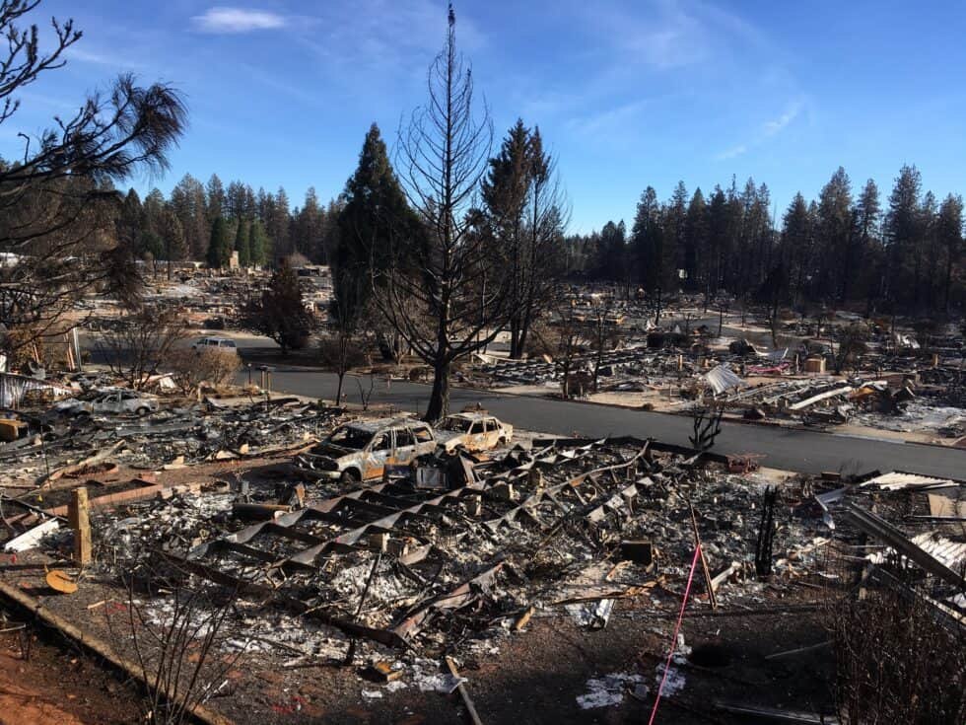
What Went Wrong
Roadways were narrow and not maintained.
Winds and smoke caused zero visibility
Cars, Poles, Trees, Debris closed exit routes
Additional Growth allowed without WUI Enforcements
Citizens waited around to see if it was bad enough to leave
Evac notifications failed

Slide 12
A subsequent Cal Fire report noted, "When the fire reached the town of Paradise, an urban firestorm began to spread from building to building, independent of vegetation." It was compared to the July 27, 1943, Royal Air Force bombing that caused the firestorm that consumed Hamburg, Germany.

Slide 13
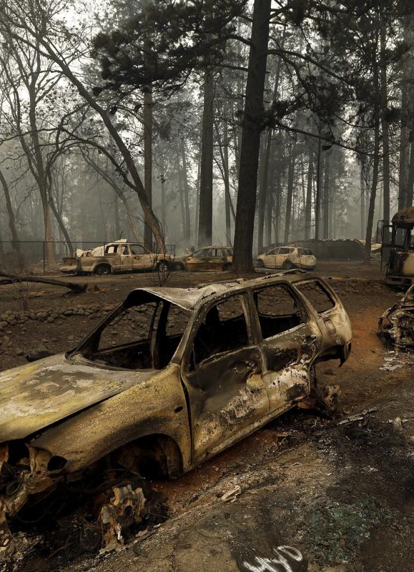
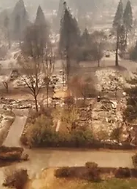

Slide 14
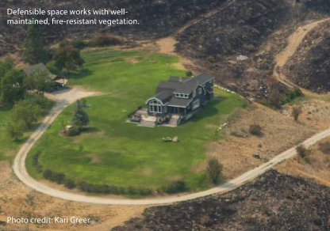
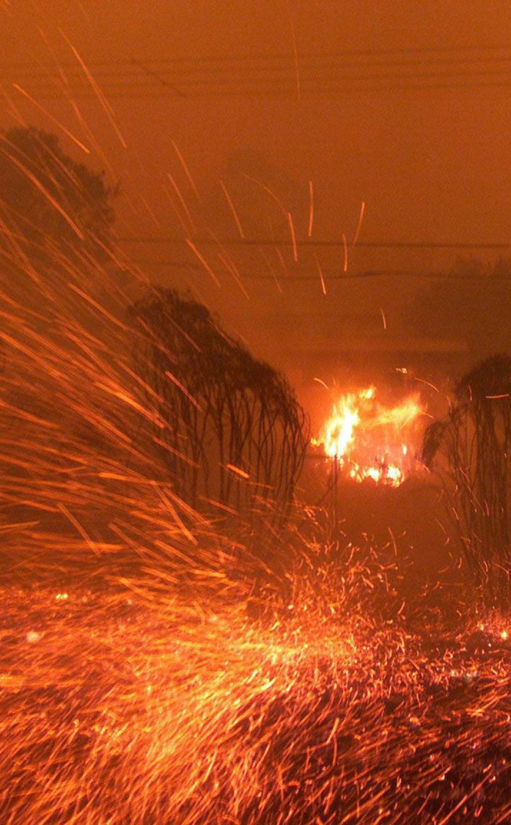
Mitigation
Unmanaged and overgrown vegetation between and around homes increases the risk of wildland fire spreading.
Embers are light enough to travel long distances and are the primary reason homes ignite, often far from the actual flame front

Slide 15
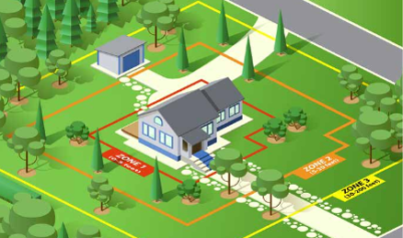
Defensible Space Zones 1, 2, and 3

Slide 16
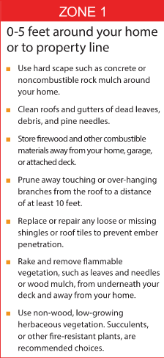
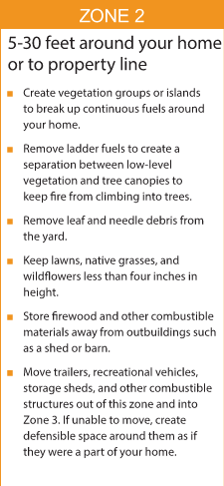
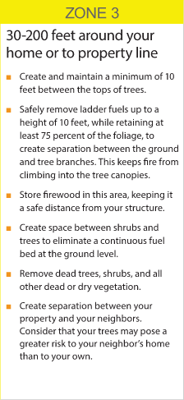
Defensible Space Zones

Slide 17
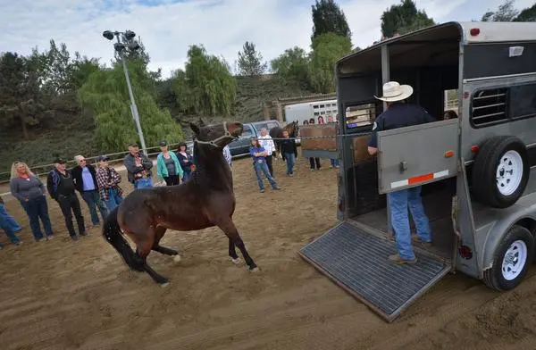
Get familiar with early season changes and how these reflect to your surroundings.
Get plugged into warning systems and alert systems. Get in touch with local OEM
Understand that our pets are our own responsibility, and we must plan for their care
Have fun and put together a Go Bag for you, your family, and your animals
Get involved in organizations that spend time focusing on emergency preparedness and response.
Preparedness

Slide 18
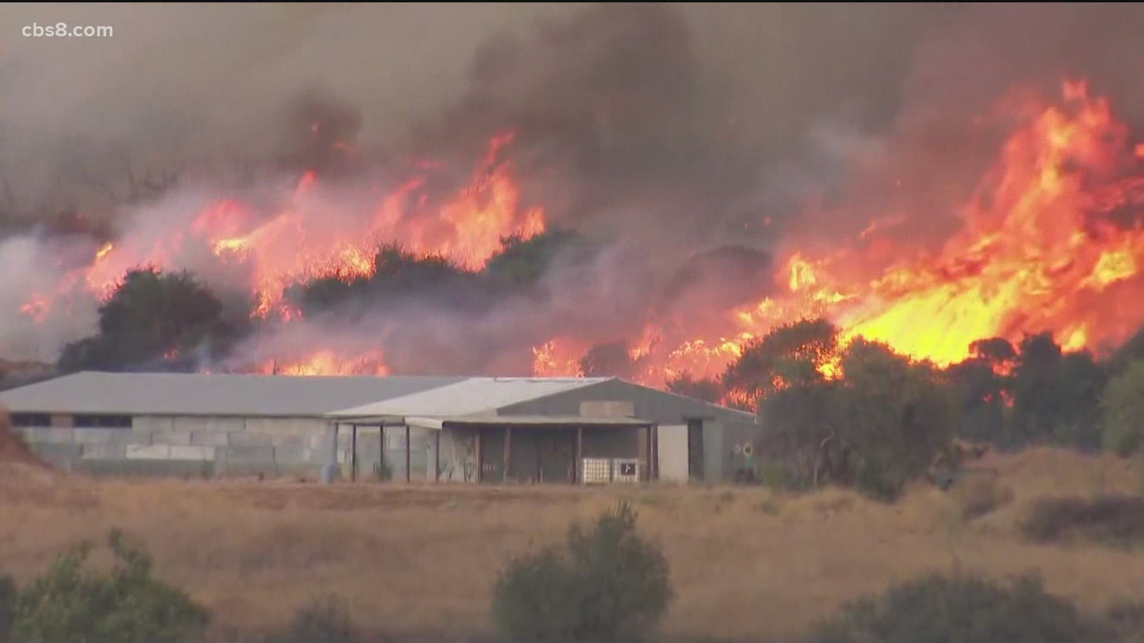

Key Factors to Consider in Preparing:
Have a go bag! Can you go for 3 days?
Do you have a good neighborhood network?
Have you developed a comprehensive documentation packet and veterinary contact list?
Have you identified a good communications plan and do people know where you will be?
  Telegram and Signal
Have you made your equipment road worthy and ready for the possibility of evacuation?
Have you trained your animals to load under stress
Is your insurance coverage up to date?
Learn shelter locations early, get to know them.

Slide 19
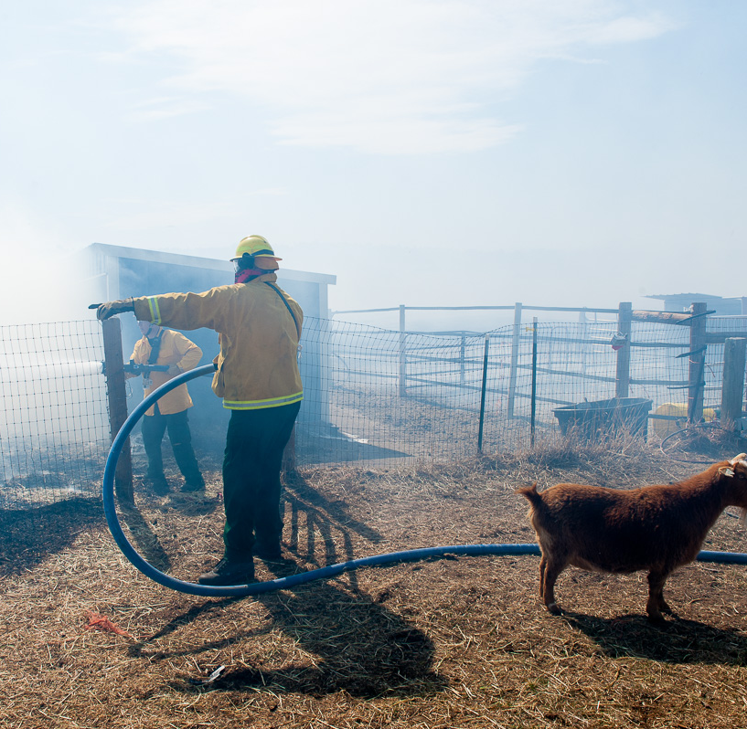
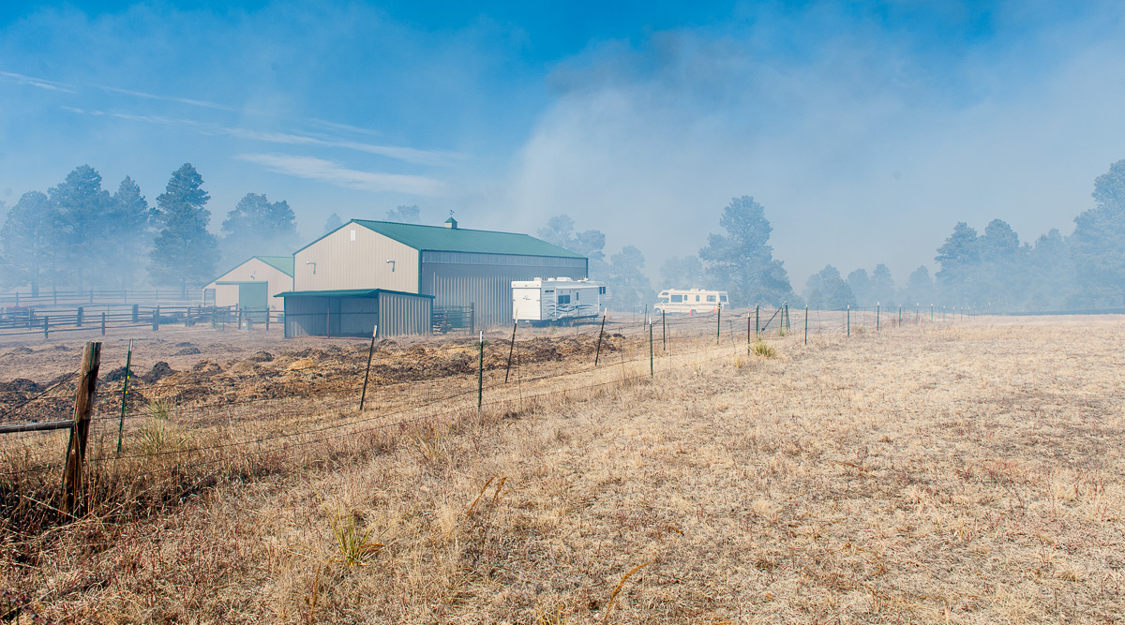
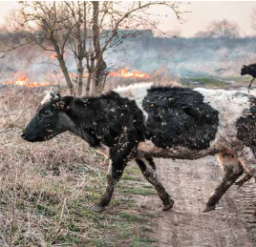
RESPONSE

Slide 20
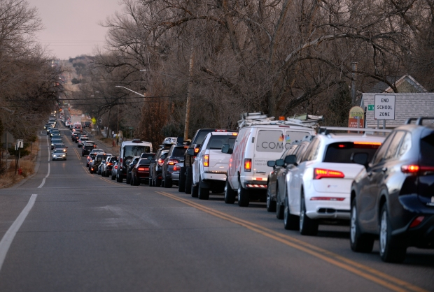
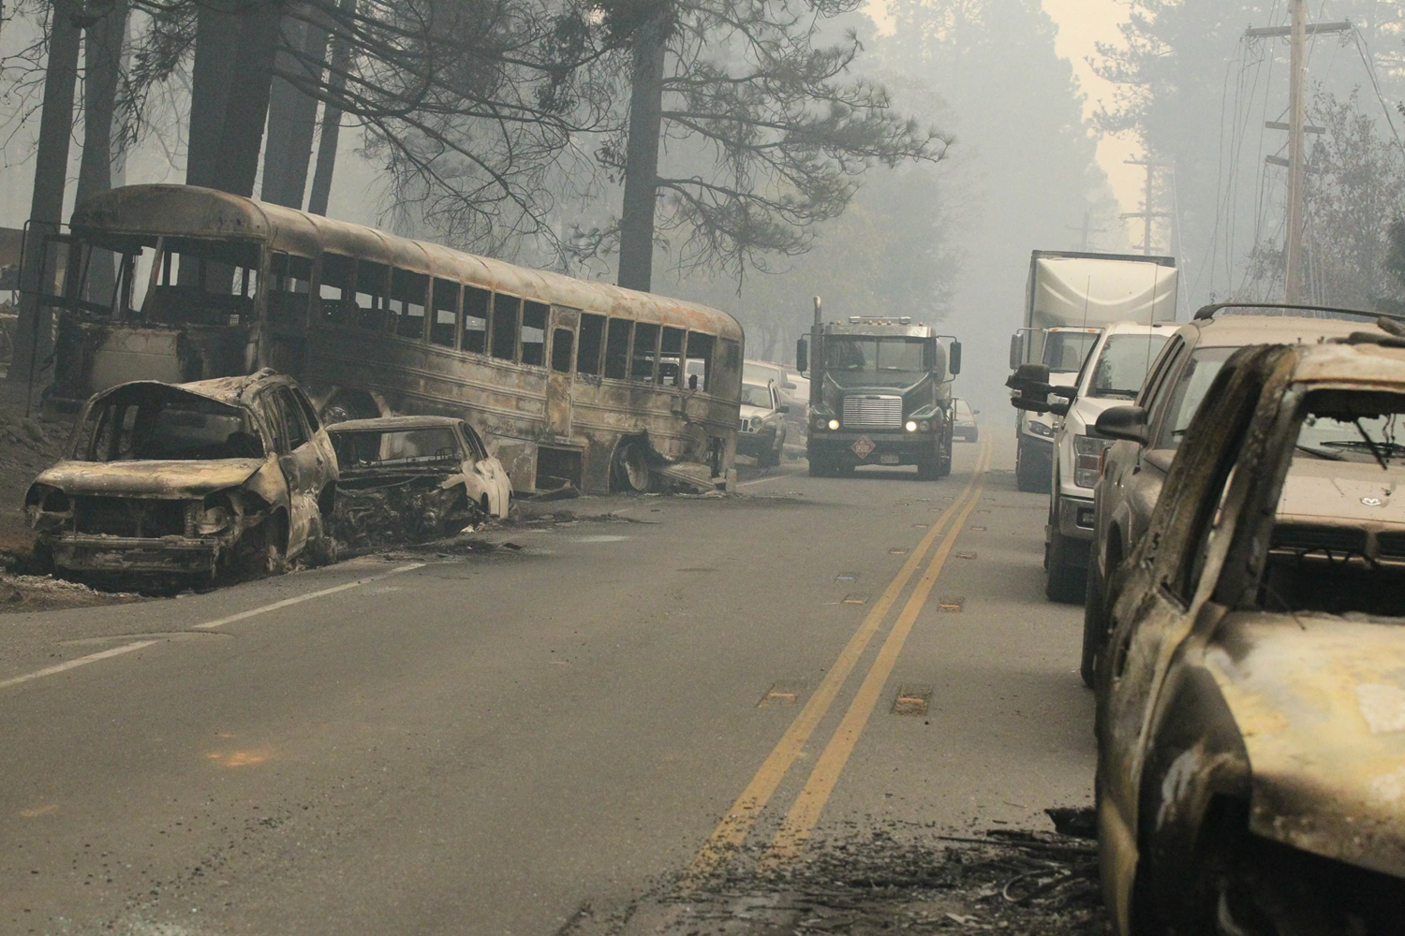
Getting Ready to Evacuate
Shut all windows and doors and turn lights on
Shut off Propane Tanks
Turn on irrigation
Know 2 ways out and practice them!
Signs “Animals are Gone” - "Evacuated"
Leave Shovels, Rakes, Hoses and Ladders Accessible
Leave gates open for firefighter access

Slide 21
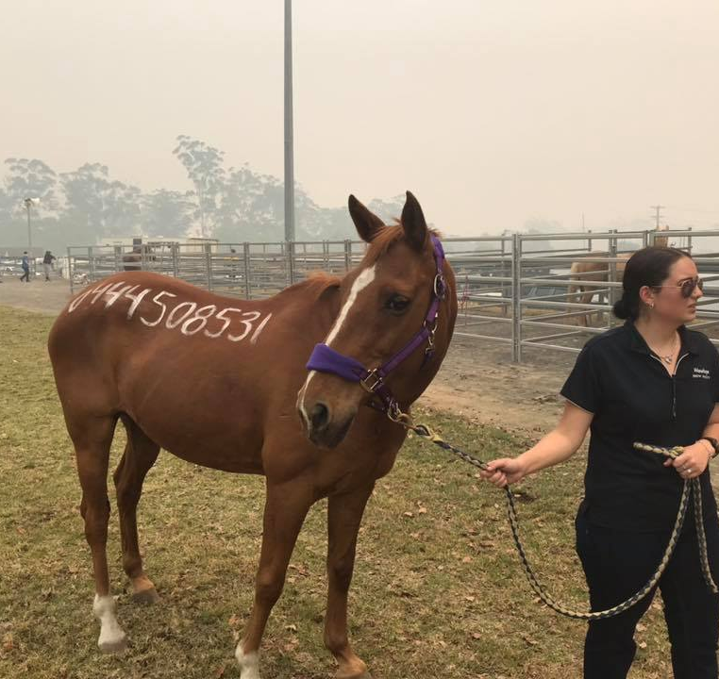
Evacuate
Go Early
Stay Informed!
Do not go back in
Know 2 (or 3) ways out.
Don’t rely only on Apps
Go Early!

Slide 22
Go Bag Basics - Humans
Medications
Toiletries
Visa Gift Card – non expiring
Cell Phone Chargers
Emergency Contact List
Snacks
Eye Glasses/Contacts
Socks, Underwear
Insurance Cards
72 HOURS

Slide 23
Go Bag Basics - Animals
Animal Medications
Specialty Feeds
Signage – Gone? Where?
Medical History Documentation
Bridals, Lead Ropes, Protective Equipment
Insurance Cards
Branding, Ownership Copies
PICTURES
Cloud Access (Google Drive, One Drive, Drop Box)
72 HOURS

Slide 24
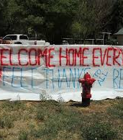
Recovery Considerations
Insurance
Relocation
Long Term Feed and Care
Well Water? Electricity?
Alternative Internet / Phone
What If Your Home or Ranch Is gone?

Slide 25
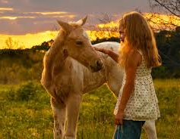
Have a Fire Safe Summer
T.J. Steck - tjs@elizabethfire.org
www.firewise.org
www.ready.gov
www.wildlandfirersg.org
https://dcsheriff.net/codered/
https://www.elbertcounty-co.gov/177/Public-Emergency-Notifications-CodeRED
You Tube
  Canberra Bush Fires
  Fire in Paradise

