Slide 1
GCGCD TownHall
April 28, 2024

Slide 2
AGENDA
Welcome – Wilfred Korth
Ander project overview – Terrell Graham
Questions/Answers
Mining permit renewal – Art Dohmann
Questions/Answers
Public meeting request – Michelle Shelton
Final Questions/Answers

Slide 3
Terrell graham
Ander project overview

Slide 4
BACKGROUND
At issue are two permits, the mining permit, and waste injection disposal wells.
Mining permit had a contested case in 2010. Waste injection permit was not contested in 2010. The TCEQ Commissioners overturned the Administrative Law Judge’s recommendation that the mining permit be remanded for further testing in 2010.
Both permits are up for renewal.
The waste injection permit renewal has had a contested case hearing which is still ongoing. Goliad County Groundwater Conservation District and about 10 landowners are parties to the hearing.
This mining permit renewal application has not been declared technically complete. Still a chance to request a Public Meeting in Goliad County, make Public Comments and request a Contested Case Hearing.

Slide 5
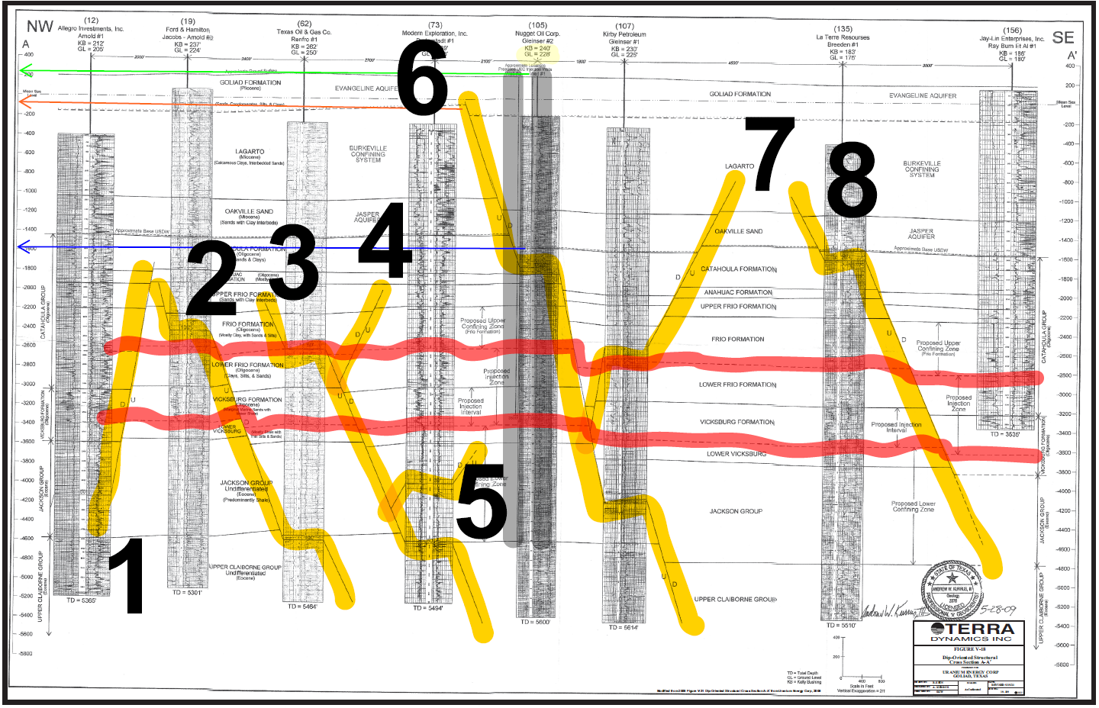
FAULTS

Slide 6
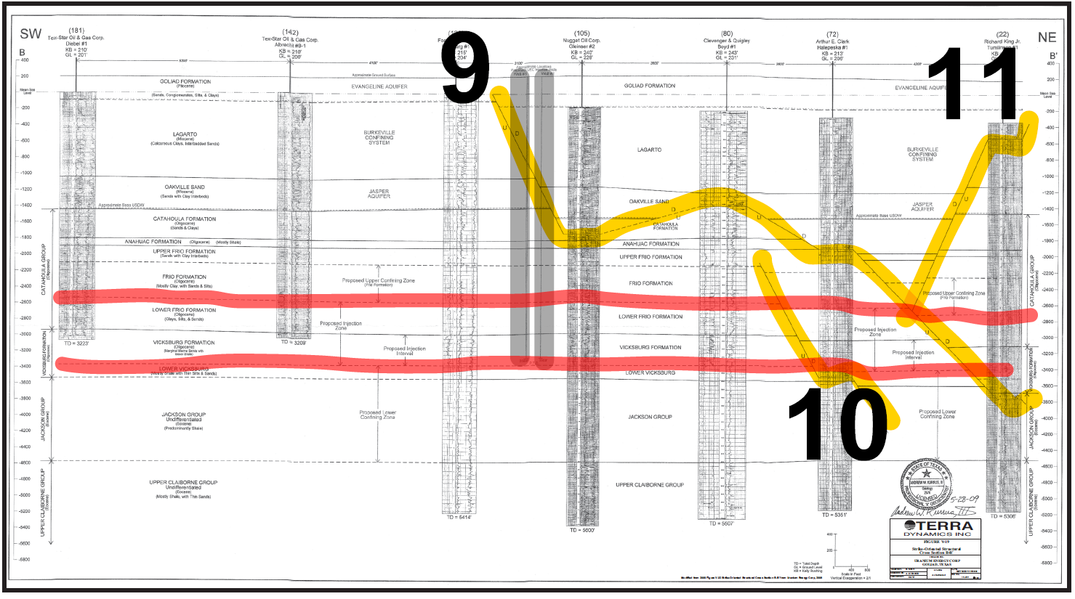
FAULTS CONT.

Slide 7
CONTESTED CASE WASTE INJECTION RENEWAL
Whether the Application Adequately Characterizes the Geology and Identifies and Assesses Faults in the Vicinity of the UEC Wells.
The ALJs concluded that Application did not provide adequate characterization the geology and assessment of faults near the proposed injection wells. Recommended remanded to the Executive Director for further consideration of this issue.
Whether the Draft Permits Provide for Adequate Monitoring of Migration of Injected Fluids in the Vicinity of the UEC Wells.
The Administrative Law Judges added that additional consideration should also be given to the site-specific conditions and the development of a monitoring program upon remand.
Whether the Location of the UEC Wells and Pre-Injection Facilities are Adequate.
Corrective action is needed to address the well plug in the Gleinser No. 2 well, and a monitoring program is needed to address the potential fluid migration through the Hausman No. 2 well.

Slide 8
Action needed
Contact Representative Morrison and Senator Kolkhurst and ask them to request that the TCEQ Commissioners uphold the Proposal for Decision of the Administrative Law Judges regarding the waste injection permit renewal. Also ask them to request the TCEQ hold a Public Meeting in Goliad County regarding mining permit renewal.
Contact the Governor’s Office ask him to ensure that the TCEQ Commissioners uphold the Administrative Law Judges proposal for Decision regarding the waste injection wells.
Contact interest groups and ask them to become involved.
Request a Public Meeting on the mining permit renewal.
Make Public Comments on the mining permit renewal.

Slide 9
ART DOHMANN
Mining permit renewal

Slide 10
In-situ uranium mining permit ur03075
The original permit presented uranium deposits nestled in a “GRABEN” with a surface fault bordering each side.
# As noted during the Injection well permit presentation, there are at least 11 faults, none of which identify with the mining permit geology provided.
# The new fault data shows connections from the deeper waste water injection zones all the way into the drinking water zones which are from 1750 feet and up.
The new fault data clearly defines the potential for the area drinking water supplies to be contaminated by waste water from below and by disturbed uranium deposits in the shallow formations.

Slide 11
In-situ uranium mining permit ur03075
CONT.
An in-situ uranium mining permit requires that area groundwater quality be restored to pre mining conditions. UEC provided water quality data that was taken while extensive bore hole drilling was being conducted. This drilling activity stirred up the uranium and other impurities that makes water quality data questionable.
GCGCD has engaged the services of Dr. Richard Abitz to evaluate the baseline data in conjunction with the water quality trending data that GCGCD has recorded by testing intervals from 2007 to current.
GCGCD data shows a significant change and improvement in water quality of area wells since the initial baseline data was recorded.

Slide 12
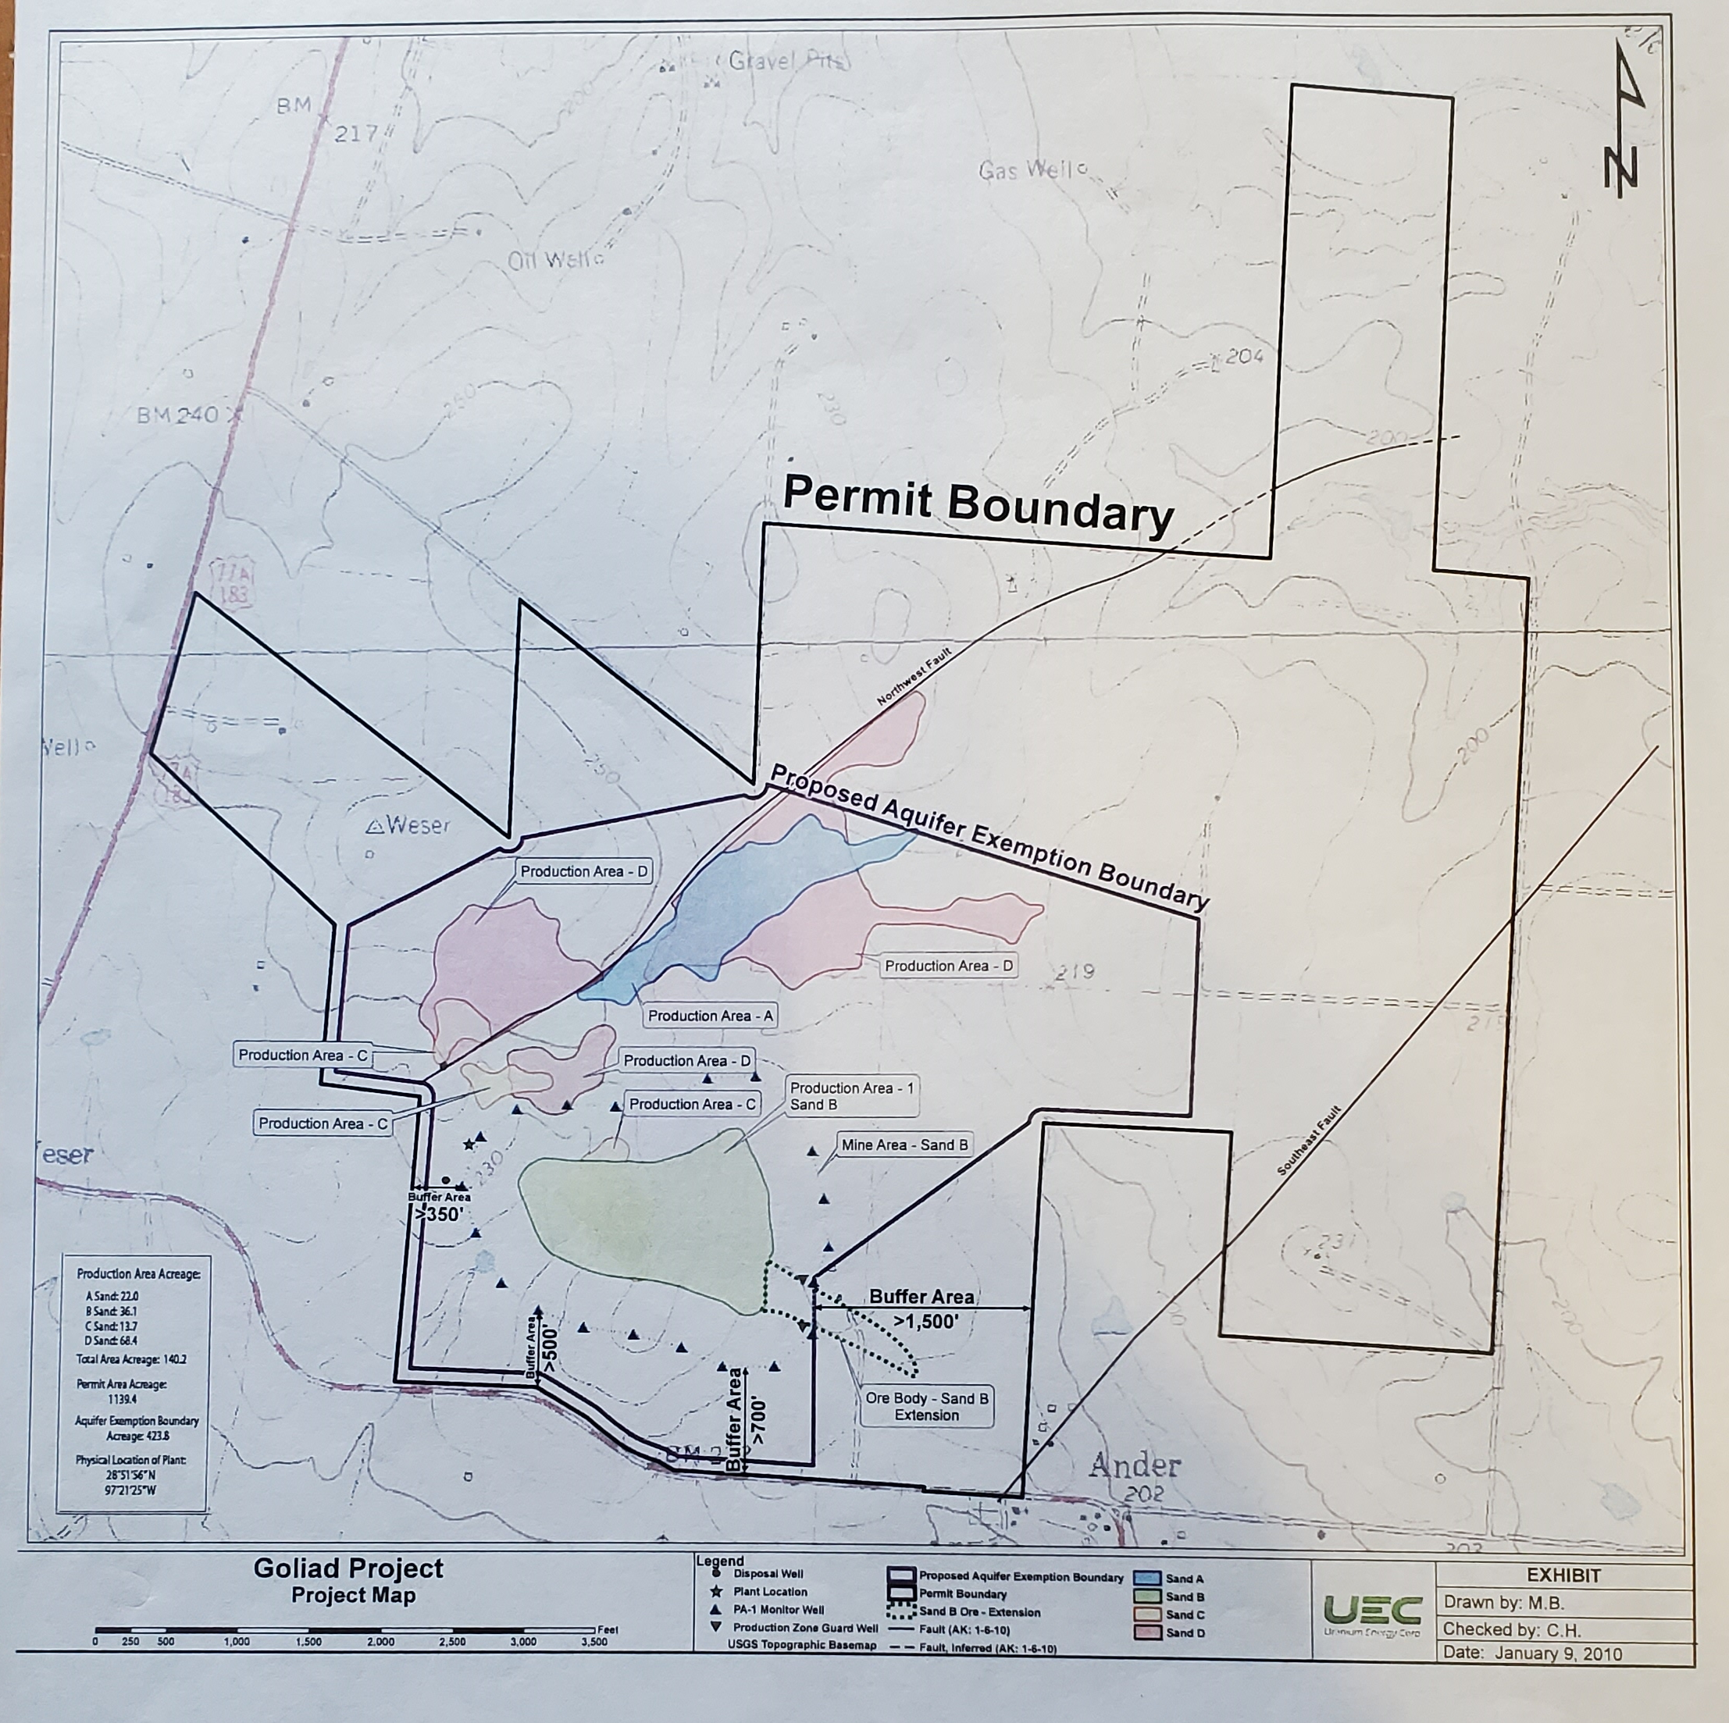
Goliad Project Map

Slide 13
Radon in Private Wells

Slide 14
ANKLAM WELL

Slide 15
ANKLAM WELL
CONT.

Slide 16
BLUNTZER WELL

Slide 17
BLUNTZER WELL CONT.

Slide 18
CHURCH WELL

Slide 19
CHURCH WELL CONT.

Slide 20
DUDERSTADT WELL

Slide 21
DUDERSTADT WELL
CONT.

Slide 22
LONG WELL

Slide 23
LONG WELL CONT.

Slide 24
WARZECHA WELL

Slide 25
WARZECHA WELL
CONT.

Slide 26
Michelle shelton
Public Meeting Request

Slide 27
SUMMARY
There is availability to a computer and will walk you through steps to facilitate a Public Meeting request to TCEQ electronically. You will need an email to submit electronically.
There are available hard copy letters pre-addressed to TCEQ to include evelopes and the District will cover the cost of postage if you would prefer to send a hard copy requests to TCEQ.
Business cards are available with email address of the committee members if you would like more information.

Slide 28
Contact information
      Governor Greg Abbott
Post Office Box 12428
Austin, Texas 78711
(512) 463-1828
Representative Geanie W. Morrison
311 East Constitution Street, Suite 100
Victoria, Texas 77901
(361) 572-0196
Senator Lois Kolkhorst
311 East Constitution Street, Suite 120
Victoria, Texas 77901
(361) 573-7300
TCEQ
Office of the Chief Clerk, MC105
Post Office Box 13087
12100 Park 35 Circle, Building F
Austin, Texas 78711-3087
(512) 239-3300

Slide 29
THANK YOU
gcgcd@goliadcogcd.org - District
naturetour12@gmail.com – Wilfred Korth
artdohmann@gmail.com – Art Dohmann
tgraham192@gmail.com – Terrell Graham
(361) 645-1716

