Slide 1
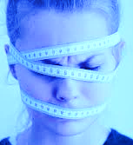
EATING DISORDERS
Understanding, Detection, and Treatment
Mary M. Boggiano, Ph.D.
Associate Professor
Behavioral Neuroscience Division, Dept. of Psychology, UAB

Slide 2
DISCLOSURE STATEMENT
I have no financial disclosure or conflicts of interest with the material in this presentation.
This presentation contains highly graphic photos
that may be disturbing to some.

Slide 3
Most common EDs
BINGE-EATING DISORDER
3
BULIMIA NERVOSA
2
ANOREXIA NERVOSA
1
Less Common EDs
Avoidant/restrictive food intake disorder
Pica
Rumination disorder
Amer Psychiatric Assoc, DSM-5 2013

Slide 4
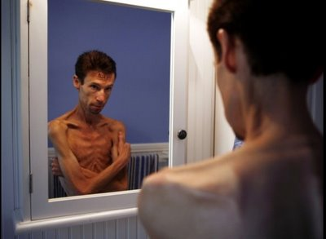
ANOREXIA NERVOSA
CRITERIA
Restriction of intake to a body weight lower than normal or expected.
Not “anorexia”
APA, DSM-5 2013

Slide 5
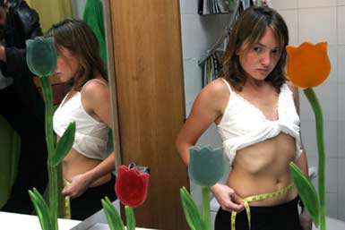
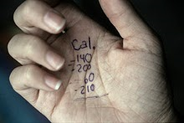
B. Intense fear of gaining weight or becoming fat, or
persistent behavior that interferes with weight gain.
But weight loss does not alleviate the fear (think OCD)

Slide 6
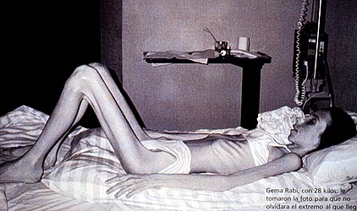

Slide 7
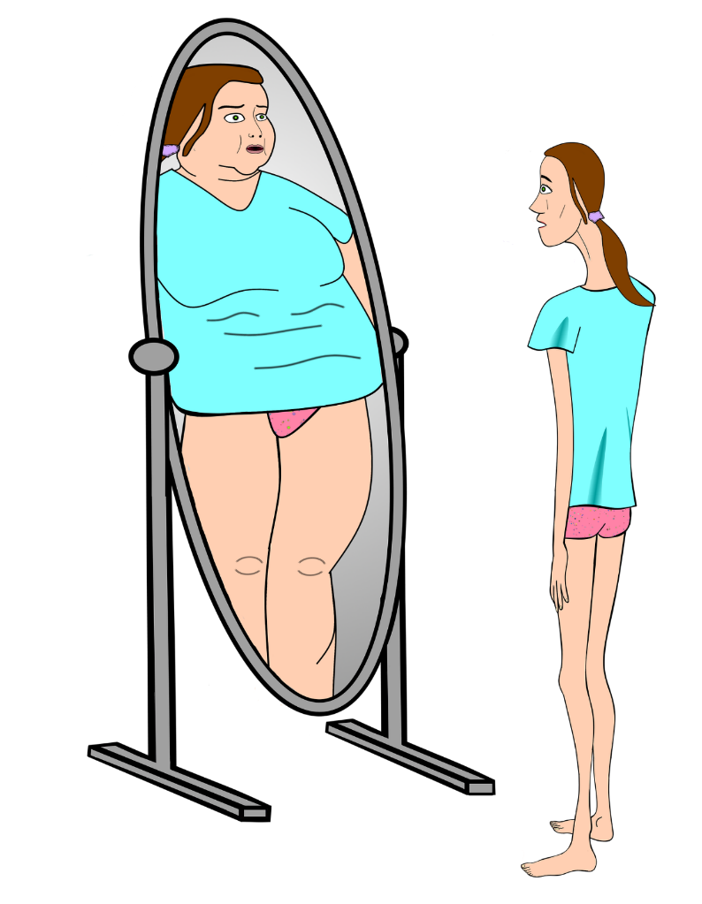
a) Disturbance in how weight or shape is experienced
Myth

Slide 8
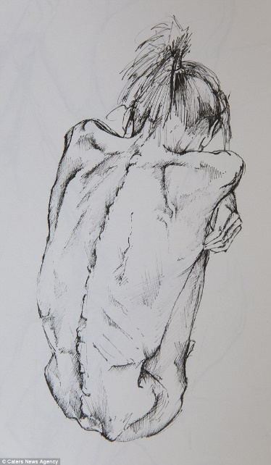
Patient self-portraits – see thinness but perception is abnormal;
preoccupation prevails
APA, DSM-5 2013

Slide 9
a) Disturbance in how weight or shape is experienced or
b) undue influence of b.w./shape on self-evaluation

Slide 10
a) Disturbance in how weight or shape is experienced;
b) undue influence of b.w./shape on self-evaluation; or
c) persistent failure to recognize seriousness of low weight

Slide 11
Subtypes of AN
Binge-eating purging type
Restricting type

Slide 12
MORTALITY
Highest of any mental disorder (up to 10%)
Circulatory collapse
Cachexia
Organ failure
Suicide
Arcelius et al., ArchGenPsych 2011; Harris & Barraclough, BJP 1998; Fichter et al., IJED 2016

Slide 13
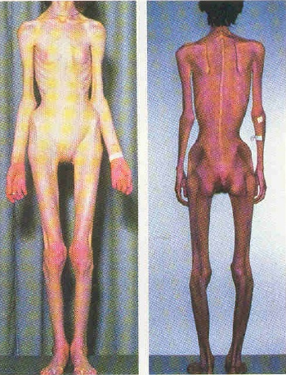
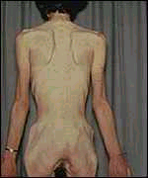
Deceased shortly post photos

Slide 14
EPIDEMIOLOGY
Onset age: 18
Onset trigger: a stressful life event
Sex ratio: 10 : 1 F/M
Prevalence: 0.6%
Course: 5 years
Ethnicity & SES: All (for all EDs)
Hudson et al., BP 2007; DSM-5 2013; Becker et al., IJED 2003; Cachelin et al., IJED 2001

Slide 15
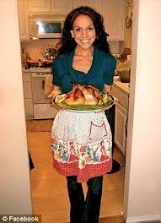
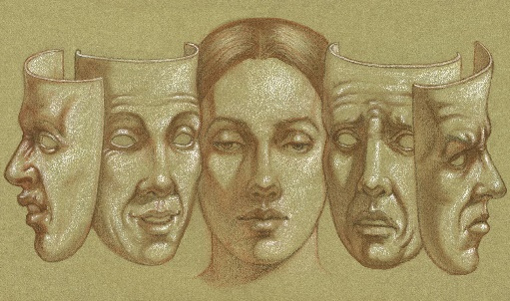
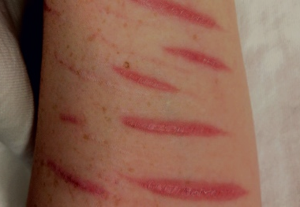
DETECTION
Behavioral
Skipping meals
Excuses to avoid food situations
Food rituals (to avoid eating)
Food obsession
Social withdrawal
Irritability
Restrained expression
Feeling of ineffectiveness
Insomnia
Dressing in layers
Self-injury
Rigid exercise regimens
Irrational thinking
DSM-5 2013; Atia & Walsh, AmJPsych 2007;Harrington et al., AFP 2015; Smithuis et al. JED 2018

Slide 16
Hyperactivity

Slide 17
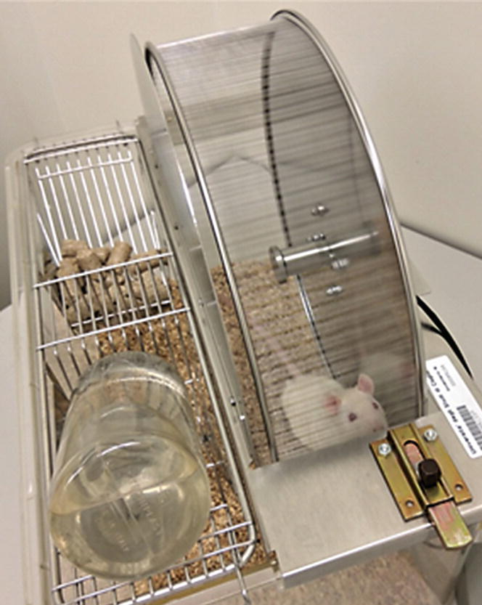
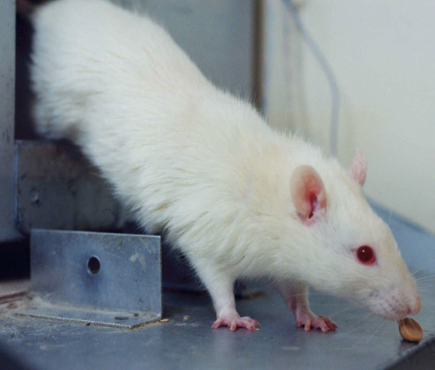
Hyperactivity
Activity-based anorexia (ABA)model
Hall et al., JCPP 1953 ; Klenotich & Dulawa, Psych Disord 2011

Slide 18
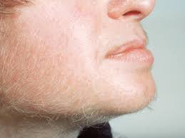
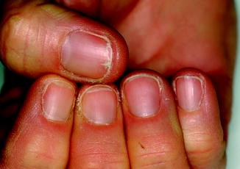
DETECTION
Physical/Medical
If present at clinic, for stomach or emotional issues
Lanugo
Poor hair, skin, nail quality
Amenorrhea, loss of libido
Labs: T4,T3, estro/testost, dehydration electro profile, high CORT
Bradycardia
Dizziness, syncope
Hypothermia
Edema
Yellowing skin
Gold et al., NEJM 1986; Mitchell & Crow, CurrOpPsych 2006; Yager et al., APA 2006; DSM-5 2013

Slide 19
MRI - cerebral atrophy
Seitz et al., Curr Neuropharm 20018

Slide 20
DETECTION
Comorbid disorders
Anxiety (75%) esp. OCD, social phobia, and GAD
Depression (42%)
Impulse Control (31%)
Substance use (27%)
DSM-5 2013; Hudson et al., BP 2007; Kaye et al., AJP 2004

Slide 21
BULIMIA NERVOSA

Slide 22
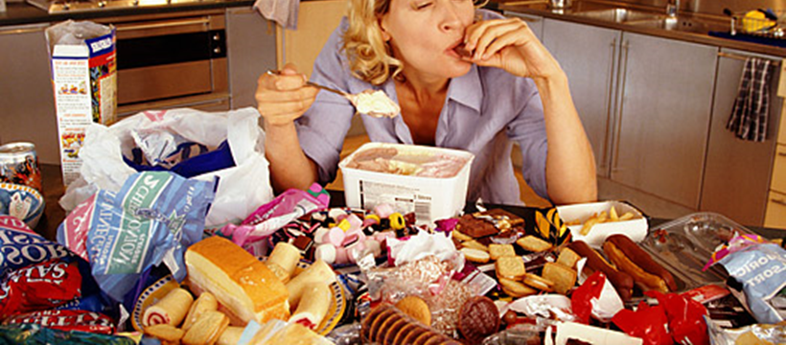
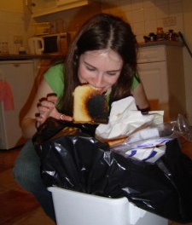
CRITERIA
A. Recurrent episodes of binge eating:
unusually large amount
discrete time
lack of control
indiscriminate (garbage, pet dishes)
concocting
painful fullness
only social interruption
concocting
can’t recall what was eaten
shame
APA, DSM-5 2013; Boggiano et al., IJED 2012

Slide 23
B. Self-evaluation unduly influenced by b.w. and shape.
preoccupation with weight loss is as intense as AN

Slide 24
C. Inappropriate compensatory behaviors
self-induced vomiting
not easy, instruments, “last time”
laxatives, diuretics, enemas
excessive exercise
fasting between binges
hence normal weight
very restrictive (eat less than AN)
D. Bingeing or purging 1/week for 3 months.

Slide 25
Strict dieting
Tension hunger & cravings
Binge eating
Purging;
disgust
shame
Continued obsession to lose weight
ABNORMAL
NORMAL
NORMAL
Adapted: Smith et al., 2019; www.helpguide.org

Slide 26
EPIDEMIOLOGY
Onset age: 18
Onset trigger: dieting to lose weight
Prevalence: 1 - 1.5%*
Sex ratio: 10 : 1 F/M
Course: 10 years and highly recidivistic
*3% with subthreshold ; Hudson et al., BP, 2007; DSM-5 2013; Smink et al., CPR 2012

Slide 27
DETECTION
Behavioral
Weight fluctuation
Avoid eating in public, or eating very little in public
Frequent bathroom trips, “showers”, and toilet flushing
Missing food, secretive food disposing
Withdrawal; isolation
Irritability, moodiness
Self-injury
Depression
APA, DSM-5 2013; Mitchell & Crow, COP 2006; Yager et al., APA, 2006

Slide 28
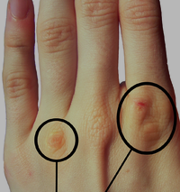
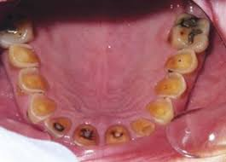
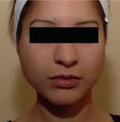
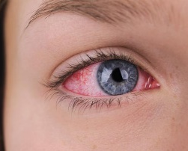
Physical / Medical
Russell’s sign
Dental erosion
Swollen parotids
Ruptured eye blood vessels
Labs: fluid & electrolyte imbalances, metab alkalosis/acidosis
Cardiac arrhythmia
Edema
Rectal prolapse
APA, DSM-5 2013; Mitchell & Crow, COP 2006; Yager et al., APA, 2006

Slide 29
Comorbid disorders
Anxiety (81%)
Depression (71%)
Substance use (37%)
Personality disorder (BPD) 36%
APA, DSM-5 2013; Hudson et al. BP 2007; Cassin & von Ranson, CPR 2005

Slide 30
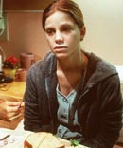
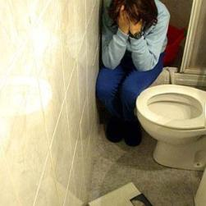
Depression is severe

Slide 31
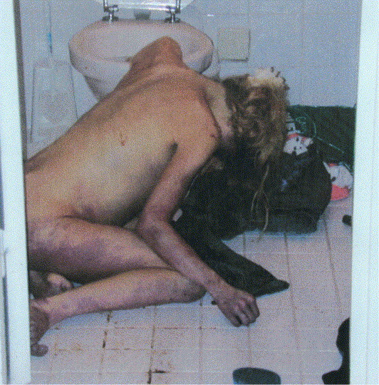
MORTALITY
Up to 5.5%
Suicide > than AN (23% of deaths)
Organ failure (electrolyte imbalance)
Gastric or esophageal rupture (rare)
Neurogenic shock
Arcelius et al., ArchGenPsych 2011; Fichter et al., IJED 2016

Slide 32
BINGE-EATING DISORDER (BED)

Slide 33
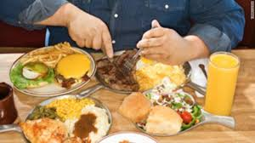
CRITERIA
A. Recurrent binge eating
APA, DSM-5 2013

Slide 34
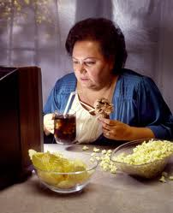
Binges associated w/ 3 of 5:
- eating more rapidly than normal
- to uncomfortable fullness
- when not hungry
- eating alone from embarrassment over amount eaten
- self-disgust, depression, or much guilt after bingeing

Slide 35
C. Significant distress over binge eating pattern.

Slide 36
D. Absence of inappropriate compensatory behavior.
Most develop obesity
Incidence of BED is very common in morbid obesity
Double-whammy
Yanovsky, AMJ Psych 2003; DSM-5 2013

Slide 37
DETECTION
Behavioral
Very rapid weight gain
Large meals and grazing when not binge eating
Convinced weight-loss will cure all problems
Obsessed with losing weight
Interpersonal problems
Negative affect
Impulsiveness
Comorbid disorders
Anxiety (65%)
Depression, bipolar (46%)
Substance use (23%)
Ulfvebrand et al., Psych Res 2015; DMS-5 2013

Slide 38
Physical / Medical
Obesity and obesity-related
DSM-5 2013

Slide 39
Physical / Medical
Obesity and obesity-related
BED ≠ Obesity
Greater psychopathology
Greater body dissatisfaction
Lower self esteem
Poorer social adjustment
Higher drop-out/success in WLP
Higher risks after bariatric surgery
More medical problems
Lower overall QOL
Greater mortality
Yanovsky, AMJ Psych 2003

Slide 40
EPIDEMIOLOGY
Onset age: 21
Onset trigger: not as specific; childhood obesity, dieting, negative affect
Prevalence: 2.8 - 5% - MOST PREVALENT of all EDs
Sex ratio: 2 : 1 F/M
Course: 10 years to lifetime
Ethnicity: As prevalent in minorities as in whites
Mortality: Uncertain; 1.5% (Fichter et al., 2016)
Hudson et al., BP 2007; DSM-5 2013.

Slide 41
CAUSAL FACTORS of EDs
Not a choice
Not about looks…

Slide 43
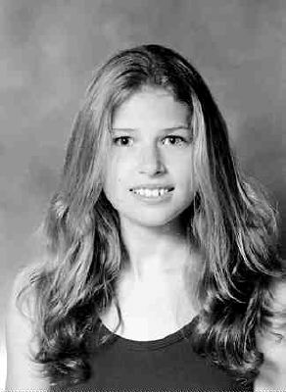
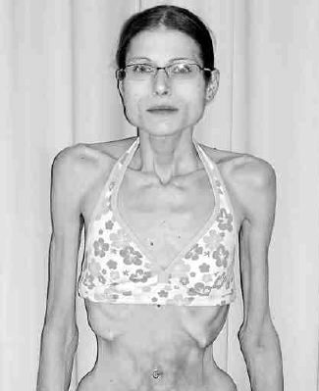

Slide 44
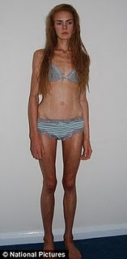
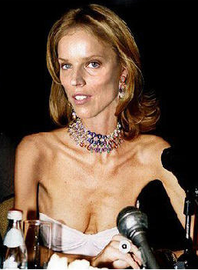
Deceased
Deceased

Slide 45
CAUSAL FACTORS
GENES
ENVIRONMENT
RISKY BEHAVIORS

Slide 46
High heritability: 59% - 82%
GENES
Bulik et al., IJED 2000; Klump et al., PCNA 2001; Fairburn & Harrison, Lancet 2003; Mitchell et al., PM 2010

Slide 47
GENES
Personality Traits
AN BN BED
Anxious
Perfectionistic
Obsessive-compulsive
Conforming
Rigid/inflexible
Harm avoidant
Anxious Anxious
Perfectionistic Novelty-seeking
Obsessive-compulsive Harm avoidant
Impulsive Impulsive
Novelty-seeking Low self-directedness
Craig 2002; Paulus & Stein 2006; Stice 2002; Kay et al., 2009; Grucza et al., 2007

Slide 48
GENES
Neurotransmitter Abnormalities: serotonin dopamine
Explain personality traits and behavior
AN: abnormal elevation of both
= harm avoidance, rigid thinking, greater fullness
Exaggerated by estrogen.
= anxiety, hyperactivity, lower reward need
Self-medicating by starving?
BN & BED: abnormal suppression of both
= impulsivity, depression, decreased satiety
= greater reward need (binge-eating raises DA)
Bailer et al, IJED 2000 & Neuroim 2000; Kaye et al., NatNeuro 2009; Haedt-Matt & Keel, 2011

Slide 49
GENES
ENVIRONMENT
RISKY BEHAVIOR

Slide 50
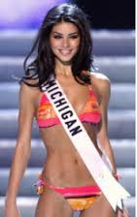
Western “thin” beauty ideal

Slide 52
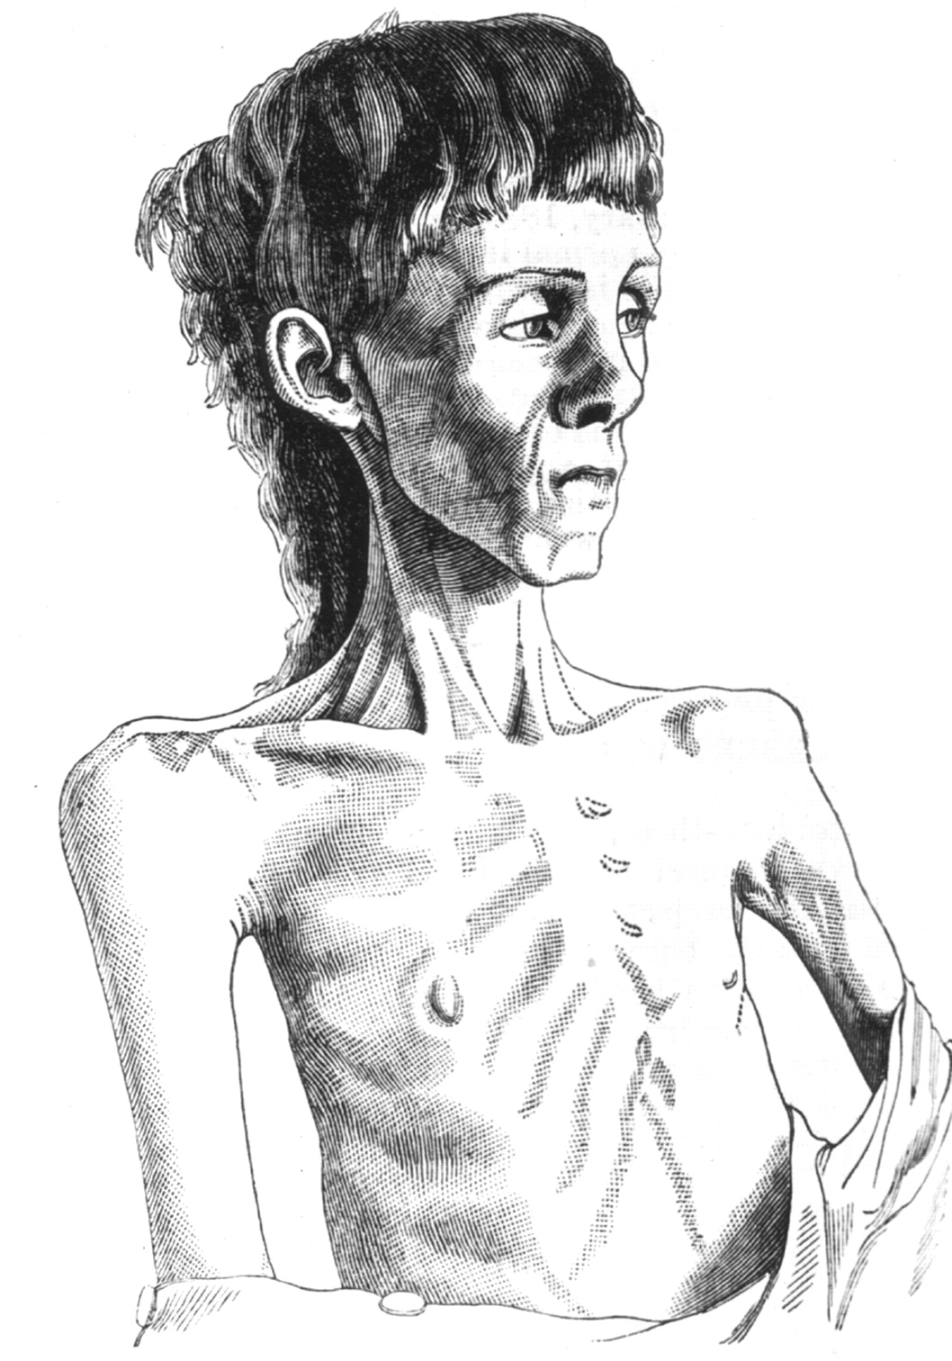
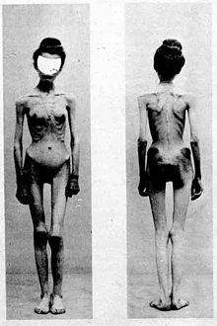
19th C drawing of young
woman with anorexia nervosa.
Images of anorexic female patient published in 1900.
Becker et al., NEJM 1999
Notes:
Nineteenth century drawing of young woman with anorexia nervosa

Slide 53
18th C body ideals
R.S. Fleming 2013

Slide 54
More Evidence against Sociocultural Factors…
Curacao Study – Predicted low to no AN in ‘fat is beautiful’ culture. Incidence was the same as in West (Hoek et al. NEJM, 1998).
Fiji Islands Study – Introduction of popular American TV shows to teens increased ED symptoms in ‘fat is beautiful’ country (Becker et al. BritJPsych, 2002). But many had symptoms before intro of shows.
EDs exist in non-Western cultures- E.g., “Prevalence of eating disorders among female adolescents in Teheran comparable to prevalence rates in Western societies” (Nobakht & Dezhakam, IJED, 2000).
EDs are still rare in U.S. despite “thin beauty ideal”.

Slide 55
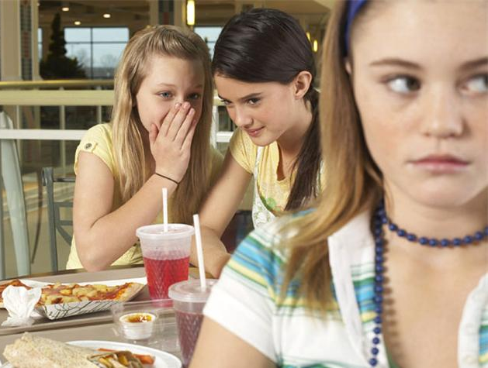
Low causality but strongest impact comes from
messages about body weight/shape between family
and friends (including comments about self).
ENVIRONMENT
Pull &* Latner, Psych Bull 2007; Vartanian & Porter, App 2016

Slide 56
GENES
RISKY BEHAVIOR
#1 is restrictive dieting
ENVIRONMENT
APA, DSM-5 2013

Slide 57
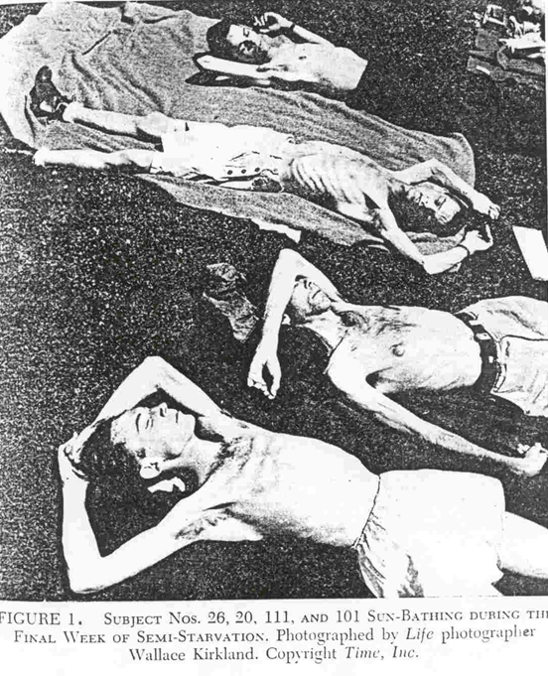
Minnesota Semi-Starvation Study
(Ancel Keys, 1944-1945)
Keys et al., Biology of Human Starvation, 1950

Slide 58
New & Lasting Symptoms
Preoccupation with b.w. and shape
Insatiable appetites
Loss of control eating
Binge-eating (6,000-7,000 kcals)
Food obsession
Hiding, hoarding, concocting
Control Starvation Rehabilitation
Keys et al., Biology of Human Starvation, 1950

Slide 59
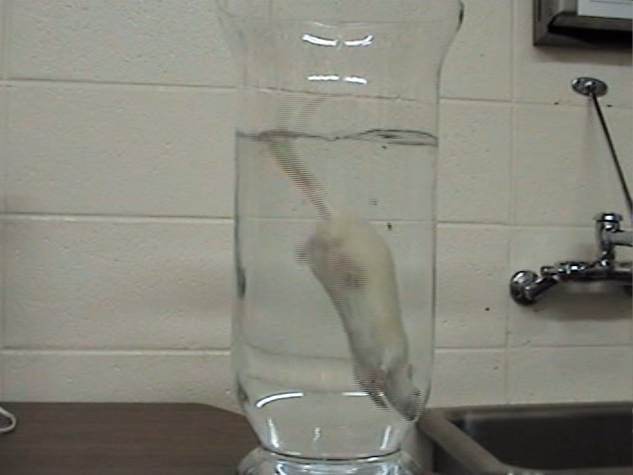
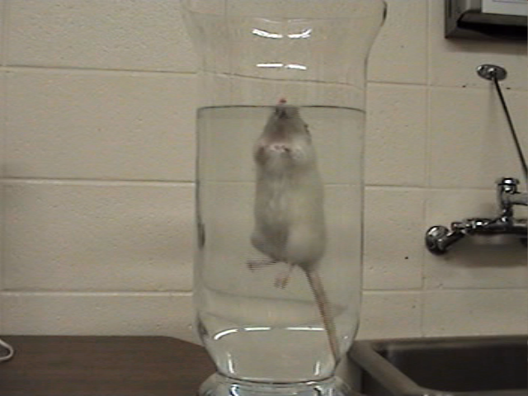
No History of Dieting
History of Dieting
Chandler-Laney et al. , Physio Biochem Behav 2007

Slide 60
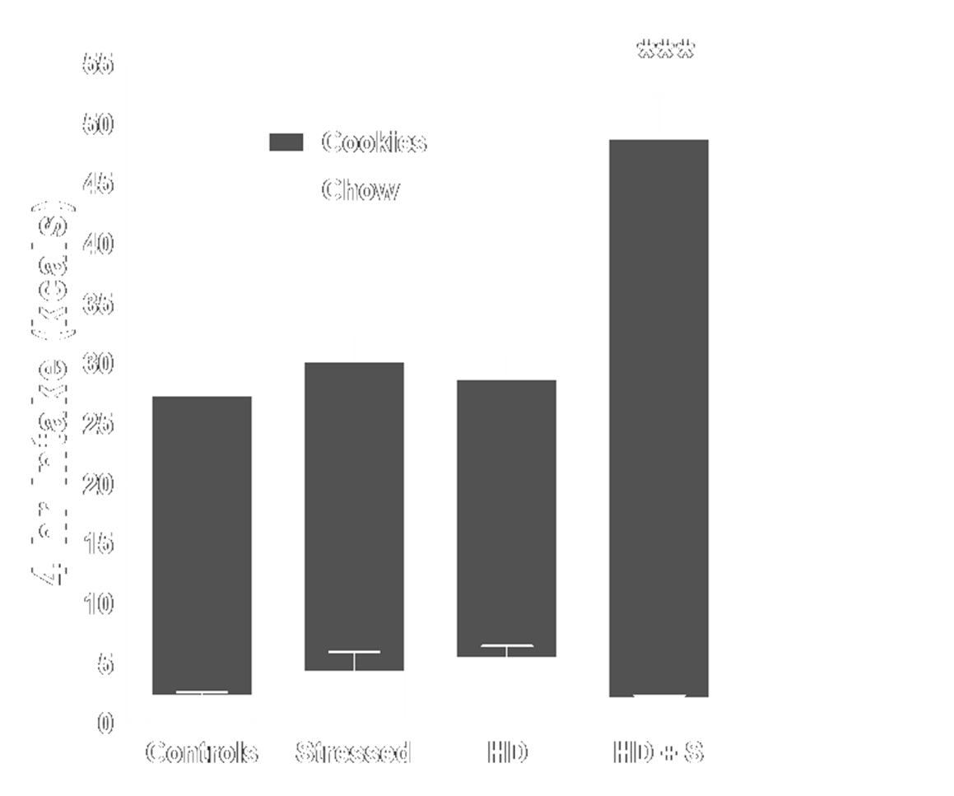
Dieting + Stress
In AN, stress is most common onset trigger.
In BN, multiple stress events is #2 onset trigger.
In BN & BED, stress maintains binge-eating.
Hagan (Boggiano) et al., P&B, 2002; Boggiano et al., Behav Neurosci 2005; DSM-5 2013

Slide 61
GENES
ENVIRONMENT
RISKY BEHAVIORS
TREATMENT

Slide 62
EFFECTIVE TREATMENT of EDs
Anorexia Nervosa
Hospitalization
Rehab or intensive outpatient center
Outpatient Team: internist, dietician, and therapist.
Psychotherapy: CBT (for adults, must be stable)
Family inclusive therapy (teens and children)
Drugs not effective. SSRI’s for depression only.
Best drug without exception:
food
Murphy et al., PCNA 2010; Harrington et al., AFP 2015; Hay & Claudino, IJN 2012

Slide 63
Bulimia Nervosa & BED
CBT and DBT (dialectical behavioral therapy)
Drugs In BN: CBT + SSRI’s benefit some
In BED: Vyvanse - Weight loss but mixed results on bingeing and mood
No data on long-term efficacy
Murphy et al., PCNA 2010; Harrington et al., AFP 2015; Hay & Claudino, IJN 2012

Slide 64
WE NEED
1. To close the gap in treatment
18 million
Kazdin et al.; IJED 2017; Hudson JBP 2007

Slide 65
Increase identification of patients
PCPs most likely to ID
Gastroenterologists
Endocrinologists
Cardiologists
Gynecologists when treating symptoms
Psychiatrists
Psychologists
Therapists when treating comorbidities
Dentists/Orthodontists
Nurse practitioners during routine visits
Kazdin et al., IJED, 2017; Linville et al., ED, 2010

Slide 66
If you suspect an ED or are unsure ASK:
“Are you worried about gaining weight?”
or “Are you (dieting, exercising, etc.) because you are afraid of gaining weight?”
“When eating, do you feel a loss of control?”
(i.e., once you start eating, you feel like you cannot stop)
Morgan et al., BMJ, 1999

Slide 67
Need increased detection in
Minorities
Diabetes patients “diabulimia” 3X increased mortality
LGBTQ patients gay men at much higher risk of AN and BN
Military vet patients look beyond drinking and drugs
Less likely to:
Be asked by provider if struggling with ED
Be referred for treatment
Seek treatment (bc of lower income, lack of insurance, fear of stigma and discrimination, not aware of resources).
Feldman & Meyer, IJED 2007; Becker et al., IJED 2003; Cachelin et al., IJED 2001

Slide 68
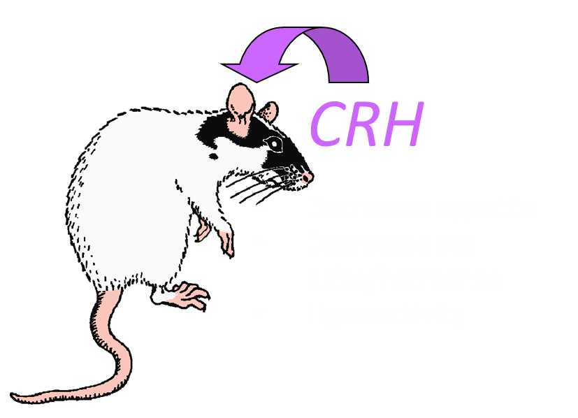
WE NEED
Regard EDs more as anxiety vs. eating disorders.
ABA is blocked by
CRF antagonists & BZDs
In AN, CRH resists dampening down by high CORT.
Most patients had an anxiety disorder prior to the ED.
Those that did not tended to be anxious, perfectionistic, harm avoidant.
Anxiety is consistent w/ their neurochemistry and family history.
In personal interactions, it is how patients and their doctors wish them understood.
Gold et al., NEJM 1986; Chen et al., CerCortex 2017; Artiga, Boggiano, Phys&Behav 2007; Kaye et al., AmJPsych, 2004

Slide 69
Education, awareness, and
evidence-based treatment
do work.

Slide 70
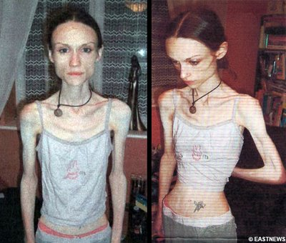

Slide 72
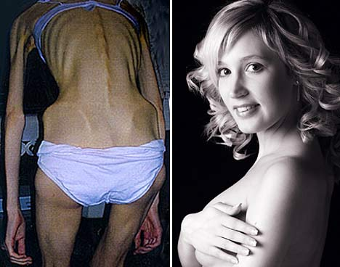

Slide 73
Eating should be a pleasure,
not a nightmare or a killer.
Thank you for educating
yourself on these disorders.
More info? Email me at: boggiano@uab.edu
Publications also under M.M. Hagan

Slide 75
EXTRA SLIDE
ARFID – restriction motivated by sensory properties of food/eating ( taste, smell,
texture), lack of interest, or fear of choking, vomiting
Pica - persistent eating of non-nutritive substances/things not culturally or socially
normal
RD – repeated regurgitation of food not due to medical condition
(Childhood and adolescence)
DSM-5, 2013

