Slide 1
10 Things We Should not Do that can harm our dreams

Slide 2
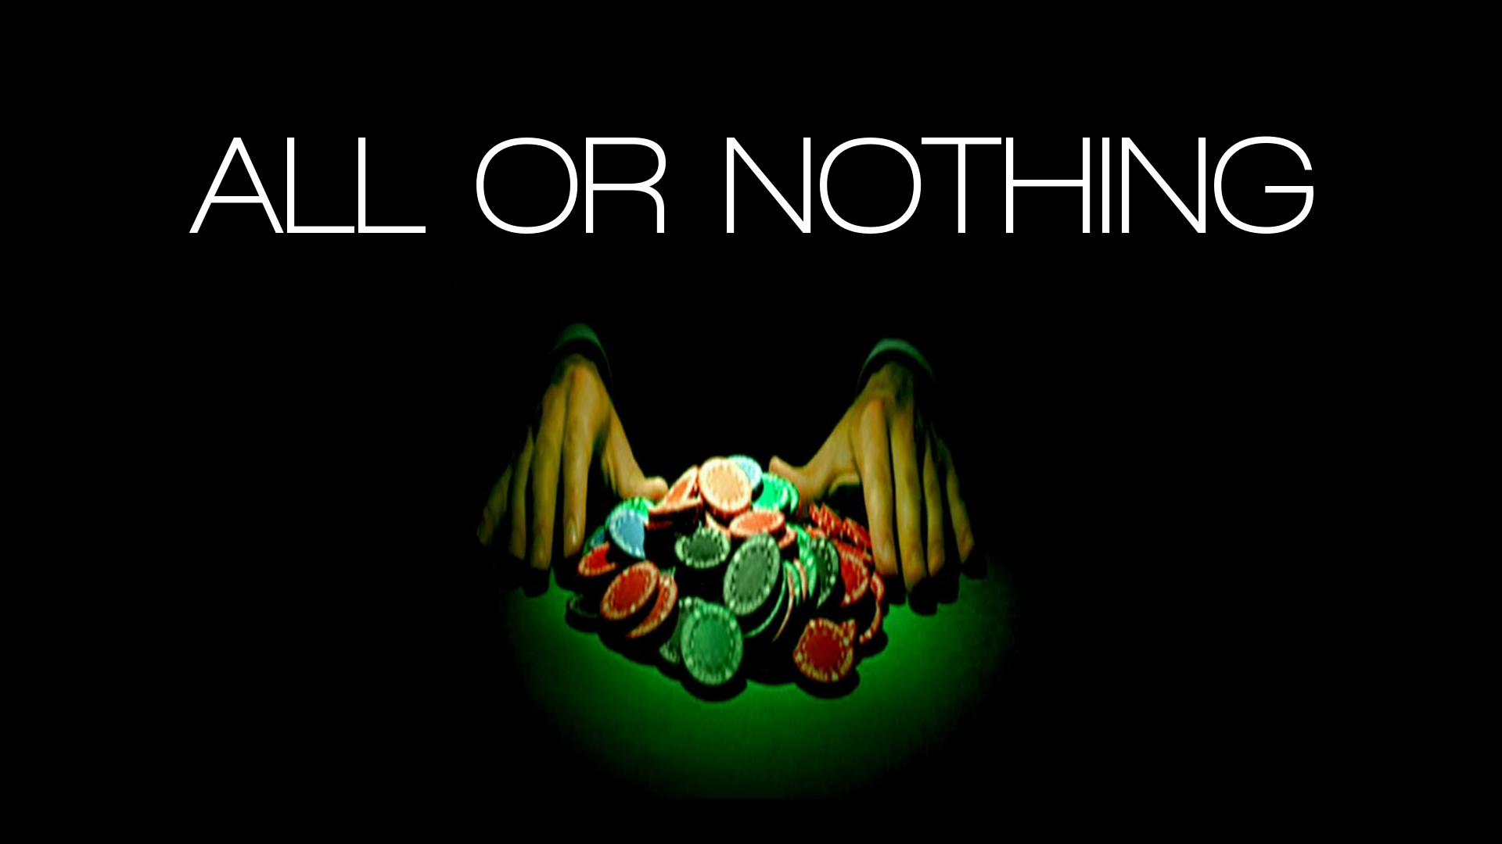
All or Nothing Thinking
Seeing things as black-or-white, right-or-wrong with nothing in between. Essentially, if I'm not perfect then I'm a failure.
I didn't finish writing that paper so it was a complete waste of time.
There's no point in playing if I'm not 100% in shape.
They didn't show, they’re completely unreliable!

Slide 3
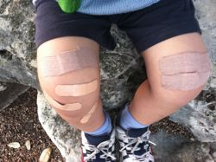
Overgeneralization
Using words like always, never in relation to a single event or experience.
I'll never get that promotion
She always does that…

Slide 4
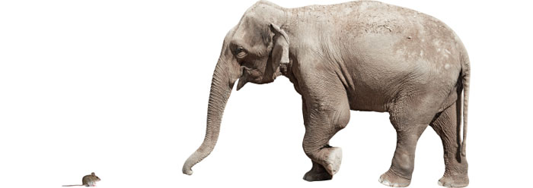
Minimizing or Magnifying
Seeing things as dramatically more or less important than they actually are. Often creating a "catastrophe" that follows.
Because my boss publicly thanked her she'll get that promotion, not me (even though I had a great performance review and just won an industry award).
I forgot that email! That means my boss won't trust me again, I won't get that raise and my wife will leave me.

Slide 5
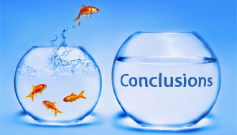
Jumping to Conclusions
1) Mind-Reading: Making negative assumptions about how people see you without evidence or factual support.
Your friend is preoccupied and you don't bother to find out why. You're thinking:
She thinks I'm exaggerating again
He still hasn't forgiven me for telling Fred about his illness.
2) Fortune Telling: Making negative predictions about the future without evidence or factual support
I won't be able to sell my house and I'll be stuck here (even though housing market is good).
No-one will understand. I won't be invited back again (even though they are supportive friends).

Slide 6

Discounting the Positive
Not acknowledging the positive. Saying anyone could have done it or insisting that your positive actions, qualities or achievements don't count…
That doesn't count, anyone could have done it.
I've only cut back from smoking 40 cigarettes a day to 10. It doesn't count because I've not fully given up yet.

Slide 7

"Should(s)"
Using "should", "need to", "must", "ought to" to motivate oneself, then feeling guilty when you don't follow through (or anger and resentment when someone else doesn't follow through).
I should have got the painting done this weekend.
They ought to have been more considerate of my feelings, they should know that would upset me.

Slide 8
Labelling
Attaching a negative label to yourself or others following a single event.
• I didn't stand up to my co-worker, I'm such a wimp!
What an idiot, he couldn't even see that coming!

Slide 9
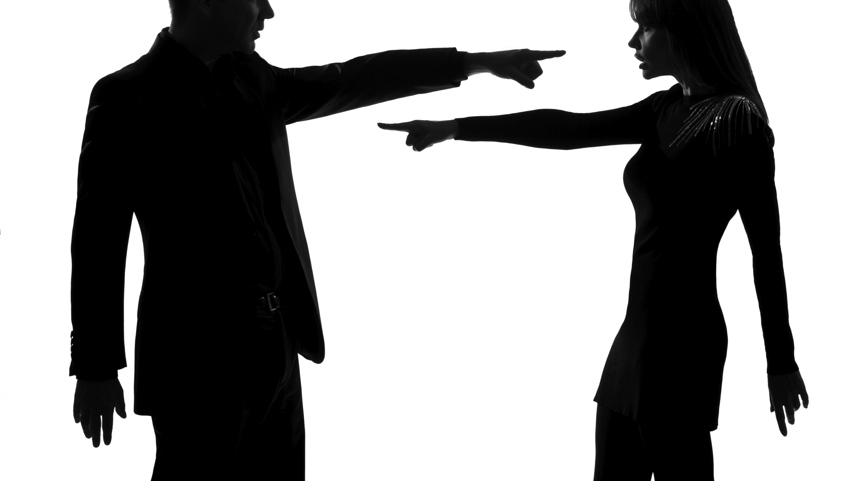
Blame & Personalization
Blaming yourself when you weren't entirely responsible or blaming other people and denying your role in the situation
If only I was younger, I would have got the job
If only I hadn't said that, they wouldn't have…
If only she hadn't yelled at me, I wouldn't have been angry and wouldn't have had that car accident.

Slide 10

Emotional Reasoning
I feel, therefore I am. Assuming that a feeling is true - without digging deeper to see if this is accurate.
I feel such an idiot (it must be true).
I feel guilty (I must have done something wrong).
I feel really bad for yelling at my partner, I must be really selfish and inconsiderate.

Slide 11

Mental Filter
Allowing (dwelling on) one negative detail or fact to spoil our enjoyment, happiness, hope etc.
You have a great evening and dinner at a restaurant with friends, but your chicken was undercooked and that spoiled the whole evening.

Slide 12


Don’t Block Your Dreams

