Slide 1
Dress For Success
How Your appearance can help or derail your Opportunities

Slide 2
Is there A Right Way To Dress?
Yes there is a right way to dress when you are trying to make your first impression to get a job or opportunity to be selected to a school or organization.

Slide 3
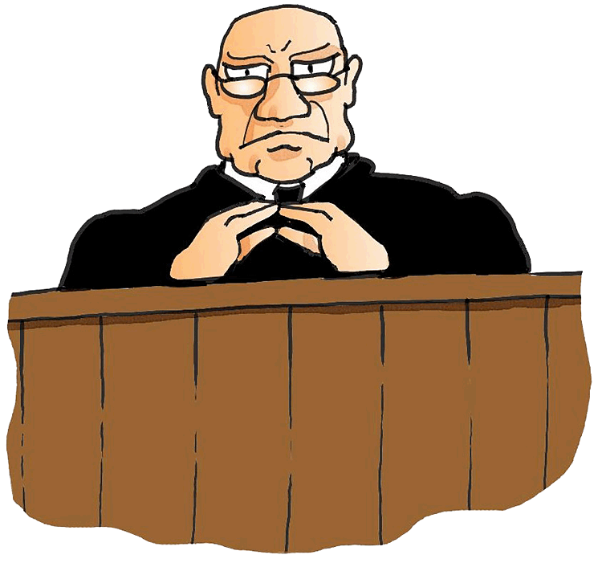
What Happens When You Meet Someone for the First Time?
Although we like to say people do not make judgments on others without having all the facts, unfortunately it does happen

Slide 4
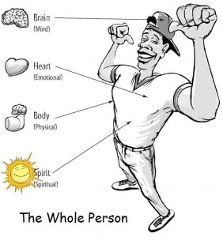
How you dress goes beyond your clothes.
Most of the time when we tell people that they need to be dressed appropriately for the job interview, meeting or opportunity, it is not about clothes only. It is about the whole person and how they present themselves. However we will focus on the outer versus the inner person.

Slide 5
Here are some tips to assist you.
Understand the position or organization that you are meeting with? Understanding the organization can tell you a lot about what they look for. This takes research or your part.
Understand not only that organization but others that are similar. This takes research or your part.

Slide 6
Here are some tips to assist you.
3. Always present your appearance in a manner that is neat and orderly. It does not matter if it is for College Entrance Board, Mechanic Job, Bagger at a Grocery Store or Manager’s position. How neat and organized your presents yourself tell that organization or individual that you respect the process and you would be neat and organized for that organization

Slide 7
Here are some tips to assist you.
4. If you have tattoos, ear rings, a different hair style, religious adherence apparel or any other things that may be out of the norm, be sure to research the companies policies on such things. If it required by you to have it be ready to explain why. There are certain thing that are legally acceptable but not all and therefore it is at that organization choice to accept it or not.

Slide 8
Always Keep these thing in mind.
Make sure your nails are clean
Make sure your breath is fresh
Be clean shaven or neatly trimmed mustache and beard unless a religious obligation prevents this from happening
Wear appropriate level of makeup if you are wearing it
Make sure your clothes are not to revealing

Slide 9
KEY POINT
Remember you are selling you/ your personal brand and you want it to be represented well.

Slide 10
BBV2M-BrothersBrooksVision2MissionLLC.com
BBV2MLLC@gmail.com

