Slide 1
Eyes in a general A+E
Central England Trauma Network May 2022
Mr Samer Elsherbiny
Consultant Ophthalmologist
South Warwickshire Foundation Trust

Slide 2
Eyes in a general A+E
“It’s an eye!!! Get me out of here!!”

Slide 3
Eyes in a general A+E

Slide 4
Eyes in a general A+E
Setting the scene
Eye emergencies (medical/surgical) vs just eye trauma
“Eye trauma and pathways”

Slide 5
Eyes in a general A+E: setting the scene
When did you last learn anything about eyes?

Slide 6
Eyes in a general A+E: setting the scene
When did you last learn anything about eyes?
When was the last time you dealt with an eye emergency?

Slide 7
Eyes in a general A+E: setting the scene
When did you last learn anything about eyes?
When was the last time you dealt with an eye emergency?
How many eye emergencies come to your department in any given time period?

Slide 8
Eyes in a general A+E

Slide 9
Eyes in a general A+E
Communication is key……

Slide 10

Eyes in a general A+E
Communication is key……
Clinical anatomy

Slide 11
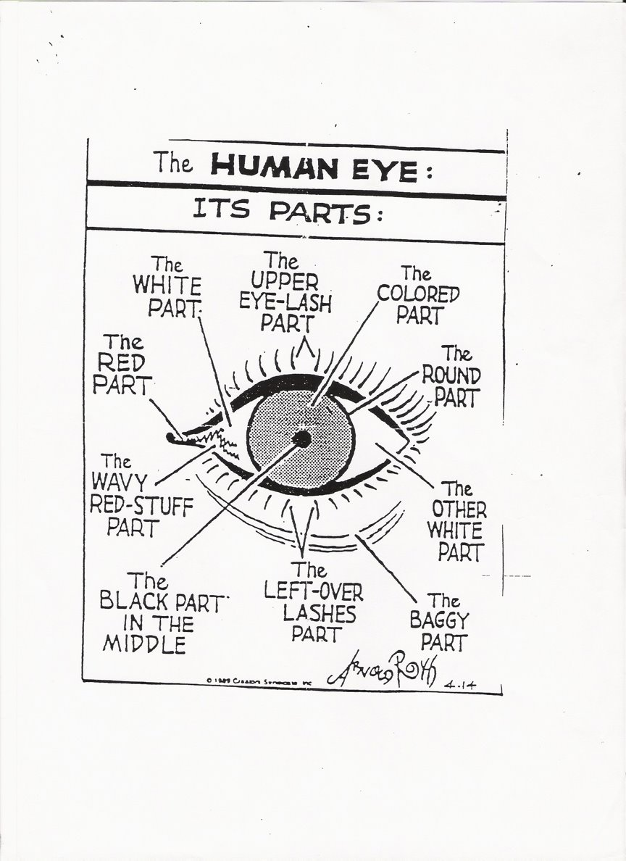

Slide 12
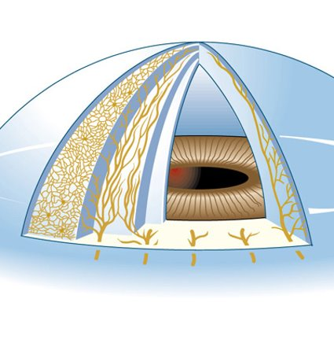

Slide 13
FOUR AREAS(depending on mechanism of injury)

Slide 14
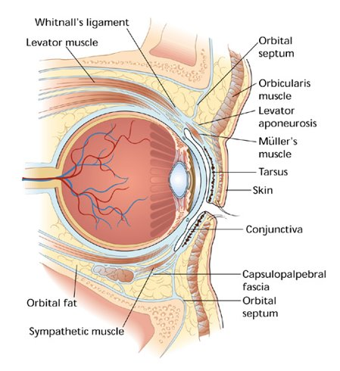
FOUR AREAS(depending on mechanism of injury)
The eye (globe)

Slide 15
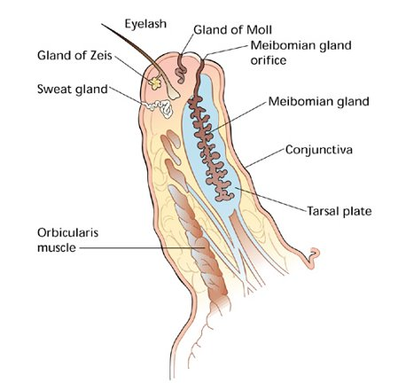
FOUR AREAS(depending on mechanism of injury)
The lids

Slide 16
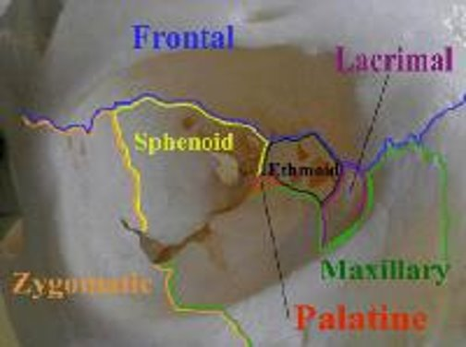
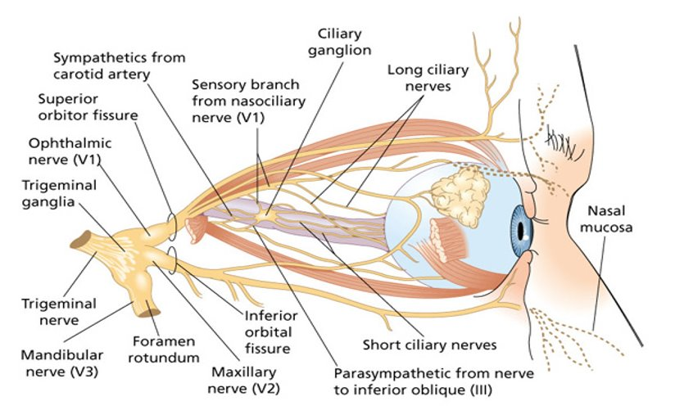
FOUR AREAS(depending on mechanism of injury)
The orbit

Slide 17
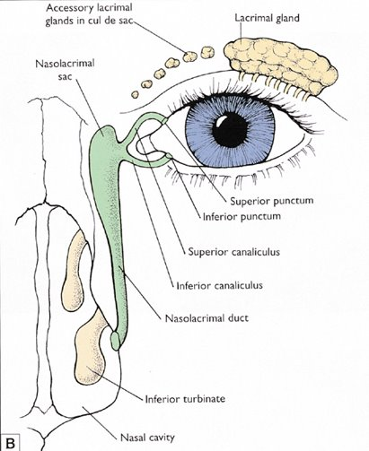
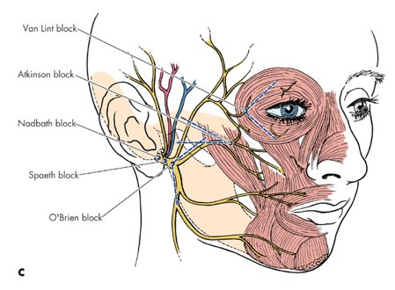
FOUR AREAS(depending on mechanism of injury)
The periorbital area/face

Slide 18
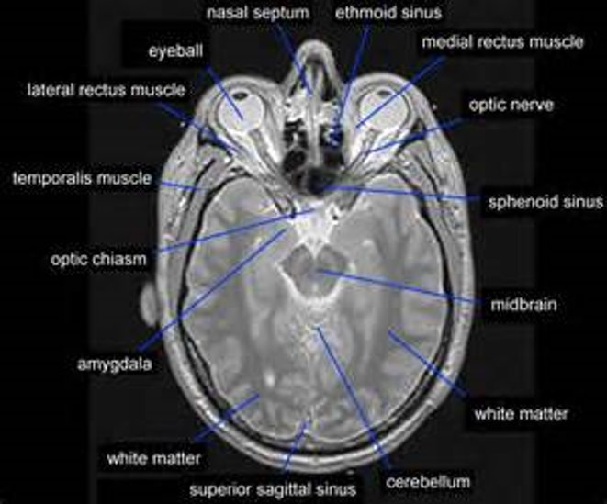
FOUR AREAS(depending on mechanism of injury)
The brain

Slide 19
Eyes in a general A+E: setting the scene
Eye trauma
  Mechanical (penetrating or blunt)
  Chemical
  Radiation (UV or ionising)

Slide 20
Eyes in a general A+E: setting the scene
Eye trauma
  Mechanical (penetrating or blunt)
  Chemical
  Radiation (UV or ionising)
The 3 H’s
The 3 D’s

Slide 21
Eyes in a general A+E: setting the scene
Eye trauma
  Mechanical (penetrating or blunt)
  Chemical
  Radiation (UV or ionising)
The 3 H’s: history, history, history!!
The 3 D’s: documentation, documentation, documentation!!

Slide 22
Eyes in a general A+E: setting the scene
Most serious:
  Blunt objects
  Large sharp objects
  Small flying particles
  Chemical burns (especially alkalis)
Other factors
  Setting (home, work, car-related, sports, recreational)
  Age
  Gender
Risk factors: 18-45; male; workplace; fireworks; no protective eyewear

Slide 23
What do I ask, do there and then, arrange?

Slide 24
What do I ask, do there and then, arrange?
Mechanism of injury (including any eyewear, protective or corrective)

Slide 25

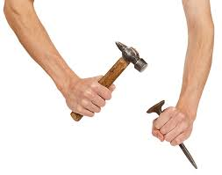
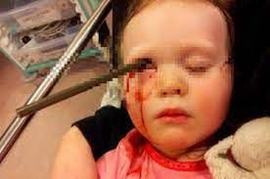
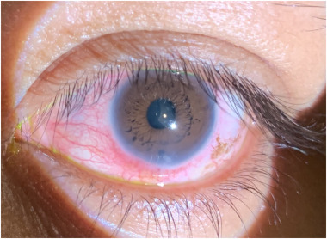
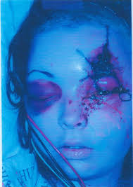
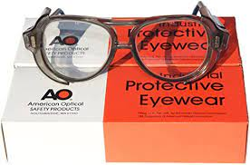
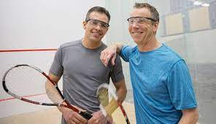
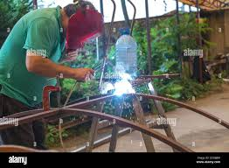
What do I ask, do there and then, arrange?
Mechanism of injury (including any eyewear, protective or corrective)

Slide 26
What do I ask, do there and then, arrange?
Mechanism of injury (including any eyewear, protective or corrective)
Symptoms at presentation:
  Loss of vision
  Pain
  Redness
  Headache
  Periocular swelling
  Wound contamination/ other organ/tissue damage
  Loss of consciousness
  Tetanus

Slide 27
What do I ask, do there and then, arrange?
Mechanism of injury (including any eyewear, protective or corrective)
Symptoms at presentation:
  BEWARE SLOW ONSET AFTER TRAUMA
  UNWITNESSED PAEDIATRIC TRAUMA
Past ocular history:
  amblyopia/surgery or other medical treatment/ trauma/contact lens wear/laser

Slide 28
What do I ask, do there and then, arrange?
Examination (contextual)

Slide 29
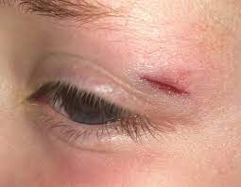
What do I ask, do there and then, arrange?
Examination (contextual)
  Inspection (??photos on hospital devices)
  Beware the hidden trauma!!!

Slide 30
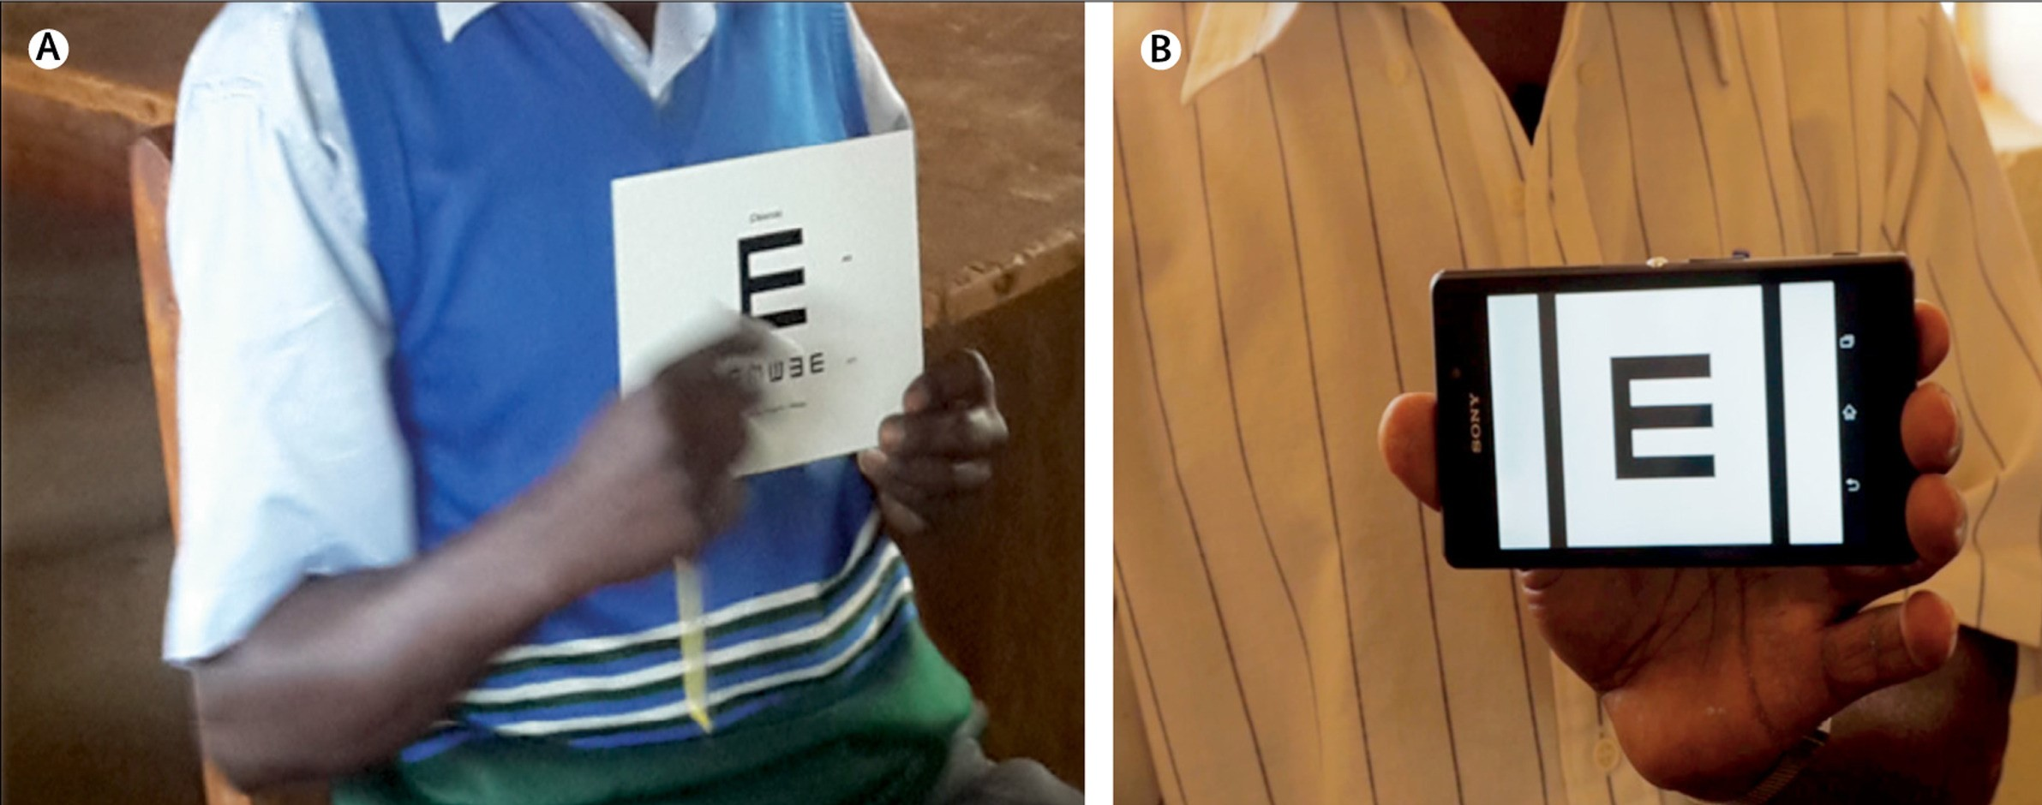
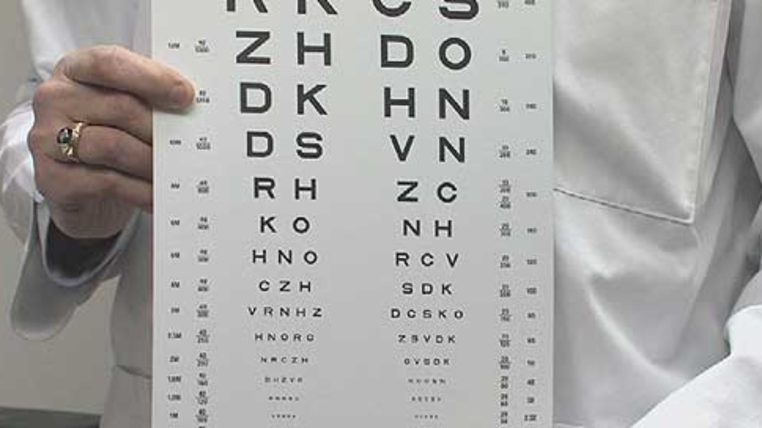
What do I ask, do there and then, arrange?
Examination (contextual)
  Inspection (??photos on hospital devices)
  Visual acuity (do you have a chart? Do you need a chart???)

Slide 31
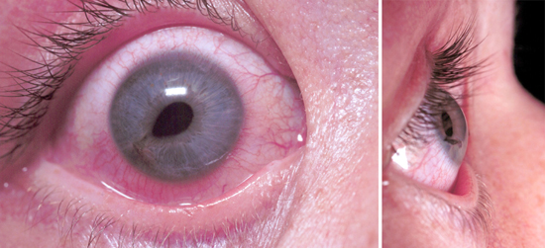
What do I ask, do there and then, arrange?
Examination (contextual)
  Inspection (??photos on hospital devices)
  Visual acuity (do you have a chart? Do you need a chart???)
  Pupils: shape and reactions:
  https://www.youtube.com/watch?v=g0bmA2rS-0o

Slide 32
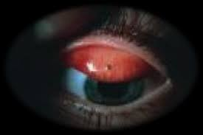
What do I ask, do there and then, arrange?
Examination (contextual)
  Inspection (??photos on hospital devices)
  Visual acuity (do you have a chart? Do you need a chart???)
  Pupils: shape and reactions
  Under the eye lids

Slide 33
What do I ask, do there and then, arrange?
Examination (contextual)
  Inspection (??photos on hospital devices)
  Visual acuity (do you have a chart? Do you need a chart???)
  Pupils: shape and reactions
  Under the eye lids
  Eye movements
  Confrontation visual fields

Slide 34
What do I ask, do there and then, arrange?
Examination (contextual)
  Inspection (??photos on hospital devices)
  Visual acuity (do you have a chart? Do you need a chart???)
  Pupils: shape and reactions
  Under the eye lids
  Eye movements
  Confrontation visual fields

Slide 35

What do I ask, do there and then, arrange?
Red flag signs
  Severe loss of vision
  Post traumatic sub-conjunctival haemorrhage
  Irregular pupil/RAPD
  Hyphaema
  Significant tissue swelling
  Tenderness/pain
  Reduced eye movement
  Severe headache

Slide 36
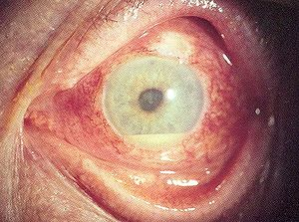
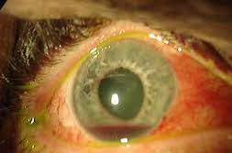
What do I ask, do there and then, arrange?
Red flag signs
  Severe loss of vision
  Post traumatic sub-conjunctival haemorrhage
  Irregular pupil/RAPD
  Hyphaema
  Significant tissue swelling
  Tenderness/pain
  Reduced eye movement
  Severe headache

Slide 37
What do I ask, do there and then, arrange?
Other tests
  (slit lamp???)
  Pen torch
  Fluorescein dye (have you got the cobalt blue light? Or the app for that??)
  Topical anaesthetic eye drops
  Fundoscopy (have you got an ophthalmoscope? Can you use it? Have you tried the mobile phone??)

Slide 38
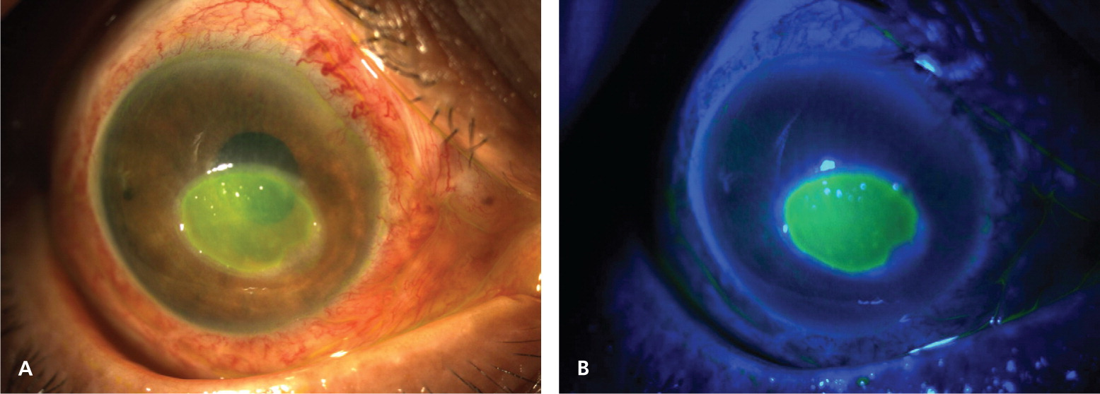
What do I ask, do there and then, arrange?
Other tests
  (slit lamp???)
  Pen torch
  Fluorescein dye (have you got the cobalt blue light? Or the app for that??)
  Topical anaesthetic eye drops
  Fundoscopy (have you got an ophthalmoscope? Can you use it? Have you tried the mobile phone??)

Slide 39
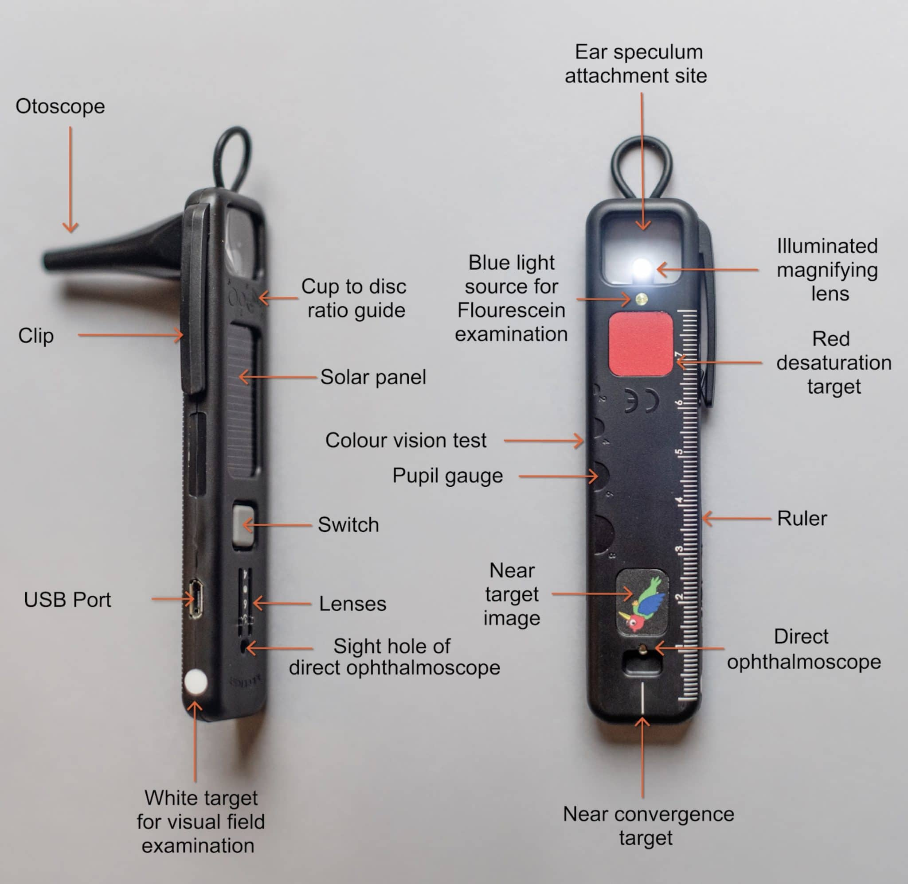
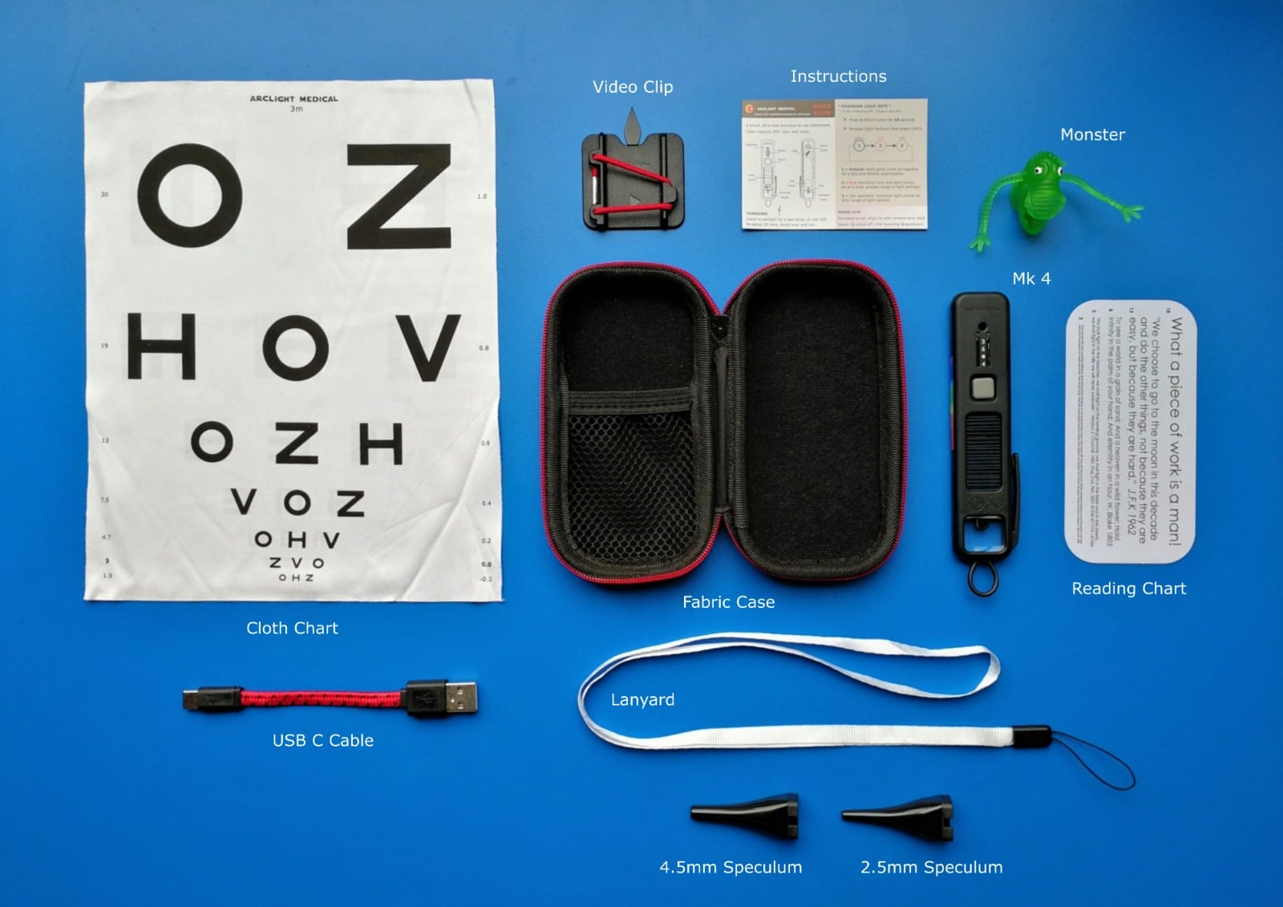
What do I ask, do there and then, arrange?
Other tests
  (slit lamp???)
  Pen torch
  Fluorescein dye (have you got the cobalt blue light? Or the app for that??)
  Topical anaesthetic eye drops
  Fundoscopy (have you got an ophthalmoscope? Can you use it? Have you tried the mobile phone??)
https://universityofstandrewsshop.com/products/arclight-ophthalmoscope-loupe-otoscope

Slide 40
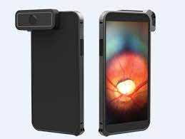
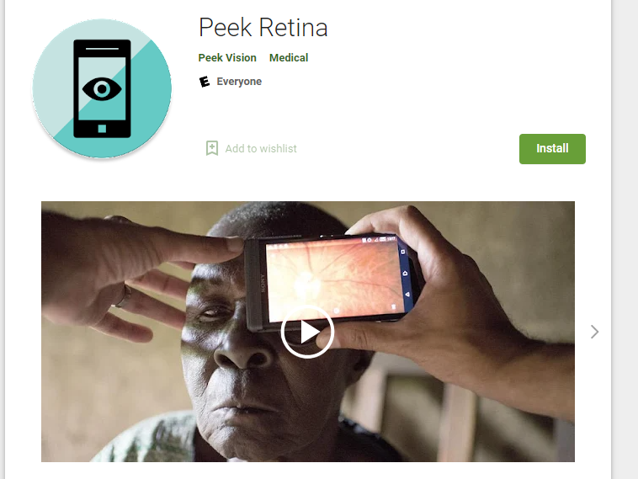
What do I ask, do there and then, arrange?
Other tests
  (slit lamp???)
  Pen torch
  Fluorescein dye (have you got the cobalt blue light? Or the app for that??)
  Topical anaesthetic eye drops
  Fundoscopy (have you got an ophthalmoscope? Can you use it? Have you tried the mobile phone??)

Slide 41
What do I ask, do there and then, arrange?
Trauma
Mechanical
Chemical
UV light
Blunt
Penetrating
Acid
Alkaline

Slide 42
What do I ask, do there and then, arrange?
Trauma
Mechanical
Blunt
Penetrating
Assess: Hx and Ex
Topical anaesthetic
Topical antibiotic
Consider: X-ray/CT brain and orbit
Protective shield
Refer to regional admitting eye unit

Slide 43
What do I ask, do there and then, arrange?
Trauma
Chemical
Acid
Alkaline
Assess: Hx and Ex
pH strip
Topical anaesthetic
Rapid commencement of irrigation with saline
Repeat pH 10 minutes post 2 litres
Irrigate further if needed
BEWARE particulate alkaline
Topical antibiotic
Discuss with regional admitting eye unit ??needs admission or close monitoring in anterior segment service

Slide 44
What do I ask, do there and then, arrange?
Assess: Hx and Ex
Topical anaesthetic
Topical antibiotic
Consider cyclopegic
Eye pad
Review as needed or refer to be seen depending on local protocol
Trauma
UV light

Slide 45
Eyes in a general A+E
“It’s an eye!!! Get me out of here!!”

Slide 46
Eyes in a general A+E
“It’s an eye!!! Get me out of here!!”
“I will see it….”

Slide 47
What do I ask, do there and then, arrange?
Hx
Ex
DOUCMENTATION
  Digital everything!
  Photos on hospital IG compliant devices and linked to electronic patient record
  Mobile apps for VA, fundoscopy and more
If it needs admission refer to the regional unit
Review current pathways in the light of ICS structures, GIRFT, Community vs Hospital

