Slide 1
The Developing Comprehensive Learner Record and Implications for Standards
PESC Data Summit
May 9, 2019
Washington, DC

Slide 2
Overview
The emergence of a CLR project
Where is the project today and what are some of its significant developments?
What are some of the gaps?
Where are standards needed and why?
Questions and discussion

Slide 3
Why are we working to create new learner records?
As a college experience becomes more common in our society, there is a desire and need to more clearly define what that means:
  Simply having a college degree is no longer rare
  College experiences are highly varied
  What is the benefit derived from some college with no degree?
The language of higher education used in records is not helping students and others understand the learning that occurs.
Technology allows us to go far beyond our historical mechanisms for student records

Slide 4
How did we get here? A partnership forms
AACRAO
  Registrars, admissions officers and other records professionals
NASPA
  Student affairs, leadership and co-curricular learning
Members of both organizations sought guidance on how innovations in digital student records could be developed and standardized
Most of the development was being driven by companies and not by colleges and universities

Slide 5
How did we get here? A partnership forms
We expanded our partnership to secure funding for our efforts
  Lumina Foundation – funding for convenings and workshops
  $1.6M US in Phase 1: 2-15 – 2017
  $1.2M US in Phase 2: 2017 – 2019
We also needed help with learning outcomes
  NILOA – learning outcomes and assessment

Slide 6
What is a Comprehensive Learner Record?
An official institutional record issued to students
A record focused on learning that occurs throughout the educational experience:
  Through coursework
  In co-curricular experiences
  In learning experiences that may occur at the same time as the educational experience but outside the institution’s oversight
Records may focus on any or all of these but go beyond rosters of courses, activities or experiences to evidence learning

Slide 7
What are we trying to join together?
Curricular experiences (courses, credits, grades)
Co-curricular experiences (work, internships, leadership, global study, etc.)
Learning outcomes by course/program
Learning outcomes by experience
Learning framework (LEAP, DQP, NACE, etc.)
CLR
Student information (identity, bio-demographic, status, credentials earned
Degree Audit

Slide 8
Where is the work today?

Slide 9
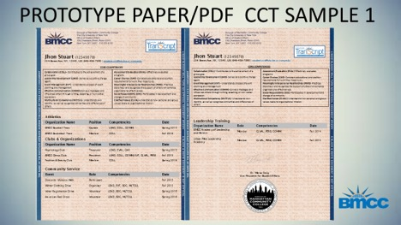

Slide 11
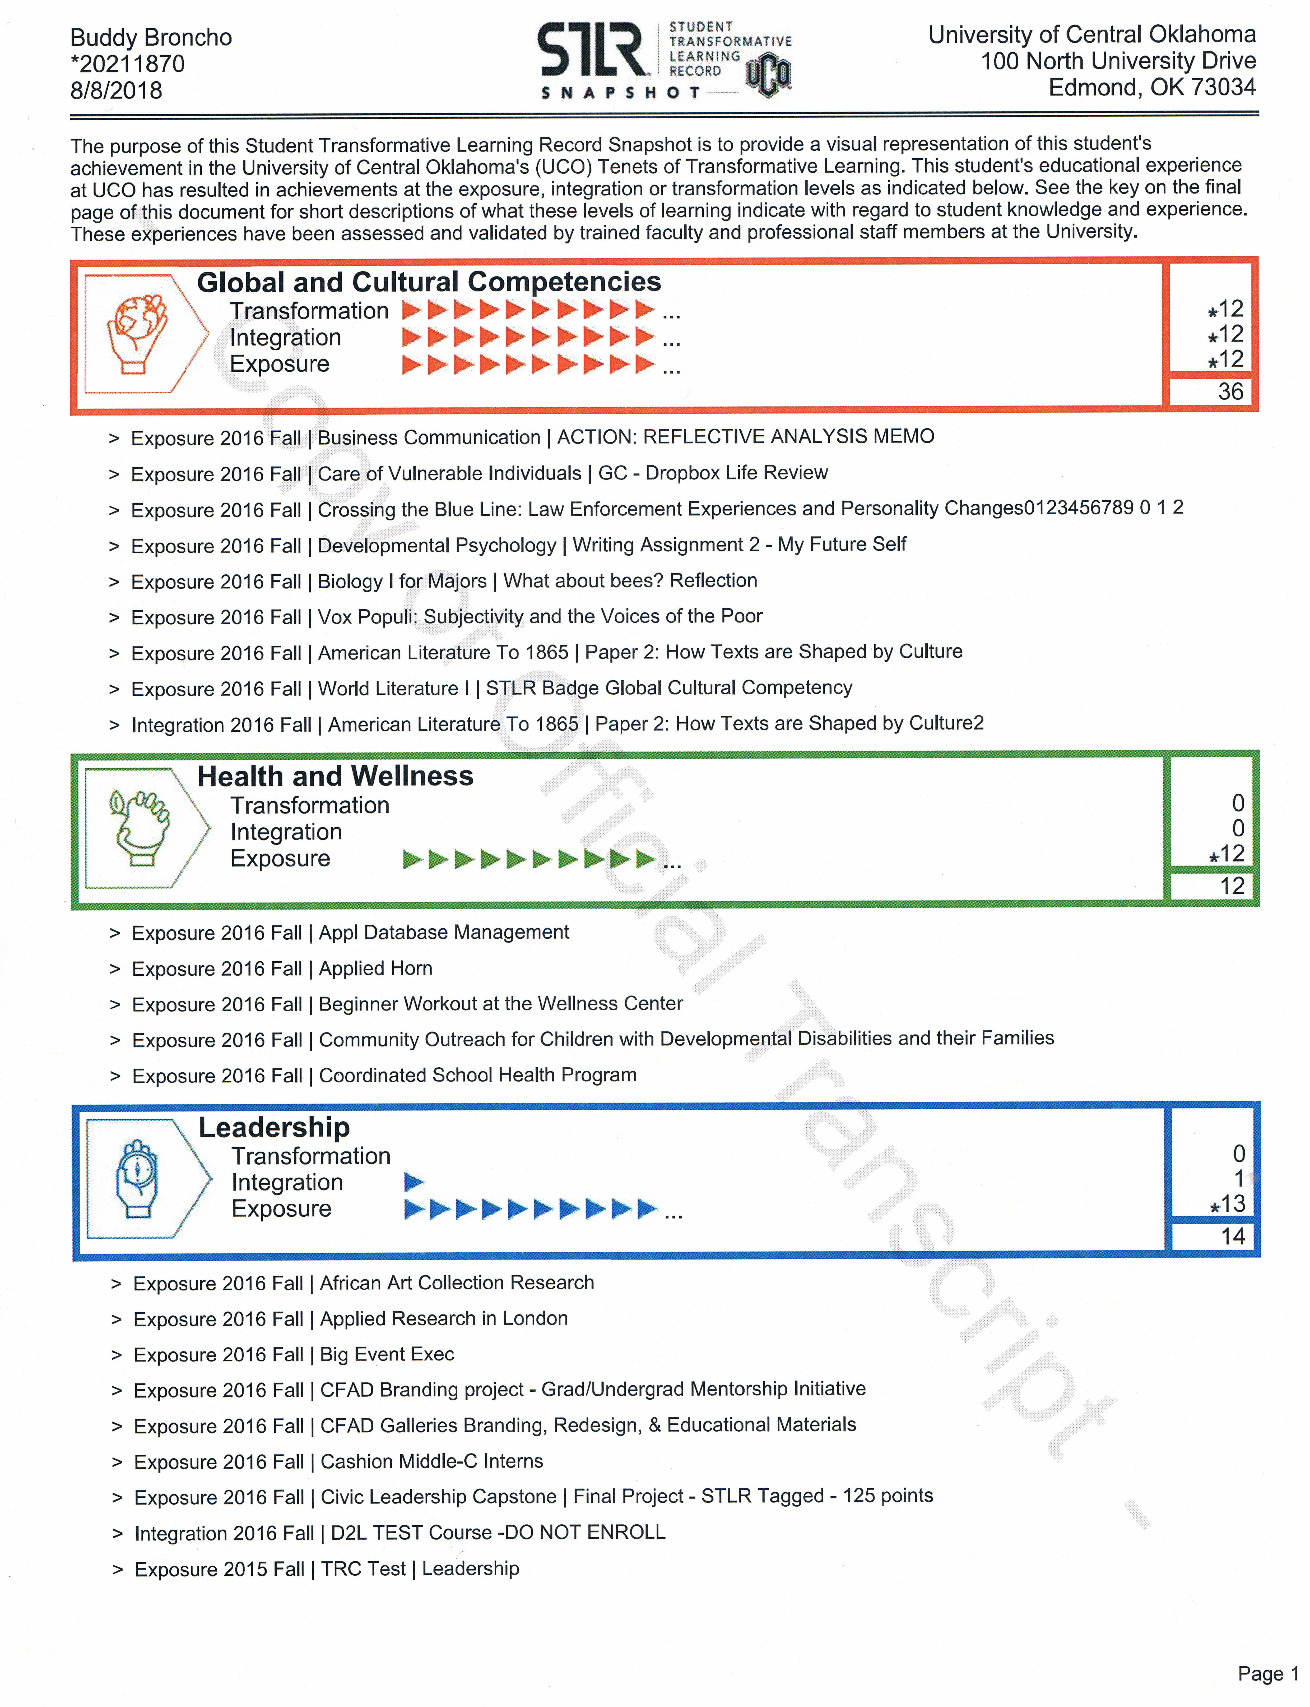
Visualization – University of Central Oklahoma

Slide 12
Recording and Tracking: University of South Carolina
The student selects the records she/he would like to display on the Experiential Learning Transcript ELR)

Slide 13
Recording and Tracking: University of South Carolina

Slide 14
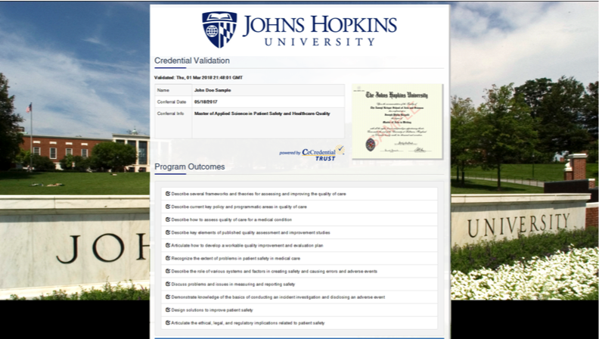

Slide 15
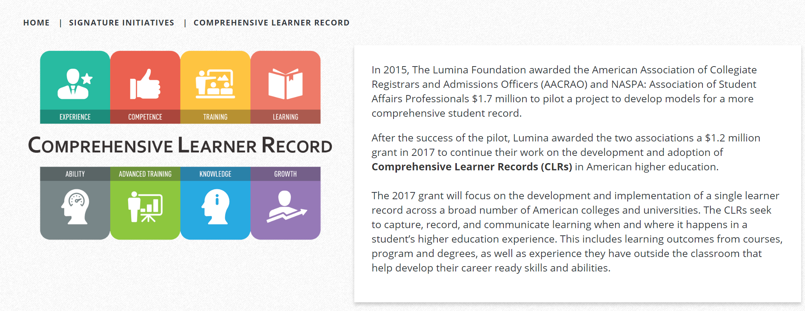
Project Webpage
aacrao.org/signature-initiatives/comprehensive-learner-record
Features: Phase One Report; Data Integration White Paper; Additional Campus Examples

Slide 16
What is the future?

Slide 17
Accelerating experimentation and invention of new digital record formats
Enhancements to existing CLR formats
Linked data source partnerships that allow deeper, more discoverable evidence of learning outcomes, discrete competencies and evidence of learning
MIT announcement of a new network of institutions that will be “creating a new digital credential system”
  EdSurge, 4/23/19
Sony partners with IBM to use blockchain in student data management
  Cointelegraph.com, 8/13/17

Slide 18
Efforts around the globe to create digital credentials and distribution networks
Australia and New Zealand’s My eQuals
Mexico’s digital diploma pilot at Monterrey Institute of Technology
  Blockchain transmission of digital diplomas
Erasmus+ network for digital credentials across Europe
Countries such as Germany, Canada and the United States are more complex:
  No central ministry or department of education that can dictate standards or implementation
  No centralized distribution network, such as UCAS in the UK

Slide 19
Some Thoughts About Guiding Principles and Standards

Slide 20
Guiding Principles
The current American academic transcript should be used to transmit vital educational data between educational institutions and to those who rely upon that data to license, certify or employ individuals:
  The information may evolve to include additional details that could be derived as new record formats are developed.
  The academic transcript is a whole record of a student’s enrollment and is not parsed when presented as this record.
New records are needed to help students and those outside higher education understand the learning that occurs in post-secondary education, easily document the veracity of claims about education, and provide more robust information about competencies, learning outcomes, assessment and evidence

Slide 21
Guiding Principles
New record formats should be focused on what was learned:
  Learning frameworks should express the “gestalt” of the educational experience of that institution.
  What was taken or the learning experiences should be the evidence that supports the learning framework, not the focus of the record.
  These records must go beyond mere lists of courses or activities.
  The scope of learning activities should reflect the context of the institution, the program of study, and the learner.
Records should be digital, secure and placed into the hands of learners for their use and distribution.
The format of new record formats should be flexible enough to reflect the uniqueness of the institution that offers it.

Slide 22
Standard for a learning experience
Encapsulate a learning experience into component parts, including:
  Description of the experience
  Learning modality (i.e., course, experiential learning, employment, etc.)
  Learning outcomes
  Rubrics and/or assessment mechanism
  Evidence
These building blocks can then be:
  Used individually, as needed
  Combined into micro-credentials, badges, certificates or degrees

Slide 23
Standard for CLR contents
There are many existing good thoughts in this realm today:
  IMS Global
  CBE Transcript
  What is the role of the e-portfolio in providing evidence of learning?
The standard must be broad enough to consider learning in multiple institutional types and experiences:
  Traditional classroom experiences and co-curricular programs
  CBE courses and programs
  Certifications and technical training
  Learning certified by educational institutions but not supervised by them

Slide 24
Questions and Discussion

