Slide 1
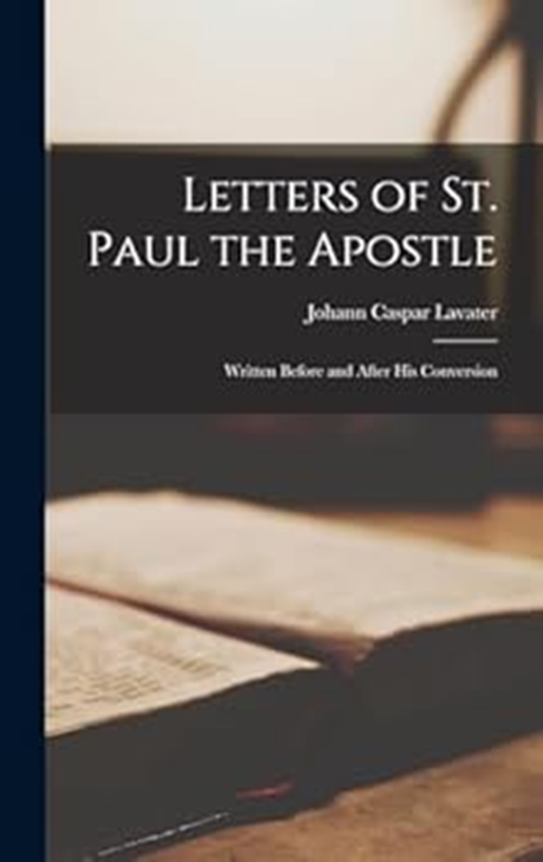
Romans 13
The Will of God

Slide 2
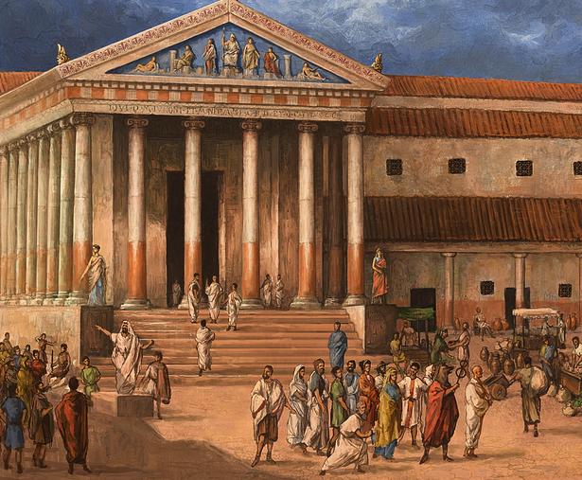
Chapter 13 theme:
God and Country.
Chapter 13 highlights:
God and government.
People and government.
People and divine law.
Count on consequences.

Slide 3
Bídahólníihii bídahwíínółnííh
1 Diné t'ááłá'í jinítínígo honanit'a'í bídahojíłníih doo. Háálá bee óhólníihii t'áá ałtso Diyin God bits'ą́ą́dę́ę́' hólóonii ádaat'é, áádóó nihinanit'a'í bibee ídahólníihii t'áá ałtso Diyin God bits'ą́ą́dę́ę́' dahólǫ́.
Submit to Government
Let every soul be subject to the governing authorities. For there is no authority except from God, and the authorities that exist are appointed by God.
Psalms 8:15-16;
15 Shí shinahjį' aláahgo naat'áanii danilíinii dahwée'aah, áádóó ałdó' shí shinahjį' naat'áanii danilíinii t'áá ákogi áhodooníiłgo hadahadziih.
16 Shí shinahjį' naat'áanii danilíinii áádóó aghá dahideezíinii, t'áá éí nihokáá'góó ándahwii'aahii t'áá ałtso, shí shinahjį' nidant'á.
By me kings reign,
And rulers decree justice.
By me princes rule, and nobles,
All the judges of the earth.
President of the Universe.

Slide 4
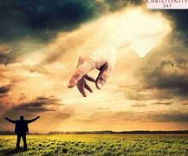
Psalms 2:2;
2 Nihokáá'góó aláahgo naat'áanii hasht'e'ádadiilyaa, áádóó Bóhólníihii Diyin God jílíinii índa Ak'ah Bik'i Yadziiziidgo Jíísį́į'ii t'áá bił naat'áanii danilíinii hach'į' nídahididookah biniyé ahidahidiikaigo kódaaní,
4 Yá gháhóką́ądi Bóhólníihii dah sidáii haa ch'ídidooldlohgo há nahodoołt'ih.
2 The kings of the earth set themselves,
And the rulers take counsel together,
Against the Lord and against His Anointed,[d] saying, …
4 He who sits in the heavens shall laugh;
The Lord shall hold them in derision.
God ESTABLISHES all government authorities.
God GIVES authority to governments.
EVERYONE must submit to authorities, except if it contradicts God’s nature and values.

Slide 5
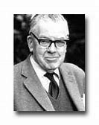
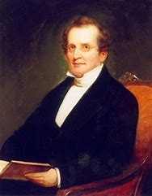
F.F. Bruce
1910 -1990
Scottish Evangelical Scholar
Charles Hodge
1797 – 1878
Reformed Presbyterian Theologian
“Generally speaking, to subject oneself to the civil authorities is but an indirect way of obeying God Himself. At bottom the issue is in a sense not “either God or state” nor “both God and state” but “God via the state.” … In that respect the Christian should instinctively view the government not as an enemy but as an ally and helper towards his own moral endeavors. In fact, the civil power is God’s servant, doing God’s work positively and negatively by virtue and discouraging vice.”
“The actual reigning emperor was to be obeyed by the Roman Christians, whatever they may think as to his title to the scepter. But if he transcended his authority, and required them to worship idols (or him), they were to obey God rather than man. This is the limitation to human authority. Whenever obedience to man is inconsistent with obedience to God, then disobedience becomes a duty.”

Slide 6
2 Éí bąą bídahólníihii dooda bee bich'į' nidzistee'ii, éí Diyin God bibik'eh hoogáałii bich'į' dooda bee nidzistee'go át'é, áko dooda bee nidzistee'ii bee haa nídahódóot'įįłii ák'ijį' bídajílná.
3 Háálá bíd ahólníihii diné yá'át'éehgo dayíkáahii doo yił yéé' ádahósin da, nidi diné doo yá'ádaashóonii t'éiyá yił yéé' ádahósin. Doósh bídahólníihii bits'ąą síníti' da doo, danohsin? Yá'át'éehgo ááníił le', áko nizhónígo naa haniih doo.
Therefore, whoever resists the authority resists the ordinance of God, and those who resist will bring judgment on themselves.
For rulers are not a terror to good works, but to evil. Do you want to be unafraid of the authority? Do what is good, and you will have praise from the same.
Rebel with a cause.

Slide 7
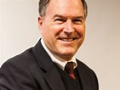
“Paul thus approached the relation of church and state not as a Sadducee who lived from the advantages of the state, nor a Zealot who lived to overthrow the state, nor as the Pharisee who divorced religion from the state, nor as a Roman citizen for whom the state was an end in itself. Paul wrote as a free man in Christ, and he appeals to the church to be equally free in obedience to the state, but not conformed to it.”
James R. Edwards
1948 –
American NT scholar
Sadducee – first-century liberal, religious, political party.
Zealot – first-century religious, political party that called for armed rebellion against Rome.
Pharisee – first-century religious, political party that called for strict observance of OT law.

Slide 8
4 Háálá ná yá'át'ééh biniyé éí Diyin God yá naal'a'í nilį́.
For he is God’s minister to you for good.
“Paul says the function of government is to be God’s agent for good in that government provides a rule of law that guards against anarchy and the excesses associated with it. Even bad governments protect its citizens to some extent from injustices like murder and robbery. Even bad governments provide roads and streetlights.”
– G. Martin & L. Richards. 2007 by GRQ, Inc, The Book of Romans.
Good government.
Anarchy – complete absence of government.

Slide 9
Nidi doo ákǫ́ǫ́ ánít'į́į́góó éí bik'ee nił yée' doo, háálá doo t'áadoo biniyéhígóó bibee adziilii hólǫ́ǫ da. Jó, éí Diyin God yá naal'a'í nilį́įgo doo ákǫ́ǫ́ ájít'íinii Diyin God t'óó báhádzidgo bibee até'él'íinii yee atíhodoolííł.
5 Éí bąą diné ts'ídá ak'eh hojíł'į́į doo, t'áá hazhó'ó Diyin God t'óó báhádzidgo bibee até'él'íinii t'éiyá bits'ąą ájít'į́į dooleełgo éí dooda, nidi t'áá ákogi át'éego baa ákoznízingo ałdó' biniyé ak'eh hojíł'į́į doo.
6 T'áá éí ałdó' bąą tax nidahohłé, háálá nihinanit'a'í éí Diyin God yá nidaalnishgo ts'ídá éí yindaalnish.
But if you do evil, be afraid; for he does not bear the sword in vain; for he is God’s minister, an avenger to execute wrath on him who practices evil.
Therefore, you must be subject, not only because of wrath but also for conscience’ sake.
For because of this you also pay taxes, for they are God’s ministers attending continually to this very thing.
Count on consequences.

Slide 10
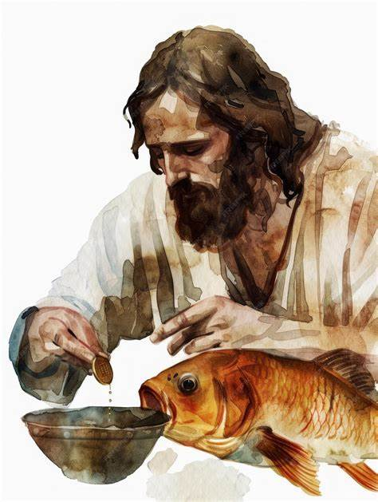
Did Jesus pay His taxes?
Read Matthew 17:24-27
In the Bible, Jesus pays taxes from a fish in Matthew 17:24-27. When asked by Peter about paying taxes, Jesus instructs him to go to the lake and fish, where he finds a four-drachma coin in the mouth of the first fish caught. This act is meant to demonstrate that the children of the king do not have to pay taxes, as it was a way to avoid offending the tax collectors. Additionally, this event is seen as a fulfillment of prophecy, highlighting the significance of the coin found in the fish.

Slide 11
Read Matthew 22:21:
21 Nít'éé' ádahałní, Síízar lą́ą. Áko ábijiní, Éí lá bąą, Síízar bíhígíí Síízar baa nídahoh'níił ni, áádóó Diyin God bíhígíí éí Diyin God baa nídahoh'nííł.
They said to Him, "Caesar's." And He said to them, "Render therefore to Caesar the things that are Caesar's, and to God the things that are God's."

Slide 12
7 Éí bąą t'áá ałtso t'áá yą́ą́h danilį́įgo ádabidi'doolnííł góne' bich'į' ádaahnííł, yáál bihididzóhígíí bich'į' nahalyéii yáál bihididzóhígíí bich'į' nidahohłé, tax bich'į' nahalyéii tax bich'į' nidahohłé. Diné dahodísin yą́ą́h danilíinii dadíínóhsin, diné ił ílį́ yą́ą́h danilíinii nihił danilį́.
T'áá ła' ha'oojéé' k'ehgo ayóó'áda'ahíínóh’ní
8 Diné ła'da t'áadoo le'é yee t'áadoo nihąąh hayííł'áhí, nidi ayóó'áda'ahíínóh'nínígíí t'éiyá bee ahąąh hadasooł'áa doo. Yił kééhat'íinii ayóó'áyó'níinii éí bee haz'áanii ye'eł'į́.
Render therefore to all their due: taxes to whom taxes are due, customs to whom customs, fear to whom fear, honor to whom honor.
Love Your Neighbor
Owe no one anything except to love one another, for he who loves another has fulfilled the law.
Won’t you be my neighbor?

Slide 13
9 Háálá díí bee haz'ą́: Ts'ídá doo azhdilée da, Diné ts'ídá doo diyííłhéeł da, Ts'ídá doo azhni'įįh da, Ts'ídá doo t'áá ádzaagóó hojilne' da, Ts'ídá doo adázhnoolníi da, nínígíí áádóó t'ááłáhídi ha'oodzí'ígíí bee, bee haz'áanii t'áá át'é bi'al'į́įgo kóní, T'áá ni ádííní'nínígi át'éego bił kééhót'íinii ayóó'ííní'ní.
10 Ayóó'ó'ó'níinii éí yił kééhat'íinii doo niyiiłchxǫǫh da, éí bąą ayóó'ó'ó'níinii éí bee haz'áanii t'áá át'é yi'ósinii nilį́.
For the commandments, “You shall not commit adultery,” “You shall not murder,” “You shall not steal,” “You shall not bear false witness,” “You shall not covet,” and if there is any other commandment, are all summed up in this saying, namely, “You shall love your neighbor as yourself.”
Love does no harm to a neighbor; therefore, love is the fulfillment of the law.

Slide 14
Christ nínáádoodááł bich'į' yoołkááł
11 Ákót'éego dahinohná, háálá Jesus nihíká níyáago yisdánihidooniłígíí k'ad koshídę́ę́' hoolzhishgo nihił béédahózin. Da'iisiidląąd yę́ędą́ą́' ánízah hadziih yę́ę k'ad t'áá bi'oh ánízah hadziih. Áko t'áá íídą́ą́' ch'éédadiidziłjį' ahoolzhiizh.
Put on Christ
And do this, knowing the time, that now it is high time to awake out of sleep; for now, our salvation is nearer than when we first believed.
Salvation – total deliverance when Jesus returns.
Wake up and smell the coffee.

Slide 15
12 Nízaadgóó ayííłką́, k'adę́ę hool'įįh lá. Áko haa'íshą' chahałheełgóó baa nideiikaii yóó'adahididiit'ááł, áádóó adinídíínjí bee na'abaahii bee hadadidii'nííł.
13 Haa'íshą' jį́įgo áhát'ínígíí beełt'éego hazhó'ó ádeii'níił doo, t'áadoo adlą́ baa nideiikaií, t'áadoo tó tsi'na'iiłáii deiidlání, t'áadoo ajił baa nideiikaií, t'áadoo baa'ihgo adádaniilníní, t'áadoo ahináádadiijahí, índa t'áadoo da'ahiilch'į́dí dooleeł.
14 Nidi Bóhólníihii Jesus Christ bee hadadohne', áádóó ts'ísee k'ehgo bidádahonooníinii t'áadoo bá nahosooł'ání.
The night is far spent, the day is at hand. Therefore, let us cast off the works of darkness, and let us put on the armor of light.
Let us walk properly, as in the day, not in revelry and drunkenness, not in lewdness and lust, not in strife and envy.
But put on the Lord Jesus Christ, and make no provision for the flesh, to fulfill its lusts.
Move over, Armani.

Slide 16
Chapter 13 wrap-up:
It is sin if a believer fails to submit to the governing authorities. God has established the need and rule of authority, v.1.
Fear of authority is unnecessary. If we do what is right, the authority will do right by us. God is the author of all authority and will be with us when we are tested, vs. 2-7.
God wants us to extend love to one another, giving witness to the love and grace of God, which makes salvation possible, vs. 8-14.

Slide 17
Study questions:
Is submission to governing authorities necessary for everyone or just for some?
2. Identify five areas of your life in which you live under authority.
3. How can we free ourselves from the fear of those in authority?
4. How does conscience work against or with authority?
5. According to Paul’s analysis, why do we pay taxes?
We are to leave no debt outstanding except the debt of love. What is the debt of
love?
7. How does one put aside the deeds of darkness?

