Slide 1
Personality Test
Can You Prepare for Them?

Slide 2
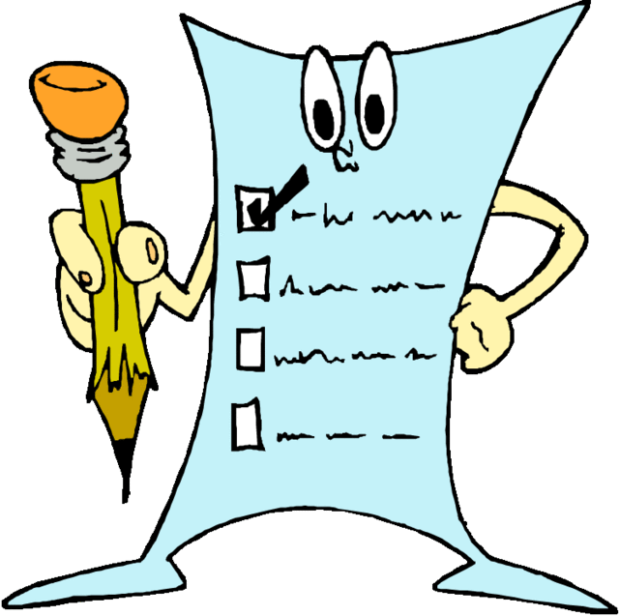
What are Personality Test?
It is a questionnaire or other standardized instrument designed to reveal aspects of an individual's character or psychological makeup.

Slide 3
Can You Prepare for Them?
Yes
Research has shown that an effective preparation can assist candidates to improve their test scores.

Slide 4
How Do You Prepare?
According to the IPC (Institute of Psychometric Coaching), key to your success is understanding the job’s requirements and how they are measured in the personality test. This will assist you to demonstrate to your employer that you have the relevant personality traits to perform in the job.

Slide 5
How do You Prepare? Continued
Practice taking several types of on-line personality test. This will help you get a glimpse of who you are and any possible blind spots that you may have as it relates to the position.

Slide 6
How do You Prepare? Continued
Be honest and open when taking such exams. The test are designed to determine if you are a match. It also determines if the company is a match for you. Faking or being dishonest may land you a job but it may not keep you there.

Slide 7
How do You Prepare? Continued
Research and learn about the culture of the organization that you are looking to work for. These test are not about capabilities but more in line regarding your temperament, character and cultural fit into that organization.

Slide 8
I know Me
You have what it takes to be successful in reaching your goals and dreams. However it starts with knowing who you are. No one knows you better than you.

Slide 9
BBV2M-BrothersBrooksVision2MissionLLC.com
BBV2MLLC@gmail.com

