Slide 1


2017
PARAMEDIC REFRESHER COURSE

Slide 2
Paramedic Refresher
Module # I
Respiratory Neurological Management
Airway Respiration ventilation neurological

Slide 3
Objectives
Differentiate between adequate and inadequate breathing.
Differentiate between respiratory distress and failure.
Explain when to oxygenate and when to ventilate a patient.
Identify the use of automated transport ventilators when managing patients.
Demonstrate effective BVM ventilation at a proper rate and depth.
Discuss advantages and disadvantages of various advanced airway adjuncts.

Slide 4
Mechanics of Breathing: Inhalation
Contraction of external intercostal muscles
  Elevates ribs and sternum
Contraction of diaphragm
  Diaphragm moves downward
  Air pressure lowers in the lungs
  Negative pressure draws air into the lungs

Slide 5
Mechanics of Breathing: Exhalation
External intercostal muscles relax
Diaphragm relaxes
Ribs and sternum return to a resting position
Pressure increases in the lungs
Air is exhaled

Slide 6
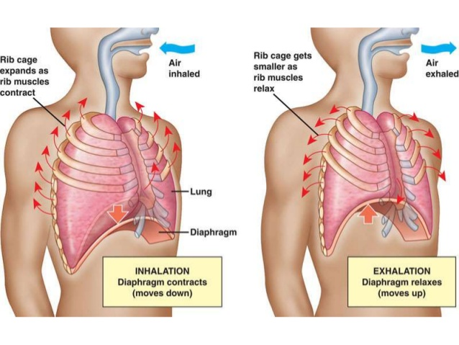
Respiratory Physiology

Slide 7
Respiratory Physiology
Primary function of the respiratory system is to provide oxygen for the cells of the body and eliminate carbon dioxide that cells produce.
Exchange of gasses occur at the alveoli.
  Oxygen diffuses into the cells from the alveoli and carbon dioxide diffuses into the alveoli from the cells.

Slide 8
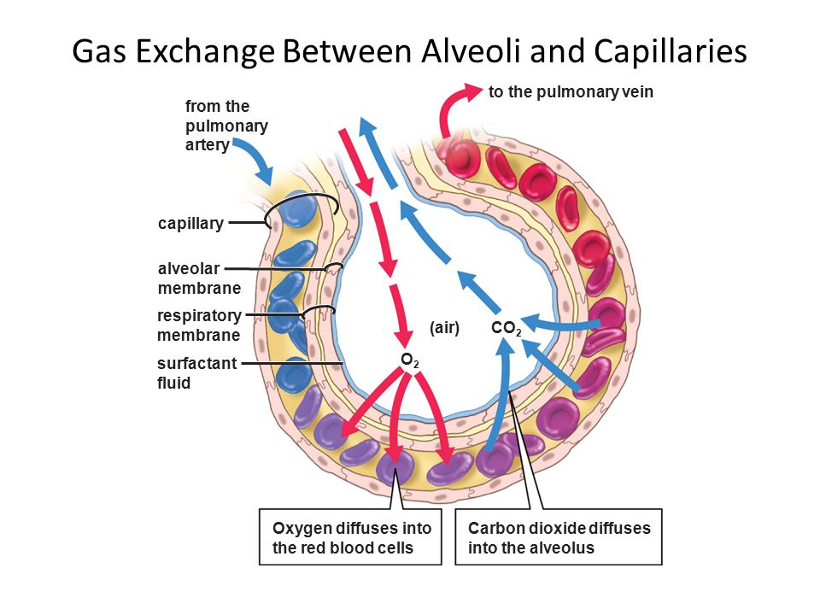
Respiratory Physiology

Slide 9
Alveoli
A film of water coats the alveolar walls
As we exhale the alveoli shrink and the water molecules become closer together creating surface tension
Because of the increased surface tension, alveoli may be vulnerable to collapsing if it wasn’t for Pulmonary Surfactant

Slide 10
What is Pulmonary Surfactant?
Surfactant decreases surface tension
Increases pulmonary compliance
Reduces tendency of alveolar collapse

Slide 11
External and Internal Respiration
External respiration
  Exchange of O2 and CO2 between the environment and the cells
Internal respiration
  Intracellular use of O2 to create ATP
  Occurs due to diffusion in relationship to partial pressure gradients

Slide 12
What is Partial Pressure?
Pressure exerted by a single gas within a mixture of gasses
A gasses partial pressure is a measurement of how much gas is present in the blood or alveoli

Slide 13
Partial Pressure of O2 and CO2 in the Body
Alveoli
  PO2: 100 mm HG
  PCO2: 40 mm HG
Alveolar Capillaries
  PO2: 40 mm HG (Low because this blood has just returned from systemic circulation)
  PCO2: 45 mm HG (High because the blood returning from systemic circulation is carrying CO2)
Because of the differences in partial pressure, oxygen can diffuse into the cells and carbon dioxide can diffuse into the blood

Slide 14
How are Oxygen and Carbon Dioxide Carried in the Blood?
Oxygen is carried in the blood
  98.5% of all oxygen is bound to hemoglobin
  1.5% is dissolved in plasma
Carbon dioxide transported from the body by cells
  60% bicarbonate
  30% carbaminohemoglobin (formed when CO2 combines with hemoglobin)
  10% dissolved in plasma
Because almost all oxygen is bound to hemoglobin, the relationship between partial pressure of oxygen and hemoglobin saturation is important.

Slide 15
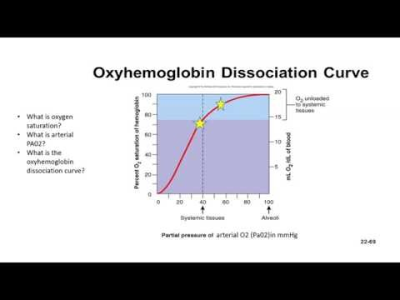
Oxygen Dissociation Curve

Slide 16
Respiration Control
Rhythmicity center of the Medulla
  Controls automatic breathing
  Consists of interacting neurons that fire under inspiration (I neurons) or expiration (E neurons)
Apneustic center
  Located in the Pons
  Stimulate I neurons
Pnemotaxic center
  Located in the Pons as well
  Inhibits apneustic center and inspiration

Slide 17
Factors in Increasing Respiration
Chemoreceptors located in the aorta and carotid arteries and also in the medulla
Chemoreceptors are stimulated more by increased CO2 levels than by decreased O2 levels.

Slide 18
Adequate Breathing
Respiratory rate is within normal limits
Respiratory rhythm is regular
Breath sounds are present, clear, and equal
Chest expansion is adequate and equal
Depth of respirations are adequate

Slide 19
Tidal Volume (Vt)
The volume of air a person moves in and out of the respiratory system in each breath

Slide 20
Minute Ventilation (MV)
The volume of air moved in and out of the respiratory system in (1) minute
Tidal volume x respiratory rate
Example: Vt of 500mL x Respiratory rate of 12 breaths per minute = 6000mL/minute

Slide 21
Alveolar Ventilation (Va)
Alveolar ventilation
  The volume of air reaching the alveoli that participates in gas exchange
  (Tidal volume – Dead-air Space) x Respiratory Rate
  Example: (500mL – 150mL) x 12 breaths per minute = 4200mL/minute

Slide 22
Inadequate Breathing
Causes
  An inadequate tidal volume
  An inadequate rate
  A combination of inadequate tidal volume and rate
  Inadequate breathing requires immediate management with positive pressure ventilations.

Slide 23
Increasing the rate of ventilation on a patient with inadequate tidal volume may maintain near normal MV, however Va where gas exchange occurs will be inadequate to maintain perfusion.

Slide 24
Ventilation and Circulation
Cardiac Output
  Stroke Volume x Heart Rate = Cardiac Output
Stroke Volume
  Amount of blood ejected from the left ventricle with each contraction

Slide 25
Ventilation and Circulation
During normal respiration
  The negative pressure caused by inhalation allows venous blood return to the right side of the heart
During positive pressure ventilation
  Air is forced into the chest causing increased intrathoracic pressure
  Increased intrathoracic pressure impedes venous blood return to the right side of the heart.

Slide 26
Respiratory Distress vs Respiratory Failure
Respiratory conditions are dynamic
  Minor respiratory distress to respiratory arrest
  Acute, chronic, or chronic with acute exacerbation
  Signs and symptoms are dynamic and may change over time depending on the state of the disease process
Many patients with respiratory disease only require comfort measures
It is important to understand when intervention is required in order to improve the patient’s condition

Slide 27
Respiratory Distress vs Respiratory Failure
Respiratory Distress
  A symptom that the patient may be experiencing.
  Additional symptoms of respiratory distress
    Agitation
    Anxiety
    Restlessness
    Accessory muscle use
    Nasal flaring
    Tachycardia

Slide 28
Respiratory Distress vs Respiratory Failure
Respiratory failure
  Inadequate gas exchange at the alveolar level
Two types of respiratory failure
  Hypoxic (Type 1)
  Hypercapnic (Type 2)

Slide 29
Respiratory Distress vs Respiratory Failure
Hypoxic (Type 1)
  Blood gas or pulse oximeter PAO2 or SpAO2 are decreased
  The cells are not getting enough oxygen

Slide 30
Respiratory Distress vs Respiratory Failure
Hypercapnic (Type 2)
  Patient is unable to eliminate CO2
  Elevated ETCO2

Slide 31
Respiratory Distress vs Respiratory Failure
Must recognize the transition of a respiratory disease from distress to failure
  Deterioration in mental status
  Confusion
  Loss of gag reflex
  Accessory muscle use
  Head bobbing
  Grunting
  Nasal flaring
  Decrease in SpO2
  Cyanosis
  Hypercarbia

Slide 32
Oxygenation and Ventilation
Oxygenation
  Addition of oxygen to the body
Ventilation
  Exchanges air between the lungs and the atmosphere so that oxygen can be absorbed and carbon dioxide can be removed
  Example: If you hyperventilate with room air, you will lower your arterial carbon dioxide content (PaCO2) significantly, but your oxygen levels won’t change much at all. On the other hand, if you breathe a high concentration of oxygen, but don’t increase or decrease your respiratory rate, your arterial oxygen content (PaO2) will greatly increase, but your PaCO2 won’t change.

Slide 33
Oxygenation and Ventilation
Hypoventilation is a common cause of hypoxia.
When breathing room air, CO2 takes up space in the alveoli, leaving less room for O2

Slide 34
Oxygenation and Ventilation
Alveolar Gas Equation
PAO2 = FiO2 (PB – PH2O) – PACO2/ R
  Where: PAO2 = partial pressure of oxygen in the alveoli
  FiO2 = concentration of inspired oxygen
  PB = the barometric pressure where the patient is breathing
  PH2O = the partial pressure of water in the air (usually 47 mmHg)
  PACO2 = alveolar carbon dioxide tension
  R = respiratory quotient, a constant usually assumed to be 0.8

Slide 35
Oxygenation and Ventilation
Alveolar gas equation example
Patient with a narcotic overdose, at sea level and breathing room air, has an alveolar PACO2 of 80 mmHg, or twice normal. That carbon dioxide takes up space and leaves less room for oxygen.
Using the Alveolar Gas Equation, that PAO2 calculation is: PAO2 = 0.21 (760 – 47) – 80/0.8 = 49 mmHg
  Normal PAO2 is about 100 mmHg, so this is quite hypoxic, especially since the alveolar PAO2 is always a little higher than the arterial PaO2. If it weren’t, oxygen would not flow out of the alveoli into the blood — it would stay in the alveoli.

Slide 36
Oxygenation and Ventilation
Treating the same patient with 50% oxygen improves PAO2
PAO2 = 0.5 (760 – 47) – 80/0.8 = 256 mm HG
With 50% oxygen PAO2 went from 49 mm HG to 256 mm HG
  Placing this patient on oxygen increased PAO2 without changing ventilation
In this scenario with a reversible cause treatment, reversal can be performed with out further need for management.
If the cause is not easily reversible the oxygen does protect the brain and heart while manually ventilating or intubating.

Slide 37
Oxygenation and Ventilation
I. AHA Guidelines now recommend that patients with suspected acute coronary syndrome (ACS) or stroke not receive oxygen unless
  SpO2 less than 94% (on room air)
    If pulse oximeter is unreliable or not available, oxygen should be administered
  Presenting with dyspnea
  Has signs and symptoms of shock or heart failure

Slide 38
Oxygenation and Ventilation
Oxygenation of chest pain and stroke patients
  2 L/min via nasal cannula for patients who
    Complain of dyspnea
    Experience signs and symptoms of shock
    Experience heart failure
    Have an SpO₂ of less than 94% (on room air)
  Titrate oxygen to maintain an SpO₂ of at least 94%

Slide 39
Oxygenation and Ventilation
Tissue damage may increase
  When high concentrations of oxygen are given to ACS and stroke patient
    Oxygen releases “free radicals;” therefore, it is no longer recommended
    Free radicals
      Byproducts of metabolism
      Toxic to neighboring cells
        Destroys their membranes
        Causes increased local tissue damage
      Reintroducing high concentrations of oxygen to cells that have been functioning anaerobically increases the production of free radicals causing cell membrane damage and tissue death
    Delivering high concentrations of oxygen to ACS and Stroke patients may be more harmful than keeping the patient on room air

Slide 40
Importance of Proper Ventilation
Excessive ventilation
  Decreases cardiac output
  Decreases vital organ perfusion
  Artificial ventilation rates greater than 12 times per minute results in poor patient outcomes.

Slide 41
Mastering the BVM
  Indications
    Respiratory failure (failure to ventilate and oxygenate)

Slide 42
Mastering the BVM
Contraindications
  Complete upper airway obstruction

Slide 43
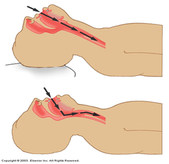
Mastering the BVM
Positioning
  Place towels under the patient’s head to position the ear level with the sternal notch
  Extend the patient’s head slightly

Slide 44
Mastering the BVM
Technique
  Open the airway
    Head-tilt chin lift
    Jaw thrust
  Place a simple airway adjunct
  Position the mask
    Use correctly sized mask for a good seal
  Hold the mask in place using E-C technique
    Two-rescuer allows for a better seal
  Ventilate the patient
    Give 1 breath over 1 second watching for chest rise and fall
      Do not over squeeze the BMV, only chest rise is needed.
    Ventilate at 10-12 breaths per minute providing adequate tidal volume
  Monitor for air leak
  Be cognizant of gastric inflation

Slide 45
Pearls of the BVM
Lift the mandible up to the mask rather than pushing the mask down
An adequate seal can be made easier with a mask that is too larger compared to one that is too small
Leave dentures in place when possible
If facial hair is making obtaining a seal difficult use water soluble lubricant over the facial hair to improve mask to face contact
The best way to prevent aspiration is good technique

Slide 46
Capnography: Ventilation Vital Sign
Capnography and ETCO2
  Provides breath-to-breath ventilation data
  Provides real-time information about respiratory effort
  Help determine the cause of respiratory distress
  Provides real-time feedback on how well treatment is working
  Provides confirmation of ET tube placement
  Can help determine shock

Slide 47
Capnography
ETCO2 represents the amount of CO2 in exhaled air
Normal ETCO2 – 35-45 mm HG
Capnography measures and displays respiratory rate
  Changes in respiratory rate are displayed immediately in the waveform and on ETCO2

Slide 48
Capnography
Relationship between CO2 and respiratory rate
  Increased RR = decreased CO2 = Hyperventilation (ETCO2 <35mm HG)
    Respiratory alkalosis
  Decreased RR = increased CO2 = Hypoventilation (ETCO2 >45)
    Respiratory acidosis

Slide 49
Capnography
Interpreting ETCO₂ and the capnography waveform
  Normal waveform of one respiratory cycle (Similar to ECG)
  Height shows amount of CO₂
  Length depicts time
  Waveforms on screen and printout may differ in duration
  On-screen capnography waveform is condensed to provide adequate information the in 4-second view
  Printouts are in real-time
  Capnograph detects only CO₂ from ventilation
  No CO₂ present during inspiration
  Baseline is normally zero

Slide 50
Capnography
Phase I
  Respiratory baseline
Phase II
  Expiratory upstroke
Phase III
  Expiratory plateau
ETCO2
  Peak level and the numerical reading displayed
Phase IV
  Inspiratory downstroke

Slide 51
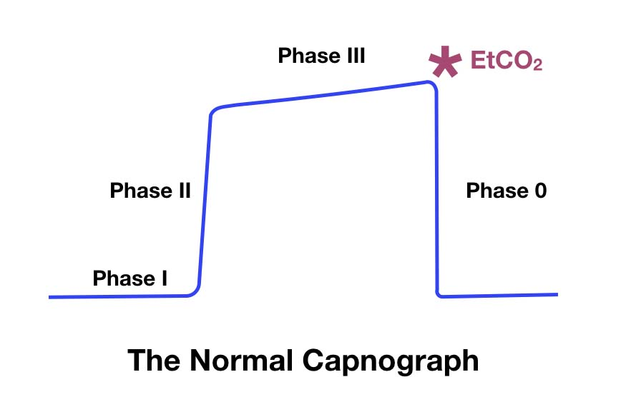
Capnography

Slide 52
Capnography
ETCO2 vs Pulse Oximetry
ETCO2 assess ventilation whereas pulse oximetry assesses oxygenation
ETCO2 will show immediate change in ventilation status whereas pulse oximetry will be delayed in showing decreased oxygenation
ETCO2 does not provide false or inaccurate readings from factors such as methemoglobin, poor perfusion, movement, or even nail polish

Slide 53
Capnography
Nonintubated applications
  Bronchospasm
  Hypoventilation
  Shock and circulatory compromise
  Hyperventilation syndrome

Slide 54
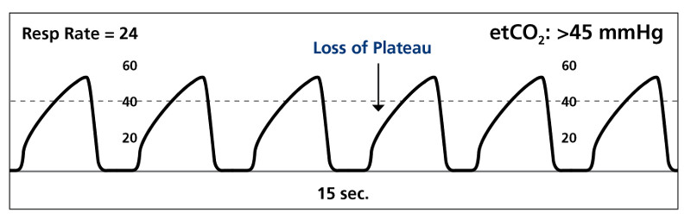
Capnography
Bronchospasm
  Shark fin with/without prolonged expiration
  Asthma, COPD, Allergic reaction
Management
  Bronchodilators

Slide 55
Capnography
Exertional exhalations
  Elevated CO2 levels should stimulate faster respiration
  No effort is needed to exhale CO2
  In COPD, asthma, and pneumonia patients must exert themselves to exhale and release trapped CO2
  Patients with these conditions may be inhaling enough oxygen to maintain a normal SpAO2, however they are struggling to remove CO2
  These patients are not effectively eliminating CO2 and may be progressing to respiratory failure from hypercarbia and fatigue, not hypoxia

Slide 56
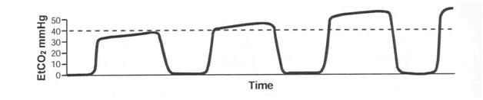
Capnography
Hypoventilation
  Prolonged waveform
  Baseline CO2 = 0
  ETCO2 >45 mm HG
Management
  Assist ventilations or intubate

Slide 57
Capnography
Shock and circulatory compromise
  Capnography has a ventilatory and circulatory component
  Low ETCO2 and other associated signs of shock indicates poor systemic perfusion

Slide 58
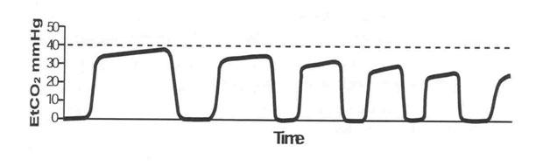
Capnography
  Hyperventilation Syndrome
    Shortened waveform
    Baseline CO2 = 0
    ETCO2 <35 mm HG
  Management
    If conscious utilize the numbers to have patient slow respirations

Slide 59
Capnography
Hyperventilation exceptions
  ETCO2 is high with tachypnea
Severe metabolic acidosis
  DKA
  Sepsis
  Salicylate poisoning
  Acute renal failure
  Methanol ingestion
  Tricyclic overdose

Slide 60
Capnography
If respirations are increased and ETCO2 is high consider the previous diagnosis and treat accordingly.
ELEVATED RESPIRATIONS AND HIGH ETCO2 IS NOT NORMAL!

Slide 61
Capnography
Intubated applications
  Verification of ETT placement
  ETT surveillance during patient movement and transport
  CPR efficiency
  ROSC
  Survival predictor

Slide 62
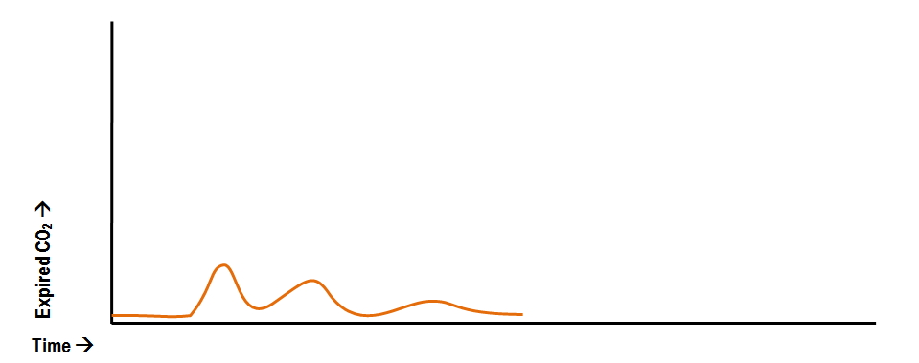
Capnography
ETT Confirmation
Esophageal Intubation
  Absence of waveform
  Absence of ETCO2
Management
  Re-intubate

Slide 63
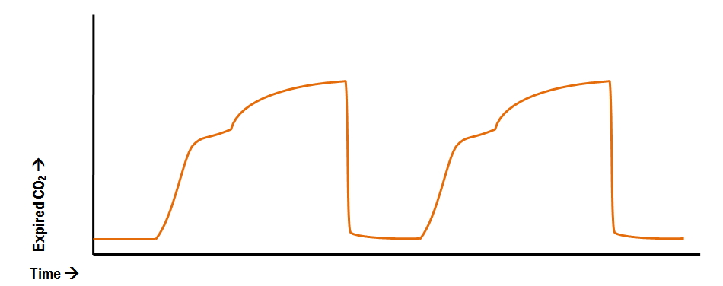
Capnography
ETT Confirmation
Right Main Intubation
  Waveform represents differential ventilation of two lungs
  Transition phase of gas escaping from the left lung up the tube
Management
  Pull ETT back

Slide 64
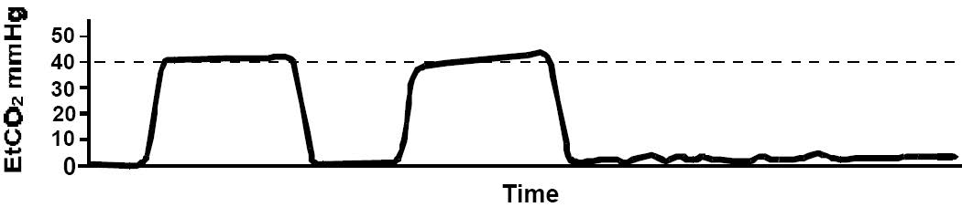
Capnography
ETT surveillance
Dislodged ETT
  Loss of waveform
  Loss of ETCO2 reading
Management
  Replace ETT

Slide 65
Capnography
CPR efficiency
  Normal waveform
  Baseline CO2 = 0
  ETCO2 = 10-15 mm HG (maybe higher with good CPR)
Management
  Change rescuers if ETCO2 drops below 10 mm HG

Slide 66
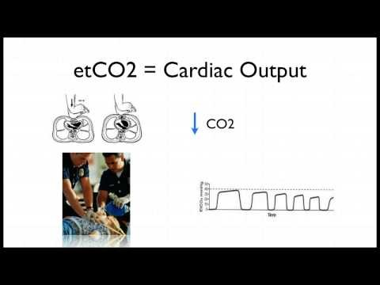
Capnography

Slide 67
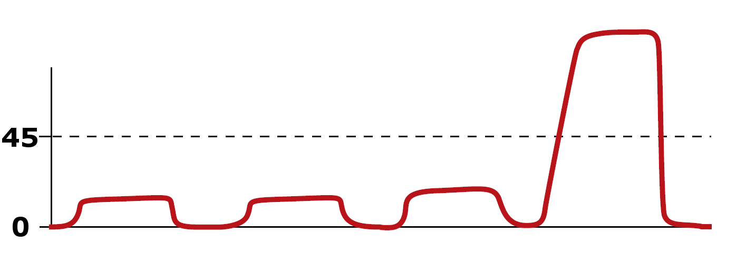
Capnography
ROSC
CPR
  Rapid jump in ETCO2 from baseline of CPR
Management
  Check for a pulse

Slide 68
Capnography
Survival predictor
  Initial ETCO2 of > 10 mm HG = higher chance of ROSC
  A decrease of > 25% in ETCO2 during resuscitation = significant likelihood of mortality
  ETCO2 is a great tool to determine when to cease efforts and when efforts should continue

Slide 69
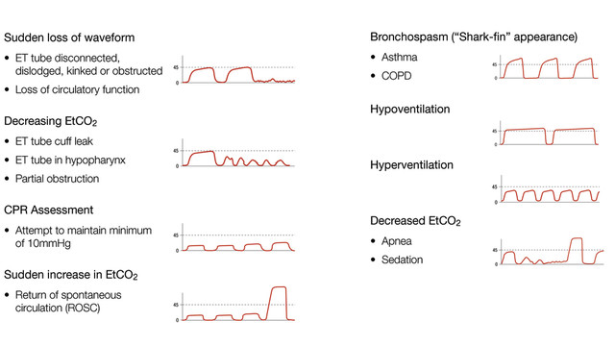
Capnography

Slide 70
Advanced Airway Adjuncts
Oropharyngeal Airway (OPA)
Indications
  Respiratory distress/failure
  Unconscious/unresponsive
Contraindications
  Gag reflex
  Presence of oral trauma (broken teeth, recent oral surgery, etc.)

Slide 71
Advanced Airway Adjuncts
Nasopharyngeal (NPA)
Indications
  Respiratory distress/failure
Contraindications
  Presence of head, facial trauma
  Presence of skull fracture

Slide 72
Advanced Airway Adjuncts
Supraglottic
Examples
  Laryngeal mask airway (e.g., LMA™)
  Esophageal-tracheal tube (e.g., Combitube™)
  Laryngeal tube (e.g., King LT ™)
  I-Gel ii.

Slide 73
Advanced Airway Adjuncts
Advantages
  Does not require visualization of the glottis (blind insertion)
  Initial training and maintenance of skills are easier
  Chest compressions do not need to be interrupted to insert
  Minimal equipment required for insertion
Disadvantages
  Contraindicated in patients with a gag reflex
  Some devices contraindicated in patients at risk for regurgitation which can lead to aspiration (e.g., LMA™)
  Unrecognized improper placement can occur

Slide 74
Advanced Airway Adjuncts
Endotracheal Tube (ETT)
Advantages
  Keeps the airway patent
  May protect the airway from aspiration
  Allows suctioning of deep airway secretions
  Potential route for drug administration
Disadvantages
  Difficult initial training
  Insufficient skill maintenance without frequent practice
  Frequently causes trauma to the oropharynx
  Hypoxemia possible with prolonged intubation attempts
  Adverse outcomes common when providers fail to recognize tube displacement or misplacement
  High incidence of complications when performed by inexperienced providers with inadequate monitoring of tube placement

Slide 75
Airway Management in Cardiac Arrest
ALS Airway management
  BVM
    . Avoid hyperventilation as it decreases preload
    Best technique is the 2-Rescuer technique with one rescuer holding mask seal and the other squeezing the bag with both rescuers watching for chest rise
    2 breaths for every 30 compressions without an advanced airway
    One breath every 6-8 seconds after placement of advanced airway
    May need to adjust ventilator rate based on capnography
  Endotracheal Tube (ETT)
    Compressions should not be interrupted in the placement of an ETT
  Supraglottic airways
    Considered an advanced airway
    Alternative to ETT placement
    Acceptable during CPR

Slide 76
Airway Management in Cardiac Arrest
Capnography should be attached to these airways
  Continuous waveform capnography
  Typically 35-45mm Hg in a normally perfusing patient
  Greater than 45 mm Hg
    Ensure adequate ventilatory rate and volume 1
  15-35 mm Hg
    Common in cardiac arrest patients with CPR in progress
  Less than 10-15 mm Hg
    Focus efforts on improving chest compressions
    Make sure the victim is not receiving excessive ventilations

Slide 77
Airway Management in Cardiac Arrest
A sudden increase in ETCO₂ could indicate a return of spontaneous circulation (ROSC)
  Use caution with interpretation of ETCO₂ values within 1-2 minutes after administration of epinephrine due to decreased pulmonary blood flow

Slide 78
CPAP
Continuous Positive Airway Pressure (CPAP)
  CPAP is used to provide better oxygenation to patients who are hypoxic
  Not designed to ventilate patients
  Reduces the effort for the patient to breathe, improves oxygenation and reduces hypercarbia
  Can prevent the exacerbation of respiratory distress or respiratory failure
  Applies positive airway pressures above atmospheric pressure during inhalation and provides positive end expiratory pressure (PEEP) during exhalation

Slide 79
CPAP
Indications
  Patient needing ventilatory support who is in moderate to severe respiratory distress or early respiratory failure
  Patient must be awake, able to obey commands, and have intact airway reflexes
Contraindications
  Inability to maintain an open airway
  Severe hypotension (systolic BP < 90)
  A respiratory rate of less than 8 breaths/min
The EMS provider needs to deliver assisted artificial ventilations to patients who exhibit deterioration in mental status because of hypoxia and hypercarbia

Slide 80
Automated Transport Ventilators
Automated Transport Ventilators (ATV)
  Intubated patients requiring artificial ventilation for a period of time may benefit from use of ATV, instead of BVM
Advantages
  Can be used for breathing and non-breathing patients
  Patients in respiratory failure
  Frees the rescuer for other tasks
  Adjustable settings provide specific tidal volume, respiratory rate, and minute ventilation
Disadvantages
  Need for an oxygen source, and sometimes electric power
  Inability to detect increasing airway resistance
  Some ATVs should not be used in children younger than 5 years old

Slide 81
Neurological Emergencies
Define AMS
State common causes of AMS
Define status epilepticus
Explain complications associated with seizures

Slide 82
Neurological Emergencies
Altered mental status definition and causes
  Definition: change in a person’s level of awareness
  Causes (AEIOU-TIPPSS— acronym for assessment of AMS patient)
    Alcohol
    Epilepsy (seizures)
    Insulin (diabetic condition)
    Oxygen (lack of)
    Uremia (kidney failure)
    Trauma
    Infection
    Psychiatric
    Poisoning (including drug overdose)
    Shock
    Stroke

Slide 83
Neurological Emergencies
Types of seizures
  Generalized
    Tonic-clonic
    Absence
  Partial
    Simple
    Complex
  Status epilepticus

Slide 84
Generalized Seizures
Tonic seizure
  Muscles stiffen and the patient loses consciousness
  Muscles contract and the back arches
  Chest muscles tighten and breathing becomes difficult
    Cyanosis to lips and face possible
Clonic seizure
  Muscles spasm and jerk
  Muscles will flex and relax rapidly

Slide 85
Generalized Seizure
Tonic-clonic (grand mal) seizures
  Tonic and clonic seizure occur together
  Rare to experience one without the other
Absent (petit mal) seizure
  Uncommon
  Occurs suddenly and without warning
  Appear to stare without moving
  Usually last less than 15 seconds
  Normally no postictal period

Slide 86
Partial Seizure
Simple partial seizure
  Localized to one area of the brain
  No lost of consciousness

Slide 87
Partial Seizure
Simple partial seizure is broken into four catergories
Motor
  A simple partial seizure with motor symptoms will affect muscle activity, causing jerking movements of the foot, face, arm, or another part of the body.
Sensory
  A simple partial seizure with sensory symptoms affect the senses: hearing problems, possible hallucinations, and other distortions.
Autonomic
  A simple partial seizure with autonomic symptoms affects the part of the brain responsible for involuntary functions: it may cause changes in blood pressure, heart rhythm, bowel function, etc.
Psychic
  A simple partial seizure with psychic symptoms affects parts of the brain that trigger emotions or previous experiences: it may cause feelings of fear, anxiety, déjà vu

Slide 88
Partial Seizure
Complex partial seizure
  Affect any lobe of the brain
  Cause alteration of awareness due to spreading seizure activity
  An aura often described as a warning may present
  Patients may stare blankly into space
  Non-purposeful/repetitive movements

Slide 89
Status Epilepticus - Definition
A continuous seizure lasting more than 30 minutes
Two or more seizures without regaining consciousness between any of them
Prolonged seizures last between 5 and 30 minutes
  Should be treated as status epilepticus

Slide 90
Status Epilepticus - Epidemiology
  Mortality rate can be around 20%
    Especially if treatment is not initiated quickly
  Highest mortality occurs from anoxic and cerebrovascular causes
  Seizure duration is the greatest predictor of mortality
    Status epilepticus lasting >1 hour has significantly higher mortality
  Most common in ages >60 years old and <12 months old
  High prevalence in patients with chronic epilepsy

Slide 91

Status Epilepticus – Time is Brain
Status is an emergency and needs to be treated promptly

Slide 92
Physiologic Changes in Status Epilepticus
Phase 1: Compensation
  First 30 minutes
  Cerebral metabolism is increased due to the seizure activity
  The body is able to meet the increased metabolic demands
  Cerebral tissue is protected from hypoxia and metabolic damage

Slide 93
Physiologic Changes in Status Epilepticus
Increased brain metabolism | Elevated systemic and pulmonary artery pressure
Increased cardiac output | Hypertension
Tachycardia | Cardiac arrhythmias
Hypercalcemia | Lactic acidosis
Massive catecholamine release | Hyperthermia
Incontinence | Vomiting

Slide 94
Physiologic Changes in Status Epilepticus
Phase 2: Decompensation
  Occurs after 60 minutes
  Increased metabolic demands cannot be met
  Hypoxia
  Cardiorespiratory functions may progressively fail to maintain homeostasis

Slide 95
Physiologic Changes in Status Epilepticus
Failure of cerebral auto-regulation | Respiratory and cardiac impairments
Hypoglycemia | Systemic hypoxia
Hypotension | Failing cardiac output
Hepatic and Renal dysfunction | Metabolic and Respiratory acidosis
Hypo/hyperkalemia | Coagulopathies
Falling lactate levels | Rhabdomyolysis
Multi-organ failure | Hyperthermia
Luekocytosis | Increased ICP

Slide 96
Status Epilepticus
Complications
  Aspiration
  Bone and spine fractures
  Brain damage from lack of oxygen and/or depletion of glucose
  Dehydration

Slide 97
Neurological Emergencies
Causes
  Medication non-compliance
  Rapid increase in body temperature (febrile)
  Infection
  Hypoxia
  TBI
  Alcohol or drug withdrawal
  Stroke
  Hypoglycemia
  Eclampsia
  Seizure disorder
  Electrolyte disturbances
  Poisoning

Slide 98
Neurological Emergencies
Assessment findings
  Spasms/muscle contractions/shaking or tremors
  Sweating
  Cyanosis during seizure activity
  Increased secretions
  Incontinence
  Postictal state

Slide 99
Neurological Emergencies
Management
  Protect from further injury; position on side to protect airway
  Ensure open airway, adequate ventilations, and oxygenation
    Consider using an NPA
  Provide emotional support; reduce stimulants that may trigger more seizures
  IV or IO
  Consider administering a benzodiazepine

