Slide 1
Mr. McSymphony’s
Sponsored by “The Steinway Society of Riverside”
“It’s All About the Piano”
A Mr.McSymphony™ Program
©2015 all right reserved

Slide 2
KEYBOARD HISTORY TIMELINE
200 B.C. - Hydraulis mechanical pipe organ – from Greece, The first instrument
in history to have a keyboard.
Post 13th century- Development of the 12 tone chromatic scale we use today which included both white and black keys..
1502- First mention of the clavichord and initially had from 3 ½ to 5 octaves
1600’s- Introduction of the harpsichord in the Baroque era-1600 to 1750
1700’s / 1800’s - Octaves increased from 5 to the current 7-1/3
1700-1720- First pianoforti built from a harpsichord in Padua, Italy by Bartolomeo Cristoforti
1732- First appearance of the word piano shortened from the word pianoforti.
1881- Player piano patent was issued to John McTammany
1859- First appearance of all the basic piano features we have today came from the Steinway concert grand piano.

Slide 3
HYDRAULIS WATER ORGAN
From this 220BC Hydraulis came the modern Pipe Organ

Slide 4
PIANO SCALES
DIATONIC SCALE on “C”
Consists of the eight white notes in an octave
C,D,E,F,G,A,B,C
CHROMATIC SCALE ON “C”
Consists of the twelve black and white keys of a piano
In ascending or descending sequence

Slide 5
“IN HYDRAULICS” BY ANTOINE BUSNOYS
Renaissance Choir with an early Organ

Slide 6
“CHORALE FANTASIA” BY Johann Adam Reincken
A Church Organ with numerous pipes in the background

Slide 7
CLAVICHORD
Normally between 3 to 5 octaves. Today the modern pianos have 7 1/3 octaves

Slide 8
“SONATA IN D Major”, finale presto, by Franz Joseph Haydn
Music from the Clavichord.
Haydn wrote over 60 Sonatas.
1732-1809

Slide 9
“SONATA IN B FLAT MAOR” , MINUET BY Franz Joseph Haydn
A minuet on a Clavichord and words from Mozart

Slide 10
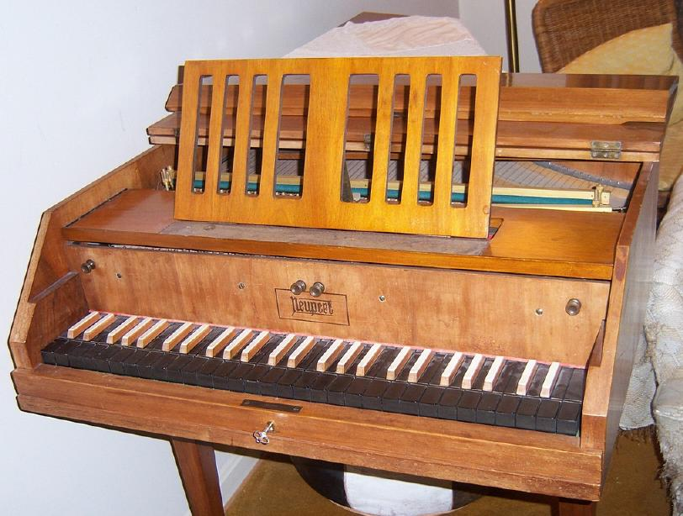
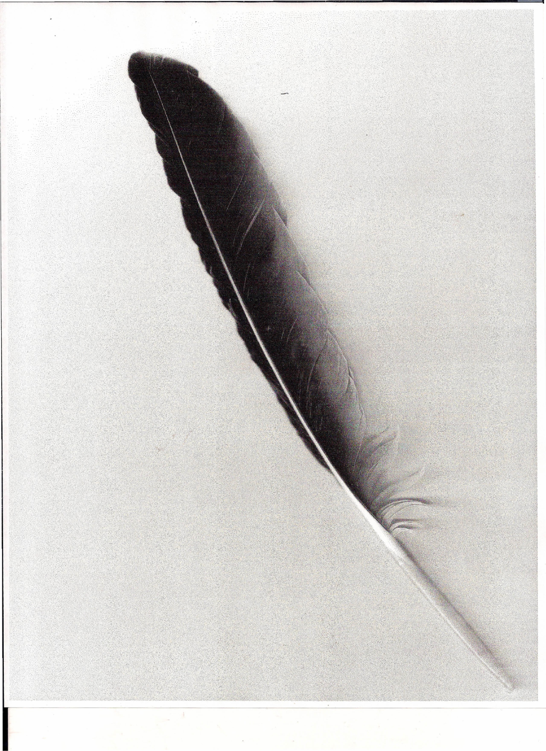
HARPSICHORD
Note the color of the keys. They reversed in 1720
Quill with feathers

Slide 11
“FANTASIA in C MINOR” BY Johann S. Bach
Music from the Baroque period 1600-1750.
The Double Harpsichord used here has two levels of keys.
1685-1750

Slide 12
“SUITE in G MINOR”, GIGUE BY George Frederic Handel
Baroque music- boring, ornate , repetitive.
Gigue is a lively dance, normally in two sections.
Can you hear the difference between the Harpsichord and the Clavichord?
1685-1759

Slide 13
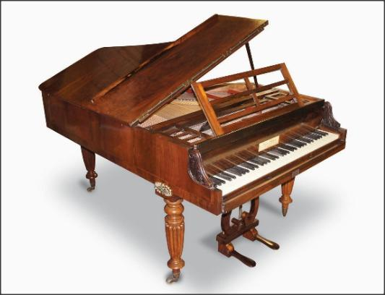
PIANOFORTI
Some changes during the Industrial Revolution: damper pedals, cast iron framing, key colors reversed and octave range increases to the current 7 1/3

Slide 14
“FANTASIA in D MINOR” BY Wolfgang Amadeus Mozart
Mozart was playing the piano at three and wrote music at the age of four.
The keyboard had a knee lever rather than a pedal to raise the dampers.
1756-1791

Slide 15
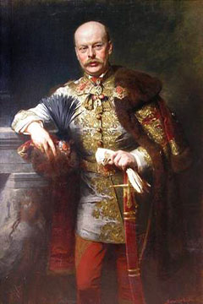
“SONATA in F MAJOR”, finale presto by Franz Joseph Haydn
1732-1809
Prince Nikolaus Esterhazy- was Haydn’s patron and employer for nearly 30 years

Slide 16
PLAYER PIANO
John McTammany received a patent for his player piano in 1881

Slide 17
“I AIN’T GOT NO BODY” by Thomas Wright
Thomas Wright better known in the JAZZ industry as FATS WALLER. All his works were put on piano rolls for the player piano.

Slide 18
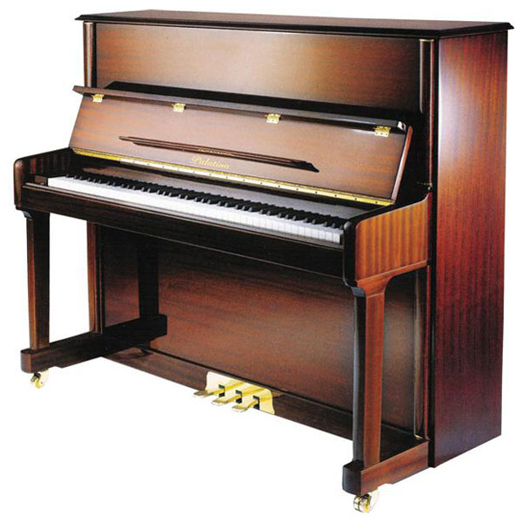
MODERN CLASSICAL PIANO and the UPRIGHT PIANO
Clavichord was too quiet, the Harpsichord was too loud, the modern piano was just right with the modern pedal controls.

Slide 19
Rachmaninoff’s “Prelude in C-sharp minor” played by Van Cliburn
In 1958 he became the first American to win the Tchaikovsky Competition in Moscow.
Note the variation of sound, clarity and dampening effect of the keyboard.

Slide 20
“CONCERTO #27 in B FLAT MAJOR”, allegro by Wolfgang Amadeus Mozart
The original score was without trumpets and drums.
Listen to the sound of the keyboard and note the balance of the piano and the symphony orchestra.

Slide 21
“FANTAISIE-IMPROMPTU OP. 66 in C-sharp” by Frederic Chopin
All of his works feature the piano.
Note this piece sounds like the music to “I’m Always Chasing Rainbows”

Slide 22
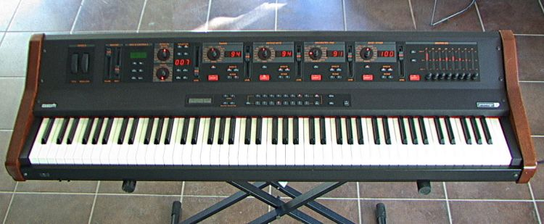
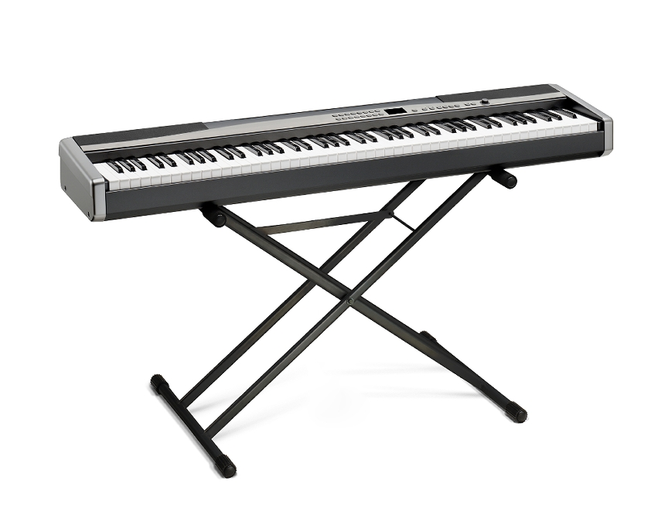
NON CLASSICAL PIANO AND SINGERS OF TODAY
KEYBOARDS
SYNTHESIZER

Slide 23
“I WAS MADE TO LOVE HER” BY Steve Wonder
Blind at birth. A child prodigy who signed with Motown’s recording company at age 11.
Played the piano, harmonica and drums.

Slide 24
“YOU AND I” BY Stefani Joanne Angelina Germanotta
Started playing the piano at age four, wrote music at 13 and performed at 14.
Better known as “Lady GAGA”

Slide 25
THE END

