Slide 1

RSAI Region Meeting
NE Region
April 2, 2024

Slide 2

RSAI Team
Nick Trenkamp & Jay Marley, NE Region Reps
Barb Schwamman, Legislative Rep
Dan Peterson, At-Large Rep to be elected at Annual Meeting in October
Jen Albers, Administrator
Larry Sigel, ISFIS Partner
Margaret Buckton, Professional Advocate
Dave Daughton, Legislative Advocate

Slide 3
Agenda:
Introductions
RSAI Overview and Processes
Election to Leadership Group
Election of Legislative Committee Rep
RSAI Proposed Bylaws, if any
Review of the 2024 Legislative Session
NE Region Priorities for 2025 Session
Brainstorming/Networking Discussion

Slide 4
Introductions
Name ____________________________________
District Role ____________________________________
One Sentence: What’s the best thing happening in your school district today?
________________________________________________________
________________________________________________________
________________________________________________________

Slide 5
History of RSAI
The Rural School Advocates of Iowa began with a few rural school leaders getting together in 2013 to discuss many things:
  Why were rural school voices not represented in statewide decision-making?
  Why did funding formulas not recognize transportation and sparsity factors?
  Why did state policy always seem to have a “one-size-fits-all” approach that left little flexibility to rural schools?
  What could rural school leaders do to change this situation to benefit students in rural schools?
July 1, 2014 RSAI officially formed with 41 member districts

Slide 6
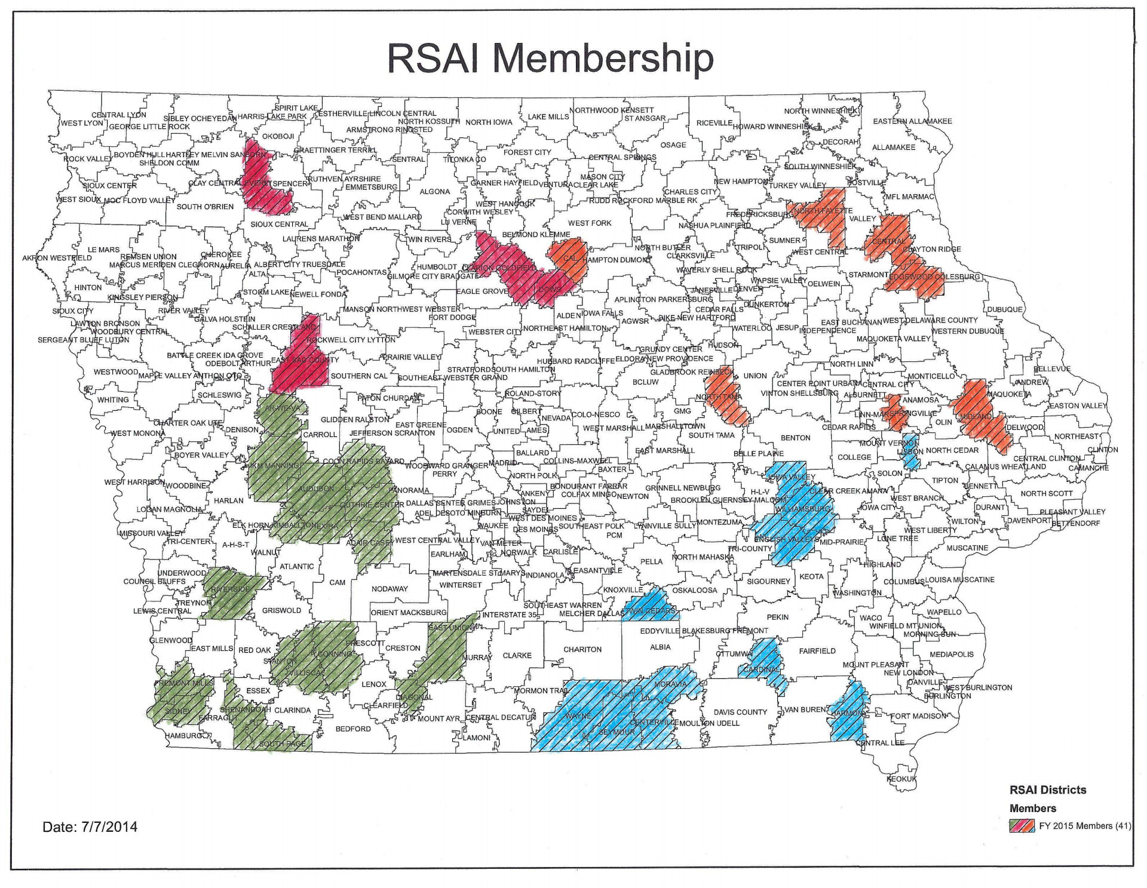
July 1, 2014

Slide 7
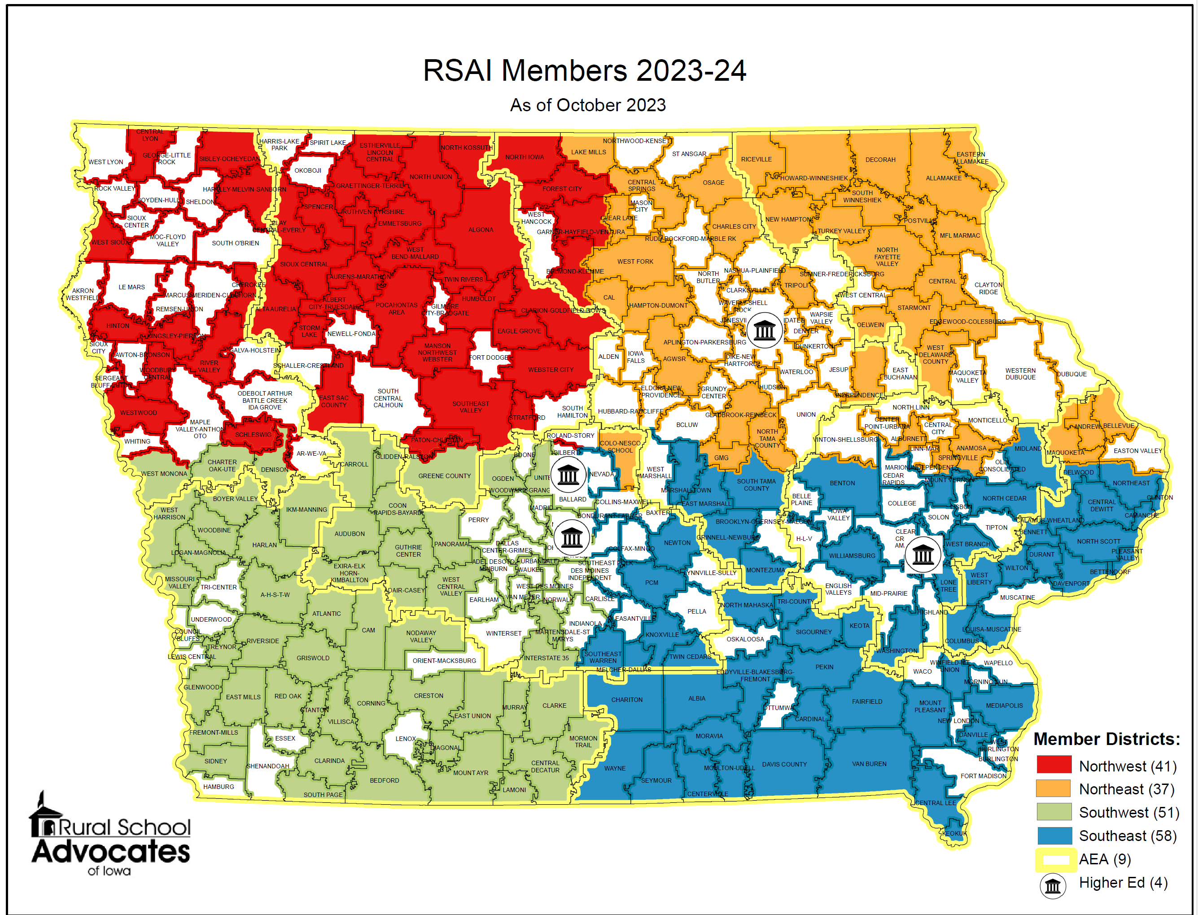

Slide 8
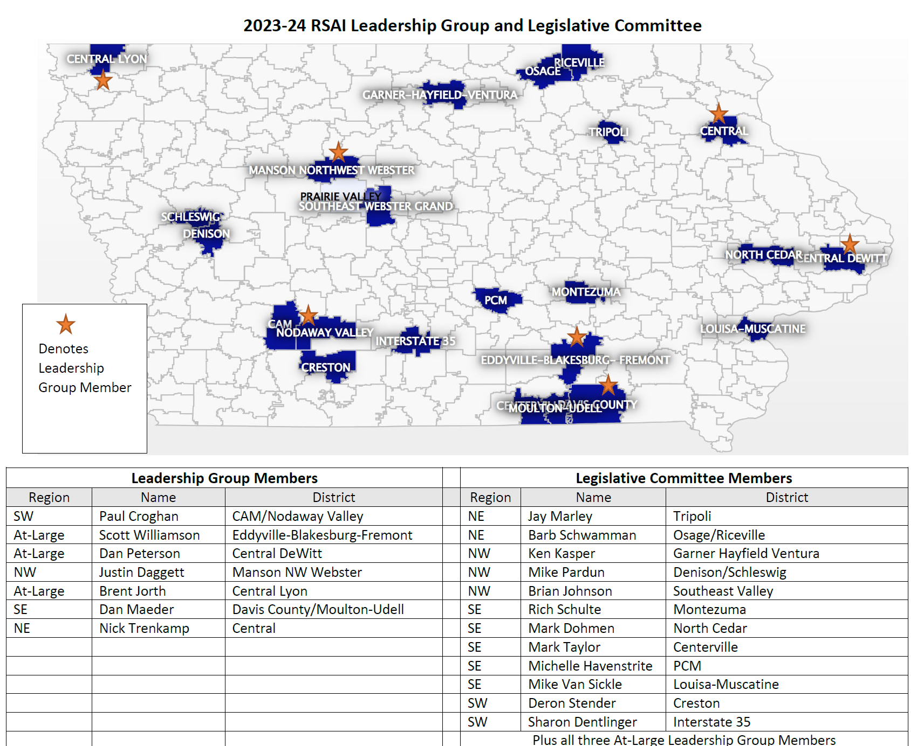

Slide 9



RSAI Relationships
RSAI is recognized as the Iowa affiliate of the National Rural Education Association (NREA) connecting members to rural school leaders nationwide, an annual conference focused on the needs and successes of rural schools
Lends Iowa’s voice to a collective effort in our nation’s Capitol through membership in the Rural Schools Collaborative.
Member of Iowa Rural Development Council to network and collaborative w/rural leaders across all areas of economic development.

Slide 10
Member Benefits
Advocacy presence at the Iowa Capitol focused on RSAI priority issues
Weekly legislative update reports and recap videos to share the latest news from the statehouse and calls to action when needed
A voice to advocate with the executive branch and represent rural schools on various task forces and stakeholder committees convened by DE.
Advocacy resources for local leaders to use, including position papers, advocacy tool kits, talking points, maps, and school finance estimates
Assistance with communications, letters to the editor or sample letters to legislators
Easy to share information, such as RSAI Legislative Priorities Video, to inform school boards, staff, and stakeholders.
RSAI is the state affiliate of the National Rural Education Association, which brings access to NREA research, updates about happenings in Washington, networking
Free Summer regional meetings and RSAI annual conference in October.
Authentic grassroots development of legislative priorities in a one district one vote democratic process.
Free access to NASDTEC teacher licensure checks with your RSAI membership. Learn more about the program here.
Discount on ISFIS Policy-hosting Service
Collective purchasing power as a group, attracting needed supports at discounted prices
Networking, Sharing, Best Practice Connections with other like districts

Slide 11








www.rsaia.org/corporate-sponsors

Slide 12
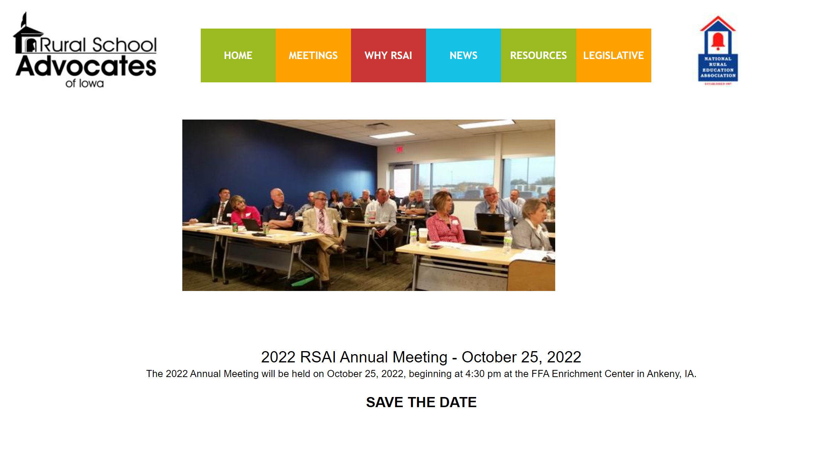
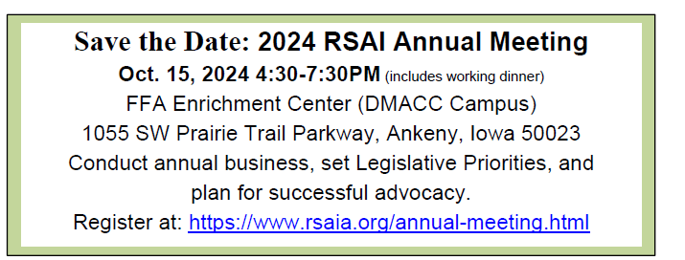
https://www.rsaia.org/annual-meeting.html

Slide 13
Election of RSAI Regional Representative to the Leadership Group.
Office is a 3-year term.
NE Region Leader Nick Trenkamp
Nick’s term expires in 2024

Slide 14
Election of RSAI Regional Representative(s) to the Legislative Committee.
Office is a 1-year appointment.
By-laws allow additional representatives so each AEA has at least one.
Thanks to those serving during the 2024 Session!
Representative attends Legislative Committee Meeting in Des Moines during August (date TBD), attends the Annual Meeting in Ankeny during October, and supports legislative advocacy efforts during the Legislative Session.
Map on slide 7-8 shows membership & current representation

Slide 15
Review of RSAI Bylaws
Any changes needed?
Comments/recommendations would be shared with the RSAI Bylaws Committee. Legislative Committee then makes final recommendation to members at the Annual Meeting, which requires a 2/3 vote for approval.

Slide 16
Accomplishments
Benefiting Rural Districts
Before 2018:
  Management fund authority to pay for retirements over age 65 and costs of arbitration
  PPEL flexibility to pay for repairs over $1,500
  DoP Flexibility
  Home Rule Statute
  Categorical Fund Flexibility
In 2018 Session
  Even more DoP Flexibility
  Even more Categorical Fund Flexibility
  Staff Flexibility – CTE options for hard-to-staff content and local offerings of on-line learning
  Progress on Transportation (grants) and Formula Equality
  Extension of Operational Sharing Incentives

Slide 17
Accomplishments
Benefiting Rural Districts
In 2019 Session
  Transportation in the Formula
  Formula Equity
  Extension of WGS/reorganization Incentives
  State Penny Extension
  Teacher shortage flexibility: Praxis waiver, concurrent enrollment STEM offer and teach, online learning flexibility
In 2020 Session
    Transportation in the Formula Continued (all the state average)
    Formula Equity – another $10 per pupil
    2.3% SSA (highest in 10 years)
    Mental Health: Telehealth services at school, Therapeutic Classroom Pilots, $2.1 million AEA funding for MH First Aid Training
    Staffing Flexibility: Online allowed for financial literacy, world languages and computer science to meet O&T, Praxis eliminated as entrance test to teaching, AA degrees for some CTE teachers, Licensure reciprocity with other states.
    Poverty: bill through House Education to study poverty weightings did not advance further

Slide 18
Summary of 2024 Legislative Session (so far)
RSAI Priority Action

Slide 19
Adequate School Resources
Priority Action: HF 2612 State Supplementary Assistance (SSA). The bill was signed by the Governor on Mar. 27. The bill does the following:
  Establishes a 2.50% growth rate to be applied to the State cost per pupil (SCPP) for FY 2025, for an SSA of $191 per pupil.
  Establishes a 2.50% growth rate to be applied to each of the State categorical cost per pupil amounts for FY 2025 (TLC, PD, EICS, and Transportation Equity). Note: 2.5% growth applied to TSS sets the state cost PP of TSS to $675 per pupil. Lowest TSS district cost per pupil is $699 for FY 2025.
  Additional levy portion of the FY 2025 SCPP is frozen at $685 per pupil, regardless of the per pupil increase (property tax relief)
  Increases the appropriation to the Transportation Equity Program to equal the amount necessary to make all transportation equity aid payments.
RSAI continues to express concerns about the 2022 historic tax cuts and several more tax cut bills pending this Session. The SSA rate of 2.5% does not meet inflation or allow districts to pay competitive wages.
But wait, there’s more. . .

Slide 20
Teacher Pay & TSS
Fiscal Year | Beginning Teacher Pay | Experienced Minimum (12 yrs)
FY 2025 | $47,500 | $60,000
FY 2026 | $50,000 | $62,000
Requires DOM to categorize all districts in up to 10 tiers according to each school district’s actual enrollment. Requires DOM to strive to include districts serving over 3,500 students together in tier(s).
Requires DOM to calculate TSS based in part on the average required for the tier to meet the costs of the two minimums and employer costs of FICA and IPERS.
If the TSS calculated for the tier is not sufficient to meet a school district’s cost of implementation, DOM must set the district’s TSS at an amount necessary to meet the district’s minimum salary requirements and associated costs.
Repeats the process for the year beginning July 1, 2025.

Slide 21
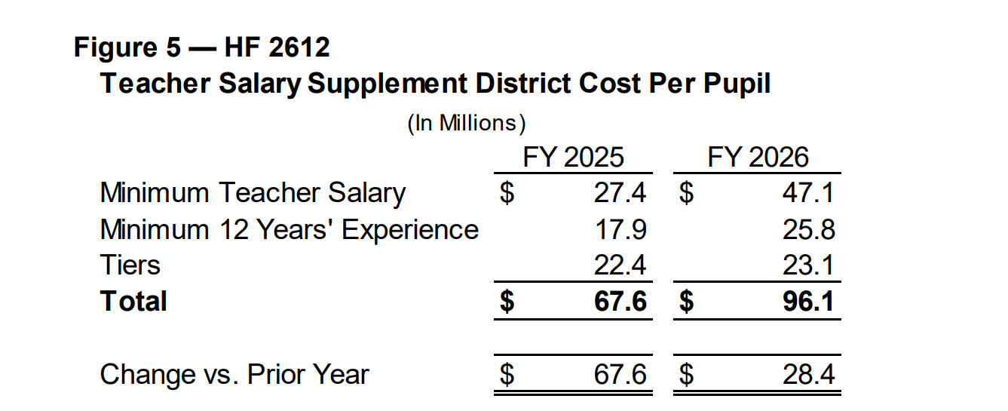
Fiscal Note Estimate of cost for Teacher Pay minimums by Fiscal Year
https://www.legis.iowa.gov/docs/publications/FN/1448318.pdf

Slide 22
Teacher Pay
For the budget year beginning July 1, 2026 and future years, TSS will include the TSS state aid associated with the SSA rate for the year.
Allows teachers whose first month of retirement benefits is July 2024 or later, but before July 1, 2027, to return to covered employment as a teacher after receiving one month of retirement benefits.

Slide 23
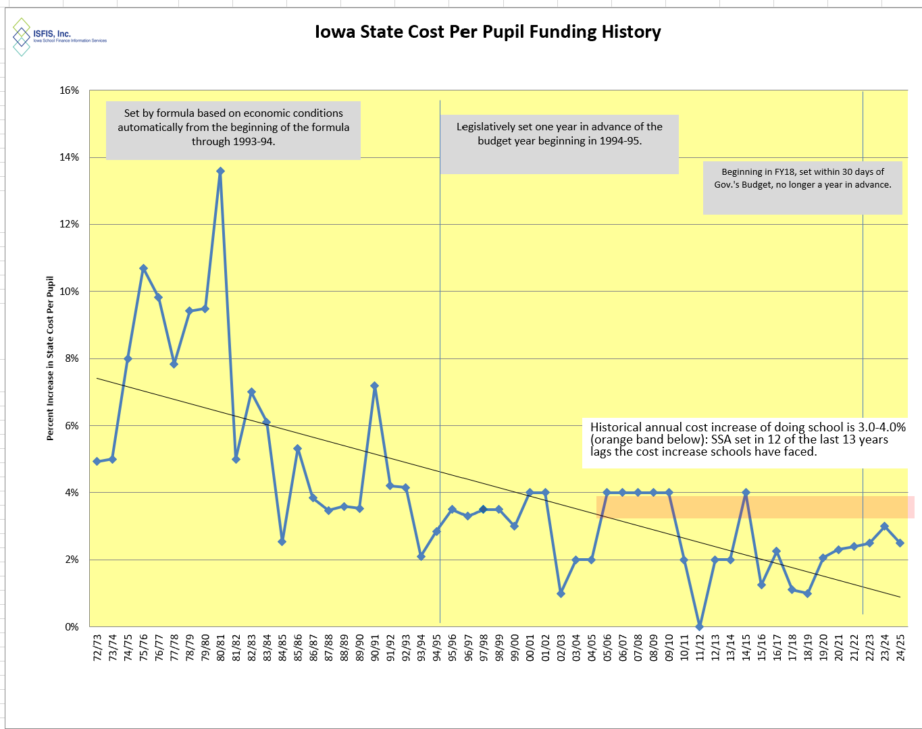
2.5% ties for the third lowest in 15 years.
Inflation is higher.
Teacher and other staff pay is not keeping up (TSS and Ed support salary pending).
Resource challenge is felt more strongly in rural schools.

Slide 24
Question of the day:
How many of our other RSAI legislative priorities would fall off the list if schools had been adequately funded in the past or were adequately funded going forward?

Slide 25
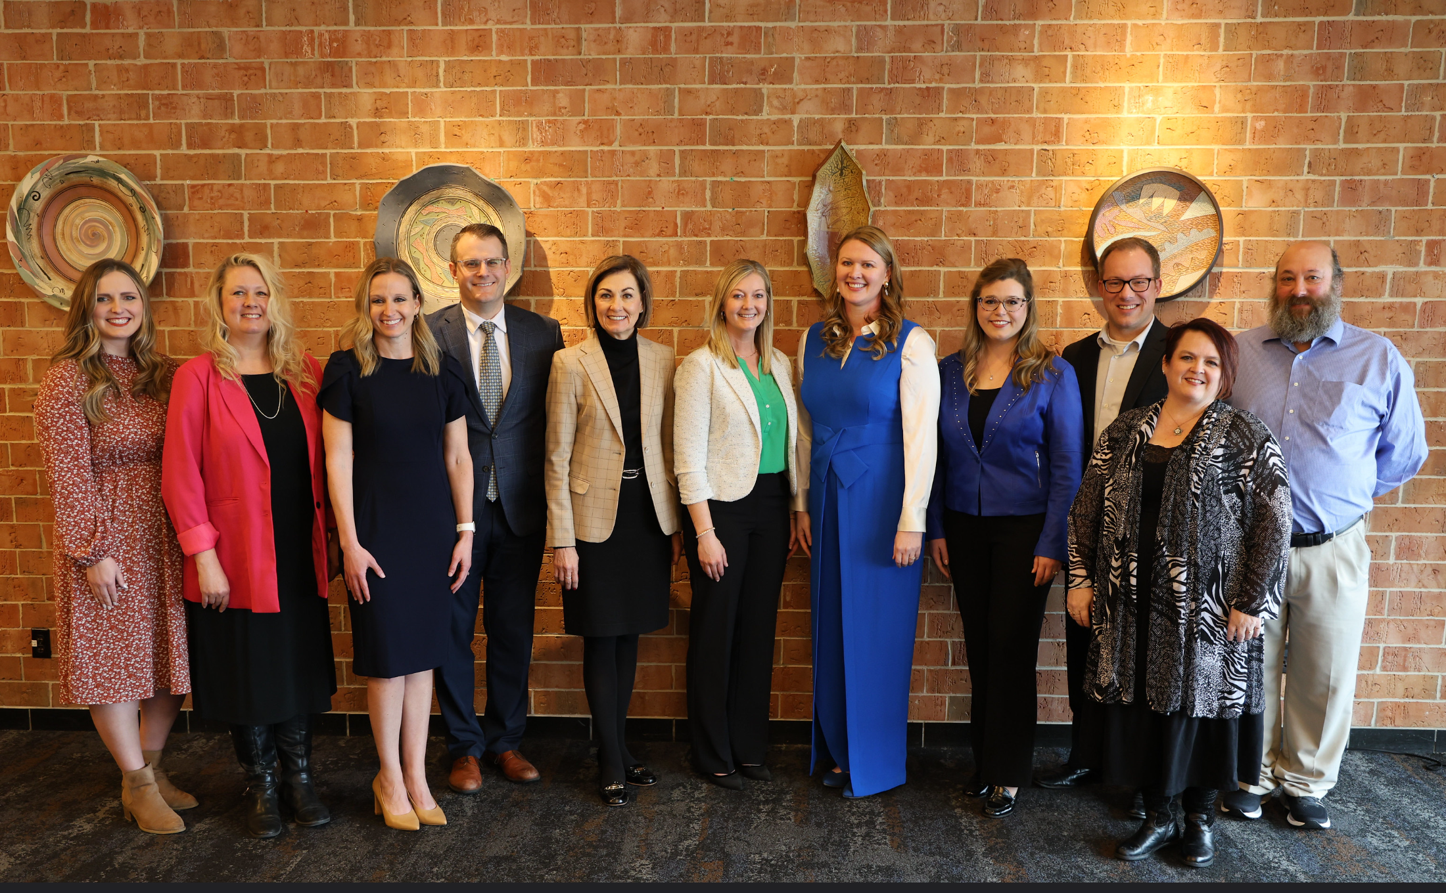
Staff Shortage
Eight 2024 Iowa Teacher of the Year award finalists were honored at the Outstanding Iowa Teachers Recognition Luncheon.

Slide 26
2024 Progress on Staffing
HF 2612 IPERS: Reduces the “bonafide retirement” period to 1 month for three years (retirements from July 1, 2024 up to July 1, 2027 (currently four months)
SF 2411 Work-based Learning includes language that reduces student teaching time for the apprentice program.
HF 2465 Agricultural Classes as Science or Math credit: allows high school agricultural classes to include units that meet up to 2 curriculum requirements.
Governor’s TPRA Grant Program was extended for an additional year (still room in RSAI Consortium for a few more slots). We are working to continue the program with State funds (and less DOL regulation) going forward
SF 392 Recruitment and Retention Plan, allows management fund for R&R plan if not used for Early Retirement plan, still in Senate Ways and Means

Slide 27
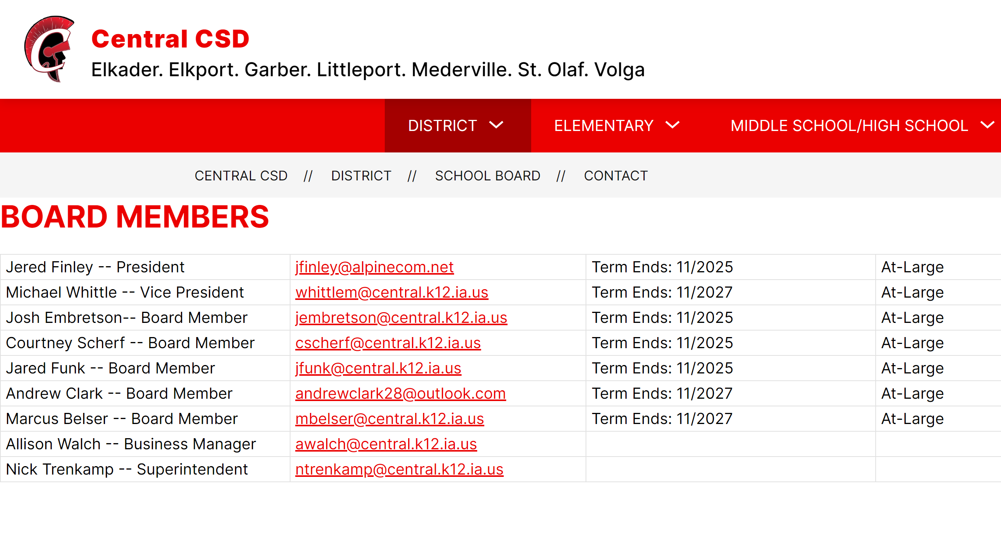
Local School Board Authority

Slide 28
Board Authority/Local Control
So many social studies, history and other curriculum bills, all dead except for the HF 2617 Pregnancy Education in the Senate (opposed) and HF 2545 Core Curriculum Study (undecided)
HF 2586 School Guards and Guns: original mandate language was removed, allowing school boards to opt out of the SRO requirement. RSAI undecided. On the Senate Calendar.
HSB 585 School Start Date: Passed the House Education Committee on Jan. 30, so survived the first funnel, but has been awaiting a new bill number ever since. RSAI supports. Dead due to the second funnel.
SF 2010 School Start Date was approved by a Subcommittee but did not advance in the Senate Education Committee. Dead by the first funnel. RSAI supports.
SF 2368 Charter Schools: Charter School funding, Open enrollment funding, and right of first refusal on school property. Division III of this bill is the start date, allowing schools to start as early as the Tuesday following the end of the Iowa State Fair. On the Senate Unfinished Business Calendar. HF 2543 is on the House Unfinished Business Calendar, but they amended the start date out of the House version in the Education Committee. Opposed but for the start date.
SF 2367 Data Collection/ Second Enrollment Count (HF 2542) on respective unfinished business calendars. Opposed.

Slide 29
Local School Board Authority and AEA changes
Media and Educational Services: SSB 3073 eliminated media/education services property taxes. HF2612 keeps $68 million in place, flows 40% through to AEAs, and lets districts retain up to 60% this first year. Changes to 100% under school district control beginning July 1, 2025. Districts could work with AEAs for up to all of the district amount, could use the funds for special education services or for any general fund purpose.
Special Educational Services: SSB 3073 gave school districts have authority over all AEA special education funding July 1 2024. HF 2612 makes no changes for July 1, 2024, requiring all special education funding going to AEAs. Allows districts to keep up to 10% in the year beginning July 1, 2025. Requires districts to work with AEAs for the 90% and requires the remaining 10% must be spent on special education services, which could be, but is not required to be, with AEAs. Prorates the $7.5 Million IC reduction. There are no changes to Early Access, Child Find, or IDEA federally-funded services. Continued deappropriations?
Task Force: HF 2612 includes an AEA Task Force of stakeholders and policymakers to review all AEA services, programs and processes and make recommendations. Will meet over the Interim and report by Dec. 31, 2024. Several parts of the AEA bill are not effective until July 1, 2025. The Task Force could recommend intervening changes.
DE Division of Special Education: SSB 3073 had a larger Division of Special Education with 139 FTEs for oversight and school improvement. HF 2612 specifies 13 FTEs in the DE’s Des Moines office and up to 40 staffed regionally, apportioned to AEAs by enrollment for compliance. Changes to AEA Staff: Various versions required termination of specific AEA staff. This final version does not. (However, reduced funding means fewer AEA staff is inevitable.)

Slide 30

Quality Preschool

Slide 31
Preschool Funding/Policy
Quality Preschool and Other RSAI Priorities: Continue to talk about the value of Quality Preschool, and Teacher and other Staff Shortages. SF 2383 Expanded Preschool is on the Senate Calendar may be in trouble due to the estimated impact of the bill on the state budget. The bill is phased in over two years, up to 1.0 weighting for students below 185% of the federal poverty level. Find Position Papers and other resources on the RSAI Advocacy website to find talking points or other resources to share when you meet with policymakers.

Slide 32
Sharing and Reorganization Incentives
Governor’s AEA bill eliminated Operational Sharing with AEAs. HF 2612 reinstates it. (undecided)
Workforce learning bill exempts college and career coordinator from 21-student limit. (supports)
SF 2105 Operational Sharing Cap (although it has been through Senate Appropriations, funnel exempt, but likely dead) on the Senate Calendar (supports)

Slide 33
Legislative Priorities Discussion: Tracking form in your packet
On your agenda see the 2024 list or on the RSAI website
https://www.rsaia.org/2024-legislative-session.html
RSAI 2024 Legislative Priorities
    1. Are there any that need to be removed?
    2. Any that need to be added?
    3. Any significant (or suggested) wording changes on those already on the list?
Small group or whole group discussion. We can go through them one at a time or consider the whole list with one vote. It’s completely up to the attendees to decide how to proceed.

Slide 34
RSAI 2025 Legislative Priorities
See the RSAI website meeting tab for more information such as RSAI Legislative Digest, Position Papers which will be updated after language is finalized during the process, Legislative Priorities, and this PPT and meeting minutes on the Regional Meeting tab. More information about the Oct. 15 Annual Meeting Coming later this Summer!
http://www.rsaia.org/

Slide 35
THANK YOU FOR YOUR VOICE on behalf of rural students!
Watch for RSAI Legislative Digest
RSAI Priority Survey later this Summer
Stay connected through the Interim
Let us know what you need to beef up your advocacy efforts.
See you at the Oct. 15 Annual Meeting!
Professional Advocate
Margaret Buckton, margaret@iowaschoolfinance.com
1201 63rd Street, Des Moines, IA 50311 (515) 201-3755 cell
Grassroots Advocate
Dave Daughton, dave.daughton@rsaia.org
(641) 344-5205

