Slide 1
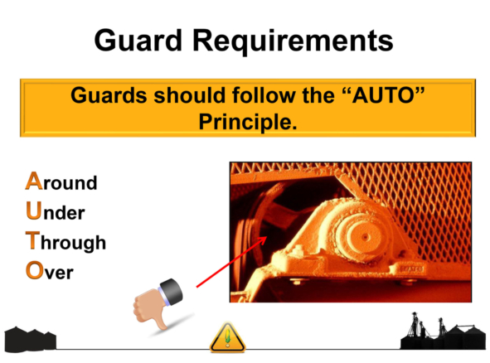
If you can reach Around, Under, Through or Over a machine guard, that machine guard is not adequate to protect you from the hazards associated with that machine.
In such cases, shut down and notify your Supervisor immediately.

