Slide 1

National Cleanup Workshop
Revitalizing WIPP’s Infrastructure
September 12, 2019
Kirk Lachman
Acting Manager, Carlsbad Field Office

Slide 2
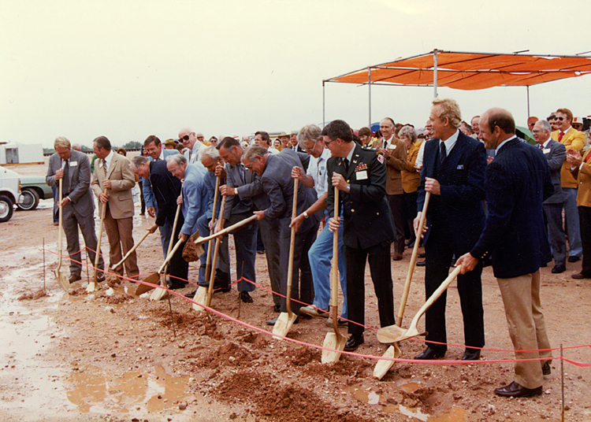
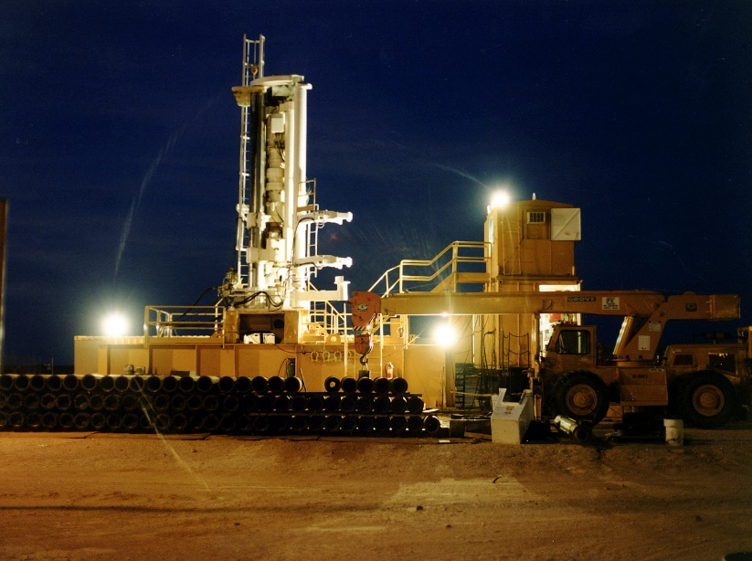
How Did We Get Here?
WIPP construction completed in 1980s
Designed as a pilot project with a 35 year operational life; decommissioning originally scheduled to begin in 2014-15
During American Recovery and Reinvestment Act, shipments were dramatically increased to an average of 20+/week
Updated TRU waste inventory shows need to keep WIPP viable to at least 2050
Groundbreaking
Sinking First Shaft

Slide 3
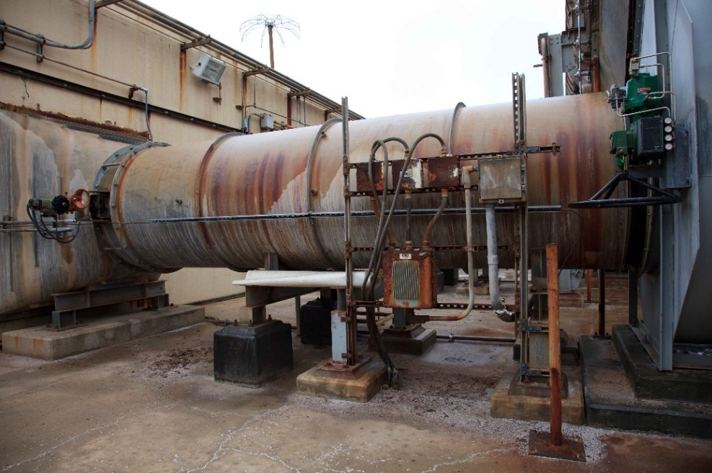
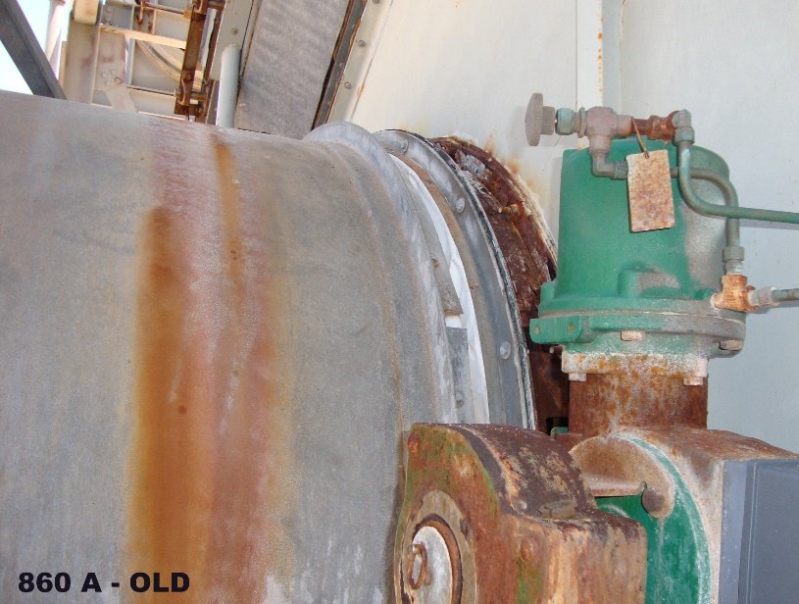
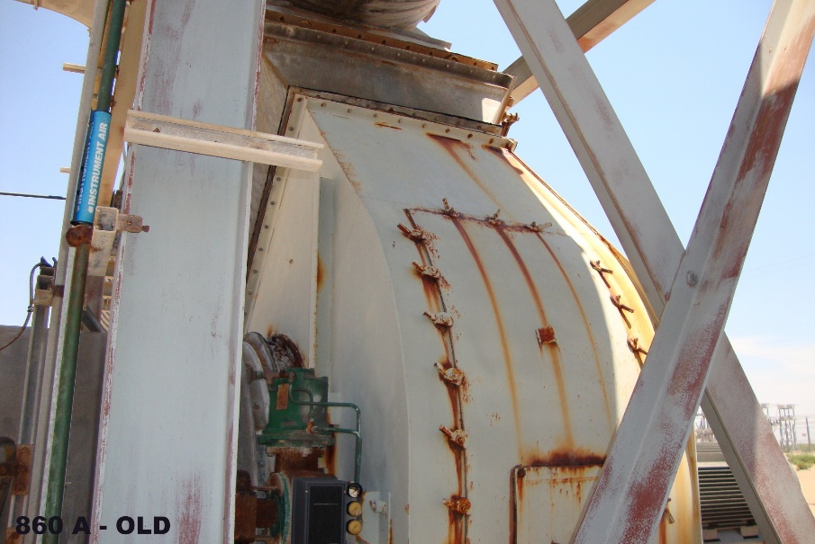
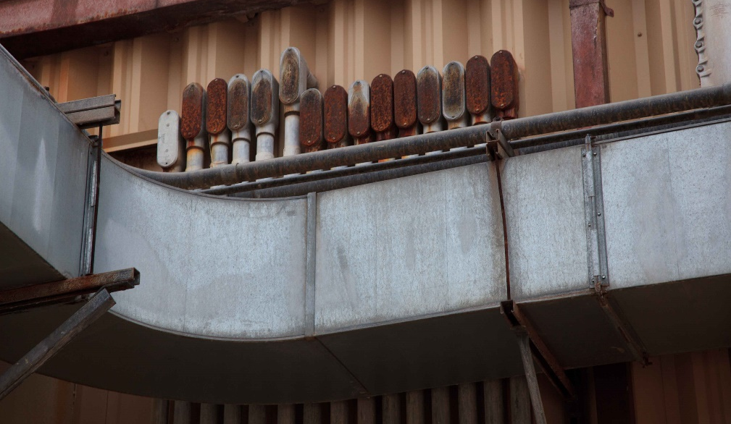
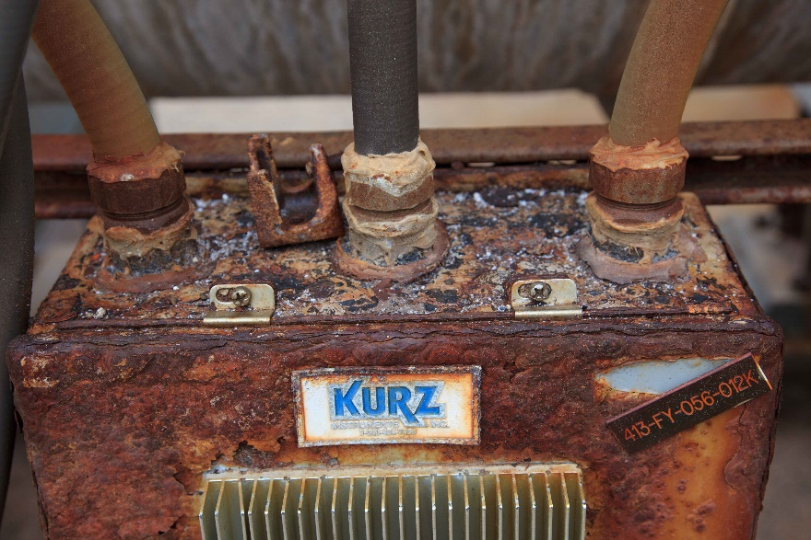
Aging Infrastructure

Slide 4
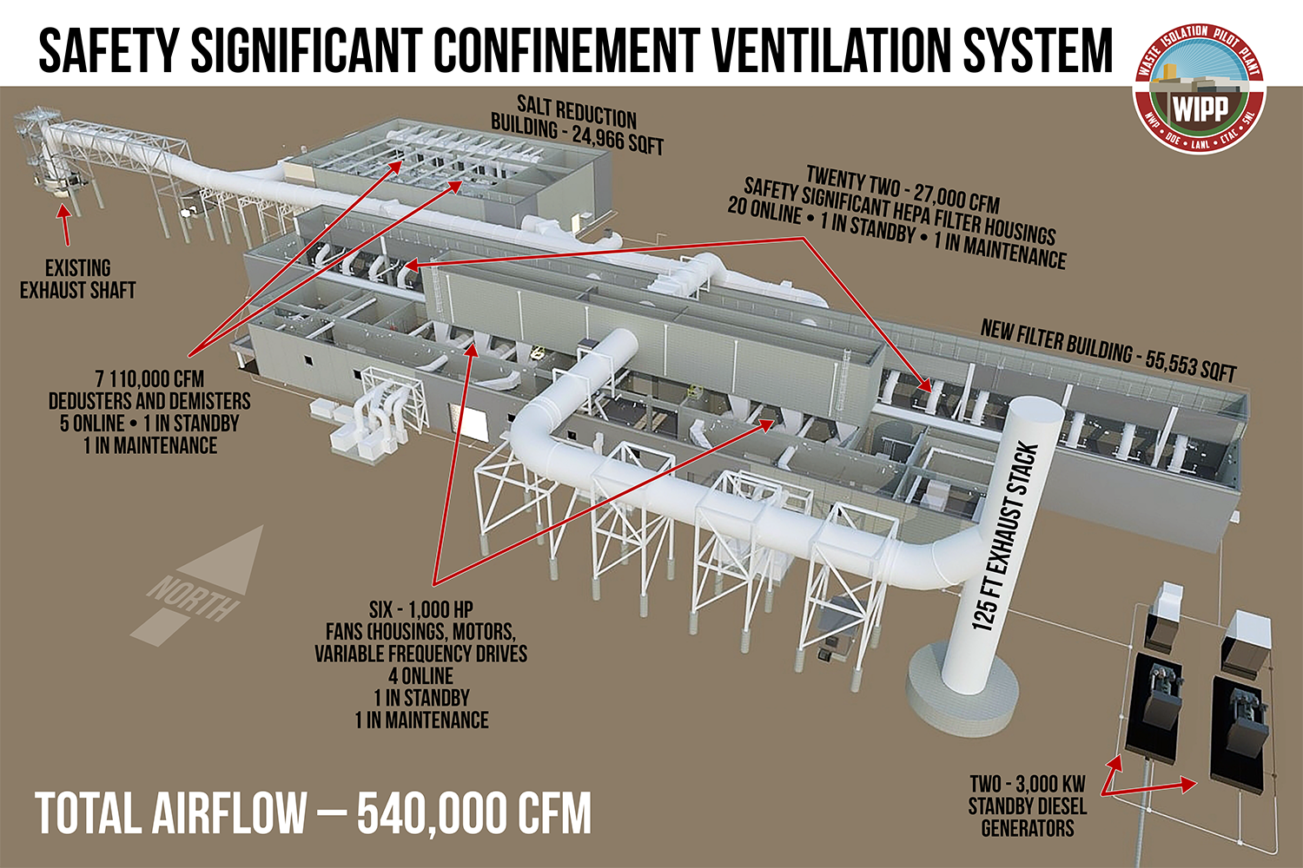
Reinvesting in WIPP’s Future
More than $500 million in capital projects
Safety Significant Confinement Ventilation System

Slide 5
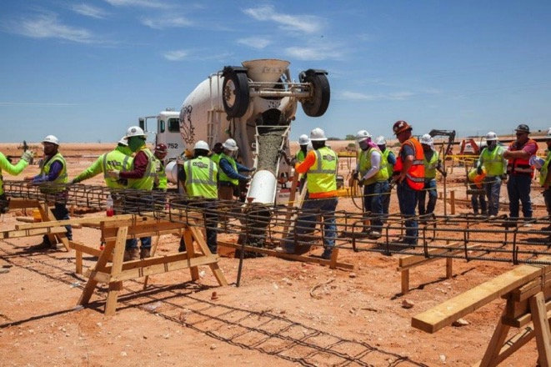
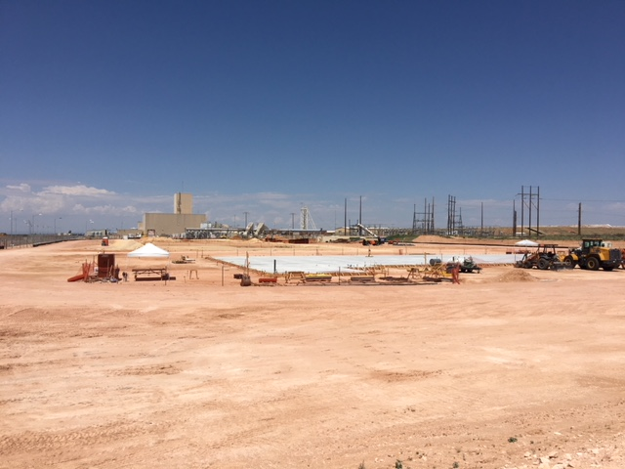
Capital Projects Status
    SSCVS Progress
  SSCVS Fabrication Assembly Building foundation slab has been poured
  Subcontractor is making preparations for steel erection
  First filter housing has successfully passed formal housing and filter banks testing
  Two diesel generators manufactured and delivered
  First de-duster components fabricated in Germany have been tested in Germany, and then sent to Grand Junction CO.
  Exhaust Fans are being fabricated in Pulaski Tennessee

Slide 6
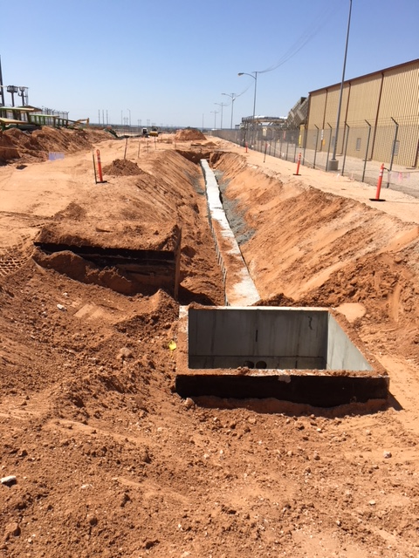
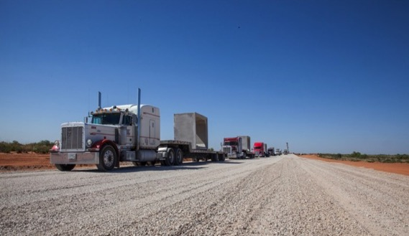
Capital Projects Status
    Utility Shaft
  Installing utility duct bank from the site to the general shaft area.
  Final grading of the 22 acre section required for the Shaft and Drifts contractor has commenced and will be completed in August
    North Access Road Bypass
  The cut and fill has been completed
  All the cattle crossings have been installed
  The City of Carlsbad has installed the water line valves and thrust blocks

Slide 7
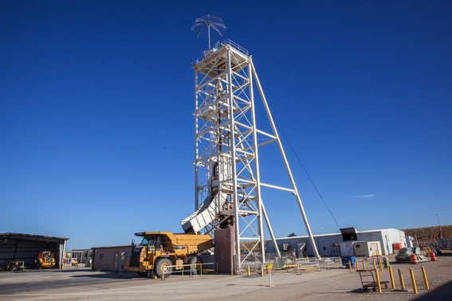
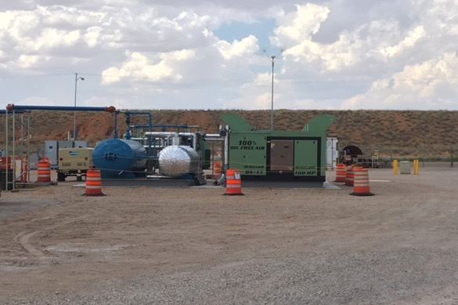
General Plant Projects
Replacement air compressors
Salt hoist repair
Underground substation replacement
Substations 1 & 3 Replacement
Above Ground Airline Replacement
WIPP Site Fire Loops
Phases 1-4
Central Monitoring Room Upgrades
Notes:
Compressors are installed along with the majority of the electrical and mechanical hook-ups. Work is continuing and will be turned over to Operations by the end of August for start-up.
Salt Hoist PUR Package has been approved by CBFO and vender award is complete
Substations 1&3 -PUR Package has been approved by CBFO and the order placed
Above Ground Airline - PUR Package has been approved by CBFO and contract has been awarded. Construction will begin by the end of this FY
Fire Loop – First part of Phase 3 has begin installing new section of pipe. NWP will execute a contract in early FY20 to hydro-excavate all of Phase 3 to determine underground interferences and then issue an RFP.
CMR – PUR Package has been approved by CBFO, long lead procurements have been made.

Slide 8
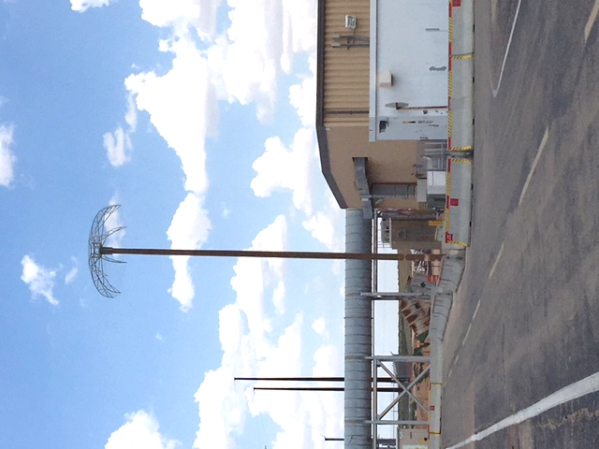
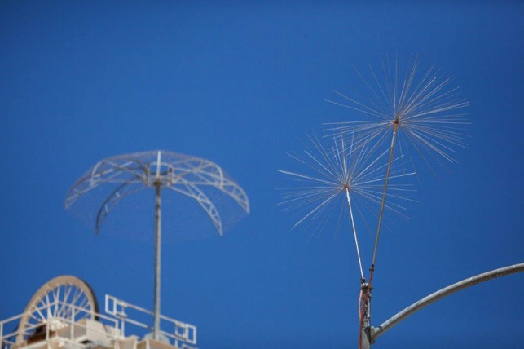
General Plant Projects
Site Infrastructure Backbone Upgrade
Lightning Array Upgrade
Safety Significant Fire Suppression Design
Public Address System
Upgrade Design
Hybrid Bolter Purchase
Notes:
Site Infrastructure Upgrade – PUR Package approved by CBFO and contract placed, initial installations will commence before the end of the current FY.
Lightning Array – Lifting plans are being developed for buildings and hoists
Building 411/412 – The 90% design was completed on August 27 and another meeting was held. When the 100% design is completed an SOW and ICE will be prepared.
Public Address System – Conceptual design of the PA system replacement has began. The preliminary design is to be completed by the end of the current FY.

Slide 9
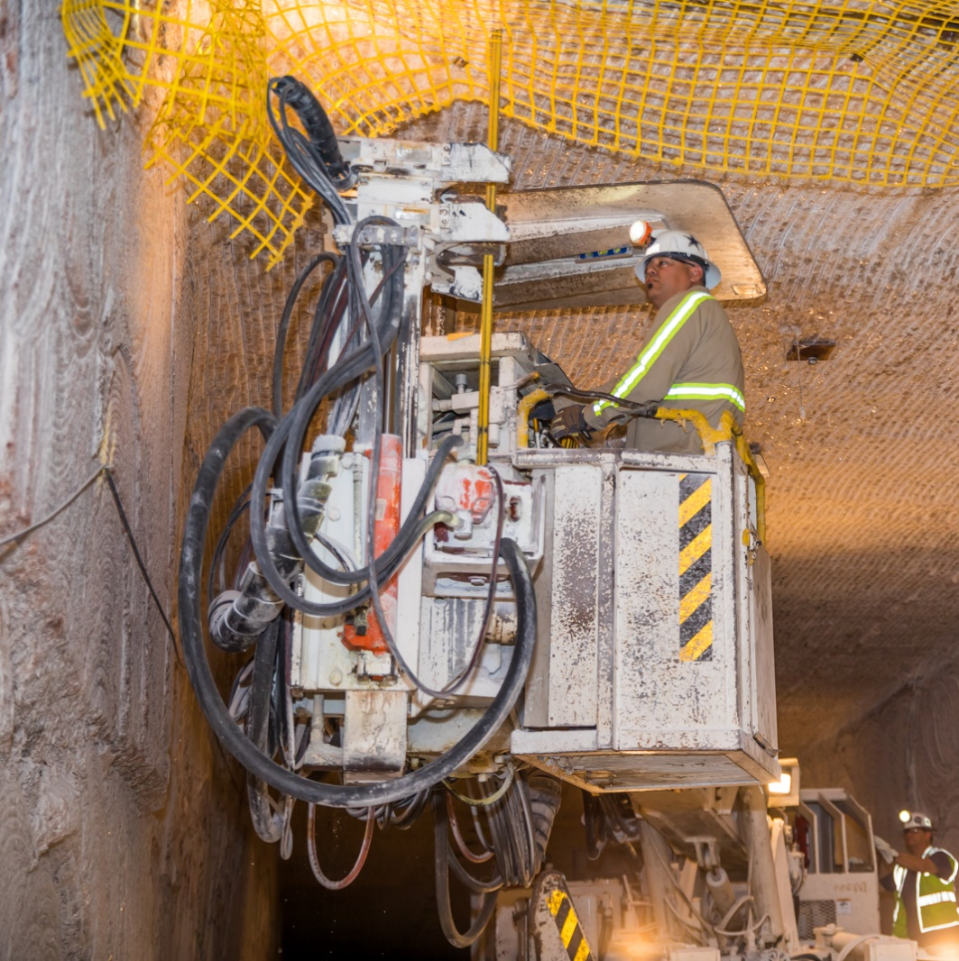
Improving Underground Infrastructure
WIPP underground operations personnel were unable to perform ground control for almost 9 months after the 2014 events
It took several months of catchup bolting to return to steady state ground control
Moving toward use of battery-electric or Tier IV final (low emissions) diesel powered vehicles

Slide 10
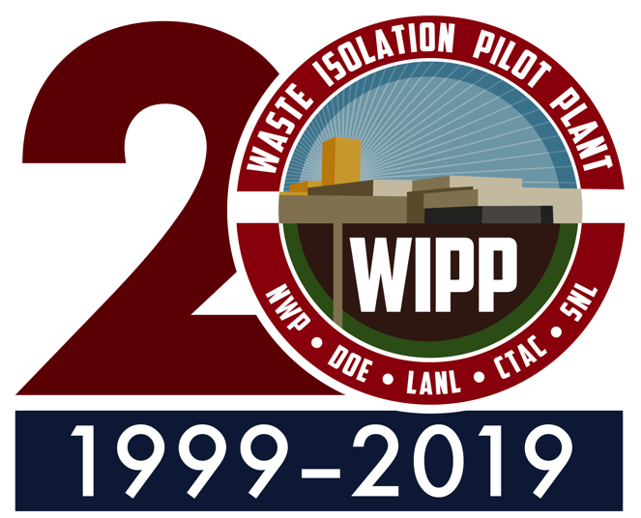
Conclusion
Reinvesting in WIPP’s infrastructure allows DOE to complete TRU waste cleanup
We are continuing to move forward in order to complete our important mission
We are also looking for ways to modernize WIPP

Slide 11
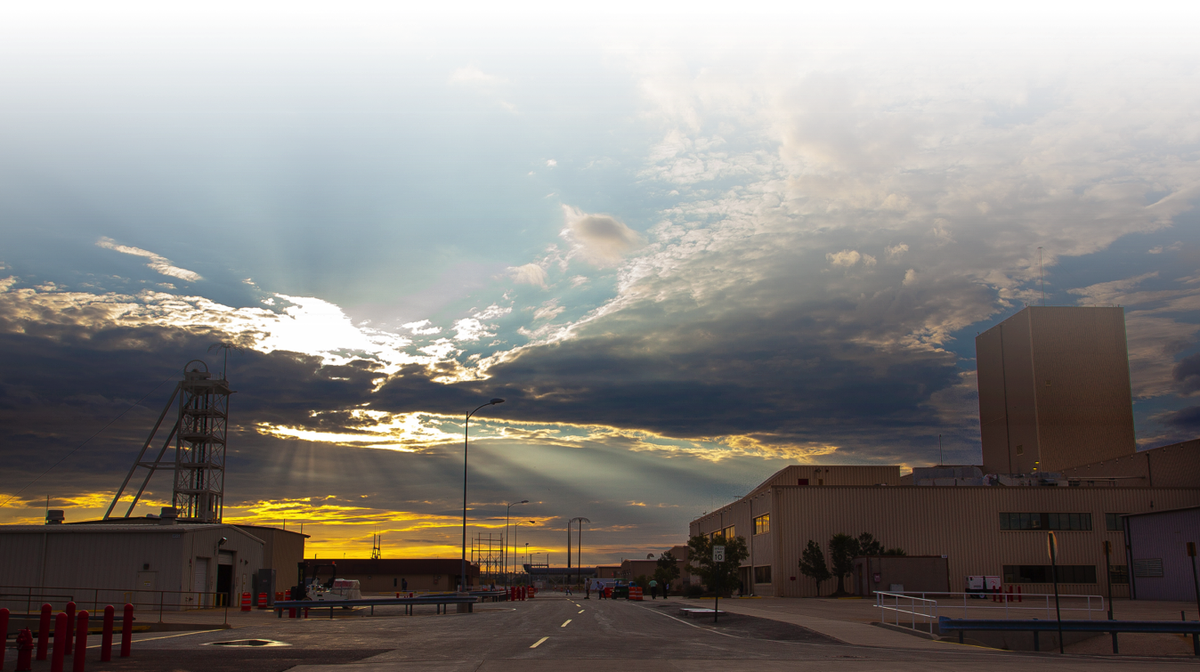
Questions?

