Slide 1
Provider Enrollment:
How It Works and
Best Practices
Office of Developmental
Programs

Slide 2
PROVIDER ENROLLMENT 101
OBJECTIVES:
    Our goal here today is to review the enrollment process.
    Review the use of CLS in the licensing process.
    Provide an overview of the revalidation process and share our helpful tips on getting your sites revalidated on time.

Slide 3
Changes coming to Provider Enrollment
Our current process is “paper-based” and includes multiple steps that can lead to delays in PROMISe enrollment.
The new process will be paperless, which will allow you to digitally transmit your site information and verifications, which ultimately will help reduce processing time.

Slide 4
BECOMING A PROVIDER
Notes:
Hand out full page version
This flow chart includes the steps required to become enrolled.
To Begin you complete HCSIS REGISTRATION;
>Complete the steps for VERIFICATION;
>Register for APPLICANT ORIENTATION SESSION;
>Complete and submit the MA PROVIDER AGREEMENT;
>Obtain a LICENSE, if applicable;
>Obtain CERTIFICATE OF SUCCESSFUL COMPLETION OF APPLICANT ORIENTATION
>QUALIFY;
>Complete PROMISe™ ENROLLMENT
>Complete and submit MONITORING FOR NEW PROVIDERS TOOL
We are going to explore a few of these steps in greater detail in the next few slides.

Slide 5
GETTING STARTED
Notes:
◆ Point out and read the highlighted boxes.
The Applicant will receive a ‘Getting Started’ e-mail. It initially refers the Applicant to the following tools:
Review 55 PA Code Chapter 51 Regulations. A thorough understanding of these regulations is essential for all providers to ensure that business practices and program operations are compliant with the regulations.
Review Consolidated & Person/Family Directed Support (P/FDS) Waivers
The waivers are located on DHS Website under the ODP tab
Approved Consolidated Waiver Renewal
Approved Person/Family Directed Support Waiver Renewal
Review ODP’s Services Definitions which are located in the Consolidated and P/FDS Waivers and within the “Individual Support Plan (ISP) Manual for Individuals with an Intellectual Disability” under Section 12: Waiver and Base Administrative Services and Section 13: Waiver Services. The waiver services section will provide you with more information about the waiver eligible services offered through ODP. A review of the service definitions is essential for all providers to determine which services your organization is willing and qualified to provide.

Slide 6
Information for New Providers
ODP’s Provider Enrollment Unit will send you our new provider informational email to help get you started. It has information regarding our agency, a tip sheet to help you register in HCSIS, and the updated ISP Manual.
It also has links to more information regarding the waivers. Please review all information before starting the application process.

Slide 7

HCSIS REGISTRATION
Notes:
An Applicant must access ODP’s electronic web-based system, HCSIS, for the provider access screens to complete your registration process.
HCSIS is an online, web-based secure system that stores a lot of information including but not limited to demographic information, provider organizational information, and service/location data for services provided under ODP and other program offices in the Department of Human Services (DHS). HCSIS is also where incident management and provider qualification is completed and Individual Support Plans (ISPs) are stored. Providers must be enrolled in HCSIS in order to provide Home and Community-Based Services to individuals in Pennsylvania and receive payment for those services. HCSIS is also used to record information about providers of services funded and/or licensed by ODP and other offices within the Pennsylvania Department of Human Services (DHS). Only providers that have signed-up, been determined qualified and have selected the appropriate services in HCSIS will be eligible to provide and receive payment for services.

Slide 8
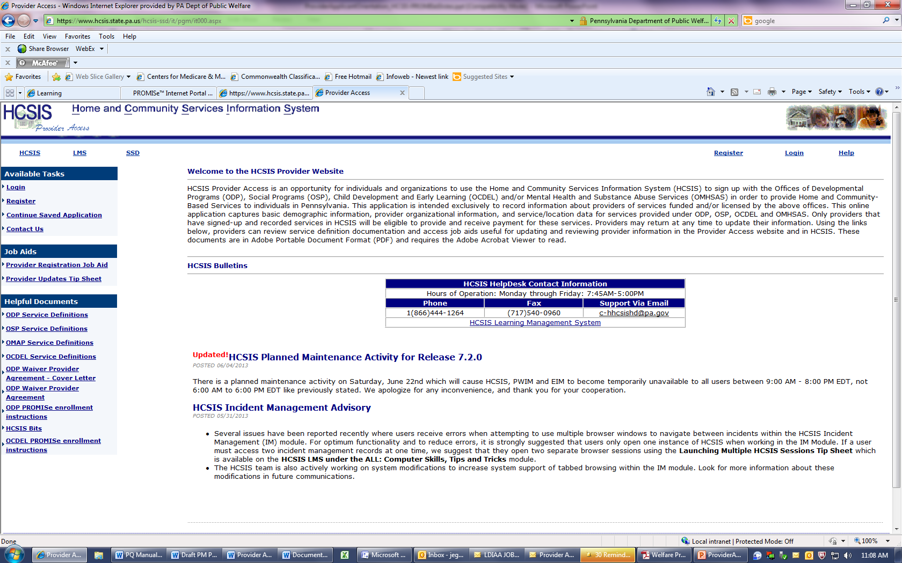
HCSIS REGISTRATION
Notes:
The next step in the ODP Provider Enrollment Process is “Complete Registration Process in HCSIS.” New providers will need to first register in HCSIS to participate in the waivers and base funded services.
ODP will not approve any new provider’s registration in HCSIS until the applicant has demonstrated successful completion of this Orientation.
The applicant registers in HCSIS via the Provider Access subsystem.
The Provider Registration Job Aid provides step-by-step instructions to enter a provider’s information into HCSIS for the first time.
When providers have decided on the services they intend to render, they can proceed with the HCSIS registration process. Enter HCSIS website, www.hcsis.state.pa.us and click on the box entitled “Provider Access”. Providers must review the “Provider Registration Job Aid” that is linked on the left side of the provider access page as these will assist providers with the initial registration process into HCSIS.
To complete the provider registration process, providers will need certain data that uniquely identifies the individual or the organization being represented. Examples of such data include the Federal Employer Identification Number (FEIN), Social Security Number (SSN) and Department of State Entity Number. The identification data entered into HCSIS will be used to establish the unique identity and Master Provider Index (MPI) number of the organization in the system. HCSIS maintains records of information the provider enters such as the services the provider offers as well as the sites where those services will be performed. The provider will also receive a Service Location ID Code (SLC) for each of the physical service location addresses used by the provider depending on the provider type. st time.

Slide 9
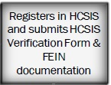
HCSIS VERIFICATION
Notes:
The HCSIS Verification Form should be completed by new agencies or individual direct service providers who are registering in HCSIS for the first time.
After the provider completes the registration process in HCSIS, ODP is responsible for what is called HCSIS verification. HCSIS verification is the action taken by ODP to validate changes made to provider information located in Provider Access, which is where the provider’s registration profile is located. Applicants must click the “Submit Application” button in order for their application to be processed.
HCSIS verification is required for both applicants registering for the first time and existing providers who make changes to their existing provider information. Applicants must submit documentation to validate their Federal Employer Identification Number (FEIN) or Social Security Number (SSN). The documentation must be from the Internal Revenue Service (IRS) to verify the FEIN and a copy of the individual’s Social Security Card to verify the SSN.
During the initial verification process, providers should pick only one provider type* and one specialty code to be verified for one physical location/address.
A provider’s HCSIS registration will remain in pending status until the verification process is completed.
Once the verification process is completed, the applicants registration profile or the changes to an existing provider’s registration profile becomes active in HCSIS and an MPI# is assigned.
Review Informational Packet #022-13 to understand the HCSIS Verification process.
* A Provider Type is the classification of a provider. The Provider Type also represents a subset of related services. For example: a Therapist provider type can provide occupational therapy, physical therapy, and speech and language therapy. Other provider type examples include provider type 51 which represents Home and Community Habilitation and provider type 53 which represents Employment – Competitive). The Provider Type is used in both HCSIS and PROMISe™.

Slide 10
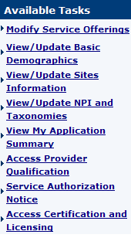
HCSIS PROVIDER ACCESS
The sidebar on the Provider Access screen contains additional options for each of the main areas of Provider Access.
Links to Provider Qualification and Certification and Licensing System information can be accessed from this sidebar.
This sidebar will be available after you log in to HCSIS through Provider Access.
Notes:
The Provider Access section is where applicants who wish to provide services for ODP can begin the registration process.
There is a variety of information which can assist with the registration and enrollment process. [See Resource Section in Attachment 2]

Slide 11
HCSIS VERIFICATIONS
Please send your HCSIS change forms and IRS verifications directly to the ODP Enrollment Unit.
Fax to: (717)783-5141
Email to: ra-odpproviderenroll@pa.gov
Notes:
New change in process.

Slide 12
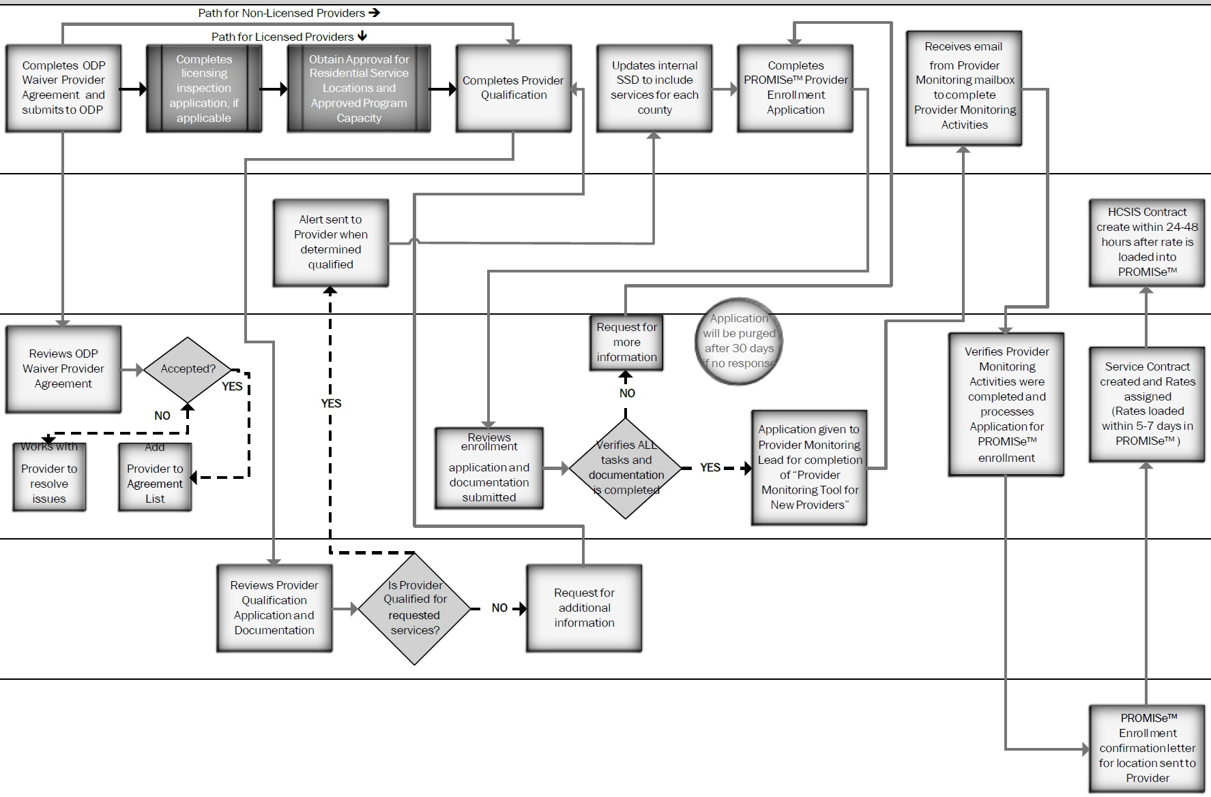
WAIVER PROVIDER AGREEMENT
Notes:
After the Master Provider Identifier (MPI) number is assigned, all waiver providers should complete and sign the ODP Waiver Provider Agreement. The ODP Provider Agreement must be on file with ODP before ODP will process a provider’s PROMISe™ enrollment application. The AE must also verify that the ODP Provider Agreement has been signed so that the provider can be qualified. The Agreement must be signed by the Provider CEO.
The ODP Waiver Provider Agreement is an agreement held between ODP and the provider listing the responsibilities that the provider must complete. This document is available on-line via HCSIS (www.hcsis.state.pa.us) under the ODP Program Links section and is entitled “ODP Waiver Provider Agreement.” The cover letter is also located in this area and is entitled “ODP Waiver Provider Agreement – Cover Letter.” The instructions for how to submit the agreement are included in the cover letter.

Slide 13
PROVIDER AGREEMENT
Please complete and submit the Provider Agreement either by Mail or as an attachment via email to : ra-odpprovideragreem@pa.gov
Please make sure your Provider name and information matches exactly to your registration.

Slide 14
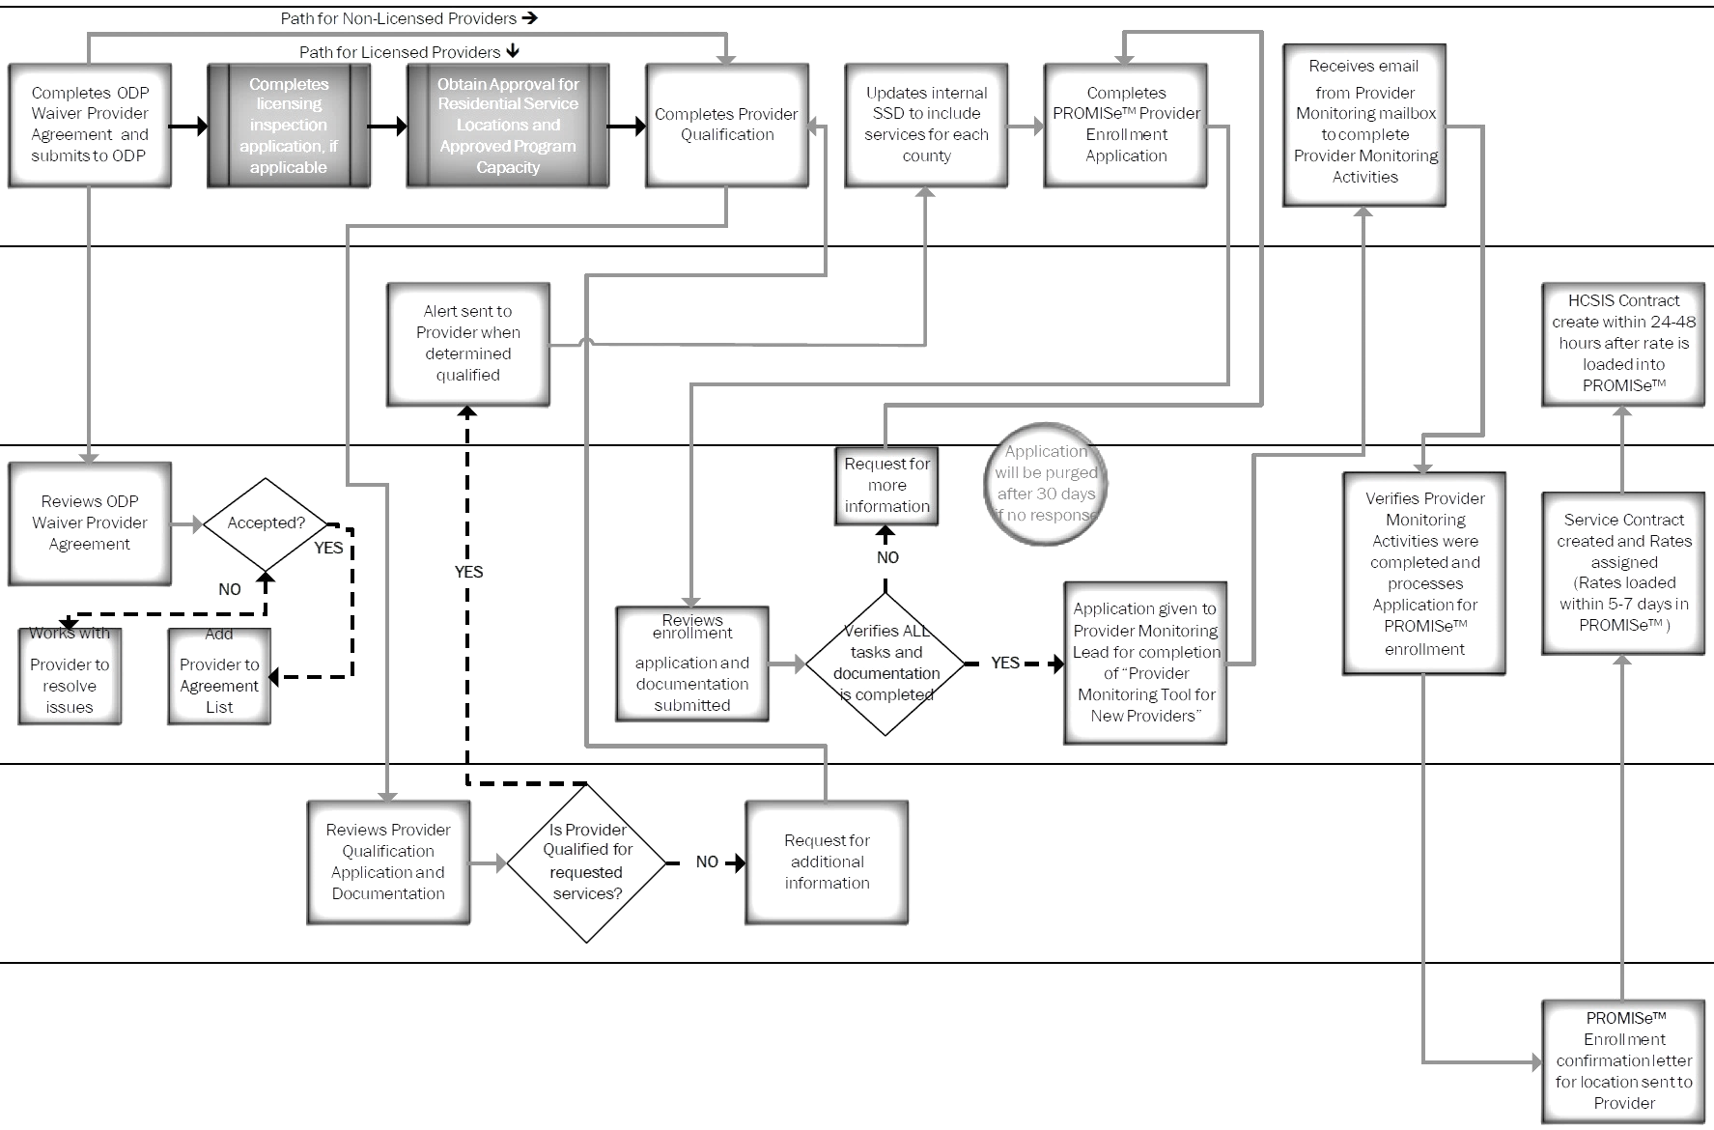
LICENSING
Notes:
The applicant should review the service definitions to determine if the service they intend to provide requires a license by the Department. On July 1, 2012, the Department of Human Services [DHS] Consolidated licensing functions previously administered in several DHS program offices into a single administrative Bureau of Human Services Licensing [BHSL] within the Department’s Office of Administration.
ODP approves the Residential Service Locations and approved program capacity [APC] or setting size for every residential habilitation setting.
Go to the DHS website to view the BHSL Manual.

Slide 15
The Human Services Licensing Process: Using the Certification Licensing System (CLS)
Oct. 20, 2015

Slide 16
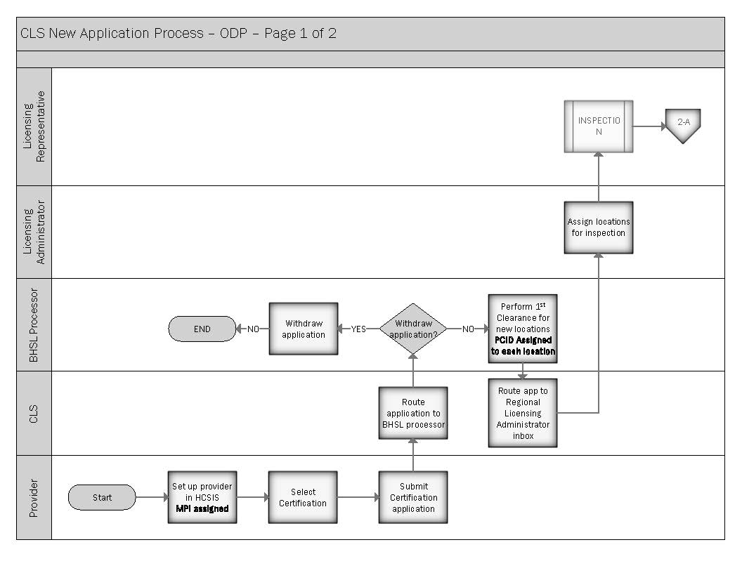
New Application
Notes:
BHSL Processor – this is a headquarters person who receives the applications in the system, processes them either by LIBRA or regular process and pushes them to the Regional Licensing Administrator. This person also receives the transmittal packets back end of the system and processes the finalized packets to the provider.
Regional Licensing Administrator – receives the application from the BHSL Processor and depending on the app type can assign them to the Cert. Rep or themselves since this person also has a Cert Rep role. This role assigns applications and approves transmittal review items and plans of correction. This role is also able to submit applications that are needed.
Certification Rep: is assigned the application from the RLA, they schedule the inspection, complete the inspection, send the LIS to the provider for a POC. Approve the POC and create a transmittal review item and push to the RLA for approval. This role also has the ability to create applications if needed.

Slide 17
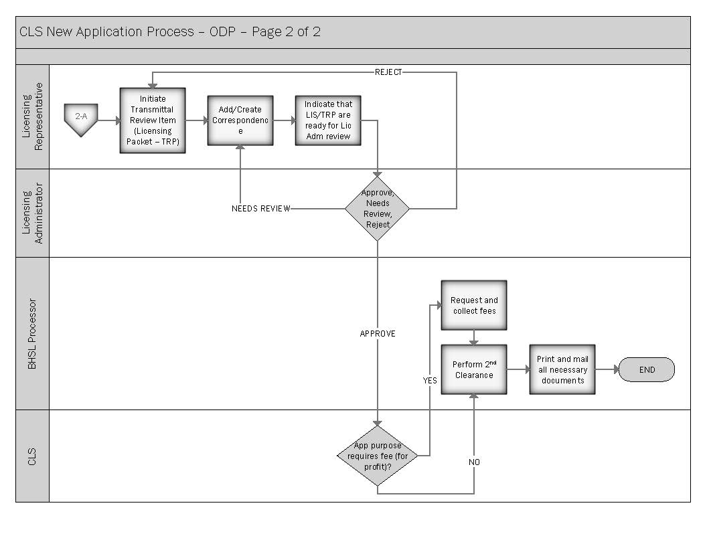
New Application

Slide 18
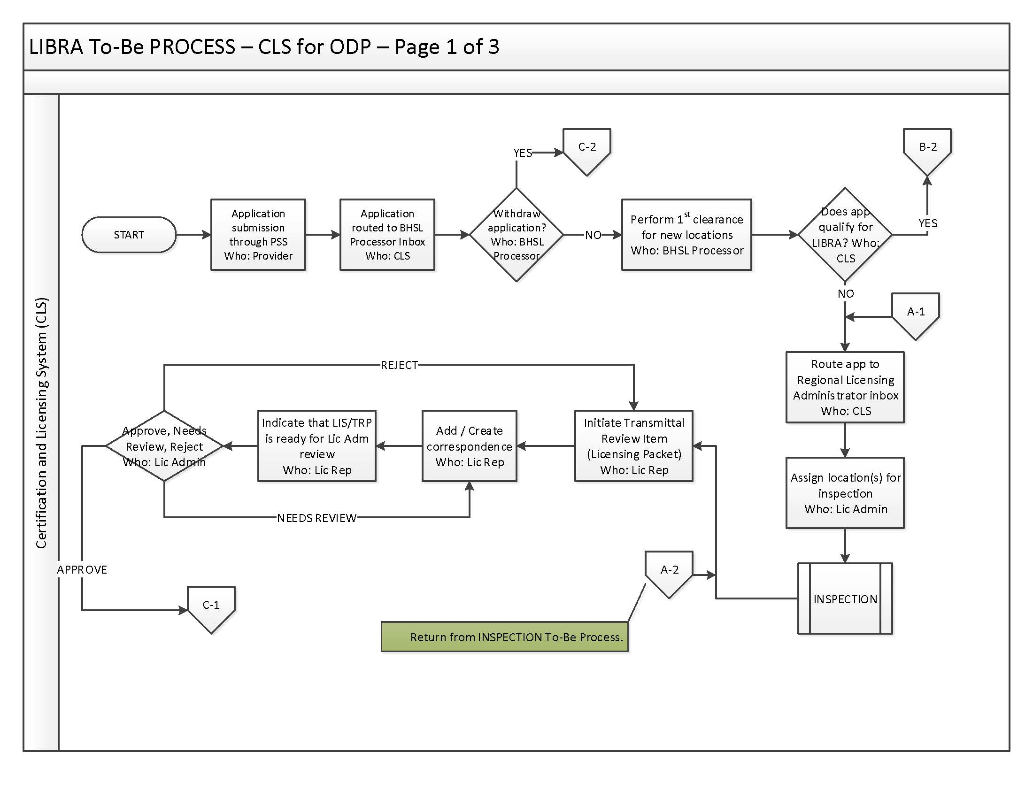
LIBRA Process

Slide 19
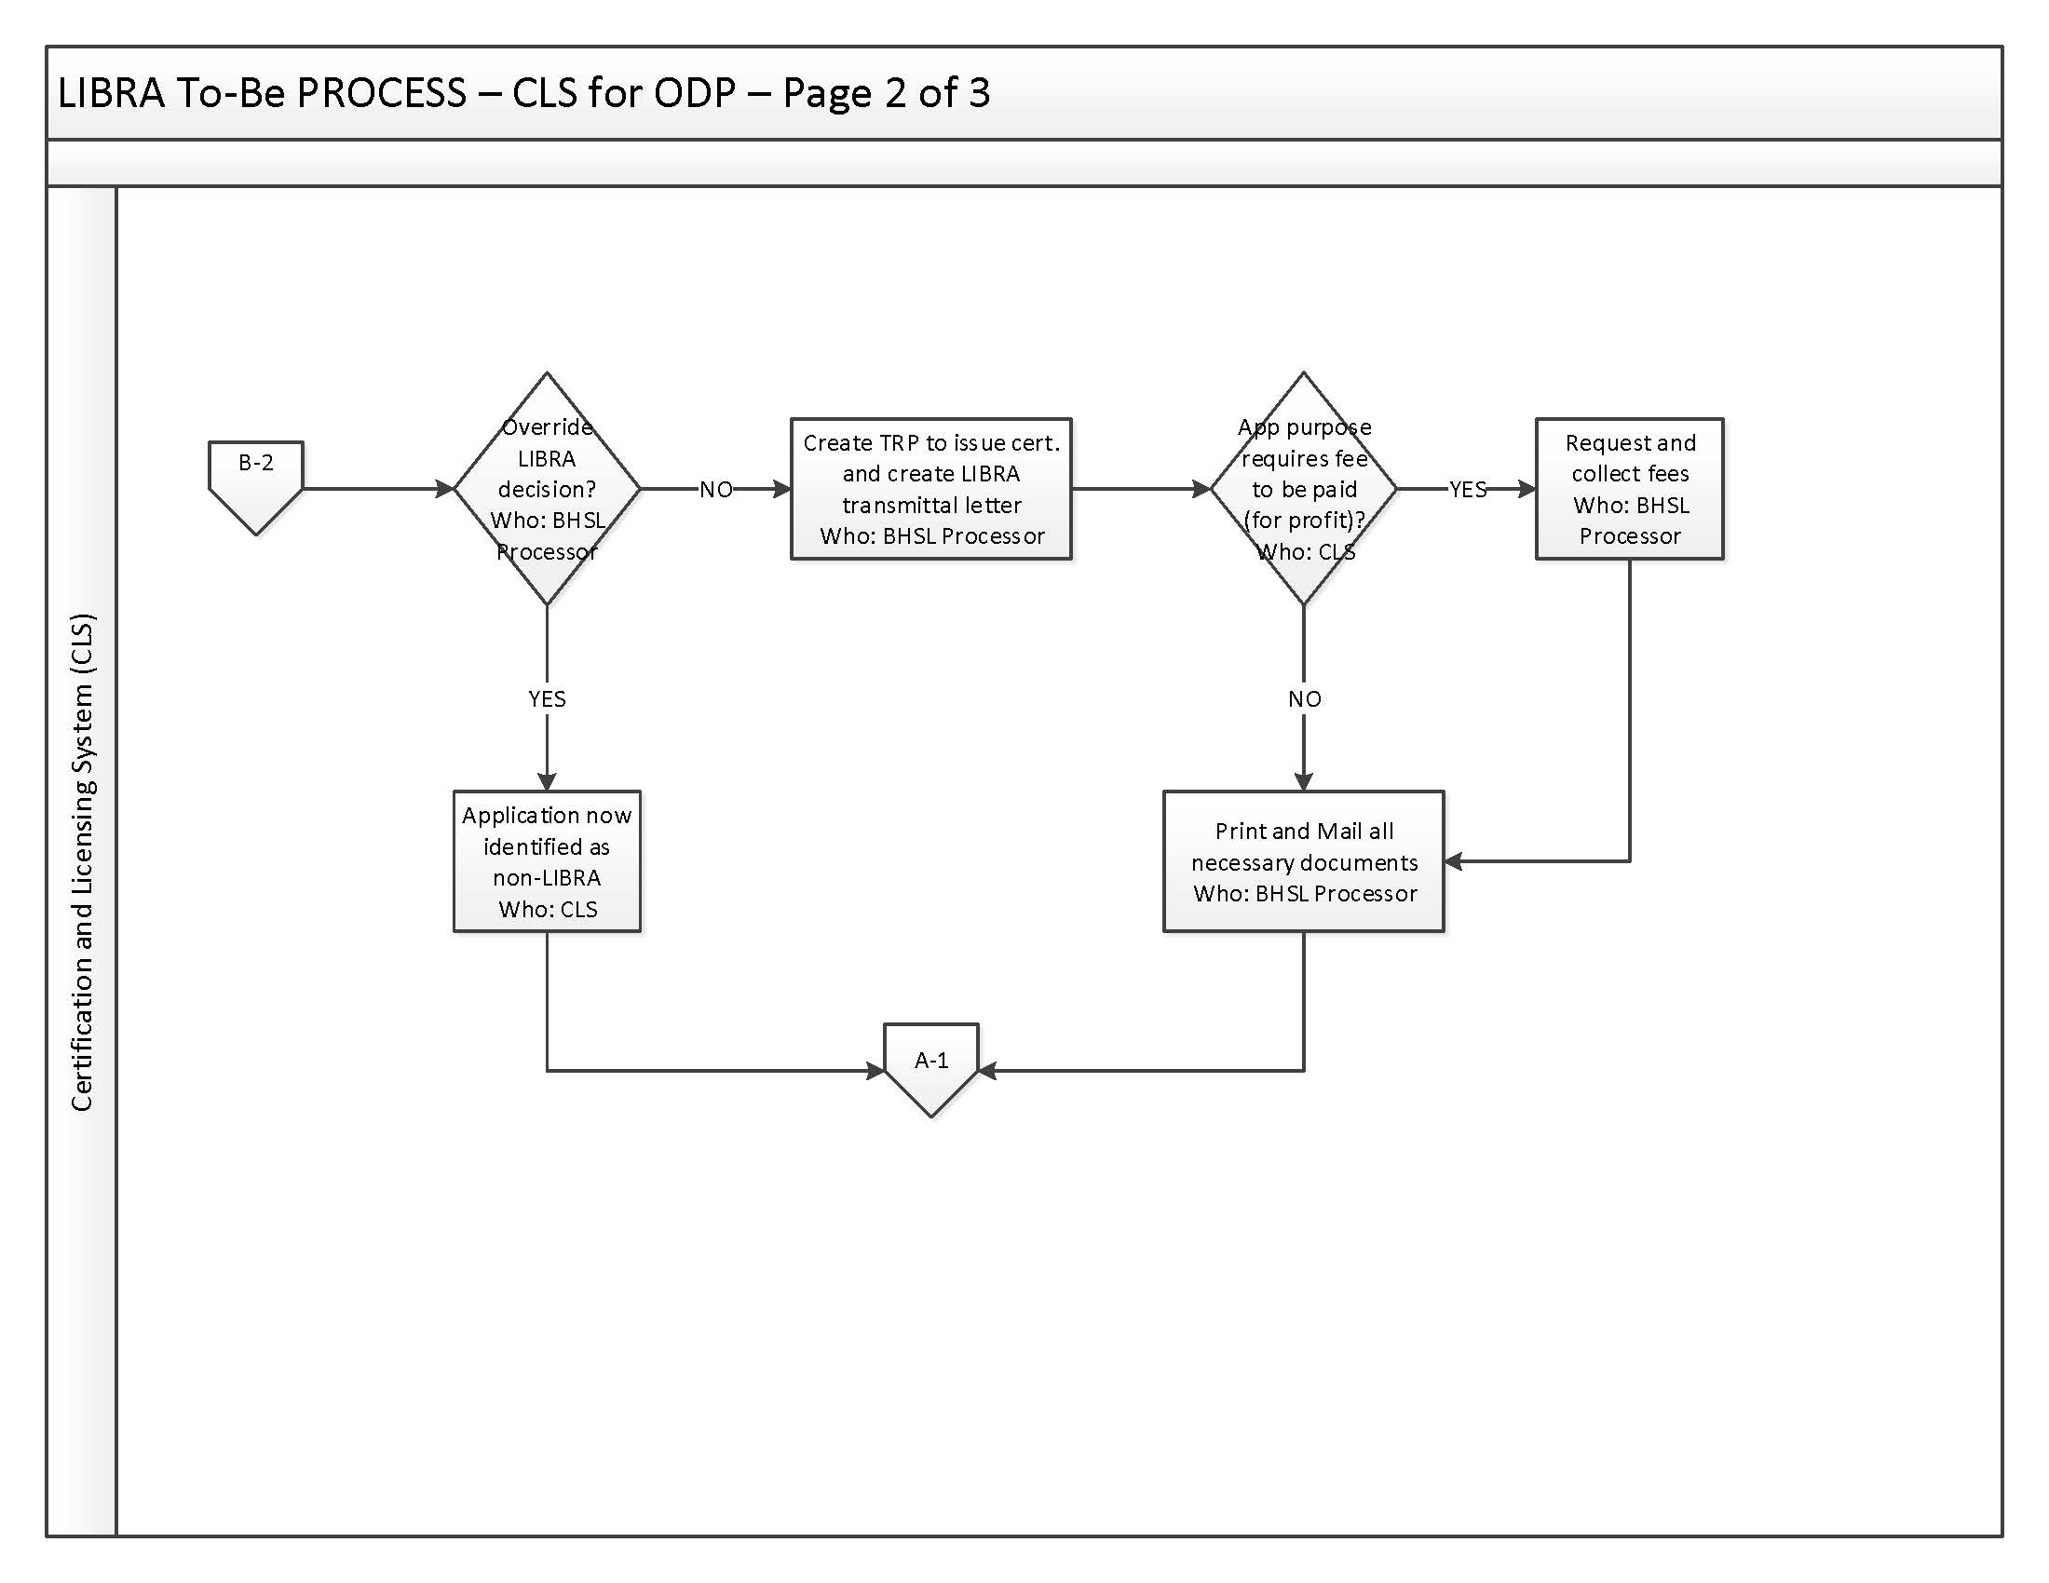
LIBRA Process

Slide 20
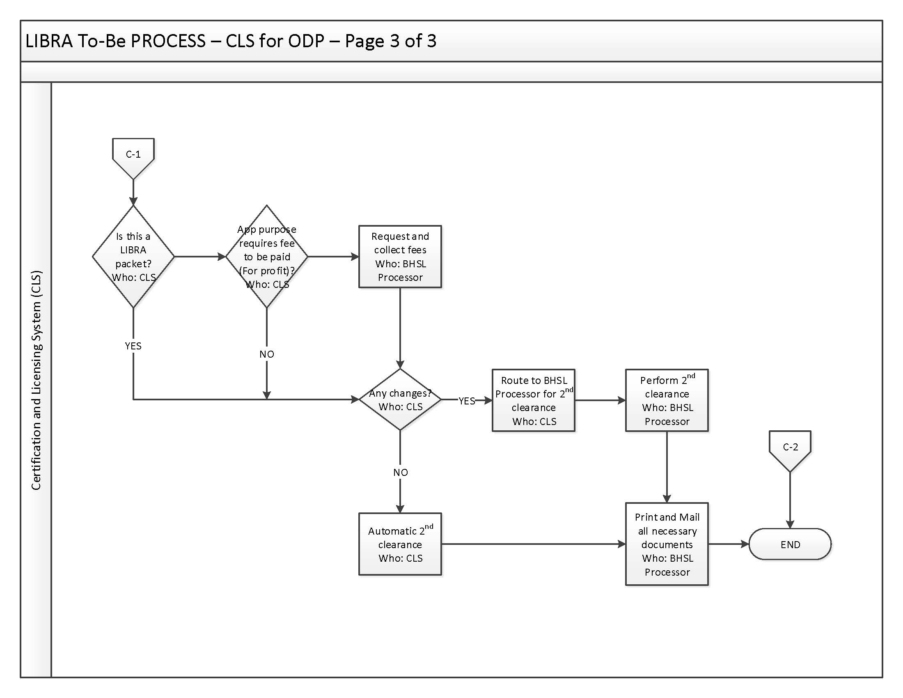
LIBRA Process (cont.)

Slide 21
Application Types:
Every action that occurs in CLS is application based. The only exception to this is the closure of a location. Closures occur by contacting your regional office (we prefer that you put the request in writing/email for tracking purposes). Regional licensing staff will close the location in the system.
Open-operate a new location – this application type is only for use when creating a new agency for Chapter 6400 (Community Home) or 6500 (Family Living) or for opening a new Chapter 2380 (Adult Training Facility) or Chapter 2390 (vocational facility). This application is not to add a satellite location to your existing license.

Slide 22
Renew location certification – This application is used to renew an existing License for all regulated chapters 6400, 6500, 2380, 2390.
Change of facility name - This application is not for Legal entity changes. Changing a location name.
Change in name of operator – this application is used to change the name of the CEO or responsible person listed on your applications.
Change of facility postal address – This would be used for postal office changes like 911 address changes.

Slide 23
Change of profit or non-profit status – This is only used when you agency changes it profit/non-profit status which is typically a legal entity change and would require an open operate new instead of change in profit status app. Rarely used.
Increase or decrease in facility capacity- This application is used for Chapter 2380 and 2390 to increase their capacity and to increase the capacity of a location for Chapter 6400 and 6500. You would complete a self-inspection packet along with completing this application type. Mail or email the self-inspection packet to BHSL headquarters.

Slide 24
Add addendum to certificate – this is Only used for Chapter 6400 and 6500 for adding a new location to an existing certificate of Compliance.
Change provider type – This application would not be used for ID licensing.
When submitting an application, you can multi-select app reasons. You can do a renewal with the change in name of operator, etc. You cannot use the multi-select option when using Add Addendum to Certificate.

Slide 25
Addendum applications
When adding a location to an existing Certificate, you first need approval from the waiver capacity manager in ODP that the location is non-contiguous.
Register the location in HCSIS.
Complete a self-inspection form.

Slide 26
ACCESS CLS THRU HCSIS

Slide 30
PSS HOME SCREEN

Slide 31
PSS HOME SCREEN

Slide 32
PLAN OF CORRECTIONS

Slide 33
PLAN OF CORRECTION

Slide 35
UPCOMING RELEASES
  Stop processing of new app when another app is in progress. You will only be able to have one app in the system at a time.
  Certification Application Get Started Page – Out-of-State Providers
  Error when exceeding text limit in free-form test fields in PSS
  PROMISe changes due to ACA requirements.

Slide 36
PROVIDER QUALIFICATION
Notes:
All providers must be determined qualified prior to rendering waiver services. The Provider Qualification Process ensures providers meet the qualification criteria outlined in the waivers for each service. The procedures to become qualified can be found in ODP Informational Packet #104-12 “Clarification and Changes to Provider Qualification Requirements”
The qualification process begins with an biennial application that each provider must complete in HCSIS. Regardless of the number of counties/AE’s in which the provider is planning to render services only one qualification application is required.
ODP delegates the qualifying of providers to the AEs. Providers are qualified by the Lead AE, the AE where the Provider serves the most individuals.
For new providers, the Lead Qualifying Administrative Entity (AE) is the AE responsible for services in the geographical area where the provider intends to offer services. The Lead Qualifying AE is responsible to collect and review qualification documentation and make a determination of whether or not the provider meets Qualification Standards. The Provider is responsible to submit required documentation to the Lead AE.
Throughout the qualification period, providers may access the system to change their application data or request an expansion of specialties by submitting Update applications.
ODP also established State regulations requiring all Consolidated and P/FDS Waiver providers to participate in the statewide qualification process prior to rendering services to waiver participants and every 2 years thereafter to ensure that they continue to meet Waiver requirements.
Please contact your lead AE or the ODP Provider Qualification mailbox at ra-odpproviderqualif@pa.gov with questions regarding the qualification process.

Slide 37
QUALIFICATIONS
PROVIDER QUALIFICATIONS
Consistent Standards & Requirements
Opportunity for Willing Providers
Biannual Requalification
Participant Choice of Providers
Statewide Availability of Qualified Providers
Notes:
ODP’s standardized provider qualification process was designed to ensure the following objectives:
Provide consistent qualification standards so that Consolidated and P/FDS Waiver participants and family members can make informed decisions about the selection of qualified providers;
Afford all interested providers with the opportunity to apply for qualification, and if they meet the qualification criteria, enroll as Consolidated and P/FDS Waiver service providers with ODP.
Promote statewide availability of qualified providers for participants in ODP’s Consolidated and P/FDS Waivers.
Ensure consistency with federal Medicaid Waiver requirements regarding participant choice of willing and qualified providers.

Slide 38
QUALIFICATIONS
STEP 1
An Applicant notifies the AE in which the applicant plans to serve the most waiver participants
STEP 2
The applicant completes the provider qualification application in HCSIS
STEP 3
The applicant sends all necessary supporting documentation to the Lead AE
STEP 4
The AE reviews the application and documentation and determines if the applicant is qualified or contacts applicant for further information
Notes:
Once you have completed HCSIS registration, verification, Applicant Orientation and Licensing, if applicable, you will initiate your Qualifications with the Lead AE in the following sequence:
Step 1
Once the applicant is registered, the applicant selects only the services that it plans to offer through Provider Access.
All applicants access the Provider Qualification application in HCSIS after determining which services they want to provide.
In the application, applicants should ensure that they select the county/AE in which they intend to serve the most waiver participants.
Step 2
The applicant may begin a Provider Qualification Application in HCSIS by following the path Provider > Qualification > Application.
When completing the application, the applicant will select the county that will need to review the application. Currently, this is the county where the applicant intends to serve the majority of people with services.
Once the applicant has completed the online application, they will be prompted to send all necessary supporting documentation to the attention of the Provider Qualification Lead at the Lead AE.
STEP 3
The supporting documentation needed for each service is detailed on the ODP Consolidated and Person/Family Directed Support Waiver Provider Qualification Documentation Requirements chart in ODP Informational Packet 104-12.
STEP 4
Applicants can view their qualification status in HCSIS;
Applicants will receive alerts in HCSIS whenever the status of the provider qualification application is updated. These alerts are available only when logged into HCSIS; click on the Alerts link on the homepage or by using the following path: Tools > Alerts > Pending Alerts and then use the search feature.
Providers need to keep track of their biennial qualification date so they know when to re-qualify. They will also be notified with an alert 60 days prior to qualification expiration that qualifications will be expiring. Providers are able to submit their qualification application in HCSIS 60 days prior to qualification expiration date. Providers should use this time to start gathering the supporting documentation that will be needed to complete the application. If an application is not submitted 30 days prior to the expiration of the provider’s qualifications, another alert will be received.
Without being qualified, services may not be rendered. And, failure to maintain a “Qualified” status for the services provided may result in a denial of service payment.

Slide 39
PROMISE ENROLLMENT
  The provider must complete the following actions before a PROMISe™ enrollment application is submitted
  ODP Provider Agreement
  HCSIS Registration
  Provider Qualification
  Service Location Code
Notes:
To complete the enrollment process, an Applicant must:
Ensure an ODP Waiver Provider Agreement is on file with ODP.
Ensure they have been determined qualified by their respective AE for the service they intend to enroll
Applicants must ensure their physical service location has been registered in HCSIS
Providers must validate their four digit service location code has been verified in HCSIS.
If the service the provider intends to provide requires a license, licensing must take place before the PROMISe™ provider enrollment application is submitted.
In some situations, additional requirements need to be met [See Info Packet 055-12]
A rate for a service cannot be applied until the entire enrollment process is complete. This includes receiving your enrollment confirmation letter for the service location code from PROMISe™.

Slide 40
PROMISE ENROLLMENT
Notes:
Effective July 1, 2009, ODP implemented the Prospective Payment System (PPS). This initiative requires all providers who participate in the ODP waiver and base programs to bill services rendered through the department’s Medicaid Management Information System (MMIS) called the Provider Reimbursement and Operations Management Information System in Electronic Format (PROMISe™).
New providers cannot be enrolled in PROMISe™ until after they become qualified. Because payment for waiver services is through PROMISe™, providers cannot bill for waiver services nor can they be authorized on ISPs until after the PROMISe™ enrollment has been completed.
ODP will notify providers once their enrollment is complete. When providers receive this notice, ODP recommends that they notify all AEs in which they plan to provide services that they are now eligible and may now be selected as a provider of choice.
Again, services may not be rendered until qualifications, Provider Monitoring for New Providers, Applicant Orientation, PROMISe™ enrollment are complete and the AE has approved and authorized in the ISP.

Slide 41
PROMISe Provider Enrollment App
Please download the application from the DHS website. As we implement the ACA regulations, the application form will be updated. When applying please use this link http://www.dhs.state.pa.us/provider/promise/enrollmentinformation/index.htm
In an effort to expedite processing of applications, we review all applications once. If it is incomplete or missing documentation, you will receive a rejection notice detailing the corrections required before reapplying.

Slide 42
PROMISe™
The reason for PROMISe™ Enrollment
To enable the claims processing system (PROMISe™) to recognize you as an active provider.
To receive a rate for reimbursement for the services enrolled
To enable ODP providers to successfully submit claims into the claims processing system.
To enable PROMISe™ to validate that your provider type and specialty are permitted to perform the service or services when submitting claims through PROMISe™.
Notes:
PROMISeTM is the claims processing system for Medical Assistance (MA) claims.
Providers of Home and Community-Based Services submit claims through PROMISeTM for payment reimbursement.
PROMISeTM stores rates and interfaces with other ancillary systems to pull in provider and recipient information that is used during claims processing.
PROMISeTM enrollment is completed after providers register in HCSIS and have been determined qualified.
It is critical that provider information in both HCSIS and PROMISeTM matches exactly because during claims processing, PROMISe™ interfaces with HCSIS to validate that the information submitted on the claim is aligned with the information stored in HCSIS.
The following information is validated during claims processing: the individual, provider, service, units, rate, service dates, and waiver/program eligibility.
It is the provider’s responsibility to ensure their data matches in both systems. If the 2 systems are out of sync, the provider will risk a delay in payment. Each system is independent of one another so they must be maintained independently as well.
Updating HCSIS does not automatically update PROMISeTM.

Slide 43
BECOMING A PROVIDER
What does this mean for you as a prospective provider?
  Registration, orientation, licensure (if applicable), qualifications, monitoring and PROMISe™ enrollment are all pre-requisites to the final approval for the applicant to begin to offer services.
  Due to the complexity of the process and depending on departmental priorities and provider responsiveness, ODP registration and PROMISe™ enrollment can take from 30-90 days to complete, dependent upon provider responsiveness.
  Applicants must be aware of the complexity of the ODP ID system and be prepared to assure compliance with all federal and state regulations.
  Qualifications and Provider Monitoring are immediately applicable.
Notes:
◆ Request additional responses from participants

Slide 44
NEW PROCESS- PROPOSED
As you process through the online application, you will select the Program offices and waivers you wish to apply for. Each department will receive a copy of your application as applicable.
You will able to scan and attach the requested documents as you complete each sections requirements.
You will be able to pause and save your application as you work on it. It will cancel your work if you do not complete your application and submit it within 30 days.

Slide 45
NEW PROCESS- PROPOSED
The System will automatically generate:
Confirmation when you submit the application.
Notice of any corrections that need made on your application, such as missing information or documentation.
You will receive a reminder to make your corrections and resubmit the corrected application before the application expires.
Notice that your application is approved or rejected.

Slide 46
NEW PROCESS - PROPOSED
Licensing will be incorporated into the online application as a step prior to final submission of the application
You will be able to view the status of your application using your login ID.
Providers will have an opportunity to make corrections and resubmit the corrected application online.

Slide 47
REVALIDATIONS
Please review MA Bulletin 99-14-06 for complete information on revalidations.
Please check all your sites in PROMISe to see the date the site is due for revalidation. Please use this link www.promise.dhs.state.pa.us
Please review the site and include all the specialties you require on the application.

Slide 48
REVALIDATIONS
You will use the same application for revalidations and new site enrollments.
IF you need to close the site because it is no longer used or needed, please do so now. It is one less site to revalidate. You can always reopen the site at a later time should you need to.
We are requesting special attention to detail on the applications you complete. Include all requested documentation with each site application. Please make sure your licenses are not expired.

Slide 49
REVALIDATIONS
Our agency is requesting the revalidation applications be mailed to our office to reduce handling time and allow us to focus on reviewing and processing your applications.
Please mail them to:
      Office of Developmental Programs/ ID Services
      Attention: Provider Enrollment
      Room 413 Health and Welfare Building
      625 Forster Street
      Harrisburg, PA 17120

Slide 50
PLEASE RETURN YOUR REVALIDATION APPLICATIONS TO OUR OFFICE NO LATER THAN 12/31/2015

Slide 51
REVALIDATIONS
Our goal is to complete your revalidations on time.
Any questions regarding your applications and revalidations can be sent to:ra-odpproviderenroll@pa.gov . Please include your MPI#, the service location, and any other helpful details in your email to help us assist you better.

Slide 52
Questions
QUESTIONS AND ANSWERS?
Contacting BHSL:
Email: RA-pwarlheadquarters@state.pa.us
Phone: 1-866-503-3926

