Slide 1
The Academy at Greenfield Central
INSSWA presentation

Slide 2
BREATHE…...
https://safeshare.tv/x/ss6075d783a32bc

Slide 3
Who we are
Alternative education program within Greenfield Central Schools
Students in grades 11-12th
Students at risk of not graduating due to one of the reasons below:
At risk of dropping out
Failure to meet credit requirements
Pregnant or parenting teen
2 teachers, 1 social worker
One lead teacher (specializing in Math and Science)
Additional teacher (specializing in English and History)

Slide 4
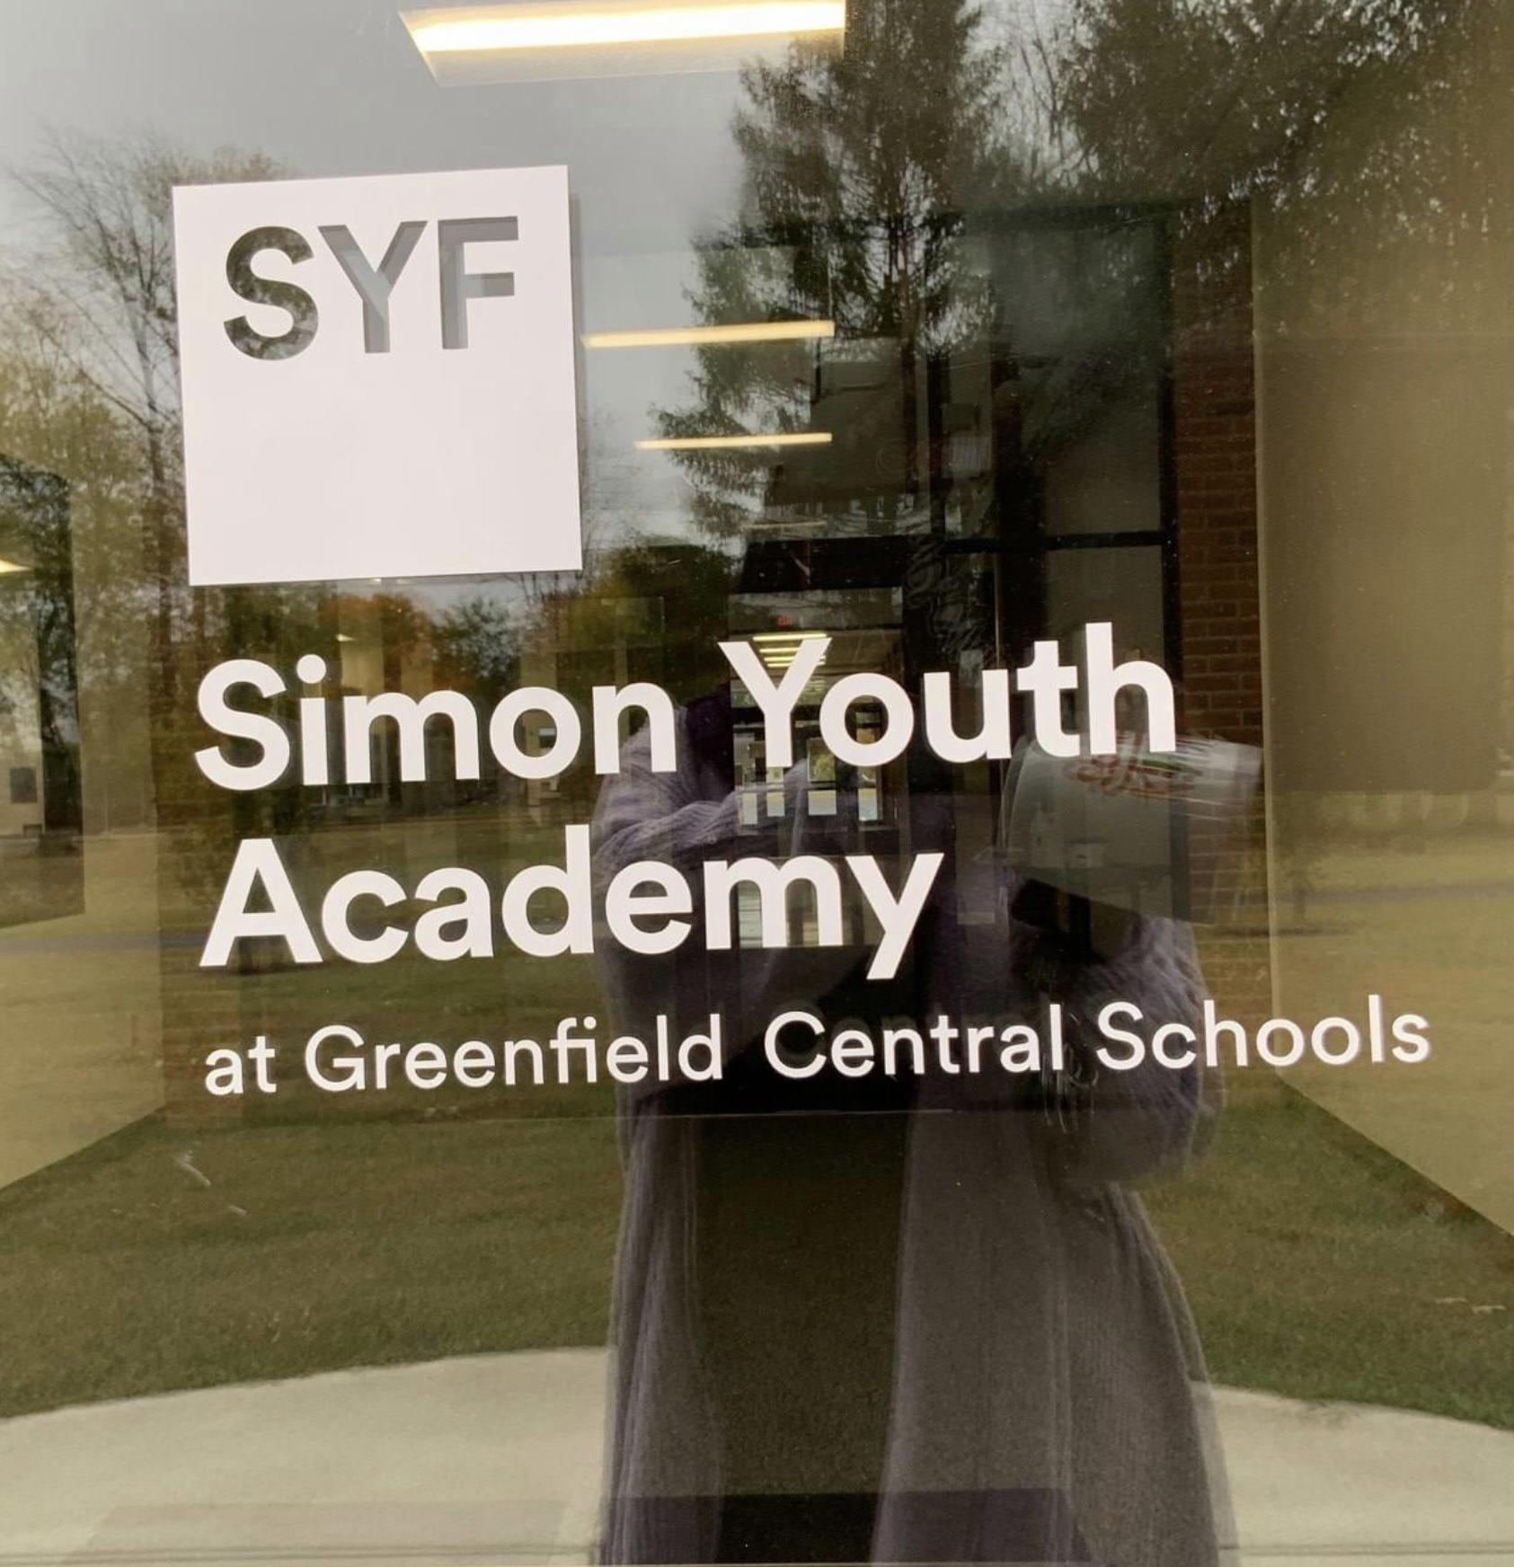

Slide 5
Simon Youth Academy
This is our first year as a Simon Youth Foundation (SYF) academy
Annual scholarship opportunities
Connected to 42 SYF Academies (7 in Indiana)
Professional Development (monthly and annually)
Enhancement grants
Graduation support

Slide 6
Program Overview
A walk as an Academy Student

Slide 7
Hello! I’m Jazmine

Slide 8
Taylor is a junior at Greenfield Central High School.
She struggles with attendance due to high levels of anxiety which prevent her from coming to school regularly.
Taylor’s short bio:
Lives with mom and younger brother (parents divorced when she was in grade school)
Has 11 credits (she should have 20-30 at this point in her academic career)
She has missed 25 days of school
She has a documented anxiety disorder and takes medication for the disorder

Slide 9
Jazmine’s Referral Process
Counselor referral
Family interview w/Academy lead teacher
Review of program expectations
Selection of AM/PM class
Setting up Edgenuity classes
Providing a Chromebook from the Academy tech library

Slide 10
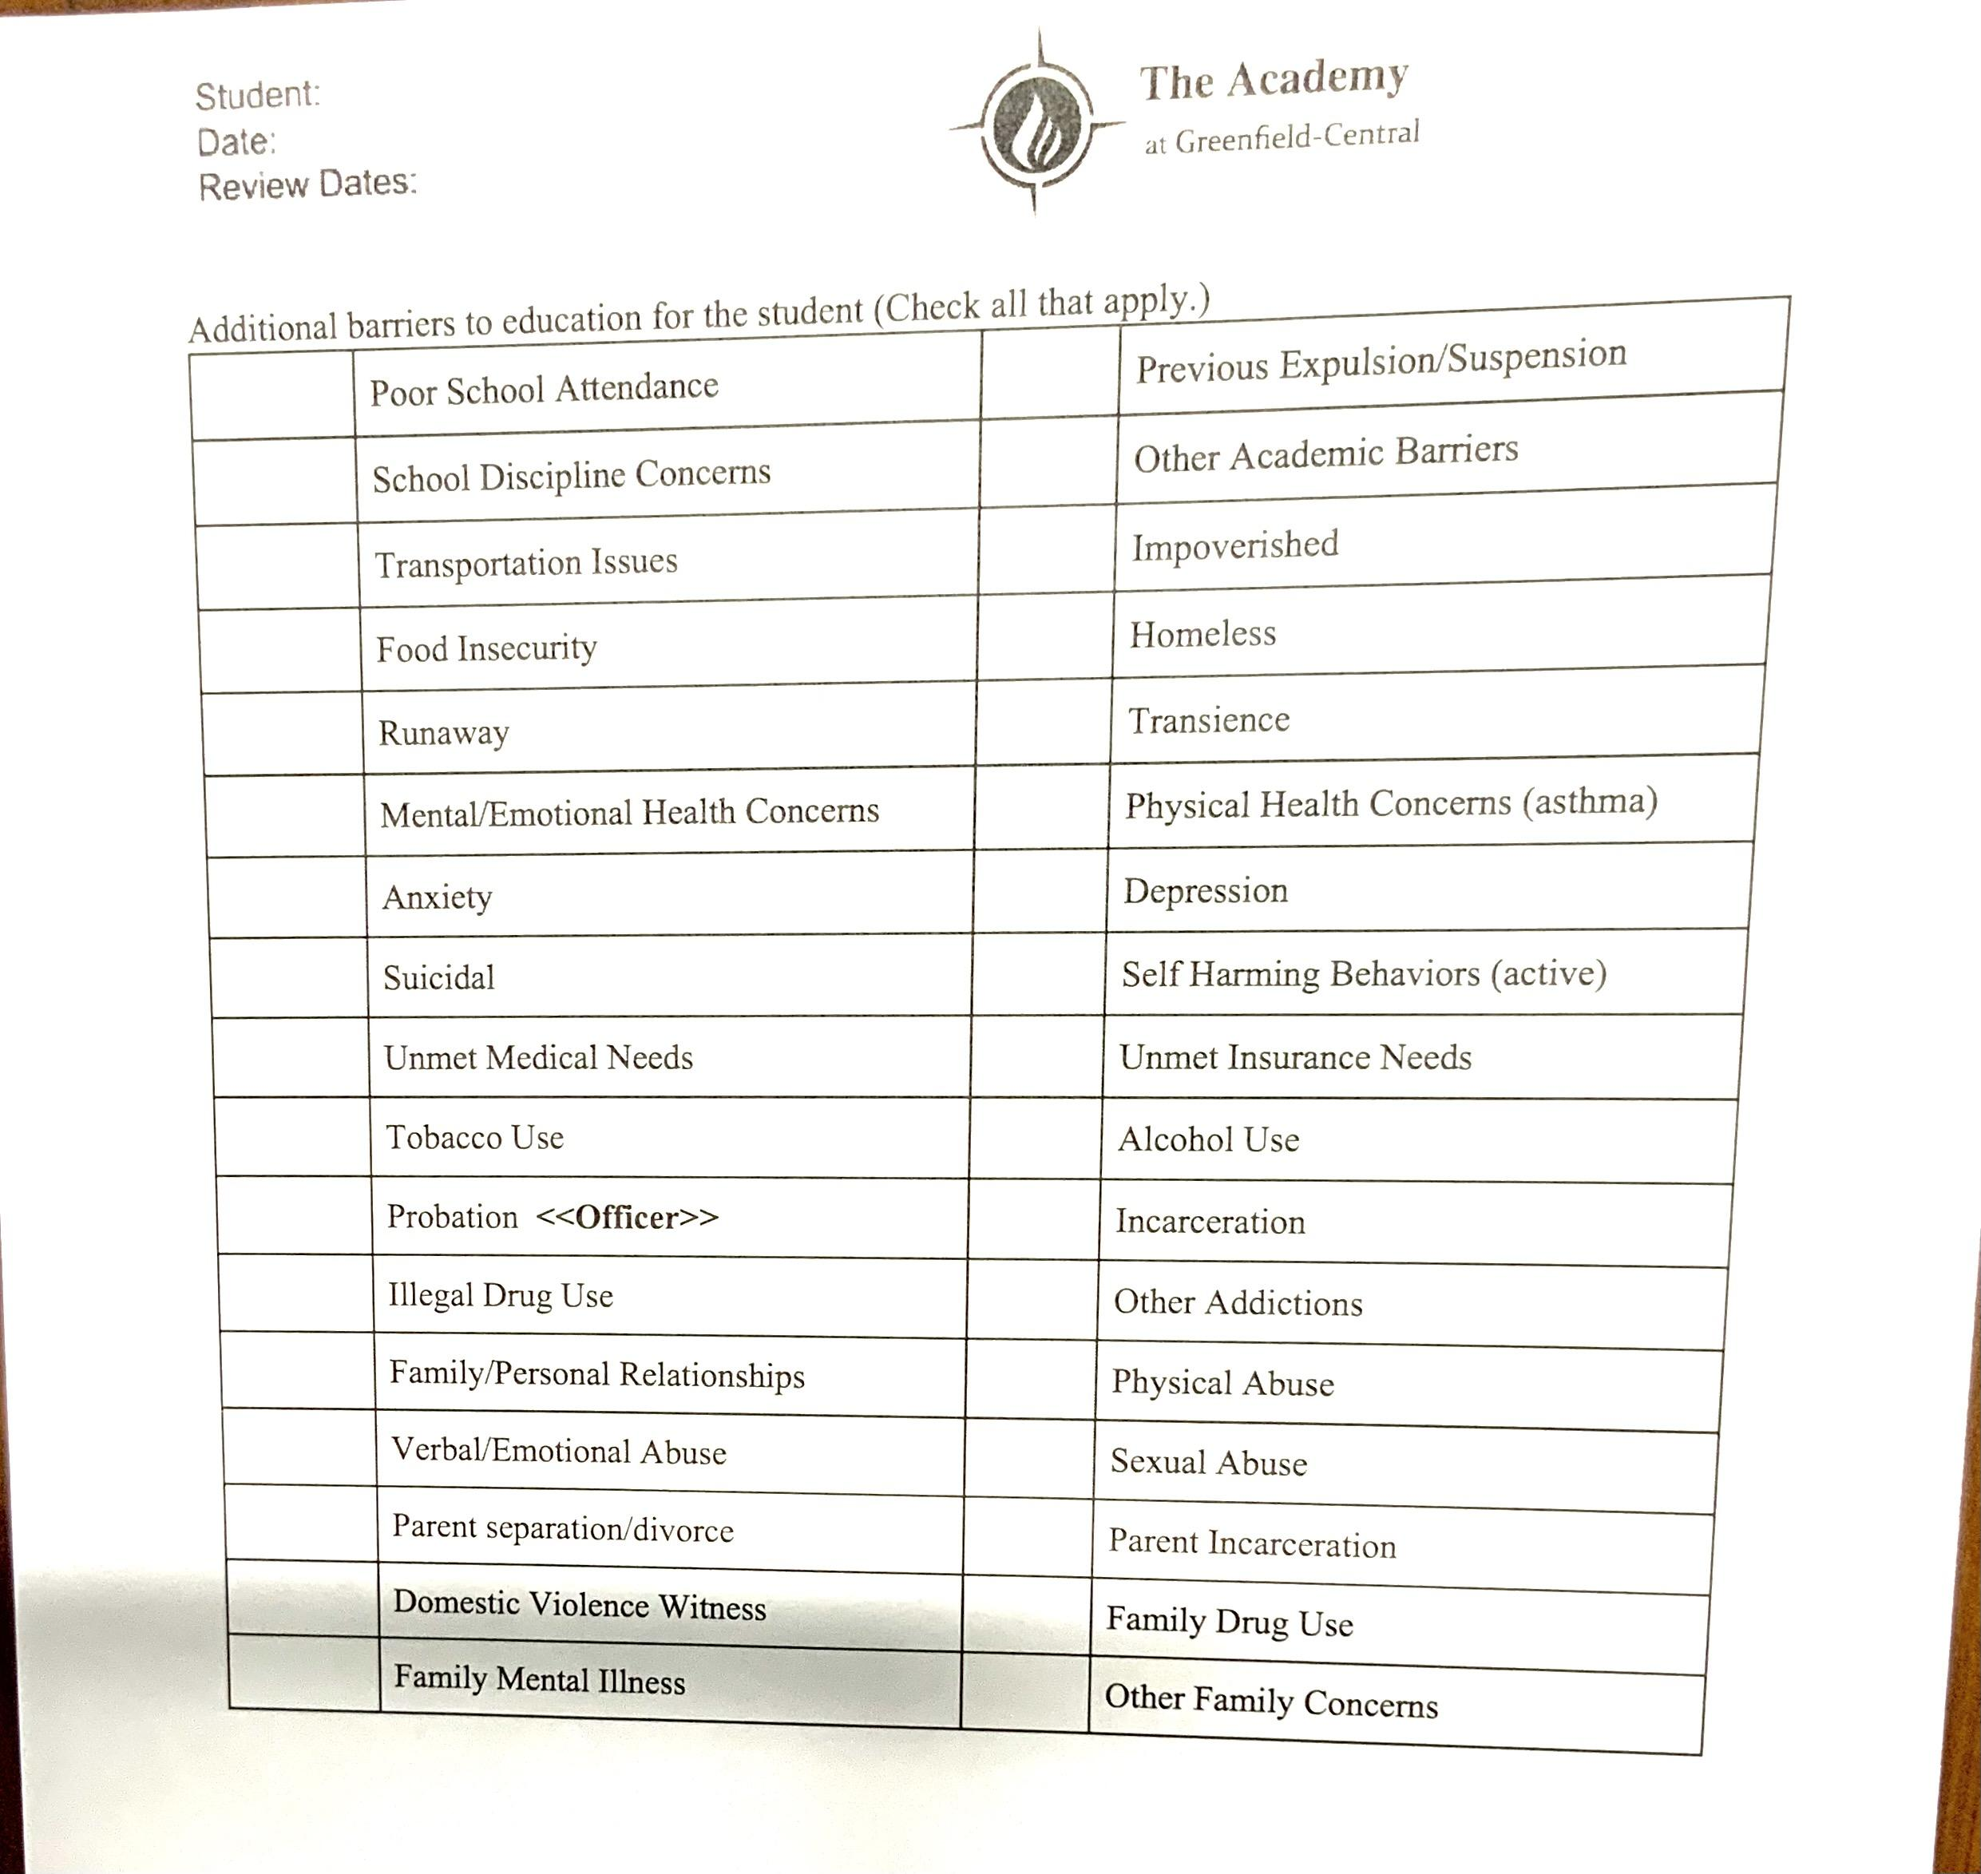
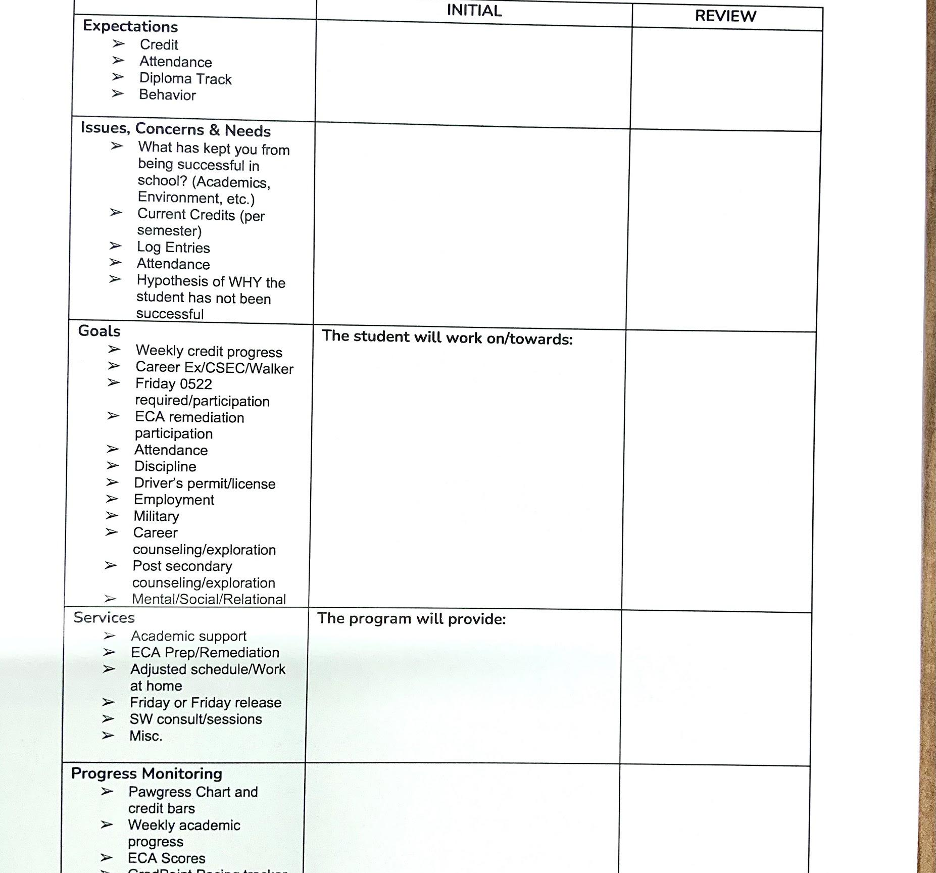
Student Service Plan

Slide 11
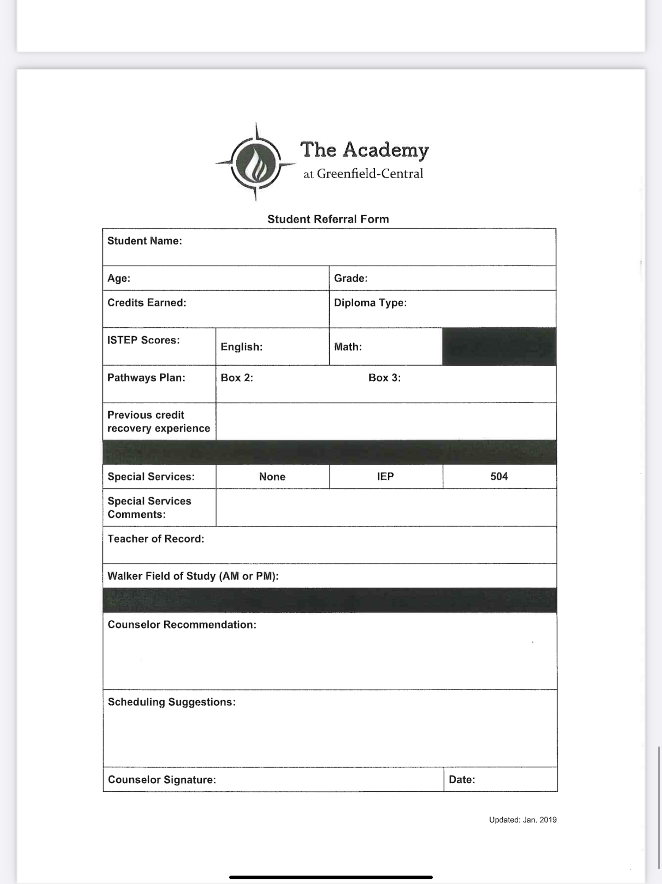
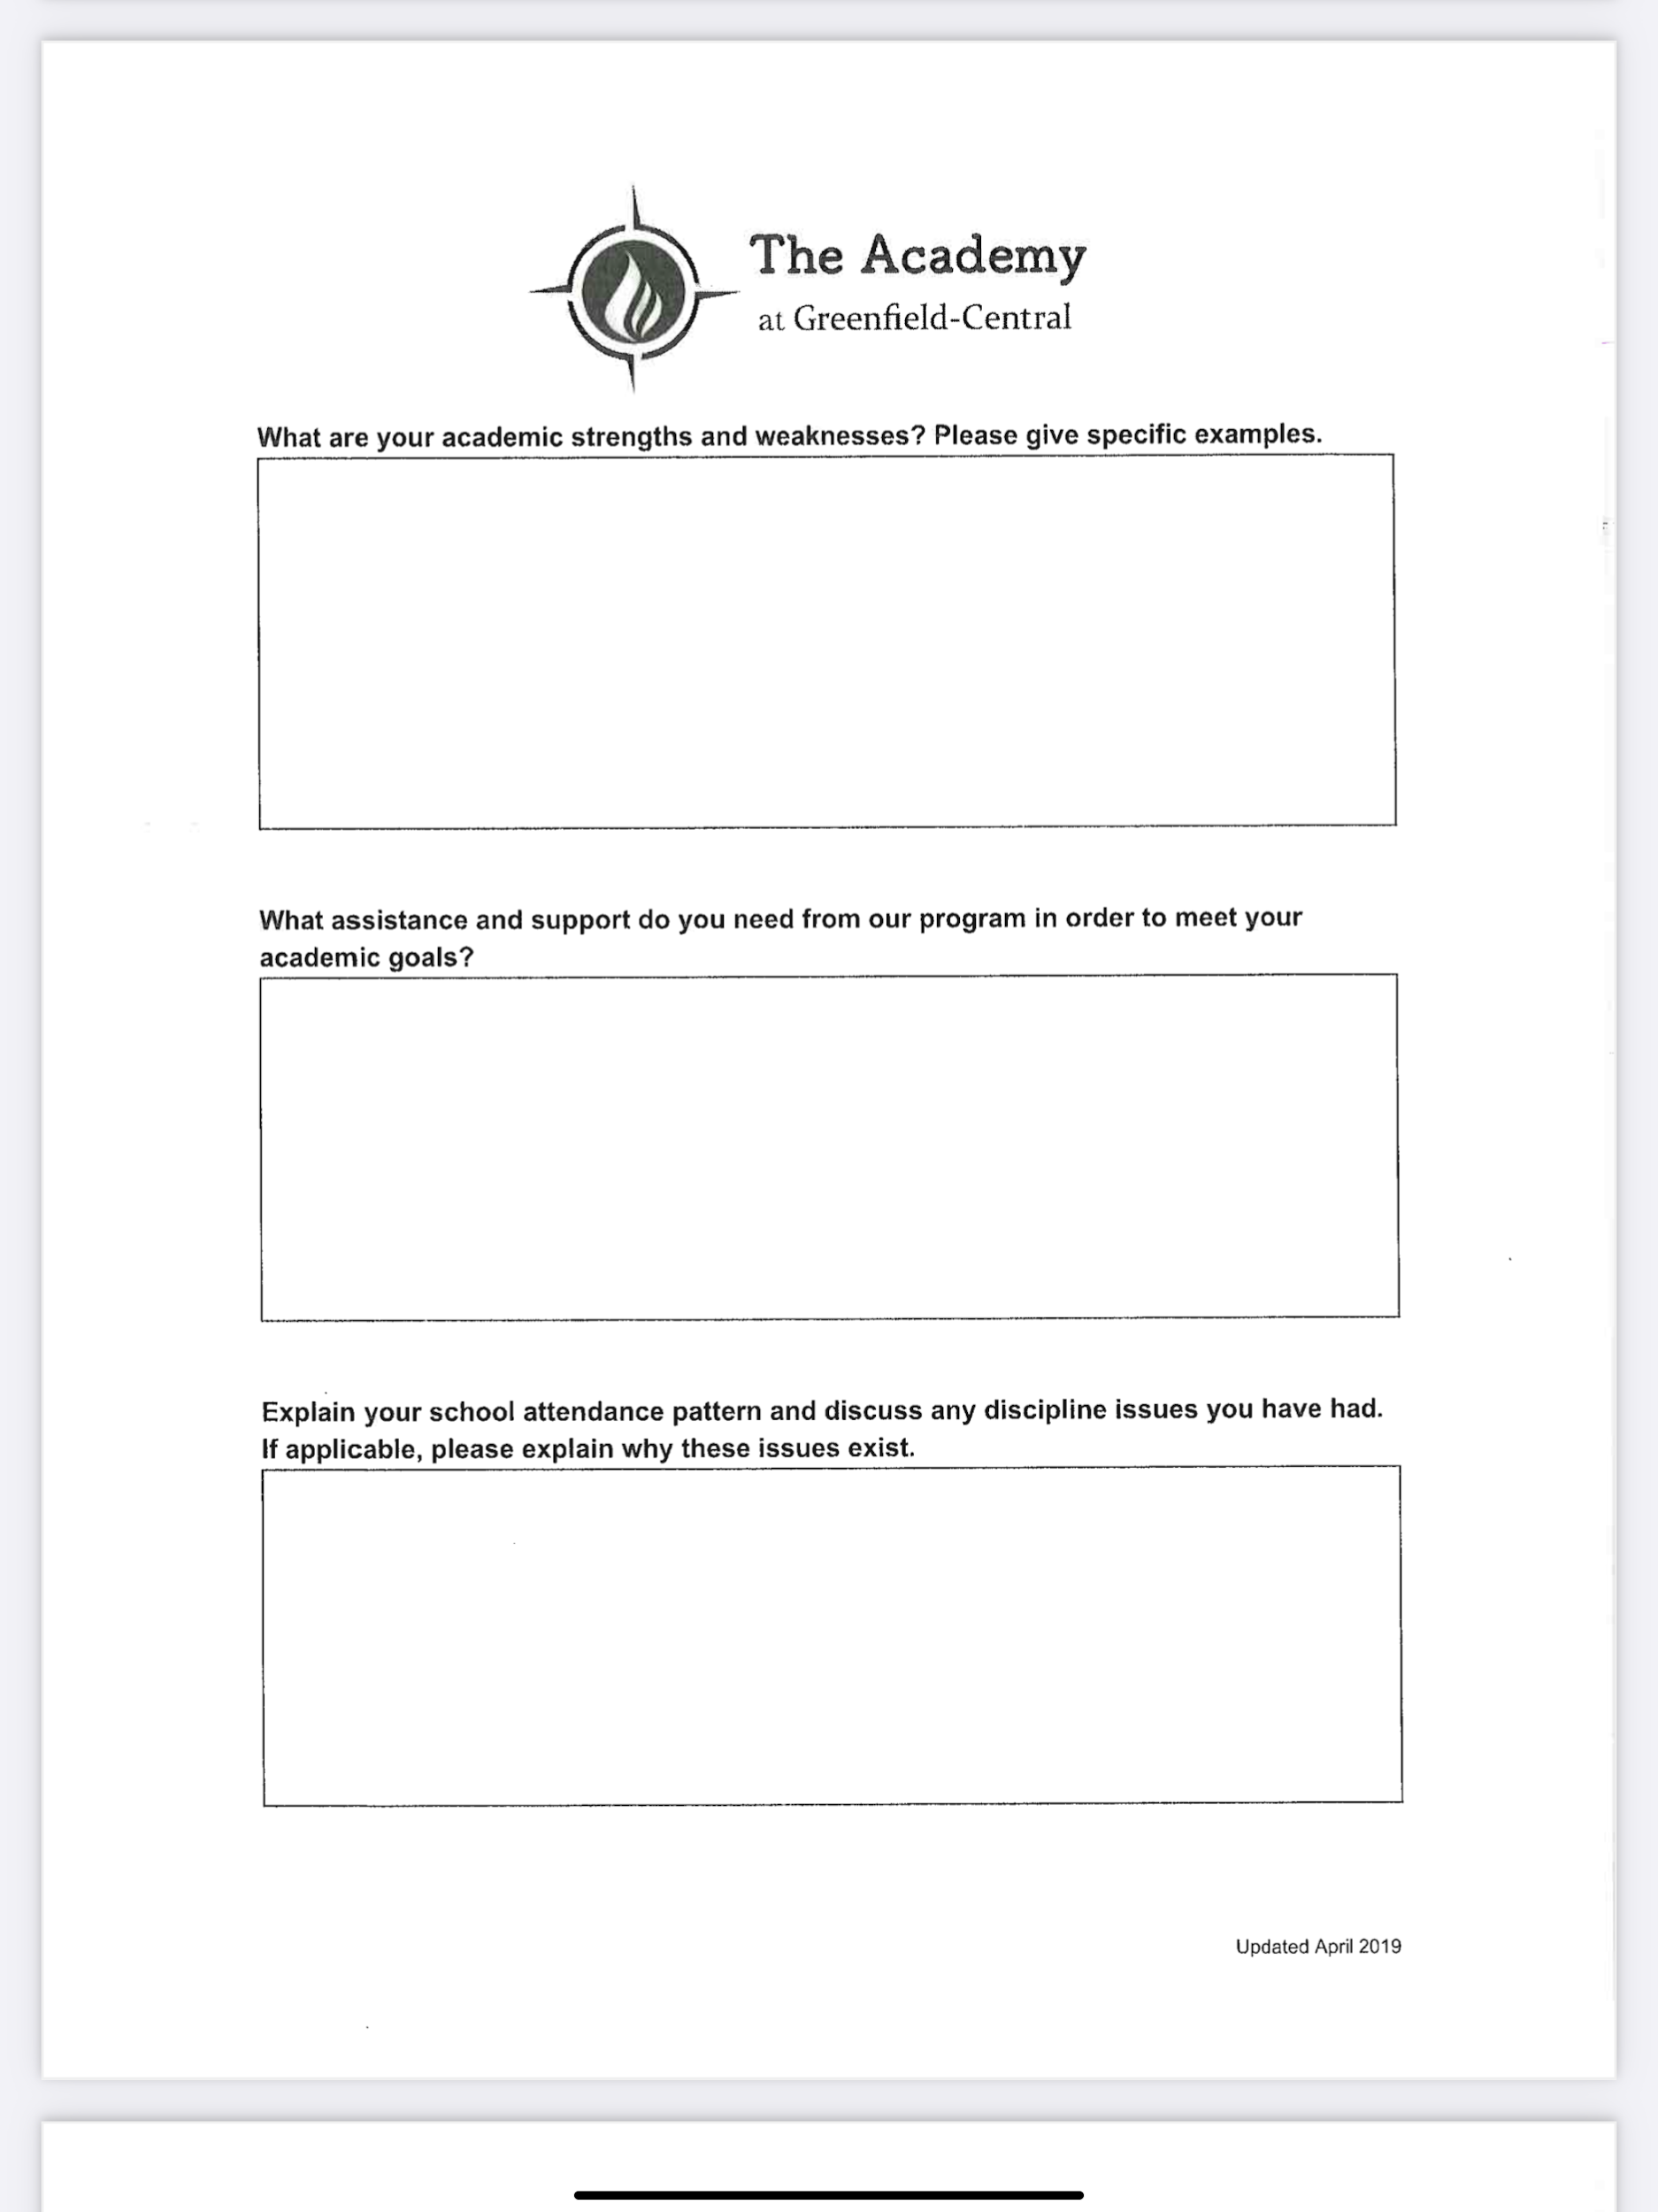

Slide 12
Academy programs offered to Jazmine
15 minute yoga sessions
Mindful Moment
QOTD Wednesday
SEL Lessons
Zones of Regulation QR code
Google form
Students can choose an intervention, depending on color selected
http://bit.ly/3evy7h1
“Recess” time

Slide 14
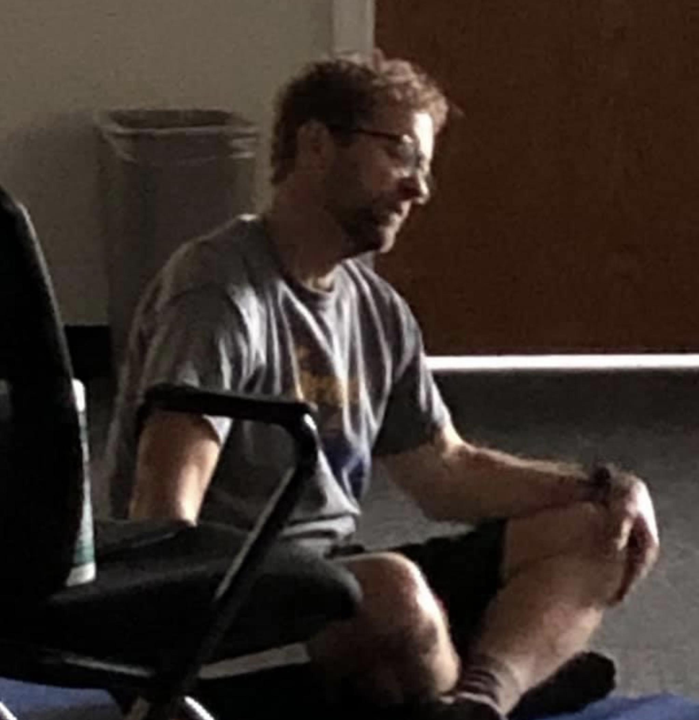
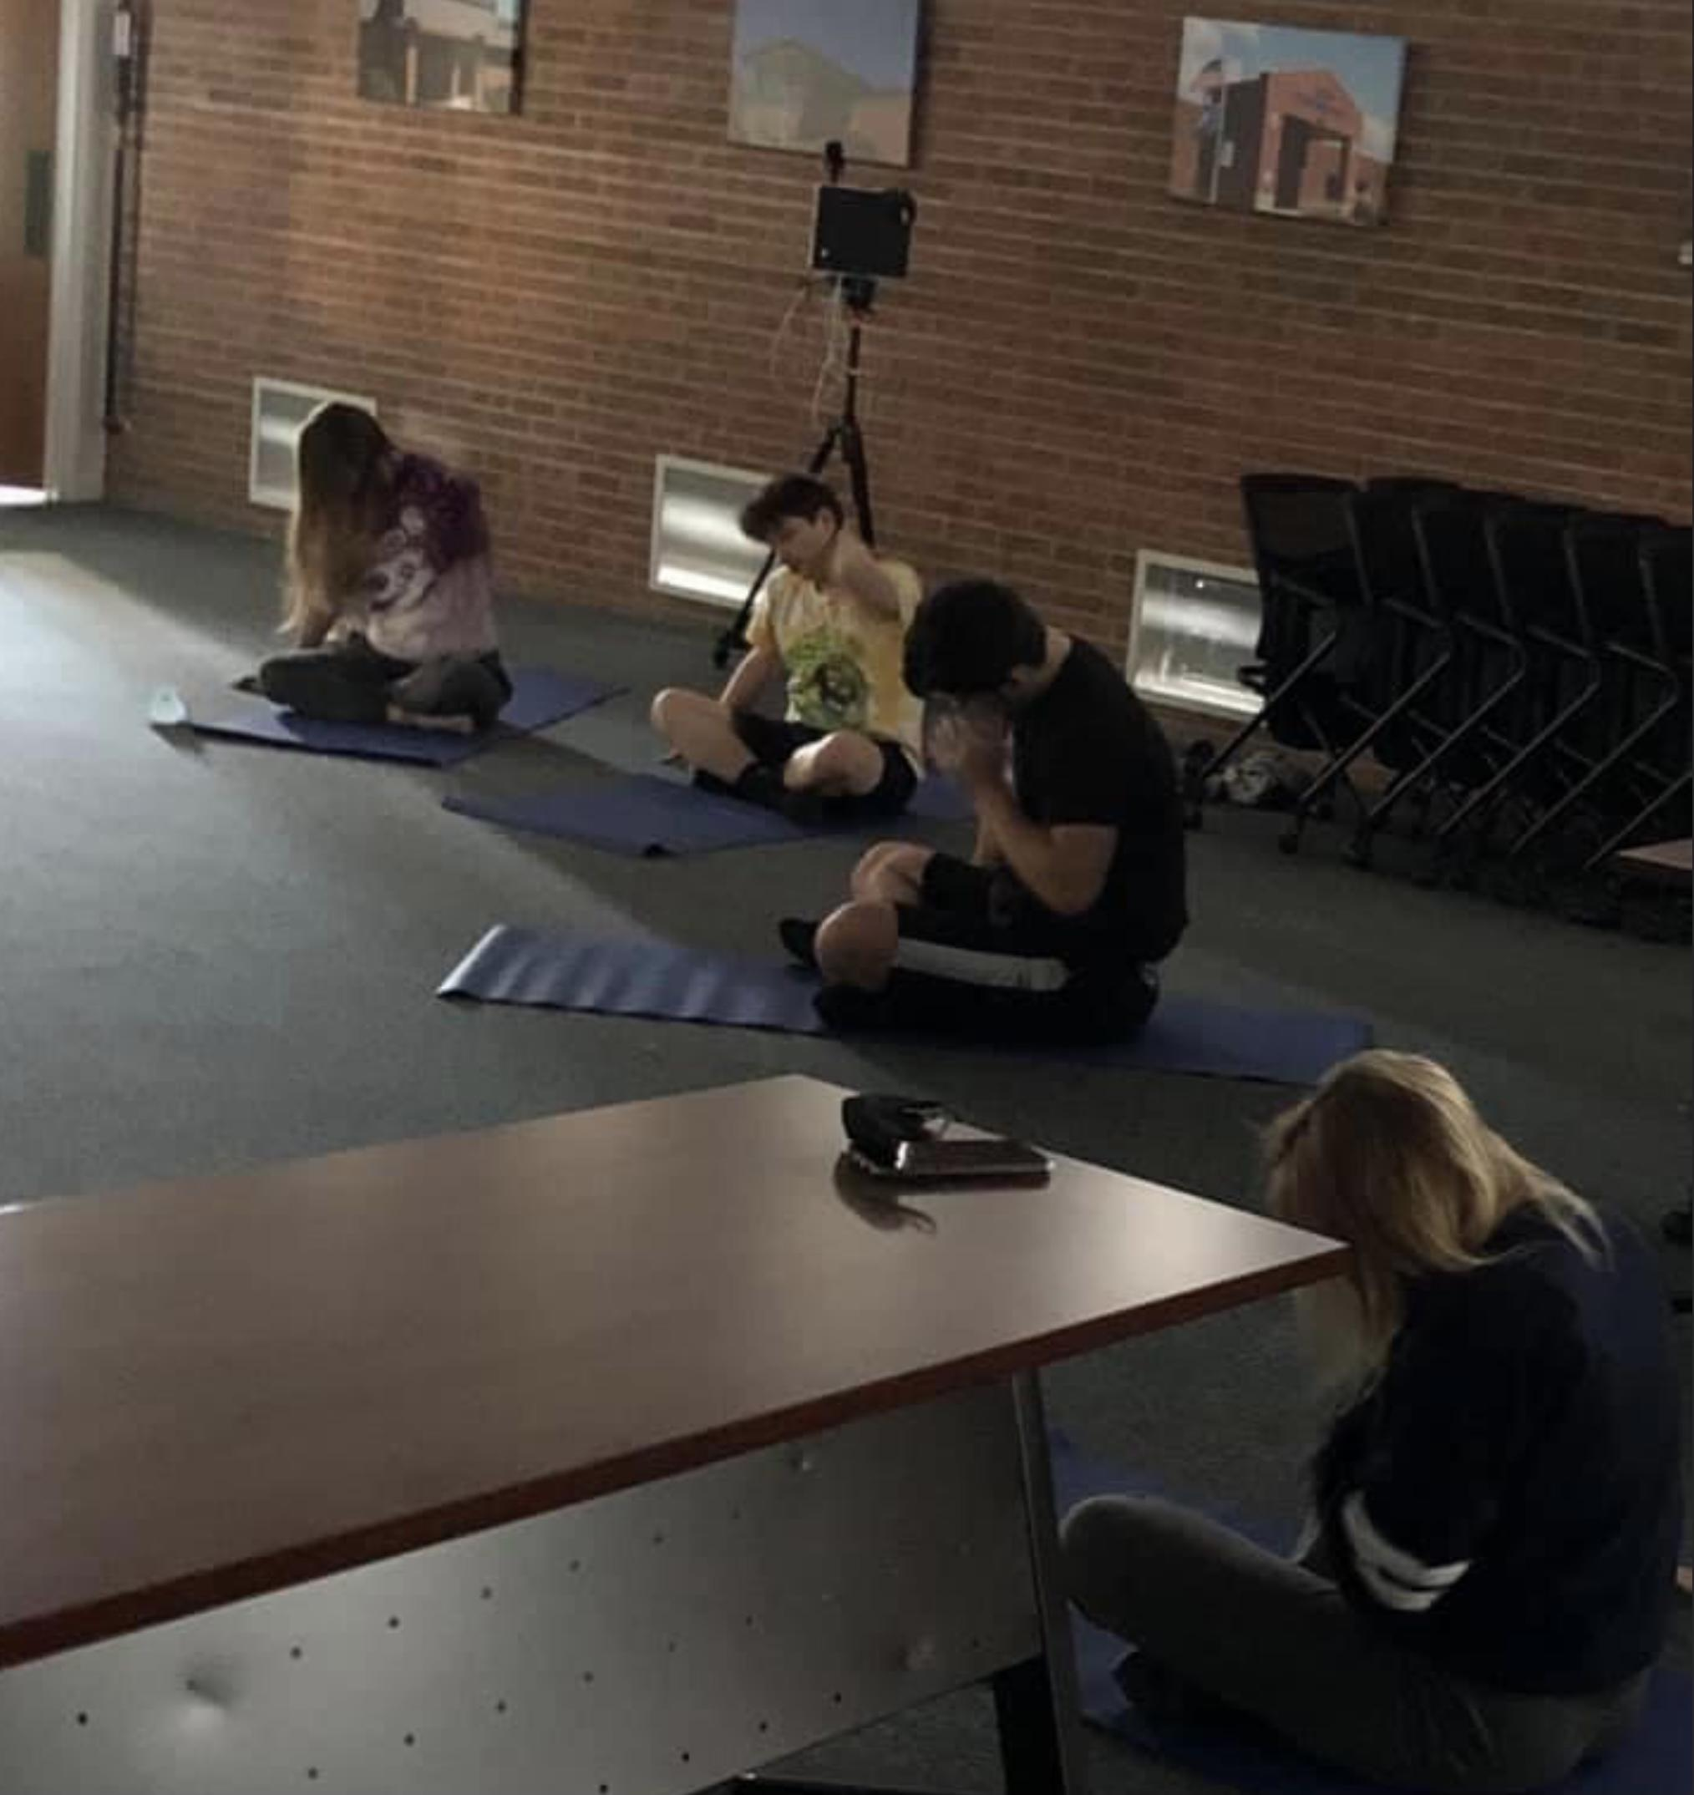
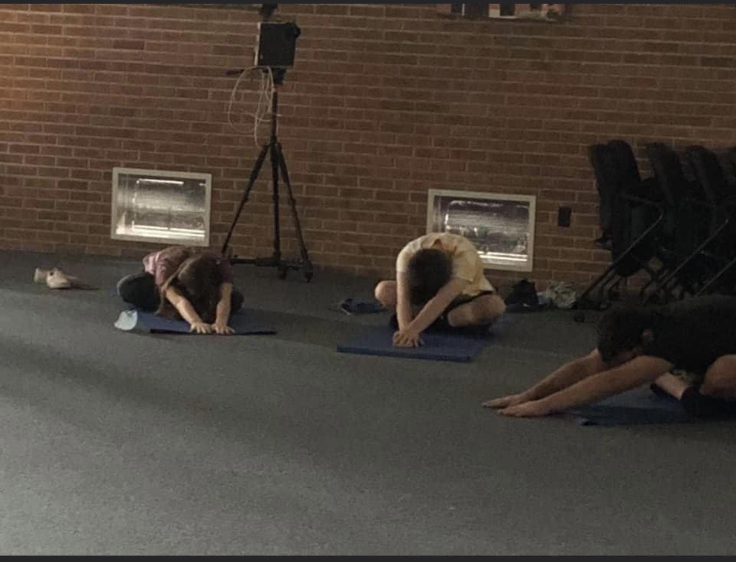

Slide 15
Support services that Jazmine can use
Community service opportunities
SW services
1:1 counseling/psychoeducation
1:1 academic support
Mental health assessments
Connection to resources
Academic advocacy w/teachers and administrators
Safe space to share and respond

Slide 16
Strategies for helping ALL students
As school social workers, how can we validate students concerns and connect them to resources?
In PLC’s,
SPED teachers are a great resource!
Expect DAILY success of EVERY student. This IS NOT always academic
Survey your students often (Google forms is a blessing!!)
Treatment preferences
Bully surveys
Career interests (most of our kids are going into the workforce)
Use Calendly to help students manage their time AND yours!

Slide 17
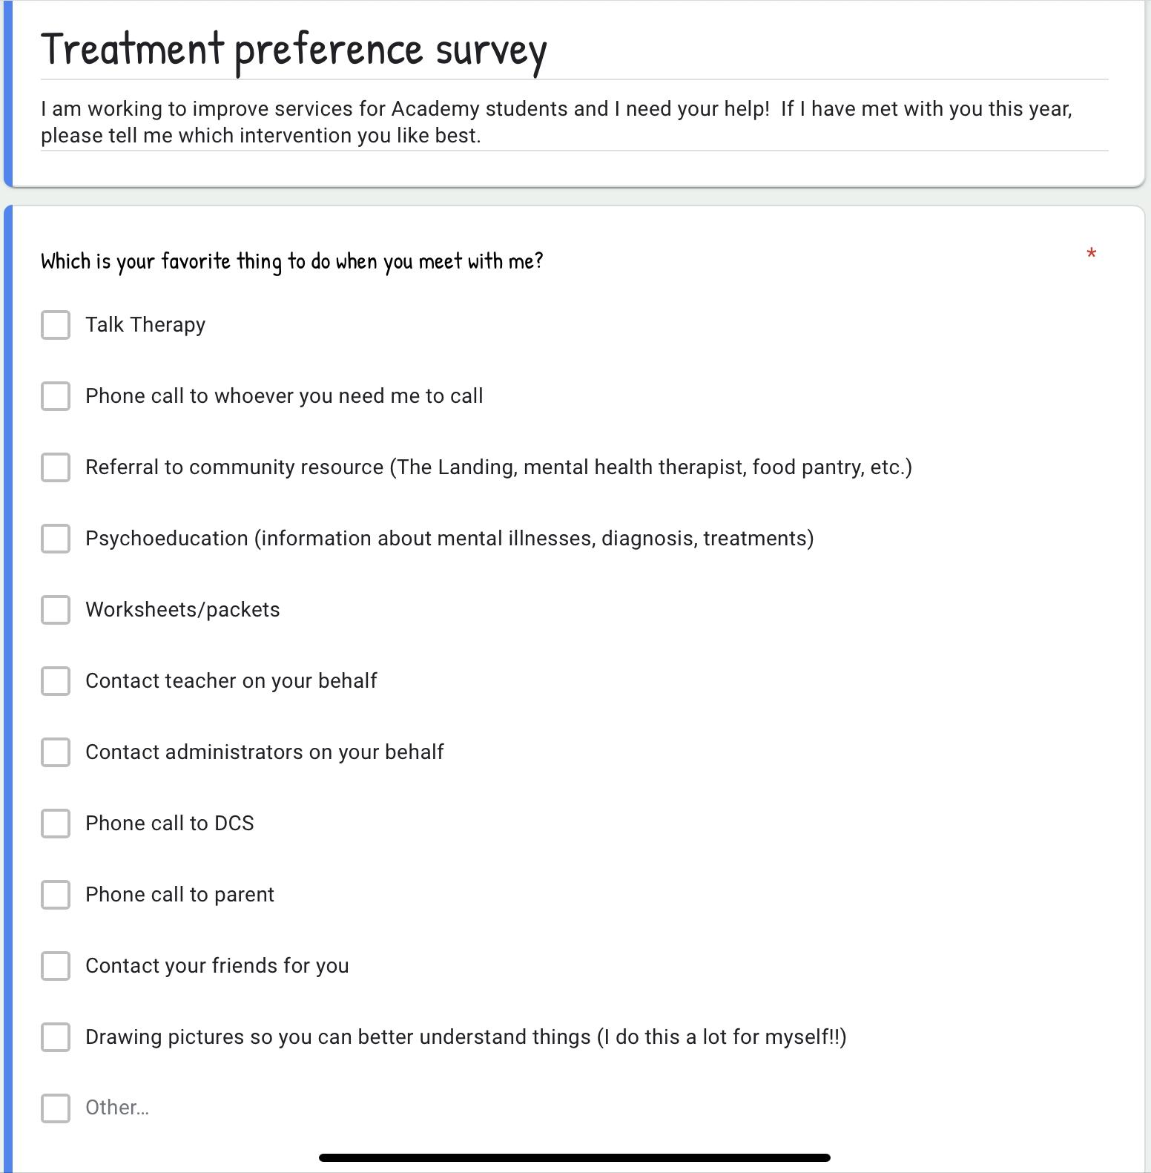

Slide 18
One-of-a-kind services
to assist the whole child
Yoga
QOTD Wednesday
Mindful minute
End of day trivia
Gift card giveaways
Daily healthy snacks
Quarterly Parent Newsletter
Driver’s Education Lessons
Outdoor frisbee and football games

Slide 19
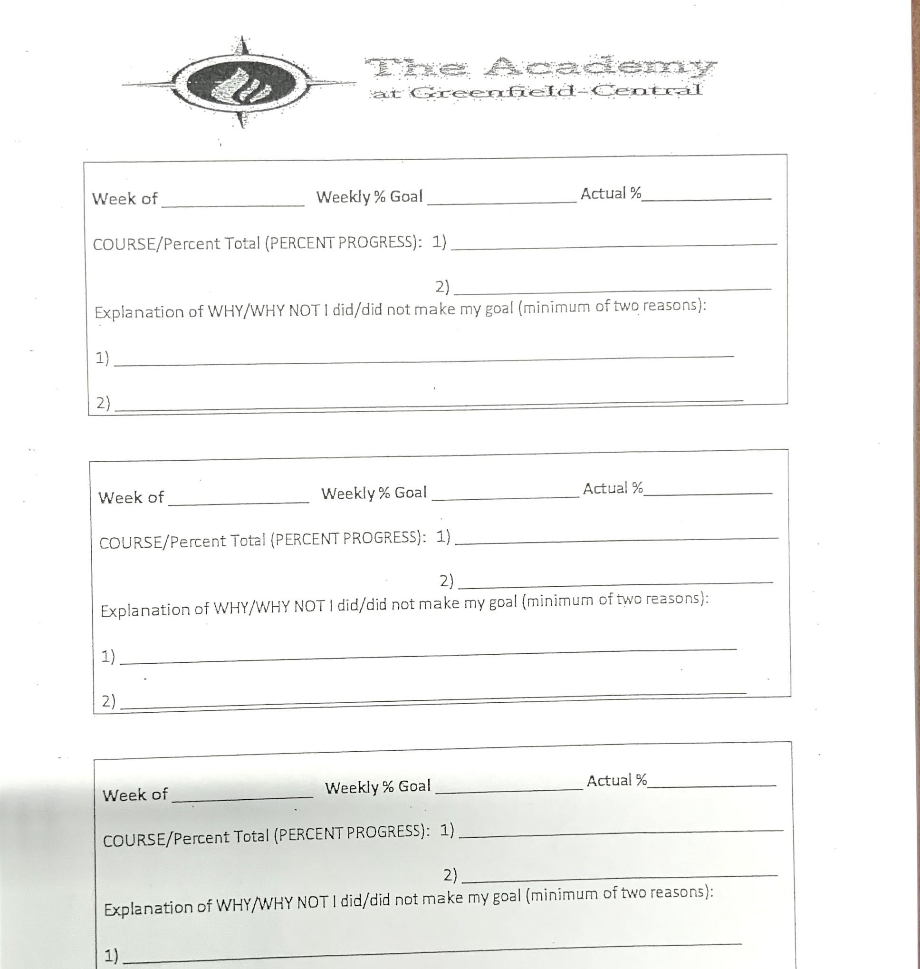
More offerings from the Academy menu
Advisories
Weekly Gift Card Drawings
Progress Monitoring

Slide 20
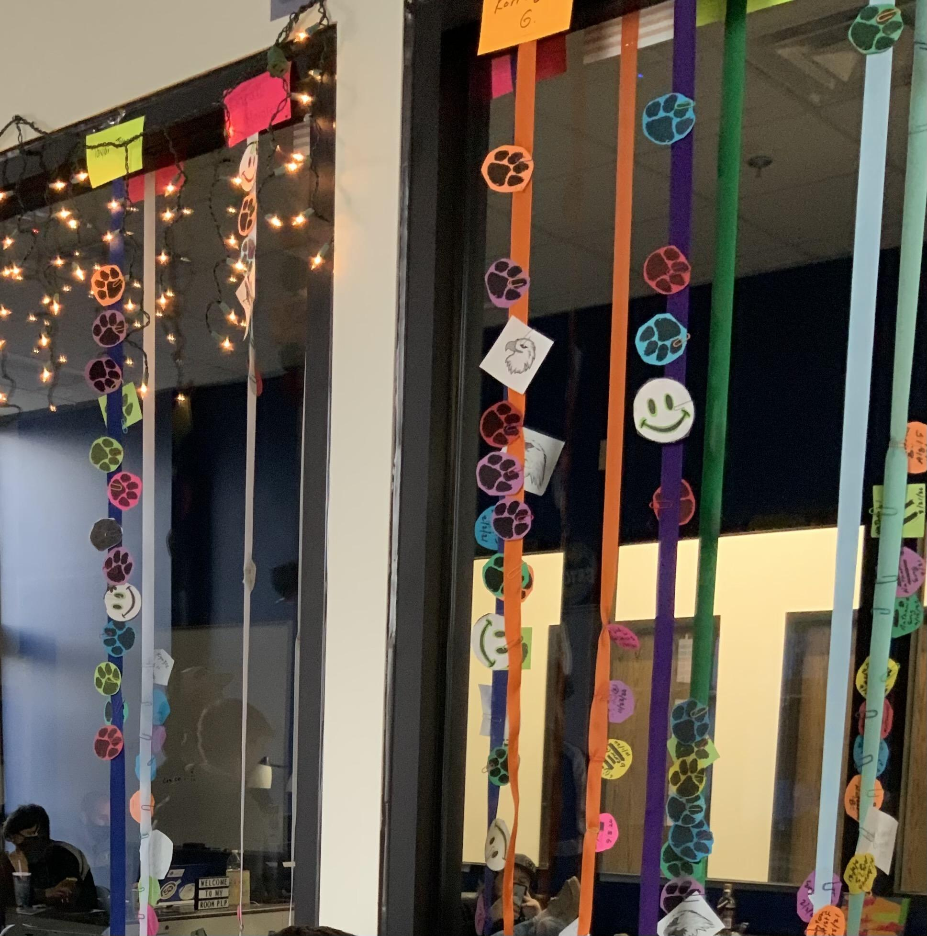
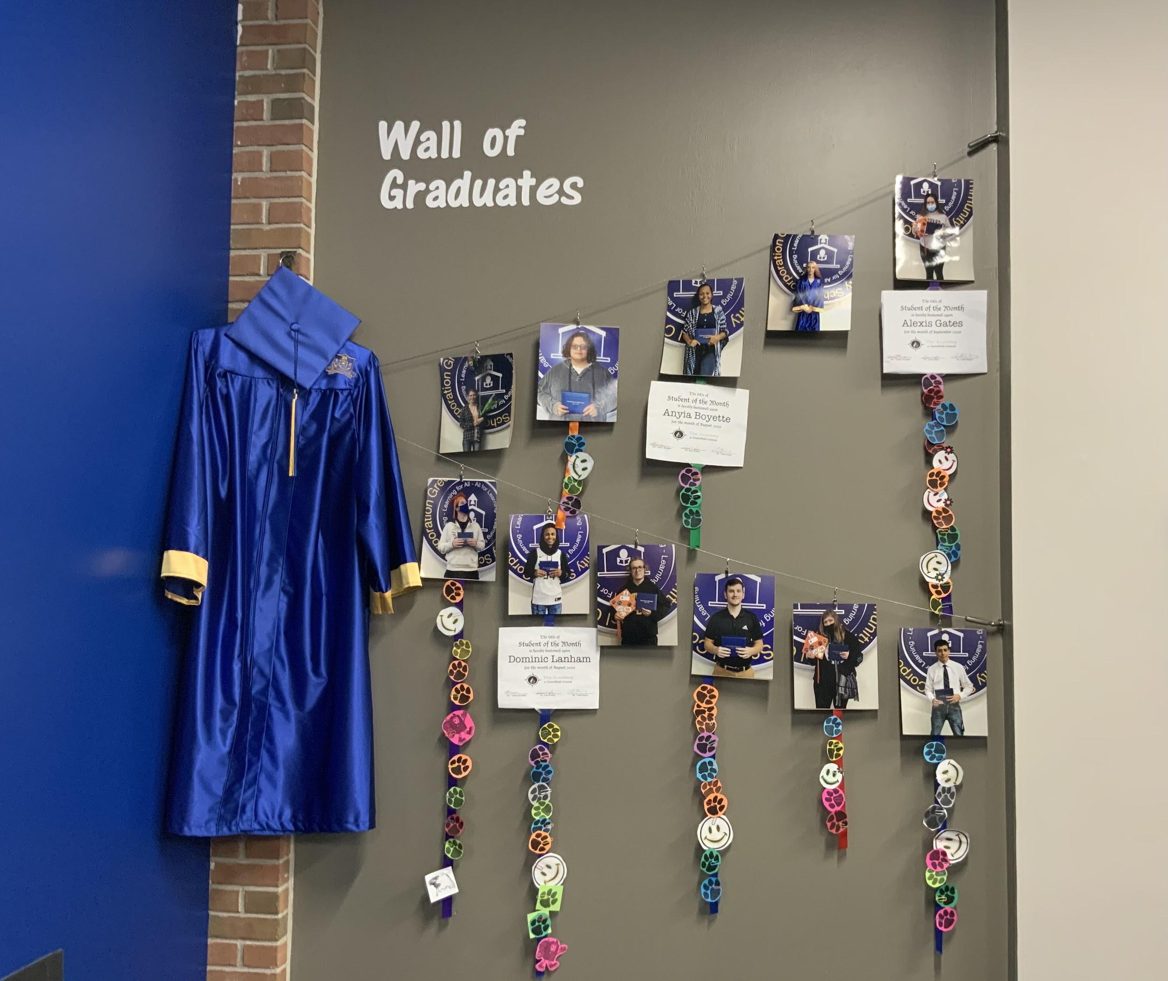
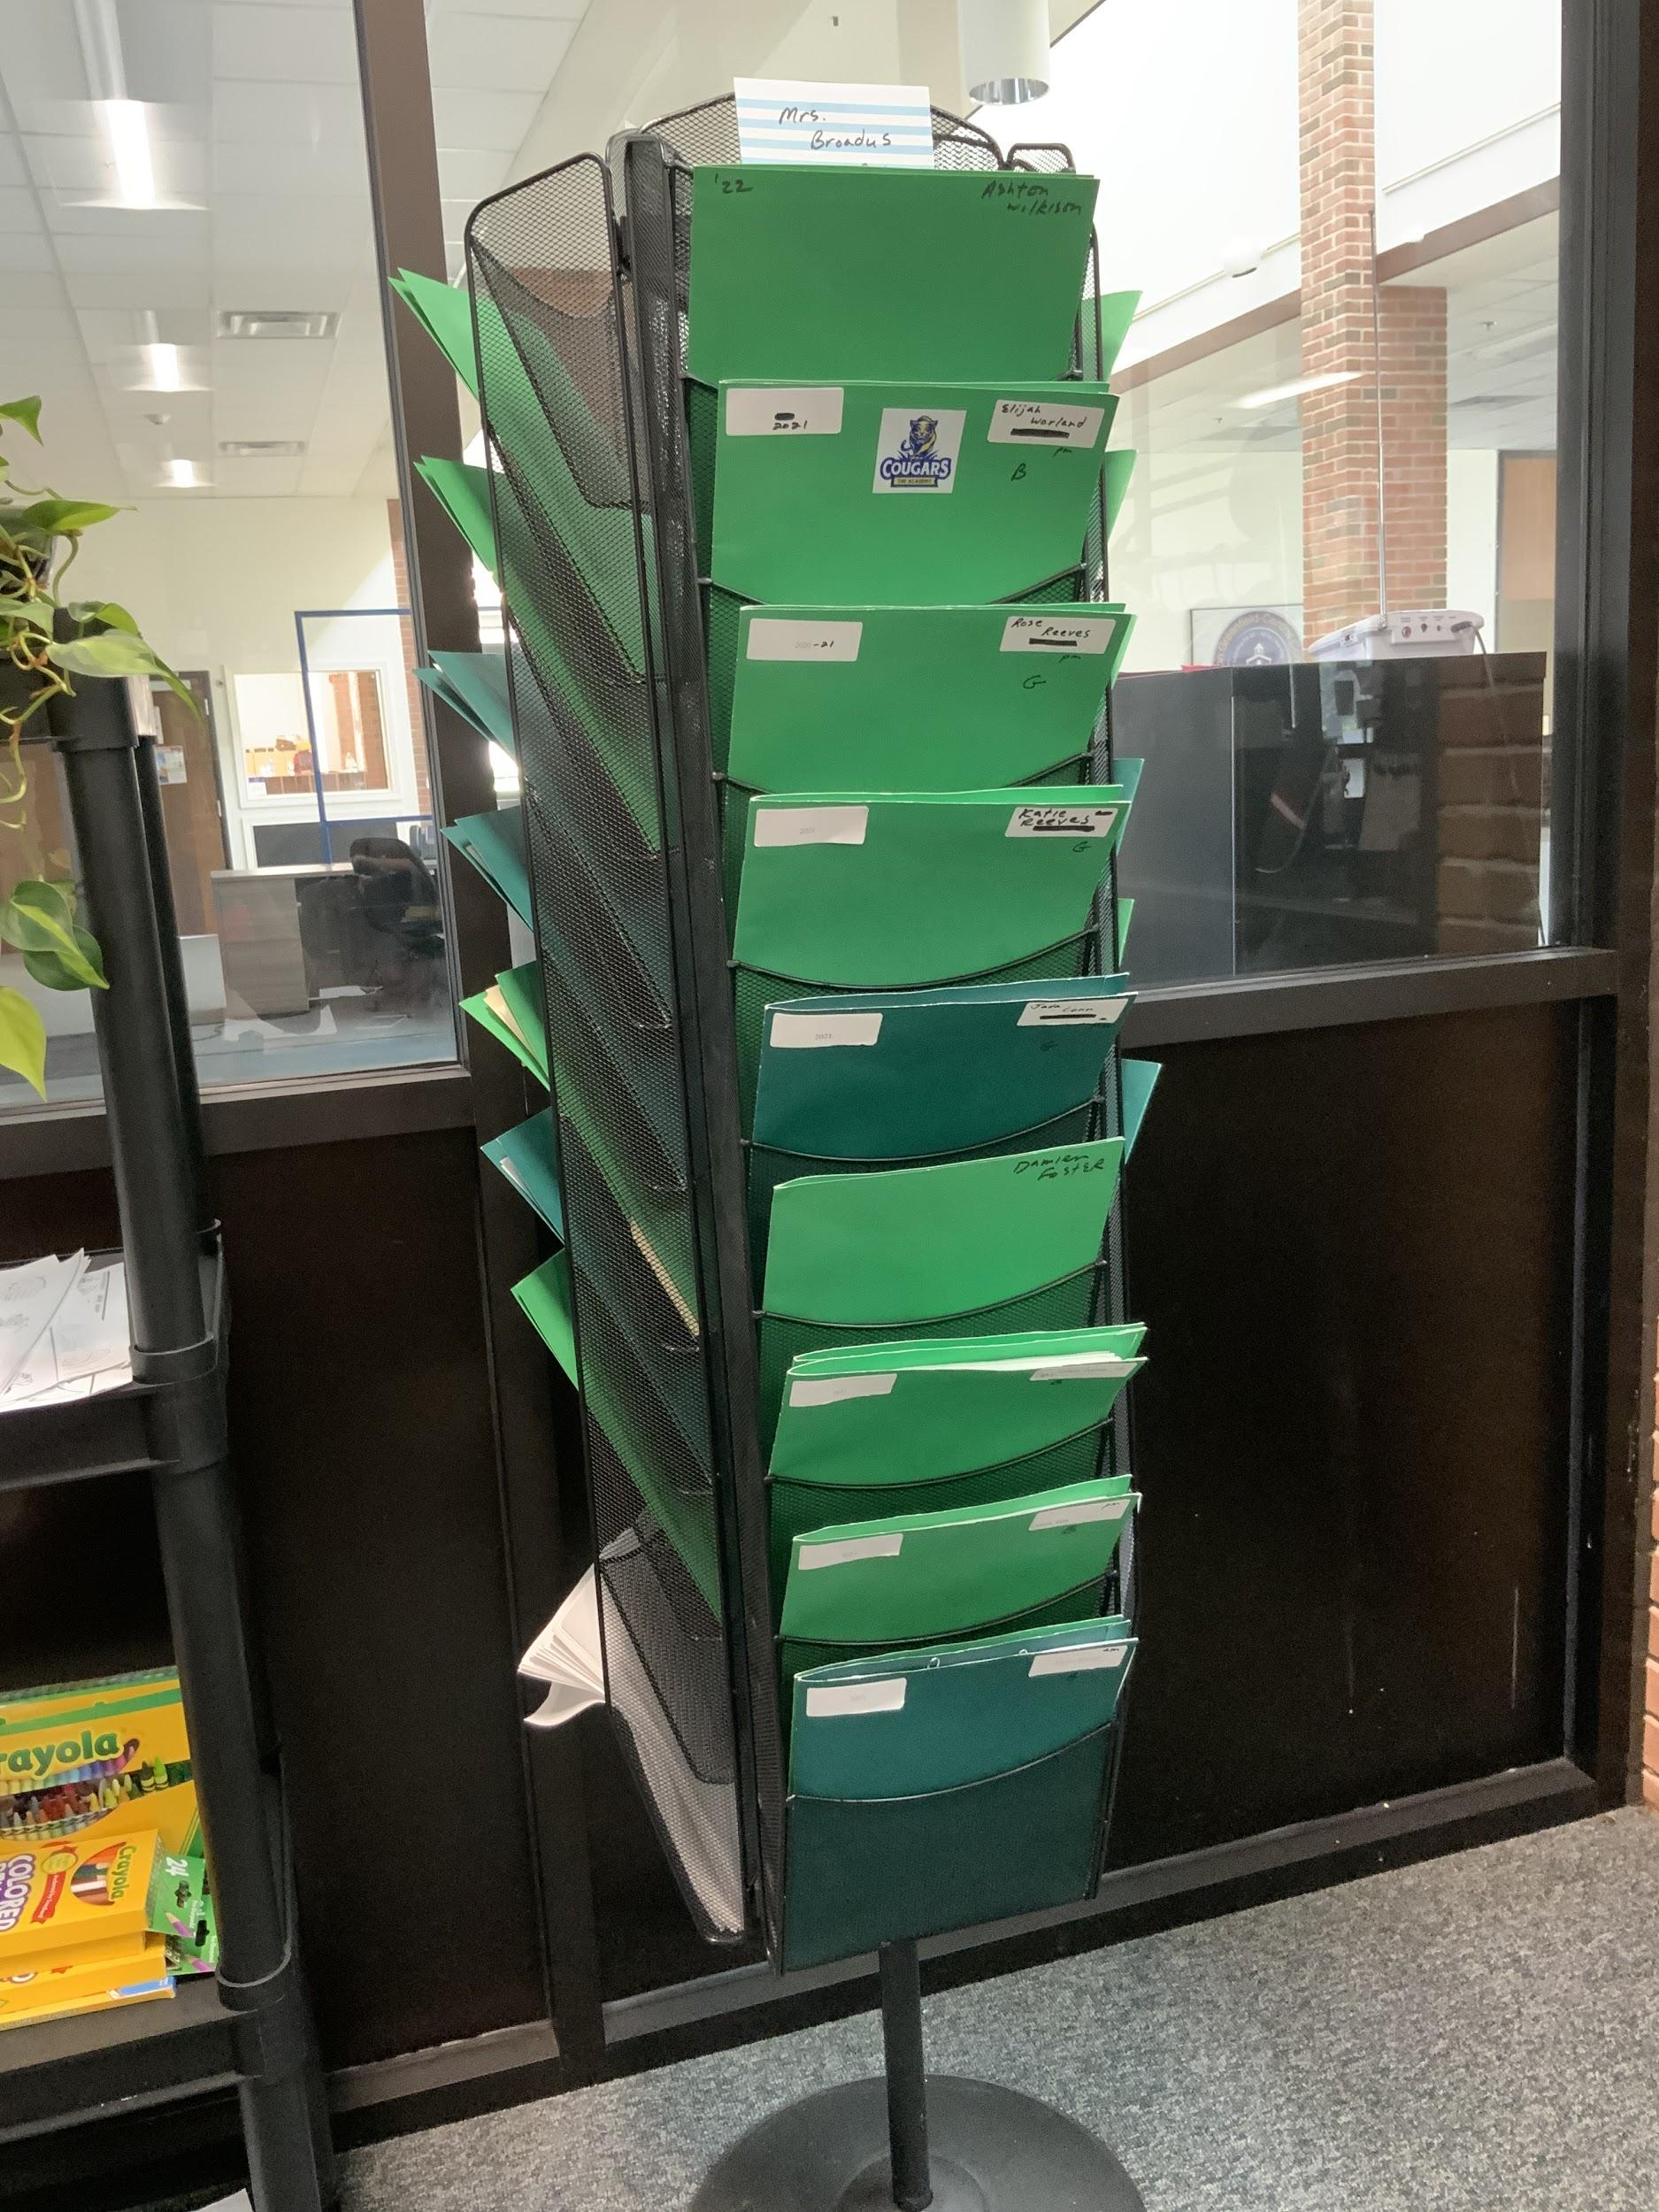
The Academy at Greenfield Central

Slide 21
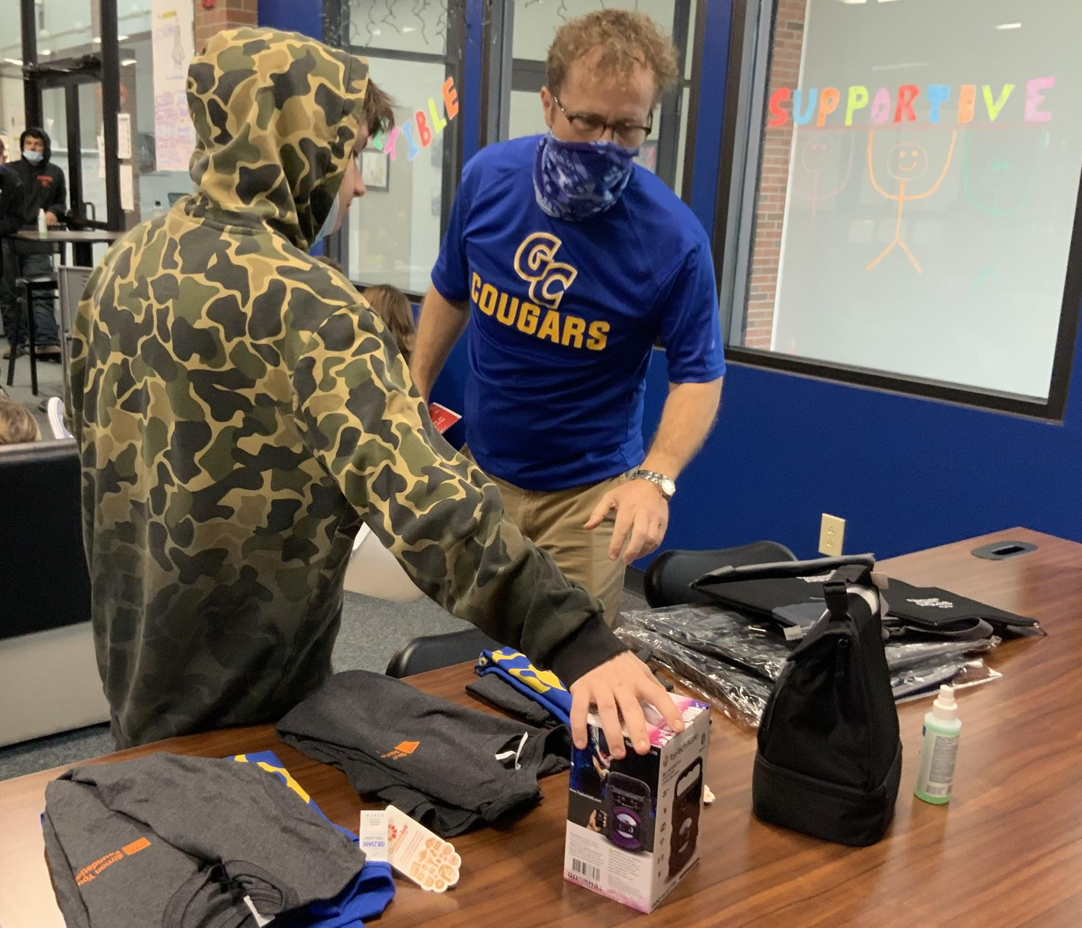
Other Delightful Tidbits
Academy special events
Cookies and cocoa holiday party
Donuts (AM) and pizza (PM) end of semester party
SYF branded materials to pass out to students (tshirts, coozies, tote bags, lunch bags, etc.)

Slide 22
Bridging the Gap…..
Creating an environment where everyone can fit in!

Slide 23
My Whole School Strategies
At risk cohort meetings
Leader on wellness team
PD’s on mental health
1:1 counseling with teachers
Presenter at new teacher induction meetings
Consult with SPED teachers for resources
College/Career Fair
Self care accountability partner
Director of culture club

Slide 24
Whole School Strategies cont’d.
Mindful Moments
Wellness Wednesday’s
Food Trucks (bldg. secretary)
Therapy Dogs (School corporation nurse)

Slide 25
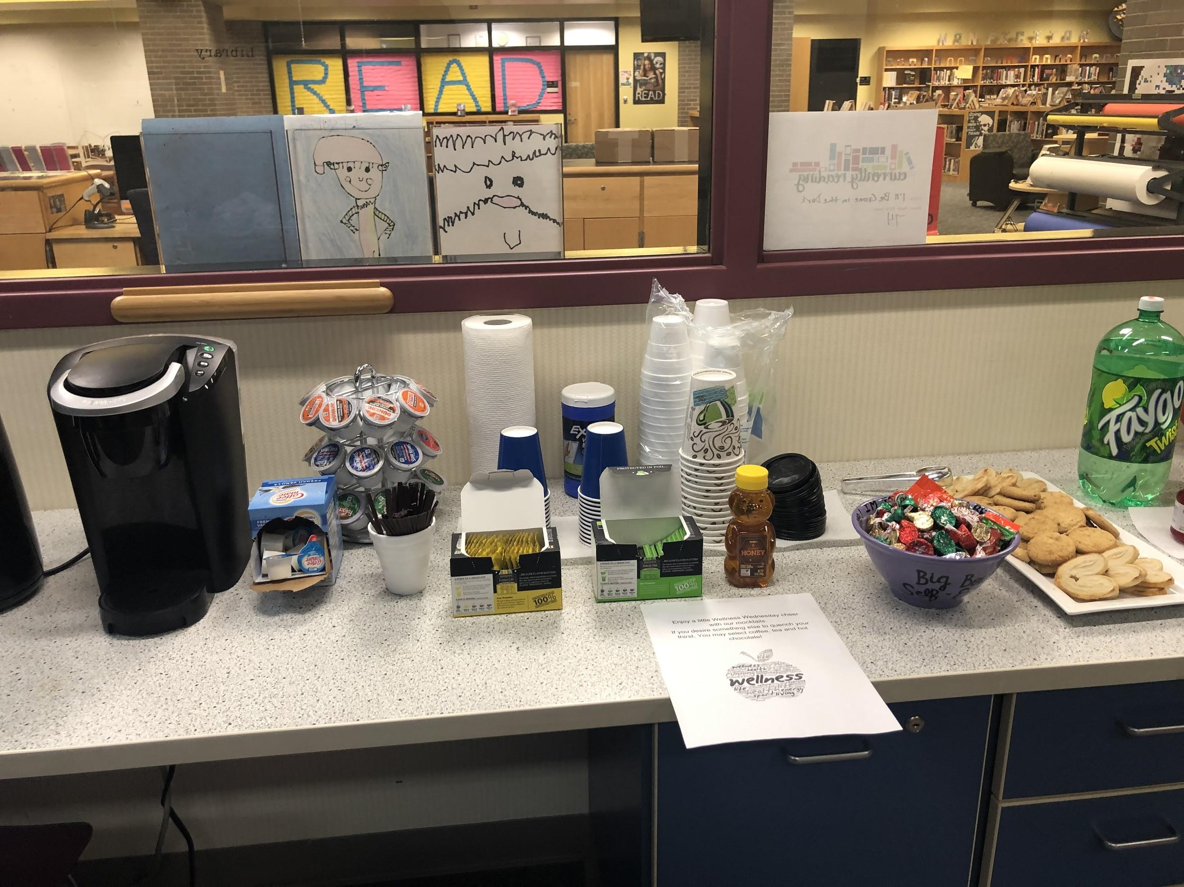
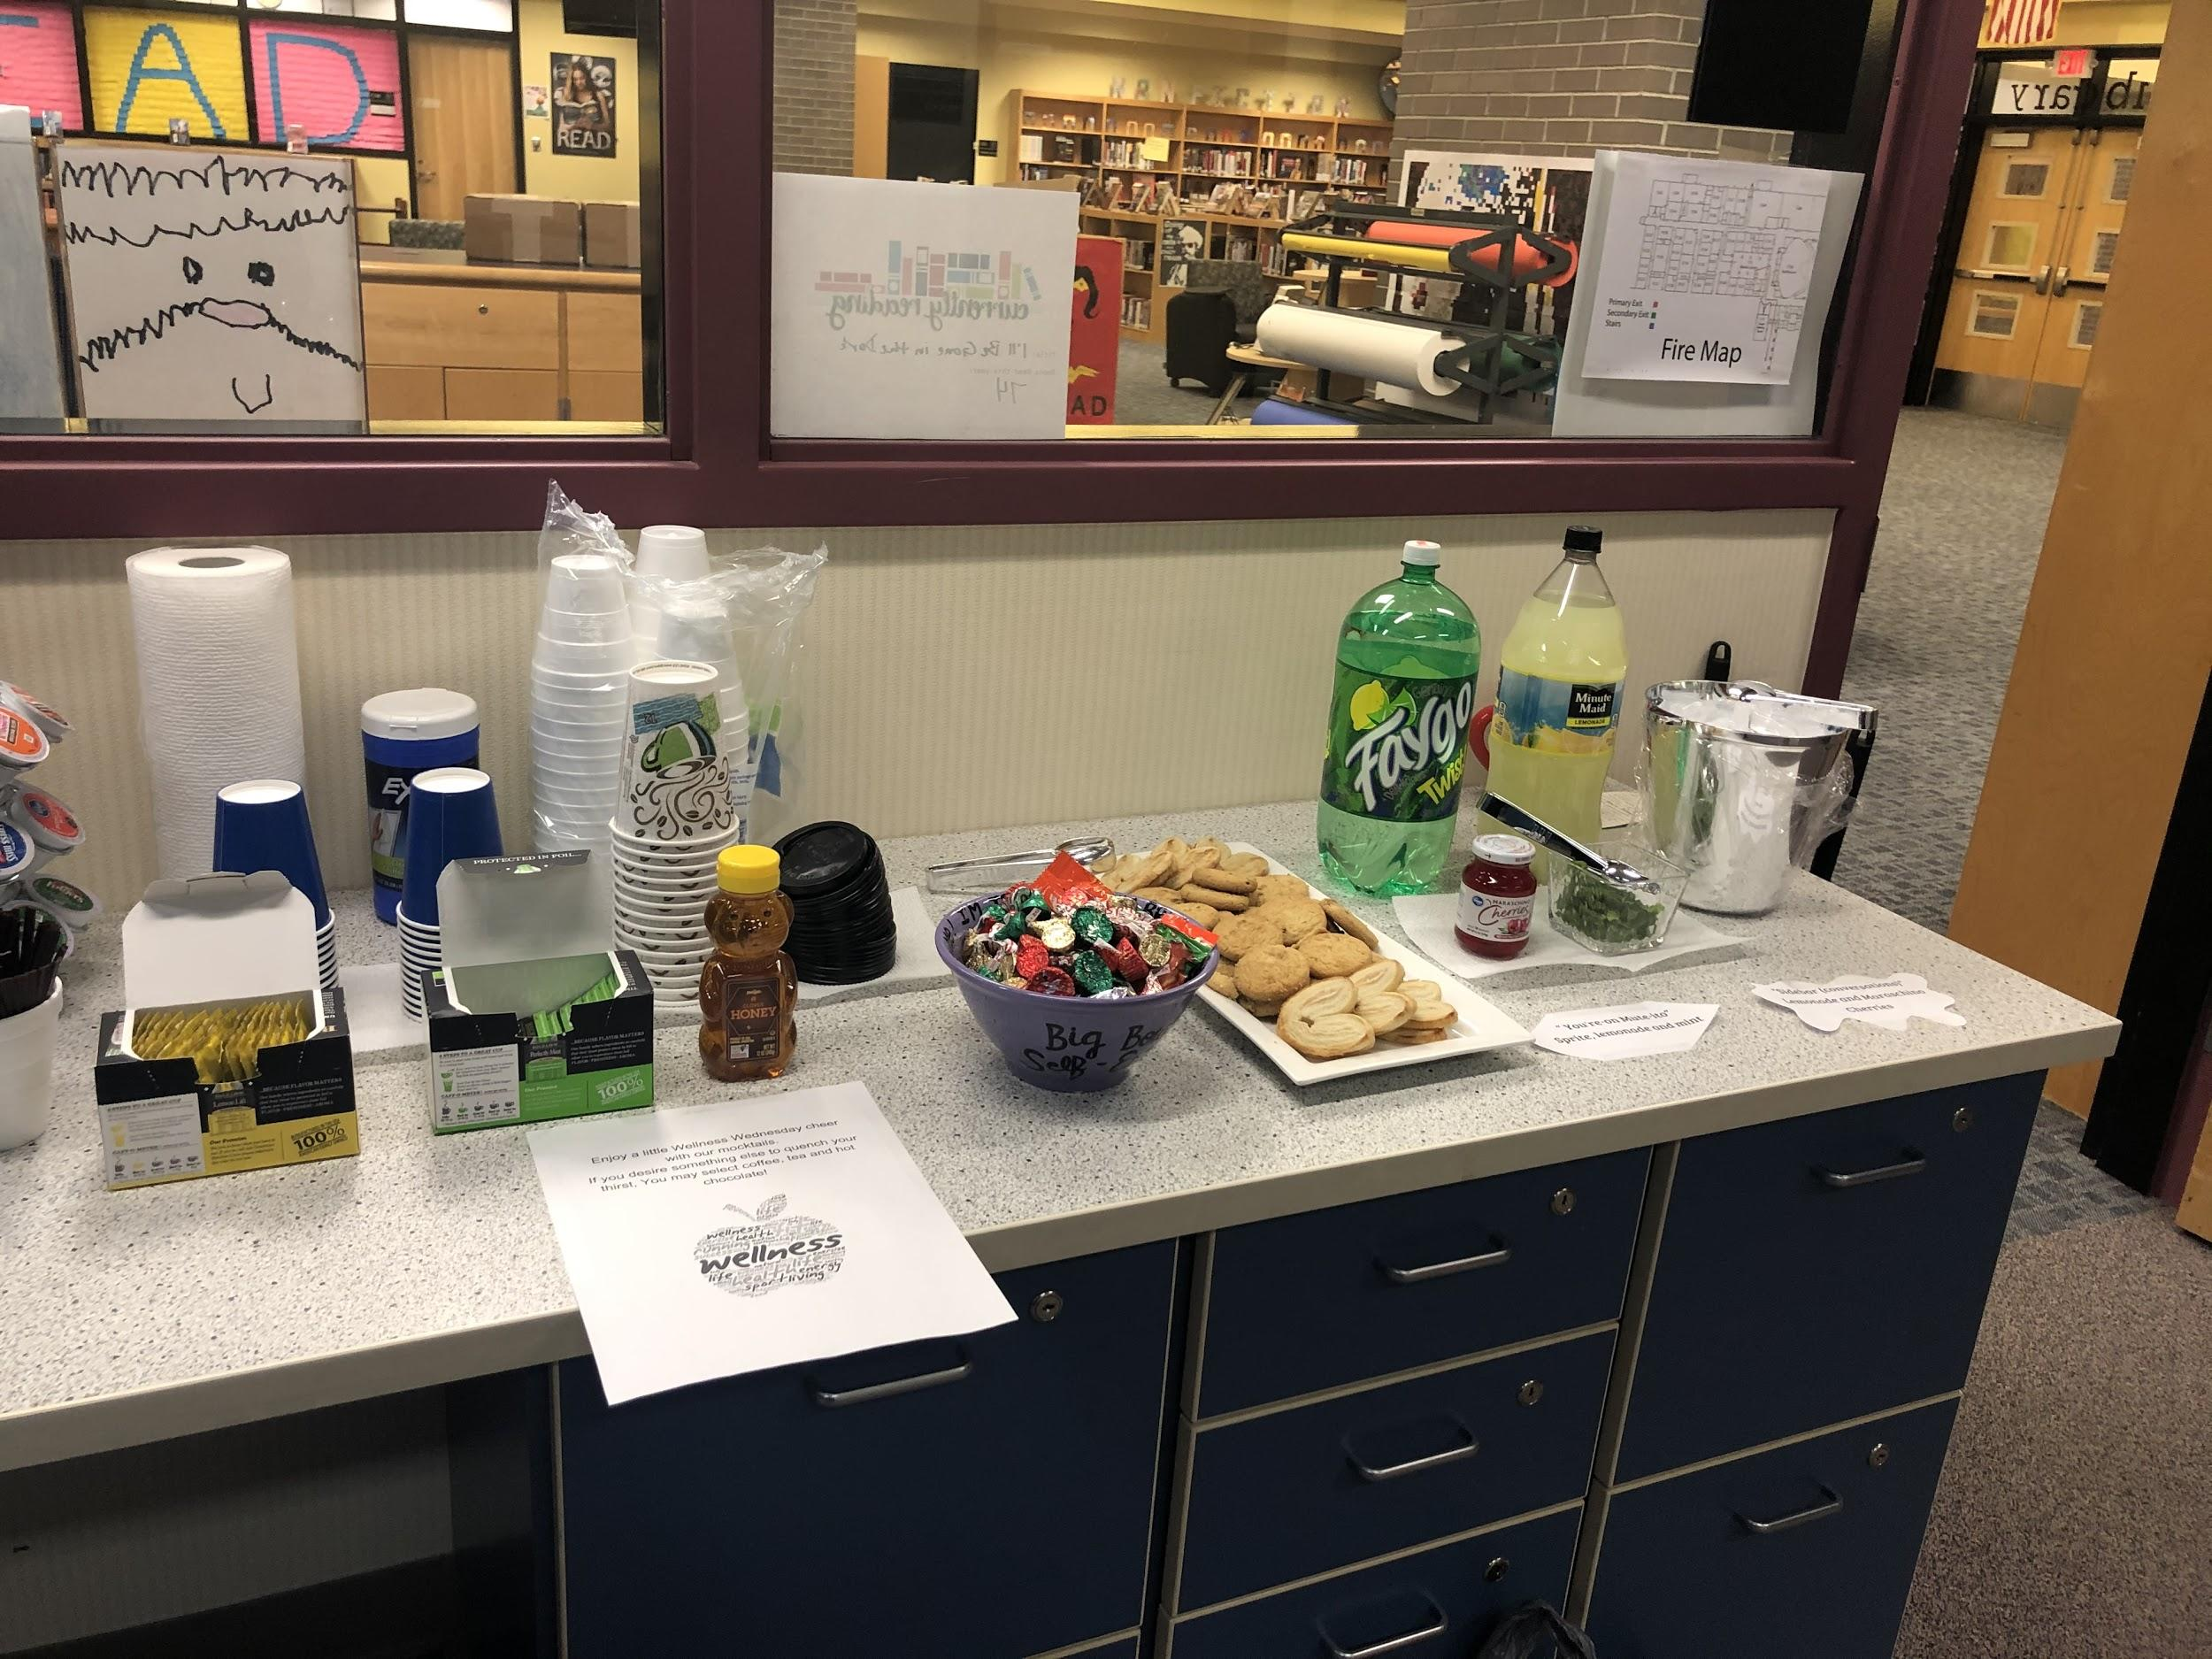

Slide 26
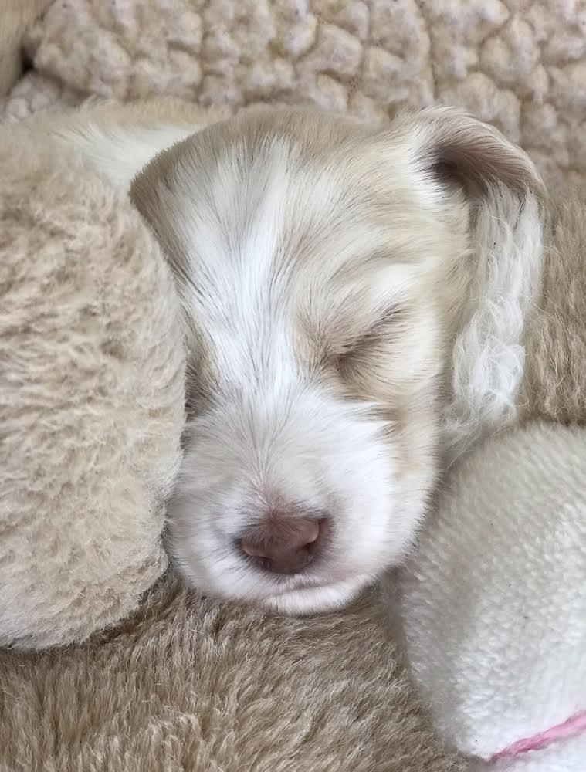
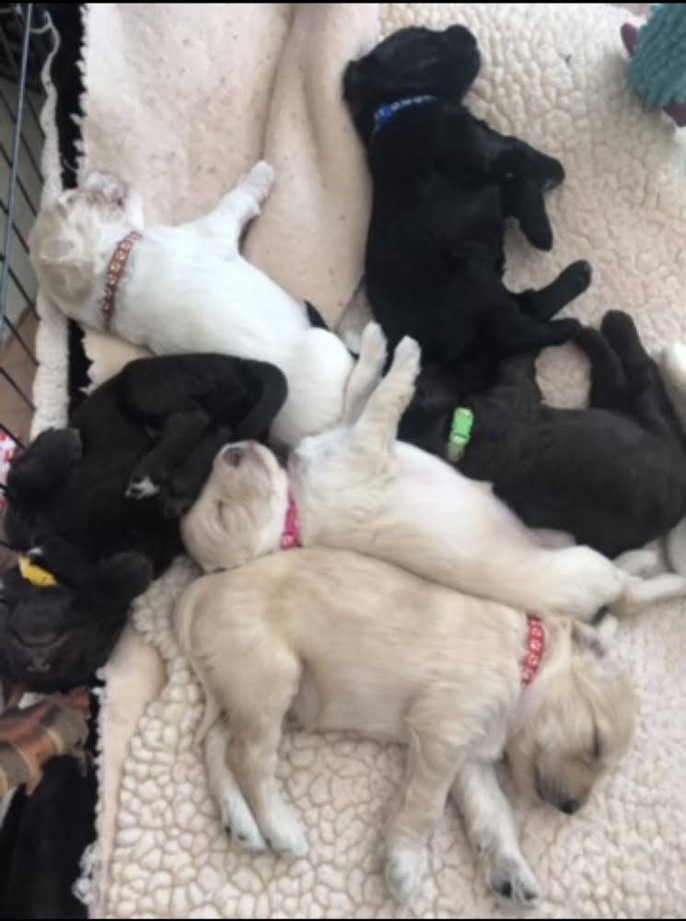
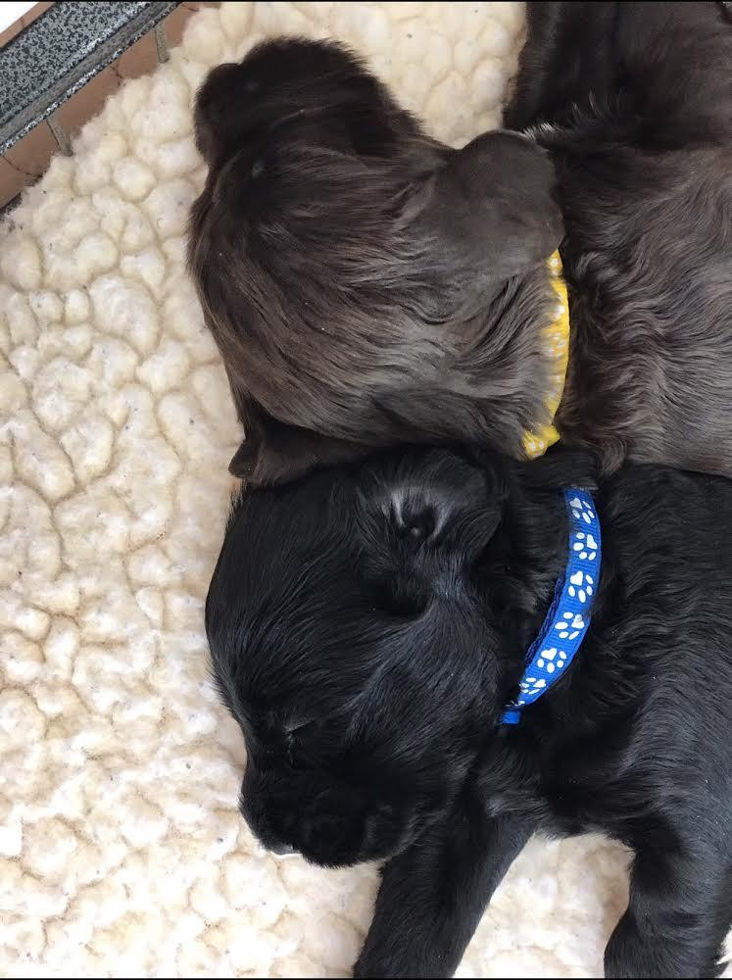

Slide 27
What is your whole child, whole school strategy?
“Breakout rooms”

Slide 29
Two Conditions for Well-Being and Learning!

Slide 30
But what if you don’t have an “Academy”?
Break room?
Mindful morning announcement
1:1 with students (Goal work? GOOP Sheet)
QOTD
GOALs room
Teacher (and IA) education/training on behavior?
SPED team work (PLCs)?
Behavior team work?
Classroom observations (secretly teachers...)?
Mindfulness work (but with teachers first!!)?

Slide 31
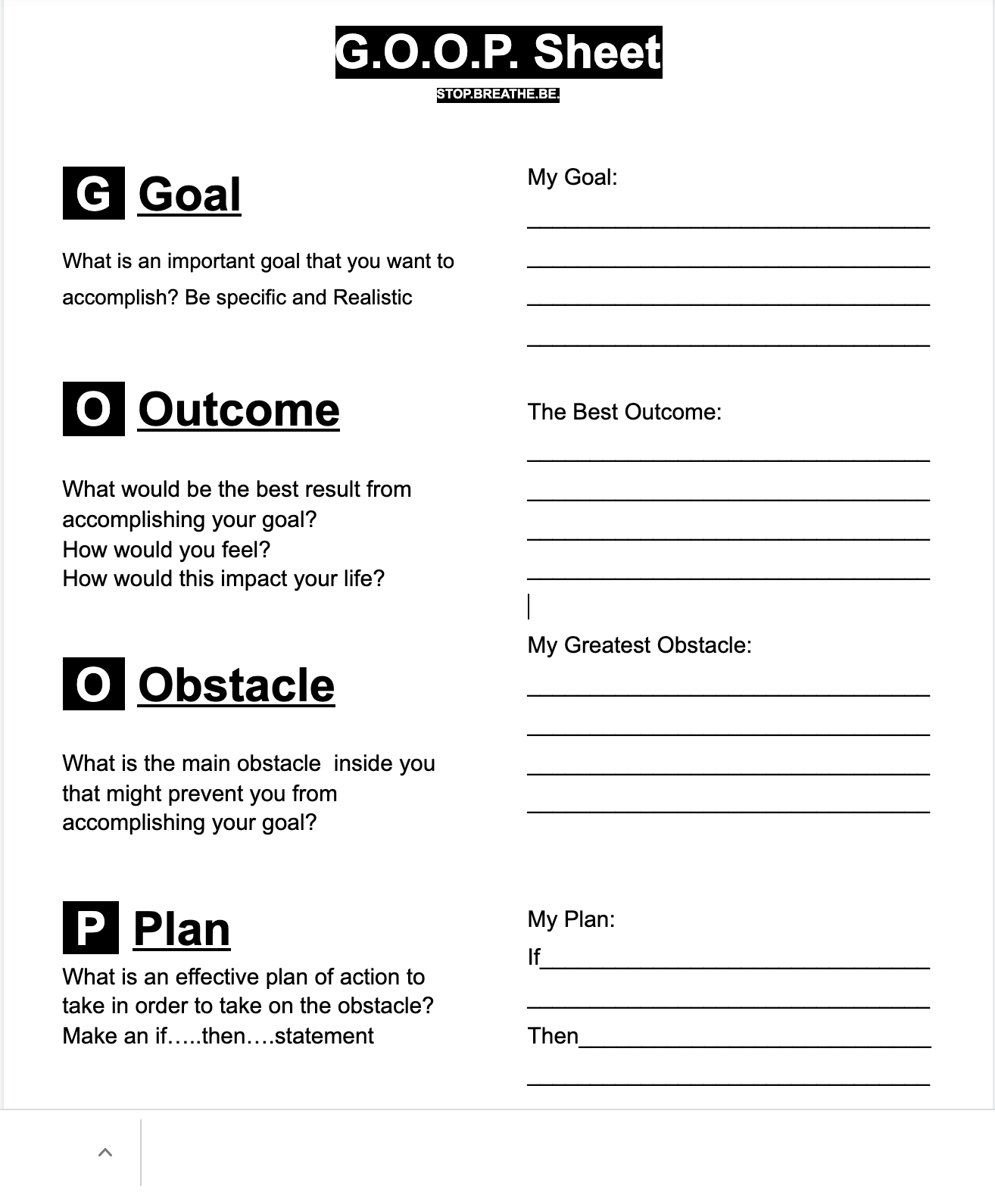

Slide 32
Notes:
Imagine its summertime, late July. You are on a small dock on the edge of a peaceful lake . You are sitting on the wooden boards, your legs dangling over the water. Its a warm day and you can feel the heat of the sun on your skin and face. Theres a refreshing drink in your hand and you can feel the coolness of the glass contrasting with the heat of the day. A light breeze blows across the water, stirring your hair, and the hairs on your arms >The breeze carries the faint smell of the reeds, earth and the lake water.
A cloud passes over the sun and then a cooler breeze blows across the water and gives you a slight shiver, reminding you that the summer is passing quickly. The new school year will soon begin. You recall that you still have some files to prep and go over before the first day. You start to wonder about the new students and old students and how they are doing-Will that one kid show up?? Did his mom remember to enroll him? And some of the jobs you left undone at the end of the year-I never did clean out those old files. Oh shoot I was going to make that new bulletin board! Did I order that mindfulness book I was going to get?
Whether or not you actually felt any sensations you probably noticed what happened there. We moved from full-on present moment sensory experiencing into thinking-planning the future with our internal narrative mode.

Slide 33
TWO MAIN BRAIN MODES:
SENSING/PERCEPTUAL
SEEING
TASTING
TOUCHING
HEARING
SMELLING
THINKING/CONCEPTUAL
LABELING
ELABORATING
ANALYZING
JUDGING
GOAL-SETTING
PLANNING
COMPARING
REMEMBERING
SELF-REFLECTING
Notes:
These two main modes of the mind- Sensing and thinking- can be observed in action using brain scans. We all have this capacity to experience our senses and to move into our thoughts and we flip from one to the other and back again, usually without even noticing. Most of us, however spend a lot of time in our thoughts and inner storytelling and not so much time experiencing the present moment directly through our sense.
A key component of training in mindful awareness is learning how to bring our attention out of the thinking mode and into our bodies and sense. Into sensing mode. We train for this not to stop our thinking, nor to be permanently in our bodies, but in order to have a greater choice of where our attention goes. TO be able to inhabit the full range of sensory and cognitive experiences, depending on what is most appropriate for the occasion. When we are stuck in or overwhelmed by thinking, we can learn to drop our attention down into the body. When we want to focus on the future to do some planning for example, then we can choose that with full consciousness, now, in this moment.
When we are having a difficult day--perhaps feeling stressed by an interaction with a parent, colleague or a negative interaction with a student acting out, or maybe we are under pressure from a pile of papers that need graded, we might be vaguely aware of our discomfort, and that we are not really in the best state of mind to walk into a classroom and teach a lesson. If though we have already established some mindfulness strategies, these may allow us to just take a moment to drop into sensing our body and breath, to acknowledge our thoughts and emotions, maybe take a deeper breath and let some of that tension go. We can thus make a small shift in our focus, even in a brief moment, that enables us to be more present with those students in front of us right now

Slide 34
How do we help teachers without making them feel singled out, but supported?

Slide 35
Questions???

Slide 36
My contact information
Tammi L. Broadus, MSW, LSW
School Social Worker
The Academy at Greenfield Central
tbroadus@gcsc.k12.in.us
Facebook: Acad Greenfield
Twitter: The Academy Gree1
YouTube channel: The Secondary School Social Worker
Instagram: Secondary School Social Worker

Slide 37
Jennifer’s Contact Information
Jennifer Haston-Maciejewski
Behavior Specialist
Stop.Breathe.Be. (Consulting)
Greenfield-Central High School
jhaston@gcsc.k12.in.us
jenhaston@stopbreathbe.us
Twitter: @mrs_haston

Slide 38
Thank you!!!

