Slide 1

BOARD BRIEFING
FEBRUARY 2025

Slide 2
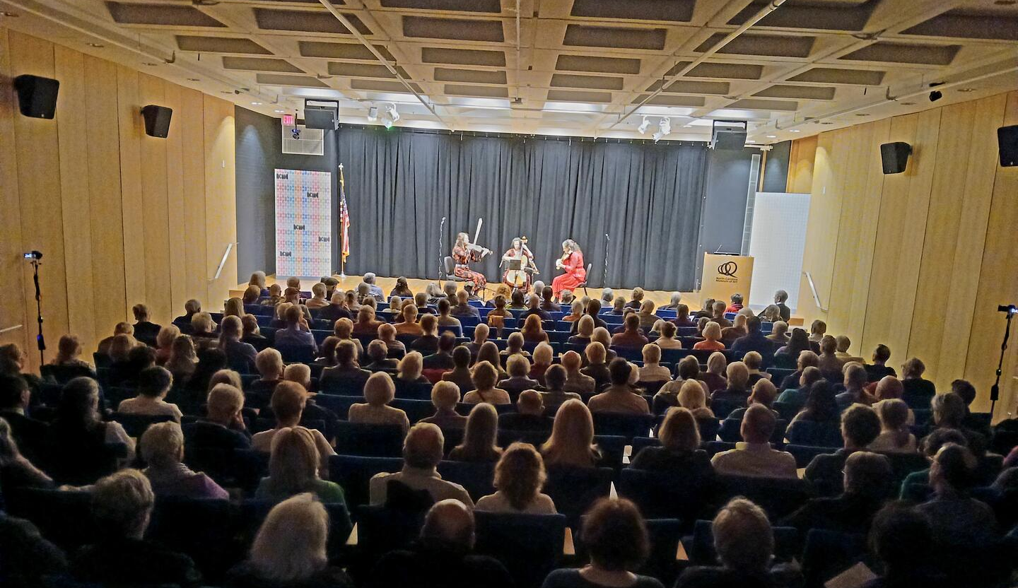
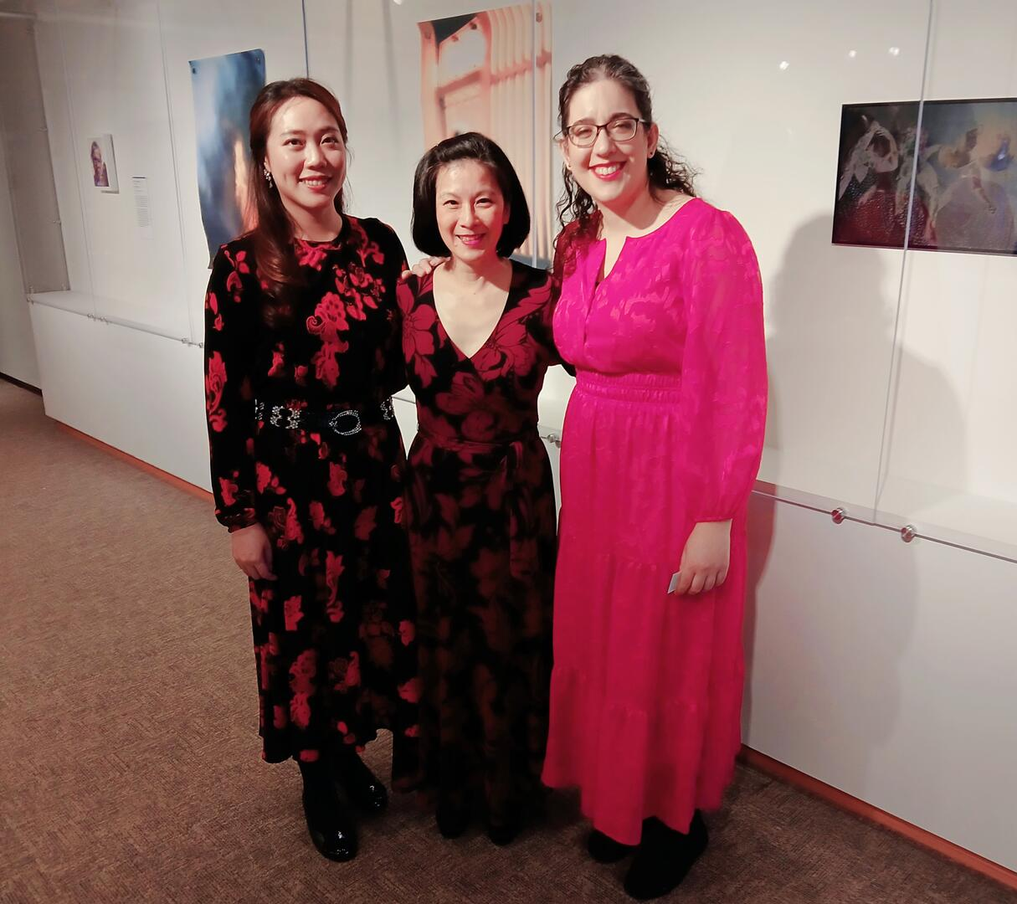
$900 Travel Stipend took their checks from $1045.06 to $1333.33

Slide 3

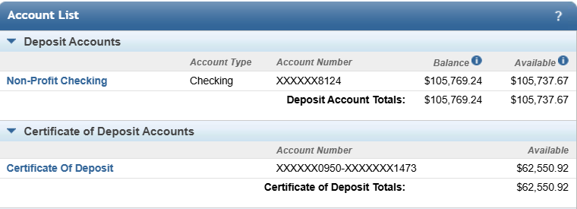
CD MATURES
2/23/2025
Currently @ 4.3% APY
Seeking support to move CD to another bank for a better 6-month rate

Slide 4


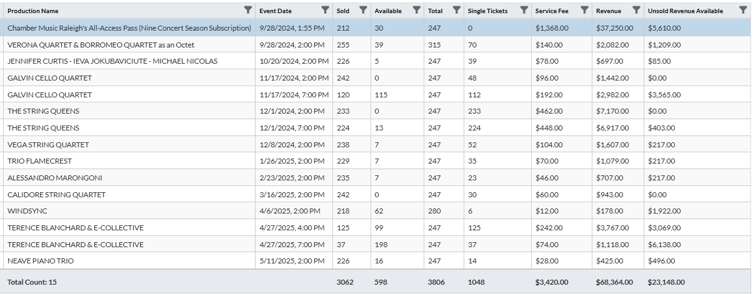
$68,364
Last Year
Feb-June
$9K
$21,850
$32,397
$10K

Slide 5

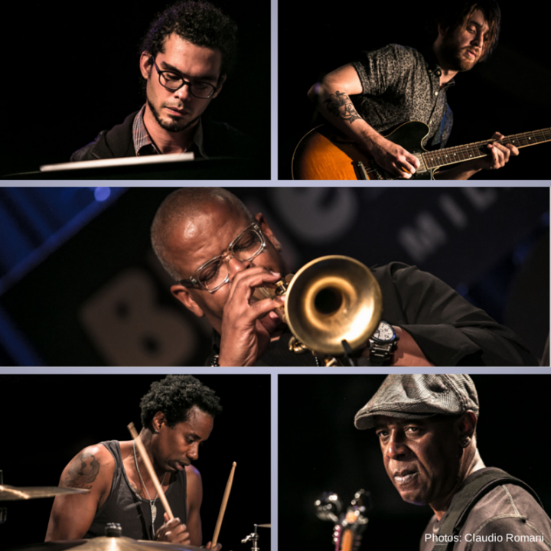

$20k Fee
$1200 Hotel
$500 Ground
$3k Backline
$24,700 Expenses
$15K Grant
$5K Cresimore
$5K SOLD
$25K Income
$9K Tickets
$34K Potential

Slide 6

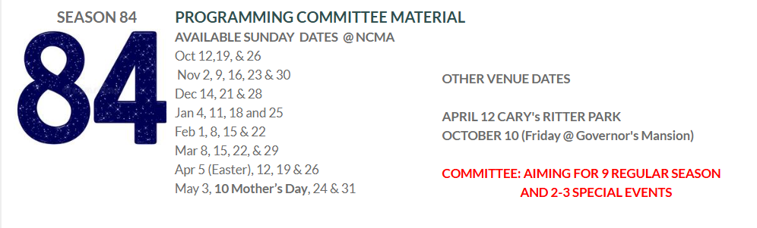
50 ENSEMBLE OPTIONS CURRENTLY
NO NCMA OUTDOOR JAZZ SERIES FOR NEXT TWO YEARS
SOUTHARTS TOURING GRANT ON HIATUS ($6K)

Slide 7
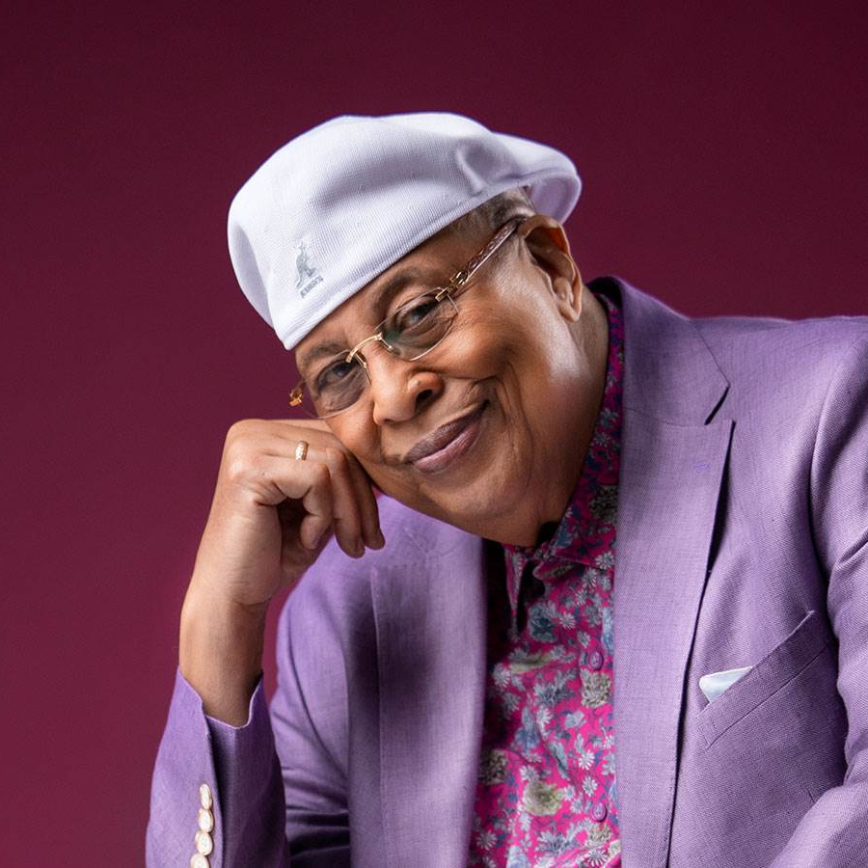
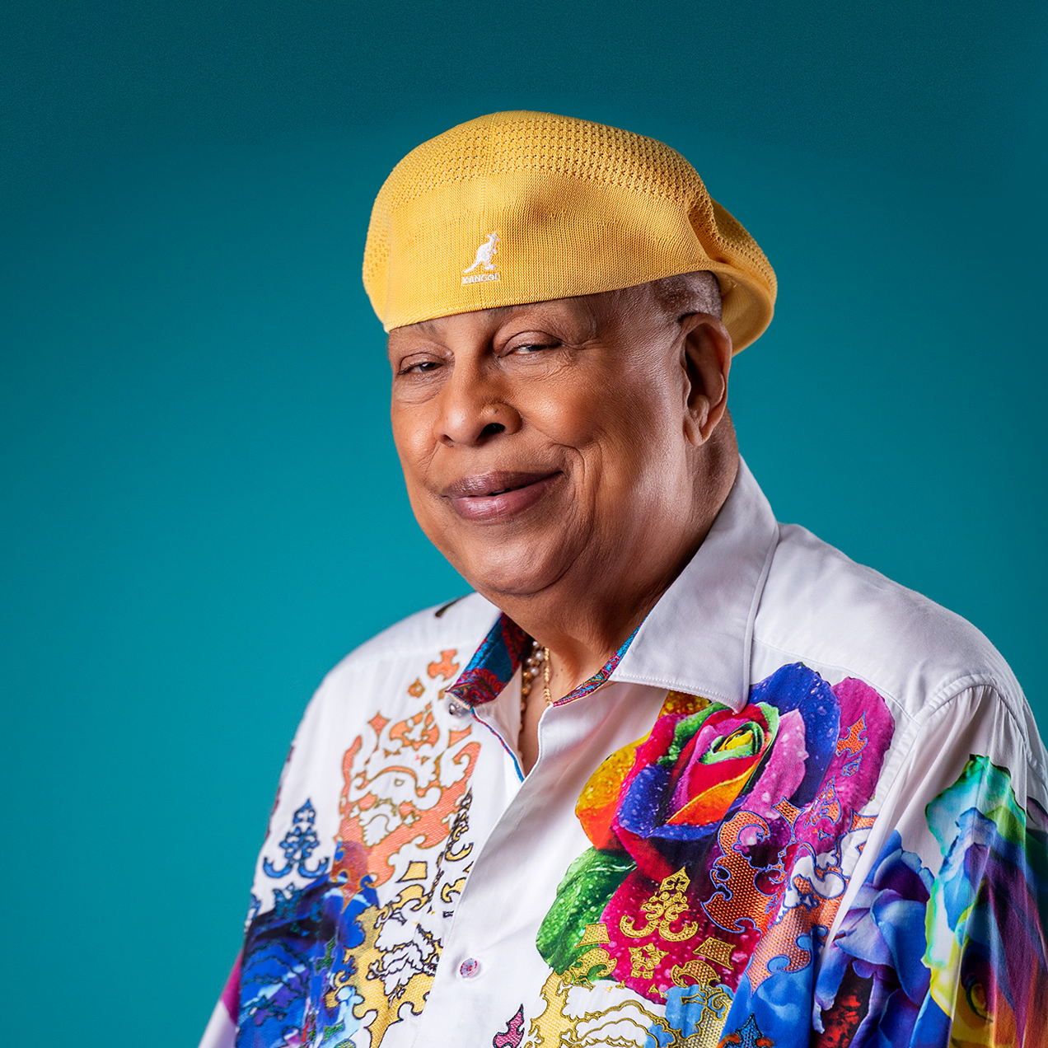
NEXT YEAR’S
NEA GRANT
PROPOSAL
FEB 13, 2025 Grants.gov Initial Submission
FEB 26, 2025 Full NEA Application Deadline
WINNER OF 7 GRAMMY’s & 6 LATIN GRAMMY’s
CHUCHU VALDÉS
Cuban pianist, composer, and arranger
Chucho Valdés is the most influential figure in modern Afro-Cuban jazz.
2025 NEA JAZZ MASTER
Can be packaged with an acoustic quartet

Slide 8

BETWEEN NOW & THE NEXT BOARD MEETING
SAT, FEBRUARY 22 – DINNER FOR ALESSANDRO MARANGONI & JOHN & NANCY LAMBERT
AT ROWENA MARIANO’S HOME
SUN, FEBRUARY 23 – ALESSANDRO MARANGONI @ NCMA (paying in cash EUROS, by the way)
SUN, MARCH 16 – CALIDORE STRING QUARTET @ NCMA
FRI, APRIL 4 – WINDSYNC @ MOREHEAD SCHOOL FOR THE BLIND
SAT, APRIL 5 – WINDSYNC @ MARBLES KIDS MUSEUM (3 Performances of Peter & The Wolf Program)
SUN, APRIL 6 – WINDSYNC @ CARY’S RITTER PARK – presented by Joe Kahn in memory of Elizabeth A. Kahn)
MON, APRIL 7 – NEXT CMR BOARD MEETING – SEASON 84 PROPOSED BUDGET & ARTIST ROSTER
SUN, APRIL 13 – Rowena Mariano (piano) & Jacob Wenger (cello) @ NCMA
$35 at www.AFRaleigh.org PROGRAM: Ravel, Chopin, Brahm & Fauré

Slide 9
