Slide 2


In support of improving patient care, Creative Educational Concepts LLC (CEC) is jointly accredited by the Accreditation Council for Continuing Medical Education (ACCME), the Accreditation Council for Pharmacy Education (ACPE), and the American Nurses Credentialing Center (ANCC), to provide continuing education for the healthcare team.

Slide 3

Activity Credit Types
Nurses (ANCC) | This activity is designated for 1.0 contact hours. Note to Nurse Practitioners: The content of this CNE activity pertains to Pharmacology.
 | This activity is designated for 1.0 contact hours. The program content has been reviewed by the Oncology Nursing Certification Corporation (ONCC) and is acceptable for recertification points.
OCN
Care Continuum
Care of the Pediatric Hematology and Oncology Patient
Oncology Nursing Practice
Professional Practice/Performance
Symptom Management, Palliative Care, Supportive Care
Treatment
CBCN
Care Continuum
Coordination of Care
Diagnosis and Staging
Nursing Practice
Psychosocial Dimensions of Care
Treatment
CPHON
Care Continuum
Psychosocial Dimensions of Care
Symptom Management, Palliative Care, Supportive Care
Treatment
AOCNP
Care Continuum
Professional Practice/Performance
Psychosocial Dimensions of Care
Roles of the APRN
Symptom Management, Palliative Care, Supportive Care
Treatment
BMTCN
Professional Practice/Performance

Slide 4
This activity may include discussions of products or devices that are not currently labeled for use by the U.S. Food and Drug Administration (FDA).
The faculty have been informed of their responsibility to disclose to the audience if they will be discussing off-label or investigational uses (any uses not approved by the FDA) of products or devices.

Slide 5

Claim Credit
QR Code
Scan the QR code to create or log in to a Creative Educational Concepts learner account. Complete the necessary requirements (e.g., pre-test, post-test, evaluation) and then claim your credit.* ​
Thank you for your participation! ​
*To receive credit, participants must register an account and apply for credit within 10 days of the live activity. For questions or technical difficulties, please contact info@ceconcepts.com.

Slide 6

Jennifer McKenna, RN, MSN, AOCNP
Nurse Practitioner
Breast Oncology Center
Dana Farber Cancer Institute
Boston, Massachusetts

Slide 7

Clara Beaver
DNP, RN, AOCNS, ACNS, BC
Manager Nursing Education/Clinical Nurse
Specialist
Karmanos Cancer Institute
Detroit, Michigan

Slide 8
Disclosures
Faculty
Jennifer McKenna, RN, MSN, AOCNP reports no financial relationships to disclose.
Clara Beaver, DNP, RN, AOCNS, ACNS, BC reports the following financial relationships:
Speakers Bureau—Padcev: drug for urothelial cancer: Astellas Pharma Inc./Seagen
Disclosures were obtained from the peer reviewers and Creative Educational Concepts staff—no disclosures to report.
Margaret Wright, BSN, RN (peer reviewer)
David Modrak, PhD (planning committee)
Evan Luberger (planning committee)
Scott J. Hershman, MD, FACEHP, CHCP (planning committee)
Sandra Caballero, PharmD (planning committee)
Sharon Tordoff (planning committee)

Slide 9
Summarize the impact of AEs associated with ADC use on the health-related quality of life of patients with HER2-negative MBC
Differentiate patients with HER2-negative MBC who are at risk of higher-grade AEs when receiving ADCs
Select optimal approaches to the management of AEs associated with ADC use by patients with HER2-negative MBC

Slide 10
Unmet Needs in
HER2-neg Metastatic Breast Cancer

Slide 11
Epidemiology and Unmet Needs in mBC
5-year BC-specific survival rates are significantly lower in Black women (80%) versus White (91%) women
Median age at death due to breast cancer
68 years all women
70 years White women
63 years Black women
Endocrine therapies are effective in HR-positive/HER2-negative disease with smaller effects on quality of life than chemotherapies
Chemotherapies for endocrine therapy–refractory HR-positive/HER2-negative and triple-negative BC are associated with diminished quality of life
AIAN, American Indian and Alaska Native; API, Asian Pacific Islander; HER2, human epidermal growth factor receptor 2
Rebner M, Pai VR. J Breast Imaging. 2020;2(5):416–421. Prakash O, et al. Front Public Health. 2020;8:576964; Giaquinto AN, et al. CA Cancer J Clin. 2022;72:524–541; Waks AG, Winer EP. JAMA. 2019;321(3):288–300.

Slide 12
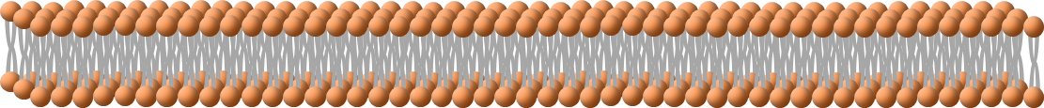
Comparison of ADCs for mBC
Sacituzumab govitecan
Datopotamab deruxtecan
Trastuzumab deruxtecan
DAR = 7.6:1
DAR = 4:1
DAR = 8:1
pH-sensitive, cleavable linker
Protease-cleavable linker
Protease-cleavable linker
SN-38
(Topo I inhibitor)
DXd (exatecan)
(Topo I inhibitor)
DXd (exatecan)
(Topo I inhibitor)
Humanized anti-TROP-2 IgG1
Humanized anti-TROP-2 IgG1
Humanized anti-HER2 IgG1
TROP-2
HER2
ADC, antibody drug conjugate.
Sacituzumab govitecan-hziy [package insert]. https://www.accessdata.fda.gov/drugsatfda_docs/label/2023/761115s035lbl.pdf.
Fam-trastuzumab deruxtecan-nxki (package insert). https://www.accessdata.fda.gov/drugsatfda_docs/label/2024/761139s028lbl.pdf.
Datopotamab deruxtecan-dlnk (package insert). https://www.accessdata.fda.gov/drugsatfda_docs/label/2025/761394s000lbl.pdf.

Slide 13
ADC Mechanisms of Action
Antibody engagement leads to
payload-independent antitumor activity via several mechanisms:
1. Fc-mediated stimulation of immune cell
2. Disruption of receptor dimerization
Most ADCs are internalized in tumor cells
The payload is released from endosomes and/or lysosomes and takes its effect on cells, leading to cell death
Membrane-permeable payloads enter neighboring cells regardless of target expression and can also kill these cells (bystander effect)
NK cell
Lysosome
Fc-mediated stimulation
of immune cell effector function
Disruption
of receptor dimerization and/or function
Microtubule
Disruption
of downstream signaling
Tumor cell
  Fc region of the mAb component of ADCs can orchestrate antibody-dependent cellular cytotoxicity (ADCC)
mAB, monoclonal antibody; NK, natural killer.
Drago JZ, et al. Nat Rev Clin Oncol. 2021;18:327-344.

Slide 14
Triple-negative Breast Cancer

Slide 15
ASCENT
Sacituzumab Govitecan in Second-line and Later mTNBC
Metastatic TNBC
≥ 2 chemotherapies, one of which could be in neo/adjuvant setting provided progression occurred within a 12-month period
Patients with stable brain metastasis were allowed
(N = 529)
Sacituzumab govitecan (SG)
10 mg/kg IV
Days 1 and 8, every 21 days
(n = 267)
Sacituzumab
govitecan
Continue treatment until progression or unacceptable toxicity
Primary Endpoint
PFS
Secondary Endpoints
PFS for the ITT population, OS, ORR, DoR, TTR, QoL, safety
pH-sensitive, cleavable linker
1:1
SN-38
(Topo I inhibitor)
Treatment of
physician’s choice
(n = 262)
Humanized anti-TROP-2 IgG1
TROP-2
DoR, duration of response; IV, intravenous; ITT, intention to treat; mTNBC, metastatic triple-negative breast cancer; ORR, objective response rate; OS, overall survival; PFS, progression-free survival; RECIST, Response Evaluation Criteria In Solid Tumours; TTR, time to response.
Bardia A, et al. N Engl J Med. 2021;384(16):1529–1541. Bardia A, et al. ESMO Virtual Congress. 2020. Abstract No. LBA17. https://oncologypro.esmo.org/meeting-resources/esmo-virtual-congress-2020/ascent-a-randomized-phase-iii-study-of-sacituzumab-govitecan-sg-vs-treatment-of-physician-s-choice-tpc-in-patients-pts-with-previously-treat; ClinicalTrials.gov. Identifier: NCT02574455.

Slide 16
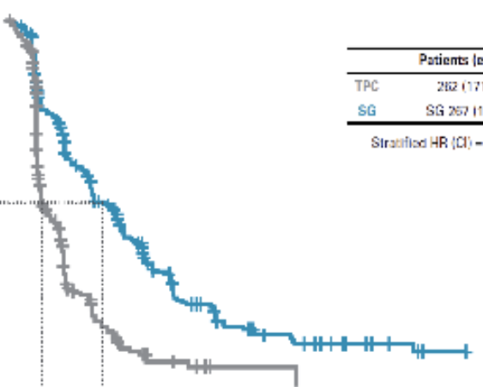
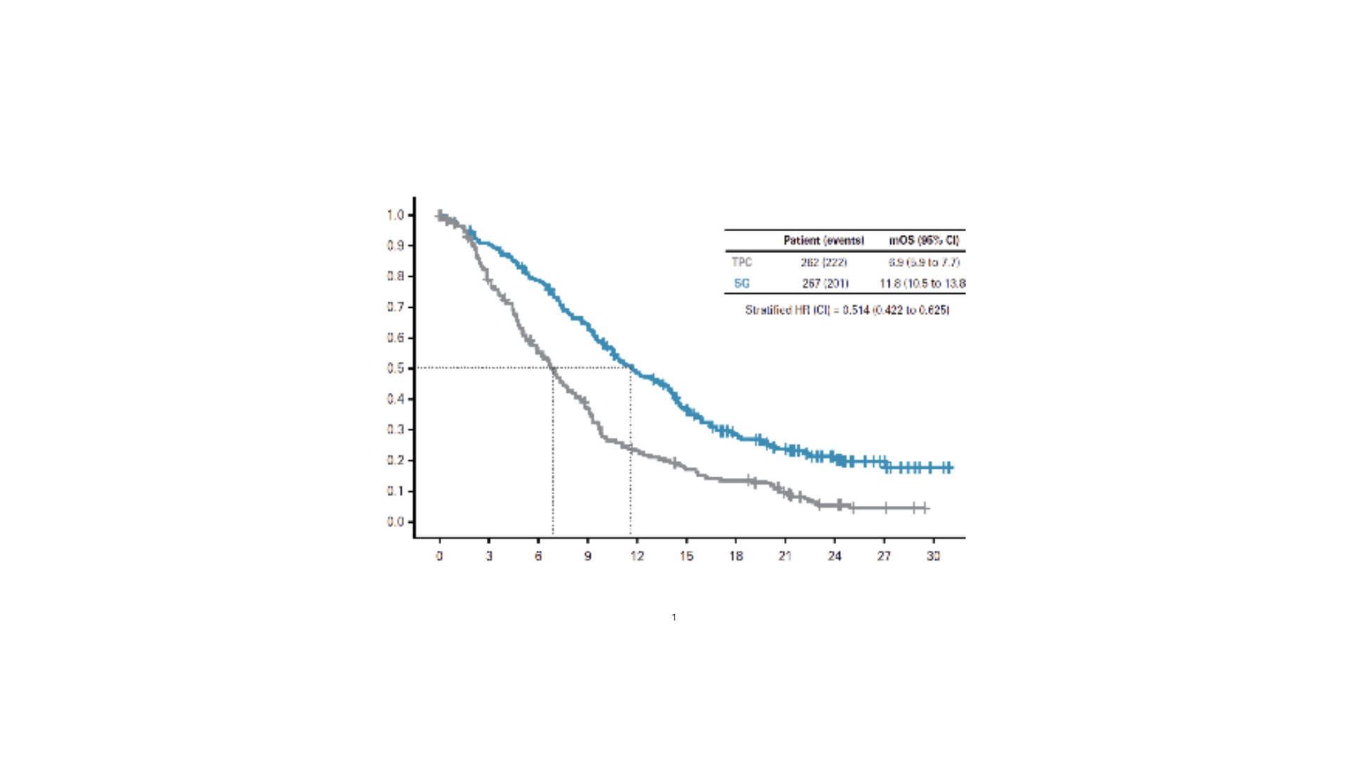

ASCENT
PFS and OS Final Outcomes
The ASCENT trial demonstrated statistically significant improvement in PFS and OS over single-agent chemotherapy in the primary study population.
Median PFS, months (95% CI)
TPC | 1.7 (1.5 – 2.5)
SG | 4.8 (4.1-5.8)
Stratified HR (CI) = 0.413 (0.330 to 0.517)
Median OS, months (95% CI)
TPC | 6.9 (5.9 – 7.7)
SG | 11.8 (10.5 – 13.8)
Stratified HR (CI) = 0.514 (0.422 to 0.625)
ASCENT → Approval in
second-line+ mTNBC
PFS (probability)
OS (probability)
Time (months)
Time (months)
ASCENT → Approval in second-line+ mTNBC
BICR, blinded independent central review; BMneg, brain metastases negative; CI, confidence interval; HR, hazard ratio;
TPC, treatment of physician’s choice.
Bardia A, et al. J Clin Oncol. 2024;42(15):1738-1744.

Slide 17
ASCENT
TRAEs Occurring in ≥15% of Patients and AESIs
System Organ Class Preferred term, n (%) | SG (n = 258) |  | TPC (n=224)
 | Any Grade | Grade ≥ 3 | Any Grade | Grade ≥ 3
Blood and lymphatic system
Neutropenia | 165 (64) | 135 (52) | 98 (44) | 76 (34)
Anemia | 103 (40) | 24 (9) | 62 (28) | 13 (6)
Leukopenia | 43 (17) | 27 (11) | 27 (12) | 13 (6)
Gastrointestinal
Diarrhea | 168 (65) | 30 (12) | 38 (17) | 2 (1)
Nausea | 161 (62) | 8 (3) | 68 (30) | 1 (< 1)
Vomiting | 87 (34) | 5 (2) | 36 (16) | 3 (1)
Constipation | 96 (37) | 1 (< 1) | 52 (23) | 0
Abdominal Pain | 54 (21) | 7 (3) | 18 (8) | 3 (1)
General
Fatigue | 133 (52) | 11 (4) | 89 (40) | 19 (9)
Asthenia | 40 (16) | 4 (2) | 29 (13) | 3 (1)
AEs of special interest
Median time to first onset of neutropenia (including febrile) was 16 days; neutropenia occurred earlier in patients with reduced UGT1A1 activity; neutropenic colitis occurred in 1.4% of patients.
  Primary prophylaxis with G-CSF is recommended starting in the cycle 1 of treatment in all patients at increased risk of febrile neutropenia (older patients, those with previous neutropenia, poor performance status, organ dysfunction or multiple comorbidities)
  Withhold for absolute neutrophil count below 1,500/mm³ on Day 1 of any cycle or below 1,000/mm³ on Day 8 of any cycle
  Boxed Warning: Severe or life-threatening neutropenia and severe diarrhea may occur with SG
AESIs, adverse events of special interest; TRAEs, treatment-related adverse events.
Bardia A, et al. J Clin Oncol. 2024;42(15):1738-1744. Sacituzumab govitecan-hziy [package insert]. https://www.accessdata.fda.gov/drugsatfda_docs/label/2023/761115s035lbl.pdf.

Slide 18
ASCENT: Quality of Life, Functional Domains
Improved functioning
Sacituzumab govitecan
Treatment physician's choice
Loibl S, et al. Future Oncol. 2024;20(34):2609-2616.

Slide 19
ASCENT: Quality of Life, Symptom Domains
Improved symptomology
Sacituzumab govitecan
Treatment physician's choice
Fatigue | Pain | Nausea/ vomiting | Dyspnea | Insomnia | Appetite loss | Constipation | Diarrhea | Financial difficulties | EORTC QLQ-C30 summary score
Loibl S, et al. Future Oncol. 2024;20(34):2609-2616.
EORTC, European Organisation for Research and Treatment of Cancer.

Slide 20
HR+/HER2-negative Breast Cancer

Slide 21
TROPiCS-02
SG in Pre-treated HR+/HER2-neg Locally Recurrent Inoperable or MBC
Metastatic or locally recurrent inoperable HR+/HER2-neg breast cancer that progressed after*
At least 1 endocrine therapy, taxane, and CDK4/6 inhibitor in any setting
At least 2, but no more than 4, lines of chemotherapy for metastatic disease
IHC 0, IHC 1+, IHC 2+/ISH Negative
Measurable disease by RECIST 1.1
Treatment was continued until progression or unacceptable toxicity
Sacituzumab
govitecan
Primary Endpoint
PFS by BICR
Secondary Endpoints
OS
ORR, DoR, CBR by LIR and BICR
PRO
Safety
Sacituzumab govitecan
10 mg/kg IV
Days 1 and 8, every 21 days
n = 272
pH-sensitive, cleavable linker
SN-38
(Topo I inhibitor)
R
1:1
Humanized anti-TROP-2 IgG1
TPC†
capecitabine, vinorelbine,
gemcitabine, or eribulin
n = 271
TROP-2
CBR, clinical benefit rate; IHC, immunohistochemistry; LIR, local investigator review; PRO, patient reported outcomes; SoC, standard of care.
Adapted from Rugo H, et al. ESMO Congress. 2022. Abstract LBA76. https://oncologypro.esmo.org/meeting-resources/esmo-congress-2022/overall-survival-os-results-from-the-phase-iii-tropics-02-study-of-sacituzumab-govitecan-sg-vs-treatment-of-physician-s-choice-tpc-in-patient.
Rugo HS, et al. J Clin Oncol. 2022;40(29):3365–3376. ClinicalTrials.gov. Identifier: NCT03901339.

Slide 22
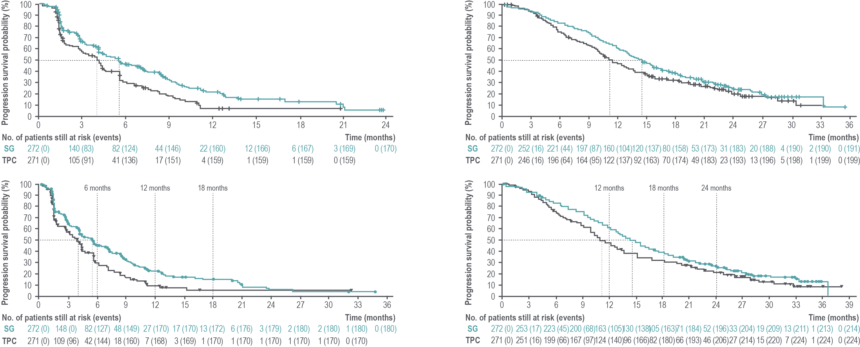
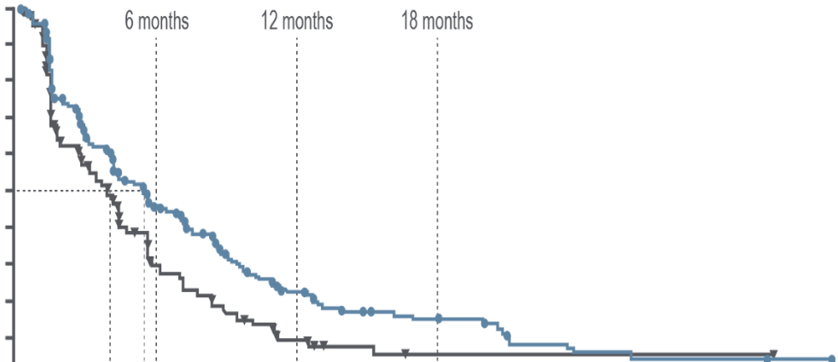
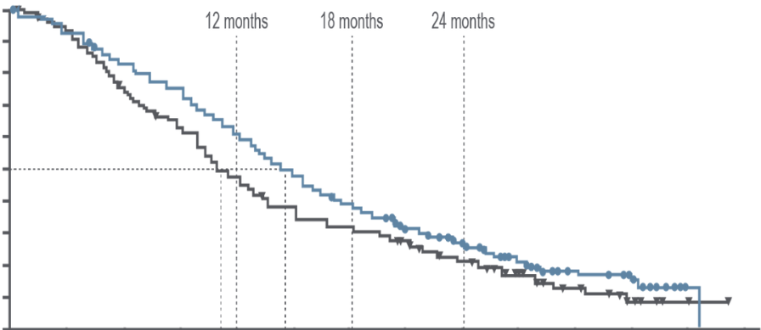
TROPiCS-02
PFS and OS vs Chemotherapy
Progression-free Survival
Overall Survival
6 months 12 months 18 months
12 months 18 months 24 months
100
100
BICR analysis | SG (n = 272) | TPC (n = 271)
Median OS, months (95% CI) | 14.5 (13.0–16.0) | 11.2 (10.2–12.6)
Stratified HR (95% CI) | 0.79 (0.65–0.95) | 17.3 (11.5–24.2)
Nominal P-value* | 0.0133 | 7.1 (2.8–13.9)
90
BICR analysis | SG (n = 272) | TPC (n = 271)
Median PFS, months (95% CI) | 5.5 (4.2–6.9) | 4.0 (3.0–4.4)
Stratified HR (95% CI) | 0.65 (0.53-0.81) | 17.3 (11.5–24.2)
Nominal P-value* | 0.0001 | 7.1 (2.8–13.9)
90
80
80
70
70
60
60
OS
50
50
PFS
40
40
30
30
20
20
10
10
PFS^{4†}
OS^{4†}
0
0
0
3
6
9
12
15
18
21
24
27
30
33
36
0
3
6
9
12
15
18
21
24
27
30
33
36
39
Time (months)
Time (months)
No. of Patients Still at Risk
SG | 272 | 148 | 82 | 48 | 27 | 17 | 13 | 6 | 3 | 2 | 2 | 1 | 0
TPC | 271 | 109 | 42 | 18 | 7 | 3 | 1 | 1 | 1 | 1 | 1 | 0
No. of Patients Still at Risk
SG | 272 | 253 | 223 | 200 | 163 | 130 | 105 | 71 | 52 | 33 | 19 | 13 | 1 | 0
TPC | 271 | 251 | 199 | 167 | 124 | 96 | 82 | 66 | 46 | 27 | 15 | 7 | 1 | 0
TROPiCS-02 → Approval in HR+/HER2-negative mBC
Adapted from Rugo HS, et al. J Clin Oncol. 2022;40:3365–3376. Adapted from Rugo H, et al. ESMO Congress. 2022. Abstract No. LBA76;
Adapted from Rugo H, et al. Lancet. 2023;402(10411):1423–1433. Tolaney S, et al. ASCO Annual Meeting. 2023. Abstract No. 1003.

Slide 23
TROPiCS (SG)
TRAEs Occurring in ≥ 15% of Patients and AESIs
System Organ Class Preferred term, n (%) | SG (n = 268) |  | TPC (n = 249)
 | Any Grade | Grade ≥ 3 | Any Grade | Grade ≥ 3
Blood and lymphatic system
Neutropenia | 188 (70) | 136 (51) | 134 (54) | 95 (38)
Anemia | 91 (34) | 17 (6) | 62 (25) | 8 (3)
Gastrointestinal
Diarrhea | 152 (57) | 25 (9) | 42 (17) | 3 (1)
Nausea | 148 (55) | 3 (1) | 77 (31) | 7 (3)
Vomiting | 51 (19) | 1 (< 1) | 30 (12) | 4 (2)
Constipation | 50 (19) | 0 | 36 (15) | 0
General
Alopecia | 123 (46) | 0 | 41 (17) | 0
Fatigue | 101 (38) | 15 (6) | 73 (29) | 7 (3)
Asthenia | 53 (20) | 5 (2) | 37 (15) | 2 (1)
AE of special interest
Median time to first onset of neutropenia (including febrile neutropenia) was 16 days; neutropenia occurred earlier in patients with reduced UGT1A1 activity; neutropenic colitis occurred in 1.4% of patients.
  Primary prophylaxis with G-CSF is recommended starting in the first cycle of treatment in all patients at increased risk of febrile neutropenia (older patients, patients with previous neutropenia, poor performance status, organ dysfunction, or multiple comorbidities)
  Withhold for ANC below 1500/mm³ on Day 1 of any cycle or below 1000/mm³ on Day 8 of any cycle
AESIs, adverse events of special interest; ANC, absolute neutrophil count;; TRAEs, treatment-related adverse events
Bardia A, et al. J Clin Oncol. 2024;42(15):1738-1744. Sacituzumab govitecan-hziy [package insert]. https://www.accessdata.fda.gov/drugsatfda_docs/label/2023/761115s035lbl.pdf.

Slide 24
Sacituzumab Govitecan for Breast Cancer
Boxed Warnings
Neutropenia: severe, possibly life-threatening
Diarrhea: may be severe and lead to dehydration
AEs of Special Concern
  Hypersensitivity and infusion-related reactions
  Nausea and vomiting
  Increased risk of adverse reactions in patients with reduced UGT1A1 activity
  Embryo-fetal harm
Hematologic
  Neutropenia (63%)
  Anemia (34%)
Other
  Fatigue (45%)
  Alopecia (46%)
Gastrointestinal
  Diarrhea (59%)
  Nausea (57%)
  Vomiting (29%)
  Constipation (17%)
  Abdominal pain (11%)
AEs, adverse events.
Sacituzumab govitecan-hziy [package insert]. https://www.accessdata.fda.gov/drugsatfda_docs/label/2023/761115s035lbl.pdf.

Slide 25
ASCENT and TROPiCS-02
Safety Outcomes by UGT1A1 Status
UGT1A1
Variants affect enzymatic function, causing reduced metabolic capacity
Over 50% of individuals may harbor a UGT1A1 polymorphism dependent on genetic ancestry
Commercial tests are available for UGT1A1 polymorphisms
 | ASCENT |  |  | TROPiCS-02
Grade ≥ 3 TEAEs By UGT1A1 Status (%) | NM | IM | PM | NM | IM | PM
Neutropenia | 53 | 47 | 59 | 45 | 57 | 64
Diarrhea | 10 | 9 | 15 | 6 | 13 | 24
Anemia | 4 | 6 | 15 | 6 | 8 | 8
Febrile neutropenia | 3 | 5 | 18 | 6 | 7 | 4
UGT1A1 Phenotype Frequencies among Racial/Ethnic Groups
UGT1A1 Phenotype | African American /Afro-Caribbean | Central/ S. Asian | East Asian | European | Latino | Sub-Saharan African
NM | 2% | 29% | 50% | 13% | 4% | 32%
IM | 20% | 50% | 42% | 46% | 33% | 49%
PM | 78% | 21% | 8% | 41% | 63% | 19%
Treatment discontinuation due to TRAEs more common in PM homozygous genotype
TRAE, treatment-related adverse events; NM, normal metabolizer; IM, intermediate metabolizer; PM, poor metabolizer.
Nelson RS, et al. Cancers (Basel). 2021;13(7):1566. Rugo, HS, et al. NPJ Breast Cancer. 2022;8(1):98.
Marmé, F, et al. Ann Oncol. 2023;8(1suppl_4):101223–101223. Rugo HS, et al. Lancet. 2023;402(10411):1423–1433.

Slide 26
Sacituzumab Govitecan Indication in Breast Cancer
TNBC
Unresectable locally advanced or metastatic triple-negative breast cancer (mTNBC) who have received two or more prior systemic therapies, at least one of them for metastatic disease.
HR+/HER2-neg BC
Unresectable locally advanced or metastatic hormone receptor (HR)-positive, HER2-negative (IHC 0, IHC 1+ or IHC 2+/ISH–) breast cancer who have received endocrine-based therapy and at least two additional systemic therapies in the metastatic setting.
Sacituzumab govitecan-hziy [package insert]. https://www.accessdata.fda.gov/drugsatfda_docs/label/2023/761115s035lbl.pdf.

Slide 27
TROPION-Breast01
Dato-DXd vs. CT in HR+/HER2-negative MBC
Key Eligibility Criteria
Unresectable or metastatic HR+/HER2-neg BC (HER2 IHC 0/1+/2+; ISH neg)
Prior endocrine therapy (ET)
1–2 prior lines of CT in inoperable/metastatic setting
Datopotamab
deruxtecan
Protease-cleavable linker
R
A
N
D
OM
I
Z
E
D
Datopotamab deruxtecan (Dato-DXd)
6 mg/kg IV Day 1, Q3W
(n = 365)
DXd (exatecan)
(Topo I inhibitor)
Humanized anti-TROP-2 IgG1
1:1
ICC
Eribulin D1, 8, Q3W; vinorelbine D1, 8, Q3W;
gemcitabine D1, 8, Q3W; capecitabine D1–14, Q3W
(n = 367)
N = 732
TROP-2
Dual primary endpoints: PFS by BICR per RECIST v1.1, and OS
Secondary endpoints: ORR, PFS by investigator, safety
ICC, investigator’s choice of CT.
Bardia A, et al. ESMO Congress. 2023. Abstract No. LBA11. https://oncologypro.esmo.org/meeting-resources/esmo-congress-2023/datopotamab-deruxtecan-dato-dxd-vs-chemotherapy-in-previously-treated-inoperable-or-metastatic-hormone-receptor-positive-her2-negative-hr-her2.

Slide 28
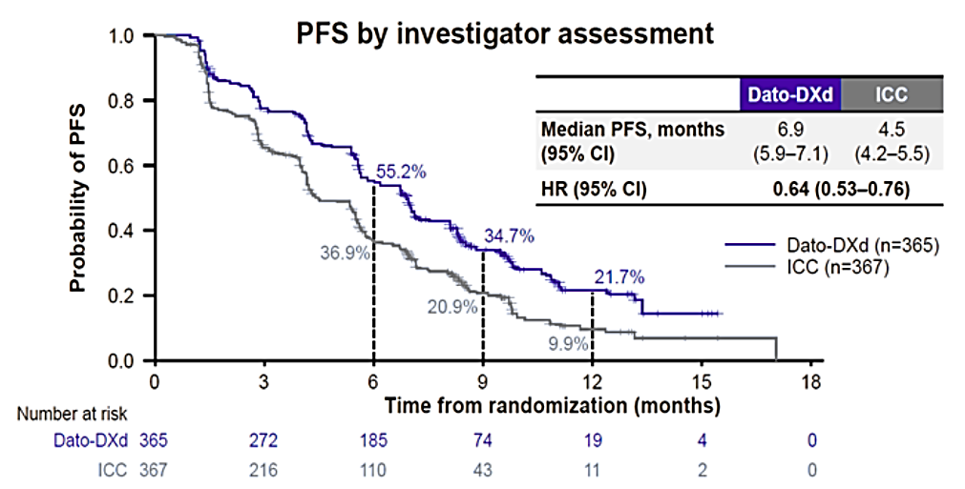
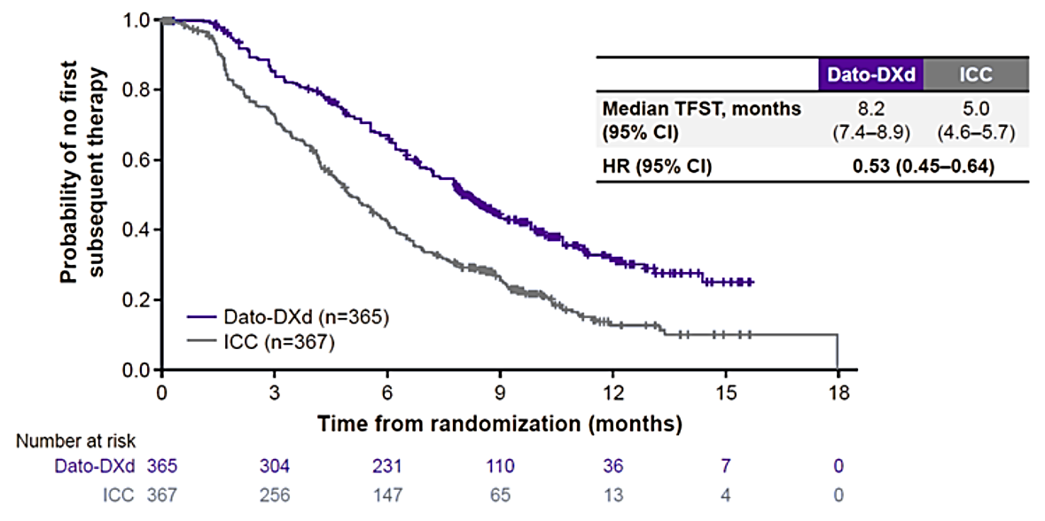
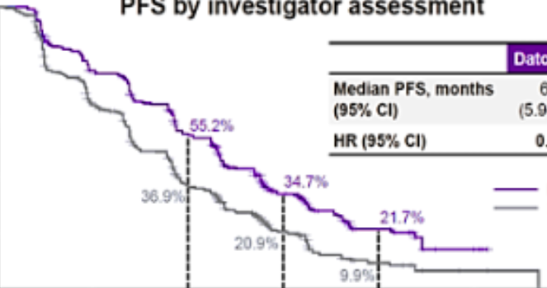
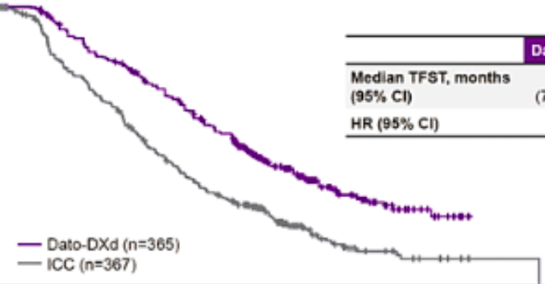
TROPION-Breast01
Dato-DXd vs. TPC in HR+ MBC PFS and Time to Subsequent Therapy
PFS by Investigator Assessment
Time to First Subsequent Therapy
1.0
0.8
0.6
0.4
0.2
0.0
 | Dato-DXd | ICC
Median PFS, months (95% CI) | 6.9 (5.9–7.1) | 4.5 (4.2–5.5)
HR (95% CI) | 0.64 (0.53–0.76)
1.0
0.8
0.6
0.4
0.2
0.0
 | Dato-DXd | ICC
Median TFST, months (95% CI) | 8.2 (7.4–8.9) | 5.0 (4.6–5.7)
HR (95% CI) | 0.53 (0.45–0.64)
55.2%
Probability of No First Subsequent Therapy
Probability of PFS
36.9%
34.7%
Dato-DXd (n = 365)
ICC (n = 367)
21.7%
Time to subsequent therapy
Dato-DXd (n = 365)
ICC (n = 367)
20.9%
9.9%
0 3 6 9 12 15 18
0 3 6 9 12 15 18
Number at risk
Time from Randomization (months)
Number at risk
Time from Randomization (months)
Dato-DXd | 365 | 304 | 231 | 110 | 36 | 7 | 0
ICC | 367 | 256 | 147 | 65 | 13 | 4 | 0
Dato-DXd | 365 | 272 | 185 | 74 | 19 | 4 | 0
ICC | 367 | 216 | 110 | 43 | 11 | 2 | 0
Median 1 line of prior chemotherapy
PFS by BICR (primary endpoint)
Median 6.9 vs 4.9 months
HR 0.63 (95% CI: 0.52, 0)
TFST, time to fist subsequent therapy.
Bardia A, et al. San Antonio Breast Cancer Symposium. 2023. Abstract No. GS02-01.
https://aacrjournals.org/cancerres/article/84/9_Supplement/GS02-01/743527/Abstract-GS02-01-Randomized-phase-3-study-of.

Slide 29
TROPION-Breast01 (Dato-DXd)
TRAEs Occurring in ≥ 15% of Patients and AESIs
System Organ Class Preferred term, n (%) | Dato-DXd (n = 360) |  | ICC (n = 351)
 | Any Grade | Grade ≥ 3 | Any Grade | Grade ≥ 3
Blood and lymphatic system
Anemia | 40 (11) | 4 (1) | 69 (20) | 7 (2)
Neutropenia | 39 (11) | 4 (1) | 149 (42) | 108 (31)
Eye
Dry eye | 78 (22) | 2 (1) | 27 (8) | 0
Gastrointestinal
Nausea | 184 (51) | 5 (1) | 83 (24) | 2 (1)
Stomatitis | 180 (50) | 23 (6) | 46 (13) | 9 (3)
Vomiting | 71 (20) | 4 (1) | 27 (8) | 2 (1)
Constipation | 65 (18) | 0 | 32 (9) | 0
General
Fatigue | 85 (24) | 6 (2) | 64 (18) | 7 (2)
Skin and subcutaneous
Alopecia | 131 (36) | 0 | 72 (21) | 0
AE of special interest
Oral mucositis/stomatitis: led to treatment discontinuation in one patient in the Dato-DXd group
Ocular events: most were dry eye; one patient discontinued treatment in the Dato-DXd group
Adjudicated drug-related ILD: rate was low; mainly grade 1/2
Adjudicated Drug-related ILD | Dato-DXd | ICC
All grades, n (%) | 9 (3) | 0
Grade ≥ 3, n (%) | 2 (1) | 0
ILD, interstitial lung disease; PTs, preferred terms; SMQ, standard MedDRA query; SOC, system organ class.
Bardia A, et al. ESMO Congress 2023. Abstract LBA11. https://oncologypro.esmo.org/meeting-resources/esmo-congress-2023/datopotamab-deruxtecan-dato-dxd-vs-chemotherapy-in-previously-treated-inoperable-or-metastatic-hormone-receptor-positive-her2-negative-hr-her2.

Slide 30
Datopotamab Deruxtecan for Breast Cancer
AEs of Special Concern
  Interstitial lung disease/ pneumonitis
  Ocular adverse reactions
  Stomatitis
  Embryo-fetal toxicity
Hematologic
  Leukopenia (41%)
  Lymphopenia (36%)
  Anemia (35%)
  Neutropenia (30%)
Other
  Fatigue (44%)
  Alopecia (38%)
  Dry eye (27%)
  Keratitis (24%)
Gastrointestinal
  Stomatitis (59%)
  Nausea (56%)
  Constipation (34%)
  Vomiting (24%)
Datopotamab deruxtecan-dlnk [package insert]. https://www.accessdata.fda.gov/drugsatfda_docs/label/2025/761394s000lbl.pdf.

Slide 31
Datopotamab Deruxtecan Indication in Breast Cancer
HR+/HER2-neg BC
Unresectable or metastatic, hormone receptor (HR)-positive, human epidermal growth factor receptor 2 (HER2)-negative (IHC 0, IHC 1+ or IHC 2+/ISH-) breast cancer who have received prior endocrine-based therapy and chemotherapy for unresectable or metastatic disease.
Datopotamab deruxtecan-dlnk (package insert). https://www.accessdata.fda.gov/drugsatfda_docs/label/2025/761394s000lbl.pdf.

Slide 32
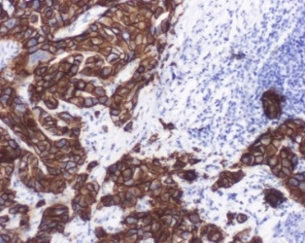
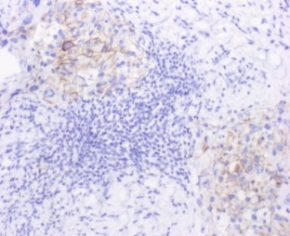
Prevalence of HER2-low by HR Status
HER2 IHC Examples
HER2-negative
HR+ Disease
N = 2,485
TNBC
N = 620
HER2+
IHC +2
8%
IHC +2
17%
IHC 0
37%
IHC +1
26%
IHC 0
66%
HER2-low
IHC +1
46%
IHC 0
IHC +1
IHC +2
HER2-neg
34%–63% of breast cancer patients considered HER2-neg under current guidelines express low levels of HER2
Schettini F, et al. Ann Oncol. 2020;13(2):S24. Slide courtesy of Aleix Prat.

Slide 33
DESTINY-Breast04
First Randomized Phase 3 Study of T-DXd for HER2-low mBC
Trastuzumab deruxtecan
(T-DXd)
5.4 mg/kg Q3W
(n = 373)
Primary Endpoint
PFS by BICR (HR+)
Key Secondary Endpoints
PFS by BICR (all patients)
OS (HR+ and all patients)
Secondary Endpoints
PFS by investigator
ORR by BICR and investigator
DOR by BICR
Safety
Patient-reported outcomes (HR+)
OS (HR+ and all patients)
Patients
HER2-low (IHC 1+ or IHC 2+/ISH negative), unresectable, and/or mBC treated with 1–2 lines of CT in the metastatic setting
HR+ disease considered endocrine refractory
Trastuzumab
deruxtecan
Protease-cleavable linker
R
2:1
TPC
Capecitabine, eribulin,
gemcitabine, paclitaxel, nab-paclitaxel
(n = 184)
DXd (exatecan)
(Topo I inhibitor)
Humanized anti-HER2 IgG1
HER2
CBR, clinical benefit rate; LIR, local investigator review; PRO, patient reported outcomes; SoC, standard of care.
Modi S, et al. N Engl J Med. 2022;387(1):9–20. Modi S, et al. ESMO Congress 2023. Abstract No. 3760. https://oncologypro.esmo.org/meeting-resources/esmo-congress-2023/trastuzumab-deruxtecan-t-dxd-versus-treatment-of-physician-s-choice-tpc-in-patients-pts-with-her2-low-unresectable-and-or-metastatic-breast-c.
ClinicalTrials.gov. Identifier: NCT03734029.

Slide 34
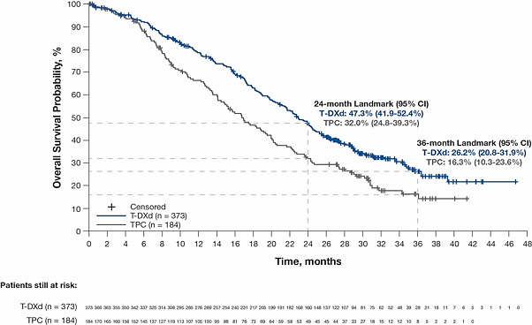
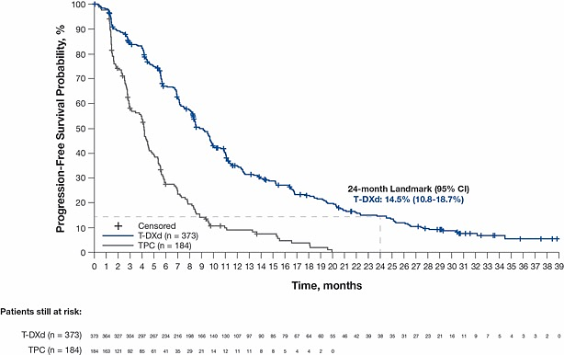
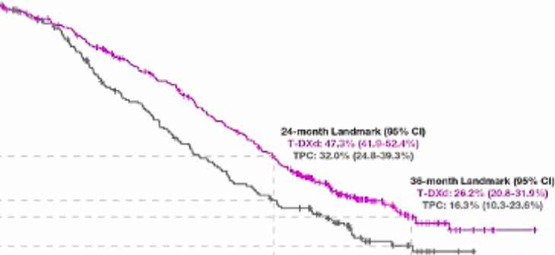
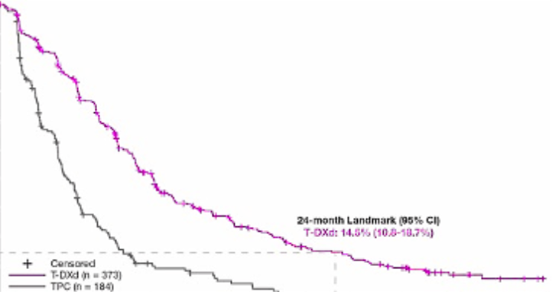
DESTINY-Breast04
Updated PFS (Investigator Assessed)
Median (95% CI) | T-DXd (n = 373) | TPC (n = 184) | Hazard Ratio (95% CI)
Primary analysis | 8.8 months (8.3–9.8) | 4.2 months (3.0–4.5) | 0.37 (0.30–0.45)
Updated analysis | 8.8 months (8.3–9.8) | 4.2 months (3.0–4.5) | 0.36 (0.29–0.45)
OS
Median (95% CI) | T-DXd (n = 373) | TPC (n = 184) | Hazard Ratio (95% CI)
Primary analysis¹ | 23.4 months (20.0–24.8) | 16.8 months (14.5–20.0) | 0.64 (0.49–0.84)
Updated analysis | 22.9 months (21.2–24.5) | 16.8 months (14.1–19.5) | 0.69 (0.55–0.86)
PFS
100
90
80
70
60
50
40
30
20
10
0
100
90
80
70
60
50
40
30
20
10
0
Overall Survival Probability, %
24-month Landmark (95% CI)
T-DXd: 47.3% (41.9%–52.4%)
TPC: 32.0% (24.8%–39.3%)
Progression-free Survival Probability, %
36-month Landmark (95% CI)
T-DXd: 26.2% (20.8%–31.9%)
TPC: 16.3% (10.3%–23.6%)
24-month Landmark (95% CI)
T-DXd: 14.5% (10.8%–18.7%)
Censored
T-DXd (n = 373)
TPC (n = 184)
Censored
T-DXd (n = 373)
TPC (n = 184)
0 2 4 6 8 10 12 14 16 18 20 22 24 26 28 30 32 34 36 38 40 42 44 46 48
0 1 2 3 4 5 6 7 8 9 10 11 12 13 14 15 16 17 18 19 20 21 22 23 24 25 26 27 28 29 30 31 32 33 34 35 36 37 38 39
Time, months
Time, months
Patients still at risk
Patients still at risk
Modi S, et al. N Engl J Med. 2022;387(1):9–20. Modi S, et al. N Engl J Med. 2022;387(1):9–20. Modi S, et al. ESMO Congress 2023. Abstract No. 3760. https://oncologypro.esmo.org/meeting-resources/esmo-congress-2023/trastuzumab-deruxtecan-t-dxd-versus-treatment-of-physician-s-choice-tpc-in-patients-pts-with-her2-low-unresectable-and-or-metastatic-breast-c.

Slide 35
DESTINY-Breast04
TRAEs Occurring in ≥ 15% of Patients and AESIs
System Organ Class Preferred term, n (%) | T-DXd (n = 371) |  | TPC (n = 172)
 | Any Grade | Grade ≥ 3 | Any Grade | Grade ≥ 3
Blood and lymphatic system
Neutropenia | 123 (33) | 51 (14) | 88 (51) | 70 (41)
Anemia | 123 (33) | 30 (8) | 39 (23) | 8 (5)
Thrombocyopenia | 88 (24) | 19 (5) | 16 (9) | 1 (1)
Leukopenia | 86 (23) | 24 (7) | 54 (31) | 33 (19)
Gastrointestinal
Nausea | 271 (73) | 17 (5) | 41 (24) | 0
Vomiting | 126 (34) | 5 (1) | 17 (10) | 0
Diarrhea | 83 (22) | 4 (1) | 31 (18) | 3 (2)
Constipation | 79 (21) | 0 | 22 (13) | 0
General
Fatigue | 177 (48) | 28 (8) | 73 (42) | 8 (5)
Skin and subcutaneous
Alopecia | 140 (38) | 0 | 56 (32) | 0
AE of special interest
Left ventricular dysfunction occurred in 17 (4.6%) of patients (2 cardiac failure: one Grade 1, one Grade 2)
Boxed Warning: Interstitial lung disease/pneumonitis — can be severe or fatal. Monitor for cough, dyspnea, fever, or other new/worsening respiratory symptoms; permanently discontinue if Grade ≥2 ILD is confirmed. Embryo-fetal toxicity — exposure during pregnancy can cause embryo-fetal harm; advise contraception during and after treatment.
Adjudicated Drug-related ILD | T-DXd | TPC
All grades, n (%) | 45 (12) | 1
Grade ≥ 3, n (%) | 5 (1) | 0
Grade 5, n (%) | 3 (1) | 0
Modi S, et al. N Engl J Med. 2022;387(1):9–20.

Slide 36
Trastuzumab Deruxtecan for Breast Cancer
Boxed Warnings
Interstitial lung disease/pneumonitis: severe, possibly life-threatening
Embryo-fetal harm
AEs of Special Concern
  Neutropenia/febrile neutropenia
  Left ventricular dysfunction
Hematologic
  Neutropenia (70%)
  Anemia (64%)
  Lymphopenia (55%)
Other
  Fatigue (49%)
  Alopecia (37%)
Gastrointestinal
  Nausea (76%)
  Vomiting (49%)
  Constipation (34%)
  Diarrhea (29%)
  Abdominal pain (21%)
  Stomatitis (20%)
FDA-approved drug: fam-trastuzumab deruxtecan-nxki. Revised January 2025. FDA website. https://www.accessdata.fda.gov/drugsatfda_docs/label/2024/761139s028lbl.pdf.

Slide 37
DESTINY-Breast04
Quality of Life
In the total population had similar baseline EORTC QLQ-C30 global health status (GHS/QoL) scores (36.3 for T-DXd vs. 37.8 for TPC)
Mean change from baseline for GHS/QoL remained stable (± 10 points) over time
  T-DXd arm (n = 331) up to 27 cycles
  TPC arm (n = 163) up to 13 cycles
    Insufficient numbers of patients beyond these data points for data to be informative
Median time to deterioration of GHS/QoL
  7.6 months for T-DXd vs. 5.1 months for TPC
In the subset of patients with HR+/HER2-neg MBC, T-DXd provided numerically higher GHS/QoL and functioning and lower pain than capecitabine
Ueno NT, et al. Annals of Oncology. 2022;33:S632-S633. Ueno NT, et al. ESMO Open. 2024;9:103210.

Slide 38
Trastuzumab Deruxtecan Indication in Breast Cancer
HER2-positive mBC
Unresectable or metastatic HER2-positive (IHC 3+ or ISH positive) BC who have received a prior anti-HER2-based regimen either:
In the metastatic setting, or
In the neoadjuvant or adjuvant setting and have developed disease recurrence during or within six months of completing therapy
HER2-low/HER2-ultralow mBC
Unresectable or metastatic HR+/HER2-low (IHC 1+ or IHC 2+/ISH-) or HER2-ultralow (IHC 0 with membrane staining) BC, as determined by an FDA-approved test, that has progressed on one or more endocrine therapies in the metastatic setting
HER2-low (IHC 1+ or IHC 2+/ISH-) BC, as determined by an FDA-approved test, who have received a prior chemotherapy in the metastatic setting or developed disease recurrence during or within 6 months of completing adjuvant chemotherapy
Fam-trastuzumab deruxtecan-nxki (package insert). https://www.accessdata.fda.gov/drugsatfda_docs/label/2024/761139s028lbl.pdf.

Slide 39
Management of AEs in ADC Therapy

Slide 40
Management of Neutropenia
Sacituzumab govitecan dose reductions due to neutropenia
Grade 3–4 neutropenia (Absolute Neutrophil Count [ANC] < 1000/mm³) or febrile neutropenia | Withhold SG until ANC ≥ 1500/mm³ for Day 1 dose or ANC ≥ 1000/mm³ for Day 8 Dose Administer G-CSF during treatment as clinically indicated Reduce one dose level for each occurrence of febrile neutropenia or prolonged Grade 3–4 neutropenia, or discontinue after 2 dose reductions
At time of scheduled treatment, Grade 3–4 neutropenia which delays dosing beyond 3 weeks for recovery to Grade ≤ 1 | Discontinue treatment and administer G-CSF
Trastuzumab deruxtecan dose reductions due to neutropenia
Grade 3 (< 1.0 to 0.5 × 10⁹/L) | Hold dosing until resolved to Grade 2 or less, then maintain dose
Grade 4 (< 0.5 × 10⁹/L) | Hold dosing until resolved to Grade ≤ 2; resume with reduced dose; discontinue treatment after second dose reduction
Datopotamab deruxtecan dose modifications for neutropenia are not specified in the package insert
G-CSF, granulocyte colony-stimulating factor.
Sacituzumab govitecan-hziy [package insert]. https://www.accessdata.fda.gov/drugsatfda_docs/label/2023/761115s035lbl.pdf; Fam-trastuzumab deruxtecan-nxki [package insert]. https://www.accessdata.fda.gov/drugsatfda_docs/label/2024/761139s028lbl.pdf; datopotamab deruxtecan-dlnk [package insert]. https://www.accessdata.fda.gov/drugsatfda_docs/label/2025/761394s000lbl.pdf.

Slide 41
GI Toxicities
Recognition and Management
The first sign of loose stools
Start antidiarrheal agents (e.g., loperamide) and increase intake of oral fluids
Grade 1
Increase of < 4 stools per day over baseline
Grade 2
Increase of 4–6 stools per day over baseline
Grade 3
Increase of ≥ 7 stools per day over baseline
Grade 4
Life-threatening consequences/urgent intervention indicated
No dose modification required
Suspend dose until toxicity resolves
to grade ≤ 1
Dose must be reduced
ADL, activities of daily living.
Sacituzumab govitecan-hziy [package insert]. https://www.accessdata.fda.gov/drugsatfda_docs/label/2023/761115s035lbl.pdf.
Fam-trastuzumab deruxtecan-nxki (package insert). https://www.accessdata.fda.gov/drugsatfda_docs/label/2024/761139s028lbl.pdf.
Datopotamab deruxtecan-dlnk (package insert). https://www.accessdata.fda.gov/drugsatfda_docs/label/2025/761394s000lbl.pdf.

Slide 42
Management of Diarrhea
Clinical Considerations
Acute or early cholinergic syndrome
  During or shortly after infusion
  Signs/symptoms: abdominal cramping, sweating, diarrhea, excess salivation
  Give atropine 0.4 mg IV every 15 minutes ×2 doses, if needed; then 0.2 mg IV for total of 1 mg
  Use atropine prophylactically in future cycles
Delayed
  Rule out infection
  If negative, start loperamide 4 mg PO after first loose stool, followed by 2 mg PO after each subsequent loose stool (total daily dose 16 mg); discontinue 12 hours after last loose stool
  High dose: 4 mg PO ×1, followed by 2 mg PO every 2 hours
  Octreotide or oral atropine if needed
  Replace fluid and electrolytes as needed
IV, intravenous; PO, by mouth.
Spring LM, et al. Ann Oncol. 2024;35(3):293–301. Benson AB, et al. J Clin Oncol. 2004;22(14):2918–2926.
Sacituzumab govitecan-hziy [package insert]. https://www.accessdata.fda.gov/drugsatfda_docs/label/2023/761115s035lbl.pdf.
Fam-trastuzumab deruxtecan-nxki (package insert). https://www.accessdata.fda.gov/drugsatfda_docs/label/2024/761139s028lbl.pdf.
Datopotamab deruxtecan-dlnk (package insert). https://www.accessdata.fda.gov/drugsatfda_docs/label/2025/761394s000lbl.pdf.

Slide 43
Management of Diarrhea
Nursing Interventions and Patient Education
Counsel patients on risks of severe diarrhea
Monitor for signs/symptoms of cholinergic syndrome
Advise patients to promptly start antidiarrheals at symptom onset
Encourage bland diet until gastrointestinal (GI) symptoms improve
Replace fluids and electrolytes (orally; IV if indicated)
Monitor and assess for signs of dehydration
Encourage patients to call if black or bloody stool, inability to drink oral fluids, or nausea/vomiting/diarrhea not responding to supportive medications
Spring LM, et al. Ann Oncol. 2024;35(3):293–301. Skay A, Kardashian A. Proceedings of UCLA Health. 2020;24.

Slide 44
Trastuzumab Deruxtecan Restart Following a Confirmed and Resolved (Grade 0) Case of Grade 1 ILD/Pneumonitis
Incidence of ILD with T-DXd treatment is reported at ~15% across all indications; most of these ILD events are low-grade (27% Grade 1 and 50% Grade 2), but ILD can be fatal if not appropriately managed
Severity
Grade 1
Grade 2-4
T-DXd dosing modification
T-DXd can be resumed if the ILD/pneumonitis fully resolved to Grade 0
If resolved in ≤ 28 days from day of onset, maintain dose
If resolved in > 28 days from day of onset, reduce dose by one level
Swain SM, et al. recommend that if ILD/pneumonitis occurs beyond Day 22 and has not resolved within 49 days from the last infusion, discontinue T-DXd
Consider corticosteroid treatment as soon as ILD/pneumonitis is suspected
Promptly initiate corticosteroid treatment as soon as ILD/pneumonitis is suspected
Permanently discontinue T-DXd
Guidelines suggest: manage and treat the ILD/pneumonitis jointly with MDT and involve a pulmonologist early
MDT, multidisciplinary team.
Swain SM, et al. Cancer Treat Rev. 2022;106:102378. Fam-trastuzumab deruxtecan-nxki [package insert]. https://www.accessdata.fda.gov/drugsatfda_docs/label/2024/761139s028lbl.pdf. Rugo HS, et al. ESMO Open. 2024;9.

Slide 45




Team-based Approach for the Management of Patients with Cancer
In general, treatment recommendations should be made by a multidisciplinary team.
MDTs increase treatment personalization, improve outcomes, preserve quality of life, and increase overall patient satisfaction.
Each person on the care team should:
Encourage use of comprehensive molecular biomarker testing
Ensure guideline-concordant care
Be available to answer questions
Pharmacist
Oncology Nurse
Specialists
Caregivers
Pathologist
Patient
Radiation Oncologist
NPs/PAs
Medical Oncologist
Cornelius LA, et al. Oncologist. 2021;26(9):e1644–e1651. Daly ME, et al. J Clin Oncol. 2022:40(12).
Notes:
~21:40 We intervene rather quickly to be able to keep them on medication safely.

Slide 46


Put information into action!
Takeaways from this program can be implemented into your practice to improve patient care.
Document the impact of AEs on QoL in patients receiving ADCs for HER2-neg MBC through obtaining improved patient histories and increased use of AE assessment tools, as documented in EHR patient charts.
Manage AEs in patients receiving ADCs for HER2-neg MBC according to updated guidelines and expert consensus, as documented by increased use of mitigation strategies in EHR patient charts.
Communication is key! Patients should be encouraged to communicate quickly when they experience AEs.

Slide 47
Additional Resources
Visit www.ceconcepts.com
for clinical information and
certified educational activities

Slide 48


Patient Resource

Slide 49
Claim Credit
QR Code
Scan the QR code to create or log in to a Creative Educational Concepts learner account. Complete the necessary requirements (e.g., pre-test, post-test, evaluation) and then claim your credit.* ​
Thank you for your participation! ​
*To receive credit, participants must register an account and apply for credit within 10 days of the live activity. For questions or technical difficulties, please contact info@ceconcepts.com.

Slide 51
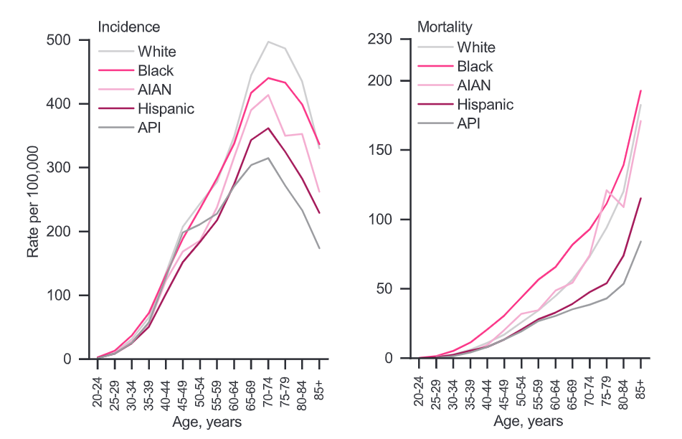
Breast Cancer Incidence and Mortality by Age
Incidence
230
200
150
100
50
0
Mortality
5-year BC-specific survival rates are significantly lower in Black women (80%) vs. White (91%) women
Median age at death due to breast cancer
68 years all women
70 years White women
63 years Black women
500
400
300
200
100
0
White
Black
AIAN
Hispanic
API
White
Black
AIAN
Hispanic
API
Rate per 100,000
20–24
25–29
30–34
35–39
40–44
45–49
50–54
55–59
60–64
65–69
70–74
75–79
80–84
85+
20–24
25–29
30–34
35–39
40–44
45–49
50–54
55–59
60–64
65–69
70–74
75–79
80–84
85+
Age, years
Age, years
AIAN, American Indian and Alaska Native; API, Asian Pacific Islander.
Rebner M, Pai VR. J Breast Imaging. 2020;2(5):416–421. Prakash O, et al. Front Public Health. 2020;8:576964.
Giaquinto AN, et al. CA Cancer J Clin. 2022;72:524–541.

Slide 52
TROPiCS-02
ORR and TTD of Global Health Status and Fatigue vs TPC
 | Patients SG/TPC, n/n | SG Median TTD, Months (95% CI) | TPC Median TTD, Months (95% CI) | Stratified HR (95% CI) | Stratified Log Rank P-value
Global health status QoL | 234/207 | 4.3 (3.1–5.7) | 3.0 (2.2–3.9) | 0.75 (0.61–0.92) | 0.006
Fatigue | 234/205 | 2.2 (1.6–2.8) | 1.4 (1.1–1.9) | 0.73 (0.60–0.89) | 0.002
Pain | 229/202 | 3.8 (2.8–5.0) | 3.5 (2.8–5.0) | 0.92 (0.75–1.13) | 0.415
CR, complete response; PR, partial response; TTD, time to deterioration.
Adapted from Rugo HS, et al. J Clin Oncol. 2022;40(29):3365‒3376. Adapted from Rugo H, et al. ESMO Open. 2022;7(4):100553.

Slide 53
Time to Definitive Deterioration in PRO Measure of Interest in Patients Receiving T-DXd vs TPC
 |  | Median (95% CI) TDD, months |  | Hazard Ratio (95% CI) | HR (95% CI) | P Value
 |  | T-DXd (n = 331) | TPC (n = 163)
EORTC QLQ-C30 | Global health status/QoL | 11.4 (8.8-16.3) | 7.5 (5.9-9.5) |  | 0.69 (0.52-0.92) | 0.0096
 | Pain symptoms | 16.4 (13.1-21.5) | 6.1 (4.2-7.5) |  | 0.40 (0.30-0.54) | <0.0001
 | Physical functioning | 16.6 (11.3-21.5) | 7.5 (4.9-9.5) |  | 0.53 (0.40-0.70) | <0.0001
 | Emotional functioning | 19.2 (16.3-24.5) | 10.5 (7.1-NE) |  | 0.69 (0.50-0.96) | 0.0266
 | Social functioning | 12.8 (10.4-15.2) | 6.0 (4.4-7.7) |  | 0.59 (0.45-0.77) | 0.0001
 | Fatigue | 11.1 (7.2-12.4) | 4.5 (3.1-6.2) |  | 0.61 (0.47-0.79) | 0.0002
 | Nausea and vomiting | 5.7 (3.8-8.4) | 9.3 (7.5-17.1) |  | 1.46 (1.09-1.96) | 0.0128
EORTC QLQ-BR23 | Arm symptoms | 14.4 (11.9-23.0) | 8.7 (5.6-NE) |  | 0.62 (0.45-0.85) | 0.0027
 | Breast symptoms | NE (24.7-NE) | NE (NE-NE) |  | 0.71 (0.50-1.01) | 0.1008
EQ-5D-5L | VAS | 12.0 (9.9-15.2) | 6.8 (4.9-11.4) |  | 0.73 (0.54-0.97) | 0.0288
Favors T-DXd
Favors TPC
EORTC, European Organization for Research and Treatment of Cancer; EQ-5D-5L, EuroQol 5-dimension, 5-level questionnaire; NE, not estimable; PRO, patient-reported outcome;
QLQ-BR23, Quality of Life Breast cancer questionnaire; QLQ-C30, Quality of Life Core 30 questionnaire; TDD, time to definitive deterioration; VAS, visual analog scale.
Ueno NT, et al. ESMO Open. 2024;9:103210.

Slide 54
Benefits of Early Side Effect Management
Goal of cancer care is to recover pre-cancer quality of life and emotional and social functions
  Only possible through the mitigation of the side-effects of anticancer treatments
  Early screening, suspicion, and prompt identification of significant AEs (e.g., ILD and pneumonitis) are crucial for improving patient outcomes
  Education for both the MDT and patients is essential for ensuring prompt and timely management of AEs
  Specialists (e.g., dermatologists and ophthalmologists) are essential for managing organ-specific AEs
  Assess potential for synergistic or overlapping toxicities when combining ADCs with other anticancer therapies
  Proactive management and interdisciplinary collaboration to address these challenges will enhance the safety and efficacy of ADCs in breast cancer treatment, ultimately improving clinical outcomes.
SG dose reductions or treatment interruptions in ASCENT trial did not appear to reduce efficacy
  PFS in those who received a SG dose reduction was similar to the overall study population
Encourage patients to discuss symptoms and side effect management challenges with the health care team
Franzoi MA, et al. The Lancet Oncology. 2021;22(7):e303-e313. Kang S, et al. Ther Adv Med Oncol. 2025;17:17588359251324889.
Rugo HS, et al. NPJ Breast Cancer. 2022;8(1):98.

