Slide 1
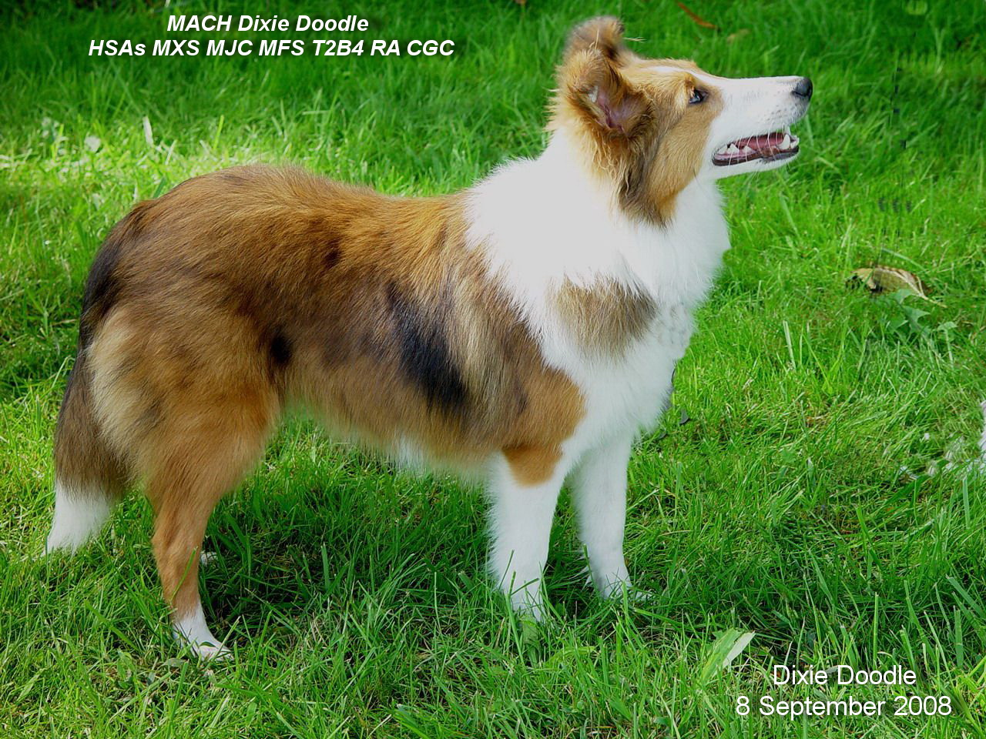
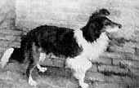
The History of the Shetland Sheepdog
Wallace – Foundation Dog
Dixie Doodle – Modern Sheltie

Slide 2
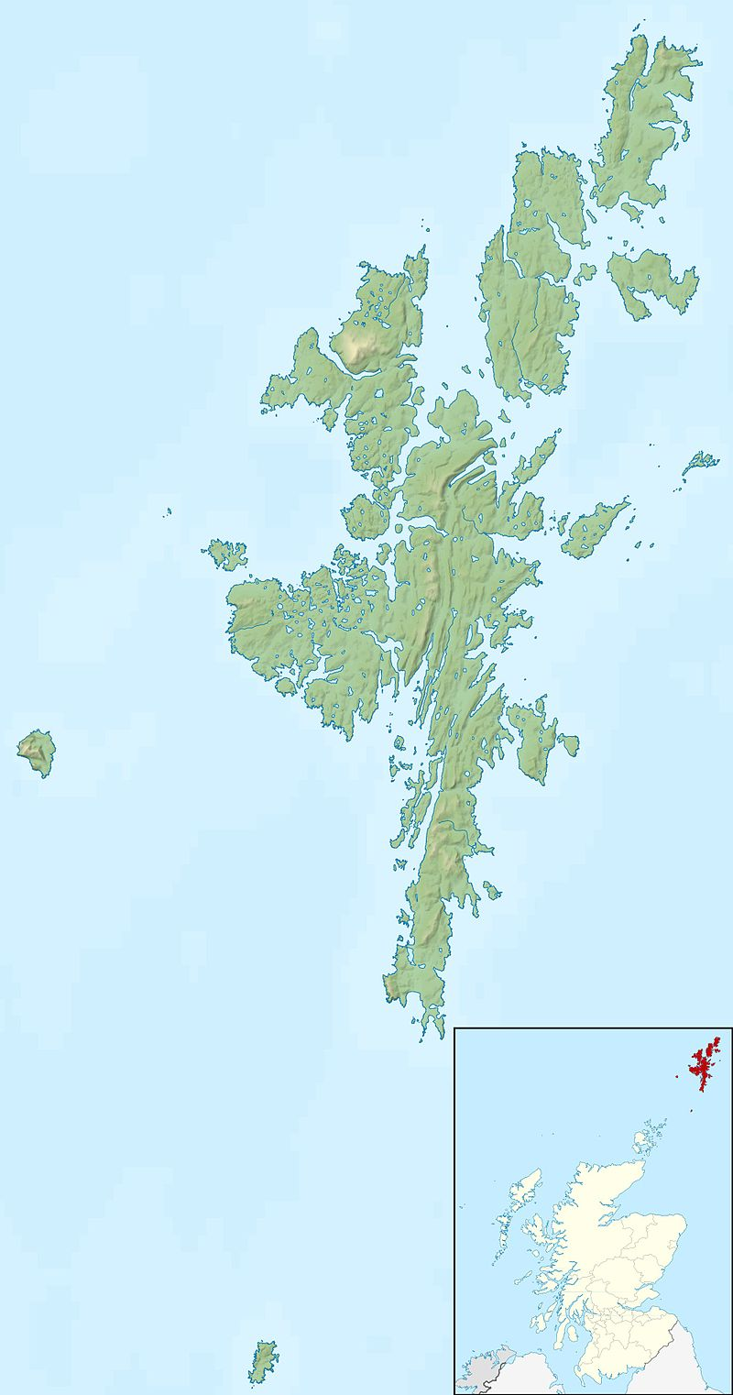
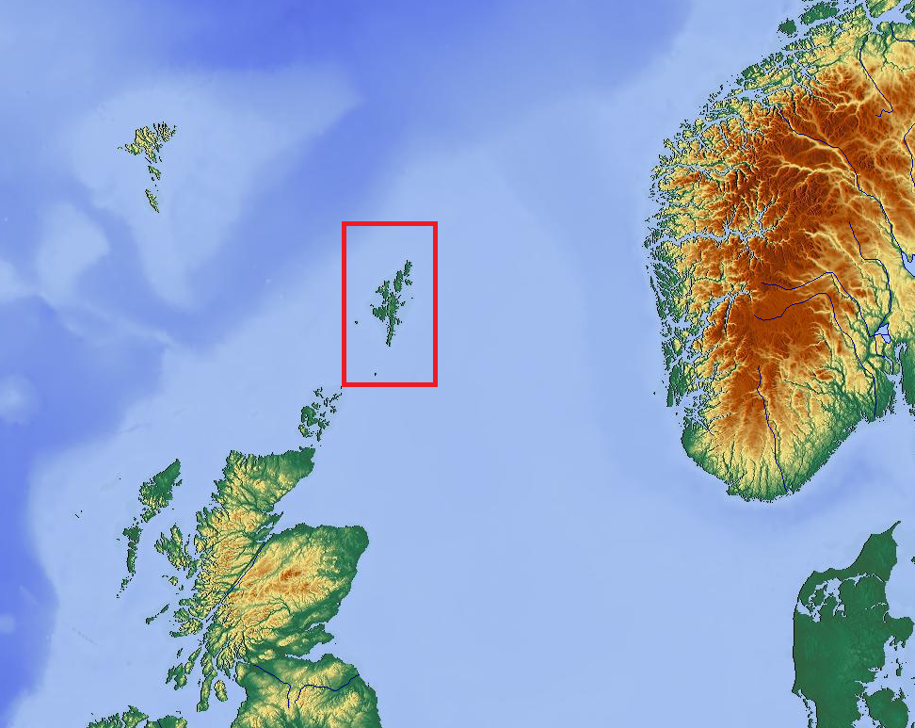
The Shetland Islands in the Northern Atlantic are a series of small islands exposed to the vagaries of the sea and north winds. They are rugged, rocky and sparse in vegetation. The people who inhabit the islands are also rough and rugged as are some of the animals that hail from there; for example, the Shetland Pony and the Shetland Sheepdog.

Slide 3
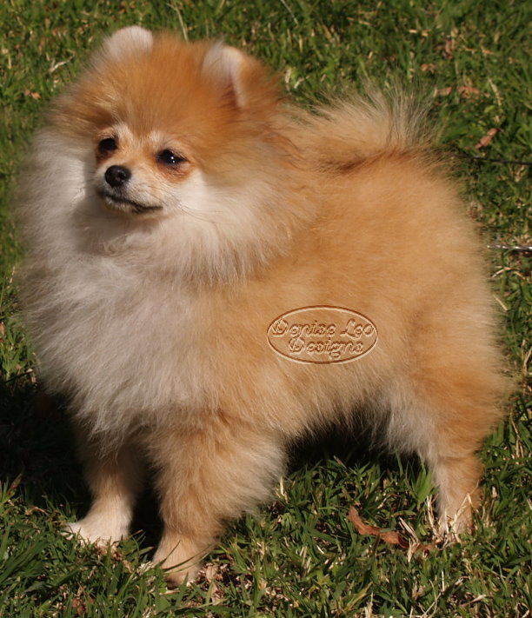
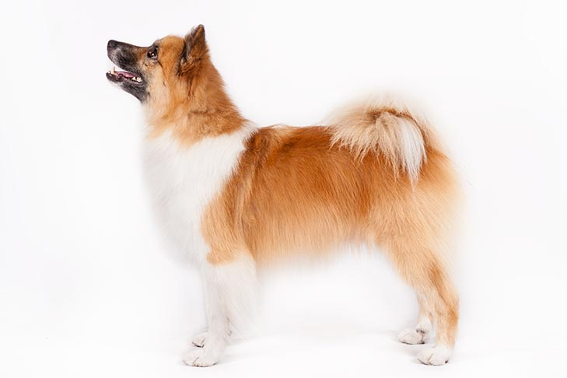
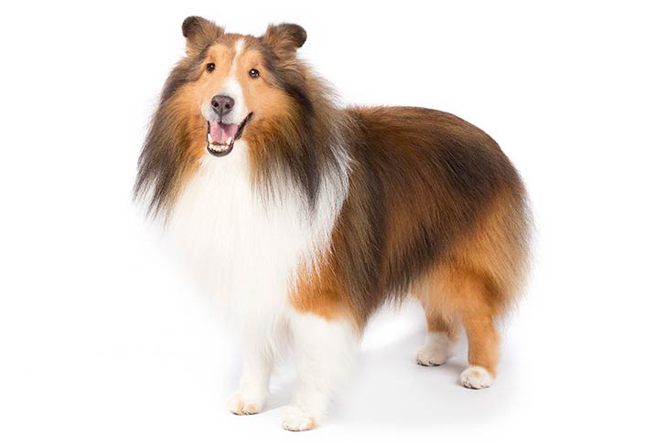
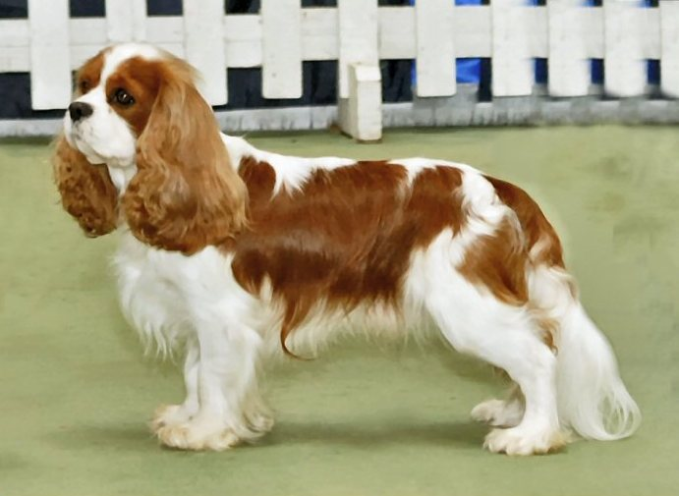
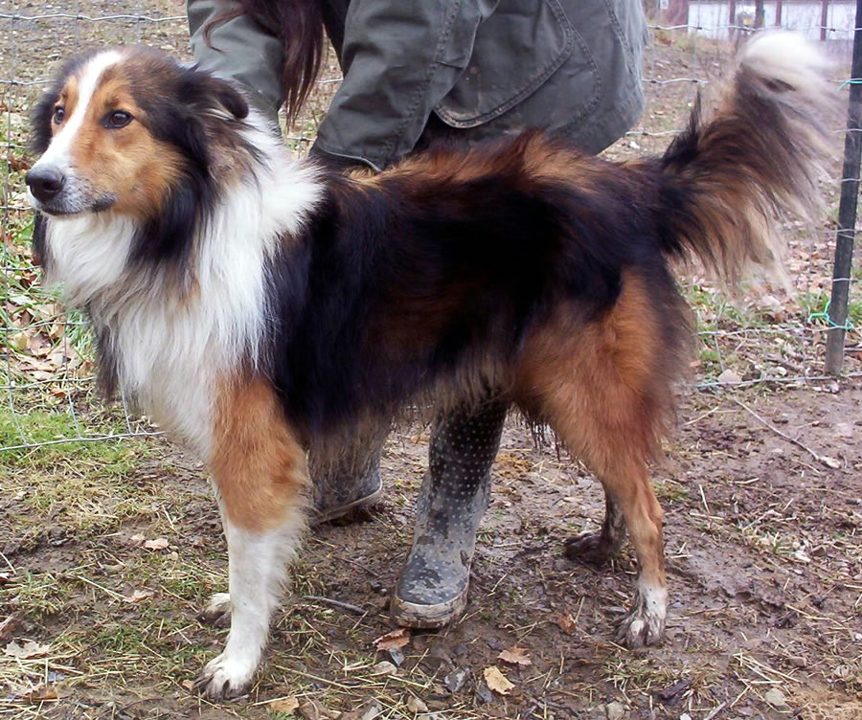
It has been long supposed that the beginnings of this breed could be traced to influence by a Northern Spitz type dog brought from Scandinavia by the early inhabitants, a King Charles Spaniel, the original Pomeranian and other dogs indigenous to the islands as well as the Scotch Collie. The actual mix of what went into developing this breed is shrouded in mystery and still debated. In the 1800s, the people of the Shetland Islands found that they could make money by selling the cute, fluffy Toonie breed to rich travelers.

Slide 4
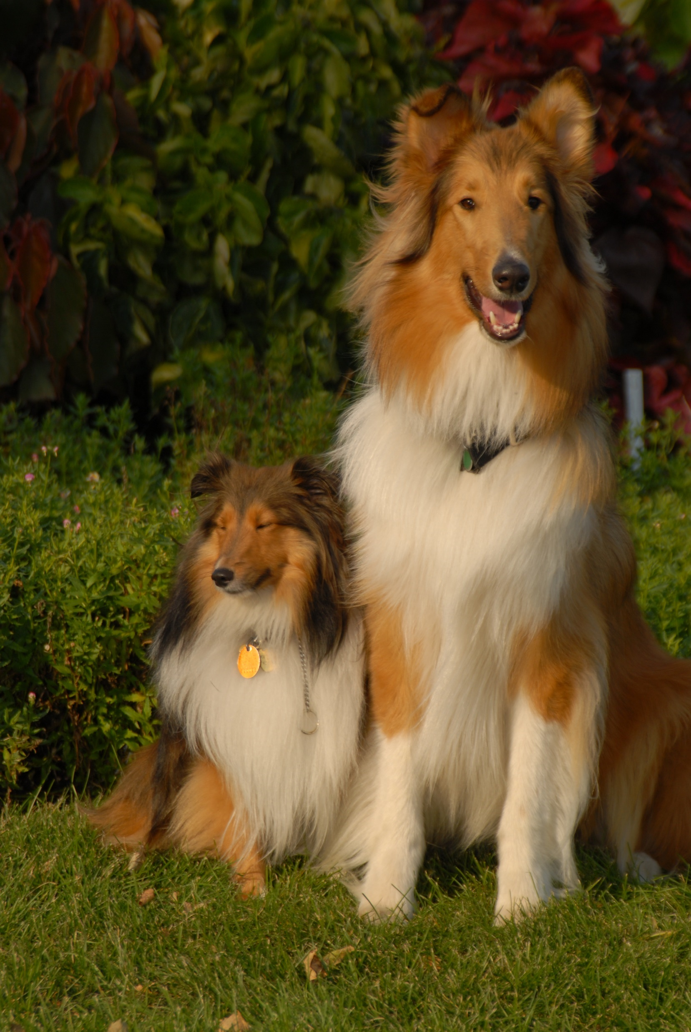
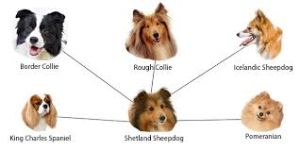

Slide 5
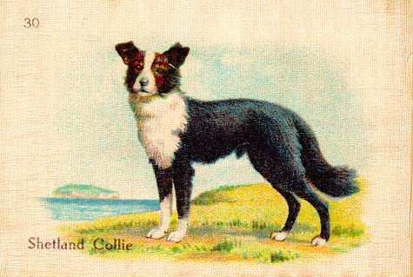
Beginnings
The Shetland Sheepdog, also known as the Sheltie, is a breed of herding dog that originated in the Shetland Islands. The original name of this breed was Shetland Collie, but when this caused controversy among the Rough Collie breeders of the time, the breed's name was formally changed to Shetland Sheepdog.
Shelties were called by other names; Toonie Dogs, Shetland Collies, Pommies, Peeire Dog, Fairy Dog or Dwarf Scotch Sheppards.
It is not really known exactly when the Sheltie has it origins, but in the very early 1800's they were thought to be a type of small working Collie which had been crossed (mostly by accident!) with the Icelandic Dog bought from Iceland on the fishing boats visiting the Shetland Islands. The original sheepdog of Shetland was a Spitz-type dog, probably similar to the modern Icelandic Sheepdog. This dog was crossed with mainland working collies brought to the islands. It has also been suggested that there may be some crossing with the Cavalier King Charles spaniel, but not actually proven.
One theory is that the sheltie was called a toonie dog because toon is Scottish for town and they were a town dog. They were bred to be sold to town people and tourists who wanted the smaller dogs to take home.
Inverness Yarrow appears in the March 1910 Kennel Gazette - one of the earliest Shelties registered. He is listed as being bred by Mr. C. F. Thompson, his sire being Inverness Hoy (unregistered) and his dam Inverness Patricia (unregistered), and was whelped April 21, 1909. He was the first registered dog in Line IH (Inverness Hoy). Inverness Yarrow's picture was selected to depict the "Shetland Collie" in a series of silk cigarette cards depicting top winning dogs of a number of breeds.
Chestnut Rainbow - This tricolor dog is behind sire line CHE, which includes almost all modern US Shelties and a few modern British dogs. He was never registered, but appears on numerous import pedigrees as by Irvine Ronnie ex Chestnut Lassie, both registered Shelties and full siblings, though from different litters. While an exact birthdate is not available, Chestnut Rainbow's dam was whelped in March, 1921, and he had puppies on the ground early in 1924, so 1922 seems a good guess for his birth year. Chestnut Rainbow sired a number of litters, his most critical litters were out of a Collie bitch, Chestnut Sweet Lady. This dog appears as many as two million times in some modern pedigrees, and most modern Shelties are very close to 23% Chestnut Rainbow.

Slide 6
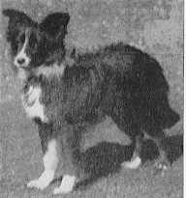
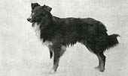
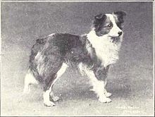
Mr. J Loggie, who was one of the first Sheltie enthusiasts from the islands, took the rather courageous step of introducing a small show Collie into the breed. This he did to establish a definite type, up until that time the little dog tended to appear as a variety of types, sometimes with a head which resembled a spitz type of dog, with pricked ears, or sometimes with a head of more rounded appearance, with a round eye to match!
The Shetland Sheepdog throughout the world is based on British breeding. In the United States, a relatively small number of imports, most of whom came to this country from the British Isles between 1929 and 1936, provided virtually all of the genetic material of the modern American Sheltie.
The Lerwick Shetland Collie Club was formed in 1908
The Scottish Shetland Sheepdog Club was formed in 1909
The year 1909 marked the initial recognition of the Sheltie by the English Kennel Club, with the first registered Sheltie being a female called Badenock Rose.
The English Kennel Club accepted these two clubs and the breed in 1909
Registered initially as Shetland Collies in Mar. of 1909, changed to Shetland Sheepdogs in Oct. 1909
The American Kennel Club accepted the breed as Shetland Sheepdogs in April of 1911
The English Shetland Sheepdog Club was formed in 1914
A total of 29 Shetland Sheepdogs were registered in 1917, 3 in 1918, and 22 in 1919. Of these, 11 appear in modern pedigrees
The American Shetland Sheepdog Club was formed in Feb. 1929
The first AKC Sheltie champion’s dam was a purebred rough collie.
Lerwick Jarl
Ch Woodvold - the first Champion
in the breed - born 1913

Slide 7
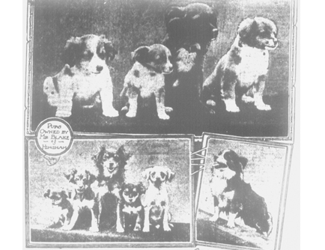
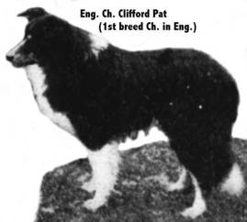
From British Isles to the United States
The modern American Sheltie is descended almost entirely from dogs imported between World Wars I and II, generally close descendants of the Chestnut Sweet Lady cross. The most influential dog in modern US pedigrees, Ch Wee Laird O'Downfield (around 27% of modern pedigrees) and the three most influential bitches (Ch Ashbank Fairy [8%], Natalie of Clerwood [6%] andDownfield Grethe[5%] were all sired by Eng Ch Blaeberry of Clerwood, the result of mating Chestnut Lucky Boy and Chestnut Blossom. The influence of the Chestnut cross descendants is such that the American Sheltie today is roughly 22% Chestnut Sweet Lady.
Dogs were sent to America in the 20's and 30's, the AKC refused to register many early top English imports because of the Collie crosses. Sheltieland Kennels went to England and convinced the Kennel Club to remove notation of the Collie crosses so the breed could be established in America. Because a great many early dogs that went to America had the Collie crosses close up, stabilization of the breed type and size was an enormous problem.
The first Sheltie to be registered by the American Kennel Club was "Lord Scott" in 1911.
Mary Van Wagenen (Sea Isle Kennels), breed historian, calculated that American Shelties have approximately 50% Collie blood.
In October 1909 a article in the Boston Globe addressed Shetland Collies being imported to Boston by gentlemen who had seen them in the Shetlands.
Two World Wars caused a drought in sheltie breeding and importation of shelties to the United States. The breed almost became extinct in 1919.
Sue Bowling’s website has a listing of the major imported shelties by name.

Slide 8
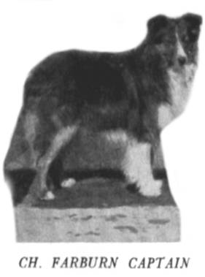
Shetland Sheepdog Breed Development in US
The first breed champion in either country was in 1914 in the USA, followed quickly by the first champion in the UK the same year. The USA champion was a bi-black by the name of Lerwick Rex.
Because of a virtual cessation of imports during and after World War II, the Sheltie in England and America are rather different today. The English have proceeded with an ideal size of 14 1/2 inches for dogs and 14 inches for bitches, while the American standard calls for dogs and bitches to be between 13-16 inches.
In 1952 The American Sheltie standard was amended to have dogs over 17” were disqualified. They wanted to include mostly white but could only have one disqualifying factor. Thus the mostly white sheltie became only a penalty.
There have been a few in-breedings by some kennels over the years to produce different traits in the sheltie. One such was the inbreeding by one kennel with terriers to attempt to improve the stop and head shape. This resulted in some undesirable traits in the sheltie like excessive barking and aggressiveness.
Other breeders have introduced inbreedings with smaller breeds and produced what is known as teacup shelties. These dogs have the traits of the breeds that were inbred as well as the standard sheltie traits.

Slide 9
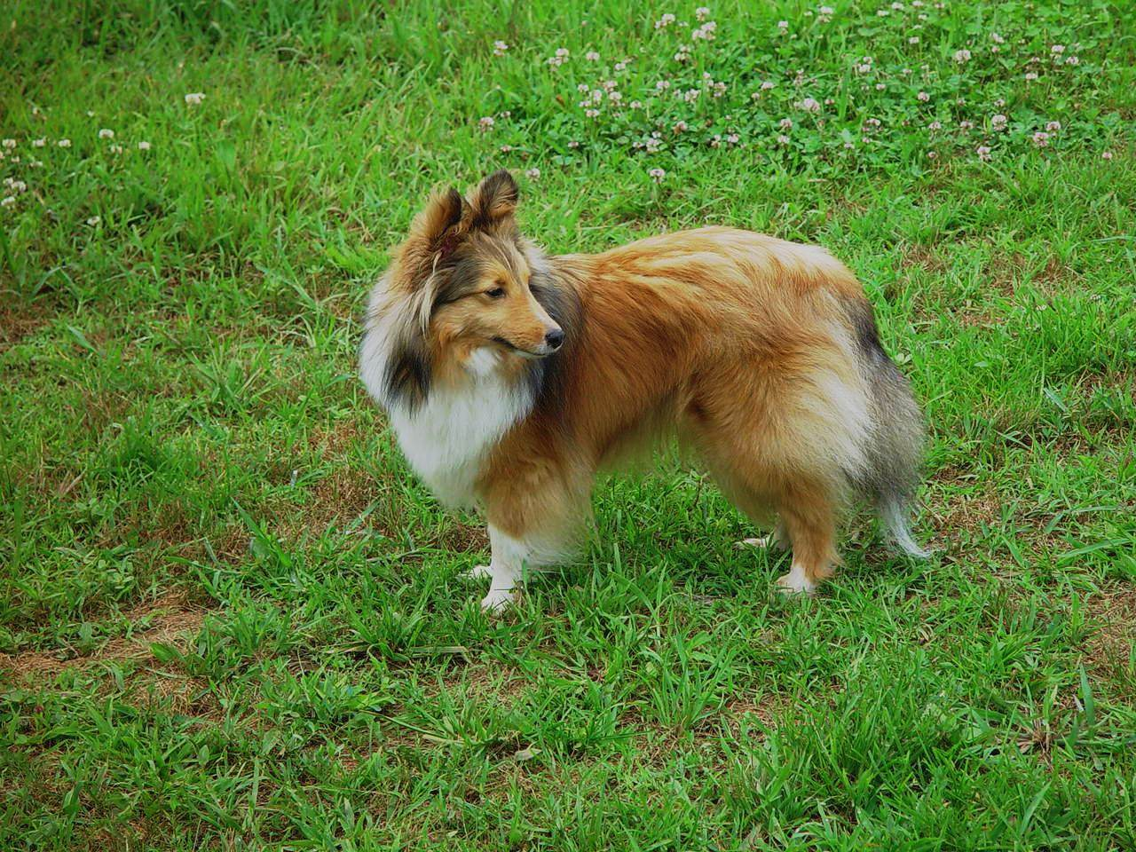
Pedigree Lines
Using the website www.pedigreedatabase.com the following line is shown for JimJans Autumn Breeze, as can be seen the lines go back to the Shetieland and Sea Isles shelties.
JimJans Autumn Breeze
Jade Mist
Memorandum
Jade Mist
Play Me a Memory
Gleneagle Jade Mist
Impulse
Jade Mist
Gleneagle
Huntsman
Romayne’s
Sportin’ Life
Fair Play of Sea Isles
Kawartha’S
Fair Game
Sheltieland
Kiltie O’ Sea Isle
Great Grandmother of Peter Pumpkin

Slide 10
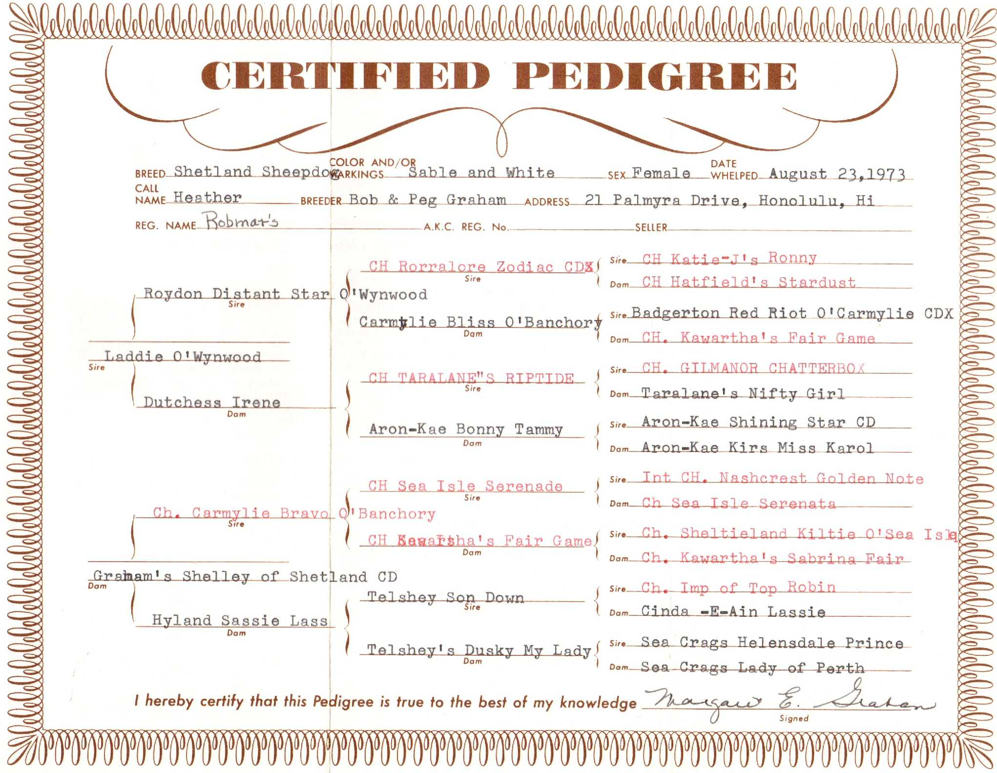
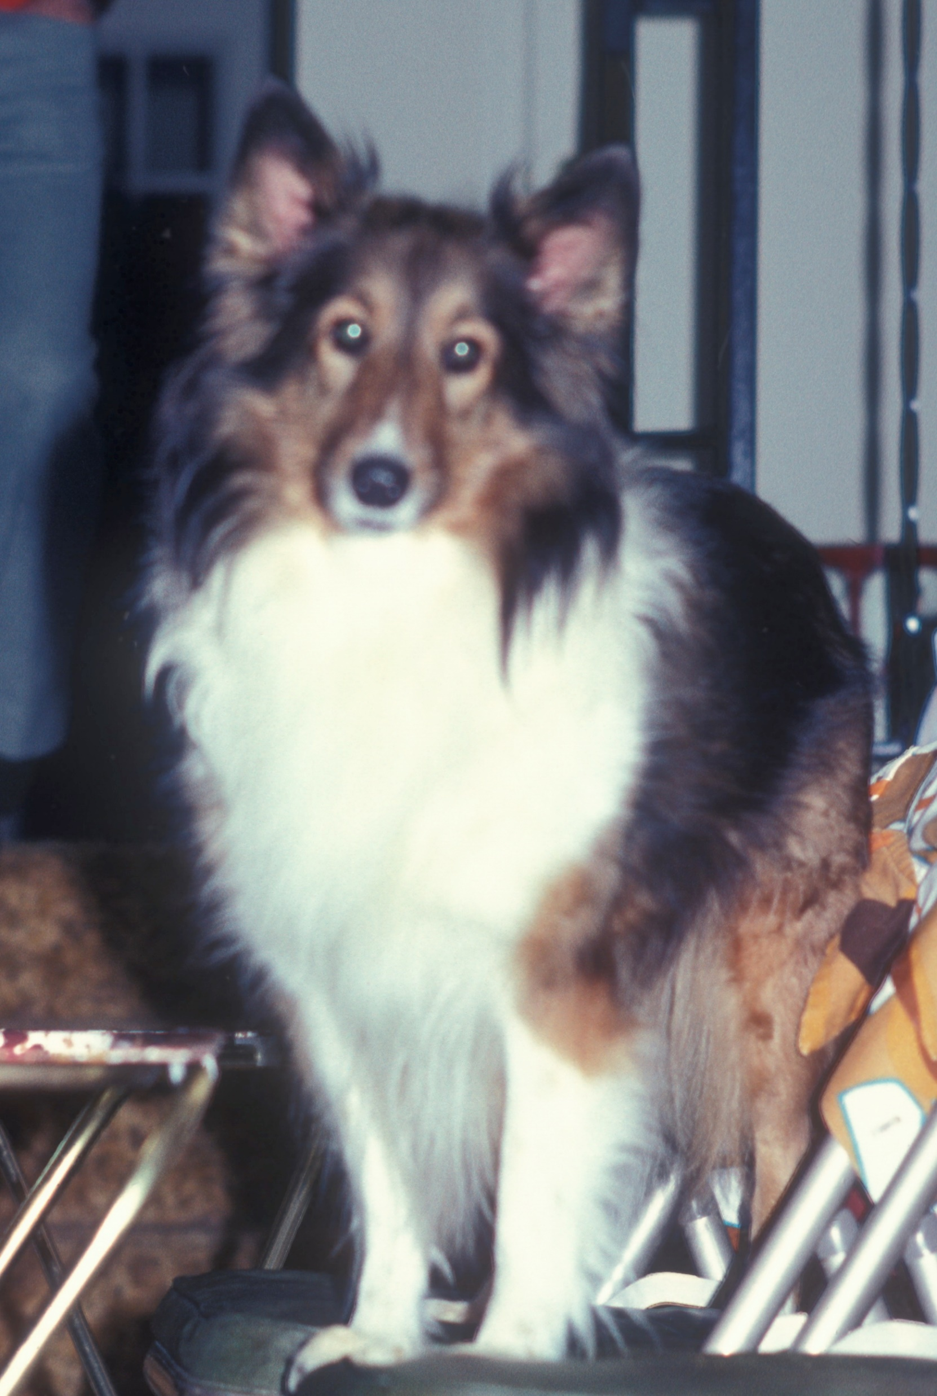

Slide 11
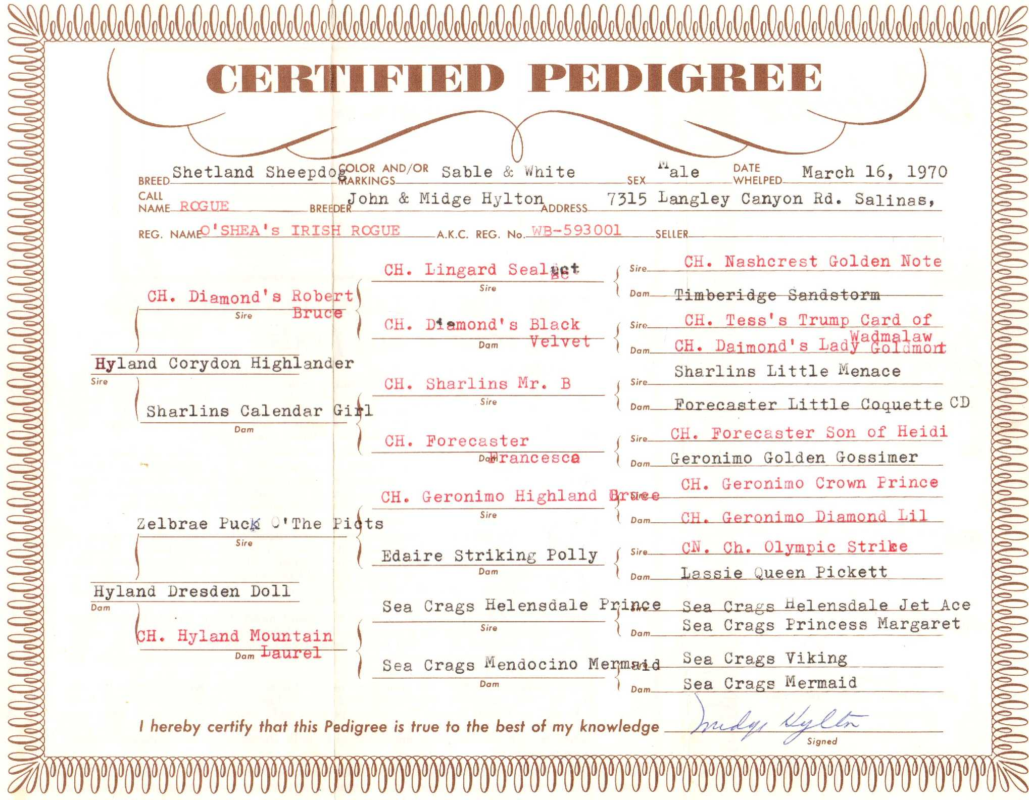
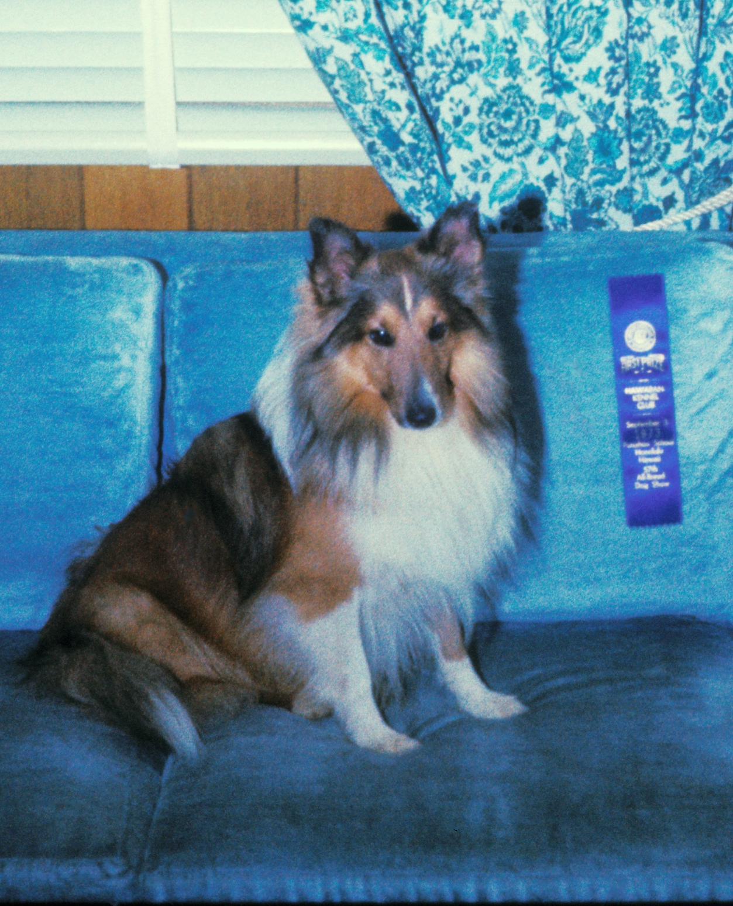

Slide 12
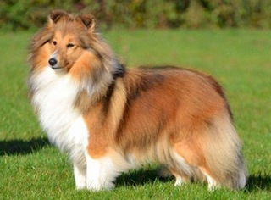
Main Breeding Kennels
Nashcrest
Sea Crags
Invernes Holy (IH)
Sea Isles
Riverhill
Houghton Hill
Kilravock
Mountfort
Exford
Chestnut (CHE)
Sheltieland
Far Sea Kennels
Anahassitt
Page’s Hill
Walnut Hall
Pocono
Bogota
Banchory
Barwood

Slide 13
References
The development of the Shetland Sheepdog
By Barbara Thornley http://www.sheltiesofuktype.org
Wikipedia http:/www.Wikipedia.com
Sue Ann Bowling Deryini Shelties – http://bowlingsite.mcf.com
Barlo Shelties – http://www.barloshelties.com (AKC Champion Lists)
ASSA – http:://www.assa.org – Pat Ferrell

