Slide 1
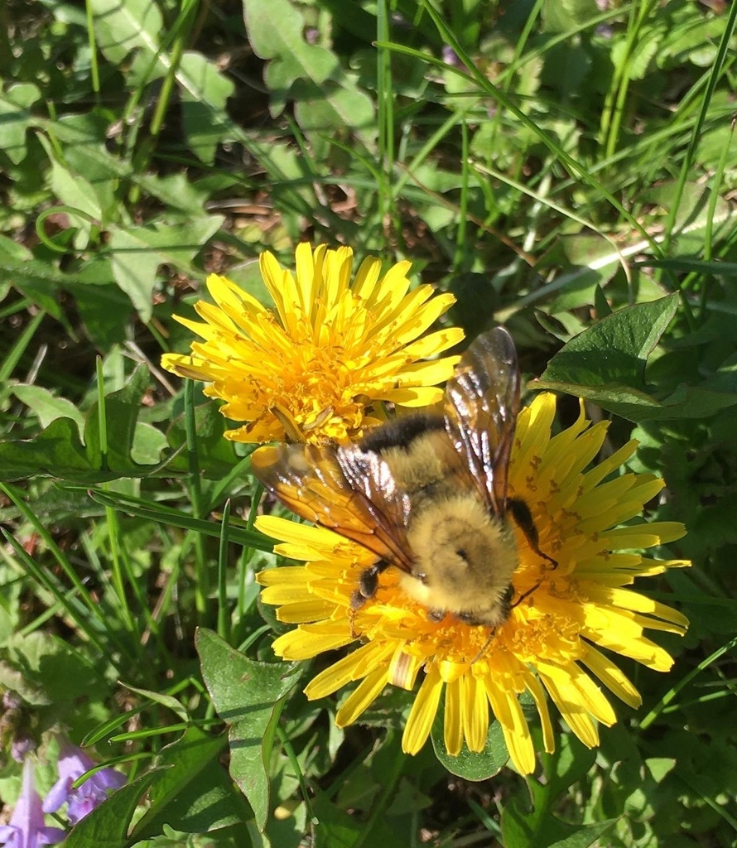
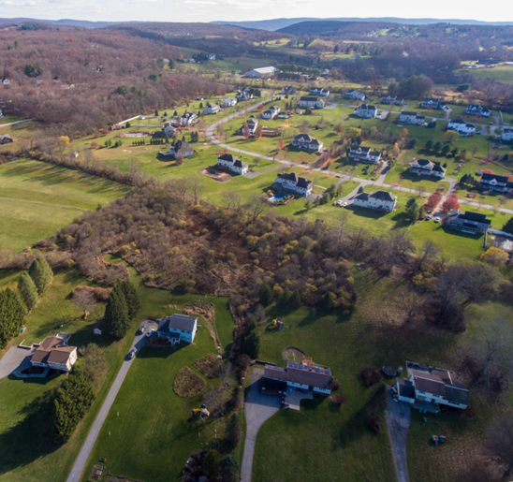
No Mow May
Low
Helping Spring Pollinators in Union Vale
A Presentation by the CAC
April 2023

Slide 2
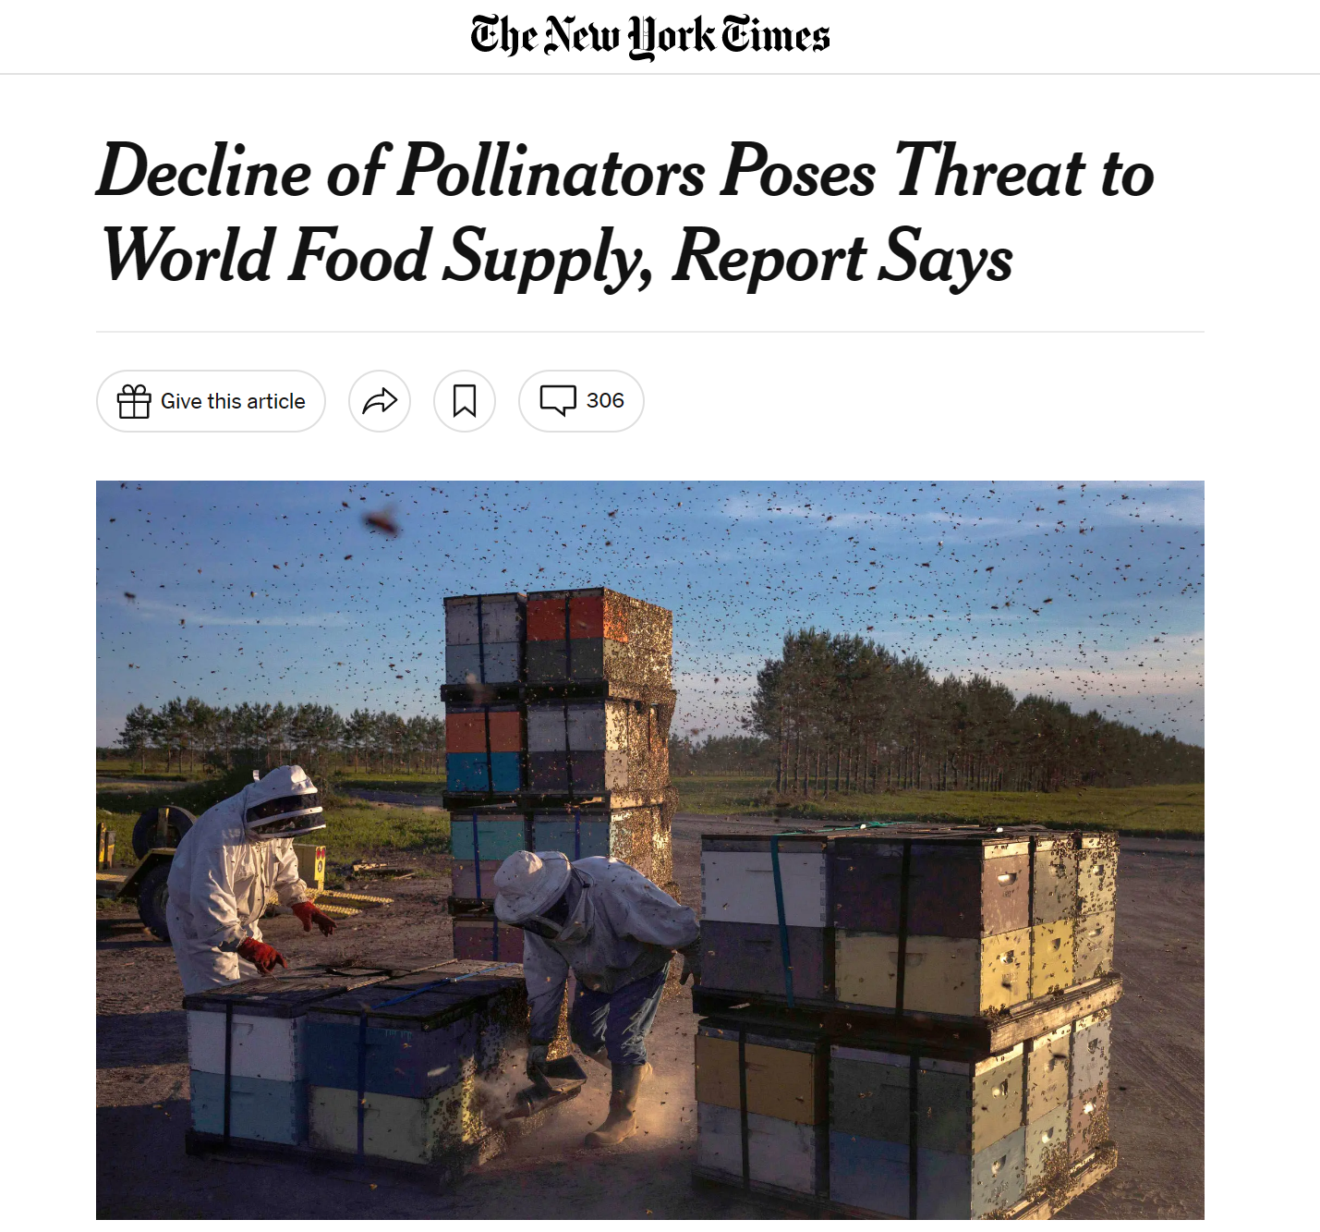
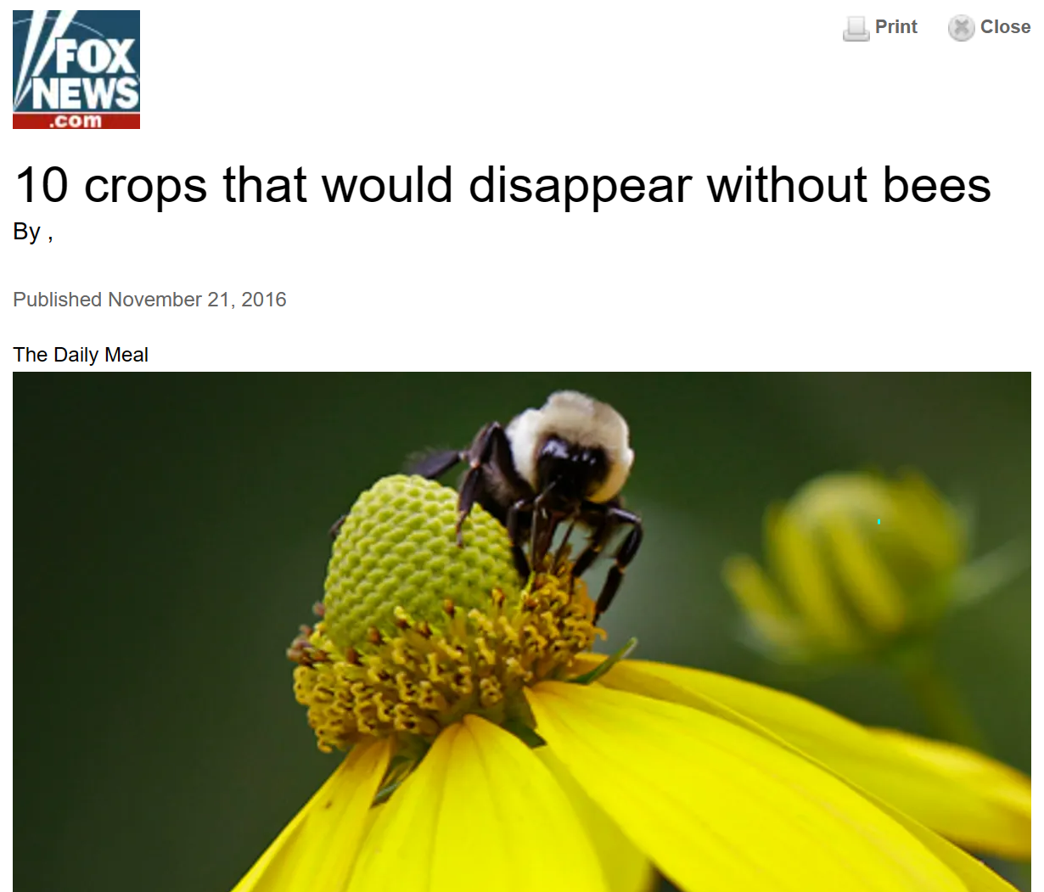
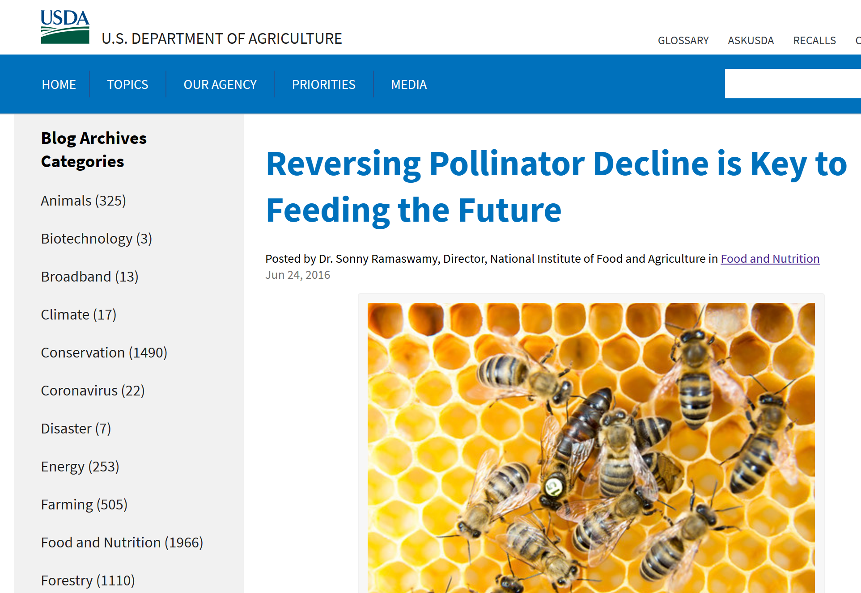
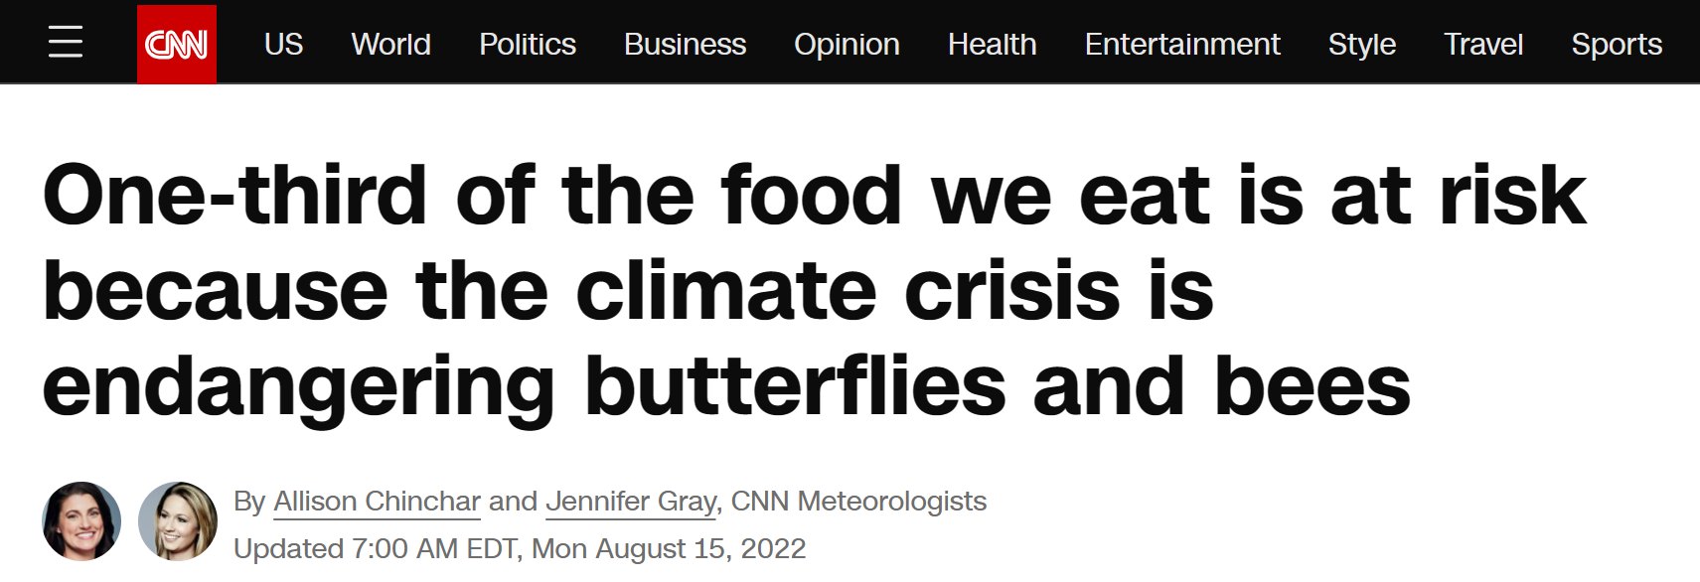
Pollinators are key to the food web, and they are in decline
3/4ths of the worlds flowering plants depend on pollinators to reproduce
35% of the world’s crops require bees and other insects and animals for pollination
1 out of 3 bites of food we eat is thanks to insect pollinators

Slide 3
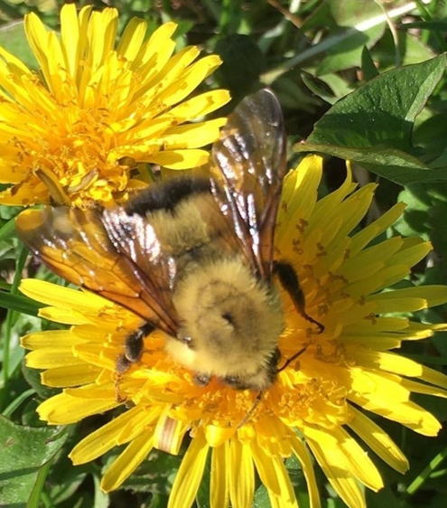
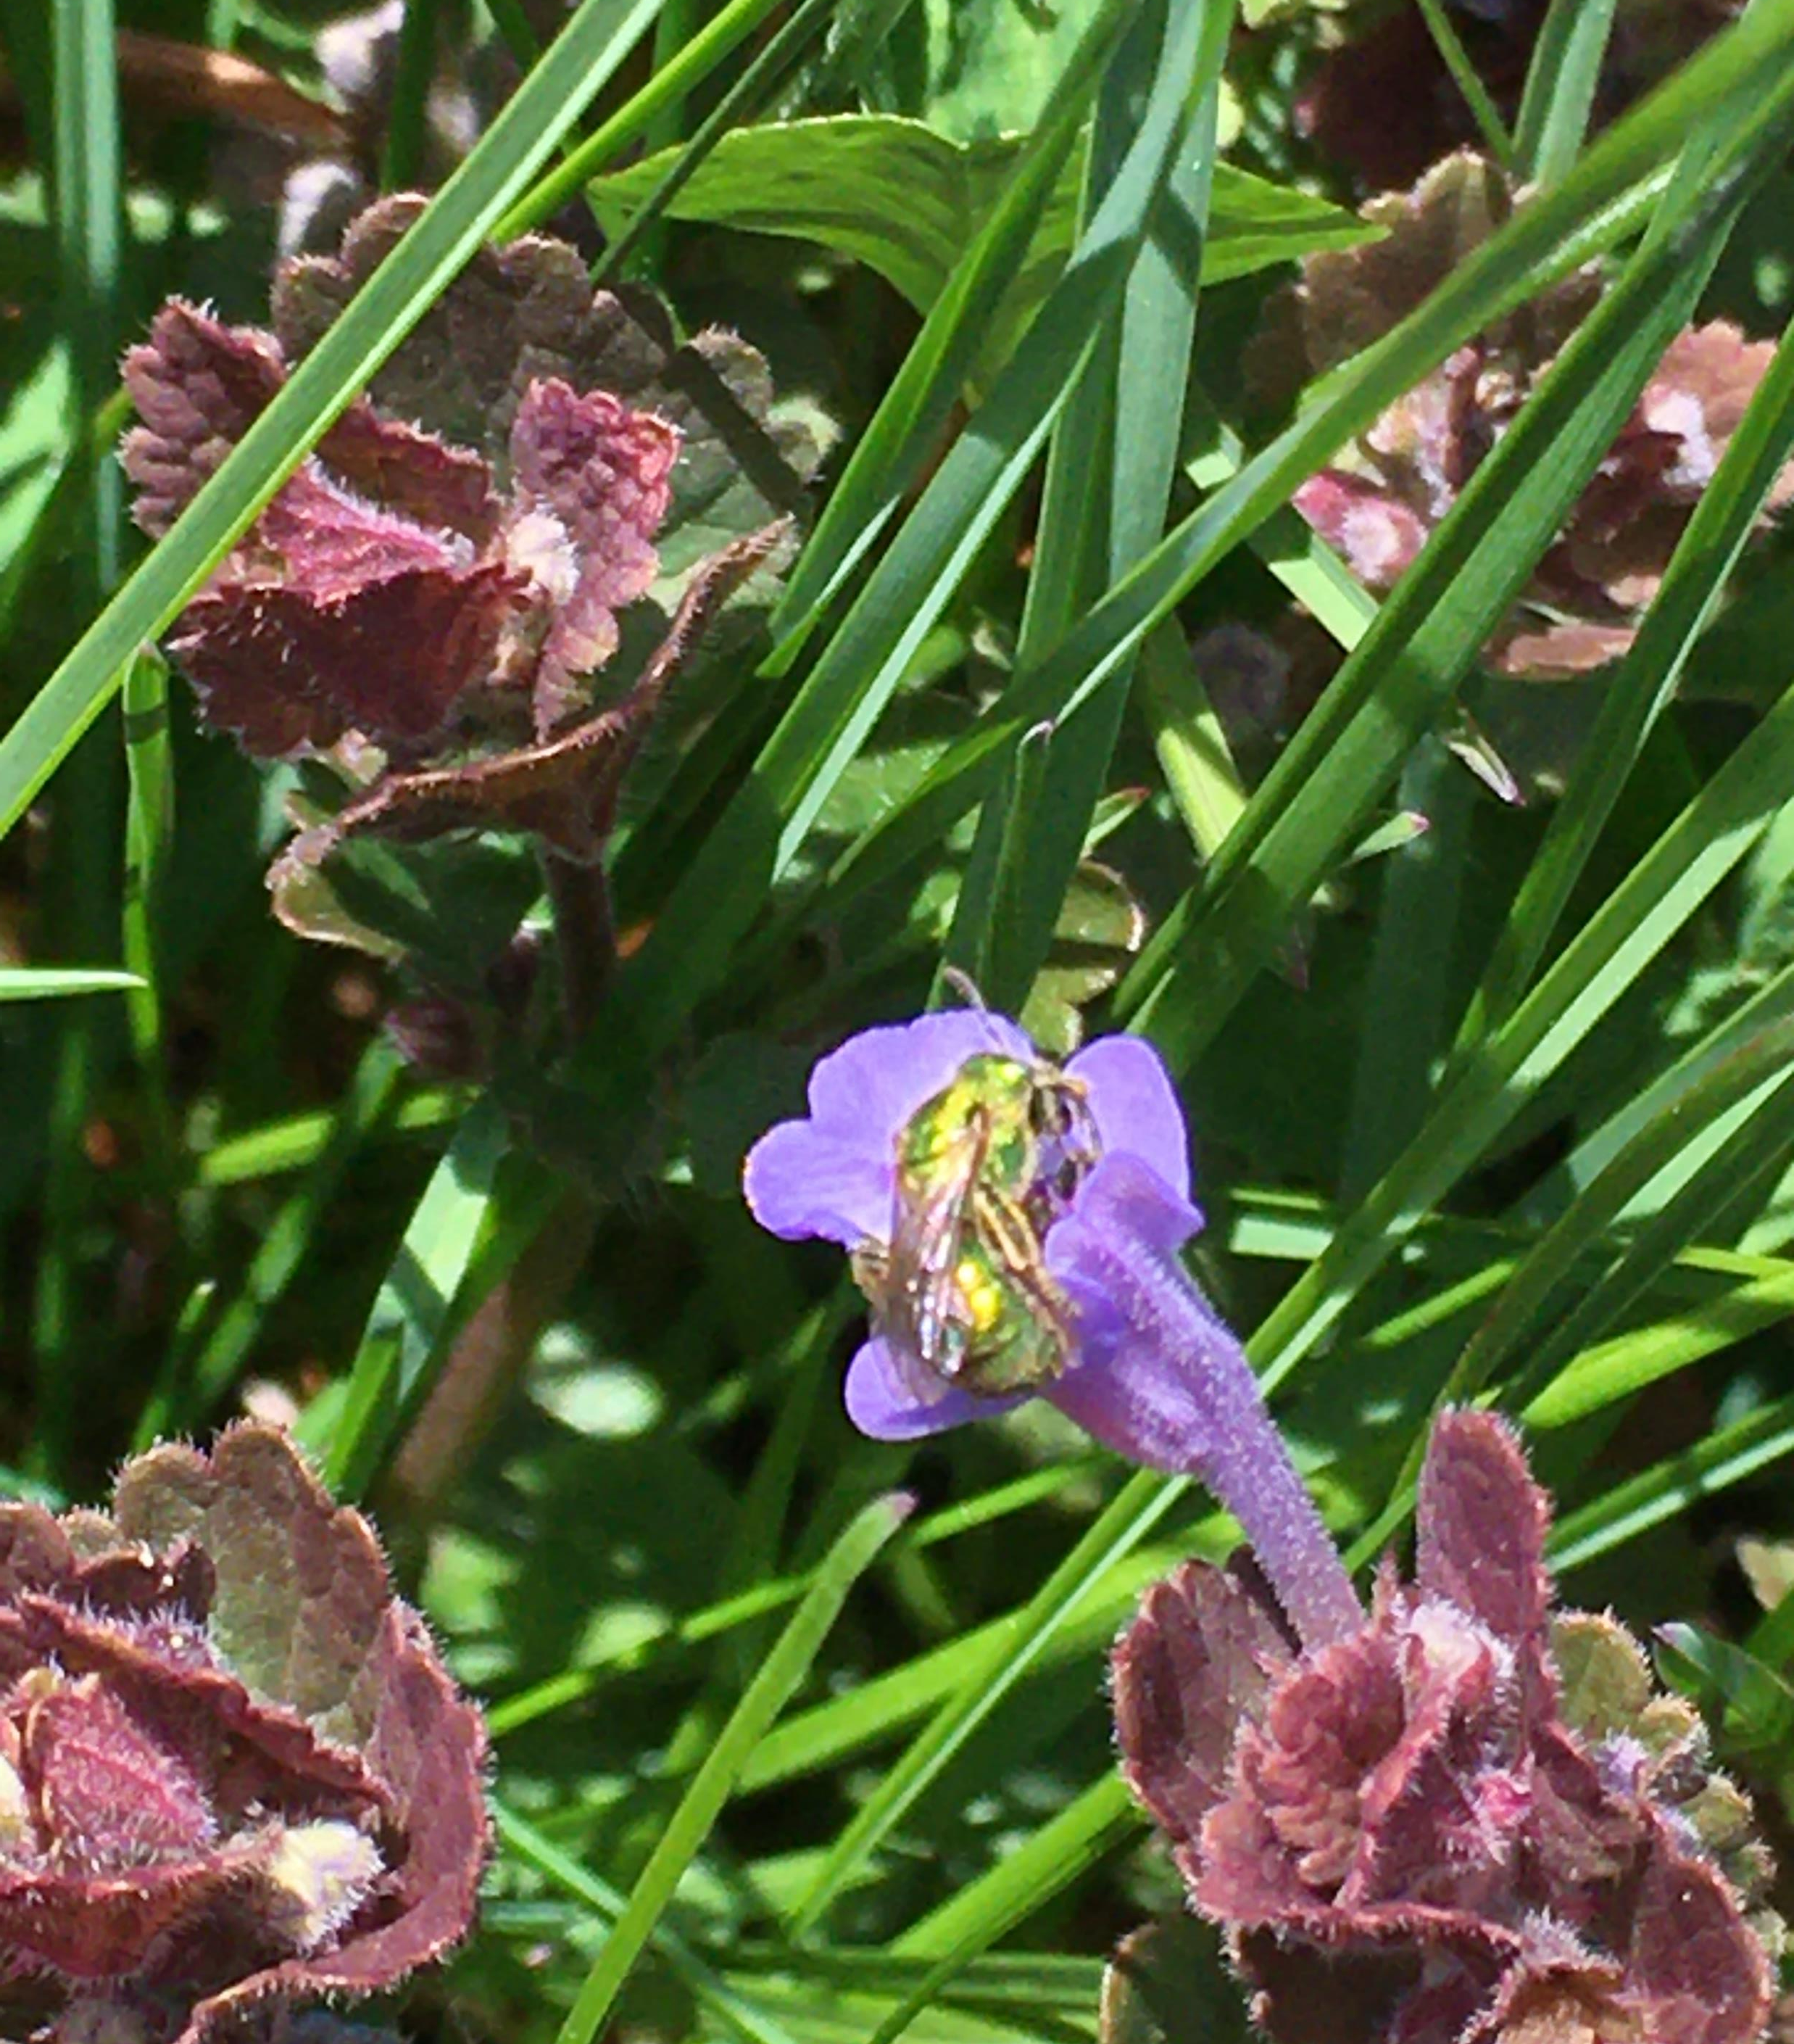
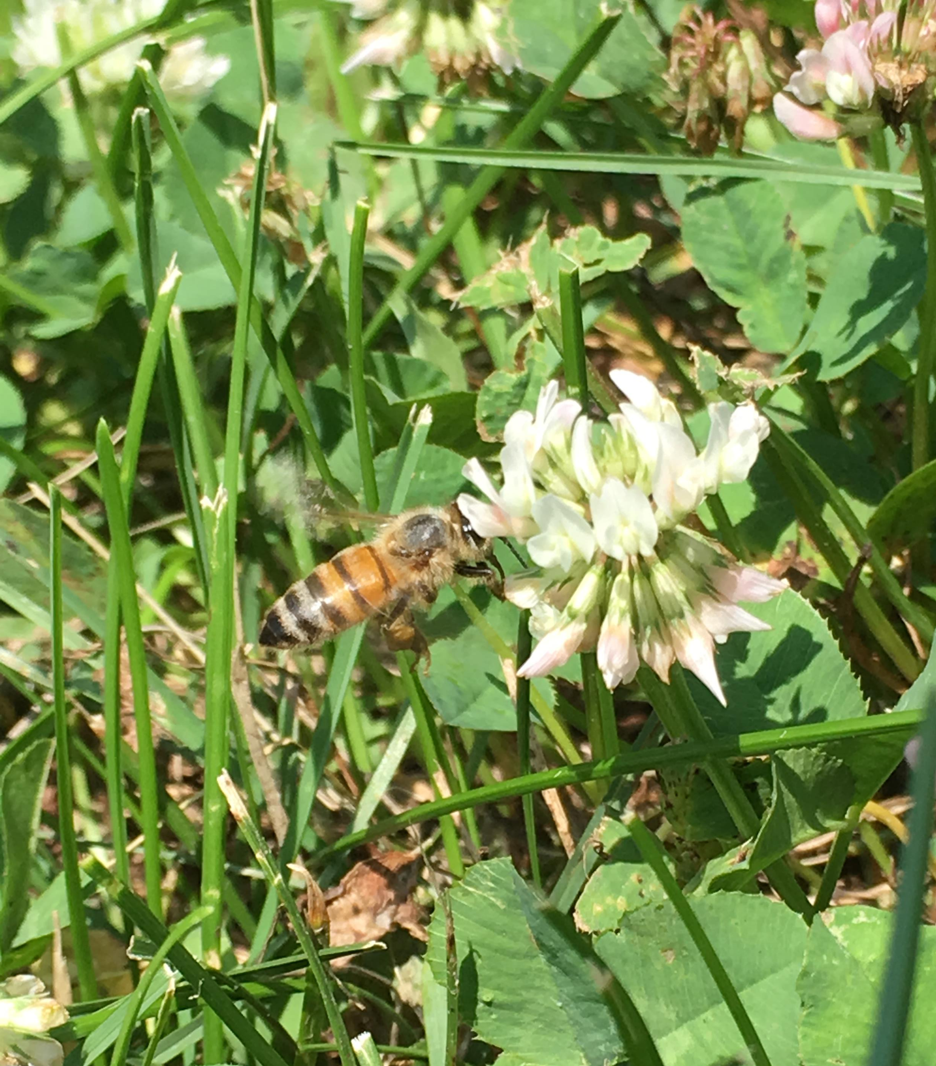
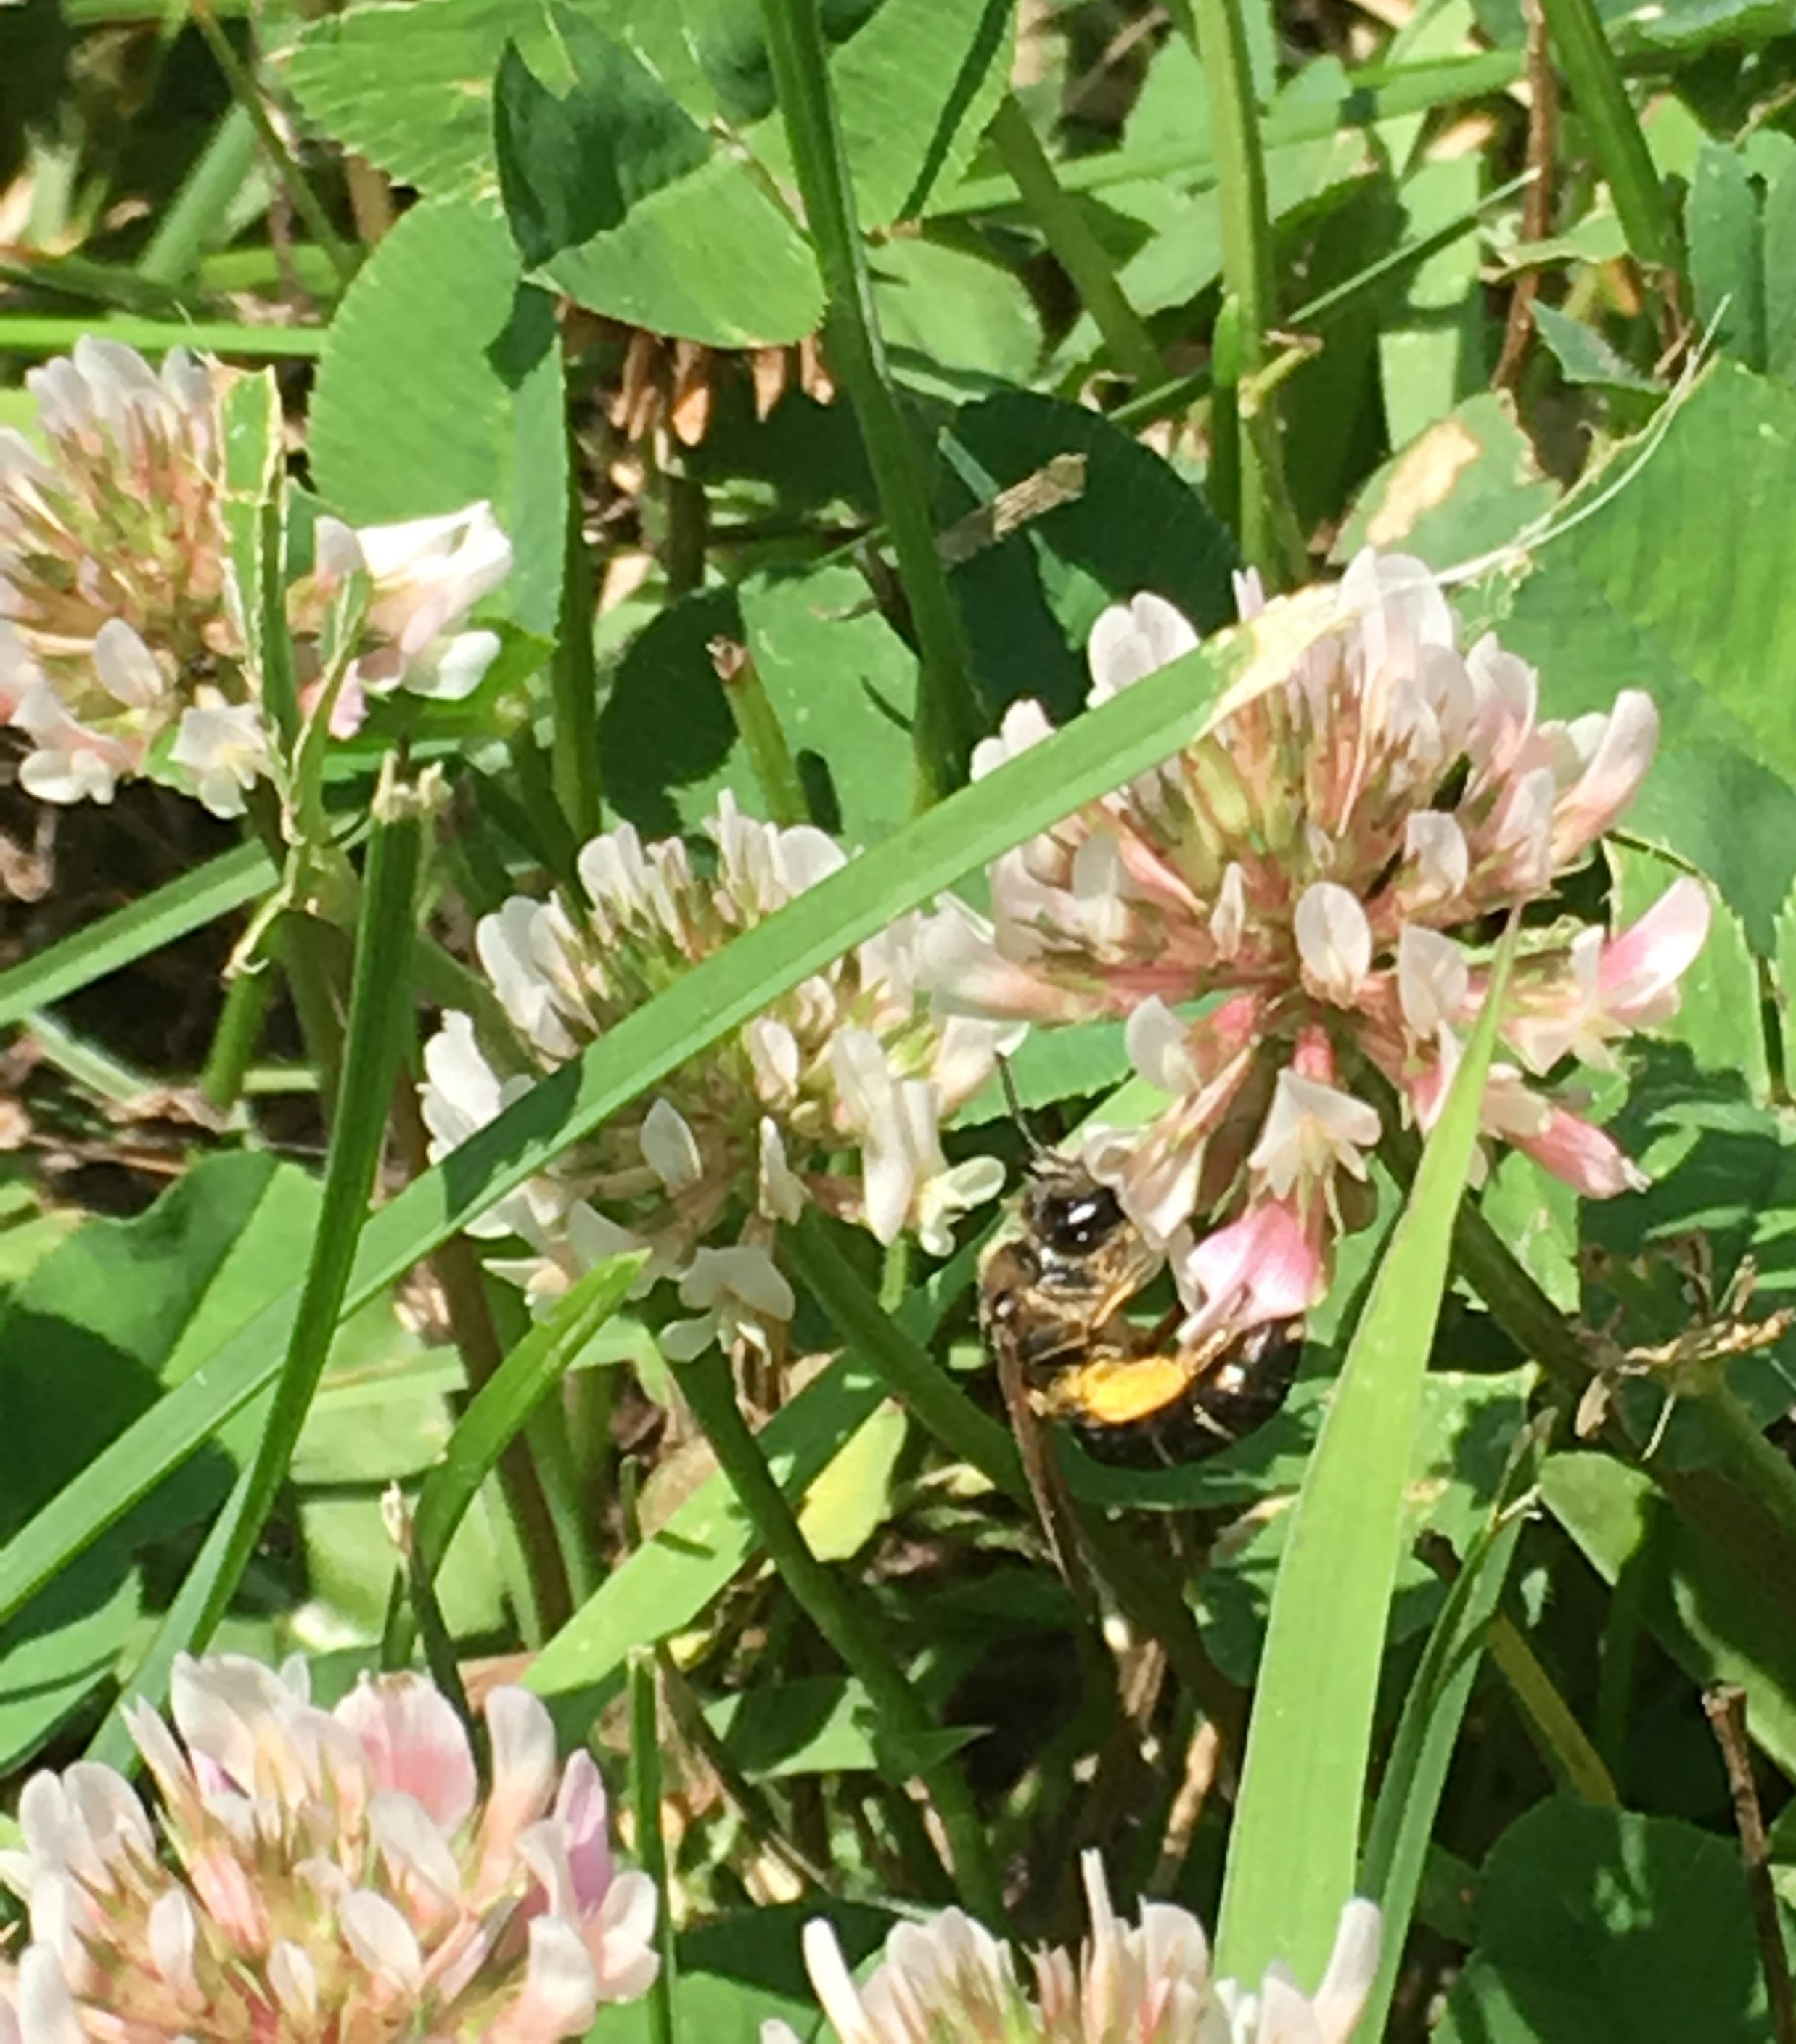
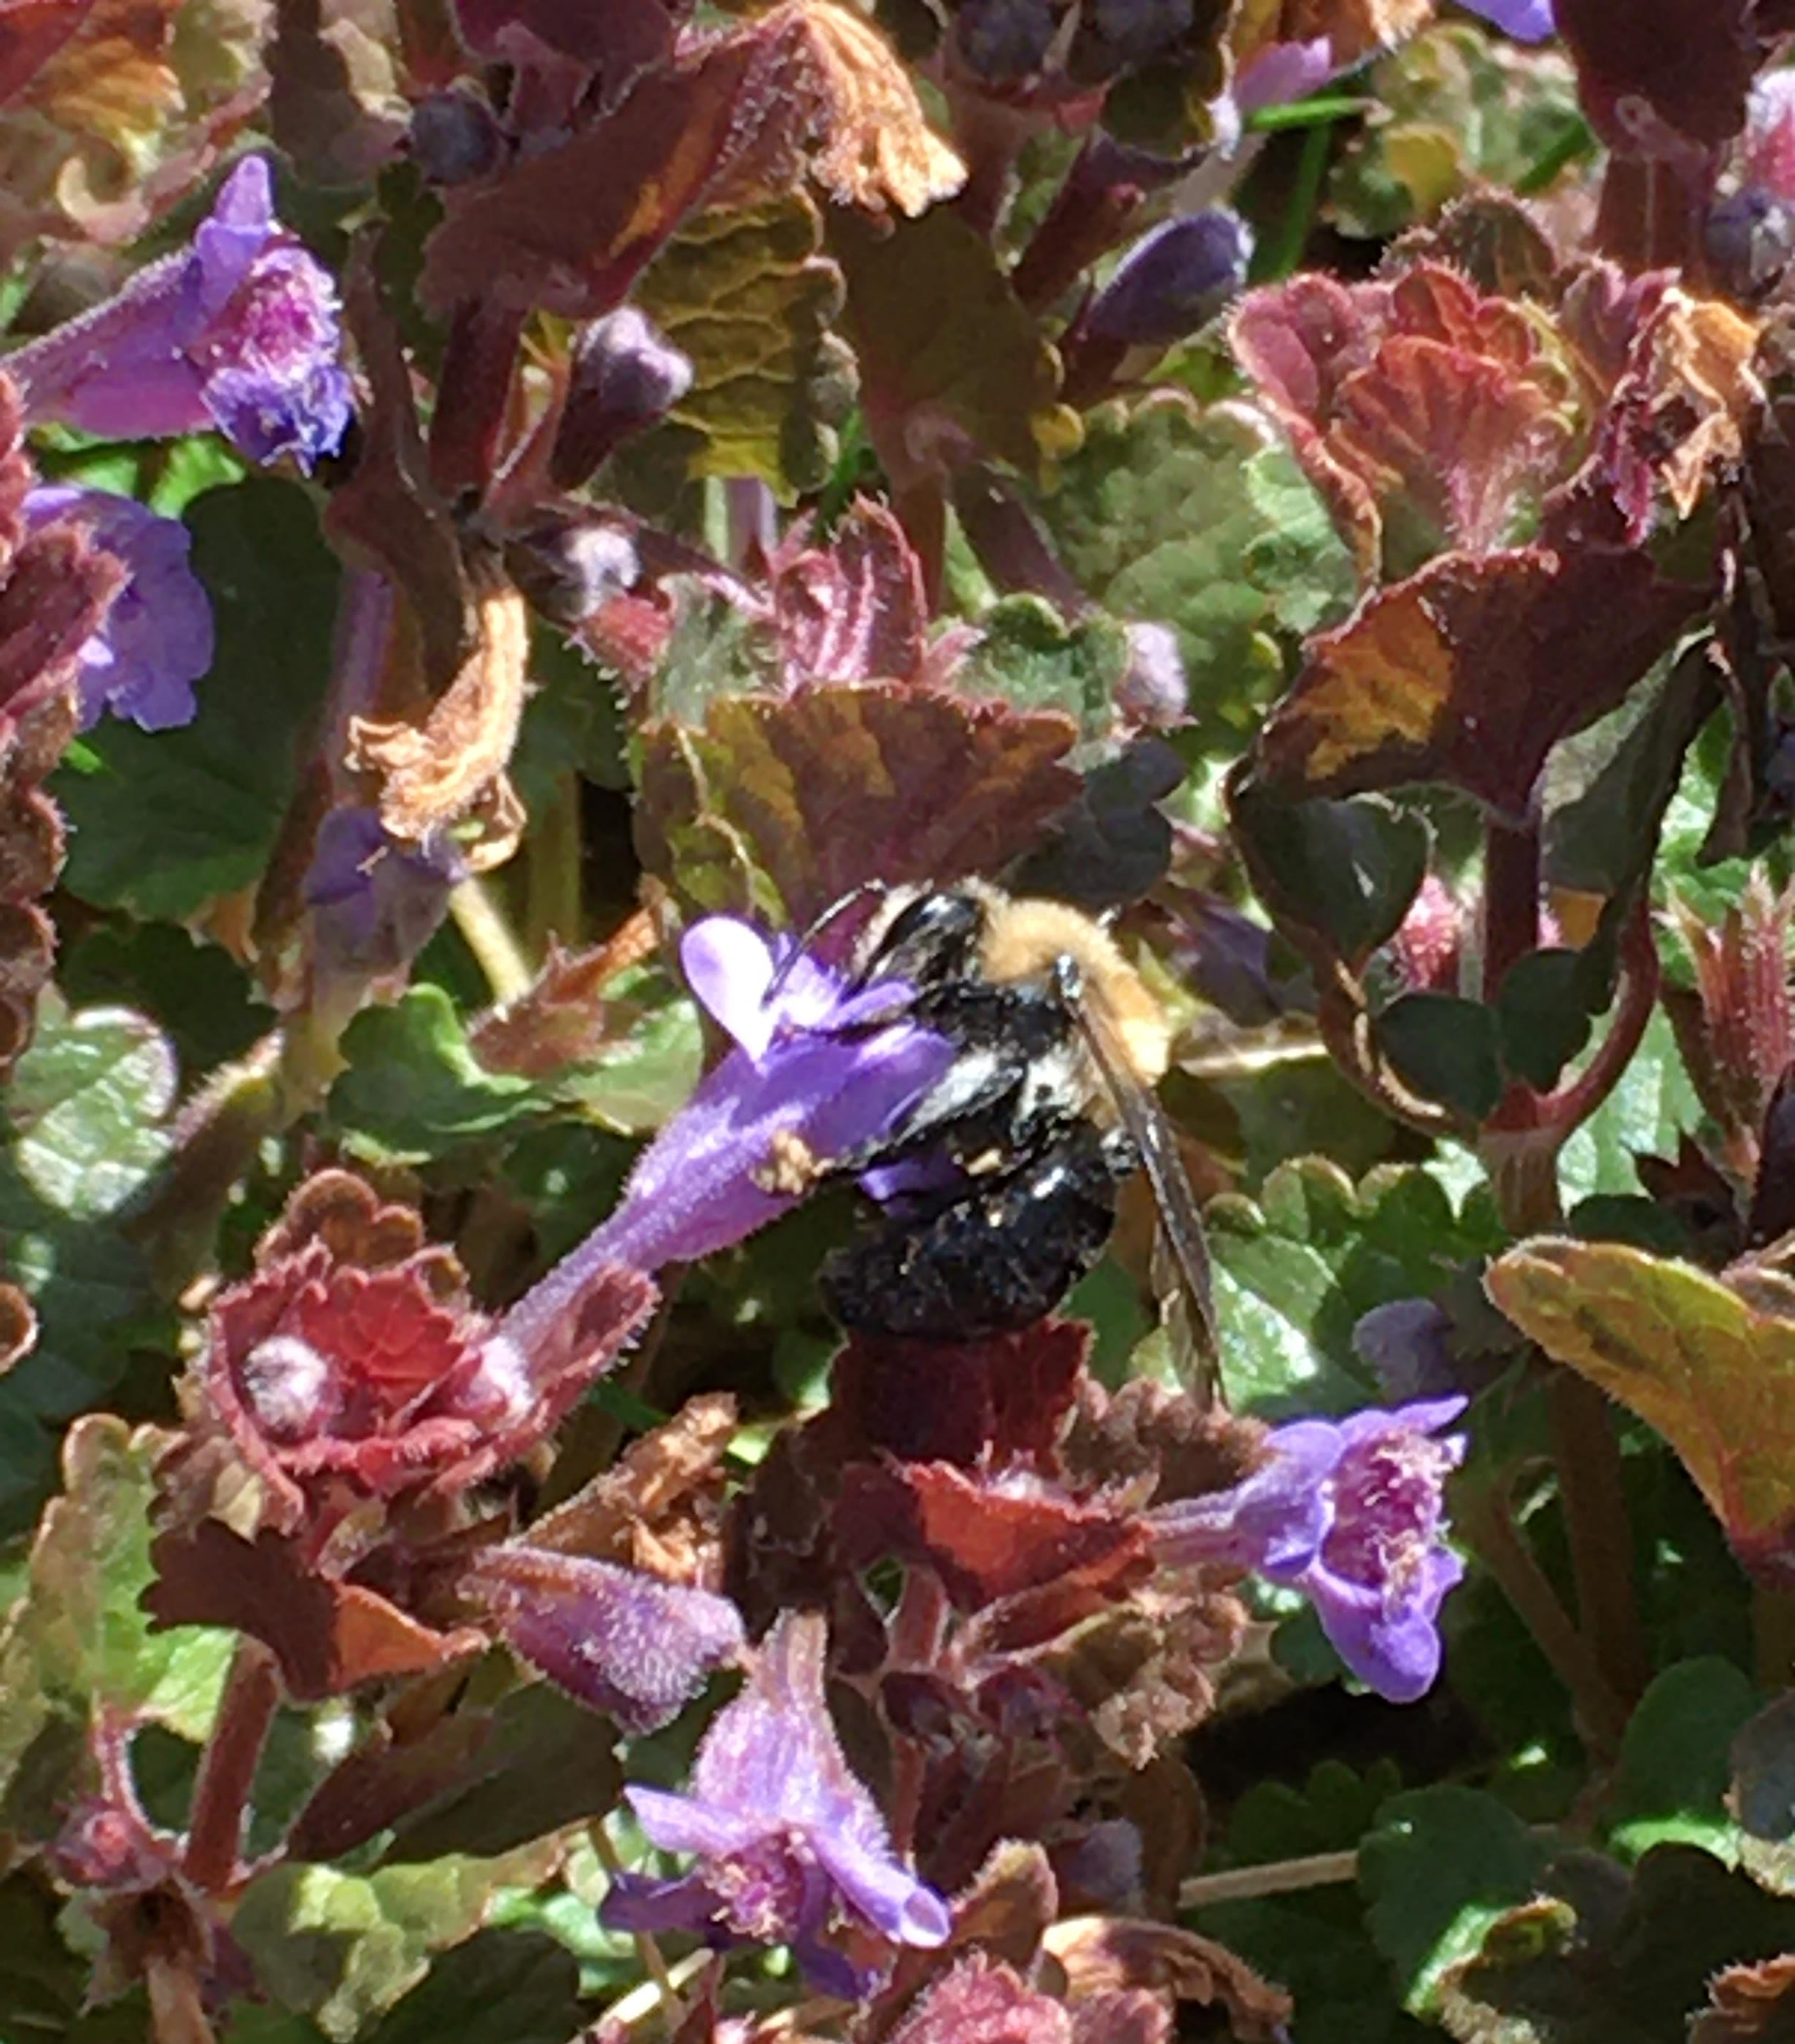
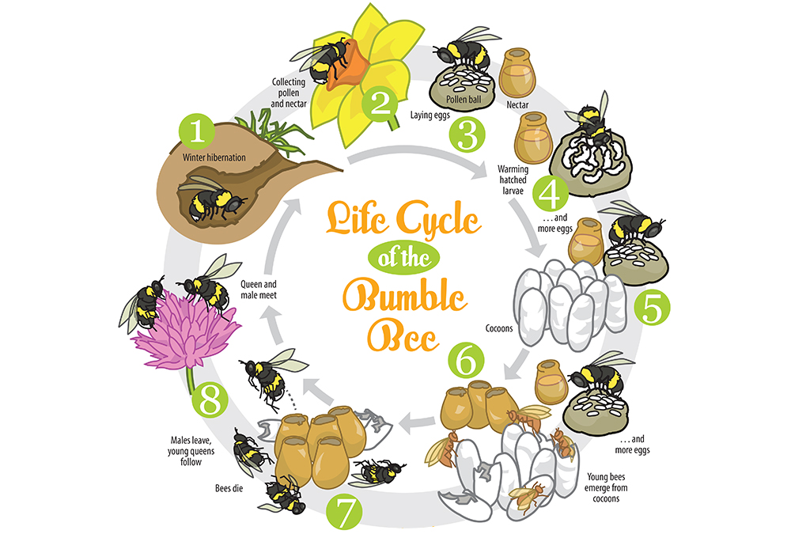
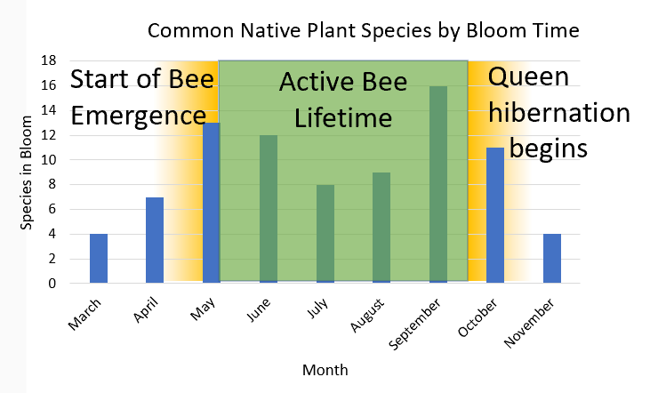
How can No Mow May help?
April through May are the restart of the Bee’s life cycle and their sucess hinges on plant bloom abundance
Metallic Sweat Bee
Honey Bee
Cellophane Bee
Mining Bee
Perplexing Bumble Bee
Native Bee lifecycles are in sync with native plant abundance
But in our non- native, cultivated landscapes what is growing abundantly?
Creeping Charlie, Clover, Dandelions
70% of all the 20,000 species of bees nest underground. In North America, most of these ground bees become active in early spring.
There are ~450 species of native bees found in NY and 54% of those bees are ground nesting.
Honey bees are not native to the US, but and as an introduced, managed, (or escaped) agriculture species, are just one species, not included in the 450 total of NY wild bee species.

Slide 4
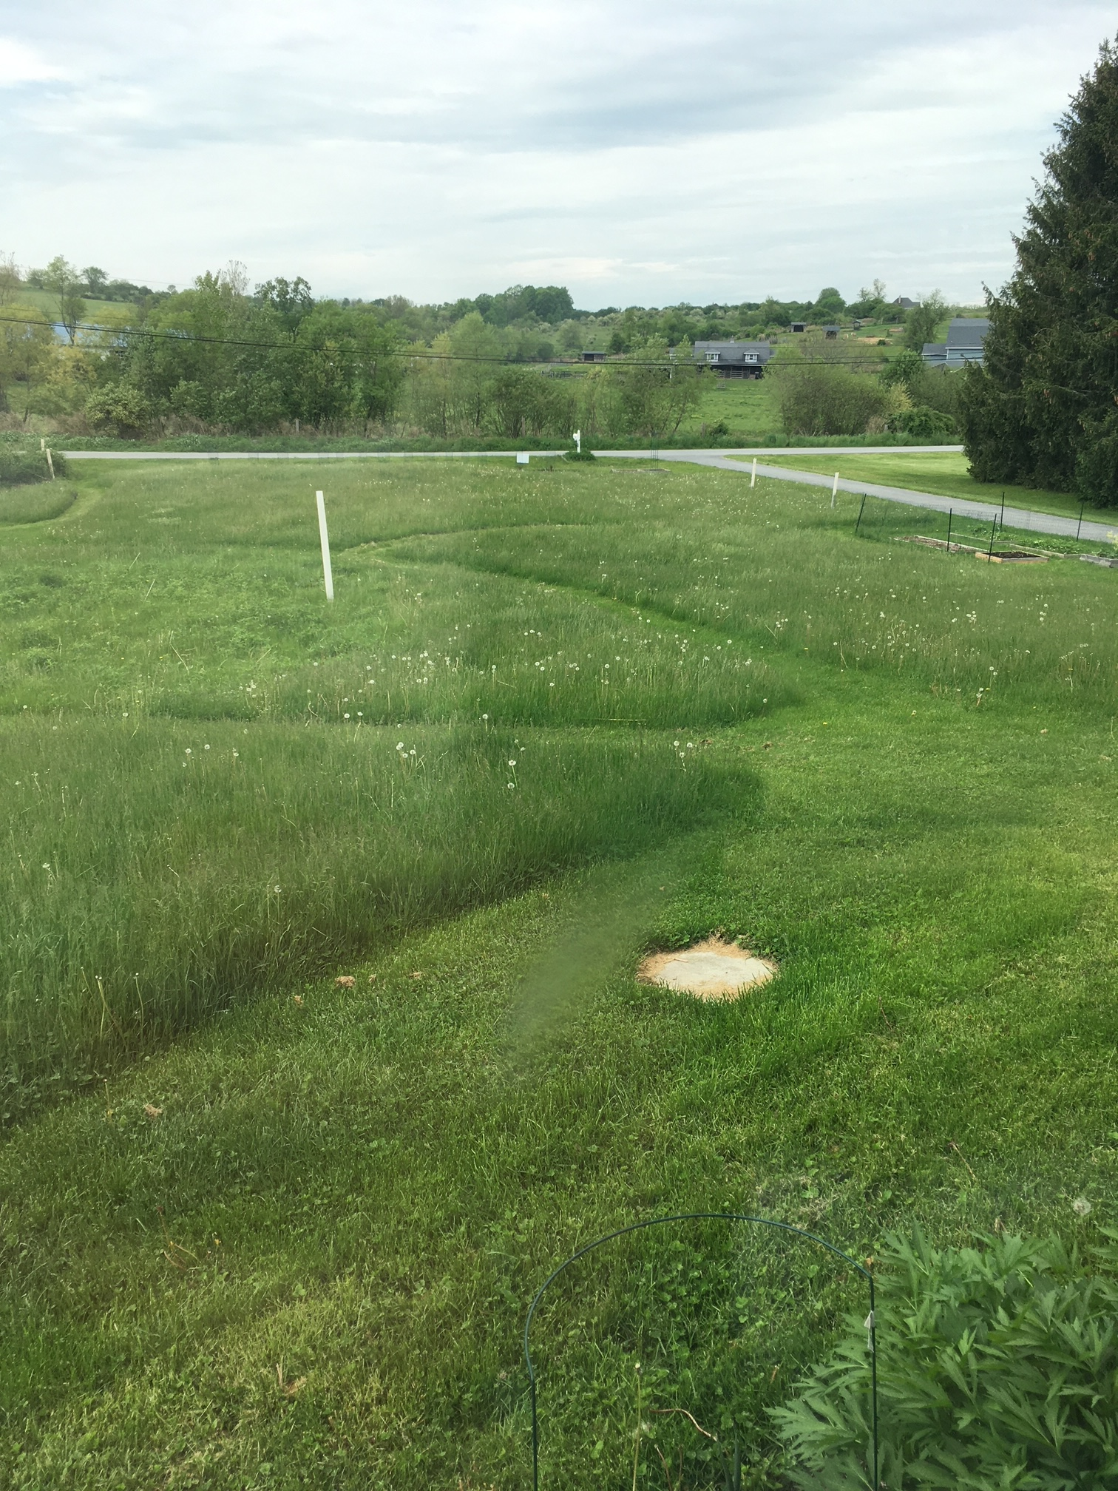
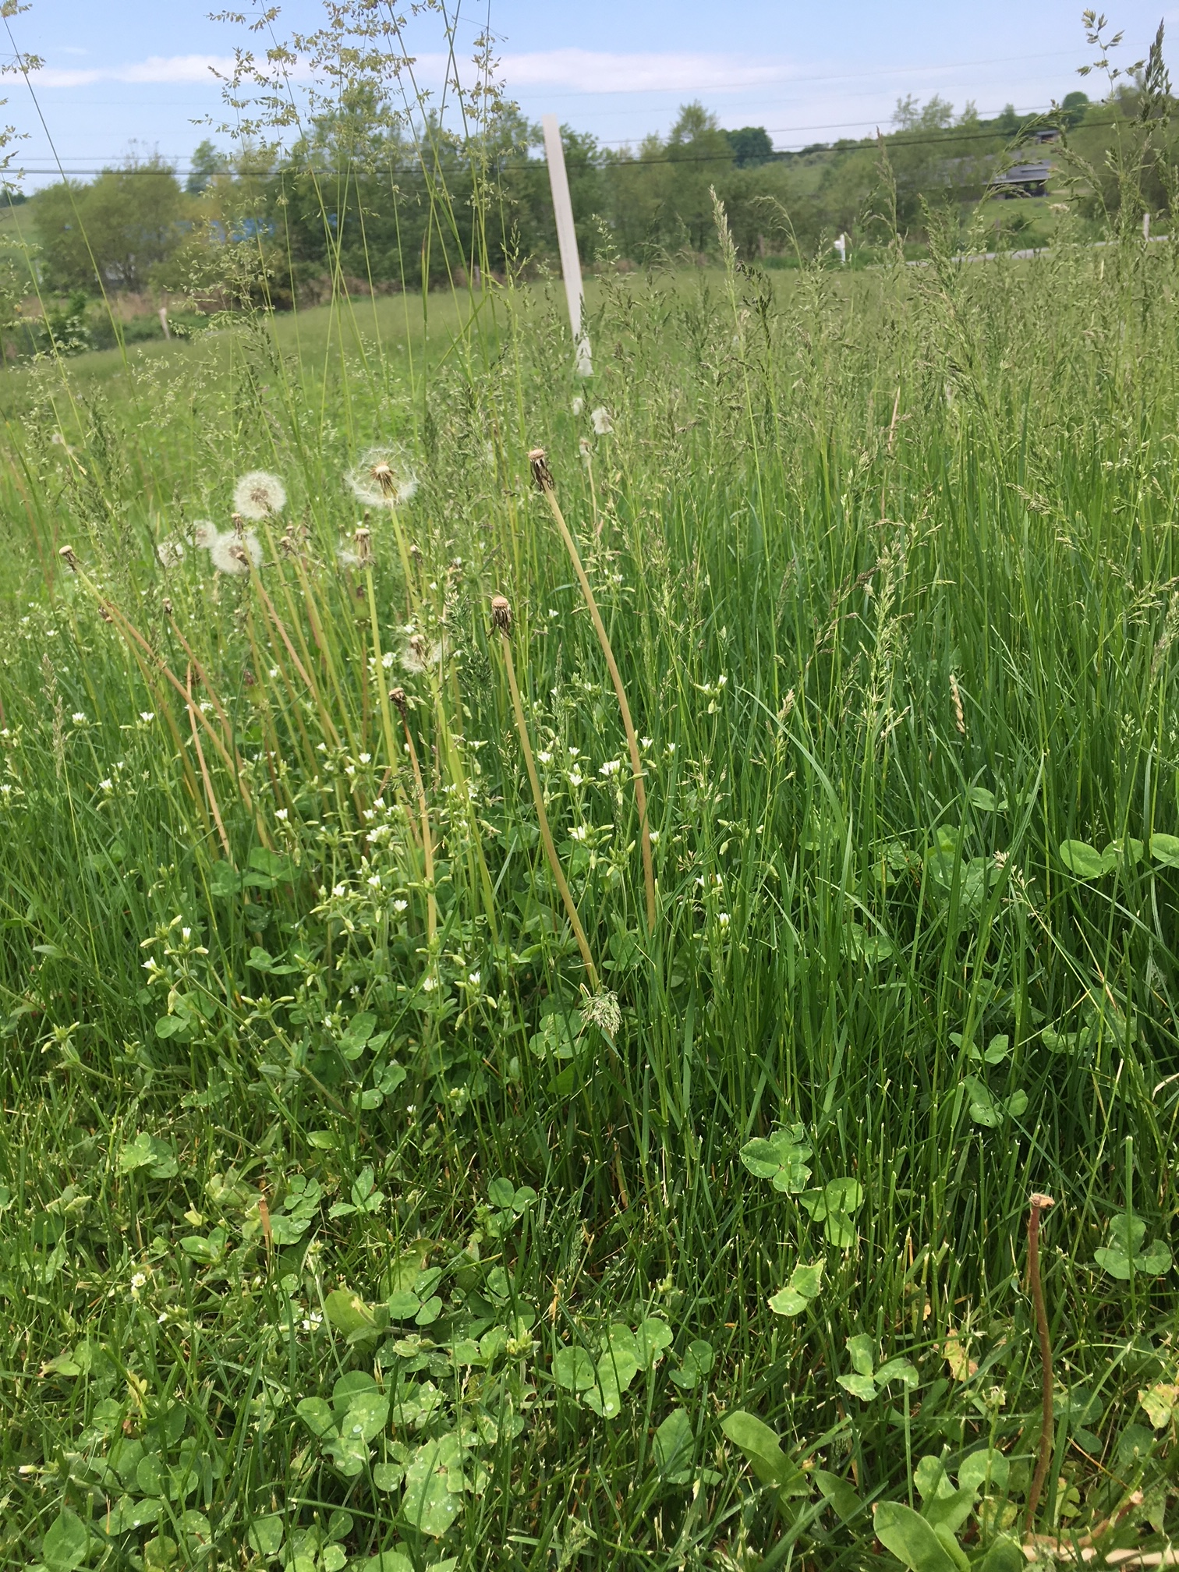
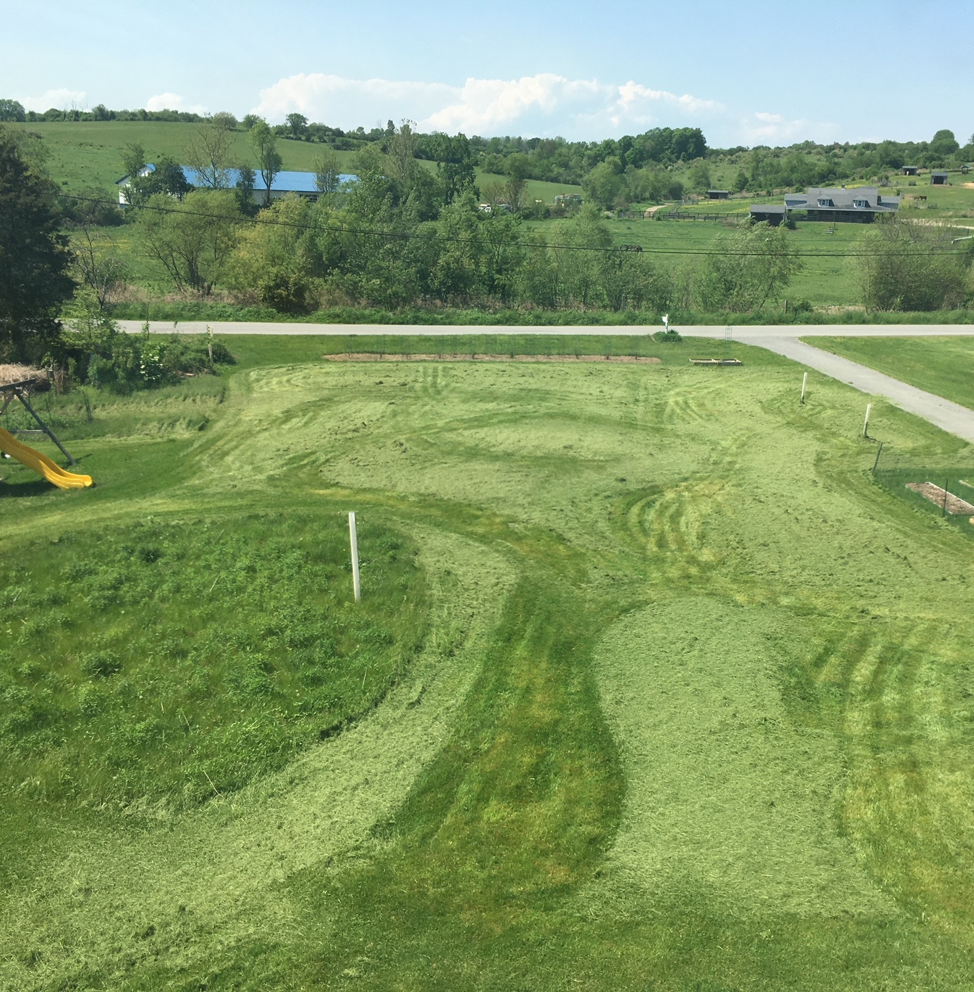
No Mow May 2022: A Case Study
We left the whole yard grow except a few paths
By the end of May the lawn was over 12” tall. Most flowers had not rebloomed and the grass went to seed
Mowing at the very end of May we were left with a thick layer of hay that required raking and collecting
Lessons Learned:
The goal of “No Mow May” is not to make hay
  Manicured lawns comprised mainly of fescue result in a yard full of hay after May → diversity of “weeds” are key
  If your whole yard is grass it is for bees→ grass is grass, cut it
Some not all →“No-mowing” select areas of your yard, particularly “weedy” areas with high plant diversity and flowering species is the best way to support bees
  Leave the margins of your lawn un-mown, or isolated patches where clover, creeping charlie, or dandelions are abundant
  Mow one site and start a new patch left un-mowed for successional flowering regions of lawn
  Mow fewer times and not as short so that flowering species can be present for longer durations and more quickly after trims
  Worried about weeds? Cut patches back before seed heads form
Consider leaving a forgotten corner of diverse weeds to leave for the bees year-round, ground nesting bees need undisturbed spaces and exposed soil

Slide 5
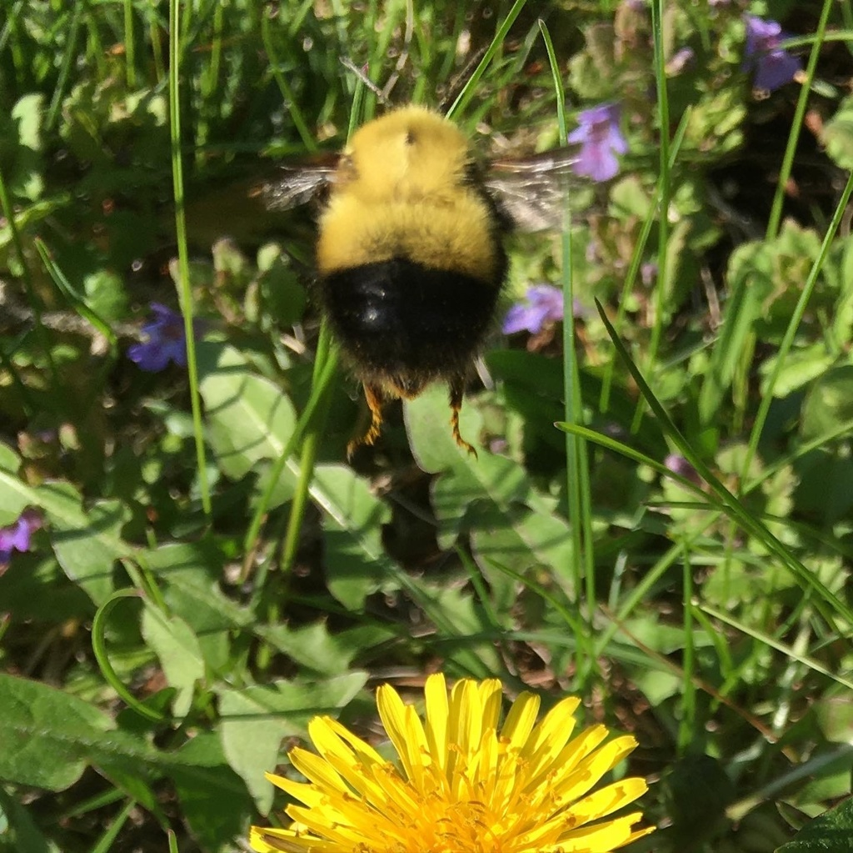
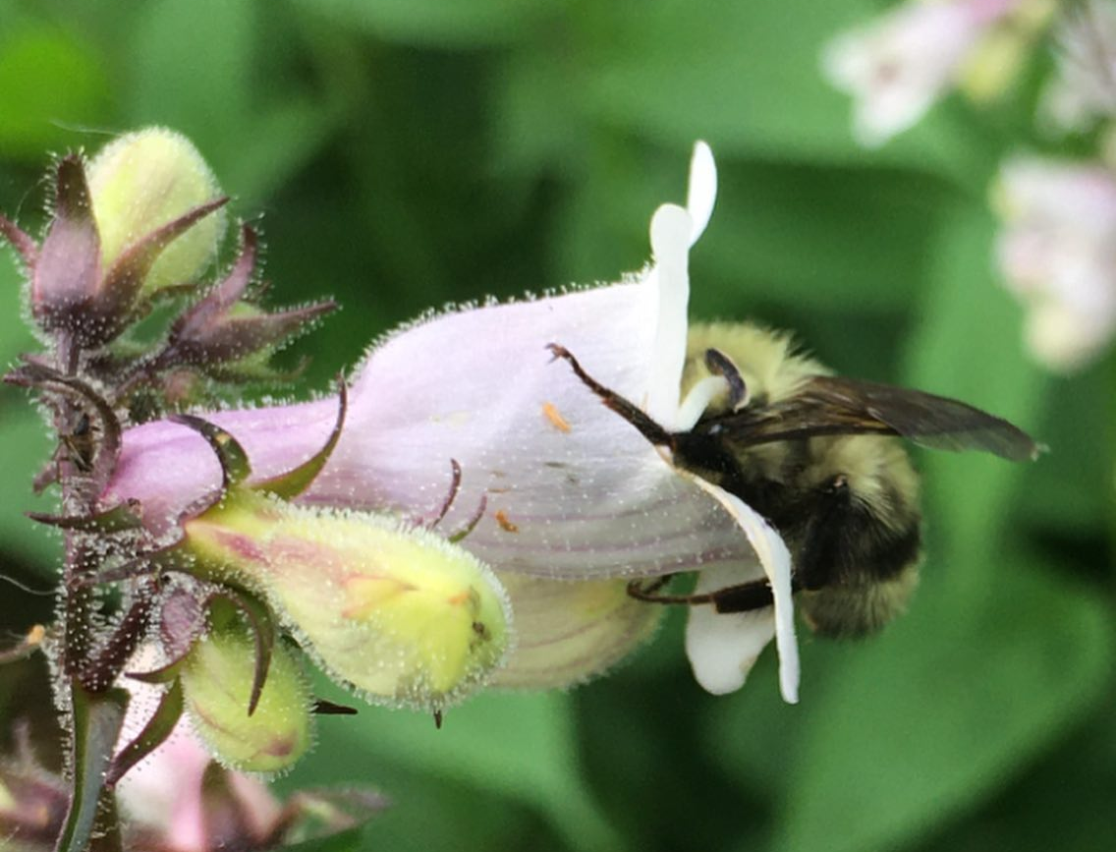
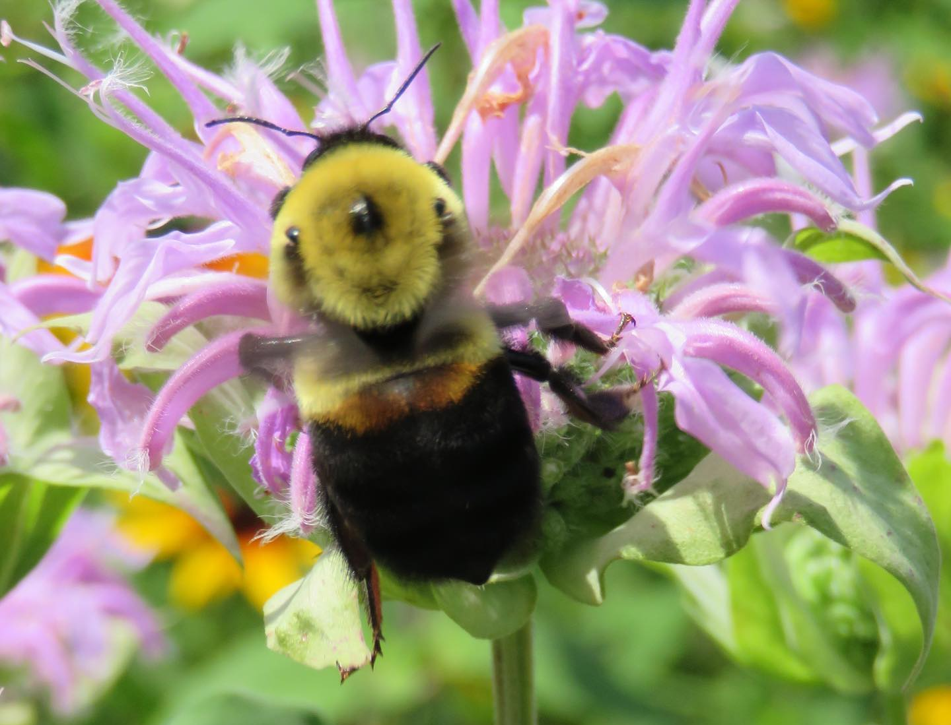
Resources and More information
https://cals.cornell.edu/pollinator-network/ny-bee-diversity
No Mow May | Bee Lab (umn.edu)
No Mow May FAQs
Summaries of Published Studies of Conservation Benefits of Reduced Mowing
Webinar: No Mow May? No Mow April? Low Mow Spring?
Blog: For Pollinators’ Sakes, Don’t Spring Into Garden Cleanup Too Soon!
Blog: No Mow May Affiliate Spotlights: Appleton, WI and Lawrence University

Slide 7
https://cals.cornell.edu/pollinator-network/ny-bee-diversity
No Mow May | Bee Lab (umn.edu)
No Mow May FAQs
Summaries of Published Studies of Conservation Benefits of Reduced Mowing
Webinar: No Mow May? No Mow April? Low Mow Spring?
Blog: For Pollinators’ Sakes, Don’t Spring Into Garden Cleanup Too Soon!
Blog: No Mow May Affiliate Spotlights: Appleton, WI and Lawrence University

Slide 8
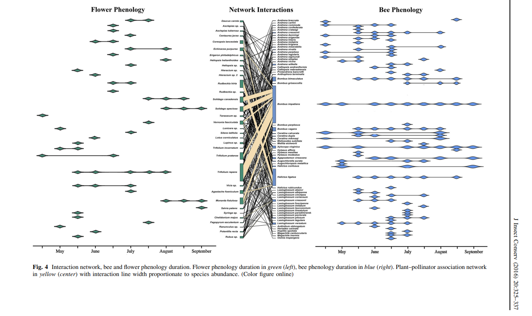
Dandelion
Crimson Clover
Buttercups
https://www.researchgate.net/publication/301741498
Wild bee pollination networks in northern New England Article in Journal of Insect Conservation · April 2016 DOI: 10.1007/s10841-016-9870-1

Slide 9
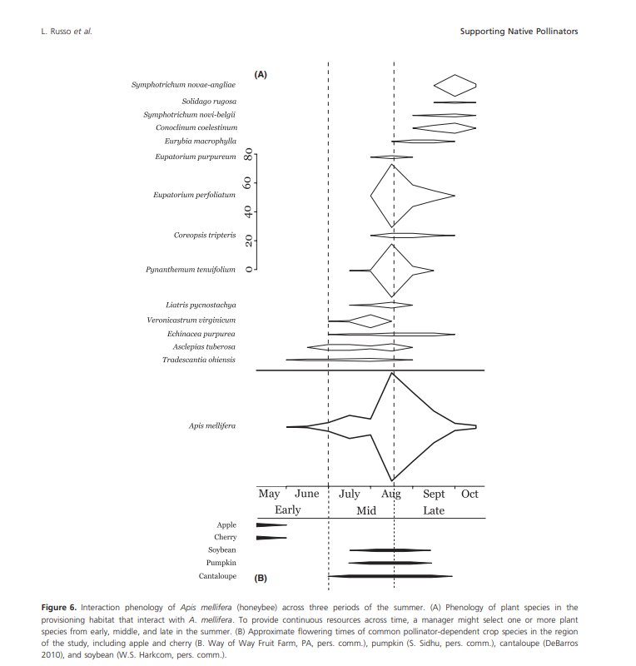
https://www.researchgate.net/publication/257531506 Supporting crop pollinators with floral resources: Network-based phenological matching Article in Ecology and Evolution · Sep

Slide 10
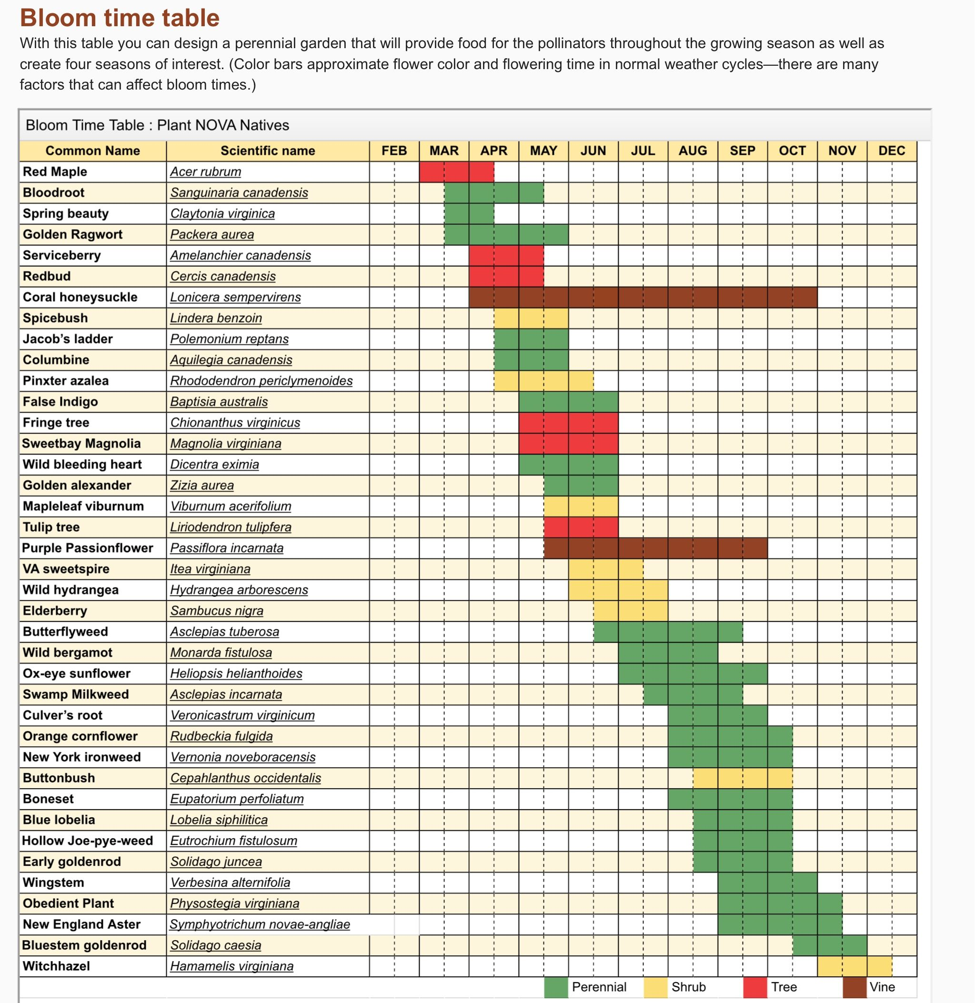
Month | QTY
March | 4
April | 7
May | 13
June | 12
July | 8
August | 9
Sept | 16
October | 11
November | 4
Start of Bee Emergence
Active Bee Lifetime
Queen hibernation
begins

Slide 11
“70% of all the 20,000 species of bees nest underground. In North America, most of these ground bees become active in early spring.”
There are ~450 species of native bees found in NY and 54% of those bees are
Honey bees are not native to the US, but are an introduced managed (or escaped) agriculture species – Just 1 species, not included in the 450 found in NY in the wild
1_BumbleInfo.jpg (1000×675) (wng.org)
B.Hedrick Unionvale,NY May 4, 2022
NY Bee Diversity | CALS (cornell.edu)

