Slide 1

Fund Development:
The Foundation’s Pit Crew
Presented by:
Charmayne B. Vincent

Slide 2
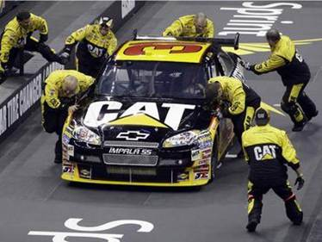
Why is the Fund Development Committee important?
Just like a race car driver and his team need a “Pit Crew” the Foundation needs a Fund Development Committee. So following our racing theme:
Board Members: Driver
Foundation Chair: Crew Chief
Fund Development: Pit Crew

Slide 3
What is the job of the Fund Development Committee?
The purpose of the Fund Development Committee is to work as a “crew” or team to raise funds to help the Foundation provide services and programs for the metro Richmond community. This includes grants along with major and minor fundraisers.
Teamwork is the “fuel” that allows common people to attain uncommon results.
- Andrew Carnegie

Slide 4
What are the plans of the Fund Development Committee?
By December 31, 2013
Conduct three (3) fundraisers
Raise $5,000
Secure at least one (1) grant
If you lock yourself in a box with the lock on the outside, you will never get out!
- Charmayne Vincent

Slide 5

FUND DEVELOPMENT
FUNDRAISER PROPOSAL FORM
Date of Submission:
Submitted By:
Contact Number:
FUNDRAISER INFORMATION
Description of Fundraiser:
Target Audience:
Date of Fundraiser:
Seed Money Needed: $
Estimated Fundraiser Expenses $ (Please attach an estimated fundraiser budget)
Estimated Fundraiser Profit: $
Will You Serve As Chair of this Fundraiser? Yes No
______________________________________________________________________________________________
Reviewed by Fund Development Committee: __________________________________________________
Committee Decision: ____________ Proceed _________Provide Additional Information _______Denied
Tentative Date to Present to PROC Foundation: ________________________________________________

Slide 6
How Can You Help?
Submit ideas for fund raisers
Be willing to chair fund raising projects
Support fund raising projects with your time, resources and finances
A good idea is like a parachute, you won’t know if it works until you try it.
- Frank Zappa

Slide 7
Fund Development Committee Members
Charmayne B. Vincent, Chair
Cheryl N. Ivey
An’Jou C. Johnson
Patricia B. Lancaster
Quan B. Myles
Darlene Sims
Karen D. Spence

