Slide 1


an introduction

Slide 2
Who is RSAI?
We are school leaders from nearly 70 rural school districts in Iowa who share the mission that all students, regardless of zip code, deserve a quality education.
We bring together school superintendents and school board members with a clear goal to strengthen support for the education of students in rural Iowa schools.

Slide 3

http://rsaia.org/

Slide 4
Organization of RSAI
RSAI is organized into 4 territories of the state
Each territory has representation on the RSAI leadership board and legislative committee
Regional meetings bring together RSAI members for important policy development and priority setting
The following slide shows the boundaries of the RSAI territories.

Slide 5
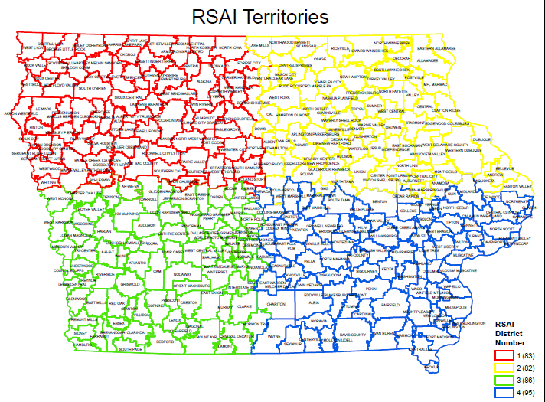

Slide 6
RSAI Leadership
A. RSAI District Leadership Representatives
Southwest - Gregg Cruickshank/Sidney and South Page Superintendent
Northeast - LeeAnn Grimley/Springville Board President
Southeast - Brad Breon/Seymour and Moravia Superintendent
Northwest - Bob Olson/Clarion-Goldfield-Dows Superintendent
B. RSAI Legislative Committee Representatives
Southwest – Willie Stone/Villisca & Corning Superintendent
Northeast – Nick Trencamp/Central Superintendent
Southeast – Dennis Phelps/Tri-County & Pekin Superintendent
Northwest – Tara Paul/Estherville Lincoln Central Superintendent
C. At-Large Representatives - on Leadership Group & liaison to Legislative Representatives
Dan Smith/Harmony Board Presdient
Brian Rodenburg/Midland Superintendent
Kevin Fiene/I-35 Superintendent

Slide 7
RSAI Mission & Vision

Slide 8
RSAI Mission and Vision
RSAI will advocate for students in rural schools to assure a fair, equal, and quality education.

Slide 9
RSAI Mission and Vision
RSAI Vision: Member schools will collaborate to promote legislation that strengthens rural education for students, by;
  1. Educating others about the value of rural education to the state’s economy and future of Iowa as an educational leader in the nation and the world;
  2. Building capacity and understanding of other groups with similar interests on legislative and educational issues to build a stronger voice;
  3. Securing adequate resources, academic and financial, to provide first class educational opportunities for rural students; and
  4. Maintaining local control through the flexibility and authority of locally elected School Boards.

Slide 10
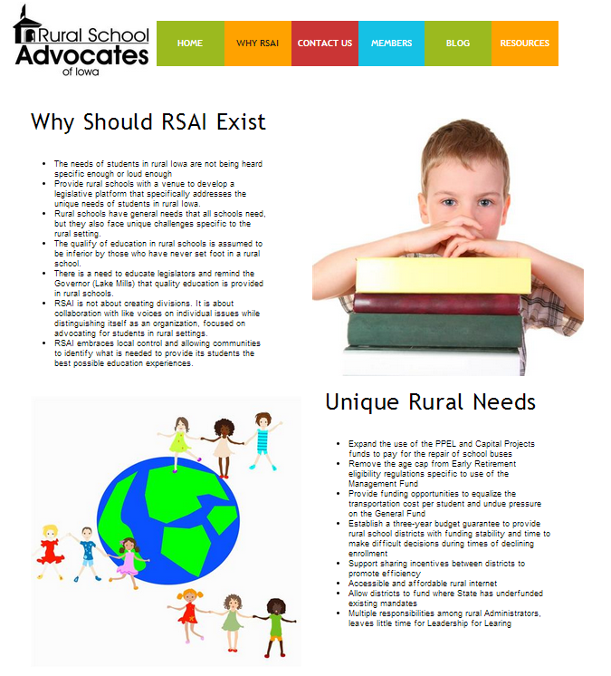
Why RSAI?

Slide 11
What do we do?
We advocate for students in rural schools championing the resources and commitment of Iowans to deliver a quality education to all students.
We support legislation and activities that strengthen and build a foundation of opportunity and stability for students in rural schools.
We recruit other individuals and organizations to advocate with a common purpose.
We tell the stories of school successes for students from rural schools.

Slide 12
Does Iowa Need a specific advocacy voice for Rural Schools?

Slide 13
Why do Rural Schools need RSAI?
Other organizations do a fine job of advocating for all schools and students, however, we have unique needs and interests that compel us to work together:
  Transportation costs well above the state average
  Growing numbers of students in low-income families
  Declining enrollments that stress the budget
  Need for flexibility and incentives to promote efficient use of resources
  Less resource while compliance with state law becomes more complicated
  Need for adequate funding that supports delivery of educational opportunities to students in rural communities
Legislators from rural communities will identify with, trust and understand us. Our very existence will strengthen the voice of the entire education community as we work together for interests in common and interests critical to rural school survival.

Slide 14
Other Advocacy Coalition Models
There are many organizations that advocate for Iowa Agriculture, which proves a good example.
  Iowa Farm Bureau Federation
  Iowa Corn Growers Association
  Iowa Soybean Association
  Iowa Cattlemen’s Association
  Iowa Farmer’s Union
  IA/Nebraska Farm Implement Dealers Association
  Iowa Pork Producers Association
  Iowa Poultry Association
In many, many instances, these organizations have similar positions on important legislation and work together for it’s passage or defeat. When they do agree, they have many voices close to different legislators that can help deliver the necessary vote for success.

Slide 15
RSAI Expectations: Strength in Numbers
RSAI bylaws indicate that membership in RSAI is not intended to replace membership in other education advocacy organizations
RSAI encourages school boards to join IASB, superintendents are encouraged to join SAI, etc.
RSAI leaders will work with education and other organizations to garner support for RSAI priorities.
Some examples of our successes follow:

Slide 16
2014 RSAI Legislative Priorities
Legislative priority: Management Fund Use for Early Retirement over aged 65 Accomplished April 2014*
*http://ruralstudentadvocates.blogspot.com/2014/03/advocacy-matters-story-of-sf-220-early.html

Slide 17
2015 RSAI Legislative Priorities
Transportation Equity of Funding: Conversation started: 6 bills introduced in the House Education Committee and legislative approval of an Interim Committee in 2015 to study inequities including transportation.
Use of PPEL and SAVE Funds for Repairs Accomplished May 2015 with passage of HF 646 allowing use of PPEL or SAVE for bus repair and maintenance in excess of $2,500.
Increased Flexibility for At-Risk Students Progress seen in July 2015 with passage of HF 658 which allows dropout prevention funds to be spent on at-risk students, granting increased flexibility
State Penny Extension/Repeal of Sunset: Partial progress as SF 477 was approved by the full Senate, 37:13 and is sitting in the House Ways and Means Committee, still alive for discussion in the 2016 Session.

Slide 18
2016 RSAI Legislative Priorities approved October 7, 2016
Transportation Equity
State Penny for School Infrastructure Extension
Funding and Flexibility for At-risk Students
Standards, Assessment and Technology
State Supplemental Assistance 6%
Operational Sharing Incentives
Equality in the formula (District cost per pupil)

Slide 19
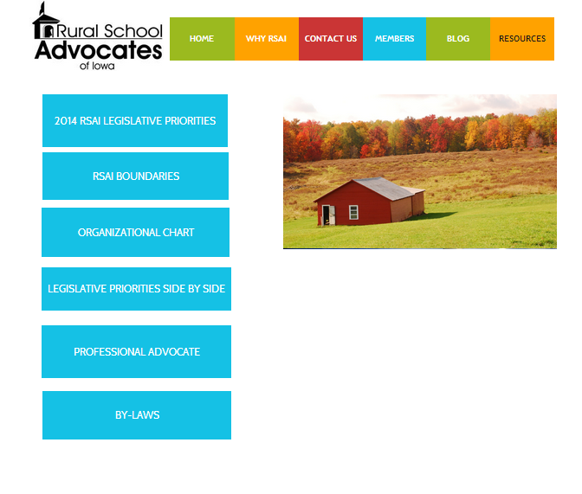
SE Brad Breon, Moravia/Seymour, Supt, brad.breon@rsaia.org
SW Gregg Cruickshank, Sidney/South Page, Supt, gregg.cruickshank@rsaia.org
NE Lee Ann Grimley, Springville, Board President, leeann.grimley@rsaia.org
NW Robert Olson, Clarion-Goldfield/Dows, Supt, robert.olson@rsaia.org
*Dan Smith, Harmony, Board President, dan.smith@rsaia.org At-large *Kevin Fiene, I-35, Supt, kevin.fiene@rsaia.org At-large
*Brian Rodenberg, Midland, Supt, brian.rodenberg@rsaia.org At-large

Slide 20
RSAI Resources
RSAI has enlisted the assistance of Larry Sigel and Margaret Buckton at ISFIS in data analysis, organizational work, membership and legislative analysis regarding development of RSAI priorities and lobbying services.
Web site http://rsaia.org/
Web site includes research about quality of education in rural schools, rural school challenges, and listing of rural school stories in the media

Slide 21
Questions
http://rsaia.org/

