Slide 1
Sponsored by:
How a flexitarian diet leaves room for modest amounts of animal products while balancing the needs of the planet
Presented by: Christine McCullum-Gómez, PhD, RDN, LD
May 26, 2021 | 2:00 pm EST

Slide 2
Learning Objectives
Identify the principles of a flexitarian diet.
Describe the nutritional advantages of a flexitarian diet.
List potential health benefits and health-cost savings of adopting a flexitarian diet.
Discuss how a flexitarian diet contributes to reducing environmental impacts of the food system.
Performance Indicators: 7.2.3, 8.3.6, 8.3.7, 12.1.3
CDR Activity Type: 171
CPE Level: 2
CEUs: 1.0

Slide 3
Presentation Outline
Consumer Trends: Plant-Based Eating & Sustainability
What is a Sustainable Food System?
What is a Sustainable Diet/Sustainable Healthy Diet?
Why are Sustainable Healthy Diets Important?
A Sustainable Food Systems Transition to Healthy Diets
What is a Flexitarian Diet?
How to Follow a Flexitarian Diet
Advantages/Benefits of a Flexitarian Diet
Nutritional Advantages
Health Benefits & Health-Cost Savings
Environmental Benefits
Take Home Messages

Slide 4
Consumer Trends
Plant-based Eating
“Plant-based” topped the list of eating patterns or diet types heard about most in the news in 2020 (22%) (IFIC, 2020a).
Sixty-five percent of respondents tried at least one new type of plant protein for the first time in the past year (IFIC, 2021):
28% tried plant alternatives to meat;
24% tried new varieties of milk alternatives;
21% tried new varieties of other dairy alternatives (e.g., plant-derived yogurt or cheese).

Slide 5
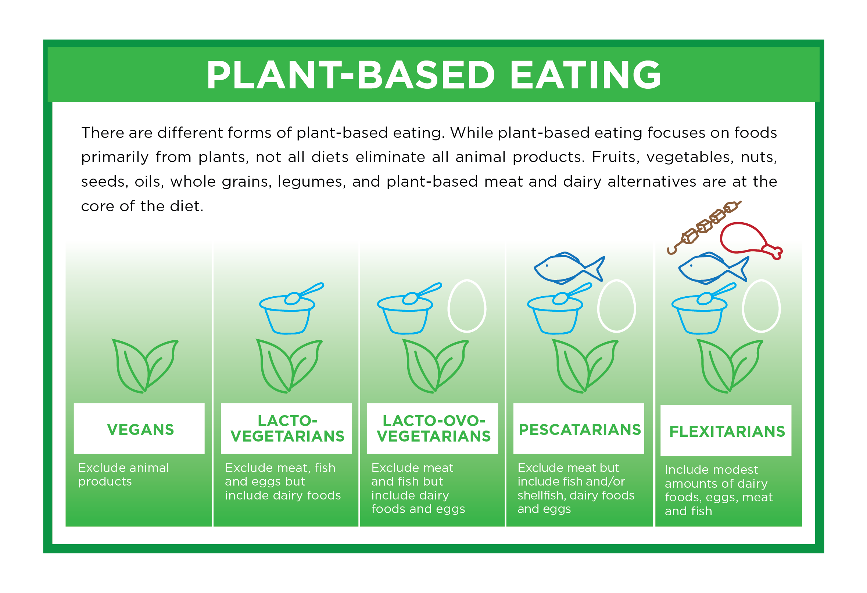
What is plant-based eating?
Alpro Foundation, 2020

Slide 6
Consumer Trends
Flexitarian vs. Other Dietary Patterns
A majority, 53%, of consumers report being primarily omnivorous while 36% identify themselves as flexitarian.
3% of consumers follow a vegan diet, 3% are pescatarian, and 5% are vegetarian.
Packaged Facts, 2020

Slide 7
Consumer Trends
Sustainability
Nearly 6 out of 10 consumers (59%) say it is important that food products they purchase are produced in an environmentally sustainable way.
The share of consumers who say environmental sustainability has a real impact on their purchases is up from 27% in 2019 to 34% in 2020.
63% of consumers agree it is hard to know whether food choices are environmentally sustainable. Of these consumers, ~ 70% say making it easier to know would influence their decisions more.
IFIC, 2020b

Slide 8
Presentation Outline
Consumer Trends: Plant-Based Eating & Sustainability
What is a Sustainable Food System?
What is a Sustainable Diet/Sustainable Healthy Diet?
Why are Sustainable Healthy Diets Important?
A Sustainable Food Systems Transition to Healthy Diets
What is a Flexitarian Diet?
How to Follow a Flexitarian Diet
Advantages/Benefits of a Flexitarian Diet
Nutritional Advantages
Health Benefits & Health-Cost Savings
Environmental Benefits
Take Home Messages

Slide 9
What is a Sustainable Food System?
“Food systems (FS) encompass the entire range of actors and their interlinked value-adding activities involved in the production, aggregation, processing, distribution, consumption and disposal of food products that originate from agriculture, forestry or fisheries, and parts of the broader economic, societal, and natural environments in which they are embedded.”
“A sustainable food system (SFS) is a food system that delivers food security and nutrition for all in such a way that the economic, social and environmental bases to generate food security and nutrition for future generations are not compromised… In order to be sustainable, the development of the food system needs to generate positive value along three dimensions simultaneously: economic, social, and environmental.”
FAO, 2018

Slide 10
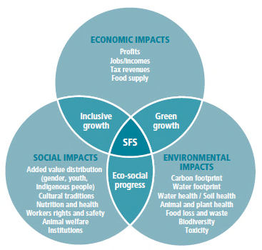
Sustainability in Food Systems
FAO, 2018

Slide 11
Presentation Outline
Consumer Trends: Plant-Based Eating & Sustainability
What is a Sustainable Food System?
What is a Sustainable Diet/Sustainable Healthy Diet?
Why are Sustainable Healthy Diets Important?
A Sustainable Food Systems Transition to Healthy Diets
What is a Flexitarian Diet?
How to Follow a Flexitarian Diet
Advantages/Benefits of a Flexitarian Diet
Nutritional Advantages
Health Benefits & Health-Cost Savings
Environmental Benefits
Take Home Messages

Slide 12
Sustainable Diets/Sustainable Healthy Diets: Definitions
“Sustainable Diets are those diets with low environmental impacts which contribute to food and nutrition security and to healthy life for present and future generations. Sustainable diets are protective and respectful of biodiversity and ecosystems, culturally acceptable, accessible, economically fair and affordable; nutritionally adequate, safe and healthy; while optimizing natural and human resources” (FAO and Biodiversity International, 2012).
“The concept of sustainable diets combines the challenges of creating a food system that supplies healthy diets for a growing population while reducing its environmental impacts and staying within planetary boundaries [i.e., biophysical limits that humanity should operate within to ensure a stable and resilient Earth]” (Springmann et al., 2018a).
“Sustainable Healthy Diets are dietary patterns that promote all dimensions of individuals’ health and well-being; have low environmental pressure and impact; are accessible, affordable, safe, and equitable; and are culturally acceptable” (FAO and WHO, 2019).

Slide 13
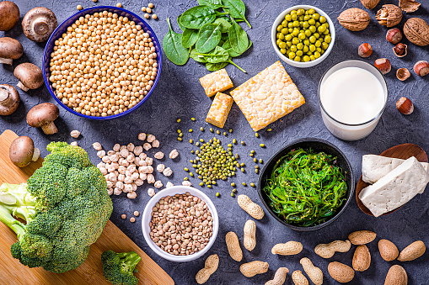
Sustainable Healthy Diets
“Examples of healthy and sustainable diets are those high in coarse grains, pulses, fruits and vegetables, and nuts and seeds; low in energy-intensive animal-sourced foods [e.g., beef and pork] and discretionary foods (such as sugary beverages); and with a carbohydrate threshold” (Intergovernmental Panel on Climate Change [IPCC], 2019a).

Slide 14
Presentation Outline
Consumer Trends: Plant-Based Eating & Sustainability
What is a Sustainable Food System?
What is a Sustainable Diet/Sustainable Healthy Diet?
Why are Sustainable Healthy Diets Important?
A Sustainable Food Systems Transition to Healthy Diets
What is a Flexitarian Diet?
How to Follow a Flexitarian Diet
Advantages/Benefits of a Flexitarian Diet
Nutritional Advantages
Health Benefits & Health-Cost Savings
Environmental Benefits
Take Home Messages

Slide 15
Why are Sustainable Healthy Diets Important?
Human Health Crisis
“Changes in consumption patterns have contributed to about two billion adults now being overweight or obese” (IPCC, 2019b).
Almost 690 million persons were hungry in 2019 (8.9 percent of the world population) (FAO et al., 2020).
More than 3 billion people could not afford a healthy diet in 2017 (FAO et al., 2020).

Slide 16
Why are Sustainable Healthy Diets Important?
Planetary Health Crisis
The global food system is a major driver of climate change, land-use change, biodiversity loss, depletion of freshwater resources, and pollution of ecosystems (Springmann et al., 2018b).
As demand for foods with greater environmental impact (e.g. meat) increases and the global population grows from 7 to 10 billion in the next 30 years, environmental impacts are expected to intensify (Springmann et al., 2018a).

Slide 17
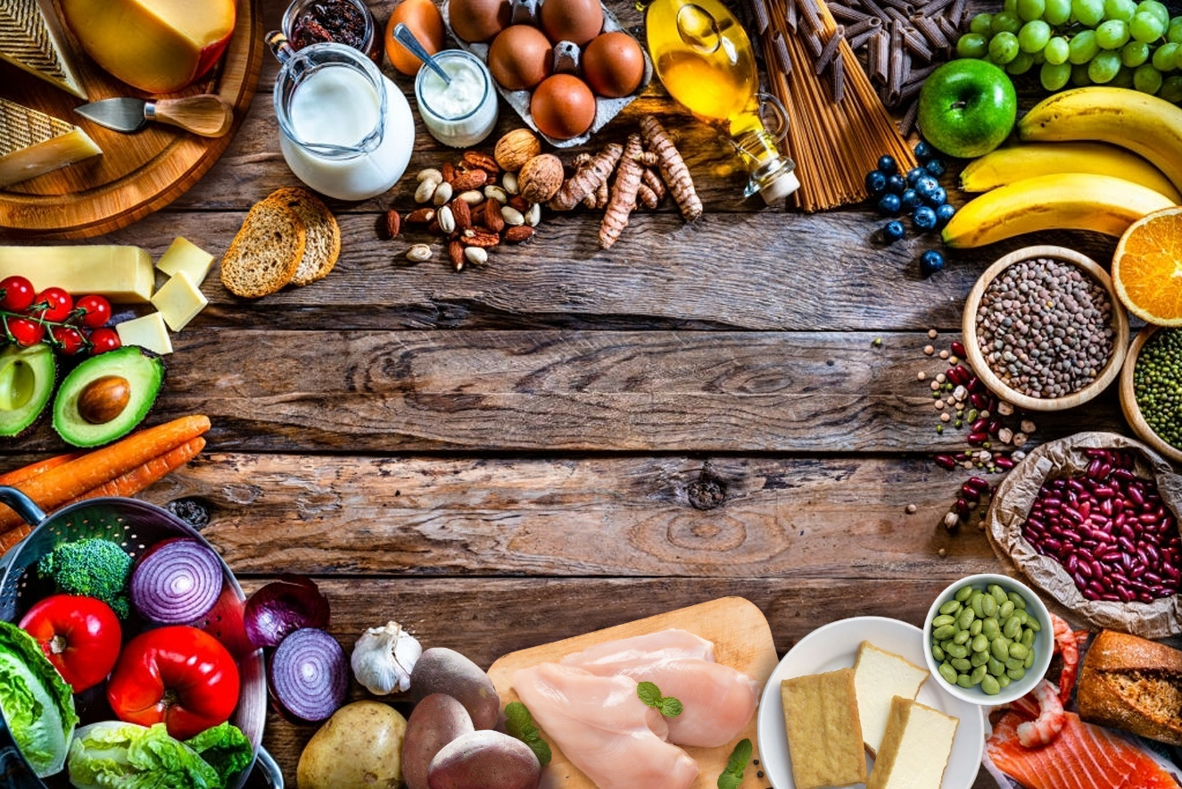
Why are Sustainable Healthy Diets Important?
Health and Environmental Benefits
“Consumption of healthy and sustainable diets presents major opportunities for reducing greenhouse gas (GHG) emissions from food systems and improving health...” (IPCC, 2019a).
“[A] dietary pattern higher in plant-based foods (for example vegetables, fruits, legumes, seeds, nuts, and whole grains) and lower in animal-based foods (especially red meat) is healthier... and gives rise to lower greenhouse gas emissions and land-use change compared to existing diets” (Secretariat of the Convention on Biodiversity, 2020).

Slide 18
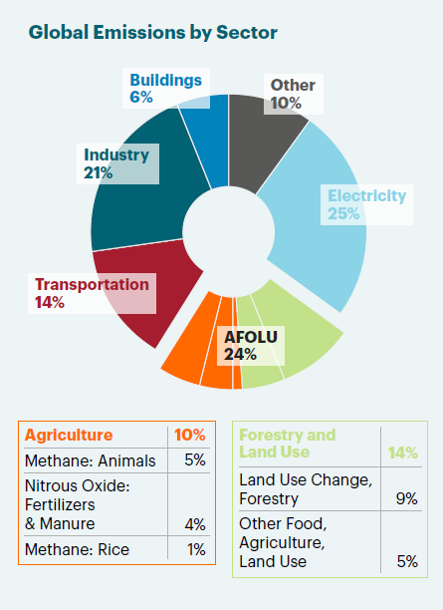
Global GHG Emissions by Sector
AFOLU: Agriculture, Forestry and Land Use
IPCC WG 3 and Jonathan Foley, Drawdown.org, Loken and DeClerck, 2020

Slide 19
Estimated global variation in GHG emissions, land use, terrestrial acidification, eutrophication, and scarcity-weighted freshwater withdrawals, within and between major selected foods. (A) Protein-rich products. Grains are also shown here. (B) Milks.
Poore and Nemecek, 2018

Slide 20
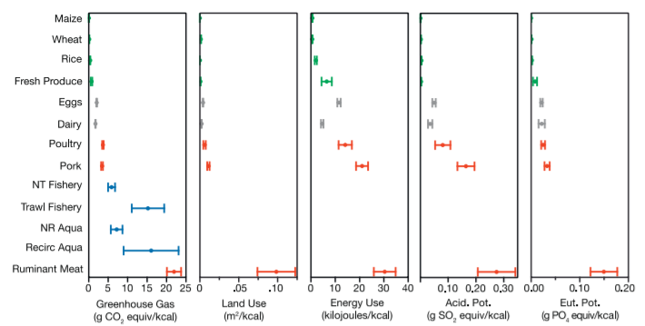
Environmental Impacts of Broad Food Groups per Kilocalorie
Clark and Tilman, 2017; Clark et al., 2020

Slide 21
Ranking of Climate Solutions
Limit Global Warming to 2.0 °C | Limit Global Warming to 1.5 °C
1. Reduced food waste | 1. Onshore wind power
2. Health and education | 2. Utility-scale solar power
3. Plant-rich diets | 3. Reduced food waste
4. Refrigerant management | 4. Plant-rich diets
5. Tropical forest restoration | 5. Health and education
Project Drawdown. The Drawdown Review. Climate Solutions for a New Decade, 2020.

Slide 22
Presentation Outline
Consumer Trends: Plant-Based Eating & Sustainability
What is a Sustainable Food System?
What is a Sustainable Diet/Sustainable Healthy Diet?
Why are Sustainable Healthy Diets Important?
A Sustainable Food Systems Transition to Healthy Diets
What is a Flexitarian Diet?
How to Follow a Flexitarian Diet
Advantages/Benefits of a Flexitarian Diet
Nutritional Advantages
Health Benefits & Health-Cost Savings
Environmental Benefits
Take Home Messages

Slide 23
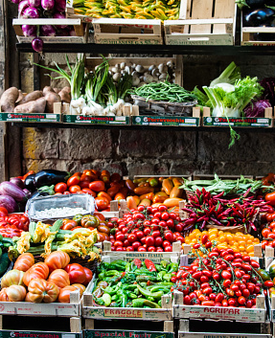
A Sustainable Food Systems Transition to Healthy Diets
The global food system must operate within boundaries for human health and food production to ensure healthy diets from sustainable food systems for an estimated 10 billion people by 2050 (Summary Report of the Eat-Lancet Commission, 2019).
The Eat-Lancet Commission developed global scientific targets for healthy diets and sustainable food production. It integrated them into a common framework, the ‘safe operating space for food systems’ so that planetary health diets (both healthy and environmentally sustainable) could be identified (Willett et al., 2019; Summary Report of the Eat-Lancet Commission, 2019).

Slide 24
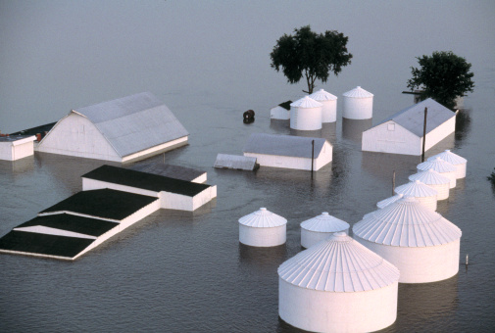
A Sustainable Food Systems Transition to Healthy Diets
“This safe operating space for food systems is defined by scientific targets for specific food groups (e.g., 100 to 300 g/day of fruit) to optimize human health and scientific targets for sustainable food production to ensure a stable Earth system” [planetary boundaries].
Planetary boundaries were proposed for 6 Earth system processes affected by food production (Summary Report of the Eat-Lancet Commission, 2019).

Slide 25
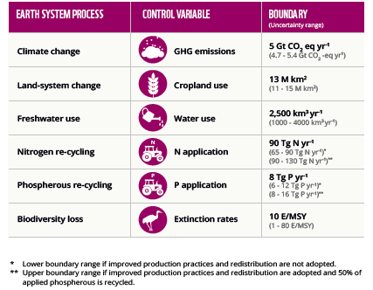
Planetary Boundaries for Food Production
World Wildlife Fund (WWF), 2020; Adapted from Willett et al., 2019
https://www.worldwildlife.org/publications/bending-the-curve-the-restorative-power-of-planet-based-diets

Slide 26
A Sustainable Food Systems Transition to Healthy Diets
Planetary health diet
Is “largely plant-based but can optionally include modest amounts of fish, meat, and dairy foods.” (flexitarian diet)
It recommends consuming a range of foods amounting to 2,500 kcal per day, which will promote health and well-being.
It is meant to be flexible and recommends intake levels of various food groups, which can be adapted to local geography, culinary traditions and personal preferences.
Eat-Lancet Commission brief for Healthcare Professionals, 2019; Summary Report of the EAT-Lancet Commission, 2019

Slide 27
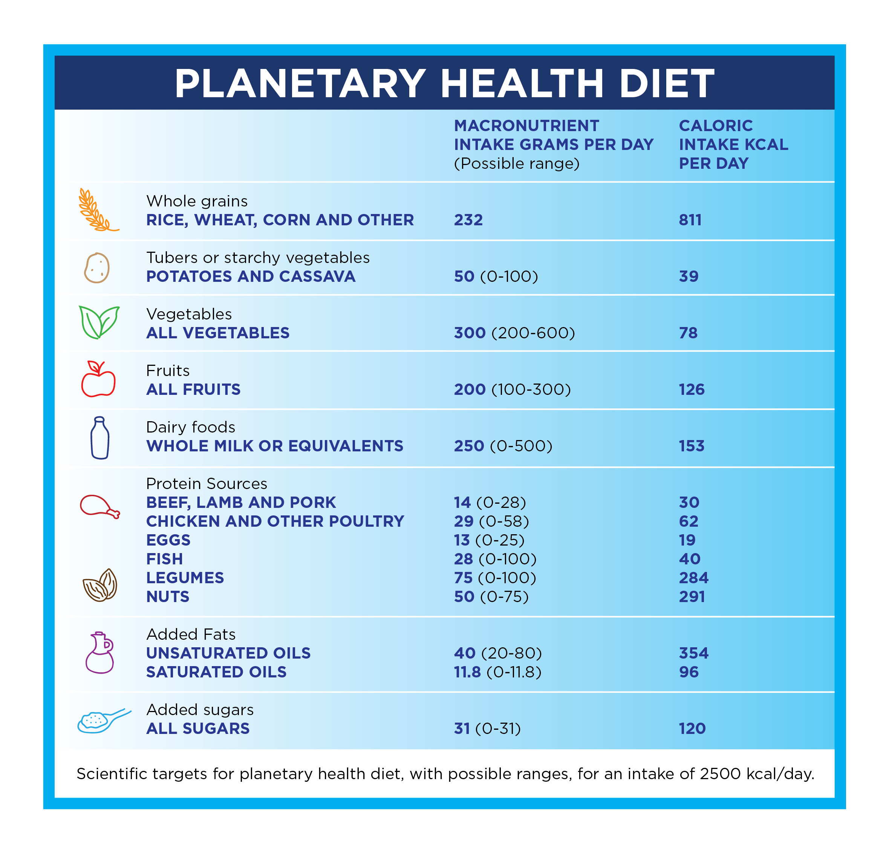
A Sustainable Food Systems Transition to Healthy Diets
Summary Report of the EAT-Lancet Commission, 2019
Willet et al., 2019

Slide 28
A Sustainable Food Systems Transition to Healthy Diets
The Eat-Lancet Commission concluded that staying within a ‘safe operating space for food systems’ “requires a combination of substantial shifts toward mostly plant-based dietary patterns, dramatic reductions in food losses and waste and major improvements in food production practices” (Summary Report of the EAT-Lancet Commission, 2019).
“The food we choose to eat, how much is lost or wasted, and how it is produced will determine whether or not we meet the Paris [Climate] Agreement and [United Nations] Sustainable Development Goals (SDGs). Food systems must transition from being a net source of GHG emissions to a net sink. Shifting toward healthy flexitarian diets is central to this goal” (Loken and DeClerck, 2020).

Slide 29
Presentation Outline
Consumer Trends: Plant-Based Eating & Sustainability
What is a Sustainable Food System?
What is a Sustainable Diet/Sustainable Healthy Diet?
Why are Sustainable Healthy Diets Important?
A Sustainable Food Systems Transition to Healthy Diets
What is a Flexitarian Diet?
How to Follow a Flexitarian Diet
Advantages/Benefits of a Flexitarian Diet
Nutritional Advantages
Health Benefits & Health-Cost Savings
Environmental Benefits
Take Home Messages

Slide 30
What is a Flexitarian Diet?
Flexible + vegetarian = flexitarian (Blatner, 2008; Derbyshire, 2017)
It is sometimes referred to as a “semi-vegetarian” diet (Derbyshire, 2017).
It is “largely plant-based but can optionally include modest amounts of fish, meat and dairy foods” (Summary Report of the Eat-Lancet Commission, 2019).
It encourages variety rather than restriction as you don’t have to exclude any specific food… For most people, it is a realistic way to significantly reduce the quantity of animal-source foods in the diet (Danone Institute International and American Society of Nutrition, 2019).

Slide 31
What is a Flexitarian Diet?
It’s based on the following principles:
Eat mostly fruits, vegetables, legumes, nuts and seeds, and whole grains.
Focus on protein from plants instead of animals.
Include dairy products and eggs.
Be flexible and incorporate meat, poultry, fish, and seafood occasionally.
Eat the least processed, most natural form of foods.
Limit highly processed foods.
Limit refined grains, added sugars and sweets.
Modern Flexitarian. Plant-Inspired Recipes You Can Flex To Add Fish, Meat, or Dairy. New York: DK Publishing, 2020.

Slide 32
Presentation Outline
Consumer Trends: Plant-Based Eating & Sustainability
What is a Sustainable Food System?
What is a Sustainable Diet/Sustainable Healthy Diet?
Why are Sustainable Healthy Diets Important?
A Sustainable Food Systems Transition to Healthy Diets
What is a Flexitarian Diet?
How to Follow a Flexitarian Diet
Advantages/Benefits of a Flexitarian Diet
Nutritional Advantages
Health Benefits & Health-Cost Savings
Environmental Benefits
Take Home Messages

Slide 33
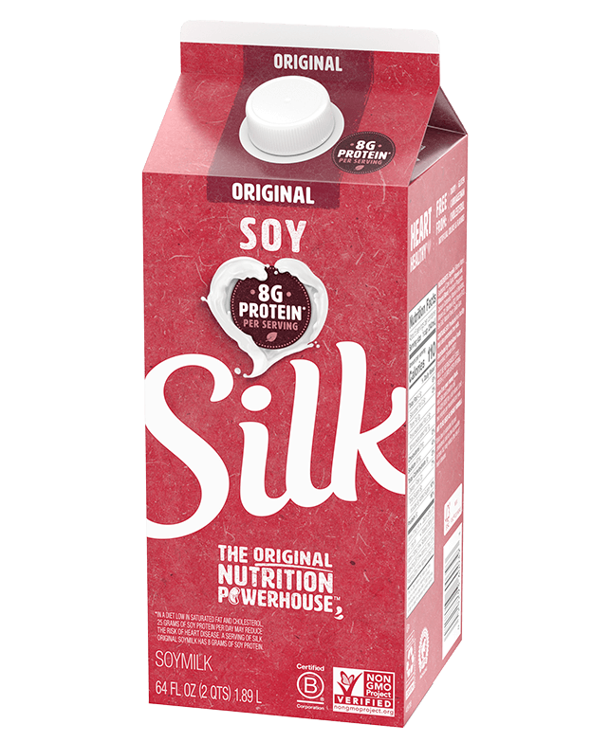
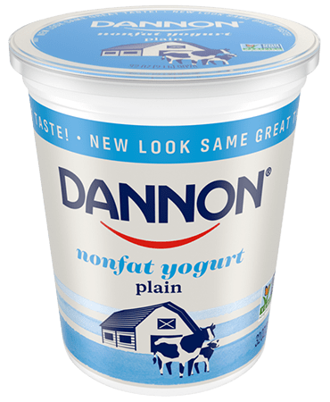
How to Follow a Flexitarian Diet
Start small. Commit to one meat-free day per week, such as “Meatless Monday,” and then steadily adjust your diet.
Substitute half the meat content in your meals for a plant-based source of protein, such as beans or lentils.
Make the most of plant-based meat-alternative products (e.g., plant-based veggie burgers, tofu, tempeh).
Dairy products and plant-based dairy alternatives (e.g., yogurt and soy milk) can co-exist.
Modern Flexitarian. Plant-Inspired Recipes You Can Flex To Add Fish, Meat, or Dairy. New York: DK Publishing, 2020.
Blatner, DJ. The Flexitarian Diet. The Mostly Vegetarian Way to Lose Weight, Be Healthier, Prevent Disease, and Add Years to Your Life. New York: McGraw Hill, 2008.

Slide 34
How to Follow a Flexitarian Diet
Take inspiration from cuisines that traditionally use beans and lentils and bring out their flavor with herbs and spices, e.g., Indian dahl or curry, Mediterranean soup or stew.
Incorporate nutrient-dense foods, such as dairy, to complement plant-based recipes.
If you feel held back by your cooking skills, take a vegetarian or vegan cooking class.
Prepare large batches of your favorite plant-based recipes. Freeze the leftovers or save them for the next day’s lunch.
Plan the week’s meals. This will minimize food waste and save time and money.
You Just Started the Flexitarian Diet – Here Are the Recipes to Make First. EatingWell, January 11, 2021. Available at:
https://www.eatingwell.com/gallery/7527978/flexitarian-diet-recipes/ Flexitarian Meal Plan. EatingWell, February 2, 2021. Available at: https://www.eatingwell.com/article/7887442/flexitarian-meal-plan/ Modern Flexitarian. Plant-Inspired Recipes You Can Flex To Add Fish, Meat, or Dairy. New York: DK Publishing, 2020. Blatner, DJ. The Flexitarian Diet. The Mostly Vegetarian Way to Lose Weight, Be Healthier, Prevent Disease, and Add Years to Your Life. New York: McGraw Hill, 2008.

Slide 35
Presentation Outline
Consumer Trends: Plant-Based Eating & Sustainability
What is a Sustainable Food System?
What is a Sustainable Diet/Sustainable Healthy Diet?
Why are Sustainable Healthy Diets Important?
A Sustainable Food Systems Transition to Healthy Diets
What is a Flexitarian Diet?
How to Follow a Flexitarian Diet
Advantages/Benefits of a Flexitarian Diet
Nutritional Advantages
Health Benefits & Health-Cost Savings
Environmental Benefits
Take Home Messages

Slide 36
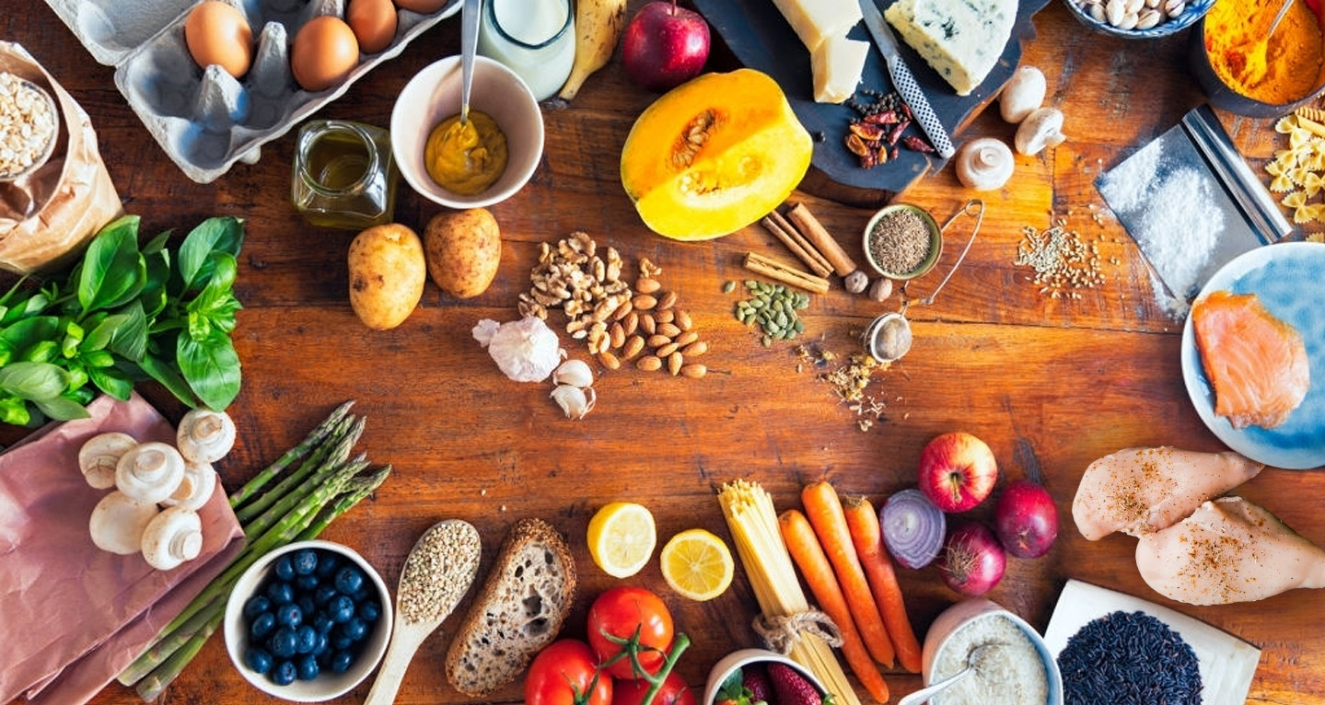
Nutritional Advantages of the Flexitarian Diet
The principles of the flexitarian diet are aligned with the 2020-2025 Dietary Guidelines for Americans
Both emphasize fruits, vegetables, dairy, whole grains and a broad range of protein foods, including lean meat and poultry, seafood, eggs, legumes, nuts and seeds, and soy products.
By consuming more nutrient-dense foods & beverages, such as veg­etables, fruits, whole ­grains, dairy products, and fortified soy milks, individuals can increase their intake of nutrients of public health concern, including calcium, potassium, dietary fiber, and vitamin D.

Slide 37
Nutritional Advantages of the Flexitarian Diet
The large quantity of plant-based foods balanced with a moderate intake of dairy products, and low amounts of meat and sugar generally provide an all-around healthy mix of high-quality protein, fiber, vitamins, minerals and unsaturated fatty acids (Danone Institute International and American Society of Nutrition, 2019).
Dairy foods can be an important source of high-quality protein and calcium as well as phosphorus, potassium, magnesium, iodine, and vitamins such as vitamin A, vitamin D, B12, and riboflavin (B2), and zinc (Ridoutt et al., 2021).
“The soybean is notable not only for its total protein content but the quality of soy protein which is higher than that of other plant proteins and similar to animal protein” (Messina, 2016).
Within the milk alternatives category, soy milk has the highest protein content—almost the same as cow’s milk—and is a plant-based source of complete protein. Fortified soy milk is also a nutrient-dense food that contains calcium, vitamin A and vitamin D.

Slide 38
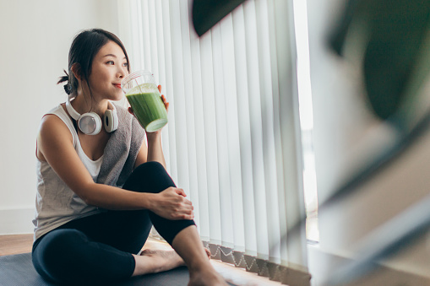
Benefits of a Flexitarian Diet
Health Benefits
Emerging evidence suggests it may provide benefits for weight management and metabolic health, including blood pressure and blood sugar (Derbyshire, 2017).

Slide 39
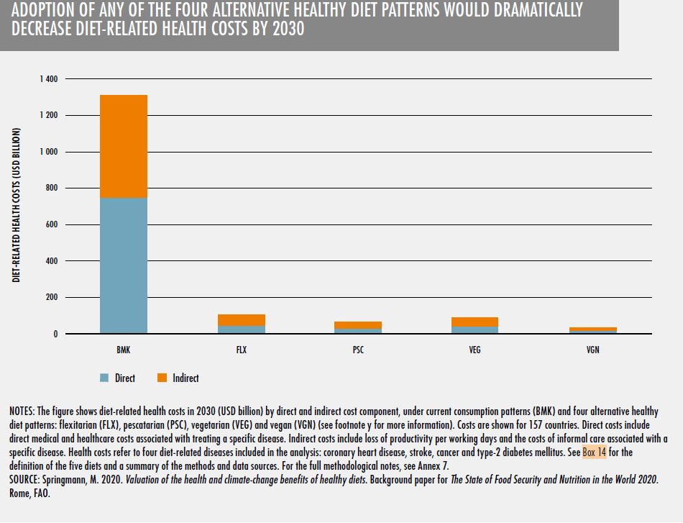
Benefits of a Flexitarian Diet
Health-Cost Savings
Adoption of any of the four alternative healthy dietary patterns would dramatically decrease diet-related health costs by 2030
ç
Diet-related health costs (USD Billion)
Current consumption
(BMK)
Flexitarian
(FLX)
Pescatarian
(PSC)
Vegetarian
(VEG)
Vegan
(VGN)
FAO et al., 2020

Slide 40
Benefits of a Flexitarian Diet
Environmental Benefits
Based on a global modeling analysis, researchers found that adopting more plant-based flexitarian diets globally could reduce greenhouse gas emissions by more than half, and reduce other environmental impacts, including nitrogen application, as well (Springmann et al., 2018a).
⁃ "[C]hanges in cropland use, freshwater use, and phosphorus application were split into reductions in high-income and middle-income countries and increases in low-income countries" (Springmann et al., 2018a).
A different modeling study found that a shift to vegetarian and flexitarian diets would bring five environmental footprints, including greenhouse gas emissions, cropland use, freshwater use, nitrogen use, and phosphorus use, well under planetary boundaries (Chen et al., 2019).

Slide 41
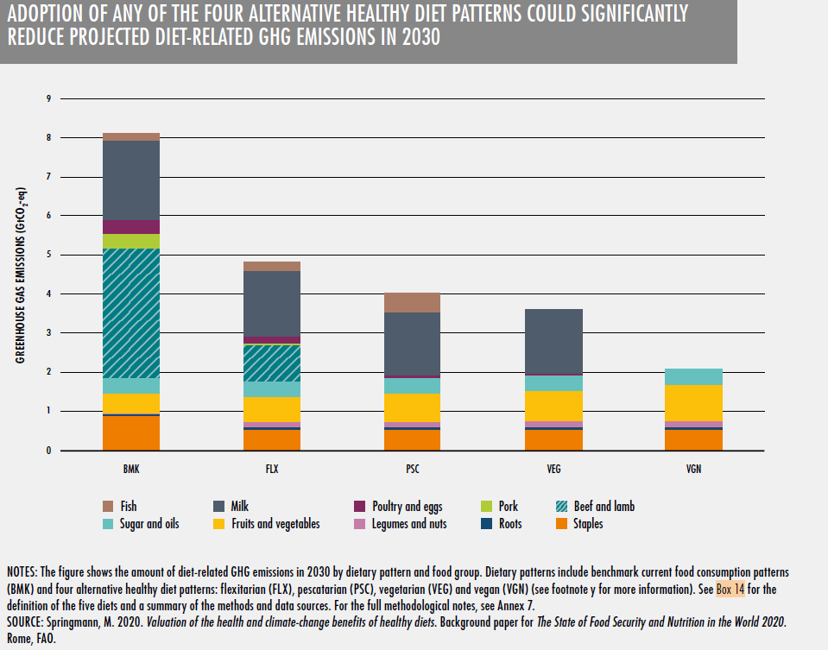
Environmental Benefits
Adoption of any of the four alternative healthy dietary patterns could significantly reduce projected diet-related GHG emissions in 2030
Current consumption
(BMK)
Flexitarian
(FLX)
Pescatarian
(PSC)
Vegetarian
(VEG)
Vegan
(VGN)
FAO et al., 2020

Slide 42
Presentation Outline
Consumer Trends: Plant-Based Eating & Sustainability
What is a Sustainable Food System?
What is a Sustainable Diet/Sustainable Healthy Diet?
Why are Sustainable Healthy Diets Important?
A Sustainable Food Systems Transition to Healthy Diets
What is a Flexitarian Diet?
How to Follow a Flexitarian Diet
Advantages/Benefits of a Flexitarian Diet
Nutritional Advantages
Health Benefits & Health-Cost Savings
Environmental Benefits
Take Home Messages

Slide 43
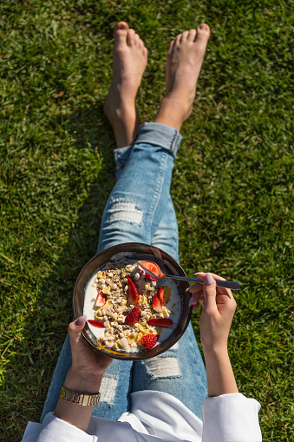
Take Home Messages
A flexitarian diet is a balanced diet rich in plant-based foods while still allowing for consumption of animal-source products, including dairy, in moderation.
It is generally a nutrient-dense diet that provides high-quality protein, fiber, vitamins, minerals, and unsaturated fatty acids.
It may provide benefits for weight management and metabolic health, including blood pressure and blood sugar.

Slide 44
Take Home Messages
Adoption of a flexitarian diet could substantially reduce diet-related health costs.
It may reduce greenhouse gas emissions and other environmental impacts, including nitrogen application, globally.
Healthy diets from sustainable food systems are needed to feed nearly 10 billion people by 2050. Major changes are necessary to build a more sustainable food system, including dietary changes.
A flexitarian diet is an example of a sustainable healthy dietary pattern.

Slide 45
Christine McCullum-Gómez, PhD, RDN, LD
Food and Nutrition Consultant, Writer and Speaker
www.sustainablerdn.com

Slide 46
References
International Food Information Council (IFIC)a. IFIC’s Year-End Survey: Consumer Insights from a Year Like No Other, and a Look to the Year Ahead. Washington DC: IFIC, December 2020.
International Food Information Council (IFIC). Plant and Animal Protein Choices: Consumer Viewpoints and Purchasing Behaviors. Washington DC: IFIC, January 2021.
Driscoll M. Sustainable Diets for Better Human and Planetary Health. Belgium: Alpro Foundation, February 2020.
Packaged Facts. Vegan, Vegetarian, and Flexitarian Consumers. Rockville, MD: Packaged Facts, September 30, 2020.
International Food Information Council (IFIC)b. 2020 Food & Health Survey. Washington DC: IFIC, June 2020.
Food and Agriculture Organization of the United Nations (FAO). Sustainable food systems. Concept and framework. Rome: FAO, 2018. Available at: http://www.fao.org/3/ca2079en/CA2079EN.pdf
Food and Agriculture Organization of the United Nations (FAO) and Biodiversity International. Sustainable Diets and Biodiversity. Directions and Solutions for Policy, Research and Action. Rome, Italy: FAO, 2012. Available at:
http://www.fao.org/3/i3004e/i3004e.pdf
Springmann M, Wiebe K, Mason-D’Croz D, et al. Health and nutritional aspects of sustainable diet strategies and their association with environmental impacts: a global modelling analysis with country-level detail. Lancet Planetary Health. 2018a;2:e451-61.
Food and Agriculture Organization of the United Nations (FAO) and the World Health Organization (WHO). Sustainable Healthy Diets: Guiding Principles. Rome, Italy: FAO and WHO, 2019. Available at: http://www.fao.org/documents/card/en/c/ca6640en/

Slide 47
References
Intergovernmental Panel on Climate Change (IPCC), Technical Summary. In: Climate Change and Land: an IPCC special report on climate change, desertification, land degradation, sustainable land management, food security, and greenhouse gas fluxes in terrestrial ecosystems. P.R. Shukla, J. Skea, R. Slade, R. van Diemen, E. Haughey, J. Malley, M. Pathak, J. Portugal Pereira (eds.). IPCC, 2019a. Available at: https://www.ipcc.ch/srccl/chapter/technical-summary/
Intergovernmental Panel on Climate Change (IPCC), Summary for Policymakers. In: Climate Change and Land: an IPCC special report on climate change, desertification, land degradation, sustainable land management, food security, and greenhouse gas fluxes in terrestrial ecosystems. P.R. Shukla, J. Skea, E. Calvo Buendia, V. Masson-Delmotte, H.- O. Pörtner, D. C. Roberts, P. Zhai, R. Slade, S. Connors, R. van Diemen, M. Ferrat, E. Haughey, S. Luz, S. Neogi, M. Pathak, J. Petzold, J. Portugal Pereira, P. Vyas, E. Huntley, K. Kissick, M. Belkacemi, J. Malley, (eds.). IPCC, 2019b. Available at:
https://www.ipcc.ch/srccl/chapter/summary-for-policymakers/
Food and Agriculture Organization of the United Nations (FAO), International Fund for Agricultural Development (IFAD), United Nations International Children’s Emergency Fund (UNICEF), World Food Programme (WFP), and WHO. The State of Food Security and Nutrition In The World. Transforming Food Systems For Affordable Healthy Diets. Rome, Italy: FAO, 2020. Available at:
http://www.fao.org/documents/card/en/c/ca9692en
Springmann M, Clark M, Mason-D’Croz D, et al. Options for keeping the food system within environmental limits. Nature 2018b; 562:519-525.
Global Biodiversity Outlook 5. Montreal: Secretariat of the Convention on Biological Diversity, 2020. Available at: https://www.cbd.int/gbo/gbo5/publication/gbo-5-en.pdf
Loken B, DeClerck, F. Diets for a Better Future: Rebooting and Reimagining Healthy and Sustainable Food Systems in the G20. EAT, 2020. Available at: https://eatforum.org/knowledge/diets-for-a-better-future/

Slide 48
References
Poore J, Nemecek, T. Reducing food’s environmental impacts through producers and consumers. Science 2018;360:987-992.
Clark M, Tilman D. Comparative analysis of environmental impacts of agricultural production systems, agricultural input efficiency, and food choice. Environmental Research Letters 2017;12 064016.
Clark M, Macdiarmid J, Jones AD, et al. The role of healthy diets in environmentally sustainable food systems. Food and Nutrition Bulletin 2020;41(2S):S31-S58.
Project Drawdown. The Drawdown Review. Climate Solutions for a New Decade, 2020. Available at:
https://drawdown.org/sites/default/files/pdfs/TheDrawdownReview%E2%80%932020%E2%80%93Download.pdf
Healthy Diets from Sustainable Food Systems: Food Planet Health. Summary Report of the Eat-Lancet Commission. Eat-Lancet Commission, 2019. https://eatforum.org/eat-lancet-commission/eat-lancet-commission-summary-report/
Willett W, Rockstrom J, Loken B, et al. Food in the Anthropocene: the Eat-Lancet Commission on healthy diets from sustainable food systems. Lancet 2019;393:447-92.
World Wildlife Fund (WWF). Bending the Curve: The Restorative Power of Plant-Based Diets. Loken et al. Gland, Switzerland: WWF, 2020. Available at: https://www.worldwildlife.org/publications/bending-the-curve-the-restorative-power-of-planet-based-diets
Eat-Lancet Commission brief for Healthcare Professionals. Oslo, Norway: EAT, January 2019. Available at: https://eatforum.org/content/uploads/2019/01/EAT_brief_healthcare-professionals.pdf
Blatner DJ. The Flexitarian Diet: The Mostly Vegetarian Way to Lose Weight, Be Healthier, Prevent Disease, and Add Years to Your Life. New York: McGraw Hill, 2008.

Slide 49
References
Derbyshire EJ. Flexitarian diets and health: a review of the evidence-based literature. Frontiers in Nutrition 2017;3:55. Doi:10.3389/fnut.2016.00055
Eating to protect our health – and our planet. What is a flexitarian diet? Yogurt in Nutrition Initiative for Balanced and Sustainable Diets, Danone Institute International and American Society of Nutrition. December 2019. Available at: https://www.yogurtinnutrition.com/what-is-a-flexitarian-diet/
Modern Flexitarian: Plant-Inspired Recipes You Can Flex To Add Fish, Meat, or Dairy. New York: DK Publishing, 2020.
You Just Started the Flexitarian Diet – Here Are the Recipes to Make First. EatingWell, January 11, 2021. Available at: https://www.eatingwell.com/gallery/7527978/flexitarian-diet-recipes/ Flexitarian Meal Plan. EatingWell, February 2, 2021. Available at: https://www.eatingwell.com/article/7887442/flexitarian-meal-plan/
U.S. Department of Agriculture and U.S. Department of Health and Human Services. Dietary Guidelines for Americans, 2020-2025. 9th Edition. December 2020. Available at: https://www.dietaryguidelines.gov/sites/default/files/2020-12/Dietary_Guidelines_for_Americans_2020-2025.pdf
Ridoutt BG, Baird D, Hendrie GA. The role of dairy foods in lower greenhouse gas emission and higher diet quality dietary patterns. European Journal of Nutrition 2021;60:27585.
Messina M. Soy and health update: evaluation of the clinical and epidemiologic literature. Nutrients 2016;8:754: Doi:10.3390/nu8120754
Chen C, Chaudhary A, Mathys A. Dietary change scenarios and implications for environmental, nutrition, human health and economic dimensions of food sustainability. Nutrients 2019;11:856. Doi: 10.3390/nu11040856.

