Slide 1

  Lauren M. Anzaldo, LCSW, CAP
  Suicide Prevention Coordinator
  Gulf Coast Veterans Health Care System

Slide 2
S.A.V.E. Training
VA Office of Mental Health and Suicide Prevention (OMHSP)
Suicide Prevention Program

Slide 3
A Little Housekeeping Before We Start:
Suicide is an intense topic for some people.
  If you need to take a break, or step out, please do so.
  Immediate Resources:
    National Suicide Prevention Lifeline: 1-800-273-8255
      Service members and Veterans should press 1 to connect with the Veterans Crisis Line.
    INSERT IMMEDIATE LOCAL RESOURCE, If present (e.g., EAP, Community Partners, Counselor Onsite, etc.)
Notes:
Today we will discuss ways that everyone can contribute to a safer environment for Veterans at risk for suicide. We understand that this is a sensitive topic and that people in attendance today may have had personal experiences involving suicide. If you find you need to take a break, please do so. Feel free to reach out to me at the end of the presentation if you need support. If you find you need to talk to someone at any time, you can call the National Suicide Prevention Lifeline at 1-800-273-8255 (service members and Veterans should press 1 to connect with the Veterans Crisis Line). Why don’t we all put this number into our phone contacts right now?

Slide 4
Overview
Objectives
Facts about Suicide
Common Myths vs. Realities
The Steps of S.A.V.E.
S.A.V.E. Training
Resources and References
Notes:
This program is focused on preventing suicide attempts and saving lives that might otherwise be lost to suicide. It is designed to train everyone who knows a Veteran to be a “gatekeeper.” The role of gatekeepers is connecting those at risk for suicide with people who can help them. You can save lives by being sensitive to people in distress and by connecting them with care.

Slide 5
Objectives
By participating in this training, you will:
Have a general understanding of the scope of suicide within the United States.
Know how to identify a Veteran who may be at risk for suicide.
Know what to do when you identify a Veteran at risk.

Slide 6
Before We Continue
What is your biggest question around suicide and talking to people in crisis?

Slide 7
Facts About Suicide

Slide 8

2019 National Veteran Suicide Prevention Annual Report
Annual Report
  Reports on trends in Veteran suicide deaths from 2005–2017
  Focuses on suicide counts and rates among various Veteran subpopulations
State Data Sheets
  Examined state level Veteran suicide deaths and compared to national and regional trends
  53 data sheets available for all 50 states, D.C., Puerto Rico, and U.S. Territories
Access the reports online:
https://www.mentalhealth.va.gov/mentalhealth/suicide_prevention/data.asp
Notes:
People may not realize that suicide is a major public health concern. A particular health concern for Veterans, it affects many Americans and people around the world. VA is a leader in suicide prevention. However, most Veterans who die by suicide are not in VA care. This is one reason that S.A.V.E. gatekeeper training is so important: It is a tool for reaching more Veterans and others who are at risk for suicide. VA provides S.A.V.E. training not just to VA Suicide Prevention Coordinators but also to people outside VA, all over the country.

Slide 9
Data: Suicide in the U.S.
National public health problem (as defined by CDC)
  Over 45,000 Americans died by suicide in 2017, including 6,139 Veterans.
Service member and Veteran issue
  In 2017, the suicide rate for Veterans was 1.5 times the rate for non-Veteran adults.
Veteran populations at risk
  Younger Veterans
  Women Veterans
  Veterans in a period of transition
  Veterans with exposure to suicide
  Veterans with access to lethal means
Notes:
Suicide affects all Americans, not only service members and Veterans.
In 2017, 45,390 American adults died by suicide, including 6,139 Veterans.
In 2017, Veterans accounted for 13.5% of all deaths by suicide among U.S. adults and constituted 7.9% of the U.S. adult population.
As a group, Veterans are at elevated risk for suicide — some subpopulations have higher risk than others.

Slide 10
Risk and Protective Factors
Risk
Protective
Prior suicide attempt
Mental health issues
Substance abuse
Access to lethal means
Recent loss
Legal or financial challenges
Relationship issues
Unemployment
Homelessness
Access to mental health care
Sense of connectedness
Problem-solving skills
Sense of spirituality
Mission or purpose
Physical health
Employment
Social and emotional well-being
Goal: Minimize risk factors and boost protective factors
Notes:
Risk factors are characteristics that are associated with an increased likelihood of suicidal behaviors. Some risk factors for suicide include: prior suicide attempt history, certain mental health conditions, access to lethal means, and stressful life events, such as divorce, job loss, or the death of a loved one.
Protective factors can help offset risk factors. These are characteristics associated with a decreased likelihood of suicidal behaviors. Some protective factors for suicide include access to mental health care, feeling connected to other people, and positive coping skills.

Slide 11
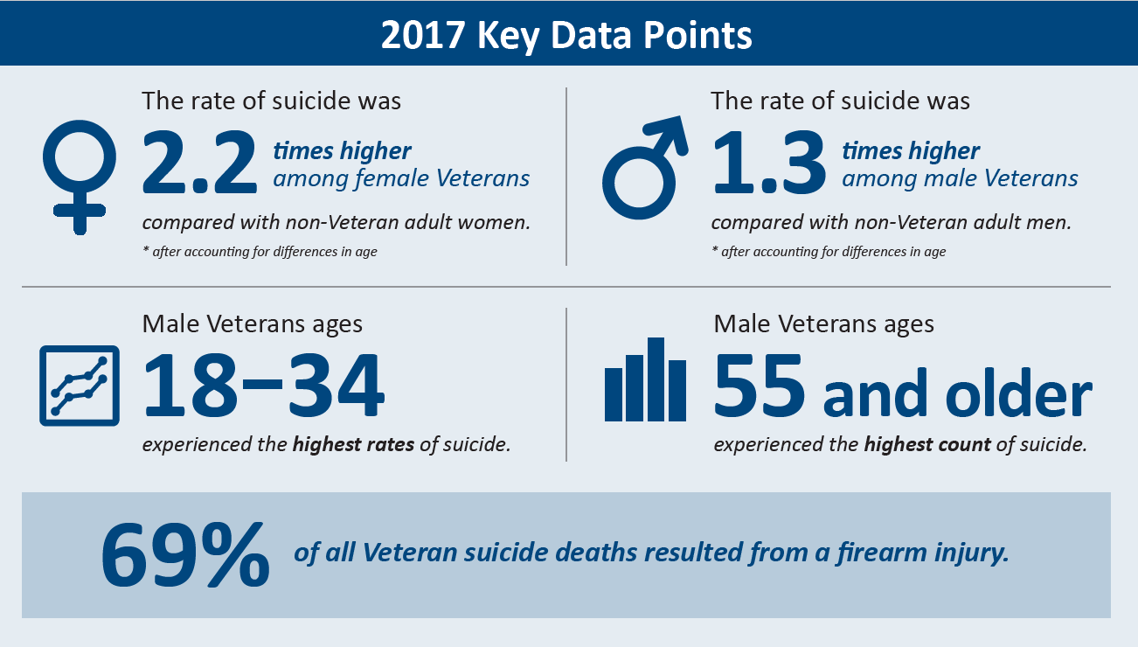
Key Data Points

Slide 12
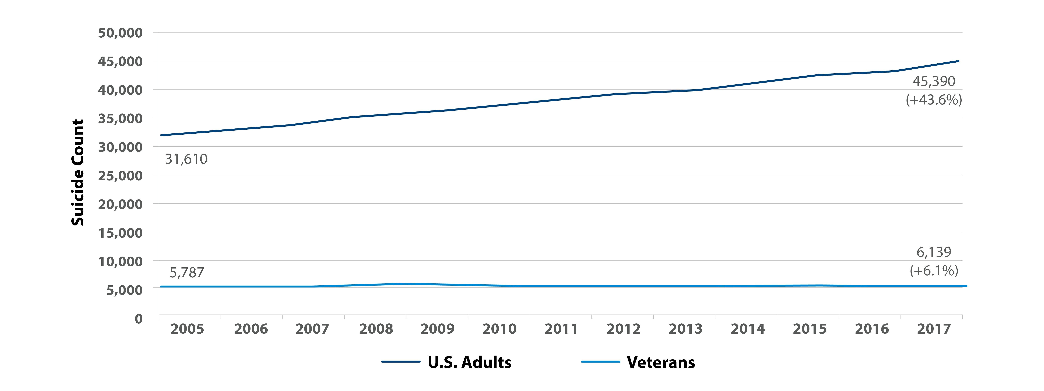
Suicide Count, U.S. Adult and Veteran Populations (2005–2017)
From 2005 to 2017, there was a 43.6% increase in the number of suicide deaths in the general population and a 6.1% increase in the number of suicide deaths in the Veteran population.
Notes:
Across the nation, the number of suicide deaths has been rising since the turn of the millennium. From 2005 to 2017,
There was a 43.6% increase in the number of suicide deaths in the general population
There was a 6.1% increase in the number of suicide deaths in the Veteran population

Slide 13
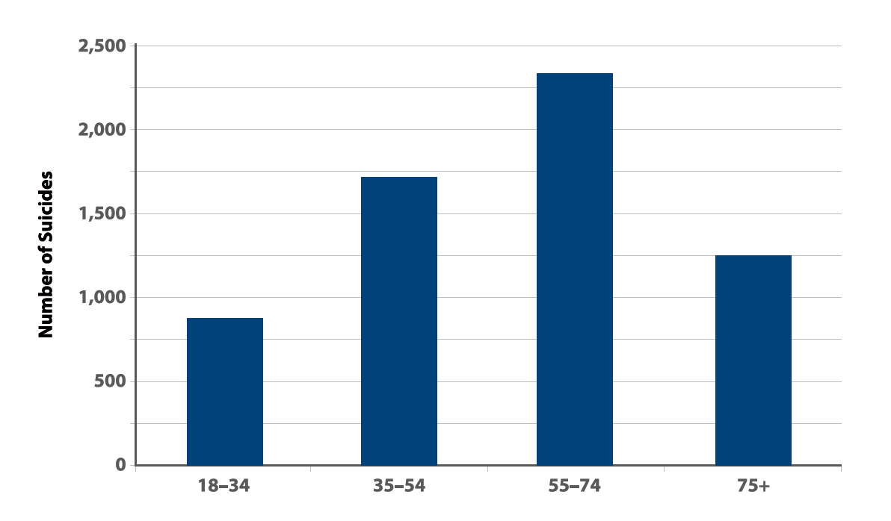
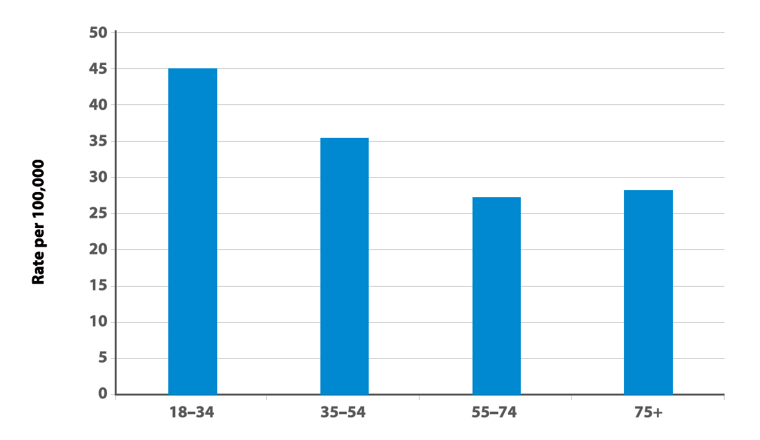
Veteran Suicide Deaths: Count vs. Rate
Veteran Suicide Deaths in 2017
The absolute number of suicides was highest among Veterans ages 55–74.
Veterans ages 18–34 had the highest suicide rate.
Notes:
Veterans ages 18–34 had the highest suicide rate in 2017 (44.5 per 100,000).
Veterans ages 55–74 had the lowest suicide rate per 100,000 in 2017.
The absolute number of suicides was highest among Veterans ages 55–74. This group accounted for 38% of all Veteran deaths by suicide in 2017.

Slide 14
U.S. Veterans and Suicide Methods (2017)
Notes:
There are many factors that contribute to suicide rates, such as access to lethal means, and those factors may vary across states, leading to differences in suicide rates.
VA respects the important role firearms play in many Veterans’ lives. VA is dedicated to educating Veterans and their families about the safe storage of firearms in a way that is consistent with each Veteran’s values and priorities.
Secure storage can put time and space between an individual and a firearm during the acute phase of suicidal crisis.
It is a myth that if somebody really wants to die by suicide, there is nothing that can be done. The reality is that the acute risk for suicide is often brief or time-limited. When a lethal mean is unavailable at the moment of intended action, an attempt may be thwarted until the potentially brief period of high risk passes

Slide 15
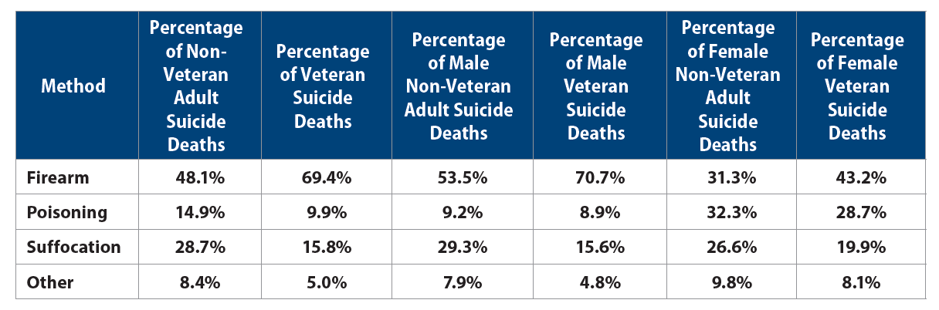
Method of Suicide Among Veteran and Non-Veteran Adults Who Died by Suicide (2017)
In 2017, 69.4% of Veteran suicide deaths were due to a self-inflicted firearm injury.
Notes:
In 2017, 69.4% of Veteran suicide deaths were due to a self-inflicted firearm injury, while 48.1% of non-Veteran adult suicides resulted from a firearm injury.
In 2017, 70.7% of male Veteran suicide deaths and 43.2% of female Veteran suicide deaths resulted from a firearm injury.

Slide 16
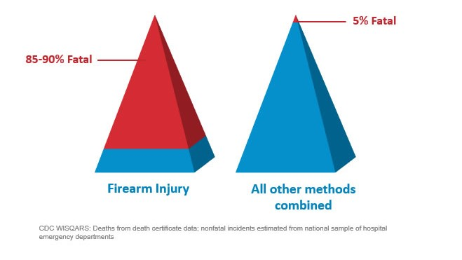
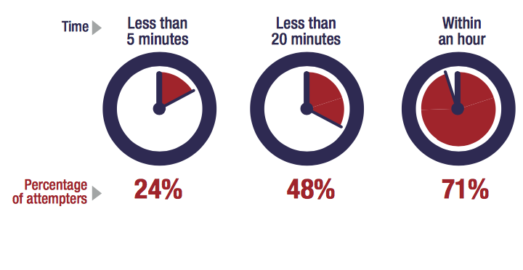

Time From Decision to Action < 1 Hour
Source: Simon, T.R., Swann, A.C., Powell, K.E., Potter, L.B., Kresnow, M., and O’Carroll, P.W. Characteristics of Impulsive Suicide Attempts and Attempters. SLTB. 2001; 32(supp):49-59.
Source: CDC WISQARS and US Dept. of Veterans Affairs
https://www.mirecc.va.gov/lethalmeanssafety/facts/
Notes:
The time between when a person decides to die by suicide and they act on the decision is often very short. A 2005 study found that 71% of attempters estimating that the process took less than an hour. This reality underscores the importance of reducing access to means for those who are at elevated risk for suicide, until the risk period passes.
Access to lethal means increases suicide risk for everyone living in the home
Acute phase of a suicidal crisis is often brief.
Building in time and space—even 30-60 minutes—between impulse to act and the means to harm one’s self saves lives
We know that people rarely “substitute” one means for another. So, it is important to restrict whichever means they have in mind to use.
Means matter—how a person attempts suicide impacts how fatal the injury will be.
About 90% of firearm-related suicide attempts are fatal, as compared to approximately 5% of suicide attempts by all other mechanisms combined
Most who survive a nonfatal suicide attempt do not go on to die by suicide

Slide 17
Suicide is preventable.
Notes:
Suicide is preventable, and preventive treatment works. Every day, people across the nation reach out for support and are able to live healthy, productive lives.

Slide 18
Common Myths vs. Realities
Notes:
Even though suicide is a major public health concern, there are a lot of common myths and misinformation about suicide. Let’s talk about some of these. Having accurate information about suicide makes it easier to reach out to others and help them.

Slide 19

Common Myths vs. Realities
Myth
Reality
People who talk about suicide are just seeking attention.

Slide 20

Common Myths vs. Realities
Myth
Reality
No matter how casually or jokingly said, suicide threats should never be ignored and may indicate serious suicidal feelings. Someone who talks about suicide provides others with an opportunity to intervene before suicidal behaviors occur.

Slide 21
Common Myths vs. Realities
Myth
Reality
The only one who can really help someone who is suicidal is a mental health counselor or therapist.

Slide 22
Common Myths vs. Realities
Myth
Reality
Special training is not required to safely raise the subject of suicide. Helping someone feel included and showing genuine, heartfelt support can also make a big difference during a challenging time.

Slide 23
The Steps of S.A.V.E.

Slide 24
S.A.V.E.: Teaching Communities How to Help Veterans at Risk for Suicide
S.A.V.E. will help you act with care and compassion if you encounter a Veteran who is in suicidal crisis.
Signs of suicidal thinking should be recognized.
Ask the most important question of all.
Validate the Veteran’s experience.
Encourage treatment and Expedite getting help.

Slide 25

Signs of Suicidal Thinking
Learn to recognize these warning signs:
Hopelessness, feeling like there is no way out
Anxiety, agitation, sleeplessness, or mood swings
Feeling like there is no reason to live
Rage or anger
Engaging in risky activities without thinking
Increasing alcohol or drug use
Withdrawing from family and friends

Slide 26
Signs of Suicidal Thinking
The presence of any of the following signs requires immediate attention:
Thinking about hurting or killing themselves
Looking for ways to die
Talking about death, dying, or suicide
Self-destructive or risk-taking behavior, especially when it involves alcohol, drugs, or weapons

Slide 27

Asking the Question
Know how to ask
the most important question of all…

Slide 28
Asking the Question
“Are you thinking about killing yourself?”

Slide 29
Asking the Question
Do’s | Don’ts
DO ask the question if you’ve identified warning signs or symptoms. | DON’T ask the question as though you are looking for a “no” answer. “You aren’t thinking of killing yourself, are you?”
DO ask the question in a natural way that flows with the conversation. | DON’T wait to ask the question when someone is halfway out the door.
Notes:
Use direct words and phrases, such as “killing yourself” and “suicide,” when asking about suicidal thoughts. Avoid using vague phrases such as “hurting yourself,” as these can have different meanings to different people. To emphasize this point, you can ask participants why it is so important to ask this question directly instead of indirectly. What may be the outcome of asking indirect questions? (Answer: indirect answers!)
Ask a direct question if warning signs (“invitations”) are evident. When “invitation statements” have been made, it can be helpful to use them as springboards to directly ask about a person’s risk for suicide. (E.g., “I want to better understand what you mean by ‘ending it all.’ Are you thinking about killing yourself?”)
Phrase questions in a way that indicates openness to listening and remain nonjudgmental no matter the answer. This is extremely important, as it will help the Veteran understand that people are willing to listen.
The question should not be an afterthought. It should be asked promptly once someone indicates that they may be at risk for suicide.
There may not be an optimal time to ask the question, and doing so may be discomforting. Acknowledge this and encourage participants to ask the question anyway.

Slide 30
Asking the Question: Check-In & Practice
What are your thoughts about “Asking the question”?
What initial concerns do you have?
Let me demonstrate a few ways of asking the question — both good and bad — and you can tell me which ones you think are most effective and direct.
Now, turn to a neighbor and practice asking the question with one of ways you feel would be most effective.

Slide 31

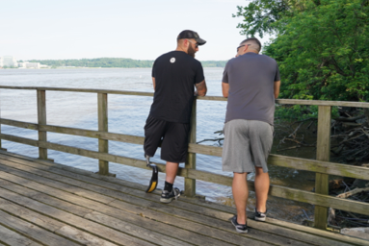
Validate the Veteran’s Experience
Talk openly about suicide. Be willing to listen and allow the Veteran to express his or her feelings.
Recognize that the situation is serious.
Do not pass judgment.
Reassure the Veteran that help is
available.

Slide 32
Validate the Veteran’s Experience: Check-In & Practice
Who can share with me a validating statement?
Turn to a partner and practice the following:
  In response to an “invitation statement” such as, “Everything is so hard. I feel like a drag on my friends.”
    Start by telling your partner, “Everything will be fine.” (Partner should respond.)
    Shift instead to a statement that validates their feelings. (Partner should respond.)
What did you notice?
Notes:
Examples of validating statements include:
“Anyone in your situation would feel that way.”
“Of course you’re overwhelmed.”
“You have been struggling with a lot.”
“This would be too much for anyone to handle.”
Direct participants to turn to a partner and practice the following, in response to an “invitation statement” such as, “Everything is so hard. I feel like a drag on my friends”:
Start by telling your partner, “Everything will be fine.” (Partner should respond.)
Shift instead to a statement that validates their feelings. (Partner should respond.)
Pause to have participants reflect on the exercise. Ask: What did you notice?

Slide 33

Encourage Treatment and Expedite Getting Help
What should I do if I think someone is suicidal?
  Don’t keep the Veteran’s suicidal behavior a secret.
  Do not leave him or her alone.
  Try to get the person to seek immediate help from his or her doctor or the nearest hospital emergency room.
  Call 911.
Reassure the Veteran that help is available.
Call the Veterans Crisis Line at 1-800-273-8255 and Press 1.
Notes:
No keeping secrets- if someone says they will talk to you about an issue “only if you promise not to tell anyone,” it’s important to be up front in saying you cannot make that promise because you care about them and want them to get any help that they may need. You don’t want to keep a secret and regret it.

Slide 34
When Talking with a Veteran at Risk for Suicide
Remain calm.
Listen more than you speak.
Maintain eye contact.
Act with confidence.
Do not argue.
Use open body language.
Limit questions — let the Veteran do the talking.
Use supportive, encouraging comments.
Be honest — let the Veteran know that there are no quick solutions, but help is available.
Notes:
Open body language signals interest in the other person and in the conversation. Maintain a relaxed posture, lean in closer, use direct eye contact, and nod in agreement to show your Veteran that you’re present in the moment with them.

Slide 35
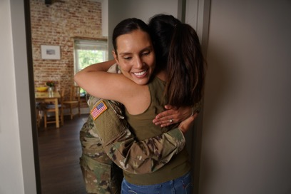
Practice Sessions
Goal: To develop a level of comfort and confidence in asking about suicide and helping a Veteran who is thinking about suicide.
Notes:
[Practice Sessions are a chance to practice S.A.V.E. skills. Encourage everyone to participate, but don’t worry if someone does not want to do it. It’s okay if they want to just watch. Flexibility is a strength here.
Depending on your group(s) and your time, you can have 1 or more role plays with a volunteer, or brainstorm role play responses with the whole group.
Use that attached role play materials to help your colleagues practice S.A.V.E. Keep slide 36 with the steps of S.A.V.E. visible for people to use.
Be positive and encouraging. Take a gentle, coaching approach. This is a sensitive issue, and a new skill for many people. If you mean well, and are doing your best, with S.A.V.E. skills, it will likely work out well.
Wrap up during last 5 min of the hour.

Slide 36
Practice Sessions
Imagine that you are talking to a friend, family member, or co-worker whom you know well. You also know this person has been having a lot of personal problems lately and seems to be withdrawing from activities, and overall seems “down” much of the time. They mention that everything feels “hopeless.”
Step 1: As you begin your conversation with them, listen for the problems that they believe suicide would solve and listen for a sign — an invitation statement. When you hear a warning sign, find a way to ask the question, e.g., “You seem very overwhelmed right now. Are you thinking about suicide?”
Step 2: As you listen, make sure to validate their experience or feelings. Continue to listen and try to expedite them to the appropriate level of care.
Switch roles.

Slide 37
Remember
S.A.V.E.
  S
  A
  V
  E
  Signs of suicidal thinking should be recognized.
  Ask the most important question of all.
  Validate the Veteran’s experience.
  Encourage treatment and Expedite getting help.

Slide 38
Signs of Suicidal Thinking
What signs did you pick up on?

Slide 39
Asking the Question
What did you notice about your “ask”?

Slide 40
Validate the Veteran’s Experience
What did your partner do or say that was validating?

Slide 41
Encourage Treatment and Expedite Getting Help
What did you do to expedite getting help?
How comfortable would you be recommending resources?

Slide 42
Debrief
Any other thoughts, feelings, questions?
Notes:
That’s a great question. The nice thing about S.A.V.E. training is that no one expects you or me to have all the answers. The Suicide Prevention Program is happy to follow up with us about any outstanding questions we may have. If you want, I can write down your question and ask them myself.

Slide 43
Resources and References

Slide 44
S.A.V.E. Training:
Spreading the Word
Psych Armor Institute’s

Slide 45
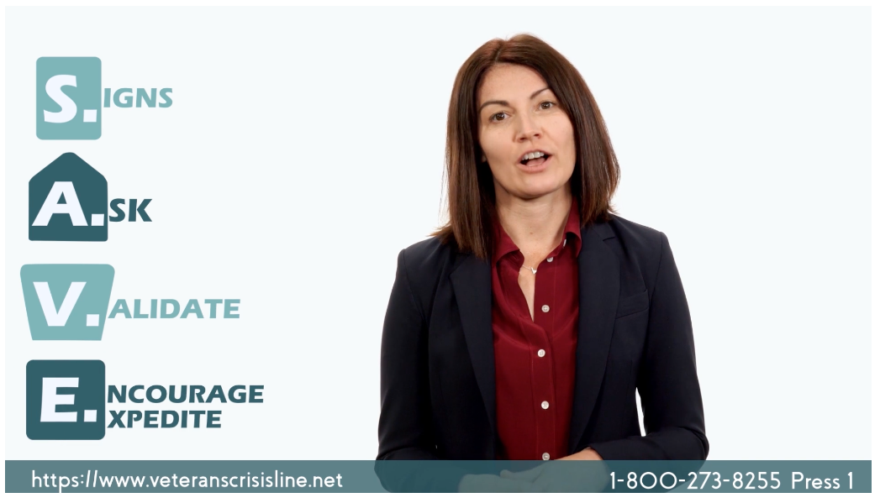

S.A.V.E. Training
A PsychArmor course developed in collaboration with the Department of Veterans Affairs and presented by Dr. Megan McCarthy, Former Deputy Director, Suicide Prevention
After taking this 25-minute course, you will:
  Develop a general understanding of the problem of suicide in the United States.
  Understand how to identify a Veteran who may be at risk for suicide.
  Know what to do if you identify a Veteran at risk.

Slide 46
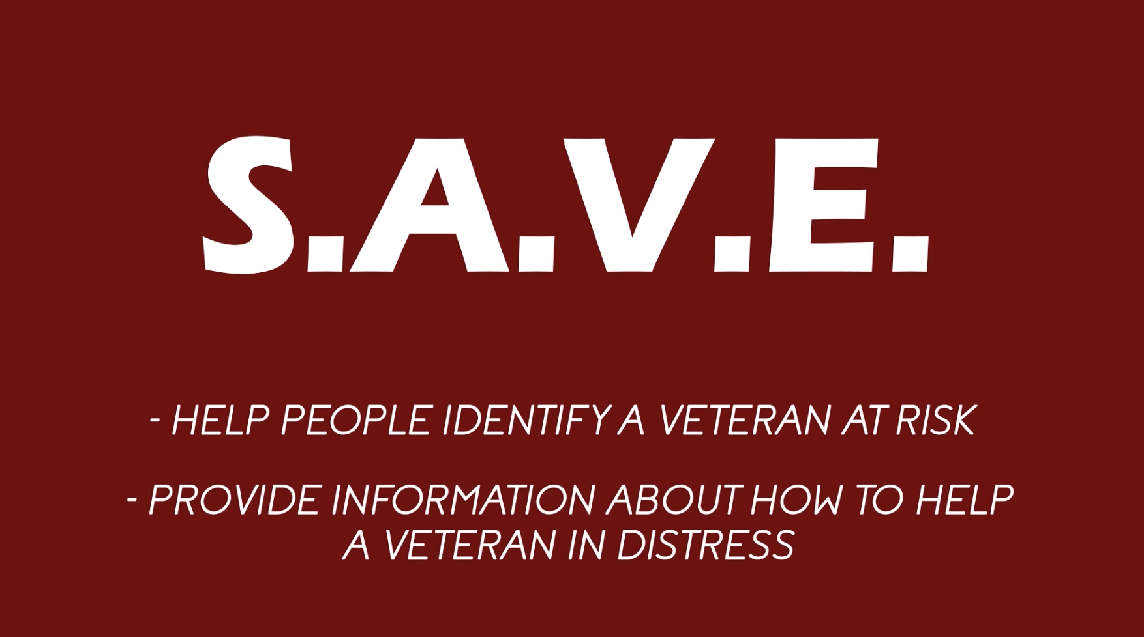
Utilize S.A.V.E. Training
S.A.V.E. is a free online Veteran suicide prevention training found on Psycharmor.org.
S.A.V.E. is provided through VA suicide prevention resources across the country, which can be found using VA’s resource locator at www.VeteransCrisisLine.net/ResourceLocator.
Available online for free: psycharmor.org/courses/s-a-v-e/

Slide 47


Utilize S.A.V.E. Training
There are two different ways to take S.A.V.E.
  Group setting
  Individually
S.A.V.E. was designed to be watched as a group. This allows for greater discussion and interaction of the topics and video.

Slide 48
Who Should Take S.A.V.E. Training?
This training is beneficial for anyone who interacts with Veterans, including:
First responders
Crisis line volunteers
Law enforcement
Members of clergy
Individuals working in the justice system
Health care employees
Faith leaders
Community members
Available online for free: psycharmor.org/courses/s-a-v-e/

Slide 49
What to Do if a Veteran Expresses Suicidal Ideation During a Phone Call
Keep the caller on the line (do not hang up or transfer).
Remain calm.
Obtain identifying information on the caller (name, phone number, and current location).
Conference call to VCL (don’t hang up until VCL responder has the call).
Solicit co-workers for assistance via Skype, etc.
If caller disconnects, dial 911 and VCL (1-800-273-8255 and Press 1.).
Tip: Practice conferencing in calls at your desk with coworkers.

Slide 50
Free, Confidential Support 24/7/365
Veterans
Service members
Family members
Friends
Notes:
When you are helping someone in crisis, having the Veterans Crisis Line number on hand in your phone will make it easier to use it yourself or share it with the person you are helping. Let’s make sure one last time that the Veterans Crisis Line number — 1-800-273-8255 — is in our phones. Include a note to “press 1.” You might also put in a note that you can text to 838255 or go to VeteransCrisisLine.net.

Slide 51
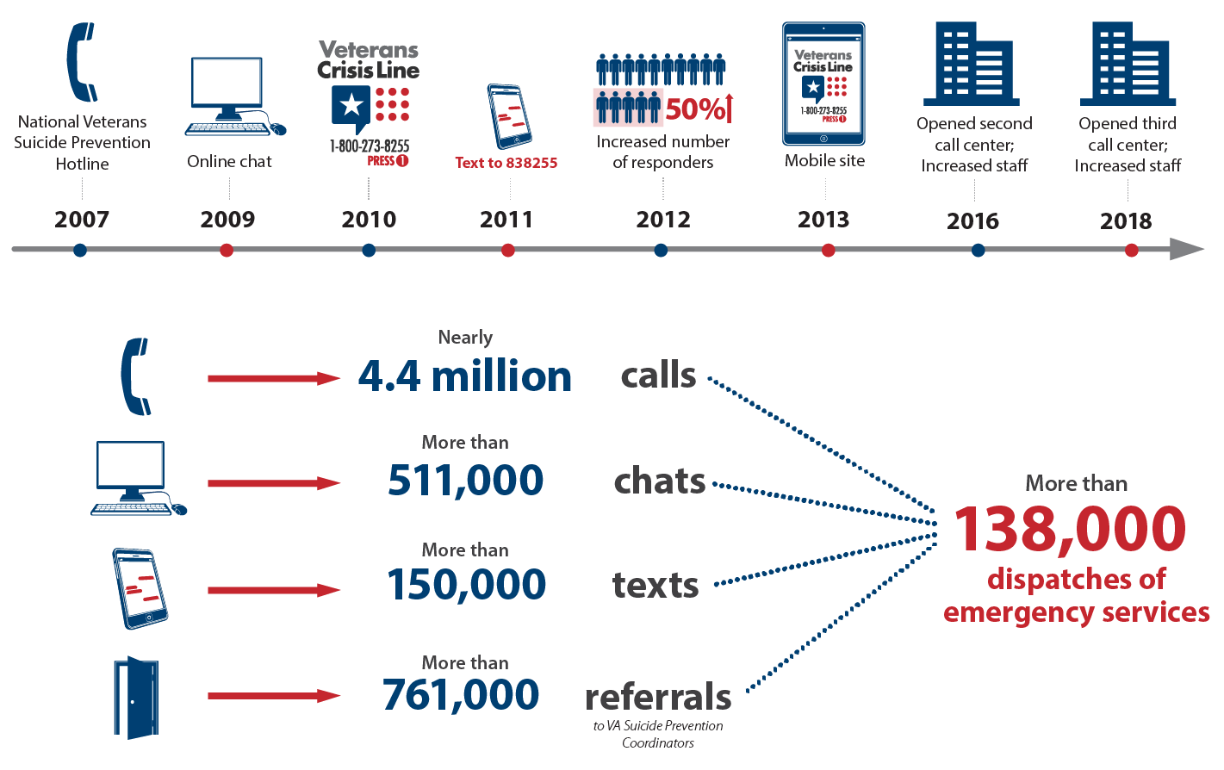
Veterans and Military Crisis Line
Notes:
Data updated November 22, 2019
Since 2007, VCL responders have answered almost 4.4 million calls, held more than 511,000 online chats, and responded to 150,000 texts. Their efforts have resulted in the dispatch of emergency services more than 138,000 times.

Slide 52
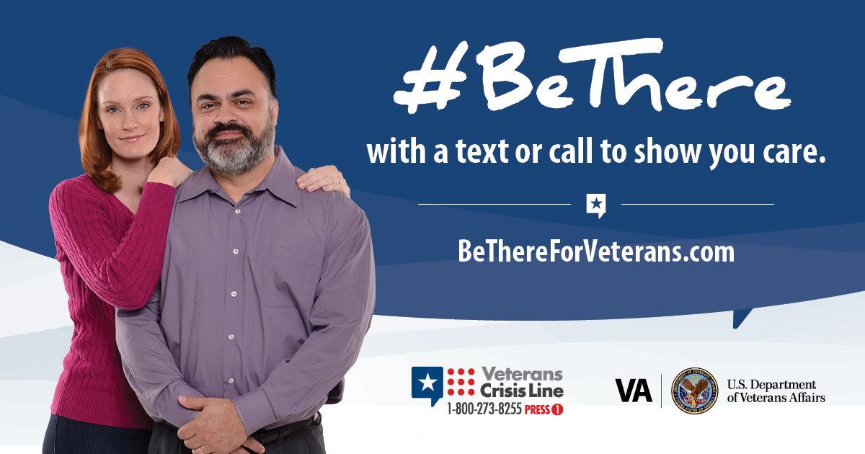
#BeThere Prevention Initiative
https://www.youtube.com/watch?time_continue=60&v=MCSZ7FjTq5I
Notes:
#BeThere Prevention Initiative: The #BeThere prevention initiative teaches members of the community how simple acts can help save a Veteran in crisis. More information is available at https://www.veteranscrisisline.net/BeThere.aspx.

Slide 53
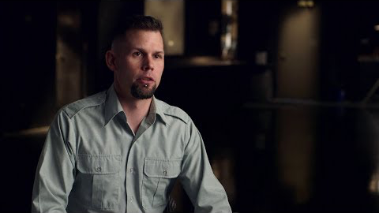
Make the Connection
Online resource featuring hundreds of Veterans telling their stories about overcoming mental health challenges.
https://maketheconnection.net/conditions/suicide
Notes:
Make the Connection: This online resource connects Veterans, their family members and friends, and other supporters with information and solutions to issues affecting their lives. More information is available at https://maketheconnection.net/.

Slide 54
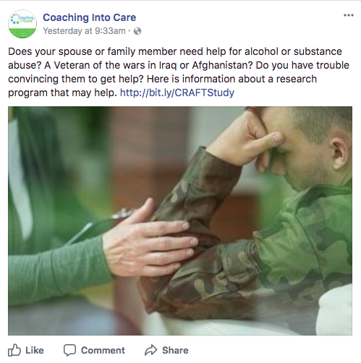
Coaching into Care
Program for families and loved ones of Veterans, helping them encourage the Veteran in their lives to seek support.
CALL 888-823-7458
Notes:
Coaching into Care (1-888-823-7458): A national telephone service of the VA, Coaching into Care aims to educate, support, and empower family members and friends who are seeking care or services for a Veteran. More information is available at https://www.mirecc.va.gov/coaching/.

Slide 55
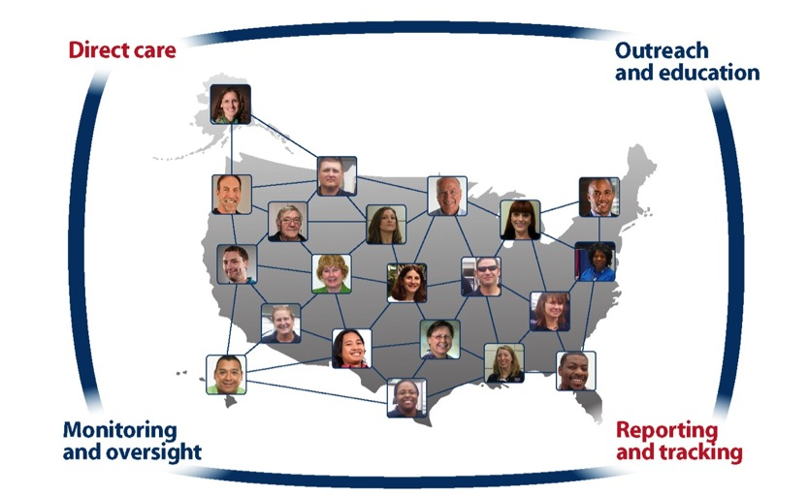
Find a Local VA SPC at VeteransCrisisLine.net/ResourceLocator
More than 400 SPCs nationwide.
Notes:
Resource Locator: This online resource helps Veterans easily find VA resources in their area including Suicide Prevention Coordinators, crisis centers, VAMCs, outpatient clinics, Veterans Benefits Administration offices, and Vet Centers. More information is available at: www.veteranscrisisline.net/ResourceLocator.

Slide 56

VeteransCrisisLine.net/ResourceLocator
Notes:
After using the Resource Locator to find your local SPC, you can call or email them for clinical support, SAVE training, or event support. This example displays results of a search for resources in Fargo, North Dakota, which connects visitors to SPC Tammy Monsebroten, pictured here.

Slide 57
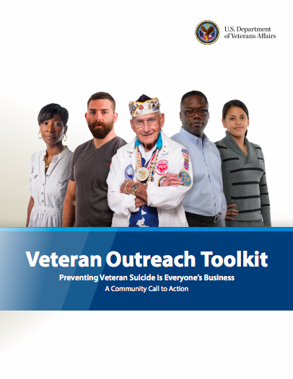
Veteran Outreach Toolkit
Includes facts and myths about suicide, as well as information on:
Establishing a suicide prevention council
Talking to Veterans about their military service
Assessing suicide risk
Developing a suicide prevention safety plan
Helping Veterans feel more connected to others
Joining public-private partnerships
Access the toolkit online:
go.usa.gov/xnwbz
Notes:
The Veteran outreach toolkit is an online guide for people and organizations who are hosting events and interacting with Veterans.

Slide 58

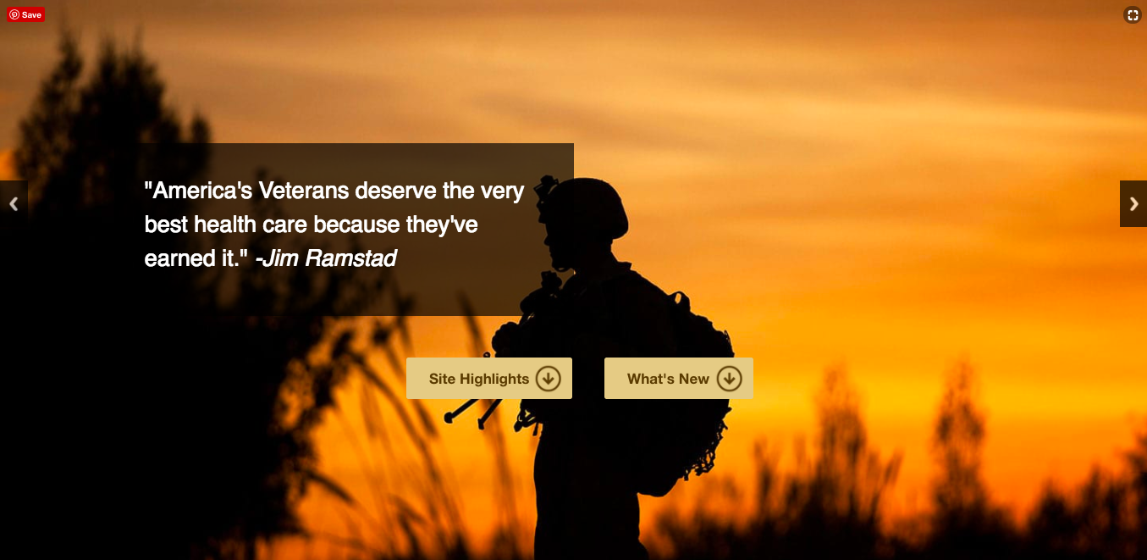
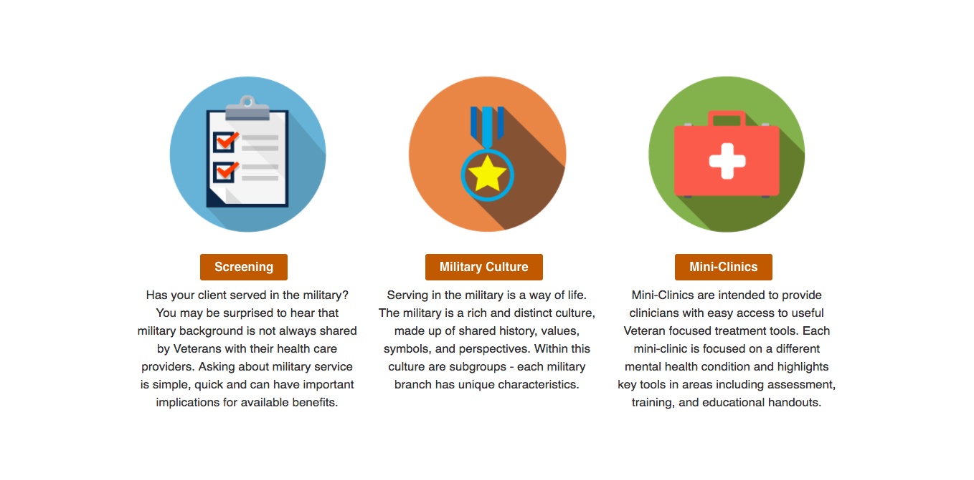
Community Provider Toolkit
Free online training on Veteran issues, including military culture, for health care providers.
Includes tips for screening clients for military service.
Military culture training can count for continuing education credits (CEUs): https://www.mentalhealth.va.gov/communityproviders/military.asp.
Access the toolkit online: www.mentalhealth.va.gov/communityproviders
Notes:
Community Provider Toolkit. This toolkit supports the behavioral health and wellness of Veterans receiving services outside the VA health care system. Resources available in this toolkit include information on screening for military service, handouts and trainings to increase knowledge about military culture and mini-clinics focused on relevant aspects of behavioral health and wellness.

Slide 59
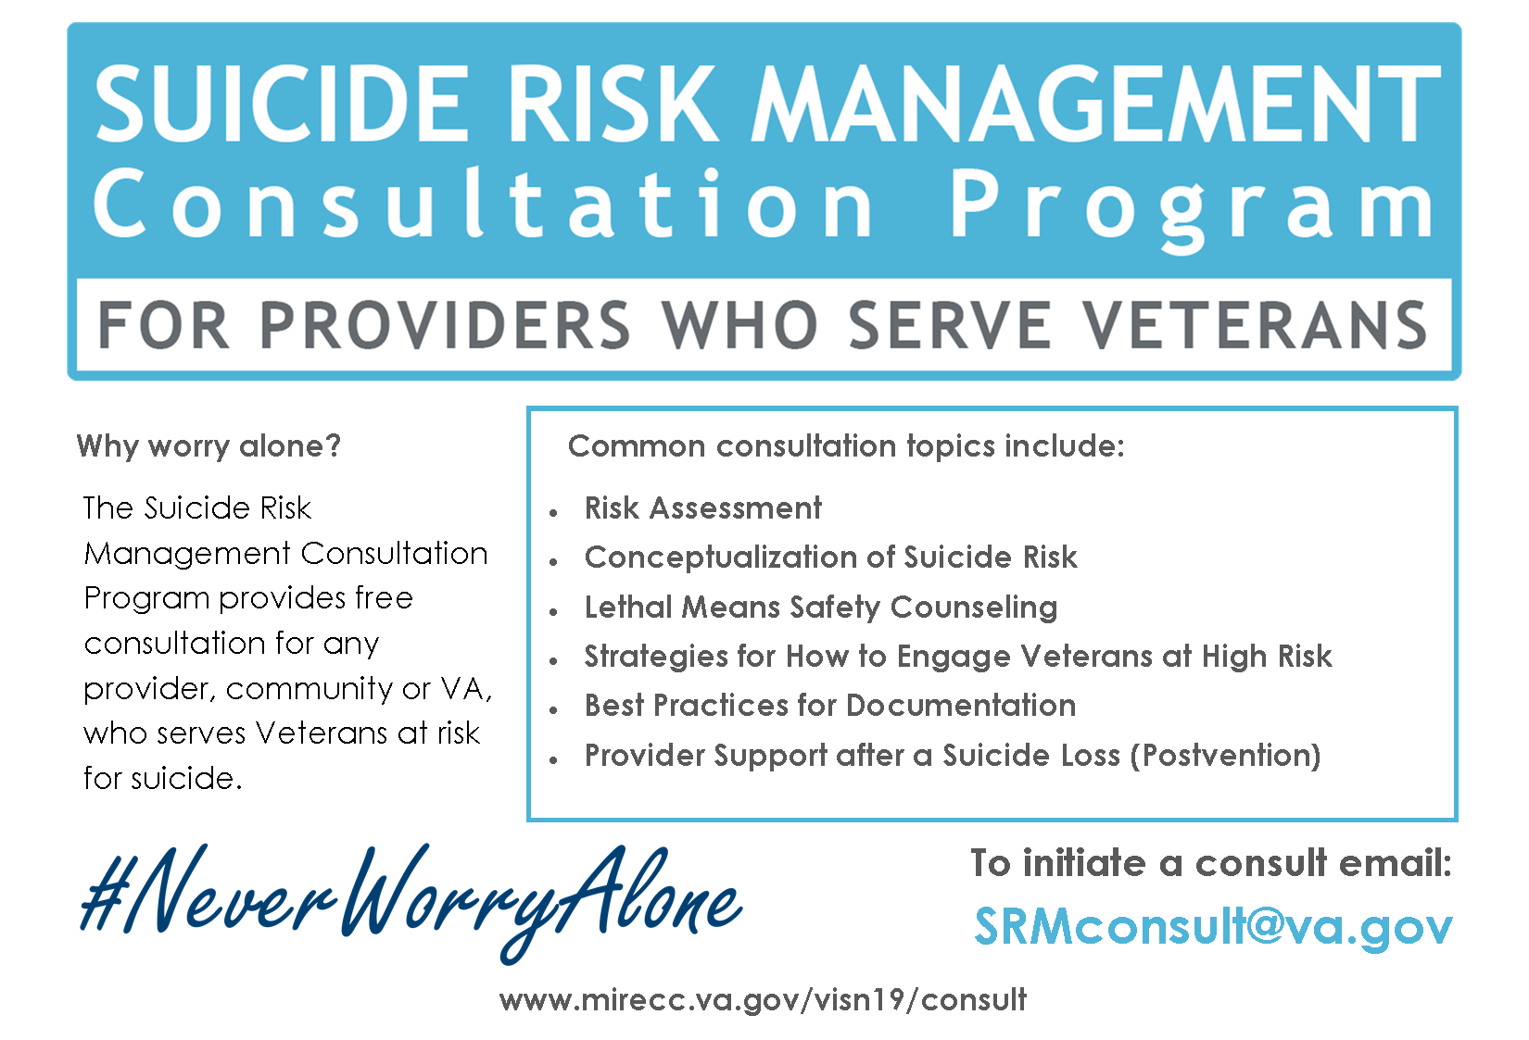

Suicide Risk Management Consultation Program
Notes:
VA Suicide Risk Management Consultation Program: Providing care for Veterans at risk of suicide may feel like a daunting responsibility. The Rocky Mountain Mental Illness Research, Education, and Clinical Center (MIRECC) for Suicide Prevention offers free, one-on-one consultation for any community or VA provider who works with Veterans. To get started, email srmconsult@va.gov. Administrative staff will set you up with the consultant who can best answer your question. The consultation is confidential and can take place by phone or email, at your convenience. More information is available at: https://www.mirecc.va.gov/visn19/consult/index.asp.

Slide 60
Gulf Coast Suicide Prevention Team
  Dawn Mucha-Johnson, LCSW, Suicide Prevention Coordinator (Biloxi) telephone # 228-523-2298
  Lauren M. Anzaldo, LCSW, Suicide Prevention Coordinator (Pensacola) telephone # 850-912-2310
  Melissa Kirkup, LCSW, Suicide Prevention Case Manager (Biloxi), telephone # 228.523.5299
  David Singleton, LCSW, Suicide Prevention Case Manager (Biloxi), telephone # 228.523.4592
  Rachel Mosley, LCSW, Suicide Prevention Case Manager (Mobile), telephone # 251.219.3900 ext. 33838
  Angela Vannuck, LCSW, Suicide Prevention Case Manager (Eglin/PC), telephone # 850.609.2631 ext. 32631
Notes:
[Thank everyone for their contribution.
These are some links to source materials for our training
Let your colleagues know you are happy to follow up with them about S.A.V.E. or to help them get in touch with specialists in Suicide Prevention at VA, if they need anything more.
Let them know you are confident that they can use S.A.V.E. in the service of Veterans (and even in their communities) to make a difference.]

