Slide 1
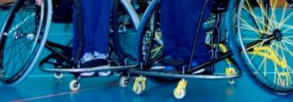


Spinal Injuries Association
Referrals
Notes:
Start by getting all up on their feet run by shacking it all about
SIA was started in 1974 by Baroness Masham who sustained a SCI through a riding accident. After months of rehabilitation at Stoke Mandeville she returned home to Yorkshire where she found there was little understanding or support available and no-one she could turn to. She set up a self-help group and SIA was born.
Since then SIA has gone from strength … from type-written, photocopied newsletters to glossy bimonthly magazines…. and from rented offices in London to a completely accessible, ecologically friendly, purpose built building in Milton Keynes.

Slide 2
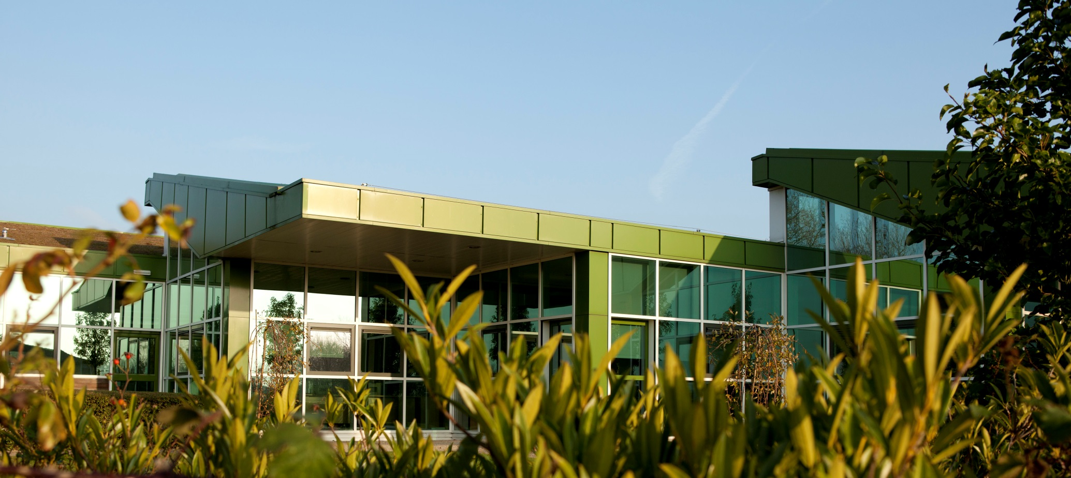
Notes:
Start by getting all up on their feet run by shacking it all about (Do the seating on the hands bit)
SIA was started in 1974 by Baroness Masham who sustained a SCI through a riding accident. After months of rehabilitation at Stoke Mandeville she returned home to Yorkshire where she found there was little understanding or support available and no-one she could turn to. She set up a self-help group and SIA was born.
Since then SIA has gone from strength … from type-written, photocopied newsletters to glossy bimonthly magazines…. and from rented offices in London to a completely accessible, ecologically friendly, purpose built building in Milton Keynes.

Slide 3

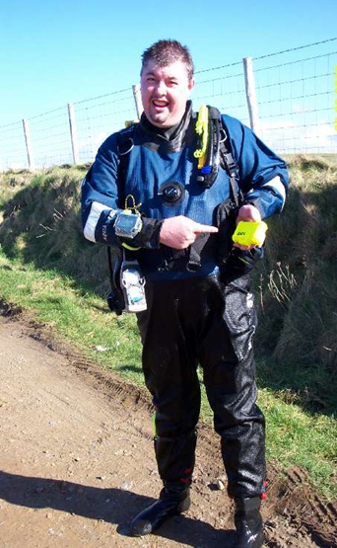
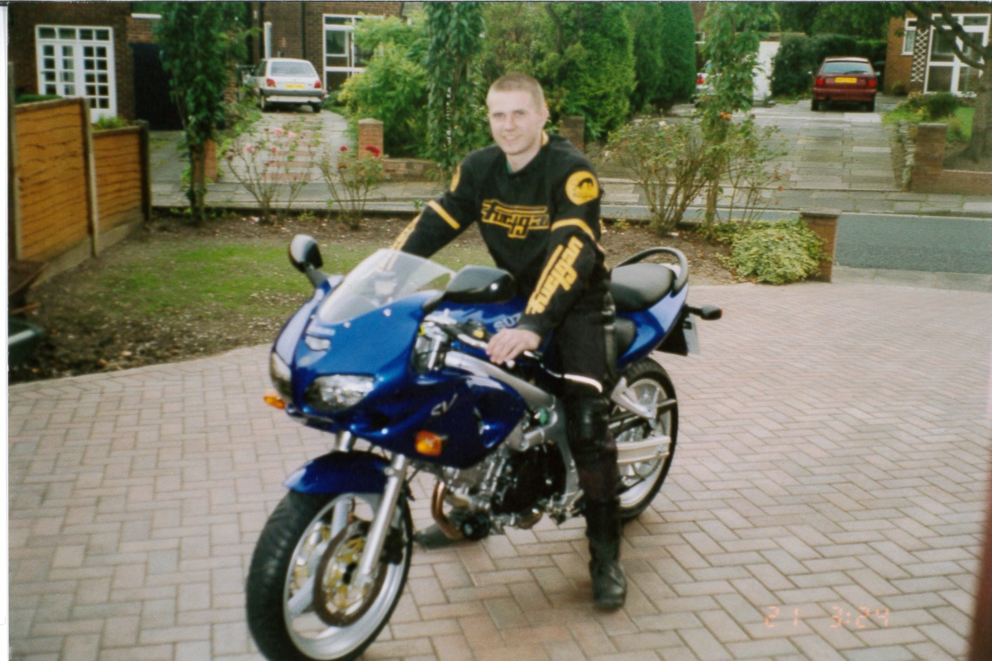
Our Lives
Picture of Gary before injury
Notes:
We all have our own lives doing many different things in our lives.
So there you are in hospital maybe never know any one with SCI or who has to use a wheelchair most of the time now.
No one knows what around the corner. (Explain our injury in brief) to lead onto why we think you should make rehearsals to SIA.

Slide 4

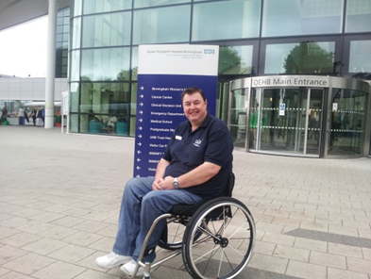

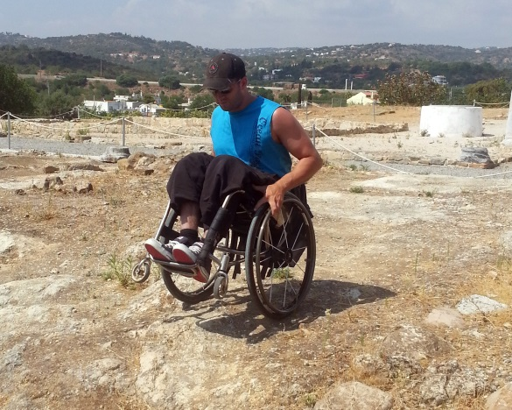
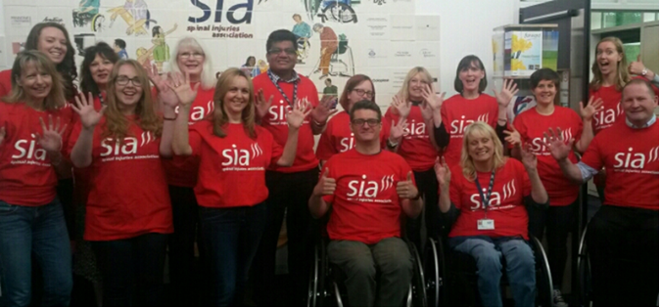
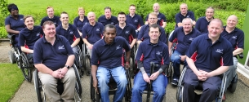
Why Make Referrals
Picture G ARY
E-mail
Notes:
Once you got your SCI you are laying there in hospital not knowing how you are going to deal so many thinks going through your mind.
You just don’t know where to turn or who to ask. Also the family need help too (put up New poster to show. we hope to get HCP a where or us with the evidence it show 74%)
So if we can see patient early and there families has SCI does affect all in many different ways We can start to support them along their journey.
Has been there got the t/shirt. But we not just about peer support SIA is much more than that (List run one of each other)
Advice line, APPG, ETC
It also about the strap line Rebuilding lives after spinal cord injury.
Overall we are links in the chain that attached to very big and secure anchor.

Slide 5
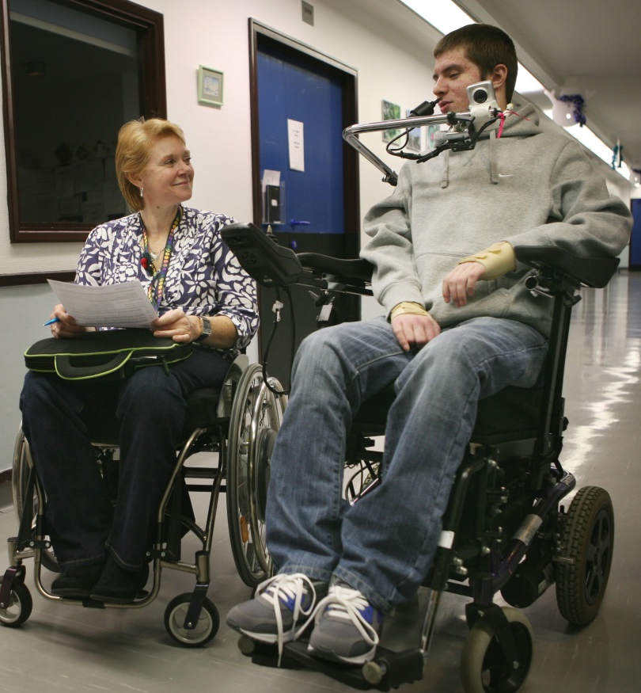
What we do…
We Listen, We Talk, We Help.
All peer support officer have SCI so can relate to the patient better
Give them or the families NIP full of helpful information
Having peer support you can trust
Notes:
We need your support to help patients know we are out there and they are not alone.

Slide 6
Notes:
This maybe another slide to use ?

Slide 7

Questions?
Notes:
Any question

Slide 8

Notes:
Thank you as we think you are all stars in your own field.

