Slide 1
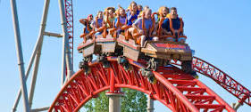
A Roller Coaster Ride
Parenting Gifted Children and Teens
Susan R. Rakow, Licensed Professional Counselor (LPC)
Ph.D. in Education
susanrakow@earthlink.net
216-570-4976

Slide 2
Developmental Perspective: Gifted Child, Gifted Tween, Gifted Teen
Elementary School
Middle Grades
High School
Beyond High School…

Slide 3
Definition of Giftedness
Not Genius!! Not Prodigy!!
Individual who is performing significantly above and beyond what would be expected/typical for his or her chronological age in one or more areas.
State of Ohio defines these areas as: Superior Cognitive Ability; Specific Academic Ability in Math, Reading/Language Arts, Science or Social Studies; Visual and/or Performing Arts; Creative Thinking.
Continuum of Giftedness: mild, moderate profound (How far is the child from what is “typical”)
Asynchronous Development

Slide 4
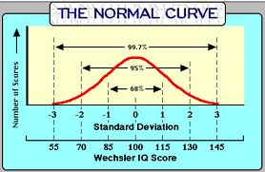
What’s “typical?” “normal?”

Slide 5
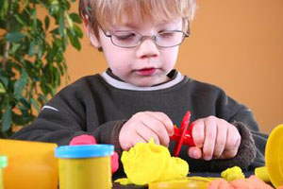
Possible Indicators of Giftedness
•Intense fascination with a particular subject;
•Advanced Verbal Ability
• Ability to ask unusually reflective, deep, and probing questions
• Exceptional memory
• Rapid pace of learning

Slide 6
Formal Identification
• Individual or group tests (State list)
~ IQ (WPPSI, WISC, Naglieri, CogAT)
~ Achievement Tests (ex. Woodcock-Johnson, Iowa and/or Stanford Achievement Tests)
• Behavioral checklists, observations, interactions

Slide 7
Social-Emotional Characteristics of Gifted Children and Teens
Emotional Intensity and High Sensitivity
Enhanced Capacity to Empathize
Highly Developed Sense of Fairness and Justice
Low tolerance for hypocrisy and pretense
Interests that are more common in older children or adults
Advanced Play Patterns and Preference for being with adults
Intense and Lengthy Task Commitment (don’t want to be interrupted!)

Slide 8
Additional Social-Emotional Characteristics
May need little sleep; lots of energy
More advanced sense of humor
Vocabulary that may contribute to alienation from others their age
Frustration when small motor coordination limits don’t allow them to produce artwork or writing that expresses fully what is in their imaginations (children)
Frustration with chronological age limitations set by institutions and/or parents (teens)

Slide 9
Unique Needs of Gifted Subpopulations
2e individuals
Cultural and Ethnic Minorities, including ELL
Gifted Girls
Profoundly Gifted
LGBT

Slide 10
Pressures and Stress for Gifted Children and Teens
• Academic
Perfect v. Excellent v. Good Enough (Perfectionism)
Multipotentiality – “doing it all” v. Focus & Domain Specificity
College and Career
School-Home Partnership
“boredom”
Over-attention to kids’ negative comments

Slide 11
Pressures and Stress for Gifted Children and Teens
Social
• Bullying (?)
• Conforming (?)
Internal
Over-empowerment
Depression
Anxiety
Feeling “lack of control”
Parental/Family Expectations
• Physical and Gender Expectations
Risky Behaviors: Drugs, Sex, Music, Tattoos, Piercings

Slide 12
Casual Marijuana Use in 18-25 year olds…
Brain Changes (using just once a week) affect
Motivation
Attention
Learning
Memory
(April 2014, Science Daily based on Society for Neuroscience)

Slide 13
Addressing Perfectionism and Anxiety
Books (for parents and for youth)
Exercise
Down time
Meditation and Breathing
Breaking the chain of negative/anxious thoughts
Socializing
Arts and Creative outlets/visualizations

Slide 14
Achievement and Underachievement
Achievers:
self-efficacy/internal locus of control,
resilience,
high frustration tolerance,
realistic expectations by self and others,
growth mindset,
history of meeting challenges,
family security

Slide 15
Building Resilience
Teach and model connections with others and empathy.
Age appropriate volunteer work and helping others (family, friends, neighbors)
Regular Routines and Self-Care
But also, acceptance that change is part of life.
Ways to deal with anger
Goal-setting and progress (breaking things down into small achievable parts)
Nurture positive self-view (but not perfection!)
Nurture Hope and How to keep things in Perspective.
Learning from our Mistakes and from Adversity

Slide 16
Organization and Study Skills: Challenges and Frustrations
Study Skills
How to study for tests
Planning for long-term projects
Realistic goals and expectations
Organization: Time and Materials
What works for an individual student based on age, learning style
Transitions in certain grades: 4th, middle school, 9th , 11th
Grades and Grading - What’s in the Student’s Control?

Slide 17
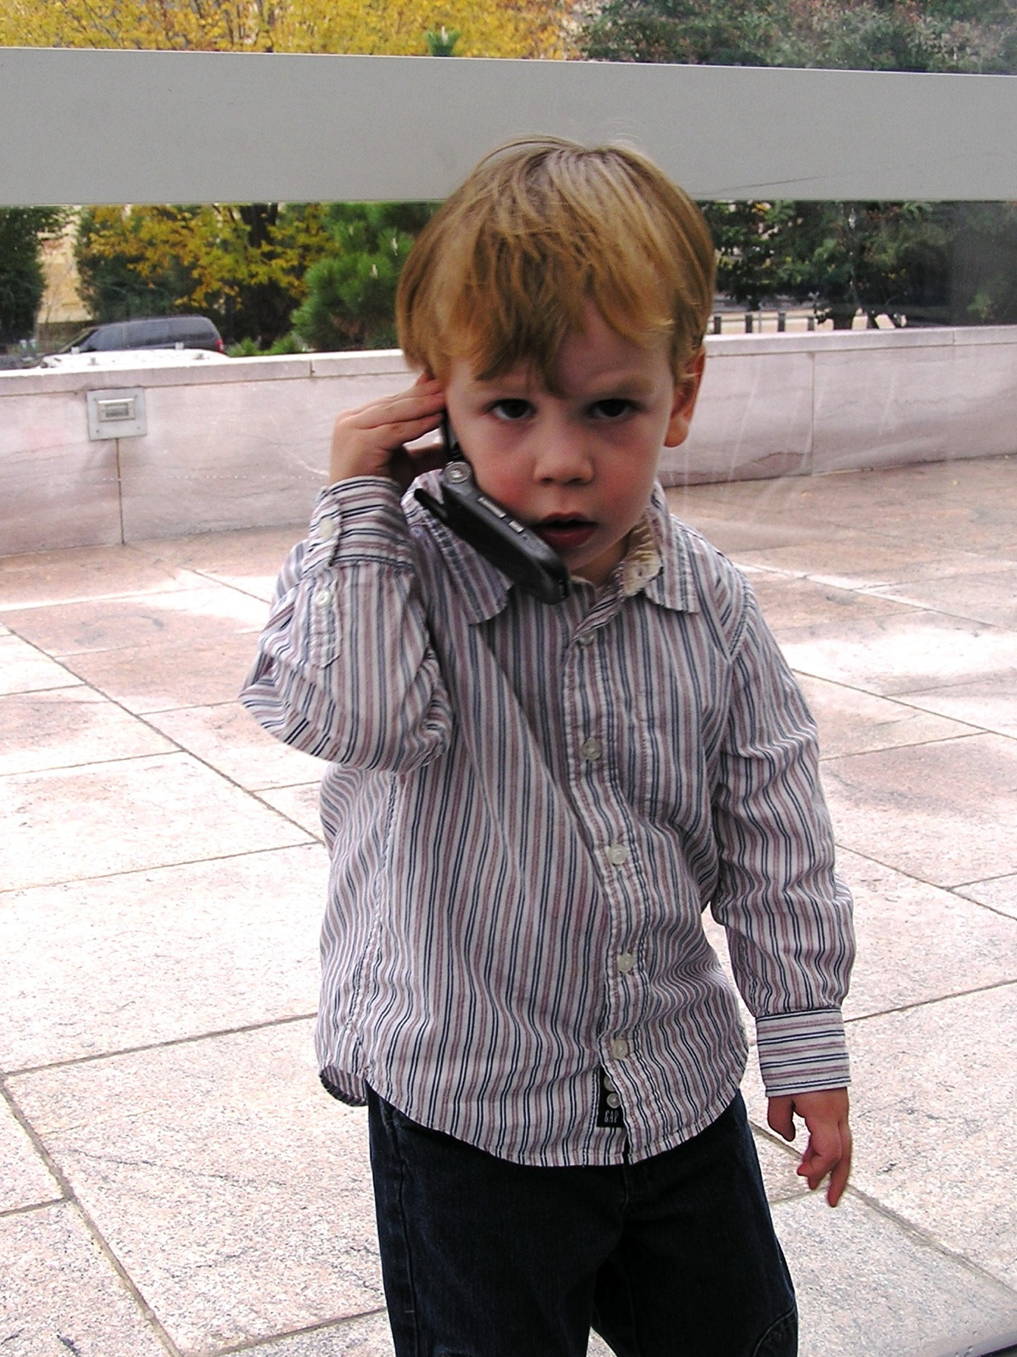
Technology Use and Abuse: Adults and Kids
How much? When and Where? What?
• Impact on Sleep and Eating Disorders including obesity
Impact on Attention
Impact on ability to have real-world social interactions and conversations
American Academy of Pediatrics recommendations:
No tech/screen time for under 2’s
“screen-free” zones and times (dinnertime; no tv, computer, cellphones or video games in kids’ rooms)

Slide 18
Danger Signals
Changes in Emotional Engagement
Conversations
Use of time (with family, with friends)
Behavioral changes – sudden or gradual
School
Home
Friends
Appearance
Weight gain or loss
Clothing
Cutting, Excessive Piercing (?)

Slide 19
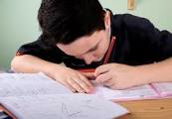
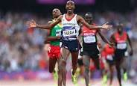
Self-Esteem, Self-Worth, and Self-Confidence
✔Growth Mindset: Work and Practice
✔
✔
How to Give Praise:
Specific Action
No “est”
Referential Speech

Slide 20
Summer Opportunities and Advantages: Academic, Artistic, and Social
Academic
Unusual courses to extend interests
Acceleration
Get required courses “out of the way”
College experiences
Competition
Artistic
Professional Mentors
Real World Competition

Slide 21
Questions and Concerns

Slide 22
Reaching Out and Resources

Slide 23
Reaching Out and Resources: People and Places
School Counselor and Psychologist
http://mcgt.net/how-can-i-help-my-gifted-child-plan-for-college
Community Agencies
Your Physician
http://therapists.psychologytoday.com/rms/state/OH/North+Canton.html
Resilience Guide for Parents and Teachers http://www.apa.org/helpcenter/resilience.aspx#
Family Achievement Clinic
Dr. Sylvia Rimm (www.sylviarimm.com)
Susan Rakow, LPC (susanrakow@earthlink.net)

Slide 24
Reaching Out and Resources: A Few Books
Sylvia Rimm: How to Parent So Children Will Learn
James Delisle: Parenting Gifted Kids
Susan Rakow: Educating Gifted Students in Middle School (2nd Ed.)
James Webb: Searching for Meaning – Idealism, Bright Minds, Disillusionment, and Hope
Michael Piechowski – “Mellow Out,” they Say. If I Only Could
Maureen Garth – Moonbeam, Starbright (two books of meditations for children)
Gina Biegel – The Stress Reduction Workbook for Teens: Mindfulness Skills to Help You Deal with Stress
Lisa Schab – The Anxiety Workbook for Teens: Activities to Help you Deal with Anxiety and Worry
Lawrence Shapiro – Stopping the Pain: A Workbook for Teens Who Cut and Self-Injure

