Slide 1
Northern Virginia Regional Commission Climate Resiliency Programs

Slide 2
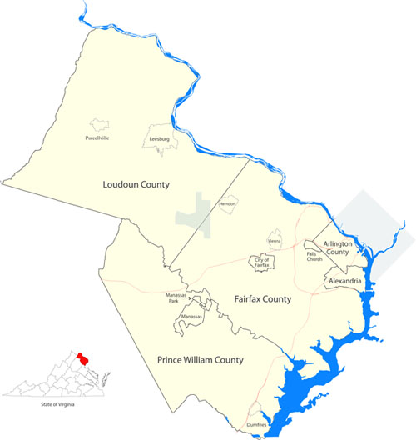
NVRC Environmental Program Background
Environmental programming across Northern Virginia:
Watershed Programs
Stormwater Management
Litter and Waste
Trails and Heritage Resources
Energy
Coastal Program
Resiliency Planning
Notes:
All looking to better incorporate climate resiliency into their programming and projects in the future.

Slide 3
2018 Resilience Roadmap
First official resilience planning document for NVRC
Lays out objectives and strategies for climate resilience in Northern Virginia:
Interpret climate conditions and timelines
Assess vulnerability of critical infrastructure
Build regional partnerships and programs
Identify potential projects

Slide 4
Northern Virginia Flood Mitigation and Resiliency Workgroup
What: Ad hoc group of individuals interested in navigating increasingly complex flooding patterns and to find ways to deal with a rising level of rain-related property damage.
Purpose: Identify common trends/issues related to current and future flood risk and damages. Discuss potential solutions and strategies for implementation.
Who: Northern Virginia City, Town, County floodplain administrators and other staff involved in stormwater or floodplain management; state and academic partners
Quarterly/As needed. First meeting held in October 2021.
Notes:
Stormwater engineers, planner, public works, communications and outreach staff
Speakers will talk about their current projects and initiatives, look at prior slides
Invite partners from planning district commissions from their resilience guidelines, shared issues for shared solutions

Slide 5
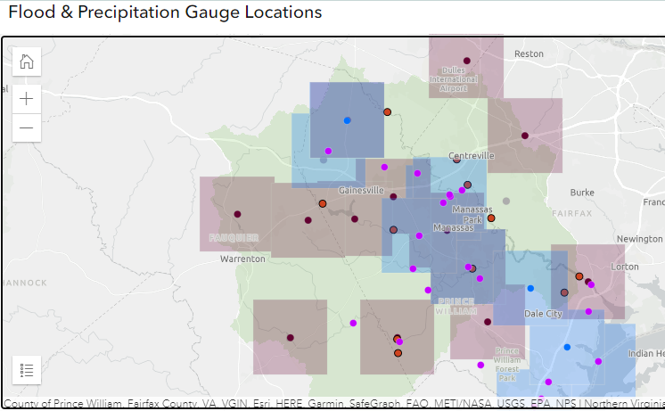
Rain Gage Desktop Analysis
AEM rain gage desktop analysis
Task 1: Review AEM stream and rain gage locations and known public gages,
Task 2: Evaluate radar coverage, compare Rain Gage network to data needed for GARR coverage, identify areas for further study
Task 3: Draft technical memorandum summarizing findings
Notes:
Image source: PWC storymap (not public)
Recent technology developments in the area, independently installing rain gauge system
At state level looking to go through a full update for gauges statewide
Department of homeland security have had multiple localities receive gauges

Slide 6
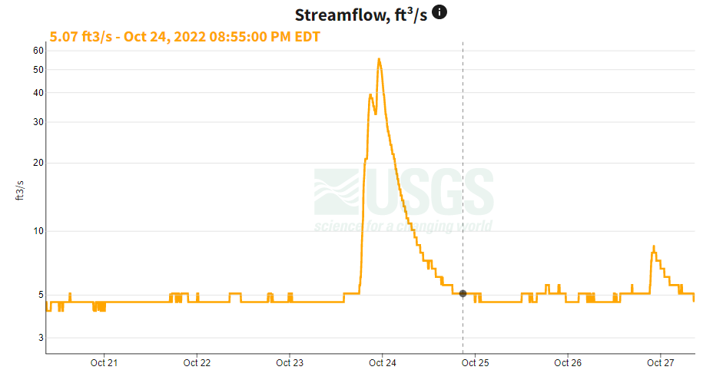
Four Mile Run Hydrologic Study
Community Flood Preparedness Fund
USGS to complete a hydrologic study using existing FMR streamflow and precipitation data to assess historic impacts of urbanization in the watershed.
The study will provide locally-specific information to inform effective watershed resource management
Objectives of this effort are to:
Compute a suite of hydrologic metrics to characterize the flow regime,
Investigate multi-decadal trends in those metrics,
Compare metrics at Four Mile Run to other monitored streams in the region where similar analyses have been conducted.

Slide 7
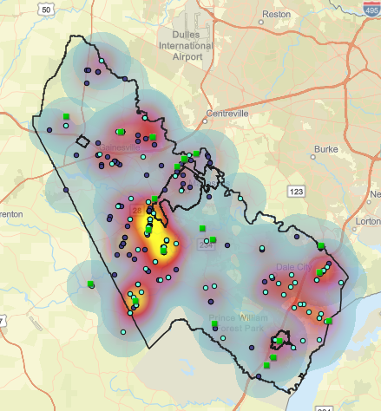
Virginia Climate Center
Current Project: Swift Water Rescue Mapping Exercise
Goals:
Serve as climate extension service for localities based out of George Mason University
Produce locally specific data and projections of changes for precipitation and other weather
Help NVRC and partners to better understand jurisdictional needs and new resilience opportunities
Road closures,
Flood rescues,
Emergency flood calls
Precipitation data
Notes:
Image: PWC storymap (not public)

Slide 8
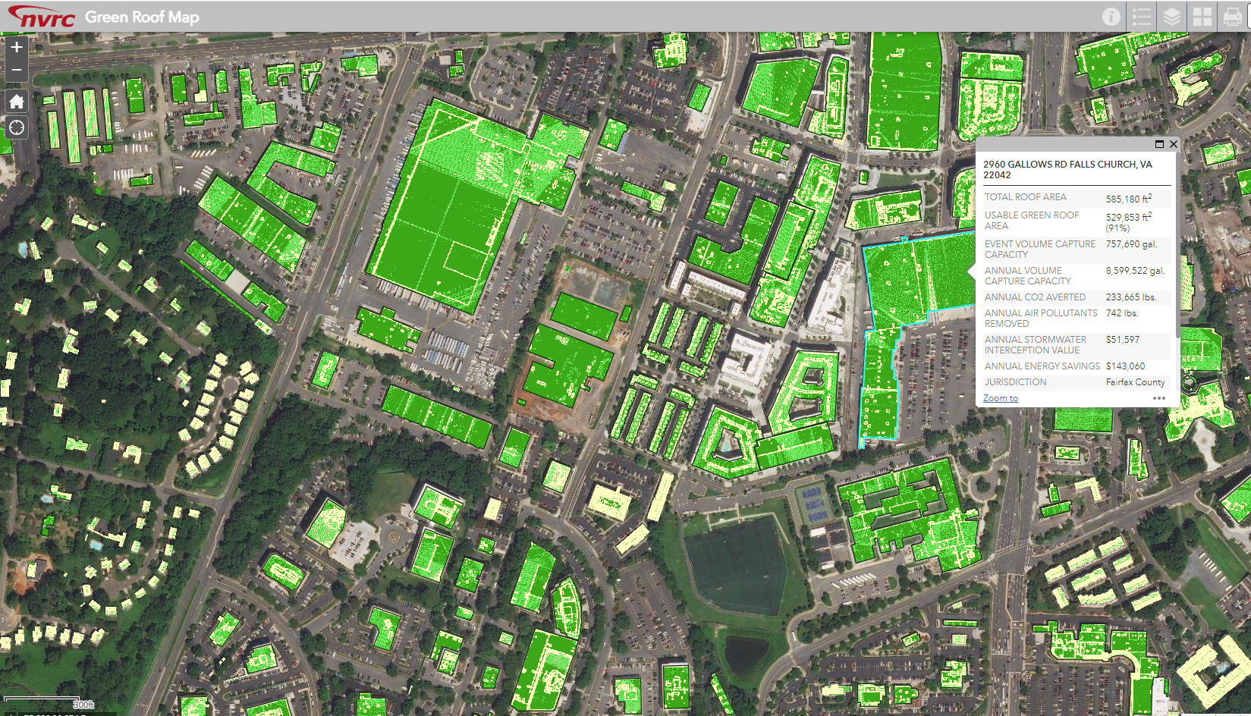
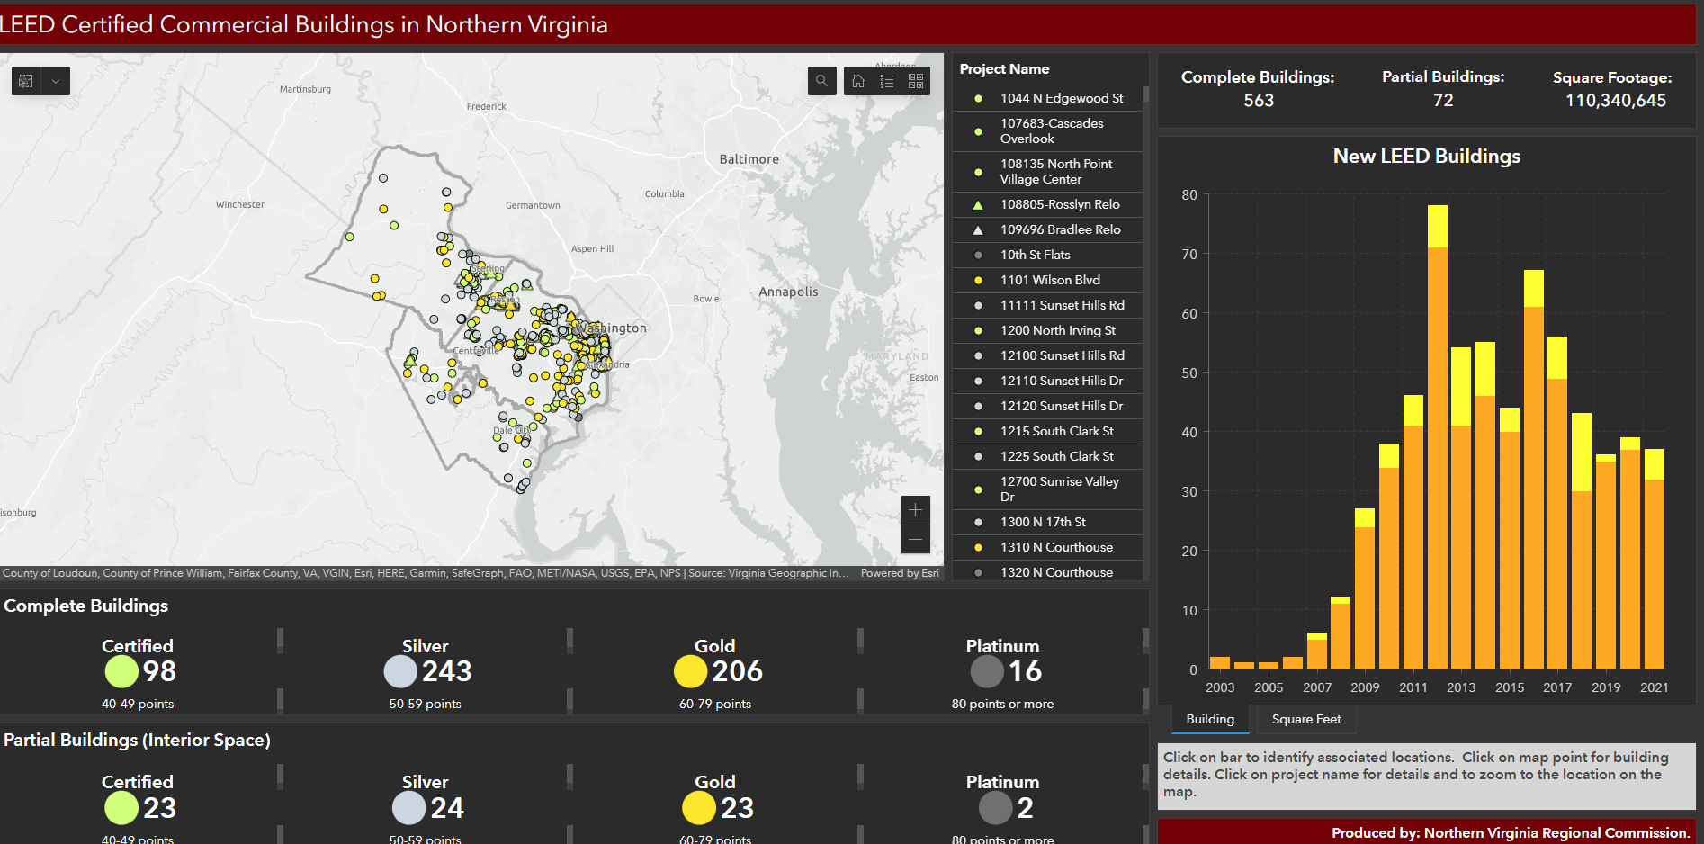
Green Buildings and Roofs
Highlight of sustainable, climate-friendly opportunities for green roofs and buildings in NoVA
Green Roofs Dashboard: Green roof potential for buildings
Green Buildings Dashboard: LEED Certified Commercial Buildings
Notes:
LEED: leadership in energy and environmental design

Slide 9
Webinar Series
An opportunity to share the work of climate resiliency experts and highlight best practices in an accessible format
Webinar Examples:
Nature Based Urban Heat Island Mitigation: Ideas from Germany
Flood Response Strategies in Northern Virginia: An Overview
Green Design and Planning of Data Centers: The Experiences of Frankfurt, Germany and Northern Virginia
Notes:
Partly with CZM, not always annual

Slide 10
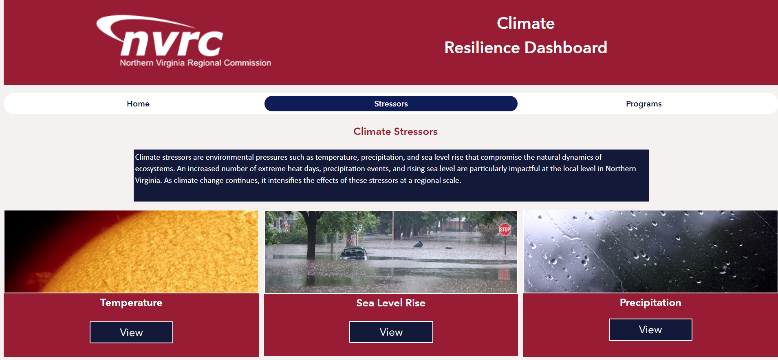
Resiliency Dashboard
Link to Dashboard HERE
Notes:
https://experience.arcgis.com/experience/d8319e3a2b5c42efa9dd241ddc0a0932/page/page_1/

Slide 11
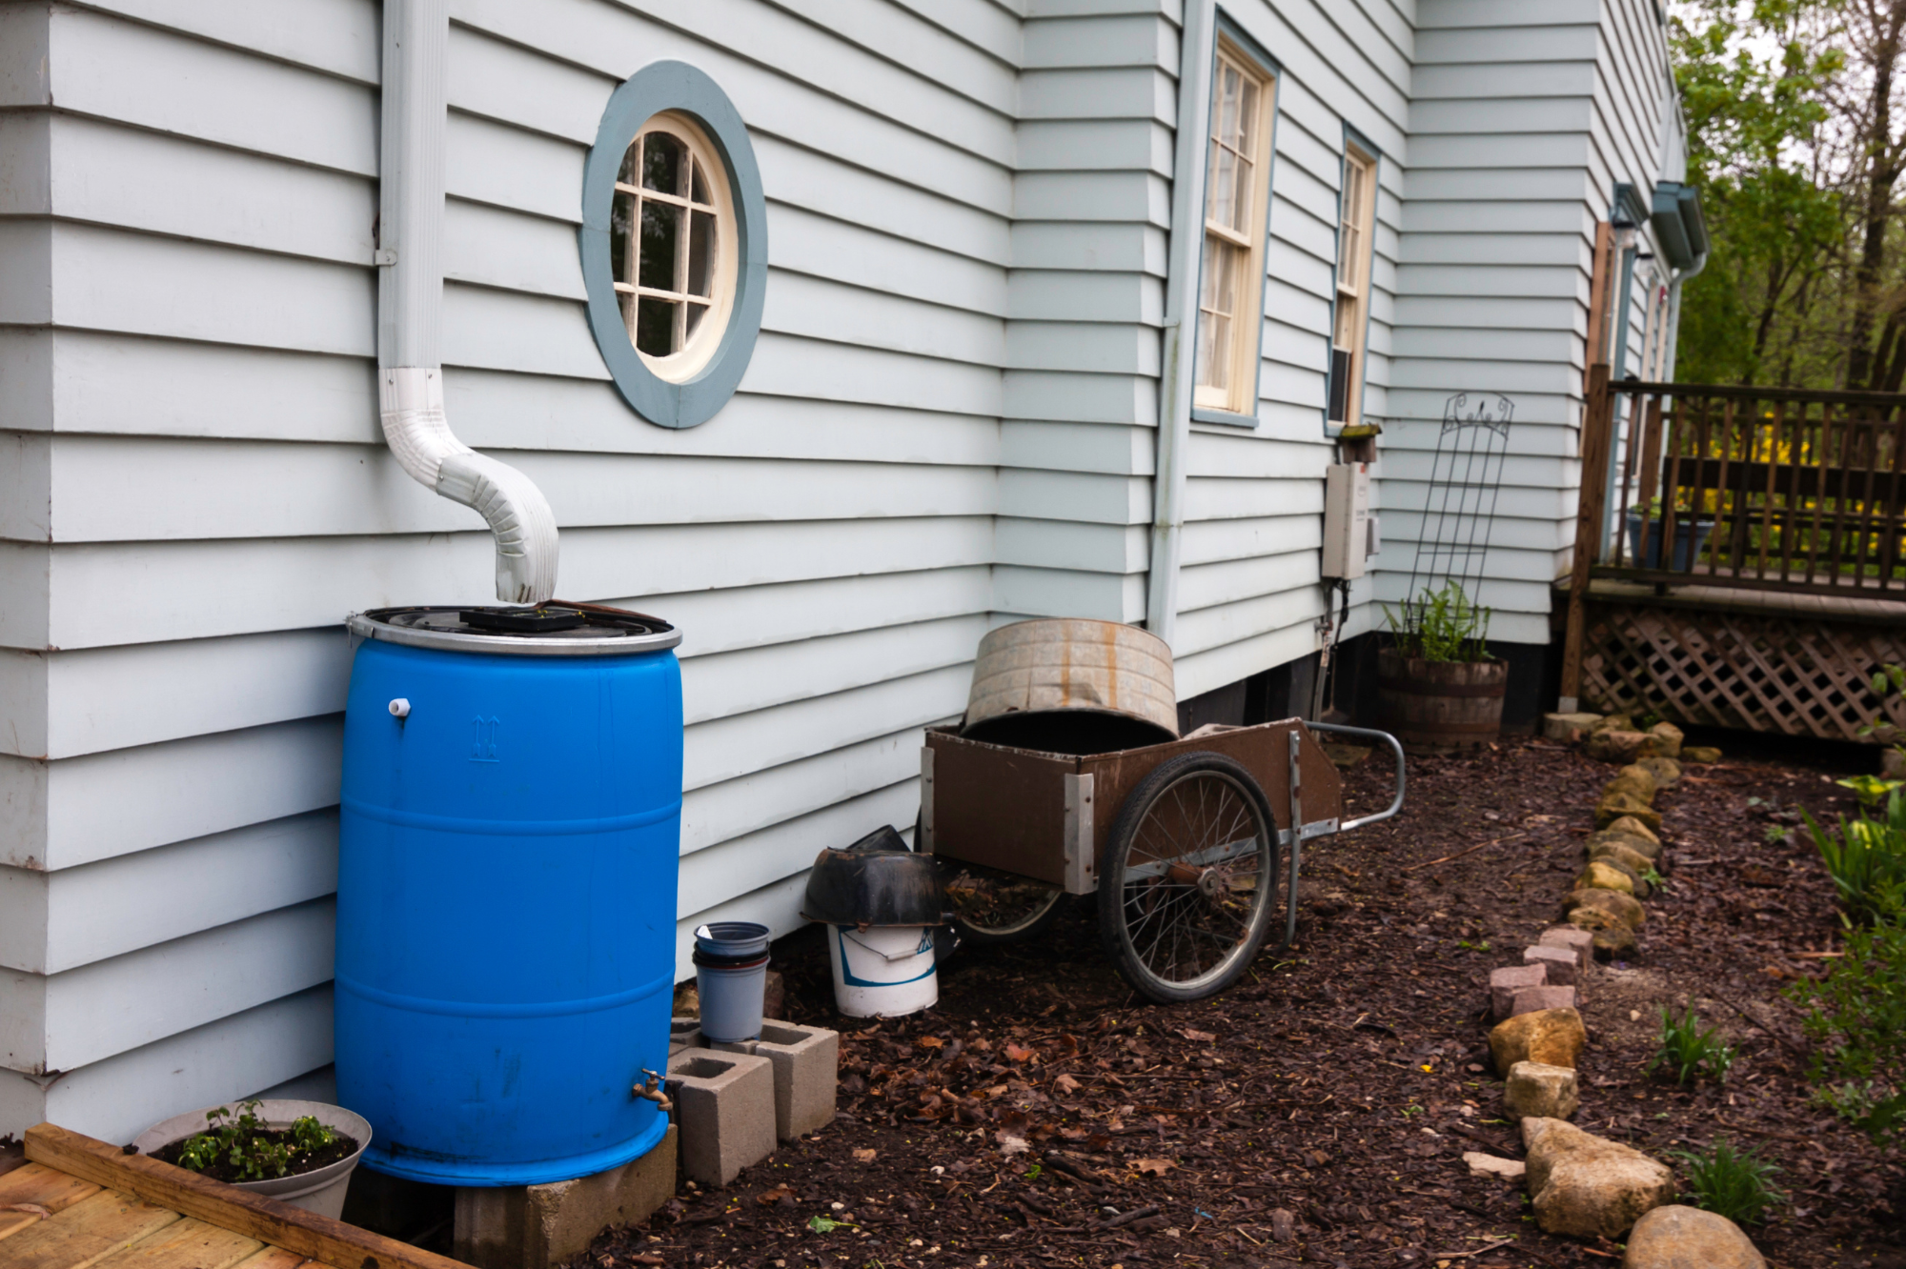
Stormwater Management
Annual workshops to educate the public about residential stormwater management practices (e.g., rain gardens, rain barrels, conservation landscaping)
Creation of Plant NoVA Natives campaign to encourage native plant purchases that reduce stormwater runoff
Serve as technical experts for local and state level stormwater policy and regulation committees

Slide 12
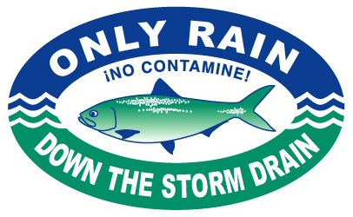
Clean Water Partners
Partnership between local jurisdictions, regional drinking water and sanitation authorities, schools, and businesses
Goal to reduce stormwater pollution to local waterways and keep residents safe and healthy
Pools funding together to conduct an annual education and outreach campaign that addresses stormwater pollution and source water protection

Slide 13
Partnership with DEQ – ChesBay WIP
PDC-EQ Contract Emphasizes Activities On Unregulated Sector/Jurisdictions
Northern Virginia Localities 100% Regulated
Do Not Require NVRC Assistance to Write Grants and Implementing Projects
NVRC Focus is on Information Gathering and Information Transfer and Coordinating With DEQ
Chair of CBP Urban Stormwater Workgroup
Member Water Quality Goal Implementation Team
Analysis of ChesBay Products
CBP Impervious vs. Local Govt Planimetric’s
CBP Septic Projections vs. NOVA Regional Projections
Northern Virginia Phase III WIP LA Assessment*
Northern Virginia Phase III WIP Regulated Area Assessment*

Slide 14
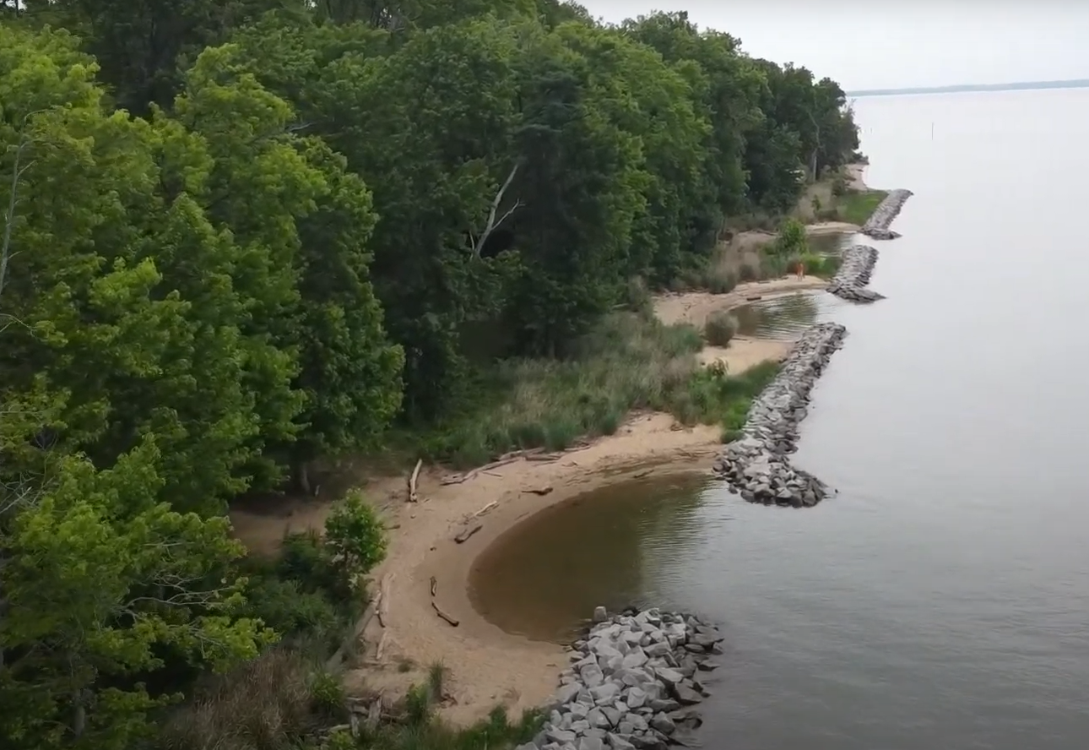
Nature-Based Solutions: Shoreline Management
Goal to adapt to sea level rise and increased flooding through green infrastructure practices that build coastal resilience
2008 – 2010: Sustainable Shorelines and Community Management Project as collaborative planning effort across jurisdictions
Collaboration on projects to restore and protect shorelines and habitat along Potomac River
Leesylvania State Park Living Shoreline Project (2017)

Slide 15
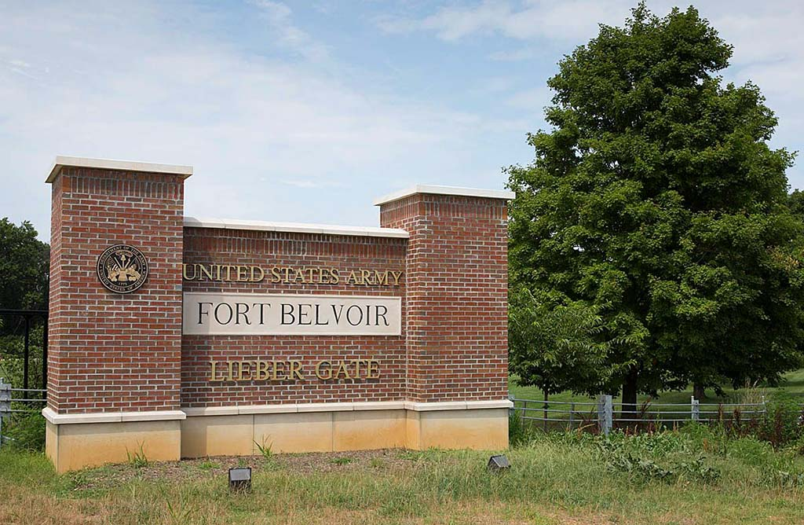
Military Installation Resilience Review
Goal: identify the risks, hazards, and vulnerabilities of concern as it relates to the ability of the military to carry out its missions on the installation that could be mitigated through investments and solutions outside the fence line in the community.
Review for three military base installations:
Joint Base Myer-Henderson Hall
Fort Belvoir
Marine Corps Base Quantico

Slide 16
Expanding Solar: Solarize NoVA
NVRC shares tools and resources to help residents and businesses go solar in the region, including a map showing solar potential of individual properties
Solarize NoVA: helps the community learn more about solar power options for their homes and businesses and facilitate the installation and financing of their own projects.
Managed by Local Energy Alliance Program with support from NVRC and other partners
As of 2022:
690 systems installed
Over $17.9 million invested from the private sector
Over 6,200 kw installed
In Alexandria:
111 systems installed
Over $2.4 million invested from the private sector
Over 818 kw installed
Solarize Dashboard HERE
Solar Energy Potential Map HERE

Slide 17
Thank You! Questions?

