Slide 1
Reducing Risk and Enabling Federal Land Reuse on the Oak Ridge Reservation
Jay Mullis, Manager, DOE-Oak Ridge Office of Environmental Management
Ken Rueter, UCOR, an AECOM-led partnership with Jacobs, President and CEO

Slide 2
Jay Mullis
Manager, DOE-Oak Ridge Office of Environmental Management

Slide 3



The Right Ingredients
Communication
Partnerships
Vision
10-Year Program Plan
Partnering agreements
Contractors
Unions
National Nuclear Security Administration
Office of Science
Goal-oriented mentality
Projects focused on progress and transformation

Slide 4
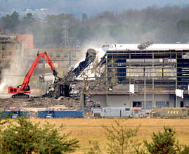
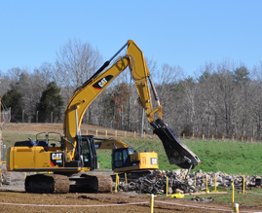
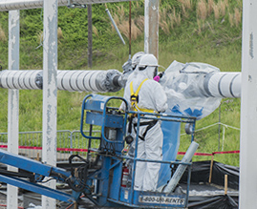
Strategic Approach
Vision 2020
All remaining facilities demolished at ETTP
Vision 2016
All five GDPs demolished
Vision 2024
Excess contaminated facility cleanup and risk reduction at
ORNL and Y-12

Slide 5
Ken Rueter
UCOR, President and Chief Executive Officer

Slide 6
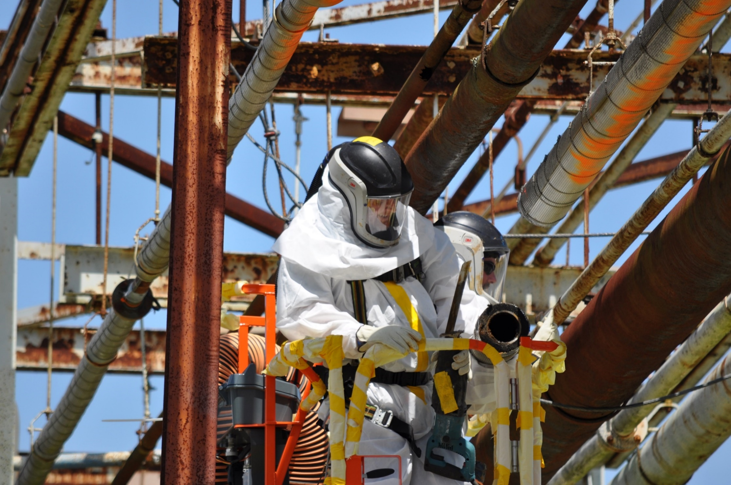

COMPLEX
ENVIRONMENTS
First-of-a-kind cleanup/demolition
Deteriorating structures
Classified components
Volumes of waste

Slide 7
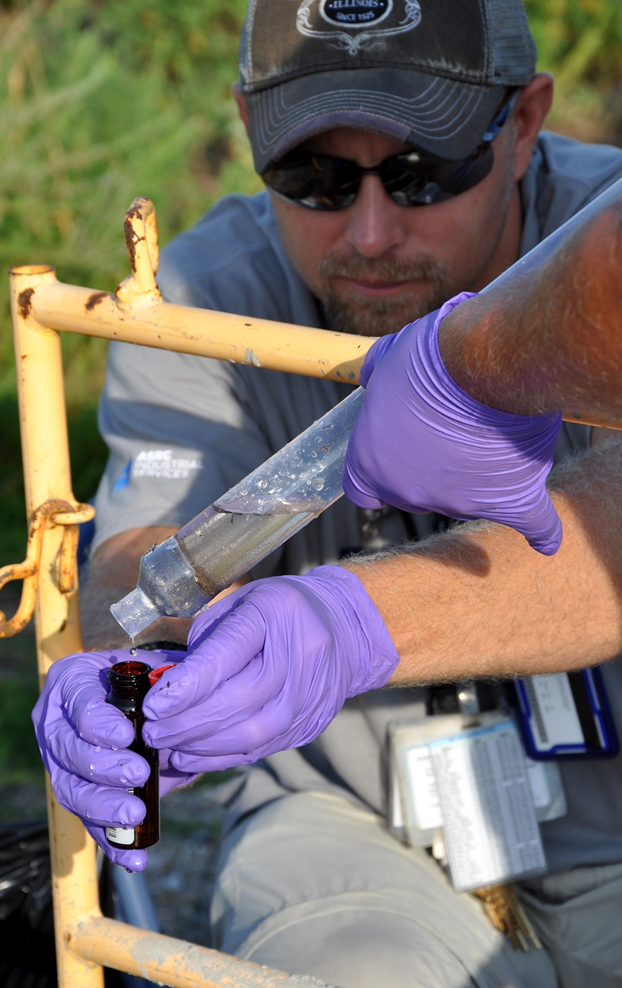

UNIQUE HAZARDS
Hydrogen Fluoride
Fluorine
Chlorine Trifluoride
Uranium Hexafluoride Pyrophorics
Shock Sensitive
Chemicals
Plutonium
High Acids/Bases
High-Dose Materials
Fuel Particles
Biological
Beryllium
Liquid Nitrogen
Asbestos
Lead
PCBs
Silica
Mercury
Freon

Slide 8
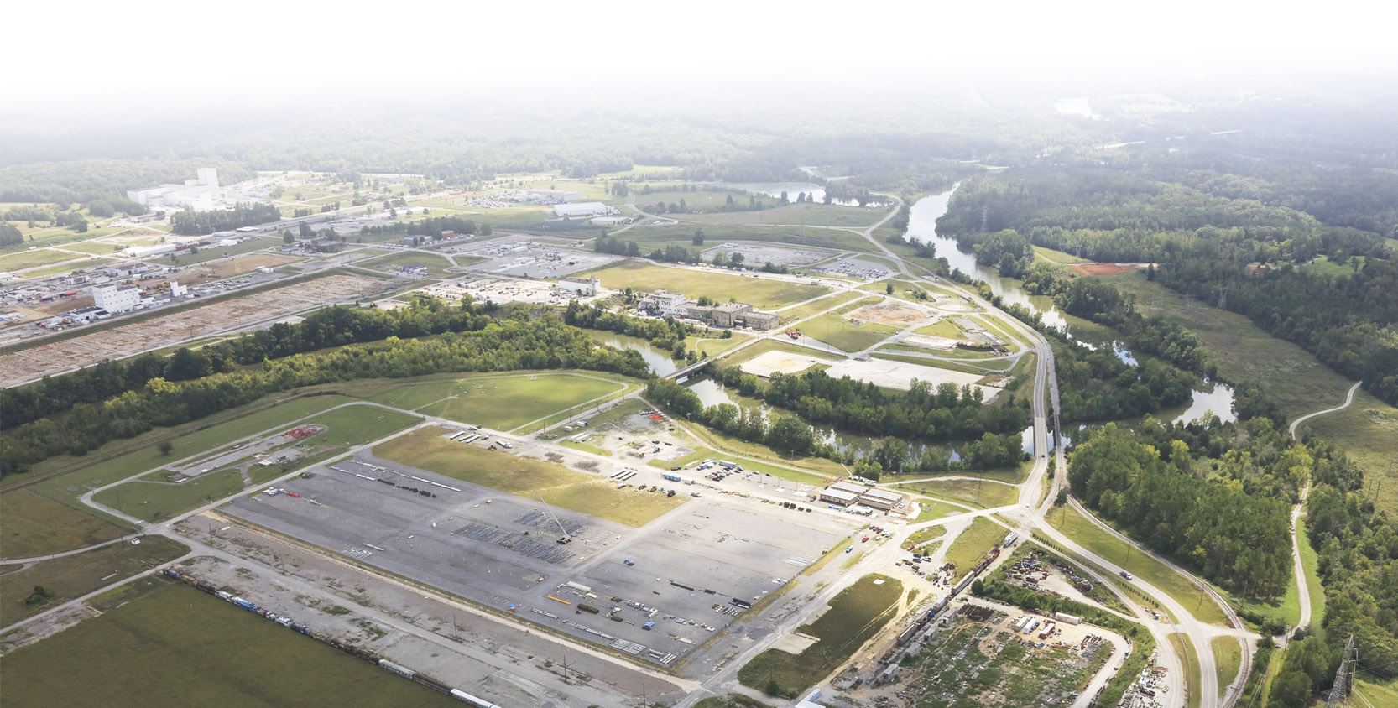
Scale and Magnitude of the Challenge
4.5M square feet demolished
~1.5M square feet to D&D
Completing Vision
2016
5,000 converters shipped offsite
Enabling Vision 2024
~10M cubic feet
of waste to dispose
137 miles piping removed
✓
57,600 waste truckloads
~311M gallons of low-level wastewater to manage/treat
Projected Amounts
1.75M square feet to demolish
Delivering Vision
2020
6.7M cubic feet of debris to dispose
3.7M cubic feet of soil to dispose
2.9M gallons water to treat
Projected Amounts

Slide 9
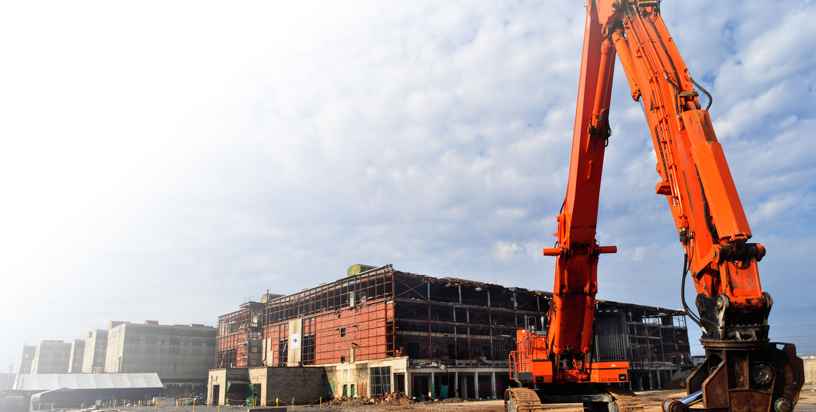
Reducing Risk –
Oak Ridge Environmental Cleanup Key Outcomes
5.5 million
square feet demolished
4.61 tons
of mercury prevented from entering the environment
28 million
cubic feet of waste disposed
782+ million
gallons of low-level wastewater managed/treated
Debris: 24M / Soils: 2.9M
By Radiological Activity
99.8%/217,411 Ci offsite
0.2%/426 Ci onsite

Slide 10
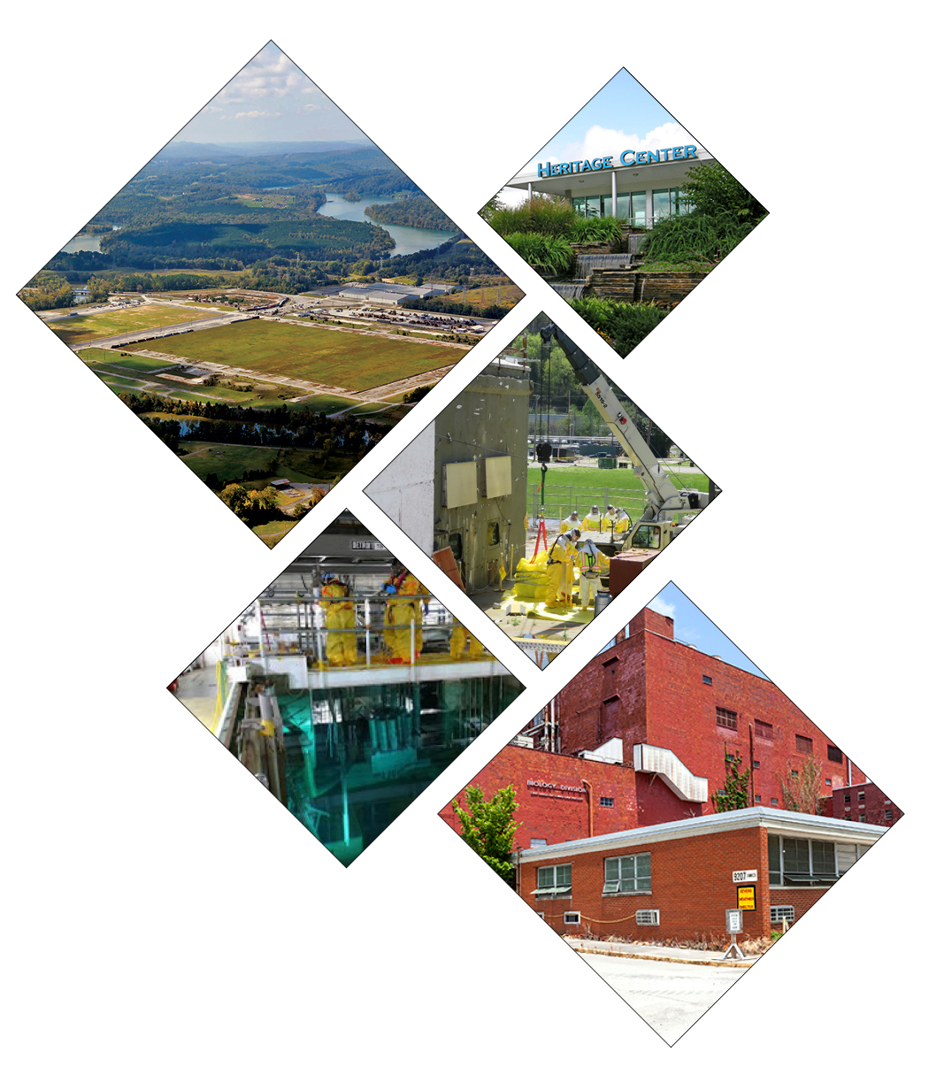
Committed to Land Reuse
ETTP
Transferred
  1,281 acres for reindustrialization
    Duct Island parcel for Coqui Pharma
  3,470 acres for conservation
Other Government Use
  K-31 site for UPF project
  K-1065 for NNSA warehouse/shipping and receiving
ORNL
Central Campus Cleanup
  Enables new missions (e.g., supercomputing, isotope production, Translational Research Capability facility)
Y-12
Biology Complex D&D
  Enables construction of new lithium facility

Slide 11
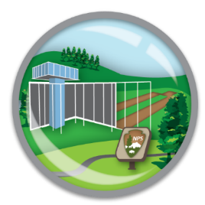


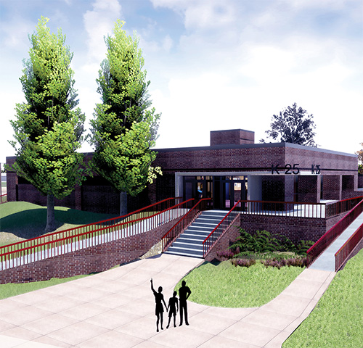
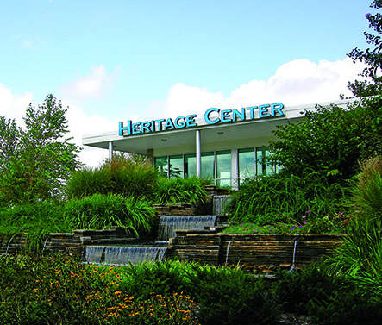
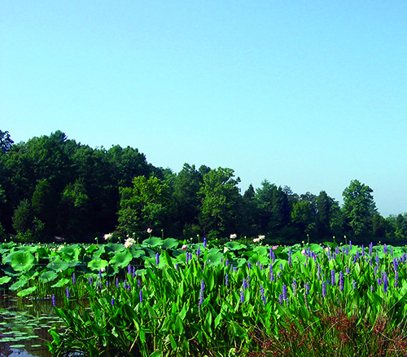
Keeping the End State in Mind
Historic Preservation
and National Park
Private Sector
Industrial Park
Conservation
Areas
~100 acres
~1,500 acres
~3,500 acres

