Slide 1
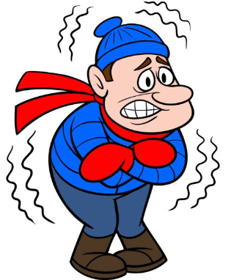
Preventing Hypothermia in Trauma Patients
Notes:
Did you know that 57% of trauma patients arrive at the hospital too cold? Hypothermia is a major complication for these patients.

Slide 2
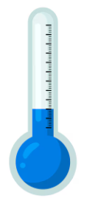
Hypothermia: big problem for trauma patients
One study found that 57% of trauma patients arriving at a trauma center had some level of hypothermia
Mortality has been reported to range between 40-100% when trauma patient core temperature falls below 90°F (32.2°C)
Notes:
Mild hypothermia begins below 95 deg F
Moderate is 89.5 – 82.4 deg F
Severe is 82.3 – 75.2 deg F
Profound is anything less than 75.2 deg F

Slide 3
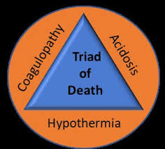
Hazards of hypothermia in trauma patients
Disrupts formation of blood clots
Slows metabolism that creates energy for cells
Limits enzymatic reactions which are important parts of cellular metabolism
Worsens acidosis
Notes:
Trauma patients already have blood loss and risk of coagulation problems.
Slower metabolism and less energy to cells also means less heat production which worsens the hypothemia.

Slide 4
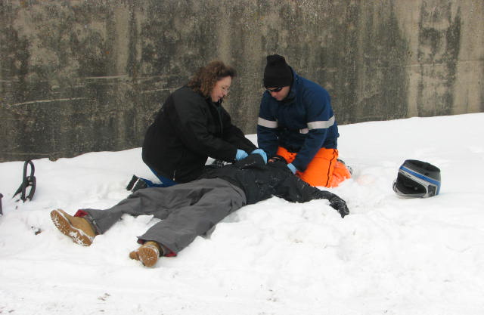
Factors that place trauma patients at higher risk for body heat loss
Laying on cold, wet ground
Wet clothing (blood, rain, sweat)
Thermoregulatory deficiencies related to current illness/ injury
Thermoregulatory deficiencies related to pre-existing conditions
Inability to shiver due to lack of energy/shock
Exposure to elements during assessment and care
Cool IV fluids
Notes:
Being in the cold, wet environment is one of the biggest overlooked risks for hypothermia.

Slide 5
Signs of hypothermia
Signs of hypothermia vary greatly depending on patient, situation, and degree of hypothermia but may include:
Shivering
Cold, pale skin
Loss of coordination
Speech slurring
Confusion
Lethargy
Muscle stiffness
Decreased HR, RR, BP
Decreased level of consciousness

Slide 6
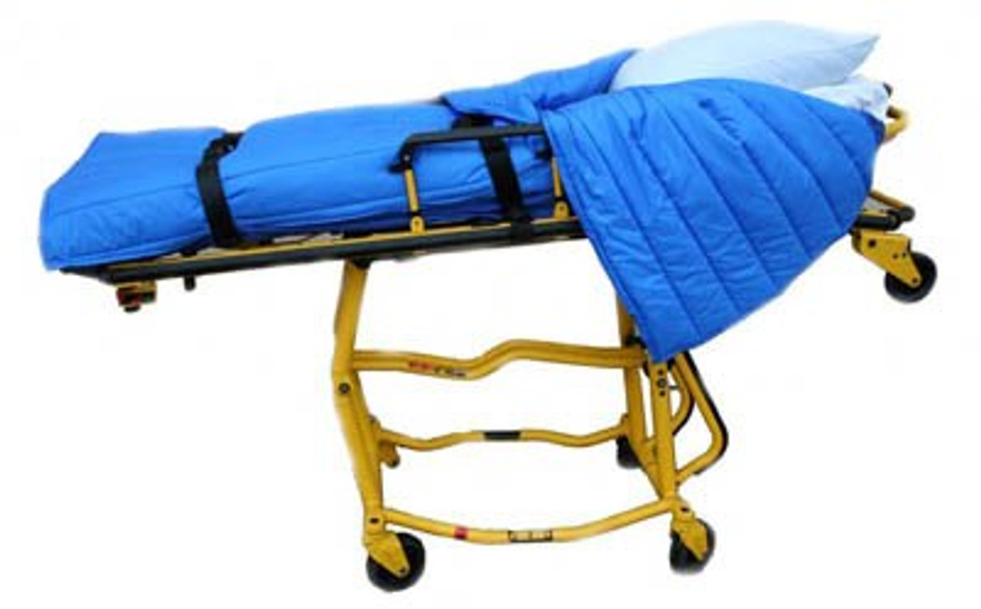
What can we do to limit the risk of hypothermia?
Move the patient from the cold ground or place a blanket under them if unable to move right away
Remove any wet or damp clothing
Limit exposure to elements after examinations and interventions – cover them back up!!
Notes:
EMS providers often leave wet clothing on patients out of concern for their privacy but removing those clothes is critical for limiting heat loss. Trauma patients must also be exposed to check for injuries. Be prepared to cover them back up quickly but don’t skip the step of removing clothing.

Slide 7
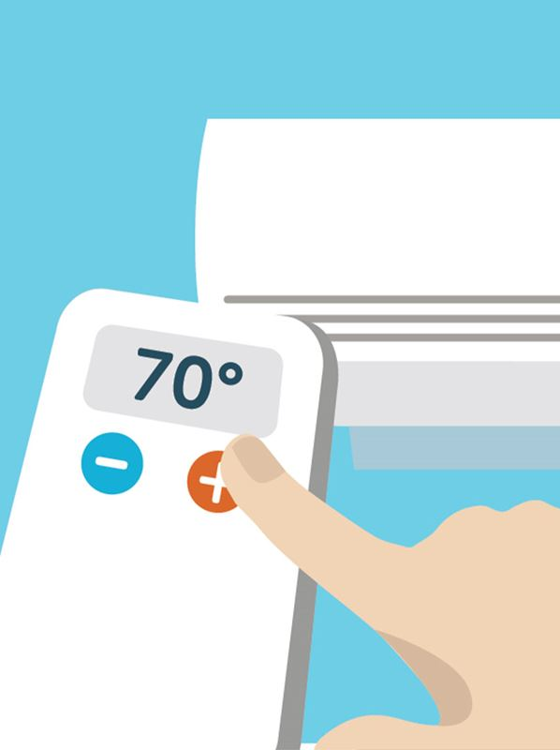
What can we do to limit the risk of hypothermia?
Heat the patient compartment of the ambulance.
IV fluids warmed to 100-108°F (37.8-42.2°C)
Keep equipment warm – backboards, splints, stretcher, blankets
Place IV lines, oxygen tank and oxygen tubing under blankets
75°F
Notes:
Keep the back of the ambulance warm to help limit heat loss for the patient but no so hot that it is too uncomfortable for caregivers and affects their work. The Wilderness Medical Society recommends 75 deg. F (24 dec C).
Keep the stretcher, blankets and other equipment in the warm ambulance until they are needed.
Follow local protocols and IV warmer instructions for specific temperature instructions.

Slide 8
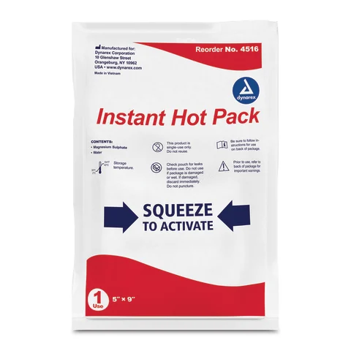
Active rewarming
Per service protocols or on-line medical control
Chemical or electric/battery heat packs or blankets
Chest, arm pits, and back
Insulate from the patient’s skin
Forced air heating products (Bair Hugger)
Monitor the patient closely and maintain ABCs
Notes:
Document all measures taken to preserve body temperature including active rewarming.

Slide 9
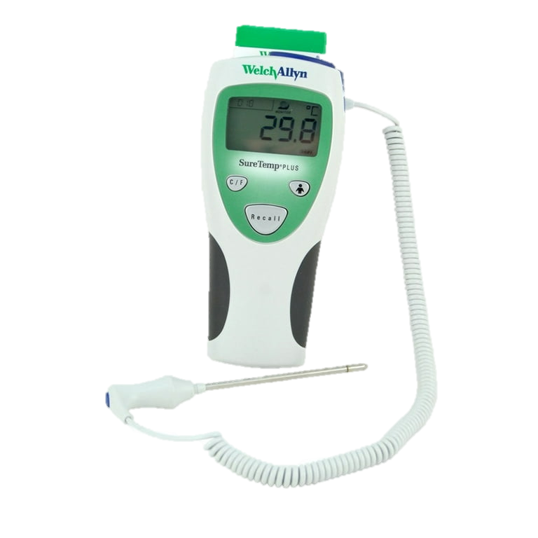
Should I take a temperature?
Pre-hospital temperature readings tend to be inaccurate
Focus should be on identifying the risk for hypothermia, maintaining ABCs and taking steps to prevent additional heat loss
Let the hospital know that the patient is at risk for hypothermia
If a temperature is recorded, be sure to include the method used, i.e. temporal scan, tympanic (ear), forehead, oral, arm pit, rectal, etc.
Notes:
Many thermometer inaccuracies are caused by improper use. Be sure you are following manufacturer’s instructions.

Slide 10
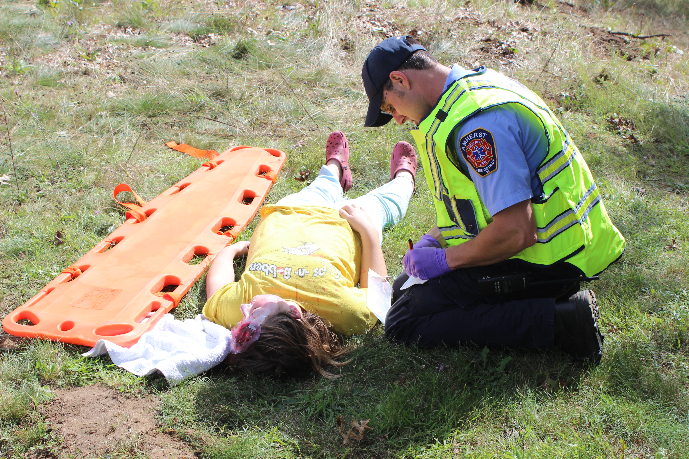
Heat loss is a year-round issue
Heat loss and hypothermia are not limited to winter and cold temperatures
Heat loss, especially when a patient is wet, can occur at any time of the year
Prevention measures should be considered year-round
Notes:
The gradient between body temperature and the temperature of the air or ground is not quite as big during the summer but it still exists.
Think of a wet patient whose normal body temperature is 98.6 deg F laying on ground that is 60 or even 70 deg. The cooler surface will still draw heat from the patient, especially if they are wet.

Slide 11
Thank you
PHTLS: Prehospital Trauma Life Support (10th ed.). (2023). Jones & Bartlett Learning.
Dow, J. (2020). 2020 Hypothermia Clinical Practice Guideline. https://wms.org/magazine/magazine/1260/2020hypothermia-CPG/default.aspx

