Slide 1
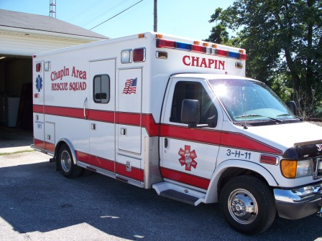
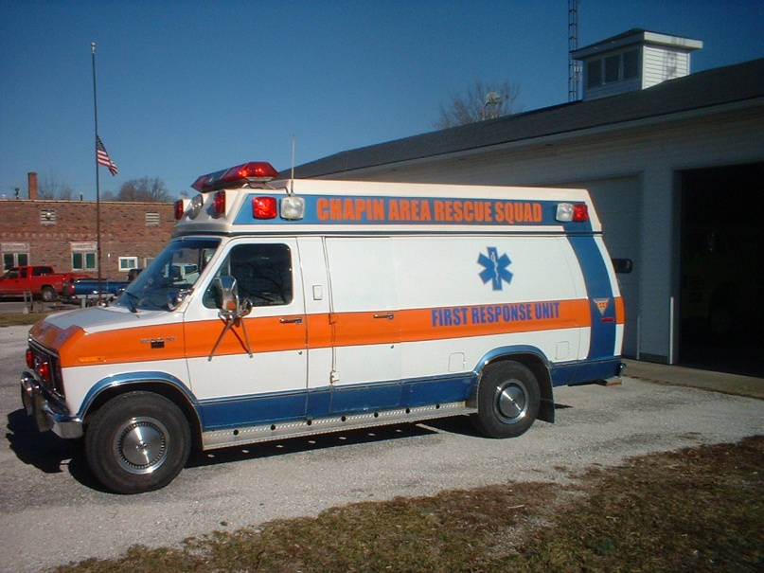
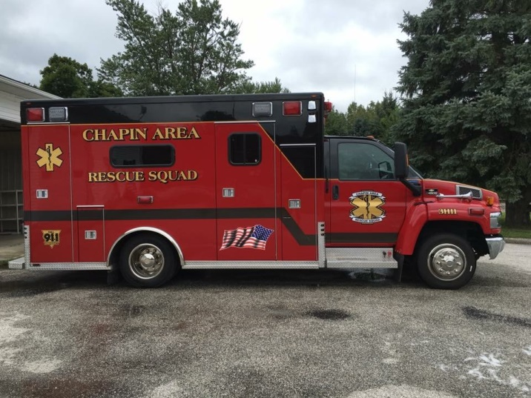
Chapin Area Rescue Squad Bloodborne Pathogen and Infection Control Plan
Bloodborne Pathogen Training

Slide 2
Bloodborne Pathogen Training
Employees must report any occupational accident, illness, or hazardous exposure to their supervisor AND to the Designated Infection Control Officer (DICO)
Contact the DICO if you have any questions

Slide 3
Bloodborne Pathogen Training
Use Engineering Controls to Reduce Risk of Bloodborne Pathogen Exposures from Needlesticks
  When feasible , “safety” syringe/needle systems will be used to reduce the risk of a contaminated needlestick exposure (when the needle will pierce human skin or be used with human blood, cells, body fluids, infectious agents, etc.) This requirement applies to clinical and laboratory (research) activities. When such contamination risk will not be present, ordinary syringe/needle systems should be used.

Slide 4

Bloodborne Pathogen Training
Village of Chapin Bloodborne Pathogen
Exposure Control Program
A Written Plan – available at the Village Hall, also includes a Respiratory Protection Program
Identifying Those at Risk
BBP Training
Preventing Exposures
Evaluating & Treating Exposures
Properly Disposing of Waste

Slide 5
Bloodborne Pathogen Training
In addition to blood, other fluids may also present an
infection risk. OSHA defines these as “Other Potentially
Infectious Materials” or OPIM. These are listed below.
Synovial Fluid Pleural Fluid
Semen Amniotic Fluid
Peritoneal Fluid Saliva in Dental Procedures
Pericardial Fluid Vaginal Secretions
Cerebraspinal Fluid HIV or HBV Cultures
Bloody Body Fluids Unfixed Tissue

Slide 6
Bloodborne Pathogen Training
Bloodborne Pathogens are micro-organisms that are
present in human blood and cause diseases in humans.
Commonly we emphasize Hepatitis B and HIV (Human
Immunodeficiency Virus) in the Emergency Medical Treatment environment.
There are others.

Slide 7
Bloodborne Pathogen Training
Employer Responsibilities Include
Implementing a written plan.
Enforcing good work practices that include disinfecting surfaces, following universal precautions, and proper waste disposal.
Controlling exposures through the use of needle buckets, biosafety cabinets, needleless IV systems, and self-sheathing needles.
Training employees initially and through annual updates.
Providing Personal Protective Equipment (PPE): gloves, gowns/aprons, eye protection (i.e., goggles, faceshields, side shields) and surgical mask
Identifying hazards by proper labeling of: incubators, freezers and centrifuges
Managing medical wastes

Slide 8
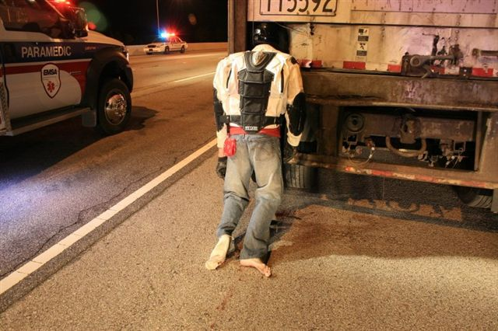
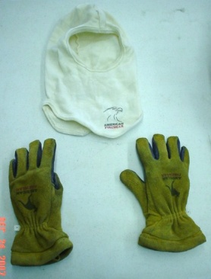
Bloodborne Pathogen Training
Individual Responsibilities
Your Actions are key to good exposure control. These
include:
Attending training.
Complying with and enforcing the Village of Chapin Exposure Control Plan.
Segregating medical waste properly.
Properly selecting, wearing, removing, and disposing of
Personal Protective Equipment (PPE).

Slide 9
Bloodborne Pathogen Training
Hepatitis B Virus (HBV),
Hepatitis C Virus (HCV), and
Human Immunodeficiency Virus (HIV)
Bloodborne viruses
Can produce chronic infection
Transmissible in healthcare settings
Data from multiple sources (e.g., surveillance, observational studies, serosurveys) used to assess risk of occupational transmission

Slide 10
Bloodborne Pathogen Training
Risk of Bloodborne Virus Transmission after
Occupational Percutaneous Exposure
Source
HBV
HBeAg +
HBeAg -
HCV
HIV
Risk
22.0-30.0%
1.0-6.0%
1.8%
0.3%

Slide 11
Bloodborne Pathogen Training
Preventing Transmission of Bloodborne Viruses in Prehospital Settings
Promote hepatitis B vaccination
Treat all blood as potentially infectious
Use barriers to prevent blood contact
Prevent percutaneous injuries
Safely dispose of sharps and blood-contaminated materials

Slide 12
Bloodborne Pathogen Training
Factors Influencing Occupational
Risk of Bloodborne Virus Infection
Prevalence of infection among patients
Risk of infection transmission after a blood exposure
Nature and frequency of blood exposures, for example splash to mucous membranes, cut, needlestick, skin contamination, quantity of blood involved and concentration of organism in the blood

Slide 13

Bloodborne Pathogen Training
Hepatitis B - Symptoms
Only a small portion of acute Hepatitis B infections may be clinically recognized.
Symptoms include:
Anorexia or loss of appetite
Vague abdominal discomfort
Nausea and vomiting
Sometimes arthralgias and rash
Jaundice or yellowing of the skin
Fever which may be absent or mild

Slide 14
Bloodborne Pathogen Training
Hepatitis B – Modes of Transmission
Hepatitis B can be transmitted in three ways:
Sexual transmission
  Either homosexual or heterosexual
Parenteral
  Such as an injury with needles and sharps
Perinatal
  - Virus can be transmitted from a mother to her infant during pregnancy

Slide 15
Bloodborne Pathogen Training
Hepatitis C Virus
Most common chronic bloodborne infection in U.S.
3.9 million Americans (1.8%) have current or past infection with HCV
40% of chronic liver disease HCV-related, leading to 8-10,000 deaths annually
HCV-associated end-stage liver disease most common indication for liver transplants in U.S. adults

Slide 16
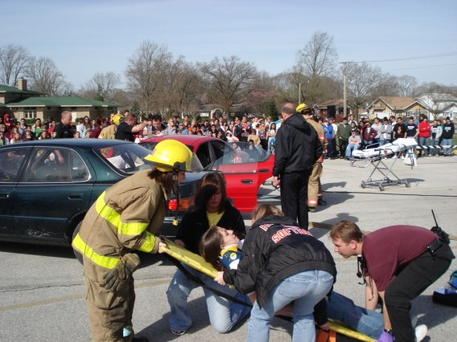
Bloodborne Pathogen Training
HCV Transmission in Prehospital Settings
Risk factors for occupational transmission not well defined
Environmental transmission not believed to be important - HCV rapidly degrades at room temperature
Neither presence of antibody nor HCV RNA is a direct measure of infectivity

Slide 17
Bloodborne Pathogen Training
Prevalence of HCV Infection in HCW
United States
Group % Infection
Hospital-based (pre-1980) 1-2
Oral surgeons (1992) 2
General surgeons (1991-1992) 1
Orthopedic surgeons (1991) 1
General dentists (1992) 1
Emergency response (1991-2000) 1-3
General population of adults 1.8

Slide 18
Bloodborne Pathogen Training
Postexposure Prophylaxis for HCV
Not recommended after exposure
  Immunoglobulin not effective
  No data on use of antivirals (e.g., interferon), which may be effective only with established infection
  Antivirals not FDA approved for this use
No guidelines for therapy during acute infection
  When HCV infection identified early, refer to a specialist for proper management

Slide 19
Bloodborne Pathogen Training
HIV – Symptoms
“Within several weeks to several months after infection
with the human immunodeficiency virus (HIV), many
people develop an acute self-limiting mononucleosis-like
illness lasting for a week or two.
Infected people may then be free of clinical signs for
Many months to years before clinical manifestations,
Including opportunistic infections and constitutional and
neurological symptoms appear”.
American Public Health Association Acquired Immunodeficiency Virus, Benenson, AS, ed, Control of Communicable Diseases Manual, Washington, 1995.

Slide 20

Bloodborne Pathogen Training
HIV – Modes of Transmission
Blood Contacts – needlesticks and exposure of skin and mucous membranes
Sexual Contact – exchange of vaginal secretions and semen
Mother to Infant – transmission can occur throughout the perinatal period – during pregnancy, at delivery & through breastfeeding
Although other modes of transmission (i.e., mosquitoes and kissing) have been suggested, none have been substantiated as distinctly different as those mentioned above.

Slide 21
Bloodborne Pathogen Training
HIV – No Vaccine Available
Research continues toward the development of an “AIDS” vaccine.
There is no vaccine available for the prevention of HIV infection.

Slide 22
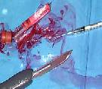
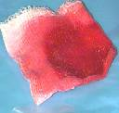
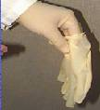
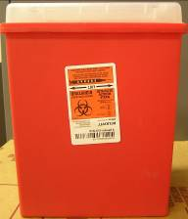
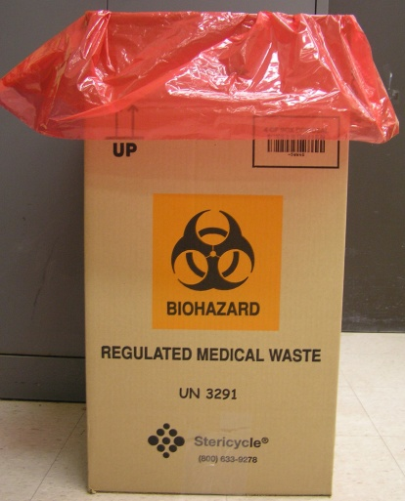

Bloodborne Pathogen Training
Segregating Medical Waste

Slide 23
Bloodborne Pathogen Training
Protective Equipment
How do I choose appropriate protective equipment?
First, determine the potential for contact with blood and
other potentially infectious materials or OPIM. Then select the items that will prevent your skin, mucous membranes, and clothing from becoming contaminated.

Slide 24
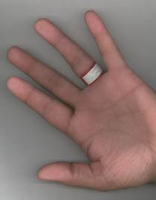
Bloodborne Pathogen Training
I’ve Been Stuck!!
Promptly wash or flush the affected area and notify your supervisor! The CDC currently recommends treatment within 2 hours of exposure.

Slide 25
Bloodborne Pathogen Training
Where do I go to be evaluated and treated?
Attempt to contact the chief. If you believe that an exposure has taken place, do not hesitate to be seen at Passavant Hospital in the Emergency Department.
Once at the hospital, tell the registration clerk that you are to be seen under the Village of Chapin as an employee compensation claim. There is additional paper work that must be filled at the Village Hall, but do not wait to be seen at the ED.
Passavant Hospital Emergency Department
245-9541 x3366

Slide 26
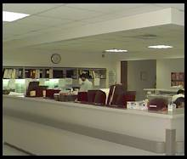
Bloodborne Pathogen Training
Where do I go to be evaluated and treated?
The Emergency Department will provide post-exposure treatment for occupational exposures and any other follow up treatment.
The Emergency Department will assess the exposure and administer appropriate therapy.
The Emergency Department is located at 1600 W. Walnut Street in Jacksonville.
Emergency Department
x3366

Slide 27
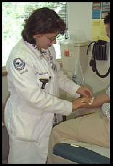
Bloodborne Pathogen Training
When should I be evaluated?
Promptly! You need to be evaluated as soon as possible after the exposure so that the severity of the injury can be assessed.
Serious exposures will require the initiation of drug therapies that are believed to be most effective when given within a few hours of the exposure.

Slide 28
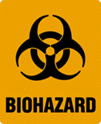
Bloodborne Pathogen Training
Signs & Labels
The biohazard symbol is reserved for indicating material with potential infection risks.
For CARS universal precautions are used – all samples with blood/body fluids are considered infectious.

Slide 29
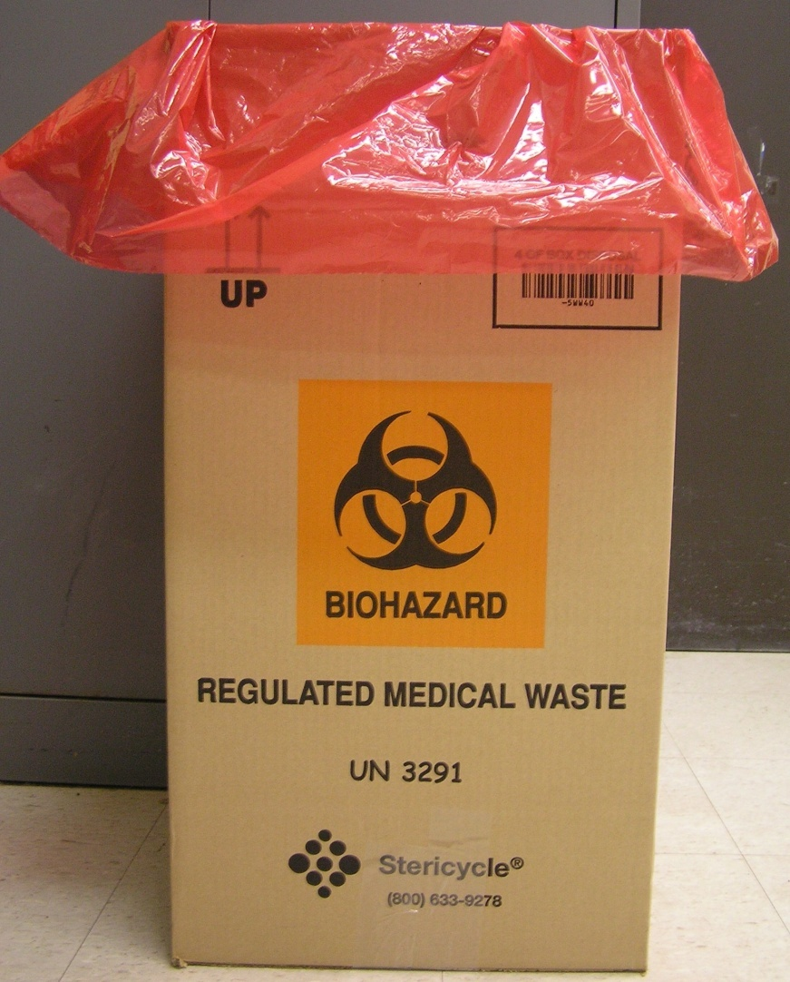
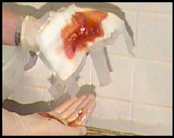
Bloodborne Pathogen Training

Slide 30
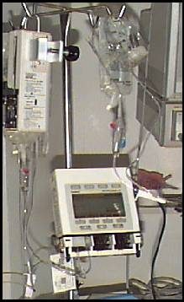
Bloodborne Pathogen Training
Other Issues
Remember to remove all sharps before disposing of IV tubing.
IV tubing and bags should be disposed of in Regulated Medical Waste (RMW).

Slide 31
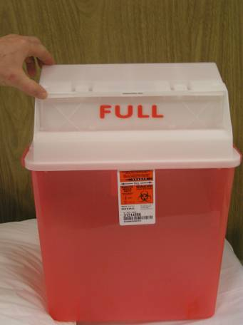
Bloodborne Pathogen Training
Other Issues
Sharps containers must be changed frequently enough so that they never become overfilled. To reduce the potential of injury due to an overfilled container, replace the sharps container when it is ¾ full.

Slide 32
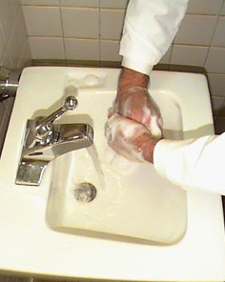
Bloodborne Pathogen Training
Other Issues
One of the best techniques for infection control is using plenty of soap and water when washing your hands!

Slide 33
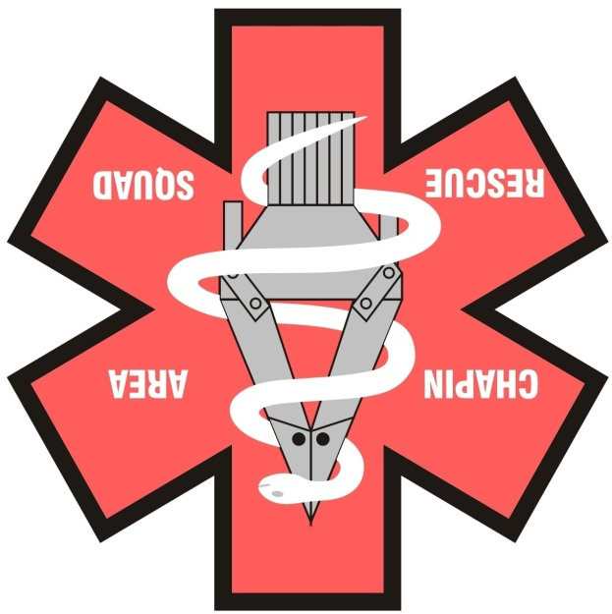
Bloodborne Pathogen Training
Conclusion
You are at risk for occupational exposure to Bloodborne Pathogens.
The Village of Chapin Exposure Control Plan outlines the steps necessary to reduce infection risk. This plan is available from Village Hall.
When accidents occur, prompt medical attention is necessary. The CDC recommends treatment within 2 hours.
Prevention is the key.

