Slide 1
Continuing Education Discussions
IIPS Conference
July 16-18, 2012
Rosallene Massey – CE SME (East)
Wayne Madry – CE SME (West)

Slide 2
Objective
Troubleshoot and develop possible generic technical solutions to workflows and processes topics
Identify Student Applications (modules) with impact to CE workflows, which are not being utilized fully
Develop strategies and support to present solutions for evaluation, implementation, and/or software adjustments/changes for CIS applications
Assess time management for topics within CIS.

Slide 3
TOPICS
Repeat Process
  COCO
  Demonstration
HDT Process
  Screenshots
  Issue to the best of your ability
  Emergency vs High vs Medium
XUIC Process
  Who does it at your College
  2012 Program Area Code Changes
New Fee Waiver Code
  Tuition Remission Report
  Query for Codes
  Statutory Waived Codes
Setting up Clinical Courses
  Clinical Sites
  Section Setup
Basic Skills Plus
CC Listings for Email

Slide 4
Customer Support
Training Needs
http://www.nccommunitycolleges.edu/Training/CIS_Training/CISTrainingHomePage.html
CIS Documentation
http://www.nccommunitycolleges.edu/CIS_Dos/index.html
Training Needs web link accesses 90-Day Training Calendar
If you have a specific training need, contact System Office at (919) 807-7178

Slide 5
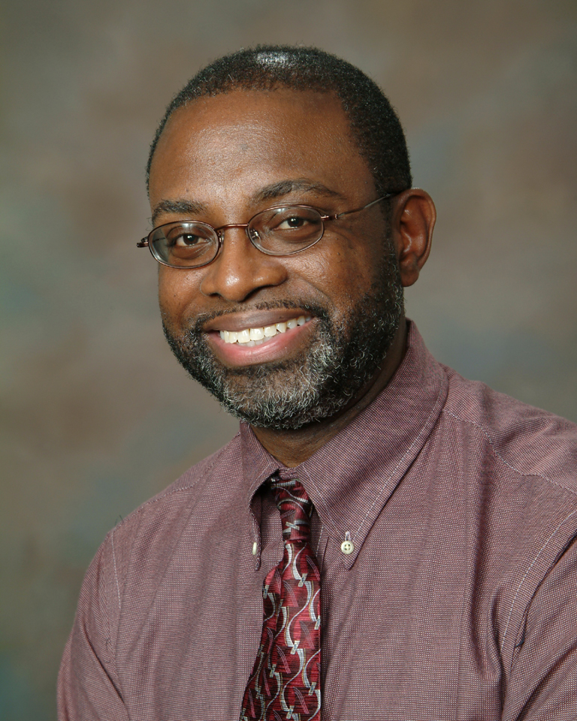
Any Questions?
Business System Analyst, CE/BSP
Mitchell Community College
(704) 978-5433
(919) 807-7178

