Slide 1
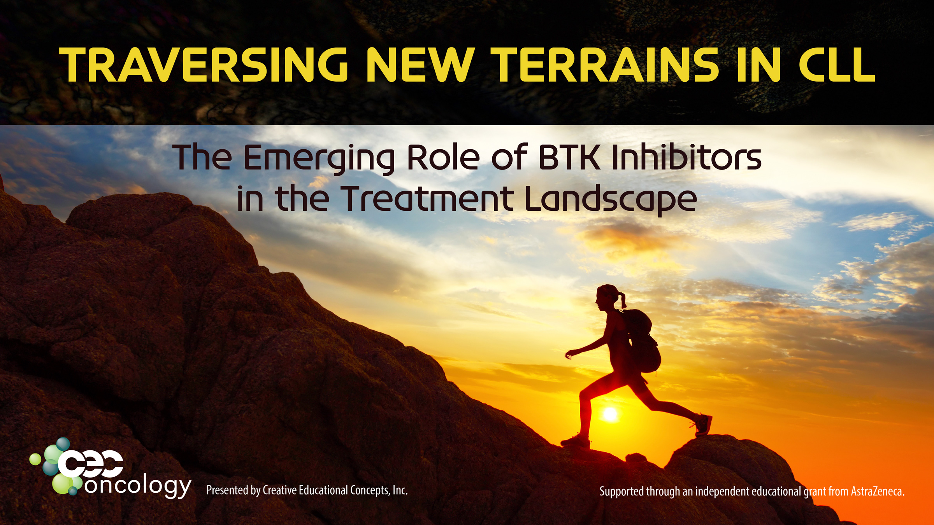

Slide 2
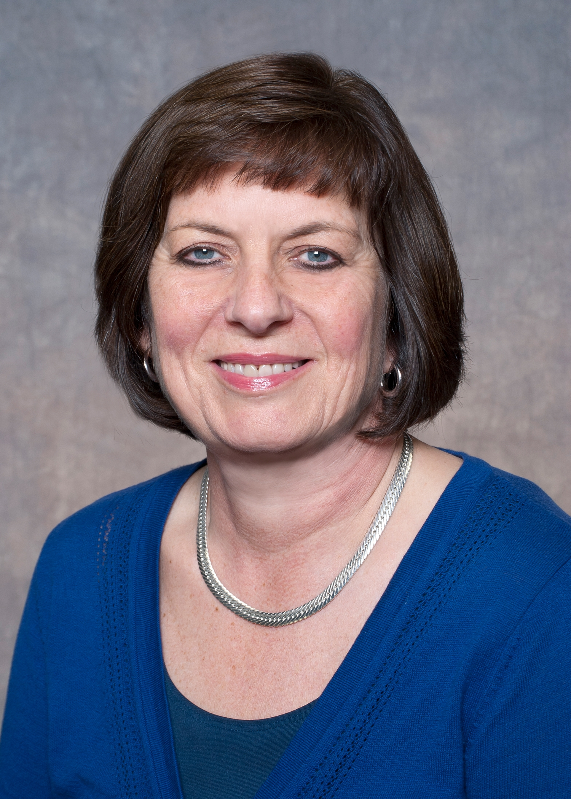
Barbara Rogers, CRNP, MN, AOCN, ANP-BC
Fox Chase Cancer Center
Philadelphia, Pennsylvania
Notes:
0:08 My name is

Slide 3

Special Thanks!
Presented by
Supported through an independent educational grant from AstraZeneca.
Notes:
0:15 special thanks to

Slide 4

CNE Certification
This activity is approved for up to 1 ANCC contact hour.
Notes:
0:28 this activity is

Slide 5
Learning Objectives
Describe the role of the B-cell receptor (BCR) pathway in the survival and proliferation of cancer cells and the rationale for targeting this pathway in CLL/SLL.
Examine the latest efficacy data on the use of BTK inhibitors in treatment-naïve and relapsed/refractory CLL and review the most recent guideline recommendations for CLL/SLL management.
Discuss the unique adverse events that may arise with the use of BTK inhibitors and explore evidence-based strategies to ensure the timely recognition and proper management of these adverse events.
Using a case-based approach, evaluate effective strategies that oncology nurses can employ to optimize therapy, anticipate and manage toxicities, improve adherence to oral chemotherapy and promote collaborative discussion with other members of the oncology care team to ensure optimal CLL patient outcome and shared decision-making.
Notes:
~0:35 - Our learning objectives are

Slide 6
Demographic and Pre-test Questions

Slide 7
What is your practice setting?
Academic Medical Center
Community Cancer Center/Hospital
Private Practice
Government
Other

Slide 8
What is your specialty?
Primarily thoracic
General oncology with thoracic
Hematologic Oncology
Other solid tumors

Slide 9
JC is a 74-year-old female who was diagnosed with CLL 3 years ago. No therapy was started at the time. She now presents with progressive symptoms (bulky disease, B symptoms), and FISH reveals del(17p).
What is the best first-line treatment option for this patient?
Ibrutinib
Acalabrutinib
Venetoclax + obinutuzumab
All the above are appropriate options
Notes:
37:52 so lets think about her again… shes 74…

Slide 10
JC was on ibrutinib therapy for over a year. She now presents with progressive symptoms, and molecular analysis finds a BTK C481S mutation present.
What is the best treatment option JC at this time?
Ibrutinib dose should be increased
Switch to a different BTKi (i.e., acalabrutinib)
Switch to venetoclax + rituximab
Add obinutuzumab to ibrutinib therapy
Notes:
43:55 So shes a 74 year old female

Slide 11
Which of the following statement(s) are true regarding arthralgias and BTK inhibitors?
Management should consist of acetaminophen and/or a short course of prednisone
Arthralgias usually do not occur until late in the course of therapy
Acalabrutinib is a more selective BTKi than ibrutinib, resulting in fewer off-target adverse events, such as arthralgias
Both A and C are correct
Notes:
49:32 So which of the following statements are true regarding arthraligas…

Slide 12
EP is a 64-year-old male with relapsed CLL who initiated acalabrutinib 100 mg PO twice daily 2 weeks ago. He presents to clinic with complaints of daily headaches.
Which of the following would be the best response?
The headache is unlikely to improve with continued therapy and alternative treatment is warranted
Continue acalabrutinib and add supportive care, such as acetaminophen and caffeine, and counsel him that headaches are often transient and resolve within 4–8 weeks
Reduce dose to 100 mg PO once daily based on package insert dosing
High-dose NSAID therapy is the safest and most effective treatment for acalabrutinib induced headache
Notes:
51:22 And so again this is our 64 year old male…

Slide 13
Targeting the BCR Pathway in CLL
A Novel Approach
Notes:
1:39 - So targeting the BCR pathway

Slide 14
Chronic Lymphocytic Leukemia
Overview
Most common leukemia in the Western world
    >20,000 new cases/year in the United States with ~4,000 deaths
Median age at diagnosis = 70 years
Heterogeneous disease with wide-ranging clinical course
Strongest tendency of leukemias for family aggregation
Incurable with standard chemotherapy
Small, mature lymphocytes accumulated in peripheral blood and/or bone marrow (CLL) or primarily in lymph nodes and bone marrow (SLL)
Brown JR. Expert Rev Hematol. 2008; Nosari A. Mediterr J Hematol Infect Dis. 2012;
https://seer.cancer.gov/statfacts/html/clyl.html; NCCN. CLL/SLL Guidelines. v4.2020.
Notes:
1:45 To just step back a little bit

Slide 15
Chronic Lymphocytic Leukemia
Signs, Symptoms and Treatment
In the absence of symptoms, “watch and wait” approach, with treatment being beneficial if symptomatic or showing disease progression.
  Severe fatigue
  Night sweats
  Weight loss
  Fever without infection
  Progressive anemia/thrombocytopenia
  Progressive bulky disease
“B symptoms”
Brown JR. Expert Rev Hematol. 2008; Nosari A. Mediterr J Hematol Infect Dis. 2012; NCCN. CLL/SLL Guidelines. v4.2020.
Notes:
3:31 So in looking at signs and symptoms for treatment

Slide 16
Genetic Abnormalities in CLL/SLL
Guiding Prognosis and Treatment Modalities
Genomic aberration | Prognosis
Deletions in 13q14 | Favorable
Deletions in 14q32.33 | Favorable
IGHV mutation | Favorable
Del(6q) | Intermediate
Trisomy 12 | Intermediate
Deletion in 17p13 | Unfavorable
Deletions in 11q22 (ATM) | Unfavorable
Complex karyotypes | Unfavorable
Elevated beta-2 microglobulin | Unfavorable
TP53 mutation (vs wild-type) | Unfavorable
Yeung CC, Shadman M. Curr Oncol Rep. 2019; NCCN. CLL/SLL Guidelines. v4.2020; Gentile M, et al. Haematologica. 2009.
Notes:
4:17 So in looking at prognositic factors and some of the genetic abnormalities

Slide 17
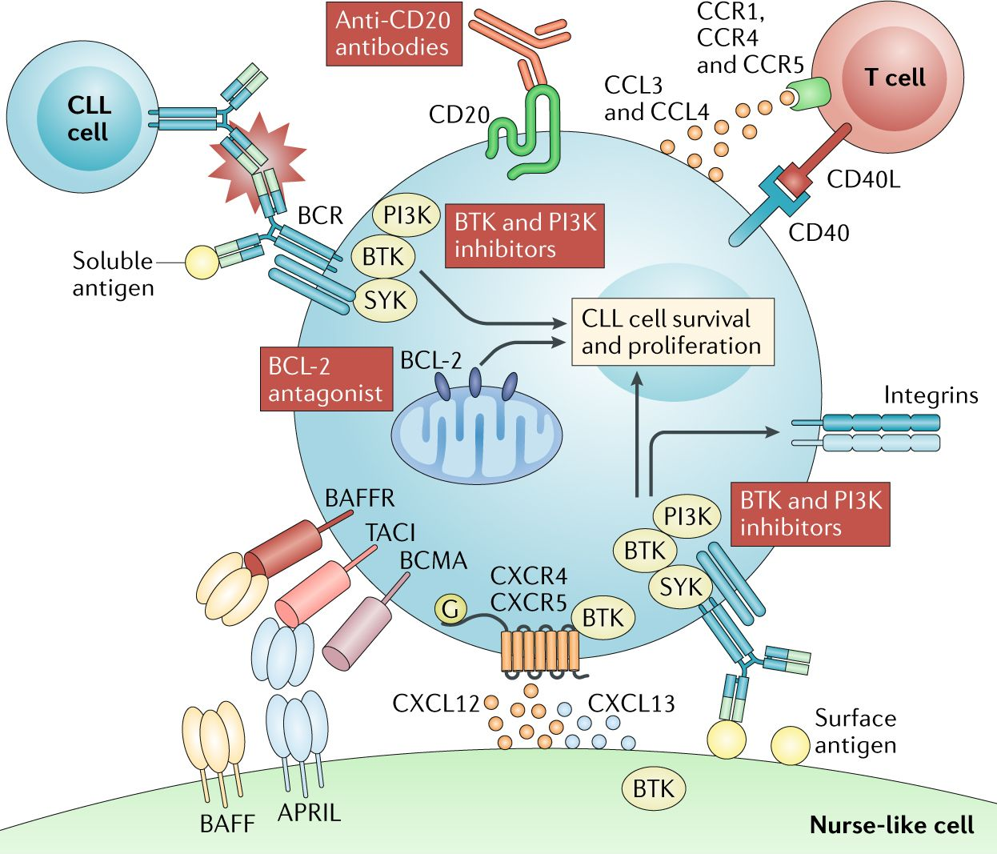
CLL is a Complex Disease
Burger JA, O’Brien S. Nat Rev Clin Oncol. 2018.
Notes:
5:14 and so CLL is a complex disease

Slide 18

The B-cell Receptor (BCR) Pathway
Normal BCR activation → appropriate cell proliferation, differentiation, and antibody production
↑ BCR activation = CLL cell survival and proliferation
  Usually increased due to many different variables
How can we exploit this increased activation to treat CLL?
ten Hacken E, et al. Biochimica et Biophysica Acta. 2016;
Davids NS, Brown JR. Leuk Lymphoma. 2012; Burger JA, Chiorazzi N. Trends Immunol. 2013.
Notes:
6:23 So If we just think about that B-cell receptor pathway that we saw

Slide 19
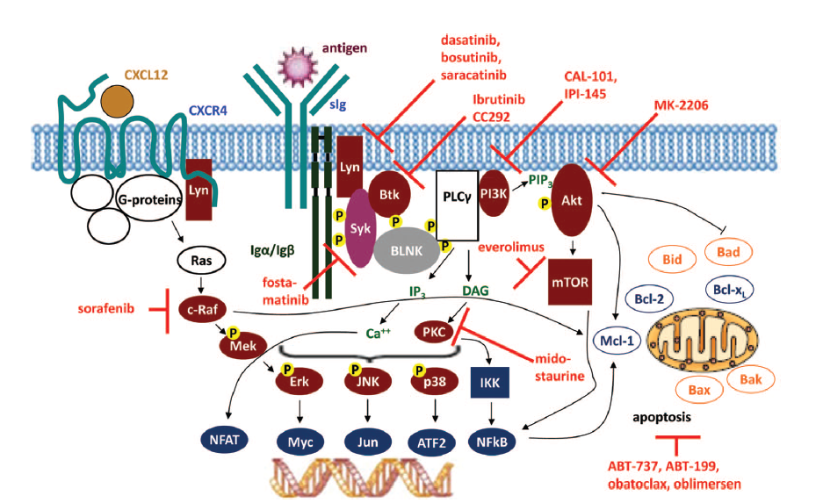
CLL Treatment in 2020
Idelalisib
Duvelisib
Copanlisib
Ibrutinib
Acalabrutinib
Idelalisib
Duvelalisib
Acalabrutinib
New Model
Inhibit the BCR pathway
Immune-based therapy
Target BCL-2
Spare the DNA
Venetoclax, ABT-737, obatoclax, oblimersen
Venetoclax
Adapted from Hallek M. Blood. 2013; FDA Prescribing Information; Clinicaltrials.gov.
Notes:
7:10 So here this side is showing you that

Slide 20
Contemporary Approaches to CLL
Taking a Deep Dive into BTK Inhibition
Notes:
7:37 So lets take a deep dive

Slide 21
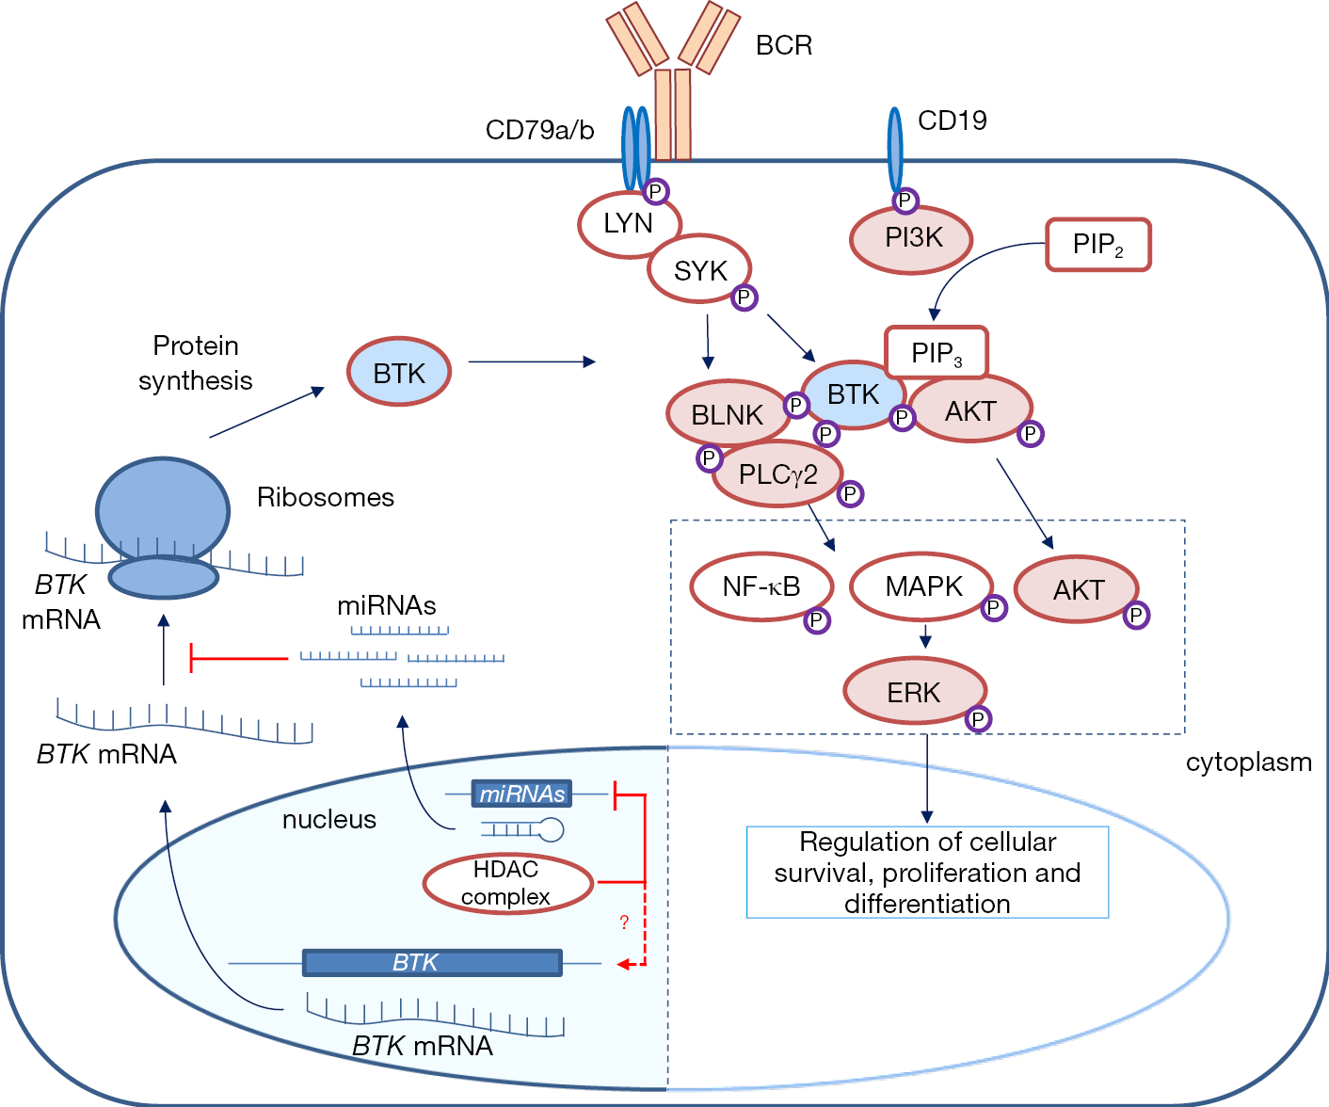
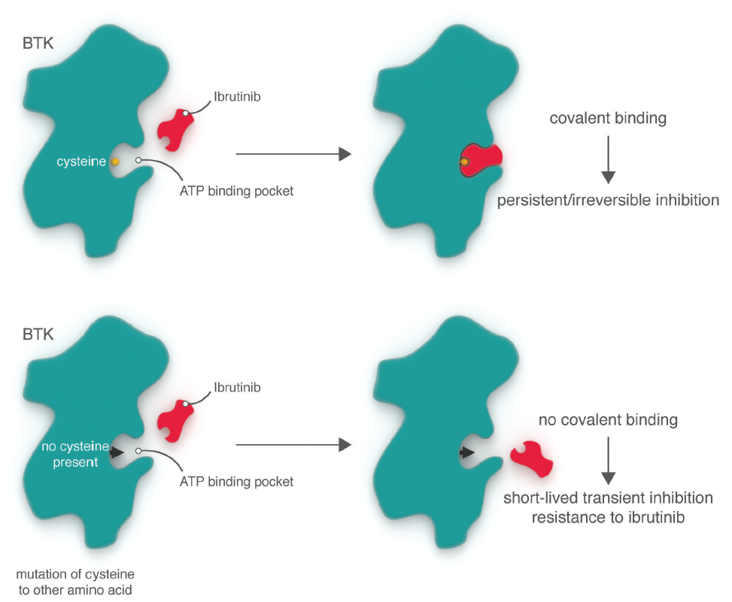

Bruton’s Tyrosine Kinase (BTK)
↑ BCR activation = ↑ BTK proteins in CLL cell
BTK inhibitors bind to these proteins and hinder the BTK’s downstream effects.
Irreversible BTK Inhibitor
BTK
Irreversible binding
=
Irreversible inhibition
Regulation of cellular survival, proliferation and differentiation
Cell death
BTK
Nucleus
Nucleus
ten Hacken E, et al. Biochimica et Biophysica Acta. 2016; Davids NS, Brown JR. Leuk Lymphoma. 2012; Burger JA, Chiorazzi N. Trends Immunol. 2013.
Notes:
7:43 so again, we talked about CLL being

Slide 22
BTK Inhibitors for the Treatment of CLL/SLL
Therapy | FDA-approved CLL Indication
Ibrutinib | Approved for CLL/SLL with or without del(17p) 420 mg tablet PO once daily
Acalabrutinib | Approved for CLL/SLL 100 mg tablet PO Q12H
Zanubrutinib | Under investigation
Tirabrutinib | Under investigation
Vecabrutinib | Under investigation
FDA Prescribing Information.
Notes:
9:08 so in looking at BTK inhibitors

Slide 23
Frontline Treatment without del(17p)/TP53 Mutation
Preferred
Ibrutinib (category 1)
Acalabrutinib ± obinutuzumab
Venetoclax + obinutuzumab
Other recommended regimens
Bendamustine + anti-CD20 mAb (not recommended for frail patients), chlorambucil + obinutuzumab, HDMP + rituximab, ibrutinib + obinutuzumab, obinutuzumab, chlorambucil, rituximab
Preferred
Ibrutinib (category 1)
Acalabrutinib ± obinutuzumab
Venetoclax + obinutuzumab
Other recommended regimens
Bendamustine + anti-CD20 mAb, FCR (preferred for IGHV-mutated CLL), FR, HDMP + rituximab,
ibrutinib + rituximab, PCR
Frail with significant comorbidities or ≥65 or younger with significant comorbidities
<65 and without significant comorbidities
Age and Comorbidities Evaluated
BR, bendamustine + rituximab; FCR, fludarabine, cyclophosphamide, rituximab;
HDMP, high-dose methylprednisolone; PCR, pentostatin, cyclophosphamide, rituximab.
NCCN. CLL/SLL Guidelines. v4.2020.
Notes:
9:51 So lets look at the NCCN Guidelines

Slide 24
Frontline Treatment with del(17p)/TP53 Mutation
Preferred
Ibrutinib
Acalabrutinib ± obinutuzumab
Venetoclax + obinutuzumab
Other recommended regimens
Alemtuzumab ± rituximab
HDMP + rituximab
Obinutuzumab
All Patients
NCCN. CLL/SLL Guidelines. v4.2020.
Notes:
11:51 So if you look at front line treatment with deletion 17 p

Slide 25
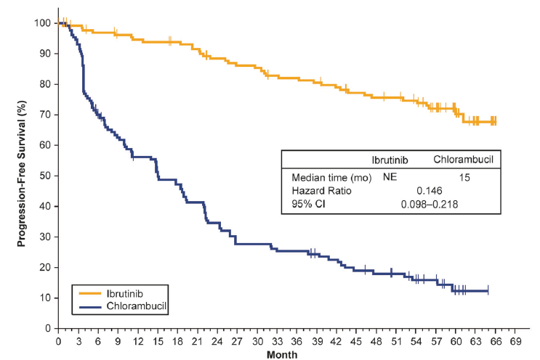
Ibrutinib Monotherapy in TN CLL
RESONATE-2 Trial—PFS after 5 Years
Randomized to ibrutinib or chlorambucil (N=269)
≥65 years old (median age 73)
Excluded del(17p)
Ibrutinib
Chlorambucil
Burger JA, et al. Leukemia. 2020.
Notes:
12:37 So lets look at this, so ibrutinib in treatment naïve

Slide 26
Acalabrutinib Combination
Phase III, ELEVATE-TN Trial
≥65 years or older or <65 years + coexisting conditions
Arm 1 (n=179)
Acalabrutinib 100 mg PO BID until disease progression
Patient Population
Randomized 1:1:1
Median age = 71
69% have high CLL-IPI score, 12% have very high CLL-IPI score
Arm 2 (n=179)
Acalabrutinib 100 mg PO BID until disease progression
Obinutuzumab 100 mg IV day 1, 900 mg day 2
  Obinutuzumab 1000 mg days 8, and 15 of cycle 1
  Obinutuzumab 1000 mg day 1 of cycles 2–6, every 28 days
Arm 3 (n=177)
Chlorambucil 0.5 mg/kg PO days 1 and 15 of each 28-day cycle for 6 cycles
Obinutuzumab 100 mg IV day 1, 900 mg day 2
  Obinutuzumab 1000 mg days 8, and 15 of cycle 1
  Obinutuzumab 1000 mg day 1 of cycles 2–6, every 28 days
IPI, international prognostic index.
Sharman JP, et al. ASH. 2019. Abstract 31.
Notes:
13:11 Acalabrutinib, moving on to another trial

Slide 27
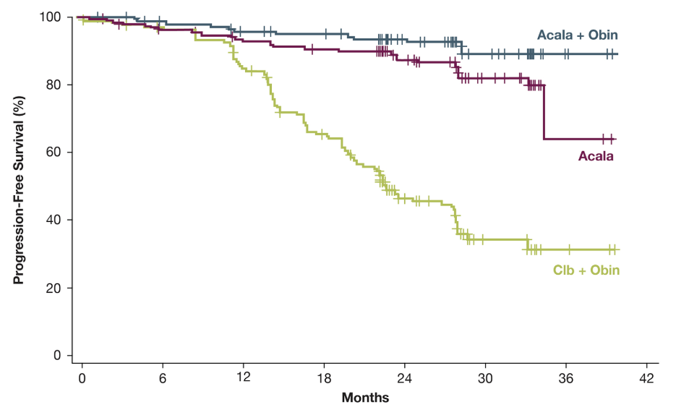
Acalabrutinib Combination
Phase III, ELEVATE-TN Trial
PFS
Acala + obin
 | Acala | Acala + obin | Obin + clb
Median PFS, mo | NR | NR | 22.6
30 mo PFS*, % | 82% | 90% | 34%
30 mo OS**, % | 94% | 95% | 90%
ORR, % | 85% | 94% | 79%
Acala
Progression-free Survival (%)
*Consistent across all subgroups, including del(17p)
Obin + clb
**Median OS has not been reached in any arm
Months
Sharman JP, et al. ASH. 2019. Abstract 31.
Notes:
13:36 and what this study found was that the acalabrutinib and obinutuzumab

Slide 28
Fit Patients—Phase III E1912
FCR vs IR in <70, without del(17p) CLL
Patient Population
Median age 58
ECOG PS 0–2
CrCl >40 mL/min
Able to tolerate FCR
No del(17p) by FISH
Arm A: Ibrutinib + Rituximab (n=354)
Cycle 1
Ibrutinib 420 mg PO daily, days 1–28
Cycle 2
Ibrutinib 420 mg PO daily, days 1–28
Rituximab 50 mg/m² IV, day 1
Rituximab 325 mg/m² IV, day 2
Cycles 3–7
Ibrutinib 420 mg PO daily, days 1–28
Rituximab 500 mg/m² IV, day 1
Cycle 8+
Ibrutinib 420 mg PO daily, days 1–28
Randomized
2:1
Arm B: FCR (n=175)
Cycles 1–6
Fludarabine 25 mg/m² IV, days 1–3
Cyclophosphamide 250 mg/m² IV, days 1–3
Cycle 1
Rituximab 50 mg/m² IV, day 1, cycle 1
Rituximab 325 mg/m² IV, day 2, cycle 1
Cycles 2–6
Rituximab 500 mg/m² IV, day 1, cycles 2–6
CrCl, creatinine clearance;
FISH, fluorescence in situ hybridization.
Shanafelt TD, et al. N Engl J Med. 2019.
Notes:
14:26 So in looking at fit patients, under 70,

Slide 29
Fit Patients—Phase III E1912
FCR vs IR in <70, without del(17p) CLL
Improved efficacy
Fewer AEs
Intent to Treat OS
Intent to Treat PFS
Intent to Treat OS
Intent to Treat PFS
1.0
1.0
IR
IR
FCR
FCR
IR
0.8
0.8
IR
0.6
0.6
Percentage of Patients
FCR
Percentage of Patients
0.4
FCR
0.4
HR=0.35 (95% CI 0.22–0.5)
One sided P<0.00001
HR=0.17 (95% CI 0.05–0.54)
One sided P<0.0003
0.2
0.2
IR (4 events/354 cases)
FCR (10 events/175 cases)
IR (37 events/354 cases)
FCR (40 events/175 cases)
0
0
0
1
2
3
4
0
1
2
3
4
Years
Years
AE, adverse event; HR, hazard ratio.
Adapted from Shanafelt TD, et al. N Engl J Med. 2019.
Notes:
15:14 So if we move on to the next slide, progression free survival is superior so far

Slide 30
Patient Selection for Frontline Treatment
Ibrutinib plays a crucial role in frontline treatment in NCCN Guidelines
  Regardless of high-risk features
  With or without comorbidities
BTK combinations require more research
  IR combination has not demonstrated benefit over monotherapy in those ≥65 years old
  Acalabrutinib and ibrutinib combinations with obinutuzumab seem promising
Alternative combinations such as venetoclax + obinutuzumab have similar PFS
  Fixed duration may impact preference
  May also be preferred over ibrutinib in those with cardiac comorbidities or predisposition for AEs
NCCN. CLL/SLL Guidelines. v4.2020.
Notes:
16:03 So in patient selection for frontline treatment

Slide 31
Ongoing and Future Trials for Frontline CLL
Trial | Patients | Study Arms | Available Data
SEQUOIA Ph III (NCT03336333) | ≥65 years old or younger if comorbidities | Zanubrutinib Zanubrutinib + venetoclax Bendamustine + rituximab | At median f/u of 7 months: ORR of 92%
ASSURE Ph III (NCT04008706) | TN cohort (further stratified by concomitant warfarin use) | Acalabrutinib | —
EA9161 Ph III (NCT03701282) | All comers, no del(17p) | Ibrutinib + venetoclax + obinutuzumab Ibrutinib + obinutuzumab | —
GLOW Ph III (NCT03462719) | ≥65 years old or younger if comorbidities | Ibrutinib + venetoclax Obinutuzumab + chlorambucil | —
AVO Ph II (NCT03580928) | All comers | Acalabrutinib + venetoclax + obinutuzumab | Interim TN cohort data 100% PR; 75% CR
www.clinicaltrials.gov; Tam CS, et al. ASH. 2019. Abstract 499;
Lampson BL, et al. ASH. 2019. Abstract 32; Fischer K, et al. N Engl J Med. 2019; Jain N, et al. ASH. 2019. Abstract 34.
Notes:
17:16 So there is a lot going on in CLL…

Slide 32
R/R Treatment without del(17p)/TP53 Mutation
Preferred
Acalabrutinib
(category 1)
Ibrutinib
(category 1)
Venetoclax + rituximab
(category 1)
Idelalisib + rituximab
Duvelisib
Other recommended regimens
alemtuzumab ± rituximab, chlorambucil + rituximab, reduced-dose FCR or PCR, HDMP + rituximab, idelalisib, lenalidomide ± rituximab, obinutuzumab, ofatumumab, venetoclax, dose-dense rituximab, BR, BR + ibrutinib, or BR + idelalisib
Preferred
Acalabrutinib
(category 1)
Ibrutinib
(category 1)
Venetoclax + rituximab
(category 1)
Idelalisib + rituximab
Duvelisib
Other recommended regimens
alemtuzumab ± rituximab, BR, FC + ofatumumab, FCR, HDMP + rituximab, idelalisib, lenalidomide ± rituximab, obinutuzumab, ofatumumab, PCR, venetoclax, BR + ibrutinib, or BR + idelalisib
Frail w/ significant comorbidities or ≥65 or younger w/ significant comorbidities
<65 and without significant comorbidities
Age and Comorbidities Evaluated
BR, bendamustine + rituximab; FCR, fludarabine, cyclophosphamide, rituximab;
HDMP, high-dose methylprednisolone; PCR, pentostatin, cyclophosphamide, rituximab.
NCCN. CLL/SLL Guidelines. v4.2020.
Notes:
18:22 So moving on to relapsed/refactory CLL…

Slide 33
R/R Treatment with del(17p)/TP53 Mutation
Preferred
Acalabrutinib
(category 1)
Ibrutinib
(category 1)
Venetoclax + rituximab
(category 1)
Idelalisib + rituximab
Duvelisib
Venetoclax
Other recommended regimens
alemtuzumab ± rituximab, HDMP + rituximab, idelalisib, lenalidomide ± rituximab, or ofatumumab
Age and Comorbidities Evaluated
NCCN. CLL/SLL Guidelines. v4.2020.
Notes:
19:58 In patients with relapsed/refactory patients with del17p deletions

Slide 34
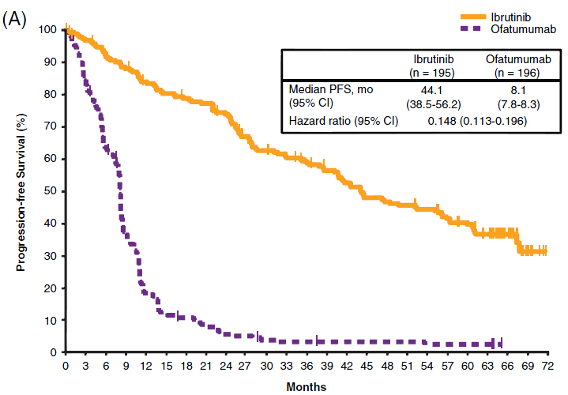
Ibrutinib Significantly Extended PFS Compared with Ofatumumab
(RESONATE ~6-year Update)
 | Median PFS (months)
All (ibrut vs ofatu) | 44.1 vs 8.11
Del(17p) | 40.6
Del(11q) | 60.7
No Del(17p)/Del(11q) | 42.5
IGHV mutated | 48.4
Unmutated IGHV | 49.7
TP53 | 40.7
No TP53 | 56.9
Ibrutinib
Ofatumumab
Byrd JC, et al. Blood. 2019; Munir T, et al. Am J Hematol. 2019.
Notes:
20:56 So this is 6 year updated data on the resonate trial

Slide 35
Phase III ASCEND (ACE-CL-309)
Acalabrutinib in R/R CLL
Arm 1 (n=155)
Acalabrutinib 100 mg PO
twice daily until PD or unacceptable toxicity
Patient population
≥1 prior therapy for CLL
ECOG PS ≤2
Interim analysis planned after ~79 PFS events
Randomized
2:1
Arm 2 (n=155)
Rituximab + physician’s choice
  Idelalisib 150 mg PO twice daily (n=119)
  Bendamustine 70 mg/m² IV (n=36)
Median follow-up, 16.1 months
Most common AEs (any-acalabrutinib)
Headache 22%
Neutropenia 19%
Diarrhea 18%
Anemia 15%
Cough 15%
Ghia P, et al. EHA. 2019. Abstract LB2606.
Notes:
21:34 And this next trial is ASCEND…

Slide 36
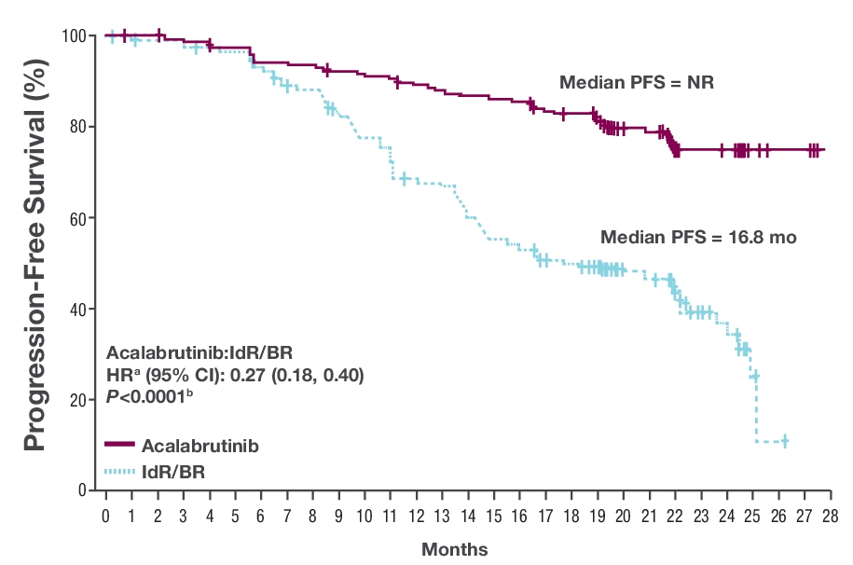
Phase III ASCEND (ACE-CL-309)
Acalabrutinib in R/R CLL
Improved PFS (including high-risk subgroups)
Acalabrutinib
IdR/BR
Ghia P, et al. ASCO. 2020. Abstract 8015.
IdR, idealisib and rituximab.
Notes:
22:15 But as you can see here the progression free survival

Slide 37
Ongoing and Future Trials for R/R CLL
Trial | Patients | Study Arms | Available Data
ALPINE Ph III (NCT03734016) | Relapsed/refractory | Zanubrutinib Ibrutinib | —
ACE-CL-006 Ph III (NCT02477696) | Previously treated, high-risk | Acalabrutinib Ibrutinib | —
Ph II (NCT04169737) | Relapsed after and/or refractory to ≥1 prior therapy | Acalabrutinib + obinutuzumab + venetoclax Acalabrutinib + early obinutuzumab + venetoclax | —
Ph II (NCT02029443) | Relapsed/refractory, ≥1 prior therapy | Acalabrutinib | ORR: 94% CR: 4% PR: 84% PD: 1%
Ph II (NCT04116437) | Previously treated, ibrutinib intolerant | Zanubrutinib | —
Ph II (NCT02756897) | Relapsed/refractory, ≥1 prior therapy (cohort 1) | Ibrutinib + venetoclax | After 24 cycles, 67% achieved BM uMRD remission
CR, complete response; PR, partial response; PD, progressive disease;
BM uMRD, bone marrow undetectable minimal residual disease.
www.clinicaltrials.gov; Jain N, et al. ASH. 2019. Abstract 359;
Furman RR, et al. ASH. 2019. Abstract 3039.
Notes:
22:36 And really, again, there is just as much

Slide 38
Treatment Considerations for BTK Inhibitors
Notes:
23:14 so treatment considerations

Slide 39
BTK Inhibitor Cardiovascular
Adverse Event Management
Toxicity | Ibrutinib | Acalabrutinib
Hemorrhage/Bleeding | 44% ≥Gr3—3% | 50% ≥Gr3—2%
Increased risk of bleeding on concomitant anticoagulant therapy or antiplatelet therapy Consider risk/benefit of withholding for 3–7 days pre- and post-surgery
Afib/flutter | 5%–77% | 3%
Periodically monitor for cardiac arrhythmias and obtain ECG for those who develop symptoms (palpitations, lightheadedness, syncope, chest pain) or new onset dyspnea Manage cardiac arrhythmias and manage as appropriate
Hypertension | 12% | NR
Monitor for new/uncontrolled hypertension Initiate antihypertensives as needed
FDA Prescribing Information; Rogers B, Khan N. J Adv Pract Oncol. 2017; NCCN. CLL/SLL Guidelines. v4.2020.
Notes:
23:19 so adverse events
Said first and second generation (remove that)

Slide 40
Risk Factors for Developing Atrial Fibrillation
Hypertension
Heart failure
Diabetes mellitus
Age
Obesity
Excess alcohol consumption
Valvular heart disease, murmur
COPD
Hyperthyroidism
Obstructive sleep apnea
Chronic kidney disease
Acute infections
Careful history and assessment—numerous risk score calculators
Optimize modifiable factors
Reassess on regular basis
Educate patient and caregivers
Stuhlinger MC, et al. Wien Klin Wochenschr. 2019; Wiczer TE, et al. Blood Adv. 2017;
https://www.framinghamheartstudy.org/fhs-risk-functions/atrial-fibrillation-10-year-risk/.
COPD, chronic obstructive pulmonary disease.
Notes:
26:04 So lets talk about this a fib a little bit more

Slide 41
Special Considerations
for BTK Inhibitor AE Management
Toxicity | Ibrutinib | Acalabrutinib
Infections | ≥Gr3—24% | ≥Gr3—18%
Cases of progressive multifocal leukoencephalopathy (PML), pneumocystis jirovecii pneumonia (ibrutinib), and infections due to hepatitis B reactivation (acalabrutinib) have occurred Monitor and evaluate patients for fever and infections; treat appropriately
Lymphocytosis | 33% | 32%
Presents during the first few weeks of therapy and typically resolves by 2 months
Second Primary Malignancies | 9% | 11%
Most common malignancy seen is skin cancer Advise protection from sun exposure and encourage routine cancer screening
Arthralgias | 24% | 16%
Usually occurs early in the treatment course APAP or short course of prednisone therapy; anti-inflammatory agents, such as ibuprofen, should be avoided to minimize bleeding Transition to a selective BTKi, such as acalabrutinib can diminish or resolve this toxicity
Headache | 13% | 39%
Usually observed early in therapy and typically resolves over 1–2 months Generally well managed with analgesics, such as acetaminophen and caffeine supplements
FDA Prescribing Information; Stephens DM, et al. Blood. 2019; Rogers B, Khan N. J Adv Pract Oncol. 2017; NCCN. CLL/SLL Guidelines. v4.2020.
Notes:
26:53 so some special considerations for adverse events

Slide 42
General BTKi Dose Modifications Due to AEs
Ibrutinib: ≥grade 3 non-hematological toxicities, ≥grade 3 neutropenia with infection or fever, or grade 4 hematological toxicities
Acalabrutinib: ≥grade 3 non-hematological toxicities, grade 3 thrombocytopenia with bleeding, grade 4 thrombocytopenia, and grade 4 neutropenia lasting longer than 7 days
Toxicity Occurrence | Dose Modification
 | Ibrutinib 560 mg | Ibrutinib 420 mg | Acalabrutinib 100 mg
First | Interrupt therapy until resolved to grade 1 or baseline; may be initiated at starting dose |  | Interrupt therapy until resolved to grade 1 or baseline level; may be resumed at 100 mg daily
Second | Interrupt therapy until resolved to grade 1; restart at 420 mg daily | Interrupt therapy until resolved to grade 1; restart at 280 mg daily
Third | Interrupt therapy until resolved to grade 1; restart at 280 mg daily | Interrupt therapy until resolved to grade 1; restart at 140 mg daily
Fourth | Discontinue
FDA Prescribing Information.
Notes:
30:13 so in looking at dose modifications due to adverse events

Slide 43
Ibrutinib Drug Interactions
Metabolized by liver, primarily CYP3A4 substrate, also inhibits P-gp
Avoid concomitant administration with CYP3A4 inhibitors/inducers and P-gp substrates, if possible
Prospective trial reported two-thirds of patients on medications that potentially interact with ibrutinib
 | Examples
CYP3A4 Inhibitors | Clarithromycin, erythromycin, itraconazole, fluconazole, posaconazole, voriconazole, ritonavir, indinavir, nelfinavir, darunavir, fosamprenavir, diltiazem, verapamil, amiodarone, dronedarone
CYP3A4 Inducers | Rifampin, carbamazepine, phenytoin, St. John’s wort
P-glycoprotein | Dabigitran, digoxin, methotrexate
Management |  | Dosing Examples
Strong CYP3A4 inhibitors | If short term (<7 days), consider interrupting ibrutinib | Voriconazole 200 mg PO BID Decrease to 140 mg PO daily Posaconazole 300 mg tablets daily Decrease to 70 mg PO daily
Moderate CYP3A4 inhibitors | Reduce ibrutinib dose to 280 mg PO daily
BID, twice daily.
Finnes HD, et al. Leuk Lymphoma. 2017; FDA Prescribing Information;
https://www.fda.gov/drugs/drug-interactions-labeling/drug-development-and-drug-interactions-table-substrates-inhibitors-and-inducers.
Notes:
31:32 drug drug interactions, this is a big issue with about every drug that we give

Slide 44
Acalabrutinib Drug Interactions
Metabolized by liver, primarily CYP3A enzymes
Increased gastric pH decreases acalabrutinib solubility
Medication | Acalabrutinib Management
Strong CYP3A4 inhibitors | Avoid concurrent use if possible If short-term use (up to 7 days), interrupt acalabrutinib
Moderate CYP3A4 inhibitors | 100 mg PO once daily
Strong CYP3A4 inducers | Avoid concurrent use if possible If concurrent use unavoidable, increase acalabrutinib to 200 mg twice daily
Proton pump inhibitors | Avoid concomitant use
H2-receptor blockers | Take acalabrutinib 2 hours before taking H₂-receptor blocker
Antacids | Separate dosing by at least 2 hours
FDA Prescribing Information.
Notes:
33:10 it is almost identical for acalabrutinib

Slide 45
BTKi and Invasive Procedures
What recommendations would you provide regarding BTK inhibitor therapy?
  Both ibrutinib and acalabrutinib recommend holding for 3–7 days pre- and post-invasive procedures
    For major procedures, hold ibrutinib 7 days prior to procedures and resume at 1–3 days or based on individual factors
  For urgent procedures, platelet transfusion to achieve 50% fresh platelets
Management of bleeding?
  Low-grade bleeding—supportive care
  Non-CNS bleeding—hold BTKi and transfuse platelets
  CNS bleeding—individualize considerations for platelet transfusion
Shatzel JJ, et al. J Thromb Haemost. 2017;
Gribben JG, et al. Br J Haematol. 2018; FDA Prescribing Information.
CNS, central nervous system.
Notes:
34:08 so in talking about that bleeding risk again…

Slide 46
Applying Clinical Trial Data to Clinical Practice
Case-based CLL Treatment Strategies for the Oncology Nurse
Notes:
35:37 So applying clinical trial data to your practice

Slide 47



Case 1—TN CLL
JC is a 74-year-old female diagnosed with CLL 3 years ago. She now requires treatment after presenting with progressive symptoms (bulky disease, B symptoms)
FISH: del(17p)+, del(13q)+, IGHV unmutated
PMHx: atrial fibrillation, GERD, osteoarthritis
Meds: metoprolol, omeprazole, aspirin, multi-vitamin
Labs: CrCl 65 mL/min, WBC 86,000/μL, ANC 1100/μL, platelets 96,000/μL, LDH 380 U/L, uric acid 6.5 mg/dL
EKG: HR 82 bpm, QTc 450 msec, BP 128/72 mmHg
ANC, absolute neutrophil count; GERD, gastroesophageal reflux disease;
iWCLL, International Workshop on CLL; NSR, normal sinus rhythm; QTc, corrected QT interval; WBC, white blood cell.
Notes:
35:45 so our first case is…

Slide 48
What first-line treatment should JC start on?
Preferred
Ibrutinib
Acalabrutinib ± obinutuzumab
Venetoclax + obinutuzumab
Other recommended regimens
Alemtuzumab ± rituximab
HDMP + rituximab
Obinutuzumab
All Patients with del(17p) and/or TP53
NCCN. CLL/SLL Guidelines. v4.2020.
Notes:
37:27 So what first line therapy should she start on?

Slide 49
Poll Question

Slide 50
JC is a 74-year-old female who was diagnosed with CLL 3 years ago. No therapy was started at the time. She now presents with progressive symptoms (bulky disease, B symptoms), and FISH reveals del(17p).
What is the best first-line treatment option for this patient?
Ibrutinib
Acalabrutinib
Venetoclax + obinutuzumab
All the above are appropriate options
Notes:
37:52 so lets think about her again… shes 74…

Slide 51
JC is a 74-year-old female who was diagnosed with CLL 3 years ago. No therapy was started at the time. She now presents with progressive symptoms (bulky disease, B symptoms), and FISH reveals del(17p).
What is the best first-line treatment option for this patient?
Ibrutinib
Acalabrutinib
Venetoclax + obinutuzumab
All the above are appropriate options
Notes:
38:28 so ibrutinib is historically the most commonly used regimen, although if we go back and acalabrutinib..

Slide 52
Case 1
Patient Considerations
Thorough history and physical, medication reconciliation, and cardiac assessment/consult
If atrial fibrillation controlled, okay to cautiously begin on ibrutinib
Not on anticoagulation at this time, if required, consider other therapy options
  Avoid warfarin, may consider LMWH or DOAC using caution with drug interactions
Bleeding risk
  Use antiplatelet agents with caution, alternative agents if possible, avoid dual antiplatelet agents; if aspirin required, use lowest dose (81 mg) possible
  Avoid use of concurrent anticoagulation and antiplatelet therapy
Ibrutinib may control disease for long duration, must consistently assess, prevent, and treat common side effects to avoid unnecessary discontinuation
Brown JR. Blood. 2018; Salem JE, et al. J Am Coll Cardiol. 2019; Shatzel JJ, et al. J Thromb Haemost. 2017; Stephens DM, et al. Blood. 2019.
Notes:
38:48 A thorough history and physical is needed

Slide 53
Case 1—TN CLL
JC was started on ibrutinib 420 mg PO once daily and responded well to therapy. After a year of ibrutinib therapy, she began to consistently experience elevated blood pressure (>160/90).
What should be done for JC at this time?
Notes:
40:06 Alright so back to our patient…

Slide 54
BTK Inhibitor Cardiovascular
Adverse Event Management
Toxicity | Ibrutinib | Acalabrutinib
Hemorrhage/Bleeding | 44% ≥Gr3—3% | 50% ≥Gr3—2%
Increased risk of bleeding on concomitant anticoagulant therapy or antiplatelet therapy Consider risk/benefit of withholding for 3–7 days pre- and post-surgery
Afib/flutter | 5%–77% | 3%
Periodically monitor for cardiac arrhythmias and obtain ECG for those who develop symptoms (palpitations, lightheadedness, syncope, chest pain) or new onset dyspnea Manage cardiac arrhythmias and manage as appropriate
Hypertension | 12% | NR
Monitor for new/uncontrolled hypertension Initiate antihypertensives as needed
FDA Prescribing Information; Rogers B, Khan N. J Adv Pract Oncol. 2017; NCCN. CLL/SLL Guidelines. v4.2020.
Notes:
40:32 So remember there are cardiac toxicities

Slide 55
Outcomes Analysis
Ibrutinib and Hypertension
Most AEs decrease over time except hypertension
  8% during first year
  15% in year 2
  20% in year 3
  19% in years >3
Hypertension
Medically manage with anti-hypertensives and closely monitor
Discontinue ibrutinib for uncontrollable HTN
O’Brien SM, et al. Am J Hematol. 2019; NCCN. CLL/SLL Guidelines. v4.2020.
Notes:
40:55 so we recently had some data

Slide 56
Case 1—TN CLL
JC was started on antihypertensives, which successfully stabilized her blood pressure. A few months later, JC returns to clinic with complaints of night sweats and severe fatigue.
It is confirmed that JC is progressing while on ibrutinib therapy. Molecular analysis reveals C481 mutation.
FISH: del(17p)+, del(13q)+, IGHV unmutated
Meds: metoprolol, omeprazole, aspirin, multi-vitamin
Notes:
41:44 So JC was started on antihypertensives

Slide 57
When the Binding Site Changes
Mutation Concerns
Ibrutinib and acalabrutinib both covalently bind to BTK at the cysteine 481 (C481) amino acid
Acquired resistance occurs due to this binding site mutation (cysteine to serine change so BTKi can no longer bind)
If C481S mutation develops, resistance will occur with both ibrutinib and acalabrutinib; do not use acalabrutinib when there is resistance to ibrutinib
Irreversible BTK Inhibitor (e.g., ibrutinib, acalabrutinib)
Irreversible (covalent) binding
Cysteine
ATP binding pocket
Persistent/irreversible inhibition
Adapted from Wiestner A. Haematologica. 2015; NCCN. CLL/SLL Guidelines. v4.2020; Byrd JC, et al. Oncotarget. 2018;
Wu J, et al. J Hematol Oncol. 2016; Byrd JC, et al. N Engl J Med. 2016; Woyach JA, et al. N Engl J Med. 2014; Woyach JA. Blood. 2018.
Notes:
42:29 So assuming that she is adherent with her dosing….

Slide 58
Poll Question

Slide 59
JC is a 74-year-old female with CLL who has been on ibrutinib therapy for over a year. She now presents with progressive symptoms, and molecular analysis finds a BTK C481S mutation present.
What is the best treatment option JC at this time?
Ibrutinib dose should be increased
Switch to a different BTKi (i.e., acalabrutinib)
Switch to venetoclax + rituximab
Add obinutuzumab to ibrutinib therapy
Notes:
43:55 So shes a 74 year old female

Slide 60
JC is a 74-year-old female with CLL who has been on ibrutinib therapy for over a year. She now presents with progressive symptoms, and molecular analysis finds a BTK C481S mutation present.
What is the best treatment option JC at this time?
Ibrutinib dose should be increased
Switch to a different BTKi (i.e., acalabrutinib)
Switch to venetoclax + rituximab
Add obinutuzumab to ibrutinib therapy
Notes:
44:25 So the correct answer here is to switch to venetoclax

Slide 61
What is Next?
Overcoming Inhibition
BTK inhibitor | Mechanism | Selectivity for BTK | Phase of development
Zanubrutinib | Covalent, Irreversible | Moderate | II/III
Tirabrutinib | Covalent, Irreversible | High | I/II
Vecabrutinib | Non-covalent, Reversible | Moderate | I/II
LOXO-305 | Non-covalent, Reversible | High | I
ARQ-531 | Non-covalent, Reversible | Low | I
Reversible, non-covalent BTKis may mitigate resistance
Trial with ARQ 53, found cytotoxicity at 72 hours against ibrutinib resistant cell lines
Activity in heavily pretreated patients with BTK mutations
Well tolerated
Reiff SD, et al. Cancer Discov. 2018;
Woyach JA, et al. EHA. 2018. Abstract PF355; Bond DA, Woyach JA. Curr Hematol Malig Rep. 2019.
Notes:
44:50 so what is next in overcoming this inhibition?

Slide 62
Case 2
Previously Treated
EP is a 64-year-old male who has new symptoms of increasing cervical lymphadenopathy, fatigue, and left upper quadrant fullness.
PMH: diagnosed with CLL 3 years ago and treated with FCR, achieving a complete response; hypertension; diabetes; multivessel coronary artery disease s/p stents (requiring prolonged dual antiplatelet therapy); and GERD
Disease: del(11q), unmutated IGHV
Meds: aspirin, ticagrelor, lisinopril, hydrochlorothiazide, metformin, and pantoprazole
Labs: CrCl 52 ml/min; Hb 11.2 gm/dL; WBC 55,000/ μL; ANC 1600/μL; and Plt 147,000/μL
Notes:
45:35 SO our second case is a previously treated patient…

Slide 63
R/R Treatment without del(17p)/TP53 Mutation
Preferred
Acalabrutinib
(category 1)
Ibrutinib
(category 1)
Venetoclax + rituximab
(category 1)
Idelalisib + rituximab
Duvelisib
Other recommended regimens
alemtuzumab ± rituximab, chlorambucil + rituximab, reduced-dose FCR or PCR, HDMP + rituximab, idelalisib, lenalidomide ± rituximab, obinutuzumab, ofatumumab, venetoclax, dose-dense rituximab, BR, BR + ibrutinib, or BR + idelalisib
Preferred
Acalabrutinib
(category 1)
Ibrutinib
(category 1)
Venetoclax + rituximab
(category 1)
Idelalisib + rituximab
Duvelisib
Other recommended regimens
alemtuzumab ± rituximab, BR, FC + ofatumumab, FCR, HDMP + rituximab, idelalisib, lenalidomide ± rituximab, obinutuzumab, ofatumumab, PCR, venetoclax, BR + ibrutinib, or BR + idelalisib
Frail with significant comorbidities or ≥65 or younger with significant comorbidities
<65 and without significant comorbidities
Age and Comorbidities Evaluated
BR, bendamustine + rituximab; FCR, fludarabine, cyclophosphamide, rituximab;
HDMP, high-dose methylprednisolone; PCR, pentostatin, cyclophosphamide, rituximab.
NCCN. CLL/SLL Guidelines. v4.2020.
Notes:
46:47 so in looking at treatment options…

Slide 64

Case 2
Previously Treated
EP starts ibrutinib 420 mg once daily. Within two months of initiating therapy, EP began to experience joint pain that severely impacted his quality of life. He is unable to take his morning jog because of the discomfort.
Notes:
47:34 So he gets started on ibrutinib

Slide 65
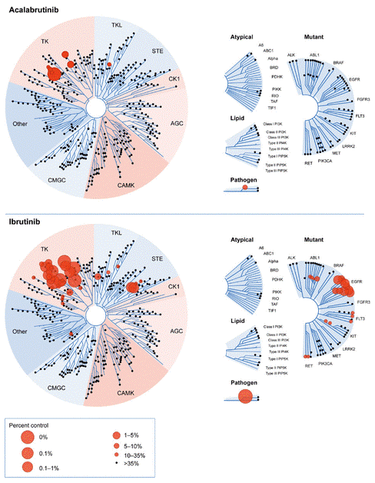
Case 2
Previously Treated
Would a switch to acalabrutinib improve tolerance?
BTK Inhibitor Selectivity
Ibrutinib
Acalabrutinib
↑ off target binding = ↑ likelihood of toxicities
Owen C, et al. Curr Oncol. 2019.
Notes:
47:54 So would you switch to acalabrutinib?

Slide 66
Case 2
Previously Treated
Would a switch to acalabrutinib improve tolerance?
  In 33 ibrutinib-intolerant patients, 72% of adverse events did not recur while on acalabrutinib therapy and 13% recurred at a lower grade¹
  Preliminary results suggest acalabrutinib is an effective option in ibrutinib intolerant patients. Direct comparative studies underway.^{1,2}
¹Awan FT, et al. Blood Adv. 2019; ²Rogers KA, et al. ASCO. 2019. Abstract 7530.
Notes:
48:49 So would you switch him to acalabrutinib to improve tolerance?

Slide 67
Poll Question

Slide 68
Which of the following statement(s) are true regarding arthralgias and BTK inhibitors?
Management should consist of acetaminophen and/or a short course of prednisone
Arthralgias usually do not occur until late in the course of therapy
Acalabrutinib is a more selective BTKi than ibrutinib, resulting in fewer off-target adverse events, such as arthralgias
Both A and C are correct
Notes:
49:32 So which of the following statements are true regarding arthraligas…

Slide 69
Which of the following statement(s) are true regarding arthralgias and BTK inhibitors?
Management should consist of acetaminophen and/or a short course of prednisone
Arthralgias usually do not occur until late in the course of therapy
Acalabrutinib is a more selective BTKi than ibrutinib, resulting in fewer off-target adverse events, such as arthralgias
Both A and C are correct
Notes:
50:06 And the correct answer here is D.

Slide 70

Case 2
Previously Treated
EP was prescribed multiple courses of steroids to treat the arthralgia experienced with ibrutinib. Unfortunately, his joint pain would continue to come back. EP noted that he had missed a “couple doses here and there” in hopes that it would alleviate the pain.
EP was switched to acalabrutinib 100 mg PO every 12 hours. His arthralgia dissipated within a couple of weeks of therapy.
EP calls the clinic stating that he has been having headaches more frequently than usual. He wants to know if this has anything to do with his acalabrutinib treatment.
Notes:
50:37 So EP gets prescribed multiple courses of steroids..

Slide 71
Poll Question

Slide 72
EP is a 64-year-old male with relapsed CLL who initiated acalabrutinib 100 mg PO twice daily 2 weeks ago. He presents to clinic with complaints of daily headaches.
Which of the following would be the best response?
The headache is unlikely to improve with continued therapy and alternative treatment is warranted
Continue acalabrutinib and add supportive care, such as acetaminophen and caffeine, and counsel him that headaches are often transient and resolve within 4–8 weeks
Reduce dose to 100 mg PO once daily based on package insert dosing
High-dose NSAID therapy is the safest and most effective treatment for acalabrutinib induced headache
Notes:
51:22 And so again this is our 64 year old male…

Slide 73
EP is a 64-year-old male with relapsed CLL who initiated acalabrutinib 100 mg PO twice daily 2 weeks ago. He presents to clinic with complaints of daily headaches.
Which of the following would be the best response?
The headache is unlikely to improve with continued therapy and alternative treatment is warranted
Continue acalabrutinib and add supportive care, such as acetaminophen and caffeine, and counsel him that headaches are often transient and resolve within 4–8 weeks
Reduce dose to 100 mg PO once daily based on package insert dosing
High-dose NSAID therapy is the safest and most effective treatment for acalabrutinib induced headache
Notes:
52:14 The correct answer is B.

Slide 74
Considerations to Ensure
BTKi Therapy Success
Continued medication access
  Unfunded, private insurance, Medicare part D
  Pharmaceutical company support/programs, prior authorization/appeal support, utilization of approved compendia for off-label use
Reinforce patient and caregiver education
  Compliance
  Adverse events
Ongoing reassessment of new medications, OTC
  Dosing/drug interactions
Notes:
52:56 So considerations to ensure BTKi therapy success

Slide 75
BTK Inhibitors and COVID-19
Patients with severe COVID-19 have hyperinflammatory immune response regulated by macrophage activation.
  BTK regulates macrophage signaling and activation
Early clinical data/case studies demonstrate that BTKis can protect against lung injury and improve pulmonary function in these patients.^{1,2}
Roschewski M, et al. Sci. Immunol. 2020.
  N=19 hospitalized patients with severe COVID-19 treated with acalabrutinib for 10-14 days
  Measures of inflammation (C-reactive protein and IL-6) normalized quickly for patients
  72.7% on supplemental oxygen were discharged on room air
  50% of ventilated patients were extubated (25% of which were discharged on room air)
¹Treon SP, et al. Blood. 2020; ²Roschewski M, et al. Sci. Immunol. 2020;
https://www.astrazeneca.com/media-centre/press-releases/2020/astrazeneca-initiates-calavi-clinical-trial-with-calquence-against-covid-19.html.
Notes:
52:56 So considerations to ensure BTKi therapy success

Slide 76
Questions?
Do you have additional questions? Send them to info@ceconcepts.com!

Slide 77
Thank You!
To receive up to 1.0 ANCC contact hour, please complete the evaluation at https://www.surveymonkey.com/r/FZ7ZWYN.

Slide 78
Notes:
54:55 And that’s ….

