Slide 1
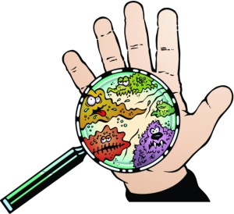
What is the Coronavirus?
A social story to explain the coronavirus to young children.

Slide 2
Sometimes people get sick.

Slide 3
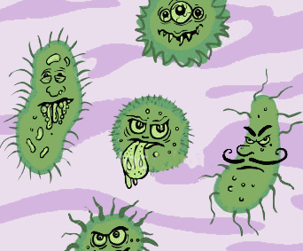
When someone gets sick, it is because of germs. Germs are tiny things that live all around us.

Slide 4
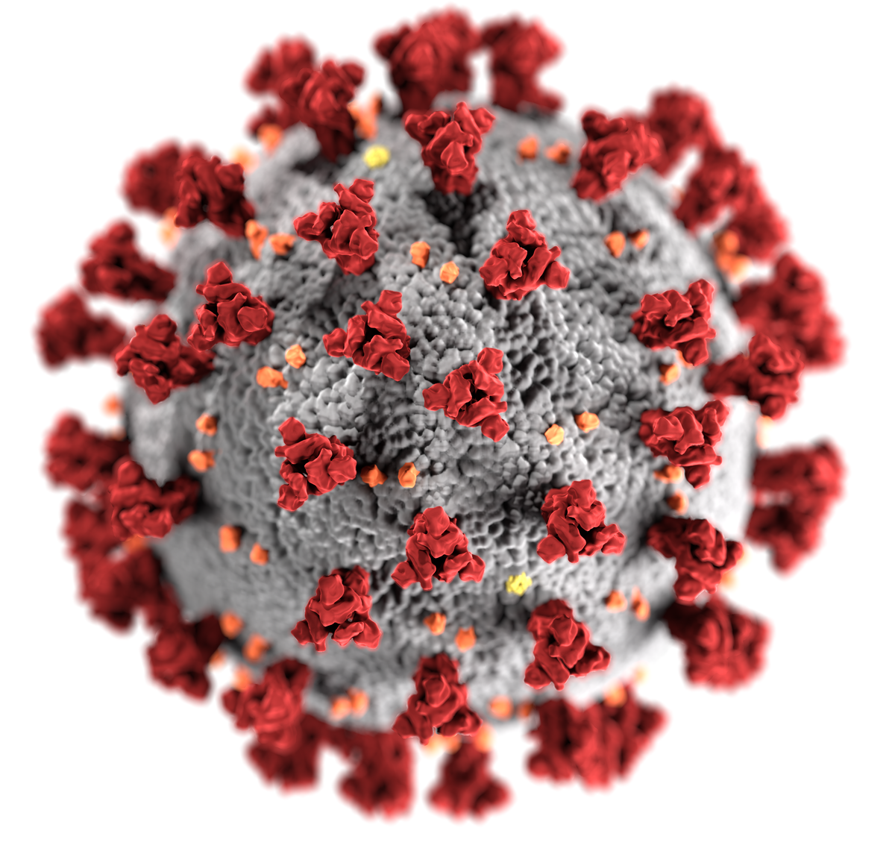
There is a new sickness called the Coronavirus.

Slide 5
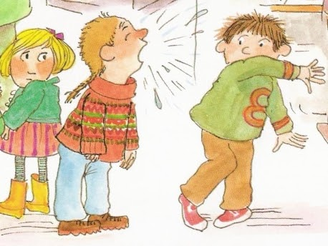
The coronavirus germs can spread very easily when someone coughs or sneezes on another person.

Slide 6
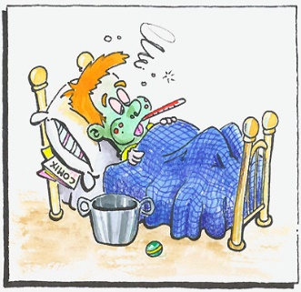
If germs stick on you, you can get sick.

Slide 7
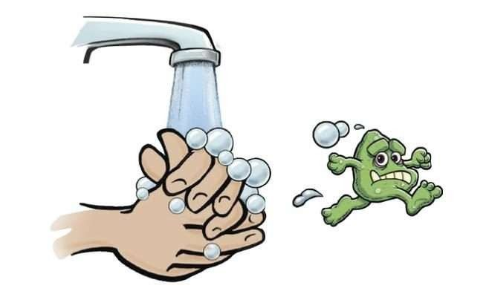
People need to wash their hands a lot to wash the germs away. Lots of handwashing will help keep people from getting sick.

Slide 8
When you wash your hands you should sing the birthday song 2 times or the ABC song, to make sure your hands are nice and clean.

Slide 9
Washing hands will keep your hands clean and help keep you healthy.

Slide 10
Sometimes, so many people get sick, that schools and work might need to close.

Slide 11
If school is closed then children will stay home to play and learn with their families.

Slide 12
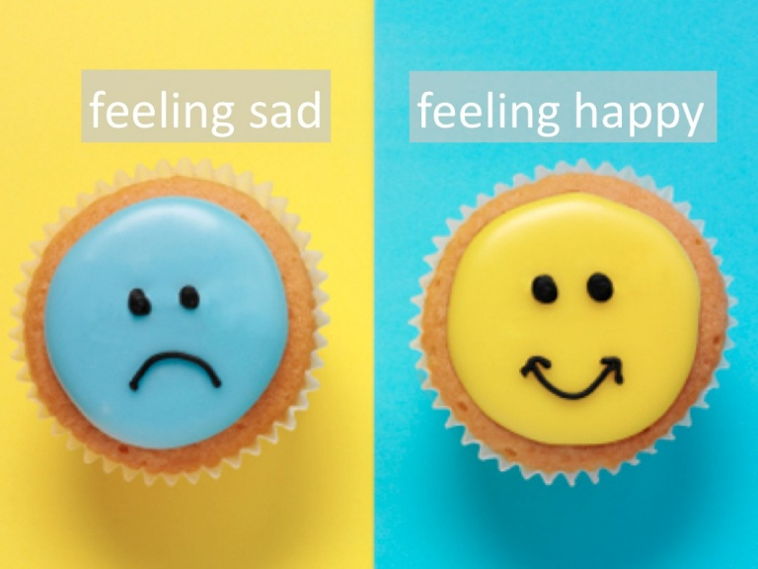
Staying home may make you feel sad. You may miss your friends from school and your neighborhood. Being with your family will make you feel happy.

Slide 13
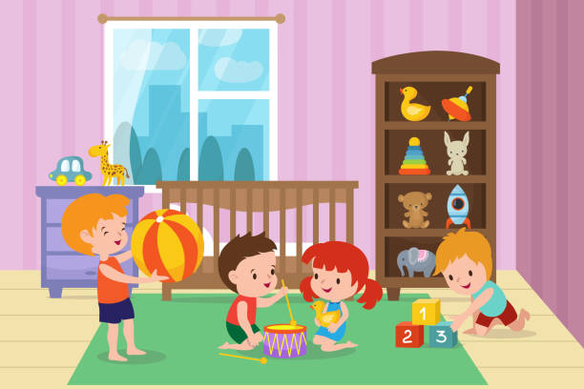
Children will be stay safe and healthy from germs at home with their families.

Slide 14
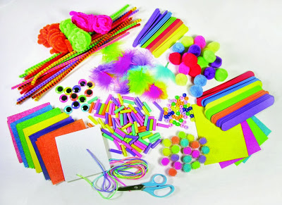
School may send home some ideas of crafts and games and songs to play at home.

Slide 15
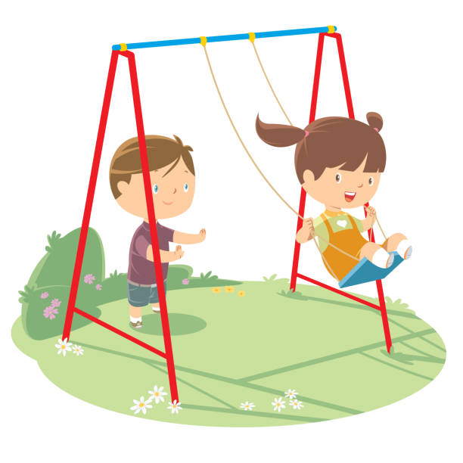
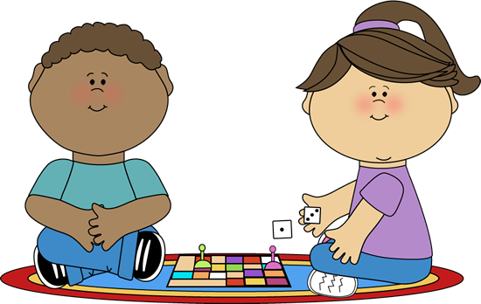
Children will have fun playing inside and outside while school is closed.

Slide 16
When the coronavirus germs are all gone, everyone will go back to school and work. .

Slide 17
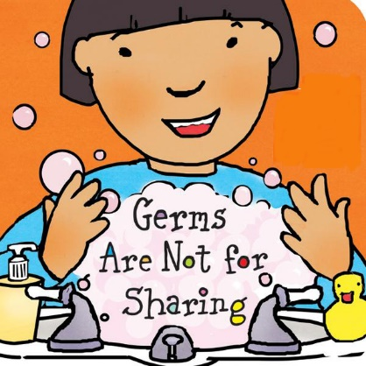
Additional Resources:
Germs Are Not for Sharing (Board Book) Board book – January 15, 2006 By Elizabeth Verdick Available at Amazon.com. To further explain how to keep ourselves well and others healthy too.
The Feelings Book Board book – September 21, 2005 By Todd Parr Available at Amazon.com. To help children understand their feelings around the coronavirus and all aspects of their emotions.
The Invisible String Hardcover – September 1, 2000 By Patrice Karst Available on Amazon.com. To help children understand that even when they cannot see of visit someone they are still connected. Edit the story to fit your family’s situation. If your child is sad they cannot visit a grandparent, this book will help your child to understand they are still connected to their grandparent by the invisible string that binds us all together.

Slide 18
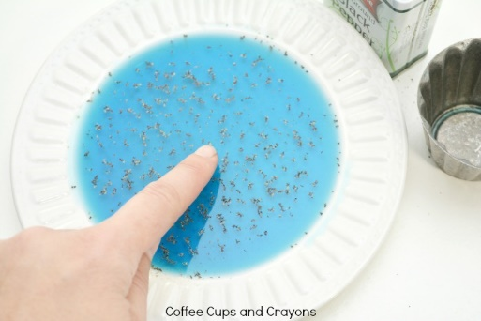
Pepper and Soap Experiment to Illustrate How Handwashing Makes Germs Go Away
Materials Needed:
Black Pepper (germs)
Water
Hand Soap
Plate or bowl
Instructions:
Using a measuring cup have your child pour water into a plate or a bowl.
Have your child shake some black pepper onto the water’s surface. Tell your child the pepper is like a germ.
Have your child dip their finger into the pepper and water.
Have them look at their finger. There should be some pepper stuck to their finger.
Have your child wash their hands well with the soap. Do not completely rinse their hands. Have your child dip their finger into the pepper water. The pepper will rush to the outer edges of the dish.
Explain to your child that washing our hands with soap and water will keep the germs away.

